Slide 1
Building an Internet Router (P33)
Handout 1: What’s a router?
Class project and logistics
Dr Andrew W. Moore
andrew.moore@cl.cam.ac.uk
Thank you
supporters:

Slide 2
Some logistics
Web page: http://www.cl.cam.ac.uk/teaching/current/P33/
TAs:
Malcolm Scott (Hardware) malcolm.scott@cl.cam.ac.uk
Chris Smowton (Software) chris.smowton@cl.cam.ac.uk
Hot-spare TAs:
Lech Swirski ls426@cl.cam.ac.uk
Jonathan Woodruff jdw57@cl.cam.ac.uk
Meta TA:
Muhummad Shahbaz muhummad.shahbaz@cl.cam.ac.uk
Grades:
Mphil (ACS) – Pass / Fail - based on a mark out of 100
All others (DTC) – Mark out of 100

Slide 3
Some more logistics
Class Mailing list: bir-list@cl.cam.ac.uk
think of this as a self-help mailing list for all of you
Staff Mailing list: bir-staff@cl.cam.ac.uk
Submission mail: bir-tick@cl.cam.ac.uk
Group aliases can appear if you require them.

Slide 4
What is Routing?
R3
R1
A
R4
D
B
E
D
R2
C
Destination
Next Hop
R5
F
D
R3
E
R3
F
R5

Slide 5
What is Routing?
R3
R1
A
R4
D
1
4
16
32
Ver
HLen
T.Service
Total Packet Length
B
Fragment ID
Flags
Fragment Offset
E
D
20 bytes
TTL
Protocol
Header Checksum
R2
C
Source Address
Destination
Next Hop
R5
Destination Address
F
D
R3
Options (if any)
E
R3
Data
F
R5

Slide 6
What is Routing?
R3
R1
A
R4
D
B
E
R2
C
R5
F

Slide 7
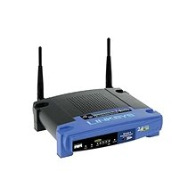
What a Router Looks Like

Slide 8
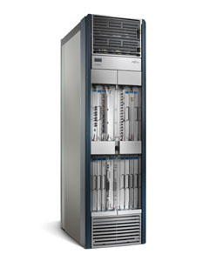
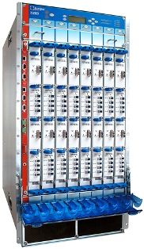
What a Router Looks Like
Cisco CSR-1
Juniper T320
19”
19”
Capacity: 92Tb/s Power: 4.7kW
Capacity: 320Gb/s Power: 2.9kW
6ft
3ft
2ft
2.5ft

Slide 9
Basic Architectural Components of an IP Router
Management
& CLI
Routing
Protocols
Software
Control Plane
Routing
Table
Datapath
per-packet
processing
Forwarding
Table
Switching
Hardware

Slide 10
Per-packet processing in an IP Router
1. Accept packet arriving on an incoming link.
2. Lookup packet destination address in the forwarding table, to identify outgoing port(s).
3. Manipulate packet header: e.g., decrement TTL, update header checksum.
4. Send packet to the outgoing port(s).
5. Buffer packet in the queue.
6. Transmit packet onto outgoing link.

Slide 11
Generic Router Architecture
Header Processing
Data
Hdr
Lookup
IP Address
Update
Header
Queue
Packet
Data
Hdr
IP Address
Next Hop
Address
Table
Buffer
Memory
~1M prefixes
Off-chip DRAM
~1M packets
Off-chip DRAM

Slide 12
Generic Router Architecture
Data
Hdr
Data
Header Processing
Hdr
Buffer
Manager
Lookup
IP Address
Update
Header
Address
Table
Buffer
Memory
Data
Hdr
Data
Header Processing
Hdr
Buffer
Manager
Lookup
IP Address
Update
Header
Address
Table
Buffer
Memory
Data
Hdr
Data
Hdr
Header Processing
Buffer
Manager
Lookup
IP Address
Update
Header
Address
Table
Buffer
Memory

Slide 13
The P33 Project: Build a 4-port x 1GE Router
Management
& CLI
Software Team
Develop s/w in Linux
on PC in lab
Routing
Protocols
Software
Exception
Processing
Routing
Table
Hardware Team
Develop h/w in Verilog
on NetFPGA board
in lab
Forwarding
Table
Switching
Hardware

Slide 14
1
2
3
4
5
6
Build basic router
Command Line Interface
Routing Protocol
(PWOSPF)
Integrate with H/W
Interoperability
Wow us!
Management
& CLI
Exception
Processing
Routing
Protocols
Management
& CLI
Management
& CLI
Routing
Table
Routing
Protocols
Routing
Protocols
Innovate and add!
Presentations
Judges
Exception
Processing
Routing
Table
Exception
Processing
Routing
Table
Emulated
h/w in VNS
Emulated
h/w in VNS
Emulated
h/w in VNS
Management
& CLI
Exception
Processing
Routing
Protocols
software
1/Feb
8/Feb
15/Feb
Routing
Table
29/Feb
5/Mar
25/Apr
hardware
Forwarding
Table
Switching
Learning Environment
Modular design
Testing
Forwarding
Table
Switching
4-port non-learning switch
4-port learning switch
IPv4 router forwarding path
Integrate with S/W
Interoperability
Wow us!
1/Feb
8/Feb
15/Feb
29/Feb
5/Mar
25/Apr

Slide 15
P33 Final presentations and demonstrations
Judges come from industry (Cisco, Redgate, Ensoft, Zeus)
Open invitation
10 Marks for each group and a best in show prize

Slide 16
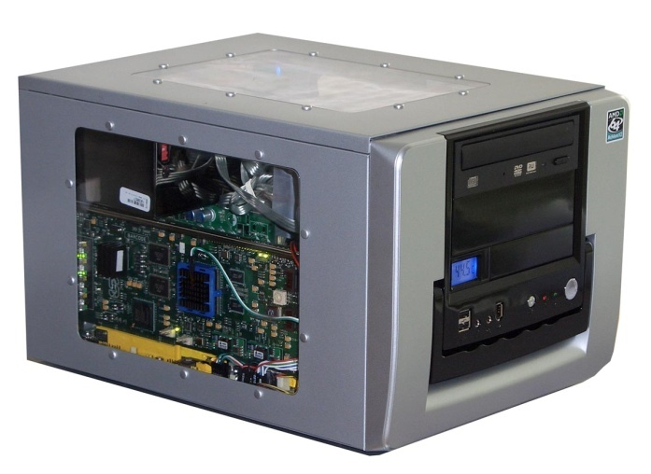
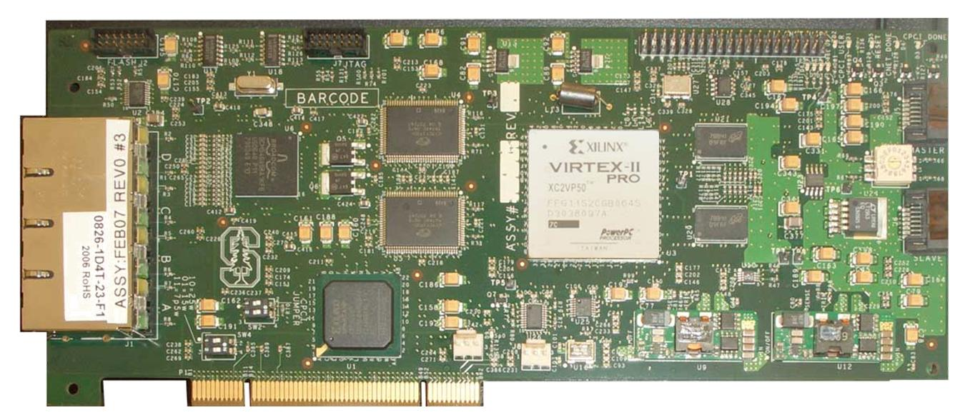
What is the NetFPGA?
Networking Software
running on a standard PC
CPU
Memory
PCI
PC with NetFPGA
A hardware accelerator
built with Field Programmable Gate Array driving Gigabit network links
1GE
FPGA
1GE
1GE
Memory
1GE
NetFPGA Board

Slide 17
Running the Router Kit User-space development, 4x1GE line-rate forwarding
Management (including CLI)
CPU
Memory
Exception
Processing
PW-OSPF
user
kernel
Routing
Table
PCI
“Mirror”
Fwding
Table
Packet
Buffer
1GE
1GE
FPGA
1GE
1GE
IPv4
Router
1GE
1GE
Memory
1GE
1GE

Slide 18
Using the nf-test machines
Each group is allocated an nf-test machine
{nf-test1,nf-test2,nf-test3,...}.nf.cl.cam.ac.uk
These machines are headless (no KVM) and located in SW02 (alcove)
Login via ssh; set your own password and go
We suggest running “vncserver” and then using “vncviewer”; as a useful way to leave jobs/desktop running and reconnect if you need to move location. (“screen” is another alternative)
SW02 is a busy classroom – please respect others
If you need to gain physical access to an nf-test machine
Do it quietly! You may be refused entry – don’t take it personally.

Slide 19
nf-test machine rules
Abuse the machines – that’s the end of this module for you – zero tolerance policy.
only connect eth0 to the cisco (access) switch
these machines run a firewall for a reason
if it doesn’t work for you, lets fix the rules
Play nicely with each other; your interoperability marks depend on it.

Slide 20
nf-test machine information
Warning: Files stored on nf-test machines are not backed up - and may be lost at any time.
You must make sure that you regularly copy your files into your REAL (computer laboratory) home directory as a back-up
Machines fail – they usually fail 24 hours before the big deadline!

Slide 21
Next steps
Explore the web page
http://www.cl.cam.ac.uk/teaching/current/P33/
Hardware: do the online tutorial http://www-netfpga.cl.cam.ac.uk
Software: explore the vns system http://vns.cl.cam.ac.uk
https://www.srg.cl.cam.ac.uk/vns/vns-assignments/simple-router/
Decide if you still want to take the class - promptly
Build a team of 2 people: 1 s/w and 1 h/w
We will stay now and help you decide what you are
Come to SW02 on Monday 2pm…

