Slide 1
GREEN IPTV
A Resource and Energy Efficient Network for IPTV

Slide 2
Main objectives of this lecture
General
Illustrate the usual route taken to make good computer science research
Specific
Exemplify with a resource and energy efficient network for IPTV

Slide 3
Outline
Route to make good computer science research
IPTV today
Research example 1: resource and energy consumption in IPTV
Research example 2: zapping delay in IPTV
Take-home message

Slide 4
Outline
Route to make good computer science research
IPTV today
Research example 1: resource and energy consumption in IPTV
Research example 2: zapping delay in IPTV
Take-home message

Slide 5

1. Look for an opportunity

Slide 6
2. Identify a problem

Slide 7
3. Analyse state of the art

Slide 8
4. Propose solution

Slide 9

5. Evaluate solution

Slide 10

6. Assess relevance

Slide 11
Outline
Route to make good computer science research
IPTV today
Research example 1: resource and energy consumption in IPTV
Research example 2: zapping delay in IPTV
Take-home message

Slide 12
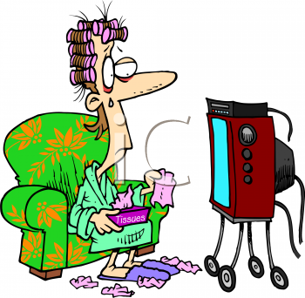
What is IPTV?

Slide 13

A typical IPTV network
Internet
IP Network
TV Head End
Customer Premises
TV
.
.
.
STB
DSLAM
PC

Slide 14
More details
All TV channels transmitted always everywhere
IP multicast used
  PIM-SM
  Static multicast trees
  No traffic engineering

Slide 15
Outline
Route to make good computer science research
IPTV today
Research example 1: resource and energy consumption in IPTV
Research example 2: zapping delay in IPTV
Take-home message

Slide 16
Why IPTV?
New service on top of an IP network
  Still an infant: around 5 years old
The sum of all forms of video (IPTV, VoD, P2P) will account for over 91% of global consumer traffic by 2013 [Cisco]
In the US there are already more than 5 million subscribers, and this number is expected to increase to 15.5 million by 2013 [Piper]
1. opportunities 2. problem 3. state of the art 4. solution 5. evaluation 6. relevance

Slide 17
Resource inefficiencies
90% of all TV viewing is restricted to a small selection of channels [Cha et al.][Qiu et al.]
metro/core
access
1. opportunities 2. problem 3. state of the art 4. solution 5. evaluation 6. relevance

Slide 18
Selective pre-fetching of TV channels
Instead of each node pre-fetching all TV channels, pre-fetch only a selection of channels
Pre-fetch active channels (channels for which there are viewers) + a small number of inactive channels
Room size = number of inactive channels pre-fetched
1. opportunities 2. problem 3. state of the art 4. solution 5. evaluation 6. relevance

Slide 19
Trace-driven simulation
Using huge dataset from a nationwide IPTV provider:
  255k users, 6 months, 150 TV channels, 622 DSLAMs, 11 regions
1. opportunities 2. problem 3. state of the art 4. solution 5. evaluation 6. relevance

Slide 20
Results – bandwidth savings
33% bandwidth reduction
50% bandwidth reduction
1. opportunities 2. problem 3. state of the art 4. solution 5. evaluation 6. relevance

Slide 21
Results – requests affected
< 2% requests affected
< 0.1% requests affected
1. opportunities 2. problem 3. state of the art 4. solution 5. evaluation 6. relevance

Slide 22
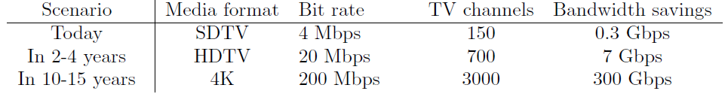
Is it worth it?
Conclusion
Today probably not, in the future probably yes
1. opportunities 2. problem 3. state of the art 4. solution 5. evaluation 6. relevance

Slide 23
What about energy savings?

Slide 24
Router power consumption model
We assume the router can turn off ports not in use
Δl and Δp based on real measurements [Chabarek et al.]
250 edge routers + 50 core routers
1. opportunities 2. problem 3. state of the art 4. solution 5. evaluation 6. relevance

Slide 25
Is it worth it? (2)
Conclusion
Today not, in the future maybe
1. opportunities 2. problem 3. state of the art 4. solution 5. evaluation 6. relevance

Slide 26
Outline
Route to make good computer science research
IPTV today
Research example 1: resource and energy consumption in IPTV
Research example 2: zapping delay in IPTV
Take-home message

Slide 27
Zapping delay
In IPTV this delay can add up to two seconds or more
  should be below 430ms[Kooji et al.]
1. opportunities 2. problem 3. state of the art 4. solution 5. evaluation 6. relevance

Slide 28
Several solutions proposed
Video coding and processing techniques
Network level
Problems of existing solutions:
  Complexity
  Additional video servers needed
1. opportunities 2. problem 3. state of the art 4. solution 5. evaluation 6. relevance

Slide 29
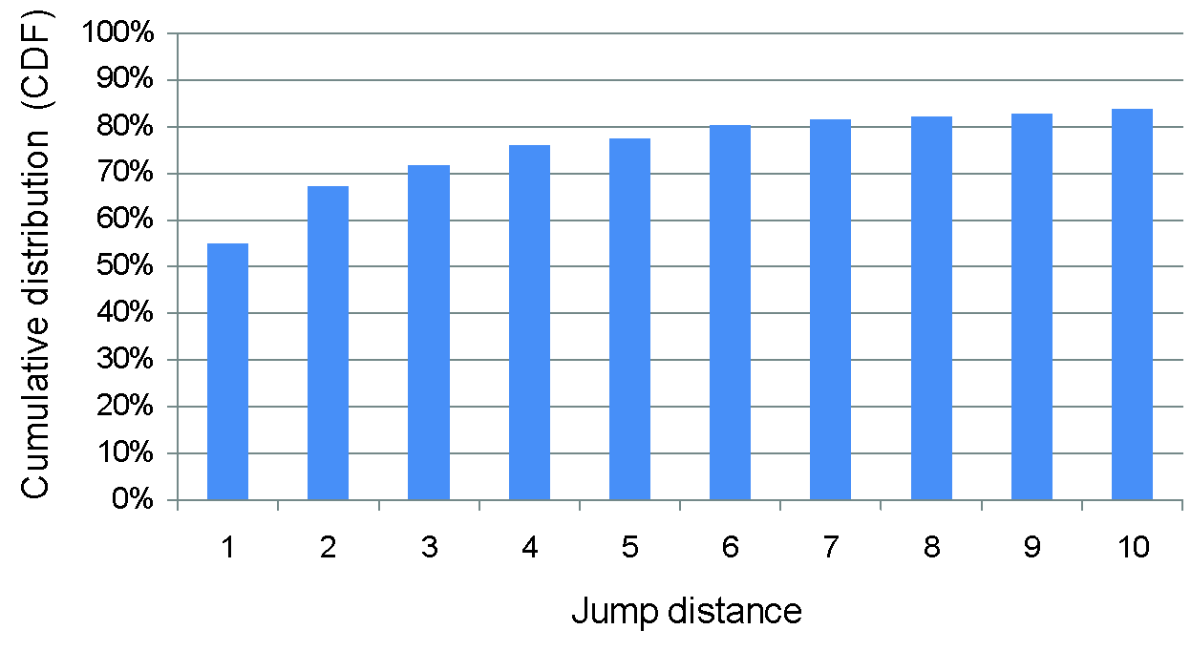
Most zapping is linear...
1. opportunities 2. problem 3. state of the art 4. solution 5. evaluation 6. relevance

Slide 30

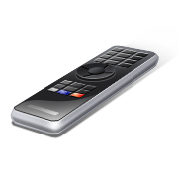
IPTV today
IPTV NETWORK
Requesting channel 3
Sending channel 3
1. opportunities 2. problem 3. state of the art 4. solution 5. evaluation 6. relevance

Slide 31
IPTV with channel smurfing
IPTV NETWORK
Requesting channel 3
Requesting channel 2,3,4
Sending channel 2,3,4
1. opportunities 2. problem 3. state of the art 4. solution 5. evaluation 6. relevance

Slide 32
Channel smurfing
Besides the channel requested, send N neighbouring channels concurrently for C seconds.
1. opportunities 2. problem 3. state of the art 4. solution 5. evaluation 6. relevance

Slide 33
Trace-driven simulation
Using huge dataset from a nationwide IPTV provider:
  255k users, 6 months, 150 TV channels, 622 DSLAMs, 11 regions
1. opportunities 2. problem 3. state of the art 4. solution 5. evaluation 6. relevance

Slide 34
Results – requests with no delay
1. opportunities 2. problem 3. state of the art 4. solution 5. evaluation 6. relevance

Slide 35
Results – requests with no delay (zapping periods only)
1. opportunities 2. problem 3. state of the art 4. solution 5. evaluation 6. relevance

Slide 36
Results – average bandwidth
1. opportunities 2. problem 3. state of the art 4. solution 5. evaluation 6. relevance

Slide 37
Is it worth it?
Very simple to implement
  Small software upgrade
  No additional video servers needed
  Performance close to optimal predictor
1. opportunities 2. problem 3. state of the art 4. solution 5. evaluation 6. relevance

Slide 38
Outline
Route to make good computer science research
IPTV today
Research example 1: resource and energy consumption in IPTV
Research example 2: zapping delay in IPTV
Take-home message

Slide 39
Take-home message
Computer science knowledge can be used in novel, practical, useful ways
It is important to build realistic scenarios to evaluate our ideas
It is fundamental to accept that any technical solution has limitations and that these should not be concealed
Be aware that a solution to a problem is only relevant if the benefits clearly outweigh the disadvantages

Slide 40
Interested in these matters?
Any idea what the “G” in GREEN could stand for? ☺
Feel free to contact me: fernando.ramos@cl.cam.ac.uk

Slide 41
References
[Cisco] Cisco visual networking index: Forecast and methodology 2008-2013, 2008.
[Piper] B. Piper. United states IPTV market sizing: 2009-2013. Technical report, Strategy Analytics, 2009.
[Cha et al.] M. Cha, P. Rodriguez, J. Crowcroft, S. Moon, and X. Amatriain. Watching television over an IP network. In Proc. ACM IMC, 2008.
[Qiu et al.] T. Qiu, Z. Ge, S. Lee, J. Wang, Q. Zhao, and J. Xu. Modeling channel popularity dynamics in a large IPTV system. In Proc. ACM SIGMETRICS, 2009.
[Chabarek et al.] J. Chabarek, J. Sommers, P. Barford, C. Estan, D. Tsiang, and S. Wright. Power awareness in network design and routing. In Proc. IEEE INFOCOM, 2008.
[Kooji et al.] R. Kooij, K. Ahmed, K. Brunnstr¨om, and K. Acreo. Perceived quality of channel zapping. In proceedings of the IASTED , 2006.

