Slide 1
Programming Methods
Dr Robert Harle
IA NST CS and CST
Lent 2008/09
Handout 5

Slide 2
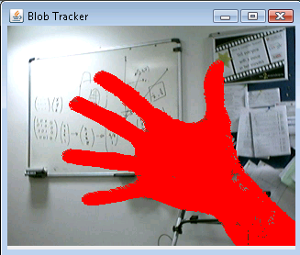
Blob Tracking
Our goal is to build an app that detects when something enters the visual range of a webcam
Example use: Detect when someone enters your room.

Slide 3
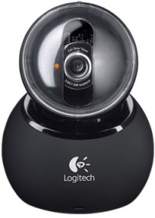

The Basic Process
Get an image from the webcam
Subtract some notion of ‘background’
‘Grow’ regions of pixels to reduce noise

Slide 4
Getting the Image

Slide 5
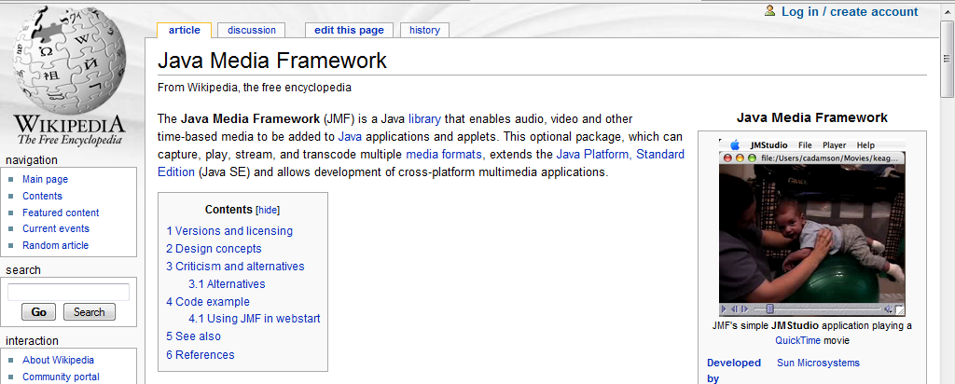
Java Media Framework
Java itself doesn’t ship with much support for video and audio media.
There are software libraries to get access however
We will be using the Java Media Framework (JMF)
  It is an ‘official’ Sun library
  Gives us access to our webcam reasonably simply

Slide 6
Abstraction, abstraction, abstraction...
We don’t want to be stuck with the JMF though
  Might need a different library for a different webcam
  Might even want to input from a video file
Try to identify the fundamental components of something that supplies us with images (=“frames”)
Abstract into an interface
public interface FrameInterface {
public void open(String descriptor);
public BufferedImage getNextFrame();
public void close();
}

Slide 7
Concrete Instantiation
The code in JMFFrameSource is not pretty because frankly the JMF is pretty awful to work with.
You can ignore JMFFrameSource.java for this course – I refuse to teach JMF!!
This design encapsulates everything about getting images from a webcam in a single class.
The interface decouples the program from the JMF so you can easily substitute a better library
<<Interface>>
FrameInterface
JMFFrameSource

Slide 8
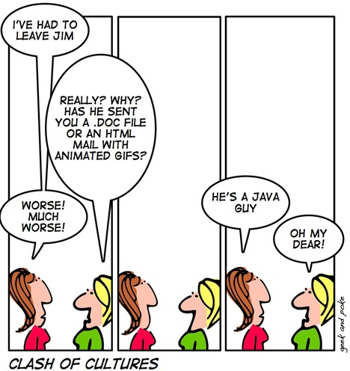
Aside: BufferedImage
The FrameInterface returns objects of type BufferedImage
  This is a standard class in the class library to handle images
  The “Buffered” bit means that the image is represented by an accessible buffer – a grid of pixels

Slide 9
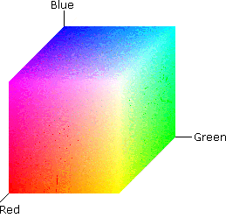
Aside: RGB Pixels
How do you represent the colour of a single pixel?
Actually many ways, but commonly we use RGB
  The colour is made up from only Red, Green and Blue.
  We use 24 bits to represent the colour
    8 bits red (0-255)
    8 bits green (0-255)
    8 bits blue (0-255)
  E.g. Purple = 160-32-240 (R-G-B)
  We can think of this as a colour space
    Like 3D space but xyz becomes rgb

Slide 10
Aside: RGB Pixels
We will need to get at individual pixels
Buffered Image provides getRGB(...) methods
Each pixel is given as an int:
32 bit int
Alpha
Red
Green
Blue
int colour=...
int r = ((colour>>16) & 0x000000FF);
int g = ((colour>>8) & 0x000000FF);
int b = ((colour) & 0x000000FF);

Slide 11
Software So Far
JPanel
JFrame
1
1
DisplayPanel
BlobTracker
<<Interface>>
FrameInterface
A DisplayPanel is derived from JPanel and allows us to display the output image on the screen
BlobTracker extends JFrame to make a window on the screen holding a DisplayPanel. It contains the main() method
JMFFrameSource

Slide 12
PhotoTile: A Custom Component
There isn’t a handy component that displays images
So we must make our own: PhotoTile.java
The closest thing to what we want is a simple JPanel
Inheritance saves us rewriting the JPanel stuff
And we override the paintComponent() method
public class PhotoTile extends JPanel {
@Override
public void paintComponent(Graphics g) {
super.paintComponent(g);
if (mPhoto!=null) mPhoto.drawImage(g, 0, 0, this.getWidth(), this.getHeight());
g.setColor(Color.black);
g.drawRect(0, 0, getWidth()-1, getHeight()-1);
}

Slide 13
DisplayPanel
public void paintComponent(Graphics g) {
Graphics2D g2 = (Graphics2D)g;
g2.setColor(Color.white);
g2.fill(getVisibleRect());
if (mImage!=null) g2.drawImage(mImage,0,0,null);
if (mHighlightPixels!=null) {
for (Pixel p : mHighlightPixels) {
// Select a different colour
g2.setColor(Color.red);
g2.drawLine(p.getX(), p.getY(), p.getX(), p.getY());
}
}
if (mHighlightRegions!=null) {
...
}
}

Slide 14
Subtracting the Background

Slide 15
Strategy Pattern
There are lots of algorithms for background subtraction
We should structure our software to make it easy to select between multiple algorithms
This of course means using the Strategy pattern
BlobTracker
1
<<interface>>
BackgroundSubtractor
Subtract(...)
SimpleBackgroundSubtractor
Subtract(...)

Slide 16
BackgroundSubtractor Interface
import java.util.List;
public interface BackgroundSubtractor {
public List<Pixel> Subtract(int[] pixels);
}
We provide an array of pixels (in ARGB as discussed)
We get back a List of Pixels representing the foreground pixels
Class Pixel just stores an (x,y) pair

Slide 17
SimpleBackgroundSubtractor
Remember the notion of RGB as a space?
We have two readings for each pixel – the saved background reading and the latest webcam reading
We treat them as two vectors (rb, gb, bb) and (rw, gw, gb)
  Then we compute the Euclidian distance apart in rgb space
  If it’s greater than some threshold, we take it as different to the background
  The threshold allows us to account for noise which is there even for a static background

Slide 18
Things to Note
The background image is ‘saved’ using clone() the first time we get a picture
Arrays have clone() implemented by default (shallow)
  This is an array of primitive ints so that’s all we need
if (mBackground==null) {
mBackground = pixels.clone();
return new LinkedList<Pixel>();
}

Slide 19
Things to Note
Always think about efficiency – avoid expensive calls if you can (e.g. sqrt):
LinkedList<Pixel> foregroundlist = new LinkedList<Pixel>();
for (int i=0; i<pixels.length; i++) {
int r = ((pixels[i]>>16) & 0x000000FF);
...
int distsq = (r-br)*(r-br) + (b-bb)*(b-bb) + (g-bg)*(g-bg);
if (distsq > mThreshold*mThreshold) {
foregroundlist.add(new Pixel(i, mImageWidth));
}
}

Slide 20
Region Growing

Slide 21
Why Bother?
There is always so much noise that it isn’t enough to just count the foreground pixels and take that as an indicator of the size of object in view
We need to find regions in the image where all the adjacent pixels are marked as foreground
So how to we go from a list of foreground pixels to lists of neighbouring, connected pixels?
Unsurprisingly, there are lots of algorithms...

Slide 22
Strategy Pattern Again
1
BlobTracker
<<Interface>>
FrameInterface
1
JMFFrameSource
<<Interface>>
RegionExtractor
extractRegions()
RecursiveRegionExtractor
ScanningRegionExtractor
extractRegions()
extractRegions()

Slide 23
RegionExtractor
public interface RegionExtractor {
public List< Region > extractRegions(List<Pixel> pixels);
}
We get back a List of Regions
Choose a List because we will want ordering
  Sort by size
  Remove small regions (noise)
How will the program know to sort the Regions by size?
  We have to tell it

Slide 24
Region
To sort objects, there must be a way to compare them
Java offers us the Comparable interface
public class Region extends LinkedList<Pixel> implements Comparable<Region>
{
public int compareTo(Region r) {
if (this.size()>r.size()) return -1;
if (this.size()<r.size()) return 1;
return 0;
}
}

Slide 25
Region
Now we can use Region in structures that sort
Either we use a structure that is always sorted (TreeSet, keys in a TreeMap, etc.)
Or we use the static sort() method in Collections
List< Region > regionlist = mRegionExtractor.extractRegions(fgpixels);
Iterator< Region > it = regionlist.iterator();
while (it.hasNext()) {
Region r = it.next();
if (r.size()<10) it.remove();
}
Collections.sort(regionlist);

Slide 26
RecursiveRegionExtractor
So how do we get Regions anyhow?
Start by translating the list of foreground pixels to an array of ints because it’s easier to search through
  -1 means the cell is background
  0 means the cell is believed to be foreground
-1
-1
-1
List<Pixel>
-1
0
-1
0
0
-1

Slide 27
RecursiveRegionExtractor
First we write a function that, given a pixel that is foreground:
  Labels it with a region number
  Runs itself on any neighbouring pixels that are foregound
  See extractRegion(...)
-1
-1
-1
-1
-1
-1
-1
-1
-1
-1
0
-1
-1
1
-1
-1
1
-1
0
0
-1
0
0
-1
0
1
-1
Start on (1,1)
Mark (1,1) with a unique region ID
Look at the neighbours to see whether (1,1) has any foreground neighbours
Run function on (1,2)

Slide 28
RecursiveRegionExtractor
Just these three pixels need a series of recursive calls to extractRegion (recursive = calls itself)
So, the bigger the region, the more function calls Java has to keep track of simultaneously
Things can go wrong...
  We see a StackOverflowException
  Always a potential problem with recursive functions
extractRegion ( Pixel: 1 1 Label 1)
extractRegion ( Pixel: 1 2 Label 1)
extractRegion ( Pixel: 0 2 Label 1)

Slide 29
ScanningRegionExtractor
In reality we want a non-recursive algorithm
  No StackOverflow
  Better performance anyway
  Much easier to debug!!
I have implemented such an algorithm for you in ScanningRegionExtractor.java
  It’s a neat algorithm but I don’t intend to go through it here
  Can you work it out and describe it in < 150 words?

Slide 30
Making it all Fly...

