Slide 1
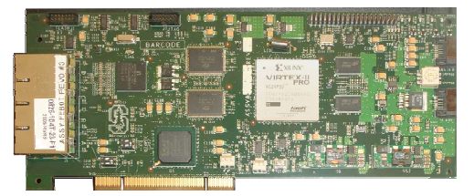





NetFPGA – Programmable Hardware for high-speed network prototypes
The NetFPGA platform provides a flexible teaching and research tool – permitting instrumentation and prototyping of real router functionality at real network speeds.
Put a NetFPGA into a PC to build hardware-accelerated, gigabit-speed network appliance.
Features:
Wire-speed packet processing
Cost-Effective
Can be programmed as:
  Any-protocol Router, Ethernet Switch, NIC,…
Interfaces:
  Four Gigabit Ethernet ports
  Standard PCI host interface
  Gigabit serial I/O
NetFPGA platform
V2-Pro50 FPGA w/ infrastructure
SRAM
PHY
MAC
18Mb
1GE
1GE
Your hardware specified
in Verilog source code
connected to components
of the Reference Router
circuits and cores.
PHY
MAC
1GE
1GE
DDR2
Four Gigabit Ethernet Interfaces
-
SDRAM
64MB
PHY
MAC
1GE
1GE
SRAM
Board
PHY
18Mb
-
1GE
MAC
1GE
FIFO
3
Control, PCI
SATA
packet
Interface
Gb
Board Interconnect
Host
buffers
Linux OS
computer
User
-
NetFPGA Kernel driver
-
defined software networking applications
Using the NetFPGA follows Cambridge Computer Laboratory tradition of working with both hardware and software.
Past networking projects have included the original Cambridge Ring, the Cambridge Fast Ring, the Fairisle ATM switch, the Desk Area Network and the Home Area Network.
Programmable network hardware allows students and researchers to do practical prototyping at real-world line-speeds.
Current Projects and Plans:
Test novel ideas for control mechanisms (buffer management, scheduling) in Optical PCI Networks
Build an accurate, fast, network emulation
Hardware implementations of behavioural classifier
Hardware supporting virtual routers/hosts
Provable routers as an F#/Kiwi target
Provable routing through Metarouting
An open network hardware platform implemented with Field Programmable Gate Array (FPGA) logic.
Support for the NetFPGA project has been provided by the following companies and institutions
http://www.netfpga.org

