Slide 1
Risk and Resilience: A Teen-centered Perspective on Teens and Technology Use
Dr. Pamela Wisniewski
University of Central Florida
Invited Research Talk

Slide 2
Dr. Pamela Wisniewski (Pronounced WIZ-NES-KEY)
Assistant/Associate Professor: University of Central Florida, Department of Computer Science
Post Doc: Pennsylvania State University, College of Information Sciences & Technology
PhD: University of North Carolina at Charlotte, Computing & Information Systems, Human-Computer Interaction, College of Computing and Informatics
Systems Developer: Financial services and Medical Consulting industries
BS/MS: University of Florida, Decision & Information Sciences
HCI - Social Computing
Adolescent Online Safety
Networked Privacy

Slide 3
Adolescent Online Safety Research
“CAREER: Safety by Design: Protecting Adolescents from Online Risks” (#1844881, 4/2019-3/2024 $550,000)
“IIP:PFI-RP: Using a Human-Centered Approach to Improve Algorithms for Detecting Online Risks” (#1827700, 9/2018-9/2022, $821,000)
“EAGER:CHS: Examining Self-Harm and Suicide Contagion Risks of Viral Social Media Challenges on Youth and Young Adults” (#1832904, 4/2018 – 4/2019, $58,053).
Early Career Scholars Grant: “Reducing Digital Inequality by Empowering At-Risk Youth to be Resilient against Online Sexual Predation Risks” (7/2018-6/2023, $350,000)
Seed Grant: “Online Social Support for Young People with Mental Health Problems: Discovering What Works” (2018-2020, $15,000)
Seed Grant: “Robustly Quantifying Parental Monitoring and Support in the Digital Age” (2018-2020, $15,000)
Any opinion, findings, and conclusions or recommendations expressed in this material are those of the authors and do not necessarily reflect the views of our sponsors.

Slide 4
Teens, Social Media, and Technology
95% of teens have access to a smartphone
45% say they are online almost constantly
Teens have mixed feelings regarding the impact of Technology and social media on their lives . . .
(Pew Research 2018)
31%
45%
24%
Positive
Meh
Negative

Slide 5
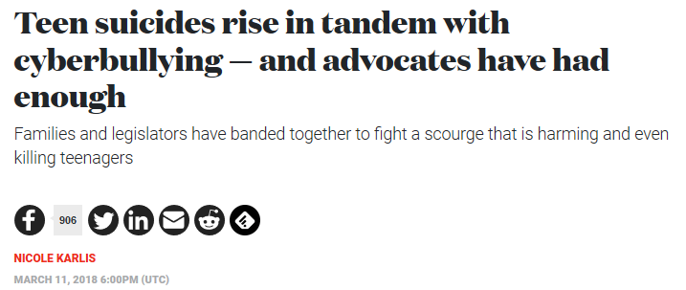
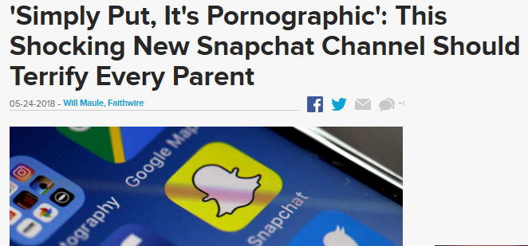
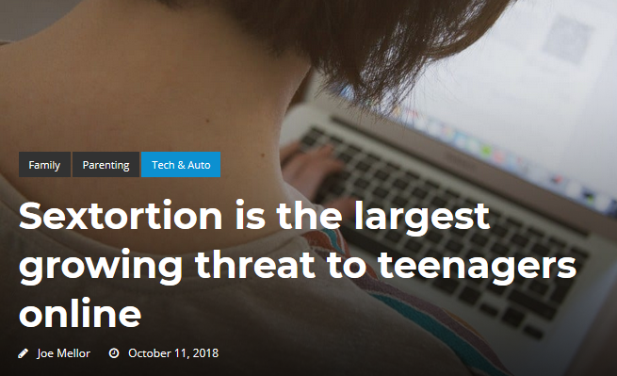
Headlines in the news
Online Risk Exposure among Youth in the United States:
1 in 4: unwanted explicit content
1 in 9: victims of cyberbullying
1 in 11: unwanted sexual solicitations
(Crimes Against Children Research Center 2012)

Slide 6
A Privacy Paradox: Social Networking in the United States
“In America, we live in a paradoxical world of privacy. On one hand, teenagers reveal their intimate thoughts and behaviors online and, on the other hand, government agencies and marketers are collecting personal data about us.”
“The personal information revealed by teenagers on these sites also attracts sexual predators.”
(Barnes, 2006)

Slide 7
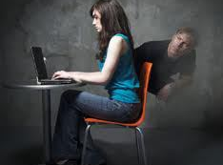
The Psychology of Fear
Shield Them from Risks . . .Protect Them!
Get the Situation under Control. . . Fix the Problem.
Their Future is at Stake!

Slide 8
We Must Protect Teens from Online Dangers!
Emphasizes high-risk narratives instead of the everyday experiences of teens
A dangerous epidemic among our youth?
A risk-adverse approach to online safety
Emphasizes an abstinence-only prevention
Equates all risk exposure to harm
Doesn’t empower youth and teach teens how to protect themselves online
“As a society, we often spend so much time worrying about young people that we fail to account for how our paternalism and protectionism hinders teens’ ability to become informed, thoughtful, and engaged adults.” (boyd, It’s Complicated: the Social Lives of Networked Teens)
(Pinter et al. 2017)

Slide 9
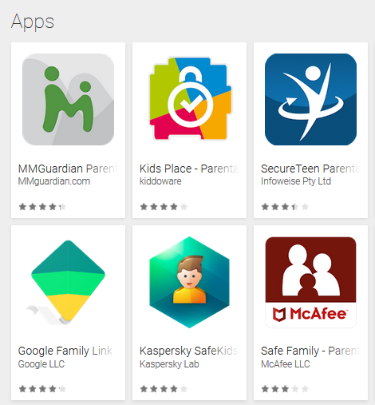
Technical Monitoring of Mobile Devices
An increasing number of mobile safety applications are being offered to help parents monitor teens (Czeskis et al. 2010)
About 16% of parents use parental control apps on their teen’s phone
(Pew Research 2016)

Slide 10
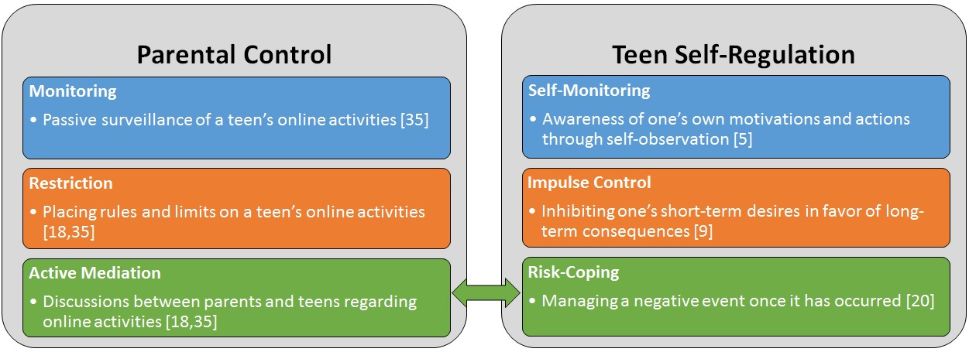
Teen Online Safety Strategies Framework
CHI 2017 Paper
Teen Online Safety Strategies (TOSS) Conceptual Framework

Slide 11
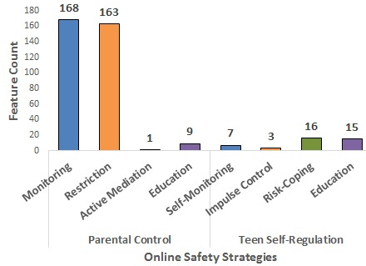
Mobile App Feature Analysis
Identified 75 mobile apps on Google Play aimed at adolescent online safety
Grounded analysis, which identified 42 unique features
382 instances of the features found within the 75 apps
Mapped features to the TOSS framework
Education emerged as a fourth strategy for both parents and teens
89% features supported parental control
11% supported teen self-regulation

Slide 12
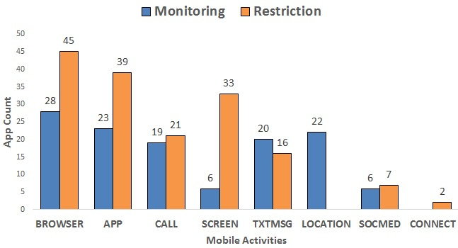
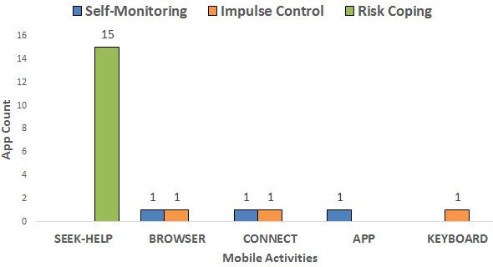
Mobile Activity Restriction & Monitoring
Where teens encounter the most risks
Parent Features
Teen Features
Highly Privacy-Invasive
“SOS” Feature to get help from an adult
All-or-Nothing Restrictions

Slide 13
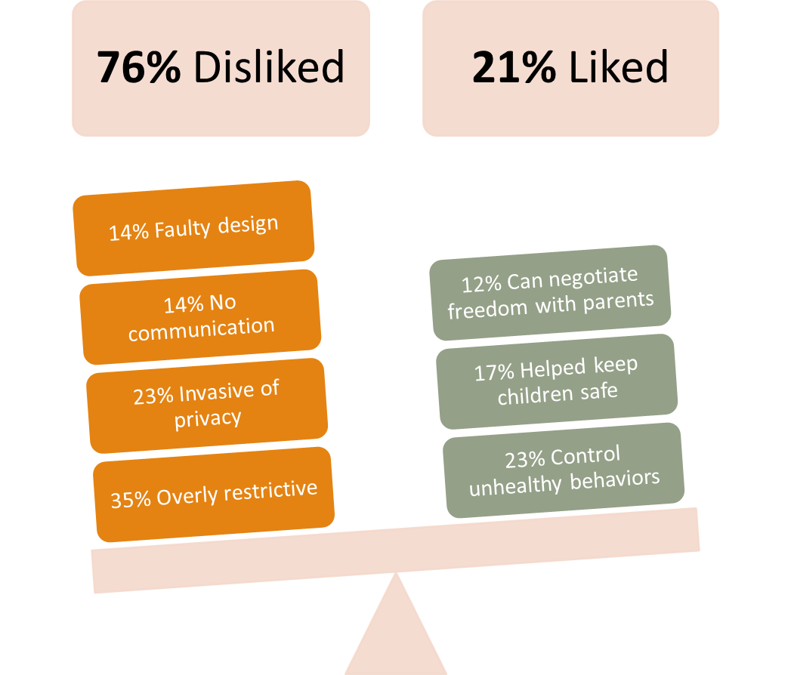
Overview of Teen Reviews
CHI 2018 Paper
N = 736 Google Play App Reviews

Slide 14
Overly Restrictive (35%): “This app sucks. Parents if you really want your kids to hide more things from you and be more rebellious then get them to down load this app. Because they will become more defiant the more you restrict them and they will make your life a living hell because your overprotective.” –One Star, Mobile Fence Parental Control, 2015
Privacy-Invasive (23%): “This totally takes ALL my privacy away. I can't even talk to my biological dad, or my boyfriend, or best friend with out being stalked by my mom.” –One Star, SecureTeen Parental Control, 2015
N = 736 Google Play App Reviews
76% of Reviews were negative
(Ghosh et al. 2018)
Harms Parental Relationships (14%): “This app will cause trust issues with your kids. Ever since my dad installed this app, he and I have grown farther apart. If he doesn't trust me enough to use my phone, then why should I trust him?” –One Star, SecureTeen Parental Control, 2015

Slide 15
Resilience as an Alternative Approach
Adolescent Resilience Framework
A strength-based approach to adolescent development
Focus on the assets and resources that enable adolescents to overcome the negative effects of risk exposure, not prevent it
Resilience cannot occur in the absence of risk
(Fergus & Zimmerman, 2005)

Slide 16
A Family Systems Perspective
Family Systems Theory (Cummings, et al., 2012)
A family system is a dynamic process where parents and children are iteratively and bidirectionally influencing one another over time
Diary-based methods are often employed to study this complex process
More naturalistic methods that afford more “situated” and “authentic” reporting (Davis, et al., 2014)
Two Month Dyadic Diary Study of Parents and Teens
Notes:
The research I am presenting today is a direct result of my post doctoral work here at Penn State, where we took a family systems based approach to studying adolescent online safety and risks by working with parents and teens. Instead of relying on cross-sectional survey data, we wanted to gain more naturalistic and situated insights from teens and parents about how teens experienced and responded to online risk exposure on a week-to-week basis. Therefore, we conducted a two month web-based diary study with parents and teens.

Slide 17
Diary Study Publications
Wisniewski, P., Jia, H., Wang, N., Zheng, S., Xu, H., Rosson, M.B., and Carroll, J.M. (2015) “Resilience Mitigates the Negative Effects of Adolescent Internet Addiction and Online Risk Exposure,” In the Proceedings of the ACM Conference on Human Factors in Computing Systems (CHI 2015), Seoul, Korea. CHI 2015 Best Paper Award
Wisniewski, P., Xu, H., Rosson, M.B., Perkins, D.F., and Carroll, J.M. (2016) “Dear Diary: Teens Reflect on Their Weekly Online Risk Experience” In the Proceedings of the 2016 ACM Conference on Human Factors in Computing Systems (CHI 2016), San Jose, CA. CHI 2016 Best Paper Award
Wisniewski, P., Xu, H., Rosson, M.B., and Carroll, J.M. (2017) “Parents Just Don’t Understand: Why Teens Don’t Talk to Parents about Their Online Risk Experiences,” In the Proceedings of the 2017 ACM Conference on Computer Supported Cooperative Work (CSCW 2017), Portland, OR.
McHugh, B.C.*, Wisniewski, P., Xu, H., Rosson, M.B., and Carroll, J.M. (2017) “Most Teens Bounce Back: A Longitudinal Analysis Demonstrating How Teens Recover Quickly from Episodic Online Risk Exposure,” Proceedings on ACM Human-Computer Interaction, 1(CSCW), Article 76.
McHugh, B.C.*, Wisniewski, P., Rosson, M.B., and Carroll, J.M. (2018) “When Social Media Traumatizes Teens: The Roles of Online Risk Exposure, Coping, and Post-Traumatic Stress,” Internet Research, 28(5), pp. 1169–88. doi: 10.1108/IntR-02-2017-0077
* Graduate student advised
Notes:
While this project was a significant undertaking, we did achieve considerable success. Our diary study alone produced five peer-reviewed full papers in journals and top HCI conferences, including two Best Paper Awards in subsequent years at CHI. To date, I have published over 20 peer-reviewed research articles on the topic of adolescent online safety.
To showcase some of this work, I will present our two Best Papers from CHI 2015 and 2016 based on the dyadic diary study.

Slide 18
ONLINE Risk Model
CHI 2015 Best Paper Award
N = 75 Teens (pre-survey)
R² = 28%
Online Risk Exposure
0.53***
0.35**
Internet Addiction
R² = 28%
Negative Affect
0.25*
* p-value < 0.05, ** < 0.01, *** < 0.001
Notes:
Our first hypothesis was supported. Internet addiction was significantly and positively correlated with online risk exposure. And online risk exposure partially mediated the relationship between Internet addiction and negative affect. Teens who were addicted to the Internet were more likely to encounter online risks, which also helped explain the variance in why teens were negatively affected by internet addiction.

Slide 19
Resilience Model
Resilience
-0.21*
-0.19⁺
R² = 41%
Online Risk Exposure
Internet Addiction
0.40***
0.16
R² = 40%
Negative Affect
0.18
+ p-value < 0.10, * < 0.05, ** < 0.01, *** < 0.001
Notes:
Resilience moderated the relationship between online risk exposure and negative affect but only at the 0.10 level, and significantly moderated the relationship between internet addiction and online risk exposure both in the directions that we hypothesized. Most interesting, however, is the additive effect where the two moderation effects of resilience changed the previously significant paths between internet addiction and negative affect and online risk exposure and negative affect to be non-significant.

Slide 20
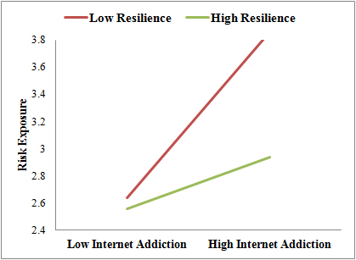
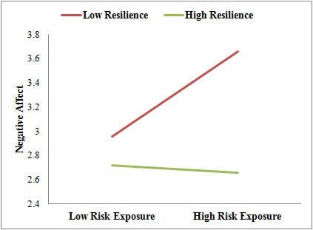
Protective Role of Resilience
Protective-Reactive Effect of Resilience
Protective-Stabilizing Effect of Resilience
Notes:
These interaction graphs further explain the protective roles resilience plays in our model. This first graph shows how teens who are highly addicted to the internet but also reported high levels of resilience are less likely to be exposed to online risks than teens who reported low levels of resilience.
In the graph on the right, we see a strong main effect of resilience where high levels of resilience seem to neutralize the relationship between online risk exposure and negative affect.
This study confirmed the importance of teen resilience when it comes to deadling with online risks, but what this study could not unpack was what online resilience actually looks like for teens.

Slide 21
Results from Diary Study of 68 teens and parents
87% of the risks reported during the diary study were coded as low to medium risk severity
84% of the risk reports suggested that teens did not intentionally seek out online risk experiences
47% of reports showed that teens took active measures to cope
Said “no” to unwanted advances, confronted the person who caused the issue, removed themselves from unwanted situations, fixed it themselves, or actively sought help
49% of the reports were considered resolved
17% so insignificant, no resolution was necessary
Experiences often gave teens the opportunity to build important social skills, such as boundary setting, problem solving, and empathy
N = 209 Reports by Teens
N = 80 Reports by Parents

Slide 22
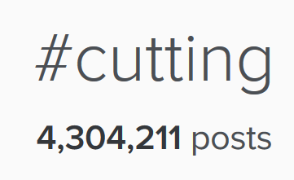
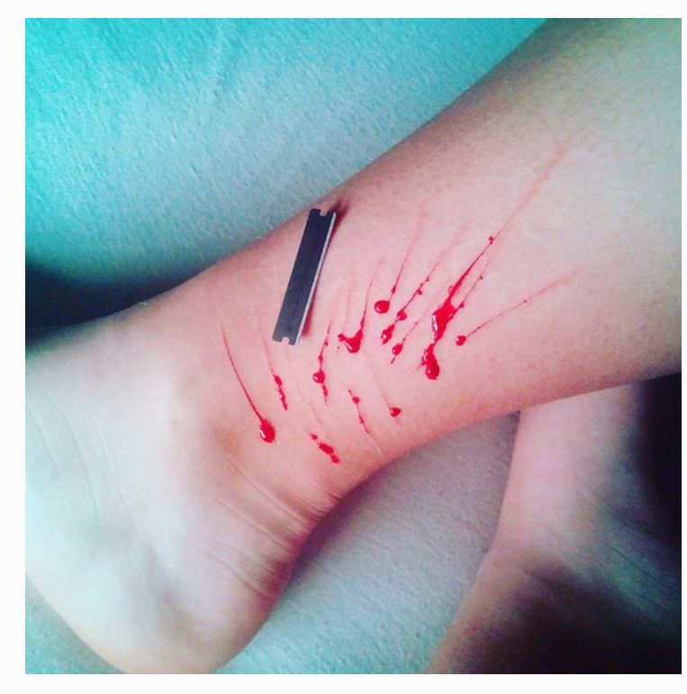
Teens see more online than you think
CHI 2016 Best Paper Award
“Oh, hon. Its the *internet*. Half of it is porn to start with. The other half is contaminated by violent material, illegal material, depression, anxiety, and morally dubious events by nature… It would really be a miracle if you managed to be on the internet without any exposure to it.”
-15-year-old female
“someone posted an instagram picture of their scars… I commented ‘stay strong,’but one comment will not save her life.”
-13-year-old female

Slide 23
Teens often Said No
“One of my old friends asked for pictures and I said no… I didn't want to send them, and I didn't give him any idea that I was going to. It was random.” -14-year-old female

Slide 24
Sometimes, teens said yes
“A friend of mine was feeling particularly sexual, and it showed in her texts. It's not like I planned it, but I certainly wasn't opposed to it.” -16-year-old male

Slide 25
Less often, it got Serious
“People [on] path and kik kept calling me a th** and a liar… It made me want to kill myself✂?”
-14-year-old female

Slide 26
parents were mostly in the dark
Family Communication regarding teens’ online risks experiences was poor and created significant differences in perception between parents and teens.
Less than 7% of the risk reports matched between teens and parents
38% parent-teen pairs had no communication regarding online risks
Parental Misperceptions, as well as their actual responses, exacerbated the lack of communication, encouraging teens not to go to their parents when they experience online risks.

Slide 27
When Parents Were (Rarely) Involved
Parents used active mediation to talk about the situation with their teens
But, it often sounded a lot like a lecture instead . . . or punishment.
“I think it is childish and ridiculous. A waste of time. He is actually watching me type this, so he knows how I feel about it.” -Mother of 15-year-old male
“The picture was not at all sexually suggestive. However, it violated the rule of NOT sending him any pictures.” -Mother of a 13-year-old female (Matched Reports)
“I had to confess when she saw the KIK message… it was just a picture of me smiling… I am under punishment for 2 weeks - which i think is excessive” -13-year-old female

Slide 28
At the End of Two Months
Parents reported significantly lower levels of family communication than in their pre-surveys
Though still significantly higher than their teens’
(Matched Reports)
“I realized that I have given my daughter a lot of trust online.”
-Mother of 14-year-old female
“That my parents don't really know what I do online, no matter how much they really think that they do know.” -14-year-old female (matched)

Slide 29
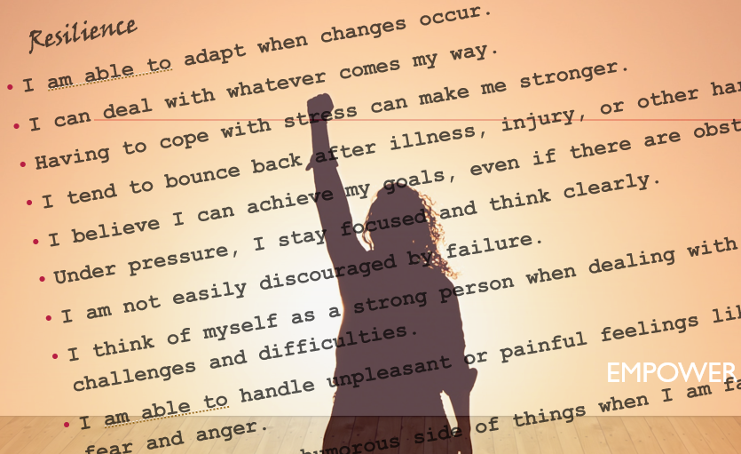
Implications for Design
Forget “abstinence-only” approaches
We cannot shield teens from any and all online risks, nor should we
Empower teens to be resilient
Facilitate teen self-regulation
Socio-technical interventions for teens (not parents)
Soft “paternalistic” nudges
Design systems to promote positive values and behaviors

Slide 30
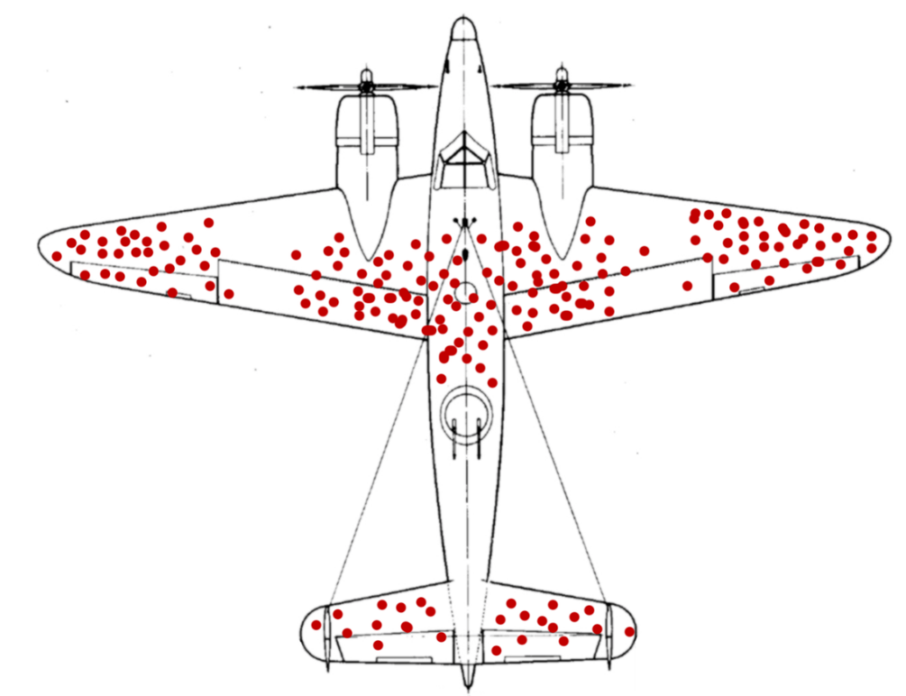
A Word of caution
Treating all teens like they are victims online, causes a sense of panic, fear, hopelessness, and fatigue
It also disadvantages youth that are at higher risk
Teens who struggle offline are often the teens who struggle online
Survivor Bias vs. Victim Bias

Slide 31
Foster Youth and Online Risks
CHI 2019 Best Paper Award
High Risk: “One of the persons she was talking to asked her what turned her on and she sent him naked pictures of a 10-year-old girl, she said that this is what turns me on.”
-Foster Mother from Indiana
Trauma: “The agency likes to say that it is ‘normalcy,’ to have the child have all of these electronics and have access like a normal child. However, the children that we get in care, more often than most, did not have a normal upbringing like your child or your siblings or yourself would have had.”
-Foster Mother from Florida
Desperation: They’ve already seen everything and done everything, so what am I supposed to do?”
-Respite Foster Mother from Florida
Restriction: “So, from that [elopement] I took my tablet away from her, and she never got to use it again.”
-Respite Foster Mother

Slide 32
So, What Can we do?

Slide 33
Online Safety as a Developmental Process
Set up parental controls when you first give your child access to technology (~Ages 8-12)
Teach them how to navigate potentially risky situations. Focus on risk coping skills for managing risks. Give them exit strategies. (~Ages 8-14)
Trust your teen to make good decisions on their own. Set clear boundaries. Let them know you are there to help if they need you. (~Ages 15-18)
Deep breaths… Withhold judgment.

Slide 34
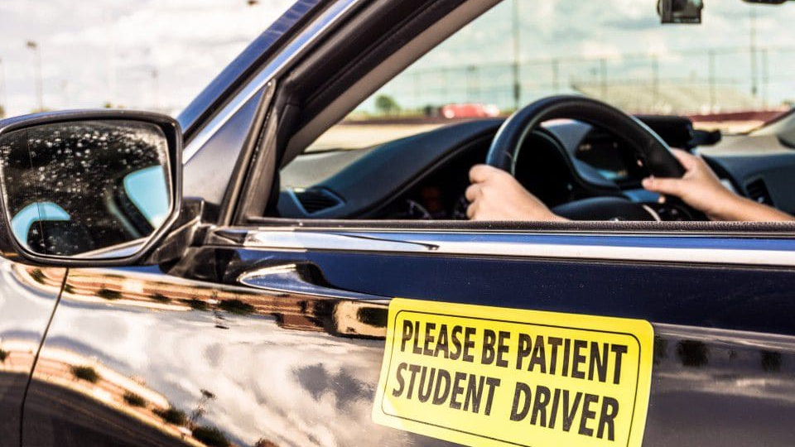
Teach
“My heart is officially broken. Just caught my 11-year-old watching inappropriate videos on YouTube. . . I was blind enough to believe I could trust him . . .”
It’s not a matter of trusting a child until they prove to be untrustworthy…
It is our job to teach them how to engage with technology safely.
It is a learned skill.

Slide 35
Support . . . LISTEN
CHI 2020 Paper: Let’s Talk about Sext
Online safety should become a part of the everyday discussion for. . .
Developing socio-emotional skills (e.g., bullying)
Mental health education (e.g., self-harming behaviors, Depression)
Sex education (e.g., forming healthy relationships)
Don’t treat online risks as more deviant than typical risks teens encounter offline.
Teens want to share . . . Make sure they feel comfortable sharing with us.
“I just sexted with my boyfriend for the first time and he's 14 and I'm 15 but omg. idk. it was actually kinda fun... and like I haven't sent any nudes. so I'm safe. but yea. just. agh. idk. can't tell anyone cuz then they'd judge me. but oh well. Idk.” -15yr old Female

Slide 36
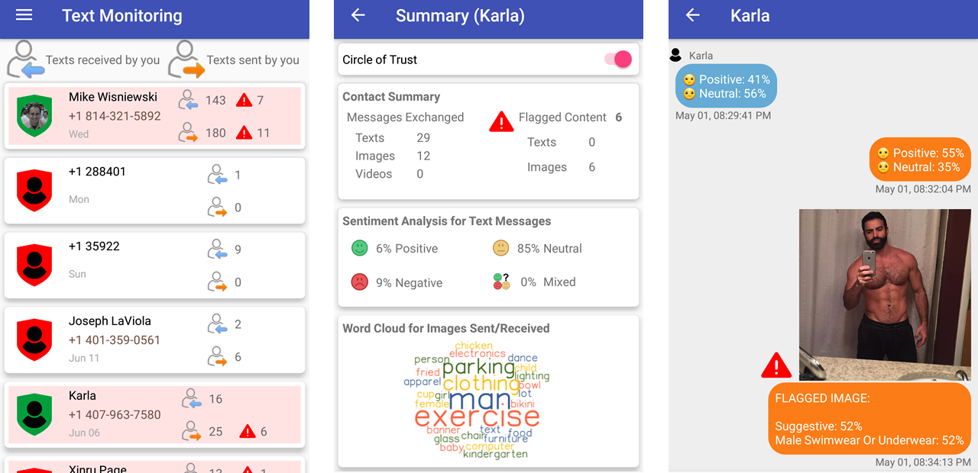
USE Human-Centered Design to Reconceptualize Keeping Teens Safe Online
CHI 2020 Paper: Circle of Trust

Slide 37
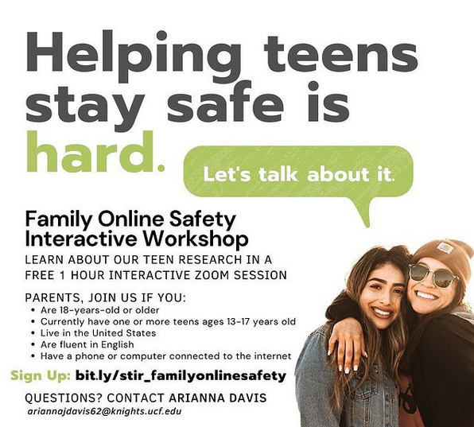
Teenovate: Participatory Action and Design Research
https://www.teenovate.org/

Slide 38
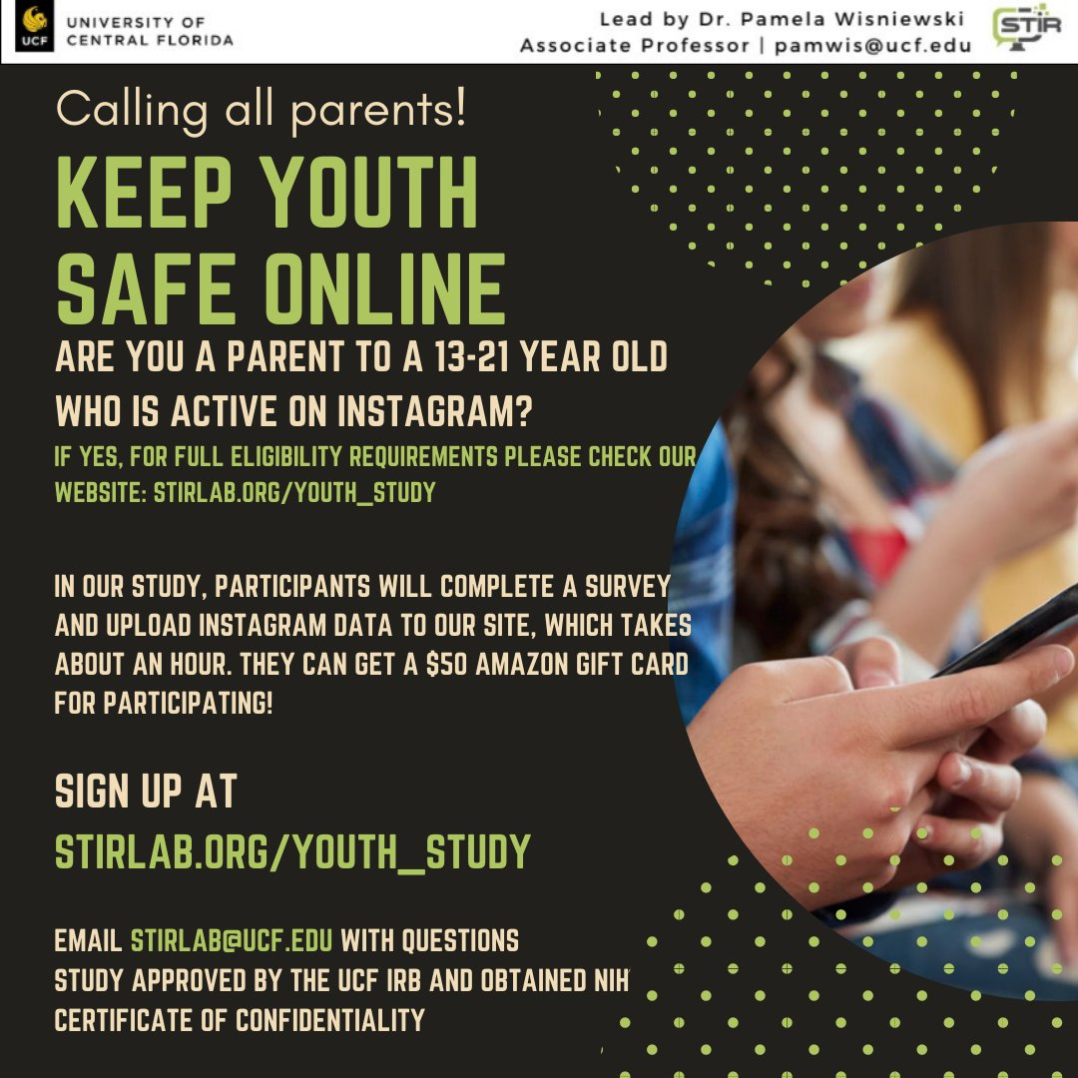
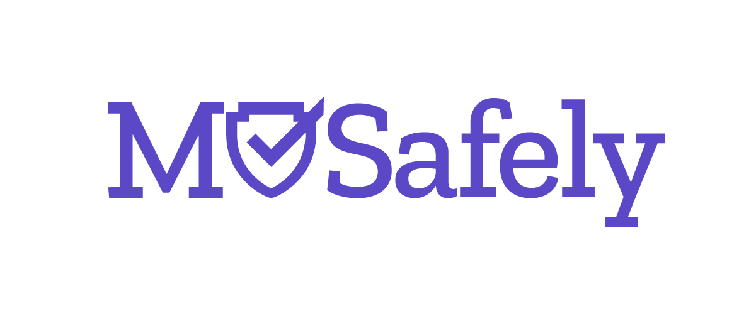
MOSafely: An open-source consortium for youth online safety
https://www.mosafely.org/

Slide 39
Create new narratives for online safety
http://www.npr.org/sections/health-shots/2017/02/27/517491502/to-keep-teens-safe-online-they-need-to-learn-to-manage-risk
https://thejournal.com/articles/2016/05/16/researchers-forget-internet-abstinence-teens-need-to-face-some-amount-of-online-risk.aspx
https://www.forbes.com/sites/tarahaelle/2017/02/28/online-risks-are-everyday-events-for-teens-but-they-rarely-tell-their-parents/#6902021b3861
https://health.usnews.com/wellness/health-buzz/articles/2017-12-05/cyberbullying-doesnt-affect-most-teens-for-long-study-says

Slide 40
Thank you! Questions?
Pamela Wisniewski, Ph.D.
University of Central Florida
pamwis@ucf.edu
Socio-Technical Interaction Research (STIR) Lab: http://www.stirlab.org
Industry-focused User Experience (iUX) Academy: http://www.cs.ucf.edu/ux/

Slide 41
Recorded Presentations
Teens and Screens: https://stirlab.org/teens-and-screens/
CHI 2020 “Let’s Talk about Sext:” https://youtu.be/TB3a8yerdBc
RSA 2019 Panel on “Security, Privacy, and Human Behavior:” https://stirlab.org/rsa-conference/

