Slide 1
DSvis: A tool for interactively exploring dynamical systems using GPU computing
Bob Merrison-Hort
Cambridge, 19th December 2013

Slide 2
Introduction
PhD student at Plymouth University, supervised by Roman Borisyuk
Officially the theme of my PhD is computational and mathematical models of Parkinson’s disease…
… but with a side-line in modelling Xenopus tadpole locomotion, in collaboration with:
Alan Roberts’ lab (Bristol)
Wenchang Li’s lab (St Andrews)
The rest of the time: DSvis (working title…)

Slide 3
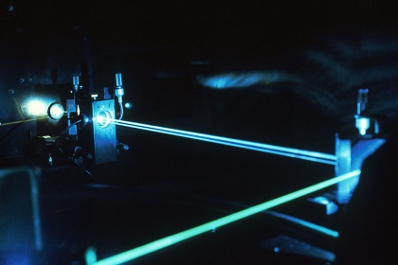
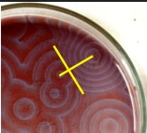
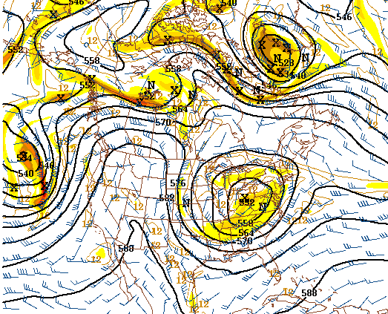
Dynamical Systems
A way of describing how things change with time
Extremely general purpose approach, with widespread applications
dx₁/dt = f(x₁, x₂, x₃, …, a, b, c, …)
dx₂/dt = g(x₁, x₂, x₃, …, a, b, c, …)
dx₃/dt = h(x₁, x₂, x₃, …, a, b, c, …)
…
Exploit the power of GPUs by simulating dynamical systems from many differential initial states and observing the trajectories in real time

Slide 4
Structure: Initialization
Template Kernel
Model Definition Objects
Pick Initial Conditions
Compile
Vertex Buffer
Kernel
Vertex Shader
Geometry Shader
Fragment Shader
GPU
Screen

Slide 5
Structure: Update
Template Kernel
Model Definition Objects
Vertex Buffer
Kernel
Update
Vertex Shader
Geometry Shader
Fragment Shader
GPU
Screen

Slide 6
Structure: Draw
Template Kernel
Model Definition Objects
Vertex Buffer
Kernel
Render
Vertex Shader
Geometry Shader
Fragment Shader
GPU
Raster
Screen

Slide 7
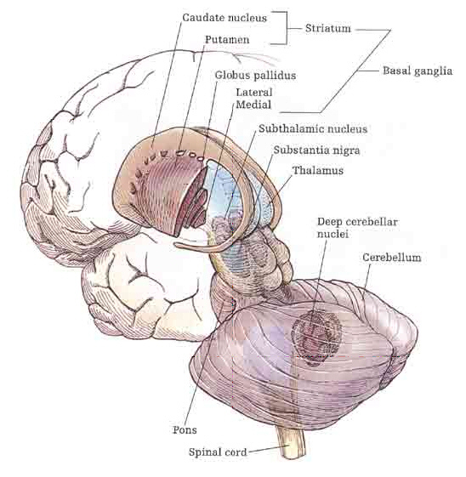
A simple model of the basal ganglia
Subthalamic Nucleus (STN)
w_{ss}
I
w_{gs}
w_{sg}
Globus Pallidus (GP)
w_{gg}
X₁ is activity level in the STN
X₂ is activity level in the GP
dx₁/dt = -x₁ + Z₁(w_{ss}x₁ – w_{gs}x₂ + I)
dx₂/dt = -x₂ + Z₂(w_{sg}x₁ – w_{gg}x₂)

Slide 8
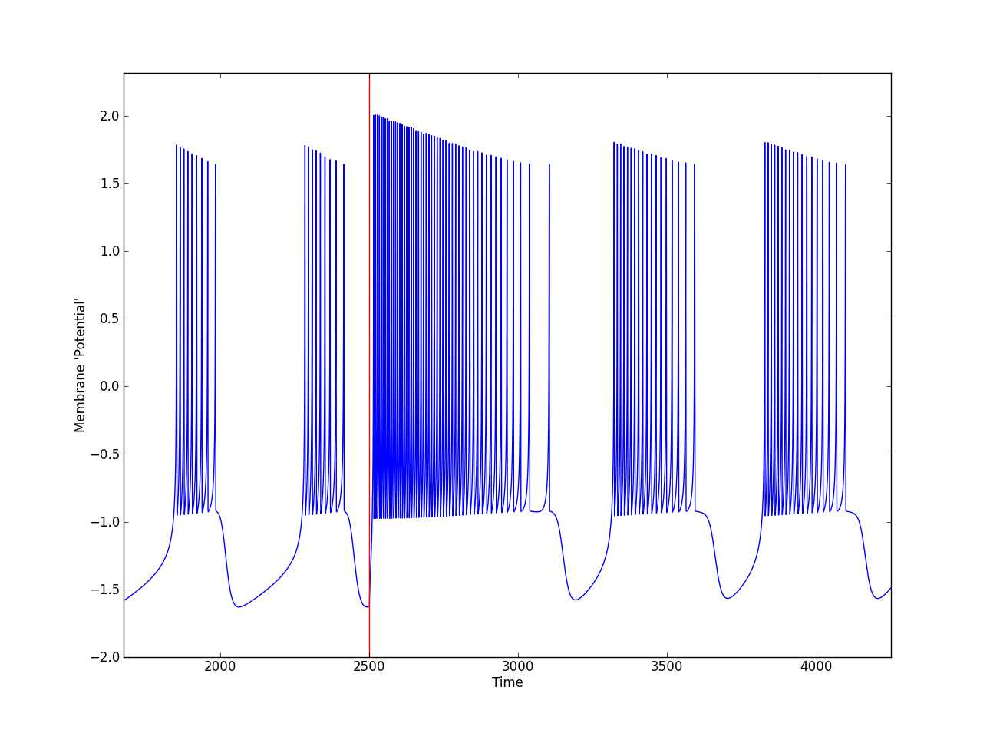
Hindmarsh-Rose Neuron Model
Three dimensional reduced model
Based on 2D Morris-Lecar model, with added slow adaptation variable
Capable of many dynamics (bursting, chaos)

Slide 9
Using the GPU makes interactive models possible
1,000,000 particles
6 frames per second
91 frames per second
CPU: Intel Core i5-2500K ($216, early 2011). C code compiled in VS2010 with optimization enabled.
GPU: NVIDIA GeForce GTX 460 ($170, late 2010)

