Slide 1
DeepDish: Multi-Object Tracking
With an off-the-shelf Raspberry Pi
Matthew Danish Justas Brazauskas Rob Bricheno
Ian Lewis Richard Mortier
Cambridge University Department of Computer Science & Technology
Centre for Digitally Built Britain

Slide 2
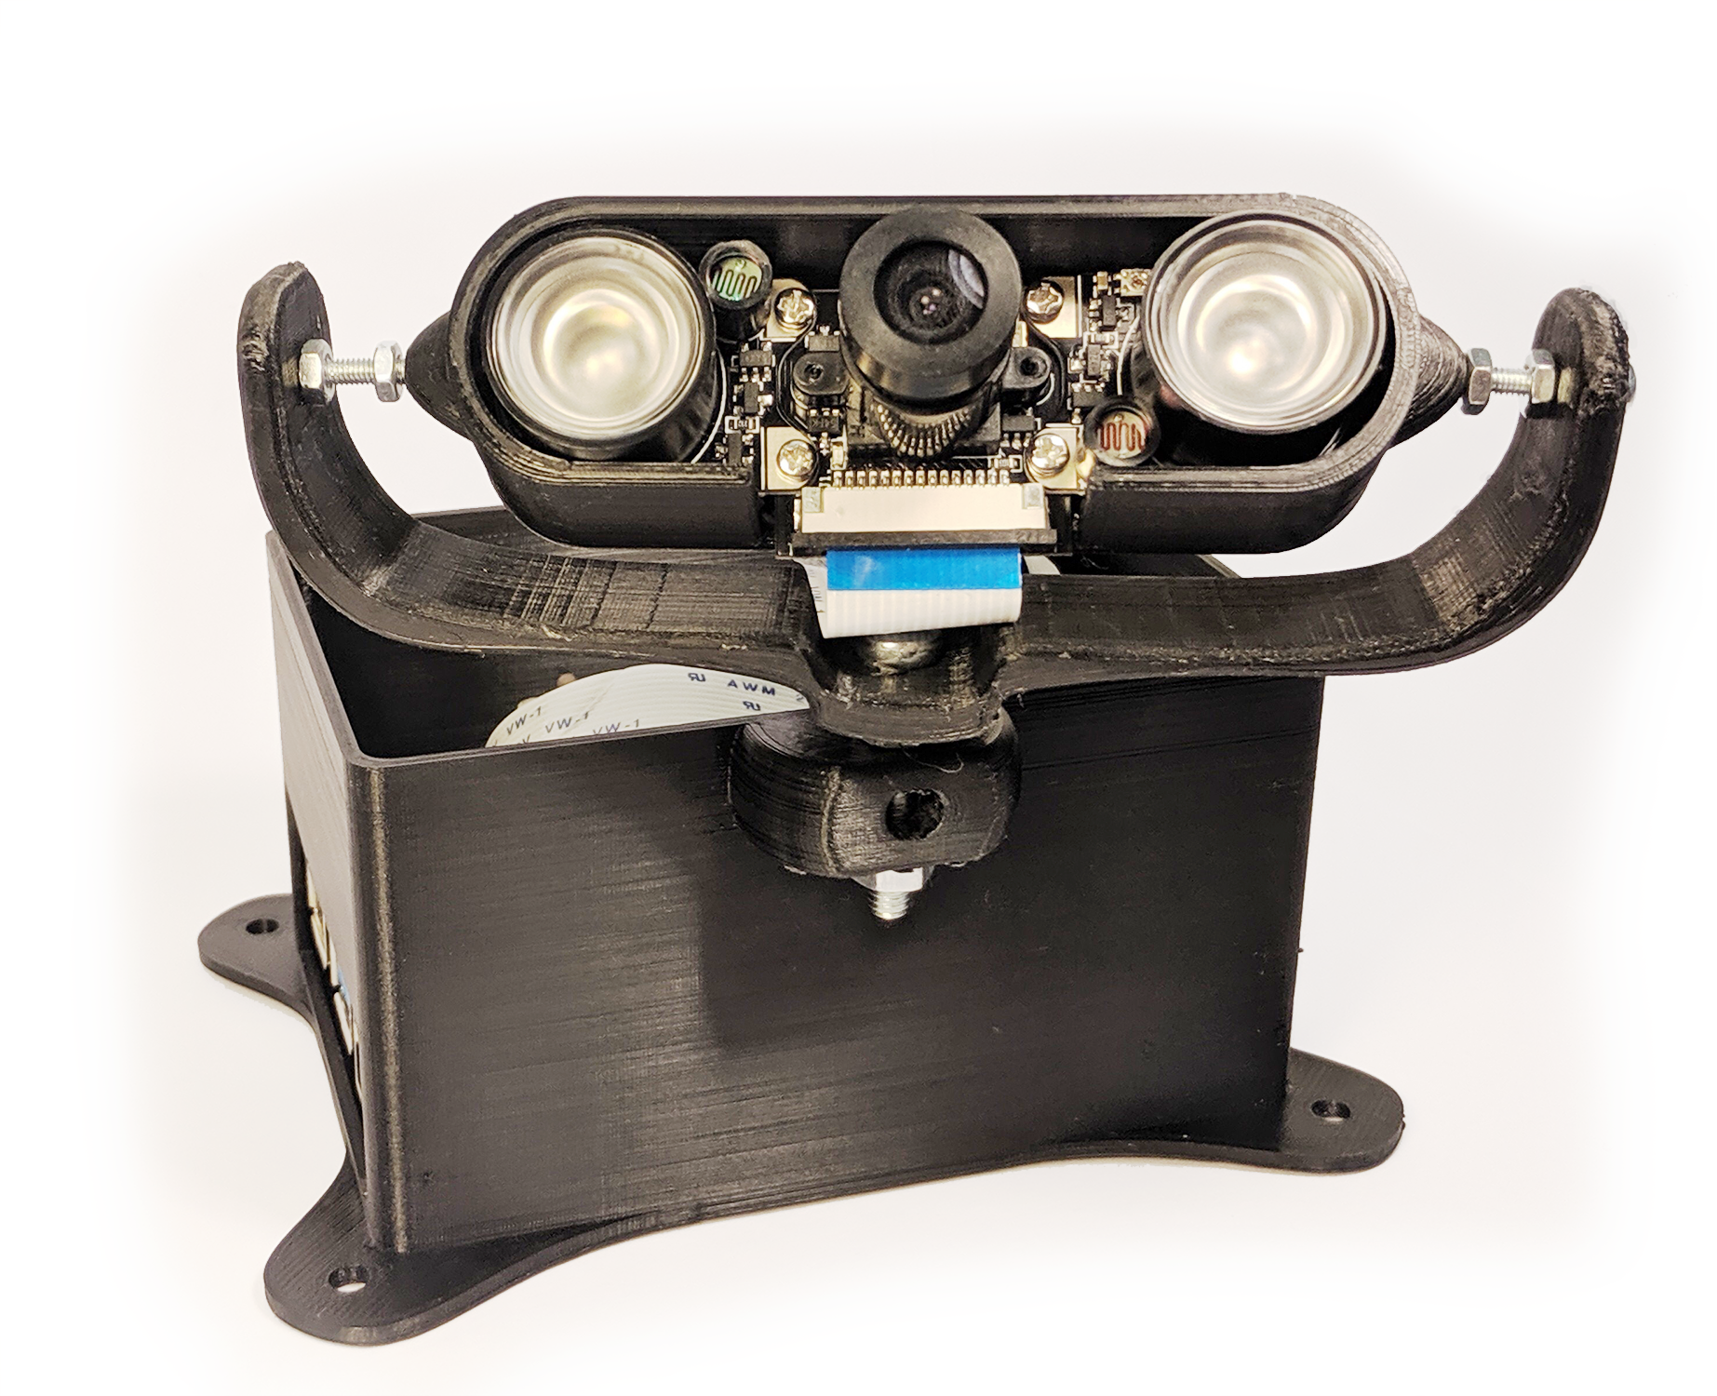
Raspberry Pi 4B (4GB RAM)
Standard camera (plus infrared lights)
Fan SHIM cooling
~£80 total
(cool 3D-printed case: extra)

Slide 3
Tracking by detection
Object detection:
MobileNet (v1)
MobileNet (v2)
YOLOv3
Feature encoding: DeepSORT (Wojke 2017)
Trained on Motion Analysis and Re-identification Set (MARS)
Cosine Distance Metric training
Combine with Kalman Filter tracking

Slide 4
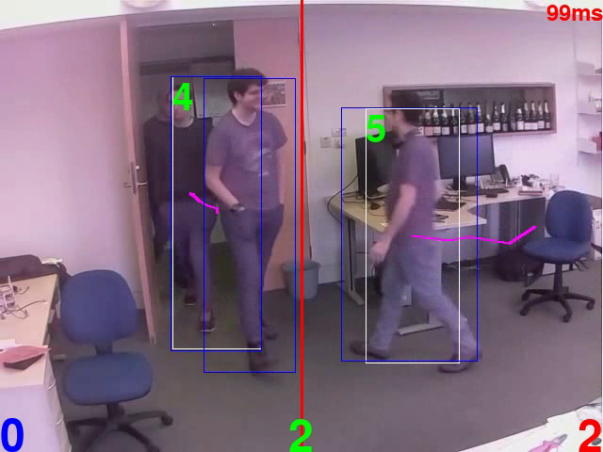

Slide 5
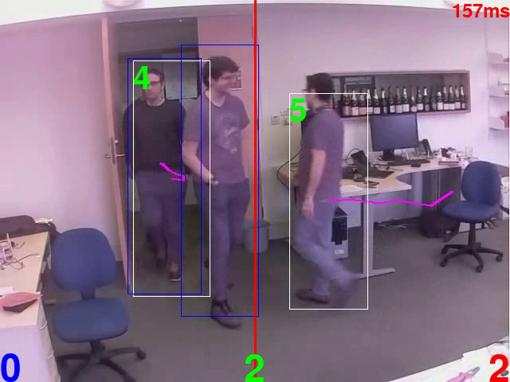

Slide 6
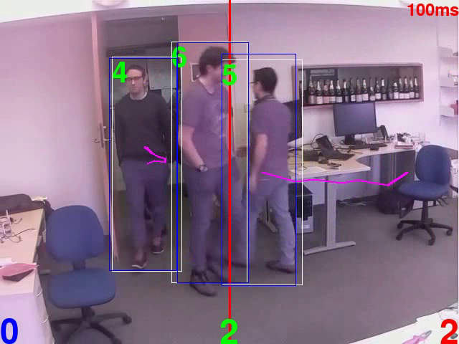

Slide 7
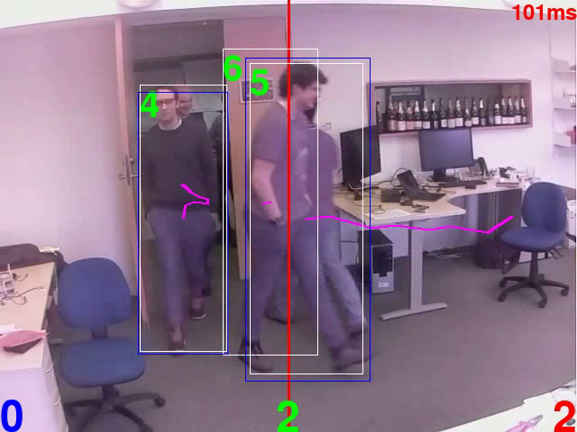

Slide 8
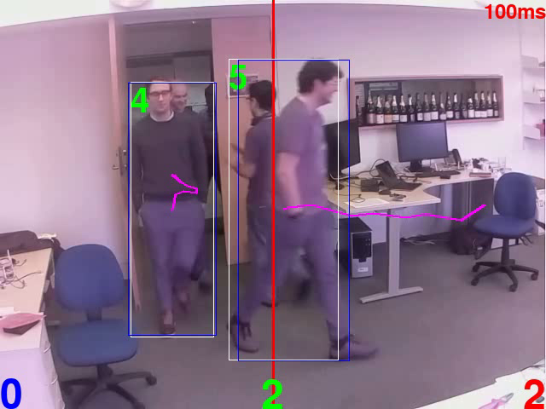

Slide 9
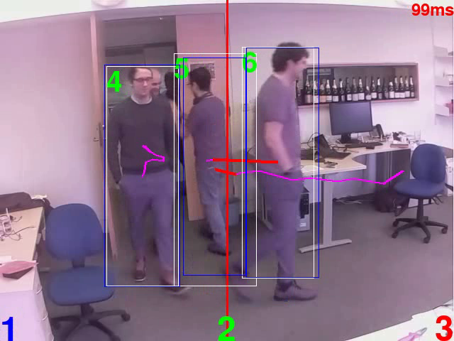

Slide 11
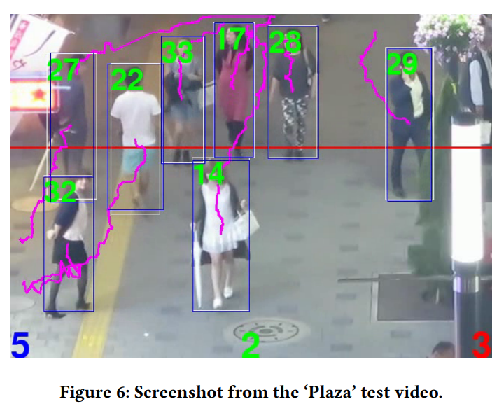

Slide 12
Scoring methodology
‘Office’ video and ‘Plaza’ video
Establish ground-truth by hand:
Count crossings in each direction, grouped into 10 second intervals
Subtract one direction from the other
Forms ‘ground-truth vector’
Testbed software performed same operation automatically
Score is 1 - cosine distance between test vector and ground-truth

Slide 13
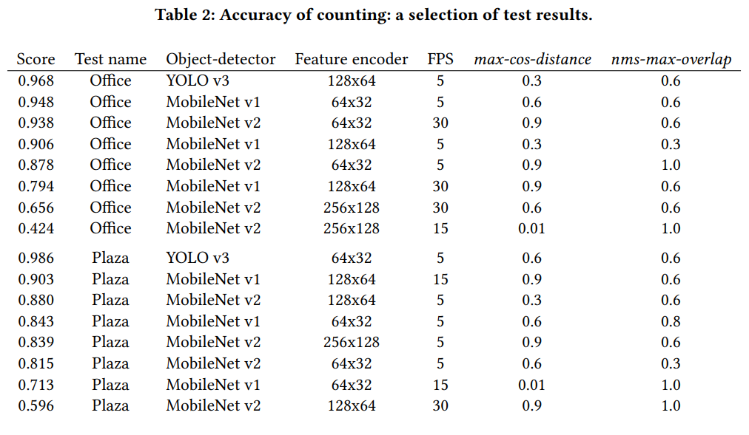
Accuracy results

Slide 14
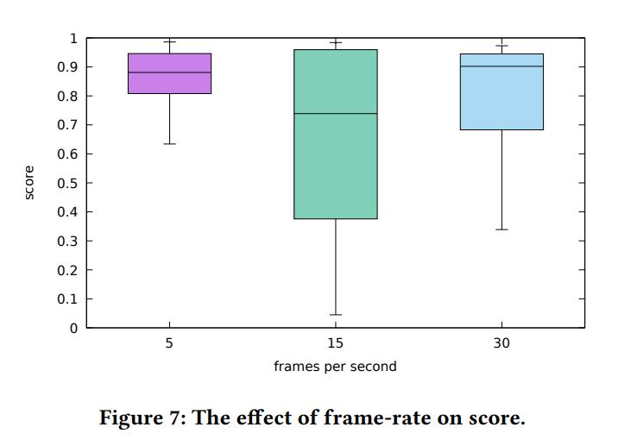

Slide 15
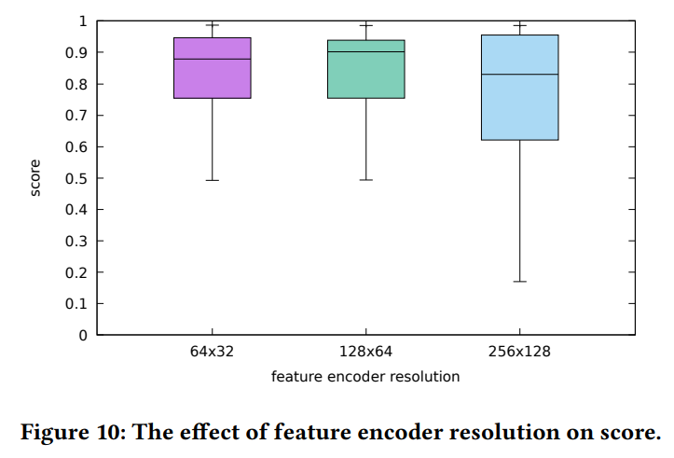

Slide 16
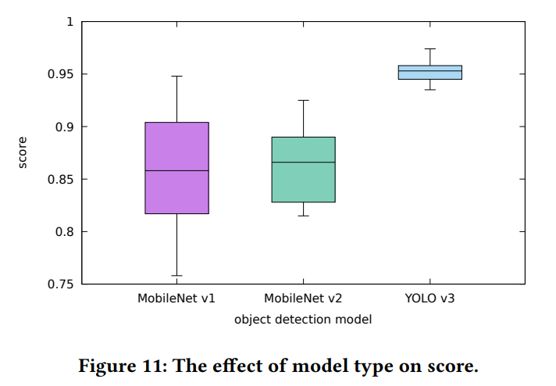

Slide 17
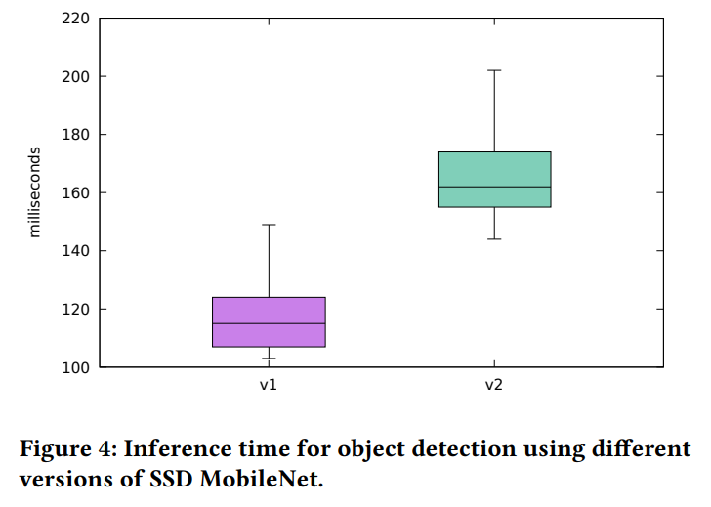

Slide 18
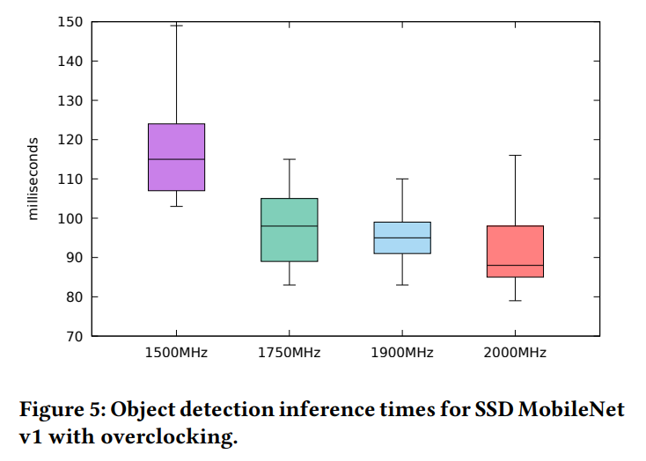

Slide 19
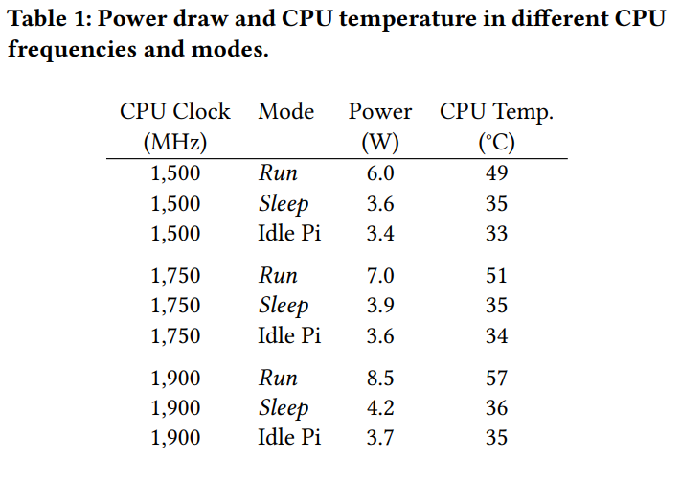

Slide 20
Other issues
Privacy
Using ‘Edge TPU’ devices
Deployment

Slide 21
Acknowledgments
This research forms part of Centre for Digital Built Britain’s work within the Construction Innovation Hub. The funding was provided through the Government’s modern industrial strategy by Innovate UK, part of UK Research and Innovation.

Slide 22
Thank you!

Slide 23
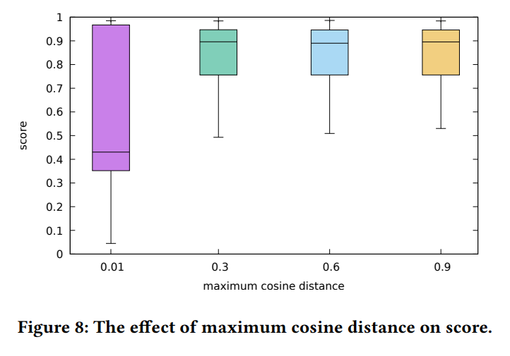

Slide 24
