Slide 1
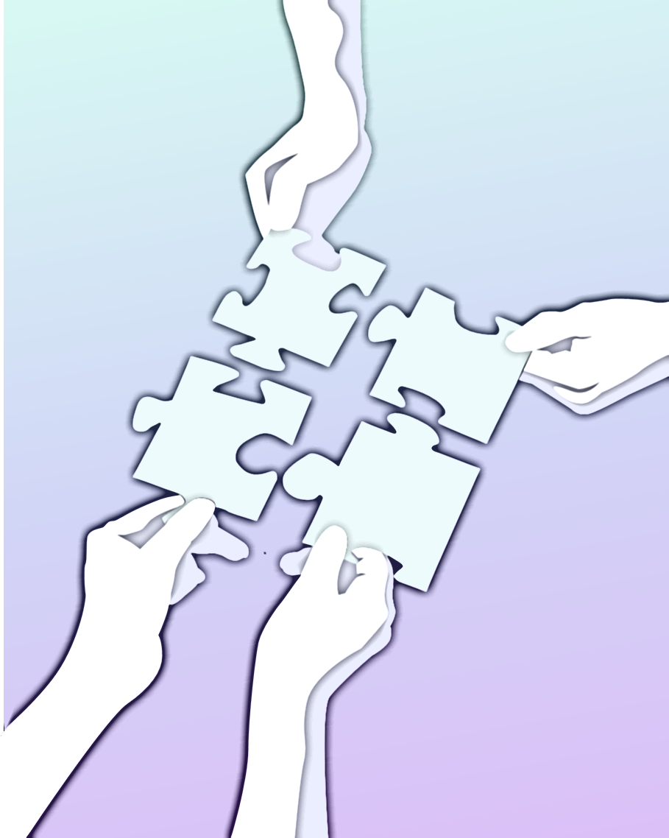
Conversation Logic:
The Interplay of Negation, Conjunction,
Disjunction, and Lexical Entailment
Lia Yeh
University of Oxford
Notes:
Thank you to Benjamin Rodatz, Razin Shaikh, and Bob Coecke for the really interesting collaboration in the past that led up to this work.
Thank you to Martha Lewis for the very insightful discussions, especially supporting us with code implementations for NLP experiments.

Slide 2
This talk
The goals of this talk are to:
Identify logical elements in conversation and their interactions
Explore past and present ideas for modelling them
Identify logical features that a useful categorical model of natural language should have, that can then be trained
Disclaimer: I research logical quantum computing gates and QNLP. I am new to linguistics, machine learning, and category theory.
Notes:
I will provide examples of concrete operations that you can perform on distributionally trained meanings, to show that they exist.
But I will not say you have to use this exact operation. Ultimately I don’t trust any operation unless there’s convincing experiments on real data to justify them.
But it is important to find concrete operations that satisfy desirable logical properties, even if that isn’t exactly how logic works in conversation. Because we can then initialize a ML model with that logical operation, which the model being trained, then modifies it to correspond to human usage of logic in conversation. Also, this directly shows that there exist concrete operations that have the desirable logical properties in the first place, instead of stating a bunch of properties we want that we don’t even know are possible to all be satisfied at once.
We want to bring logic into distributional NLP by identifying these logical features, so that an ML model to learn logic in language can check each iteration whether it’s actually learning
After disclaimer, mention my background is quantum computing, specifically my PhD research is on how to perform logical operations on quantum computers. Note that this talk is not about quantum logic, which is specifically about extending measurement probabilities for quantum observables.

Slide 3
Compositional NLP distributional NLP
hamster
guinea pig
planet
Figure from 1 Yeung and Kartsaklis. 2021. A CCG-Based Version of the DisCoCat Framework. Proceedings of SEMSPACE.
Notes:
CCG: Combinatorial categorical grammar

Slide 4
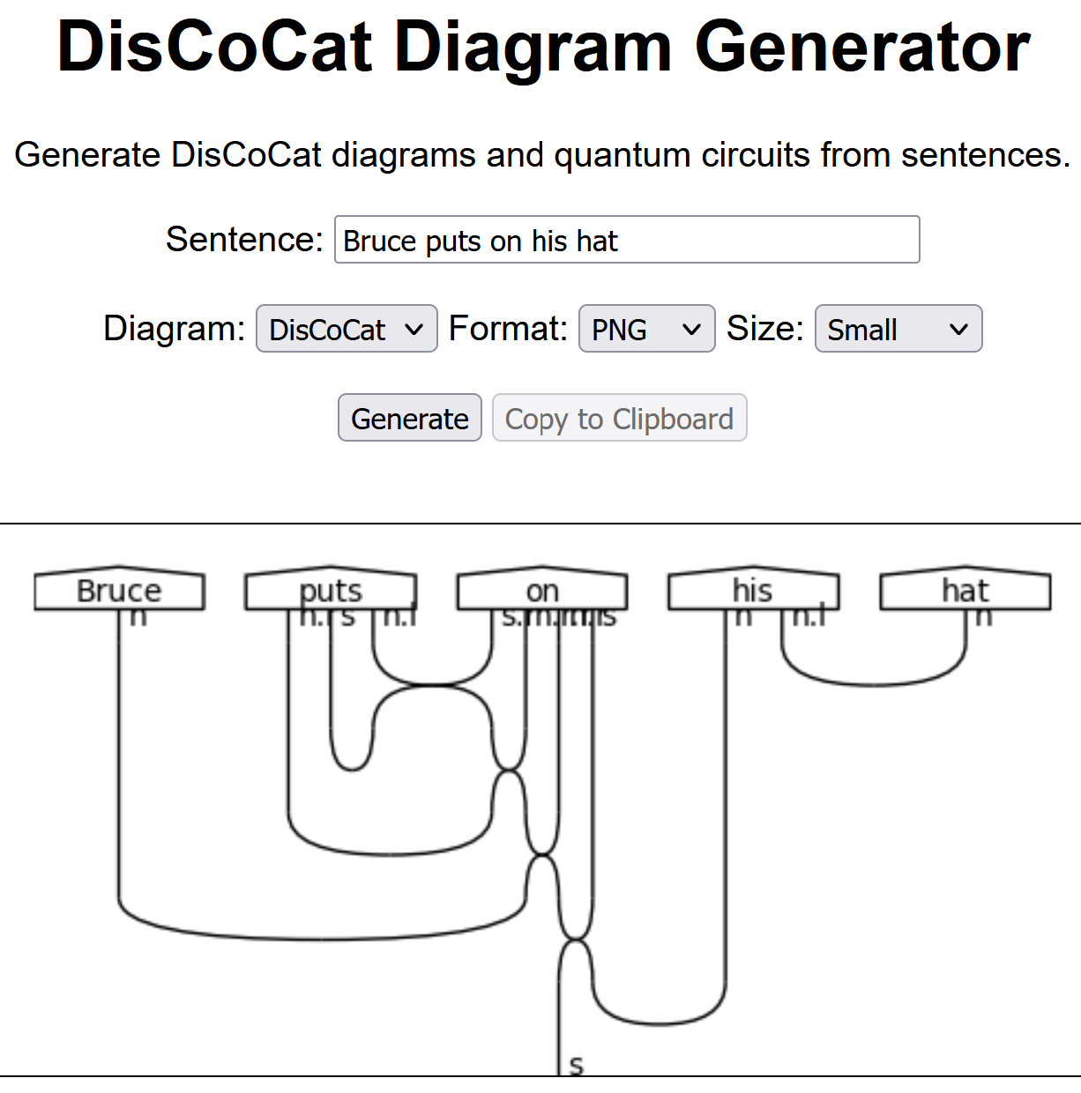
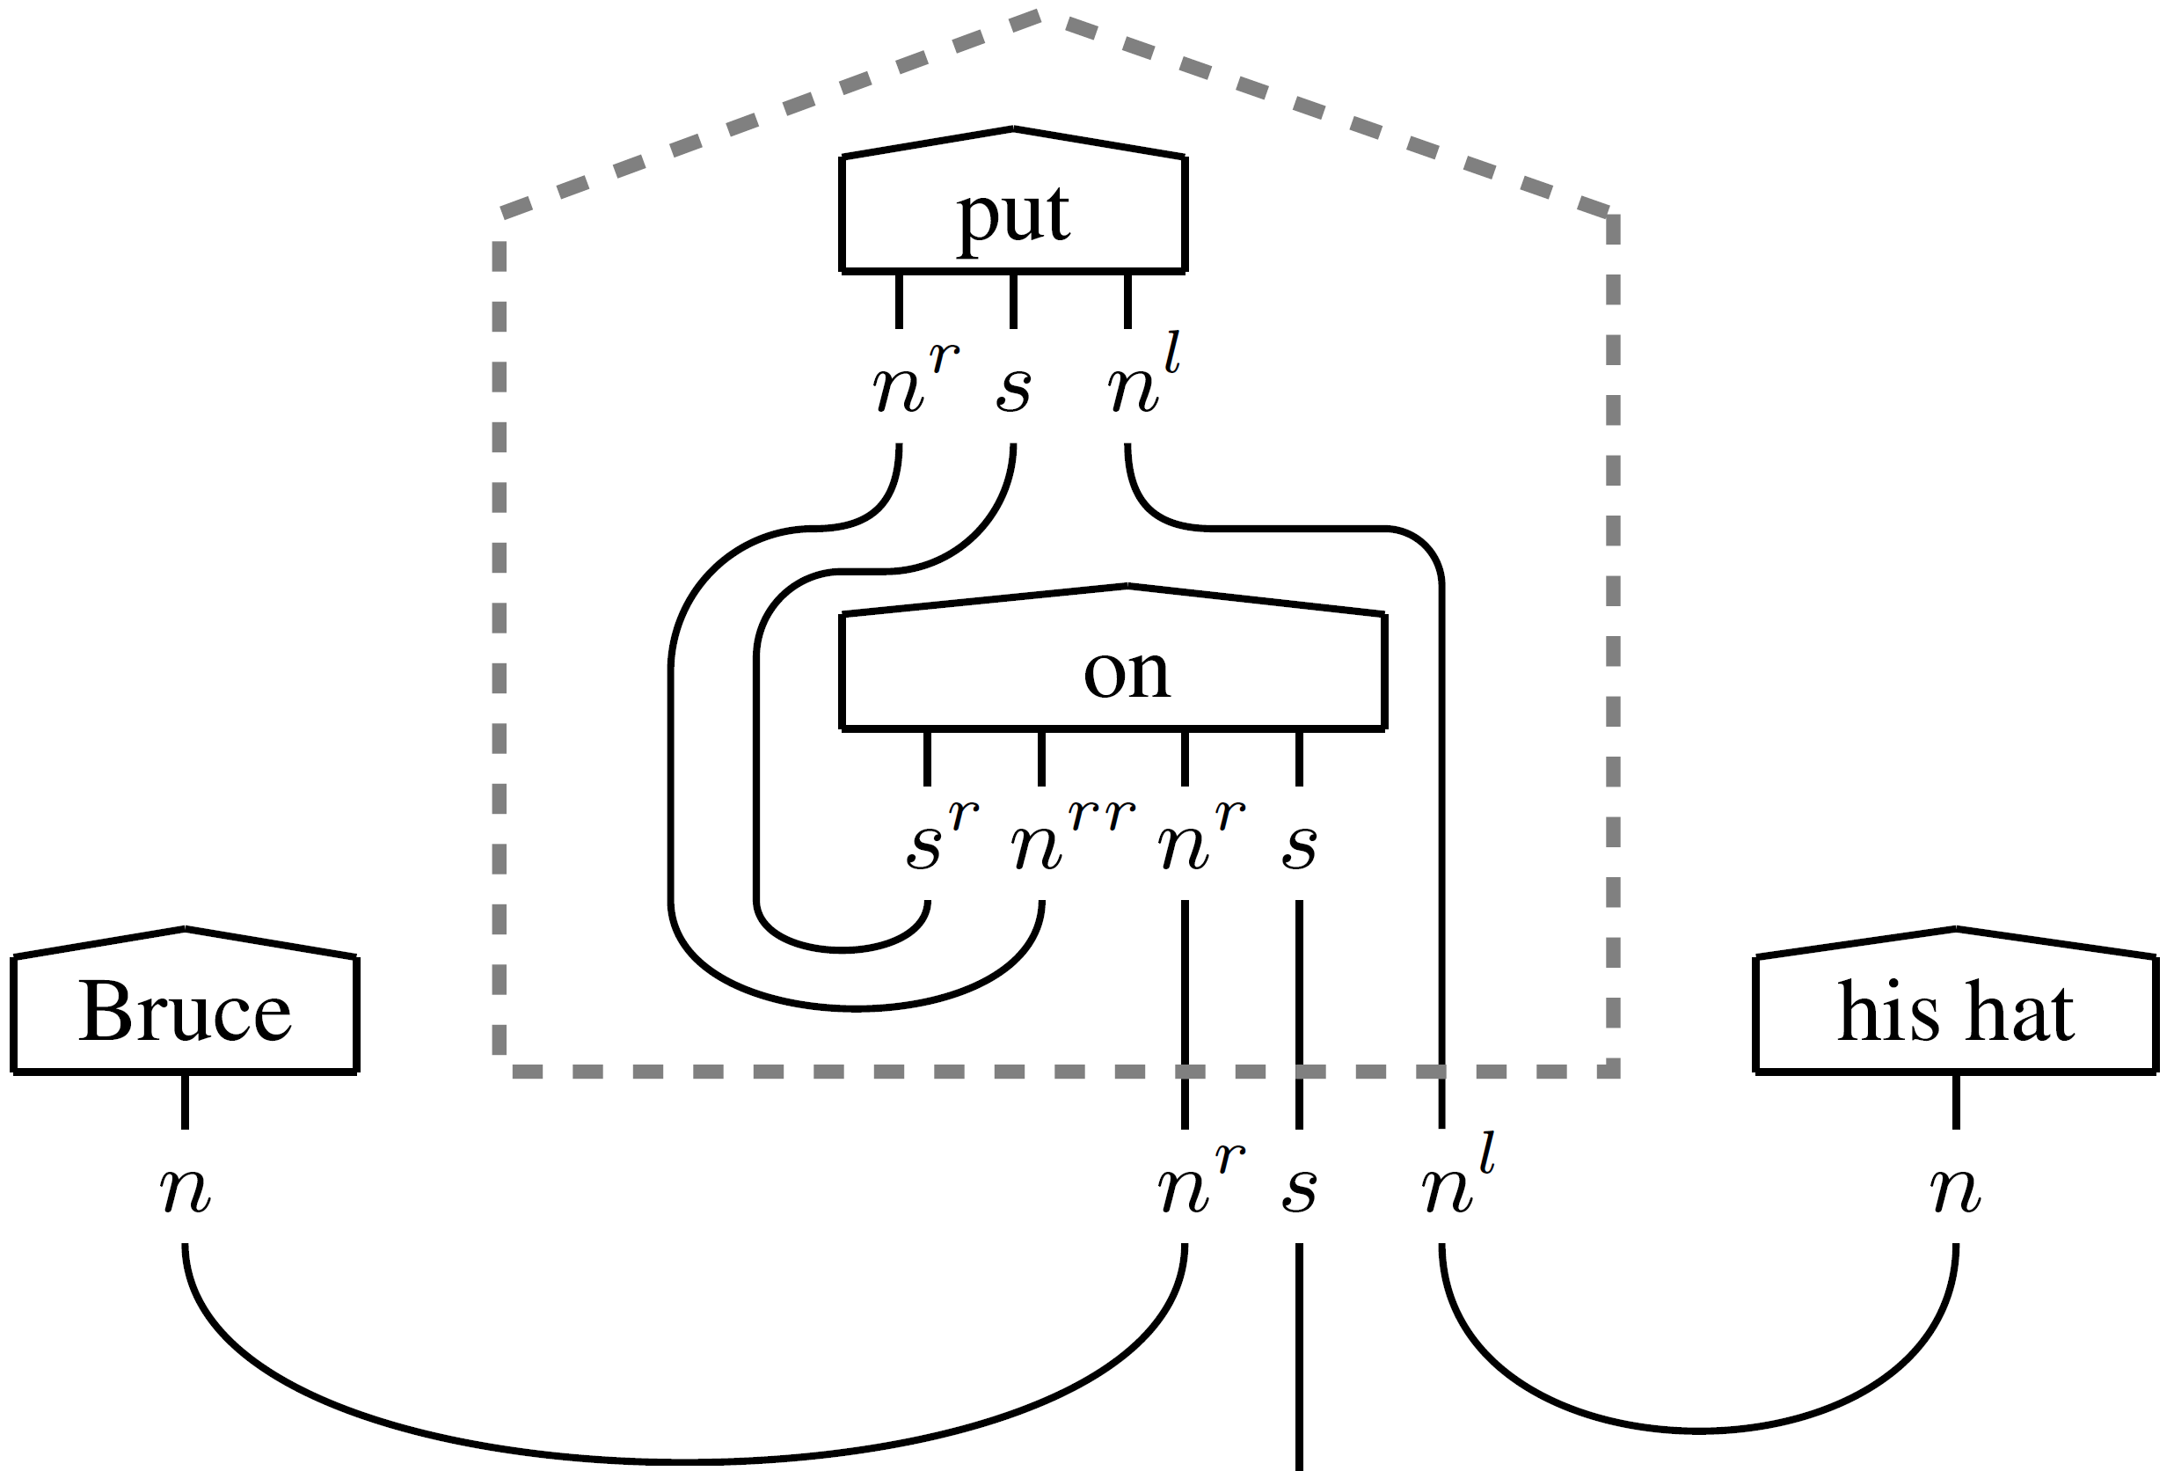
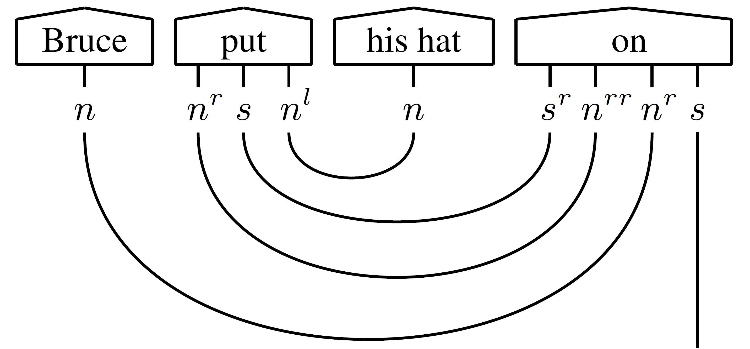
Compositional distributional Semantics for NLP
Figure s from Yeung and Kartsaklis. 2021. A CCG-Based Version of the DisCoCat Framework. Proceedings of SEMSPACE.
Screenshotted from https://qnlp.cambridgequantum.com/generate.html
DisCoCat was introduced in Coecke, Sadrzadeh, and Clark. 2010. Mathematical foundations for a compositional distributional model of meaning. Lambek Festschrift Linguistic Analysis
Notes:
Idea: vector spaces and grammar both have compact closed structure, so we can compose meaning of words to get meaning of sentences

Slide 5
Elements of logic in conversation
⊑
Hyponymy: partial order on meanings
Modelled in lexical databases such as WordNet curated by humans
Modelled in distributional NLP by cones, vector specialization, Gaussian embedding
Entailment
Notes:
Note that these onotologies are set-theoretic: either something is or isn’t an instance of something else.

Slide 6
Elements of logic in conversation
⊑
Problem: hyponymy should compose
Ex. cats climb entails mammals move
Solution: find composition operations that preserve entailment
Not clear how to do this for vectors
Furthermore, entailment is graded
cupcake ⊑ sweet — high entailment
cupcake ⊑ chocolate — medium
cupcake ⊑ liquid — low
Entailment

Slide 7
Elements of logic in conversation
⊑
Encode meaning in category CPM(FHilb)
For any positive operators X and Y (i.e. ∀v in a Hilbert space, ⟨Xv|v⟩ ≥ 0), the Löewner order is: X ⊑ Y ⇔ Y - X ≥ 0
k-hyponymy¹ is the max k s.t.
First experiments with composition in [2]
[3] proposed and experimented with Compr, composition operations preserving k-hyponymy
Entailment
1 Bankov, Coecke, Lewis, and Marsden. 2019. Graded hyponymy for compositional distributional semantics. Journal of Language Modelling
2 Lewis. 2019. Compositional Hyponymy with Positive Operators. Proceedings of Recent Advances in Natural Language Processing.
3 De las Cuevas, Klinger, Lewis, and Netzer. 2020. Cats climb entails mammals move: preserving hyponymy in compositional distributional semantics. Proceedings of SEMSPACE.
Notes:
Partial order structure on positive operators

Slide 8
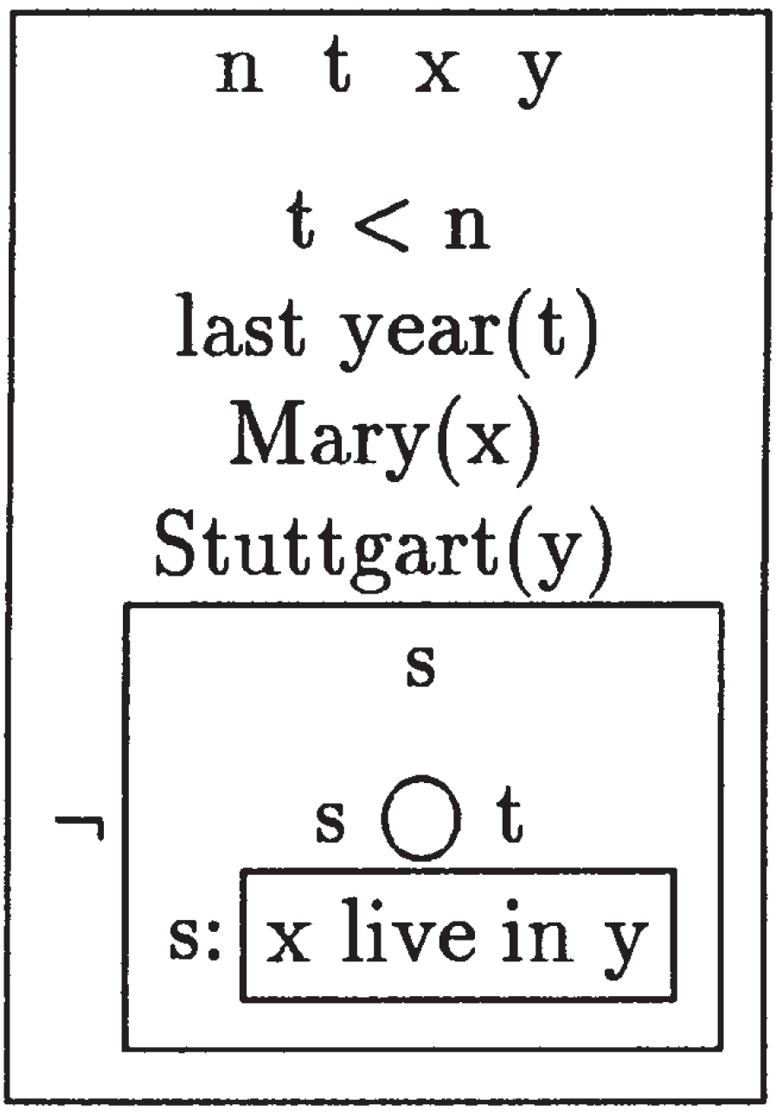
Elements of logic in conversation
NOT
Past: axiomatizing logic in language
DRS: parse sentences first-order logic:
Negation
Reprinted from Kamp and Reyle. 1995. From Discourse to Logic: Introduction to Modeltheoretic Semantics of Natural Language, Formal Logic and Discourse Representation Theory. Language
Notes:
Discourse Representation Structures
So it’s definitely well-established that we can parse logic in language.
But the problem is that this compositional approach to language doesn’t work with the mainstream, distributional approach to language.

Slide 9
Elements of logic in conversation
NOT
Problem: meanings are non-Boolean
Solution: operation s.t. given meaning of X, return meaning of not X
Logical negation on vectors¹
By projecting to orthogonal subspace
Logical negation on positive operators²
¬X = I − X s.t. I is maximally mixed state
Tested with noun-verb composition
Negation
1. Widdows and Peters. 2003. Word Vectors and Quantum Logic Experiments with negation and disjunction. Mathematics of Language.
2 Lewis. 2020. Towards logical negation for compositional distributional semantics.
Notes:
So it’s definitely well-established that we can parse logic in language.
But the problem is that this compositional approach to language doesn’t work with the mainstream, distributional approach to language
It’s not clear how a model can learn what the negation of a concept is. That’s something that humans can do --- if I give a ML model info about a new word let’s call X, then even if it’s never seen the words “not X” together, the goal is the model should be able to reason about the concept of “not X”

Slide 10
Elements of logic in conversation
NOT
Negation operation reverses Löewner order
“I did not eat ice cream” entails “I did not eat chocolate ice cream”
More generally one could require¹:
Satisfied by ¬X = I − X for crisp Löewner order¹
Satisfied s.t. k₁=k₂ by matrix inverse²
Negation is outside CPM(FHilb) as all unitary operations preserve Löewner order. ConvexRel?
Negation
1 Lewis. 2020. Towards logical negation for compositional distributional semantics. 2 Rodatz, Shaikh, and Yeh. 2021. Conversational Negation using Worldly Context in Compositional Distributional Semantics. Proceedings of SEMSPACE.
Notes:
10 min in
Notably, CPM(FHilb) is the category that unitary quantum gates on a gate-based quantum computer live in.
And we’ll come back to the category ConvexRel and introduce it properly, later on in this talk.

Slide 11
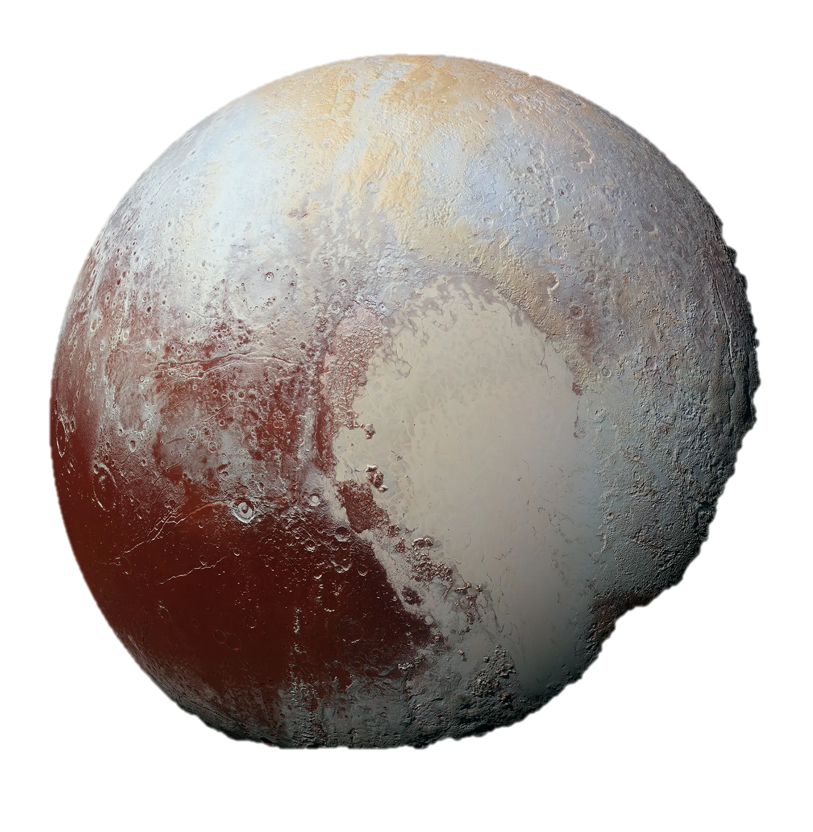
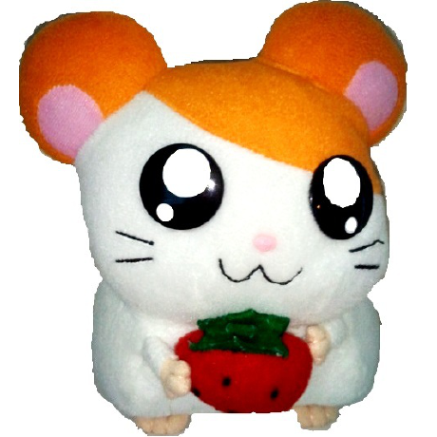
Elements of logic in conversation
NOT
Logical negation vs conversational negation
[1] concluded that NOT X is similar to X and evokes alternatives, experimenting on human judgment of sensibility of negation
Negation
X
1 Kruszewski, Paperno, Bernardi, and Baroni. 2016. There is no logical negation here, but there are alternatives: Modeling conversational negation with distributional semantics. Computational Linguistics. Example from Rodatz, Shaikh, and Yeh. 2021. Conversational Negation using Worldly Context in Compositional Distributional Semantics. Proceedings of SEMSPACE.

Slide 12
Elements of logic in conversation
NOT
Conversational negation on positive operators, with experiments, by composing with contextual info¹
Negation
Rodatz, Shaikh, and Yeh. 2021. Conversational Negation using Worldly Context in Compositional Distributional Semantics. Proceedings of SEMSPACE.
Notes:
Logical negation can be modified to correlate with human intuition. Example: apple is a fruit. Logical negation of apple would make a planet more likely than orange, because apple and orange are similar. Conversational negation corrects logical negation by re-weighting the probabilities, so not apple is more likely to be co-hyponyms of orange --- things that are not apples but also fruits, and less likely to be rare fruits or things unrelated to fruits like a movie.
Pearson correlation of 0.635
Few comments on the implications for ML. If we have a model with few million parameters like BERT, even if it works, we won’t know why. This is actually a security risk because a malicious person could inject adversarial examples into the model undetected.
So as a play on the term artificial intelligence, the idea is to do something different called compositional intelligence. So think of AI as the machines we are trusting to make many important decisions for humanity doing something magic with a bunch of vectors in million dimensional space that you and I will look at and it’s incomprehensible to us. Humans can understand the internal structure of the black boxes of the ML model into smaller boxes which are trained. From math we get a logical negation which is how we initial the conversational negation box, which takes in both the word to be negated, and information on the worldly context of the word which can be retrieved from a relational database that can also be trained.

Slide 13
Elements of logic in conversation
NOT
Sentential negation
Constituent negation: This is (not red) wine ⊑_{high} This is white wine This is red (not wine) ⊑_{high} This is red juice
Follow-up¹ proposed extending conversationally negated words to constituent negated sentences
Negation
1 Shaikh, Yeh, and Rodatz. 2021. Composing Conversational Negation. Proceedings of Applied Category Theory.

Slide 14
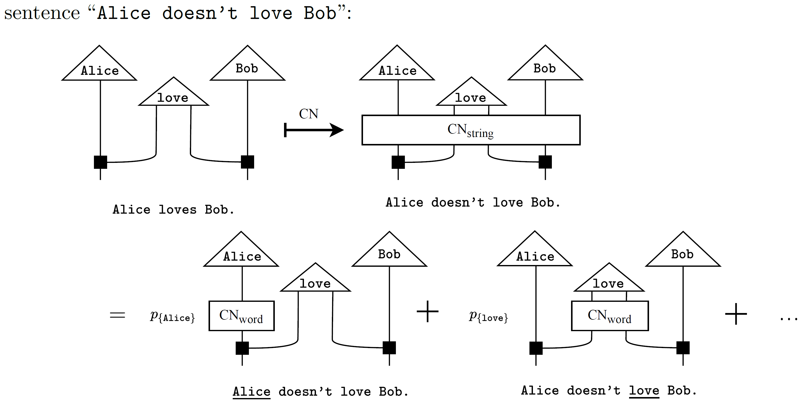
Shaikh, Yeh, and Rodatz. 2021. Composing Conversational Negation. Proceedings of Applied Category Theory.

Slide 15
The category convexrel¹
1 Reprinted from Bolt, Coecke, Genovese, Lewis, Marsden, and Piedeleu. Interacting Conceptual Spaces I : Grammatical Composition of Concepts. Conceptual Spaces: Elaborations and Applications.
Notes:
ConvexRel: define a convex algebra and a mixing operation

Slide 16
The category convexrel
Ex.: Noun space for food:
liquid
solid
Figure reprinted from Bolt, Coecke, Genovese, Lewis, Marsden, and Piedeleu. Interacting Conceptual Spaces I : Grammatical Composition of Concepts. Conceptual Spaces: Elaborations and Applications.
Notes:
We’ll make use of this banana example twice in the next few slides.

Slide 17
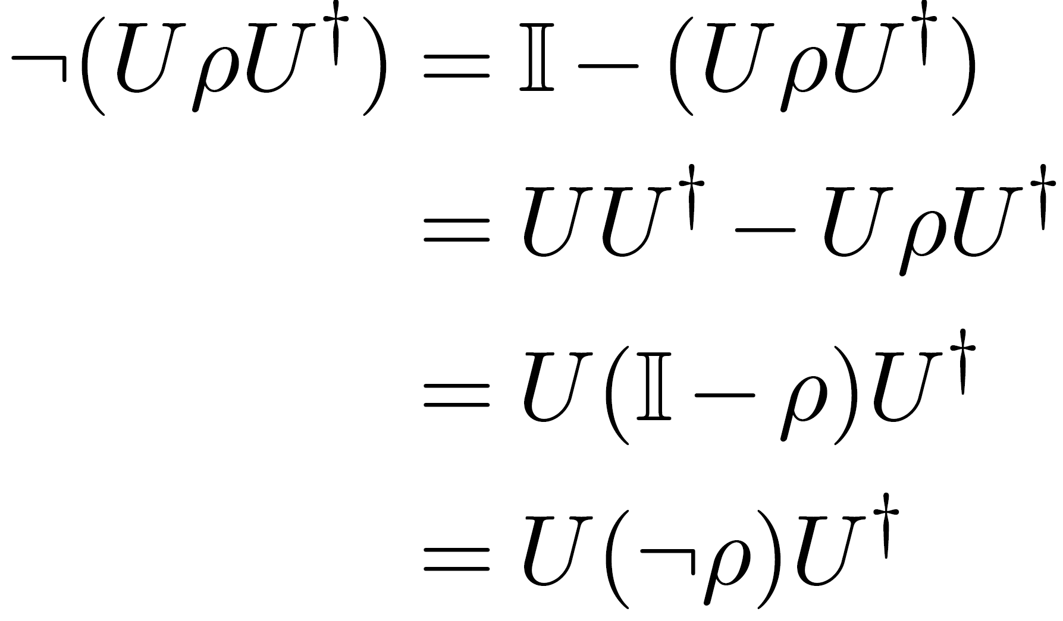
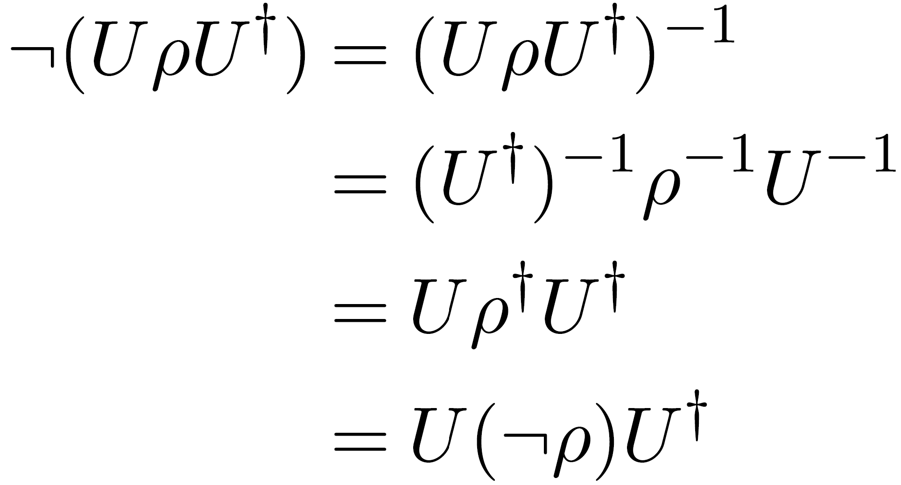
LOGICAL NEGATION ON CONCEPTS
Both logical negations commute with unitary operations. This is promising for gate-based quantum computing.
Notes:
Promising for QC because previously we thought, well, negation can’t be an operation on QC because QC operations are unitary are preserve Loewner order. But if we commute these operations with a circuit of all unitary gates, the negation becomes preprocessing: the state initialization for QC which can be done on constituent words to get negation of sentences.
So actually, the naturality condition my co-authors and I proposed in our paper on conversational negation a year ago, this was based on intuitions from past literature on linguistics that negation does not alter grammatical structure.
A year later, I felt confused that I did not notice this very simple observation (that unitary operations preserve Loewner order), which retroactively justifies that there even exists candidate negation operations that satisfy this naturality condition.

Slide 18
LOGICAL NEGATION ON CONCEPTS
For ¬ρ = I − ρ:
Negation set is maximal!
Ex. I don’t like banana (which is yellow, sweet, and mushy) but I like yellow melon (which is yellow, sweet, and crunchy)
Notes:
The negation set here is maximal: covering every possibility of negating some non-empty subset of the components

Slide 19
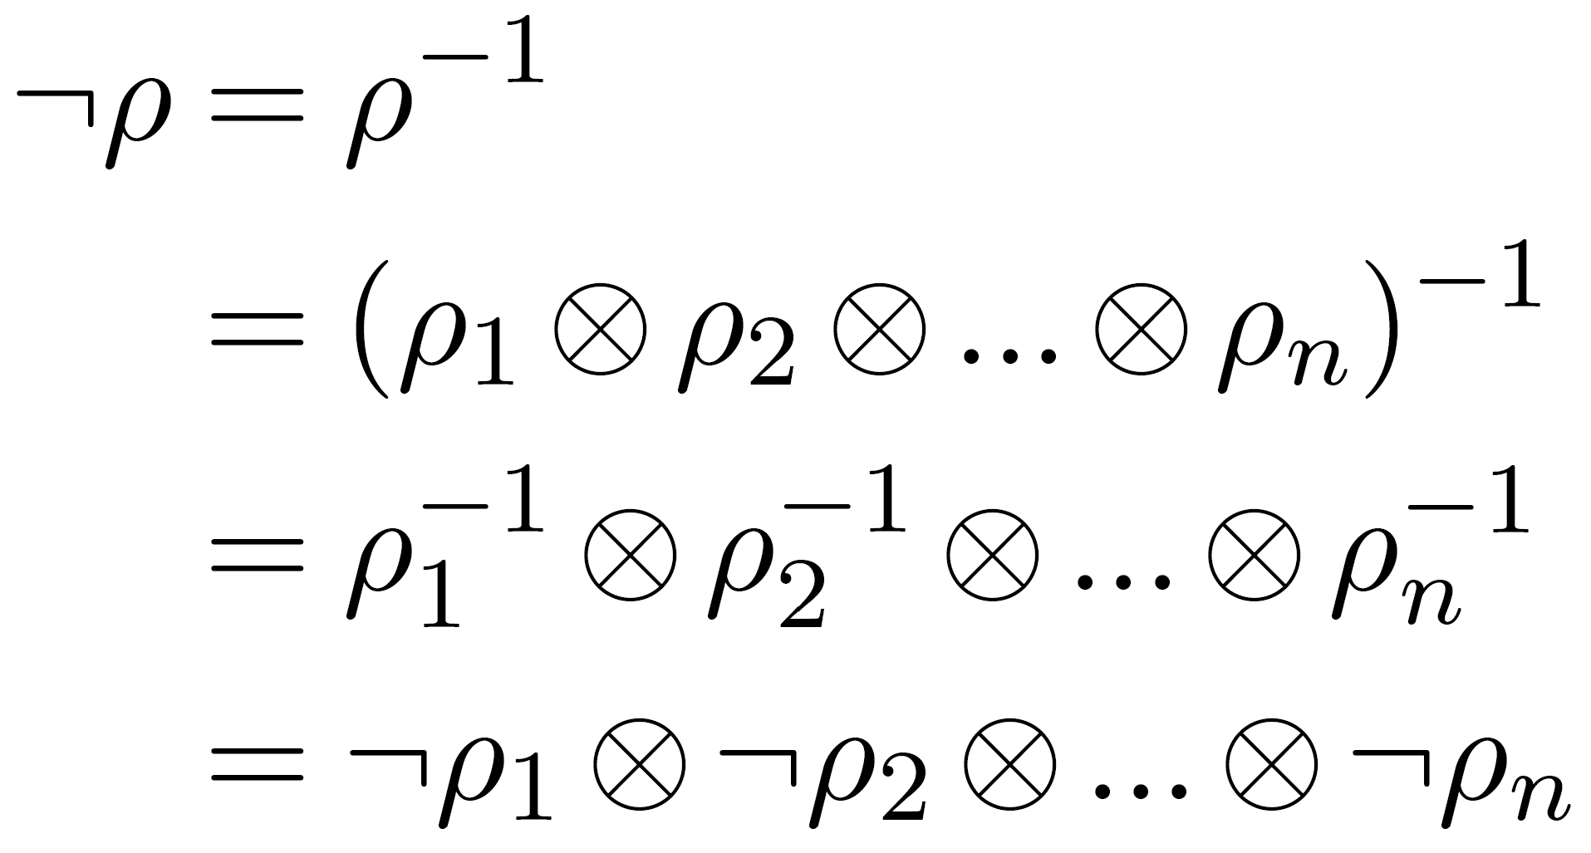
LOGICAL NEGATION ON CONCEPTS
For ¬ρ = ρ⁻¹:
Negation set is minimal!
Ex. I don’t like banana (which is yellow, sweet, and mushy) at all. Anything that reminds me of banana sickens me.
Notes:
The negation set here is minimal: only negating one possibility (all components, the smallest subset symmetric in all arguments, which cannot be the empty subset)
My friend is allergic to bananas.
So when my co-authors and I first proposed our subset negation, this was a general description for constituent negation on positive operators, that each negation set has a likelihood. And a year, later, I realize that the two logical negations we have been using all along, both are instances of this constituent negation, and moreover the two opposite extremal cases!

Slide 20
Elements of logic in conversation
NOT
OR
AND
Negation
Disjunction
Conjunction
Notes:
20 min in
In the rest of this talk, I’ll introduce a trifecta of concrete implementations which I will call instances of negation, disjunction, and conjunction.
Recall that although we don’t want to prescribe logical operations to be exactly what we have to use in distributional NLP, but is it important to find them so we know that it is possible to find operations with desirable interaction properties, and so we can initialize in our ML models these operations to then be trained on human data to modify them to be conversation logic.
Disjunction: connection to ambiguity
Conjunction: deMorgan’s

Slide 21
Elements of logic in conversation
Notes:
What’s interesting here is that these look like propositions. But instead of it evaluating to Booleans, we are taking negation, conjunction, and disjunctions of positive operators, and what we get out is another positive operator. And the reasoning that we have here between two positive operators, to what extend we have graded hyponymy.

Slide 22
Elements of logic in conversation
Notes:
This factor of half is not satisfying. Perhaps we can fix this problem, but I think it would come at the cost of weakening one of the other properties by a factor of 1/2, perhaps deMorgan’s.
This is exciting because is a universal property, and whenever we have one of these, it begs us to construct a category. That is where I leave off with this work, with the conviction that the existing distributional compositional categorical framework for NLP can be expanded to describe conversation logic. This would be a game changer for NLP.

Slide 23
Conclusion
Summary:
Background on hyponymy and negation operations in DisCo NLP
The two existing logical negations commute with unitaries, and are the two opposite extremal cases of constituent negation
Found a trifecta of AND, OR, NOT logical operations on positive operators, satisfying universal properties w.r.t. graded hyponymy
Future work:
Prove more properties of trifectas of logical operations
Categorify logic on positive operators in ConvexRel
Analyze implications for quantum NLP
Think about data sets and experiments
Notes:
The future work is very clear, it’s to finish this very much in-progress work

