Slide 1


Formal Probabilistic Methods for Combinatorial Structures using the Lovász Local Lemma
Chelsea Edmonds¹ | c.l.edmonds@sheffield.ac.uk
Lawrence C. Paulson² | lp15@cl.cam.ac.uk
University of Sheffield¹ | University of Cambridge^{1,2}
CPP 2024
PhD Research supported by a joint Cambridge Australia Scholarship and Cambridge Department of Computer Science Qualcomm Studentship¹
Presentation (partially) funded by the EPSRC in the COVERT project¹
Research additionally supported by the ERC Advanced Grant ALEXANDRIA (Project GA 742178).²

Slide 2
Overview
Motivation: techniques vs theorems – introducing the probabilistic method
What we did:
A general framework: probabilistic spaces for combinatorial structures
The Lovász local lemma
A sample application: Hypergraph Colourings
What we learnt:
Formalisation and mathematical insights
Concluding thoughts

Slide 3
1. The Motivating Problem

Slide 4
What is the Probabilistic Method?
Basic Probability Tricks
Linearity of Expectation
Alterations
Second Moment Method
The Local Lemma
Quasi-randomness
Techniques
Poisson Paradigm
Correlation Inequalities
Martin-gales
Key Idea
Given a probability space over some combinatorial structure…
Show the structure has the desired properties with positive probability.
(May be via complement)
Alon & Spencer. (2004).
The Probabilistic Method.

Slide 5
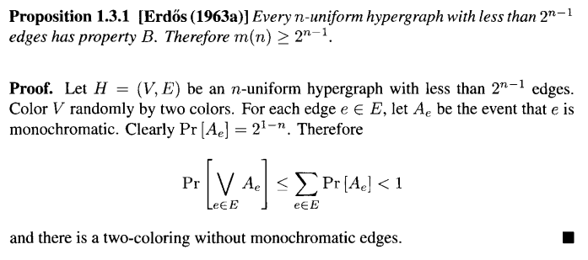
A Basic Proof
The Probabilistic Method:
Prove existence by showing a structure has a desired property with probability > 0
(or avoids bad properties with probability < 1)

Slide 6
The Probabilistic Method - Why Formalise?
The Probabilistic Method is one of the most powerful and widely used tools applied in combinatorics (Alon & Spencer, 2015).
Interest in formalised maths has grown significantly -> particularly in combinatorics.
Only three pre-existing formalisations which use the probabilistic method in combinatorics -> focused on theorems not general techniques.
Predominance of this method in modern combinatorics research -> motivated by many applications -> how can we make this easy for people to formalise future work?

Slide 7
What is the Probabilistic Method?
Basic Probability Tricks
Linearity of Expectation
Alterations
Second Moment Method
The Local Lemma
Quasi-randomness
Techniques
Poisson Paradigm
Correlation Inequalities
Martin-gales
Key Idea
Given a probability space over some combinatorial structure…
Show the structure has the desired properties with positive probability
(May be via complement)

Slide 8
2. A General Framework

Slide 9
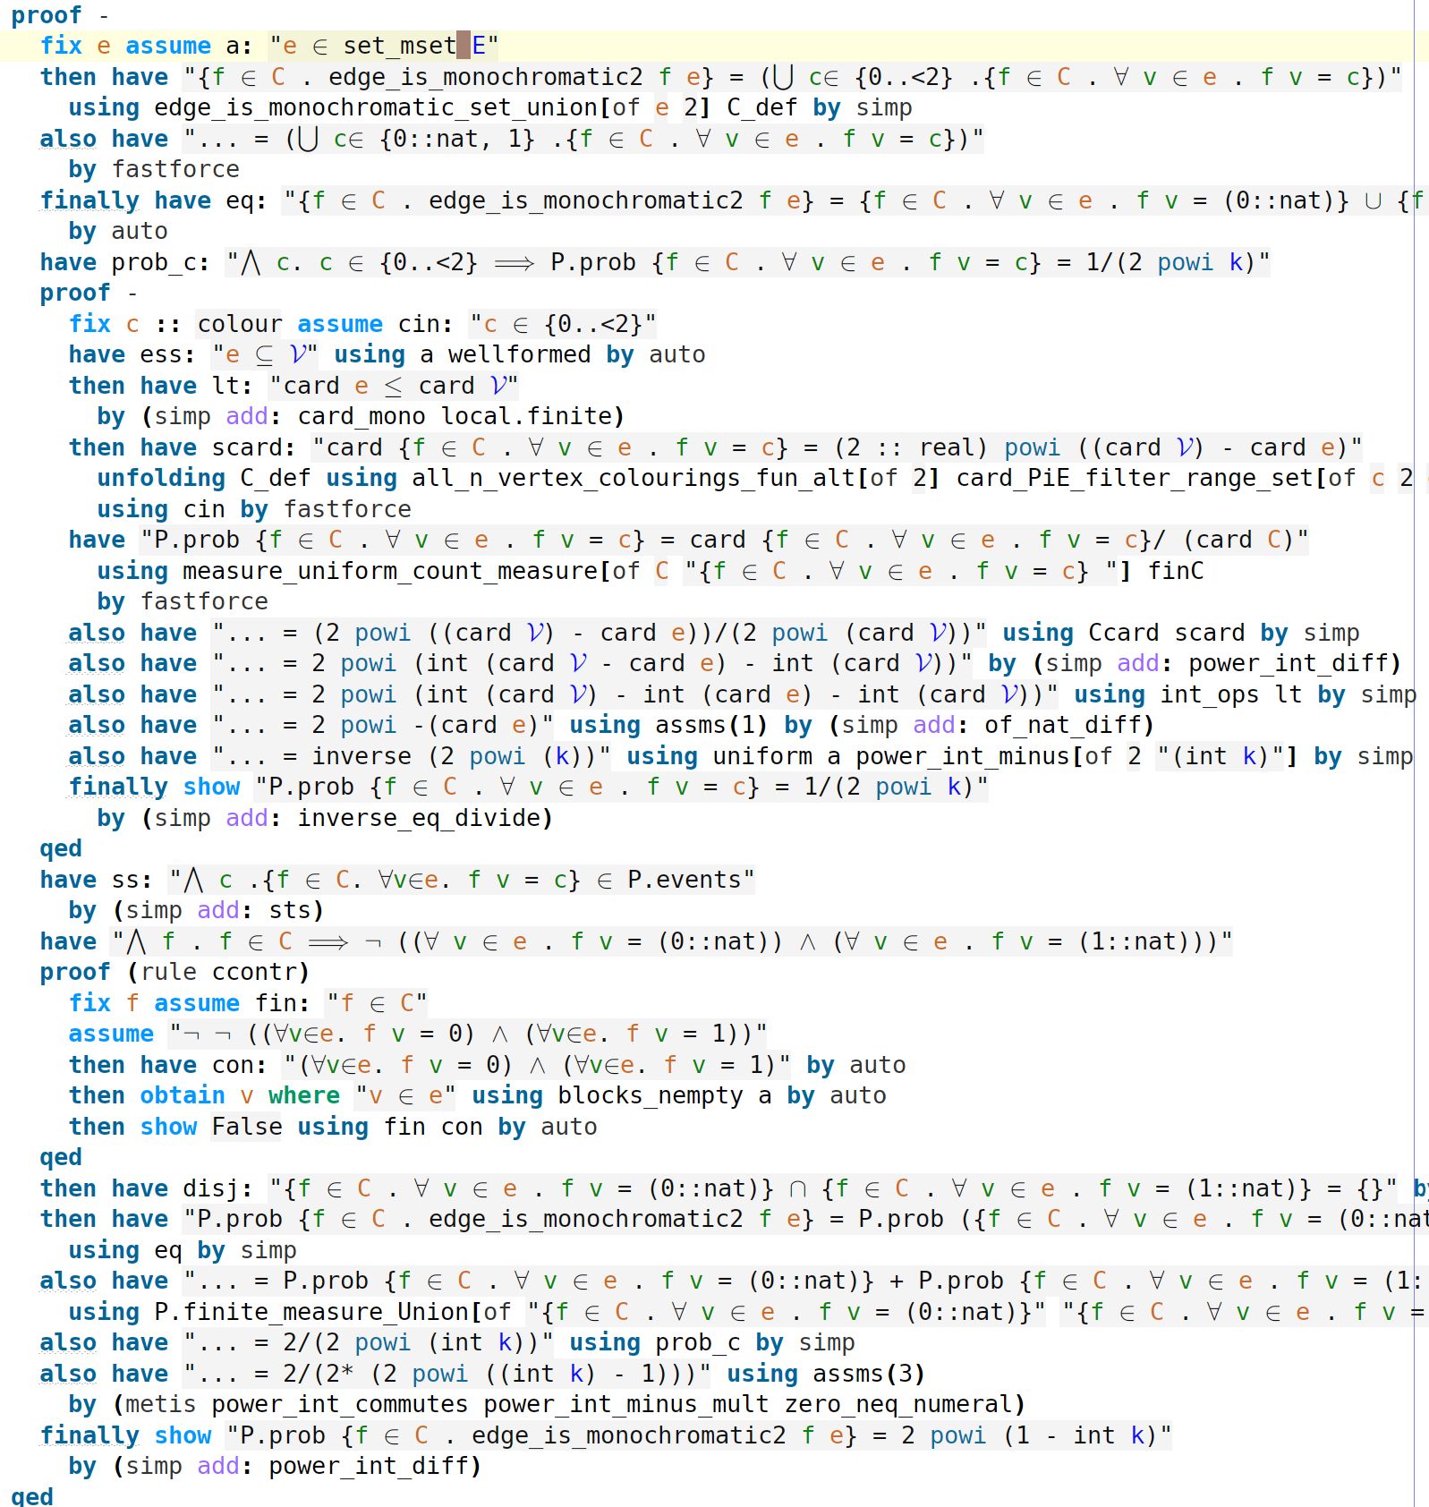
Identified Formalisation Challenges
Reliance on human intuition
Complex calculations
Set up involved
Definitions and notation
A first attempt at formalising a proof written in 1 line on paper!
General techniques are needed!

Slide 10
The Basic Method
Introduce randomness to the problem domain
Identify the desired properties/properties to avoid
Show object has desired properties with P > 0
In a finite space, there must then be an element of the space with the property!

Slide 11
Formalisation Framework - Summary
Formal Framework
Define a probability space
Define object properties
Calculate probability bounds
Obtain exemplar object
Traditional Framework
Introduce randomness to the Problem Domain
Identify the desired properties/properties to avoid
Show object has desired properties with P > 0
In a finite space, there must then be an element of the space with the property!

Slide 12
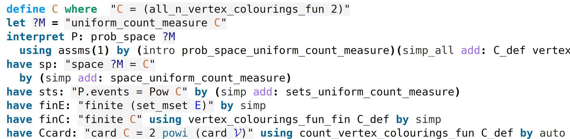

The Formalisation Framework – Step 1
To “introduce randomness” we must define a probability space $\left(Ω,ℱ, P\right)$formally
Define the measure
Define the prob space
Useful lemmas
Can we generalise?

Slide 13
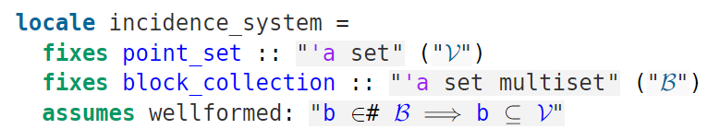

Locales Basics
Locales are Isabelle’s module system. From a logical perspective, they are simply persistent contexts.
$\bigwedge{x_{1}…x_{n}.⟦A_{1};…;A_{m}⟧}⇒C.$
Direct & indirect (sublocale) inheritance, interpretations.
A simple example (incidence system):
Notation
Parameters
Assumptions

Slide 14
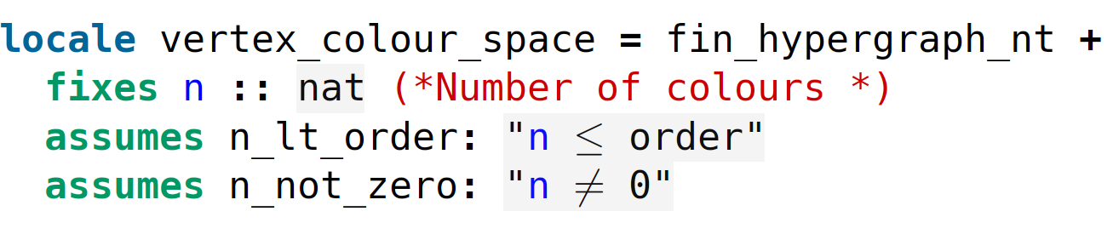
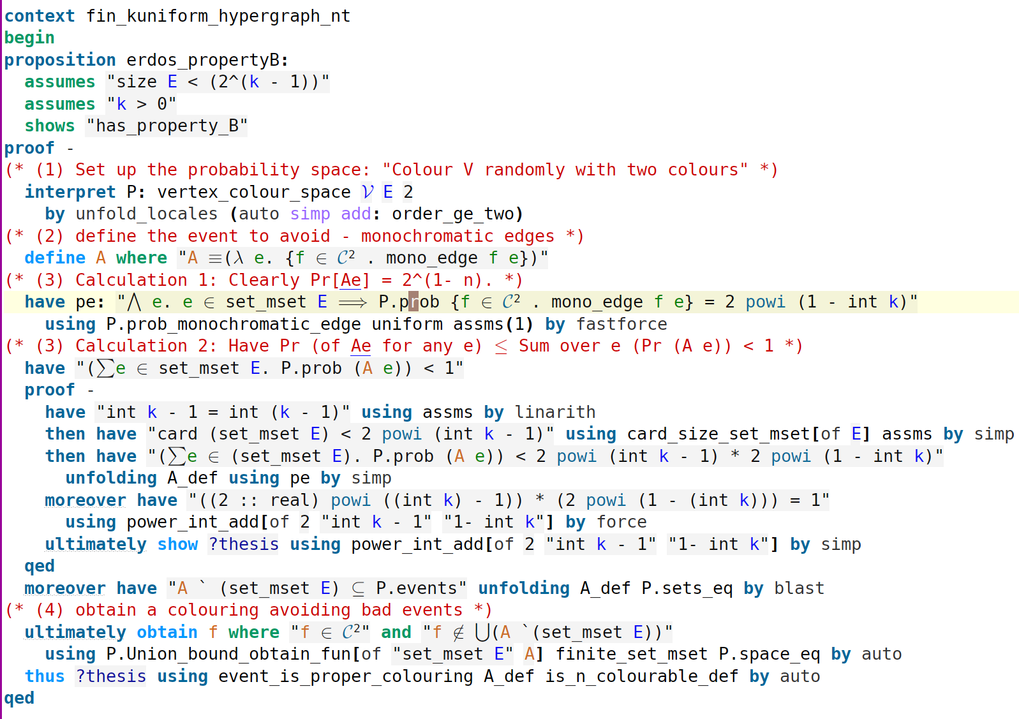
The Formalisation Framework – Step 1
To “introduce randomness” we must define a probability space $\left(Ω,ℱ, P\right)$formally
Locale definitions
A sublocale relationship
Locale lemmas

Slide 15
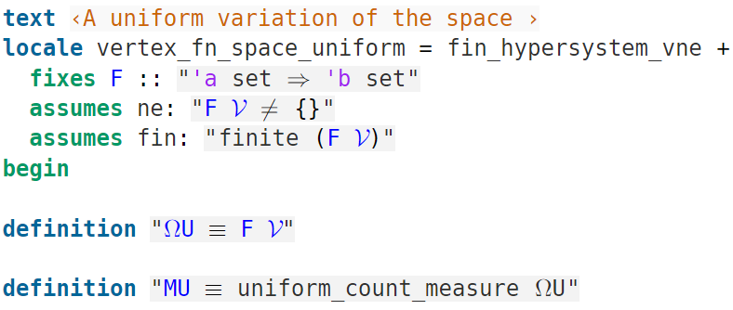
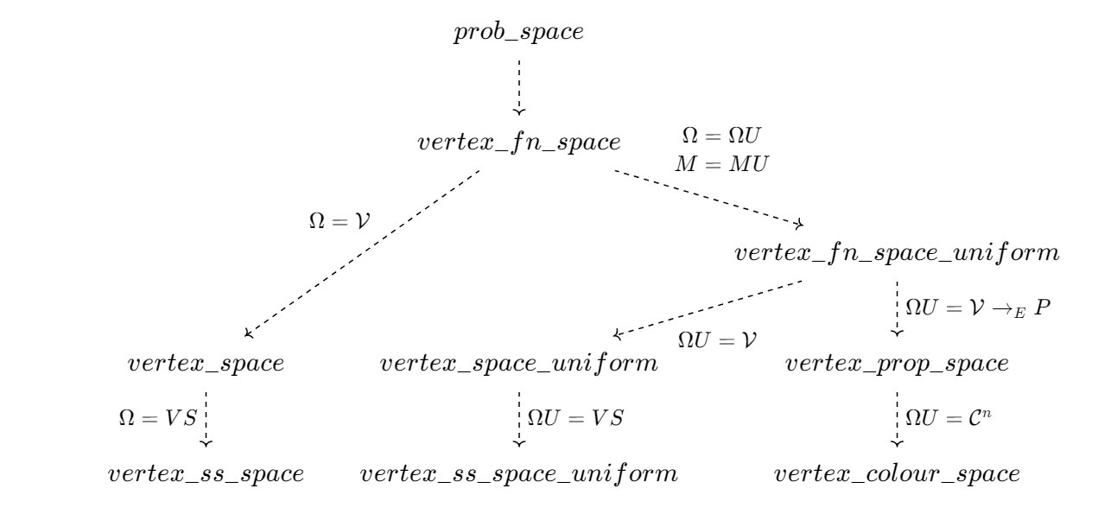
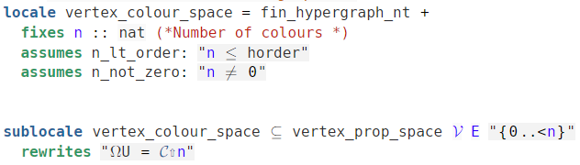
The Formalisation Framework – Step 1 General!
Sublocale relationship
Parameter rewrites

Slide 16
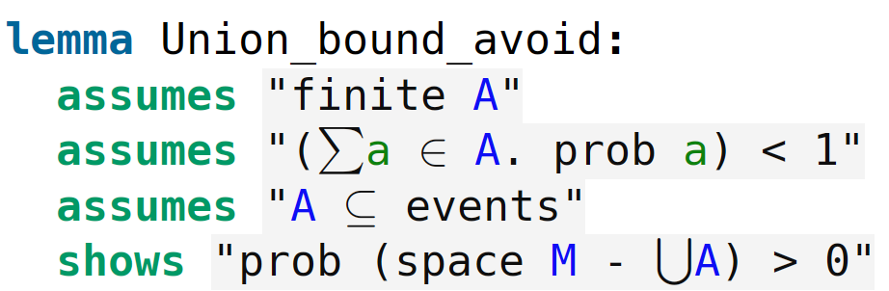
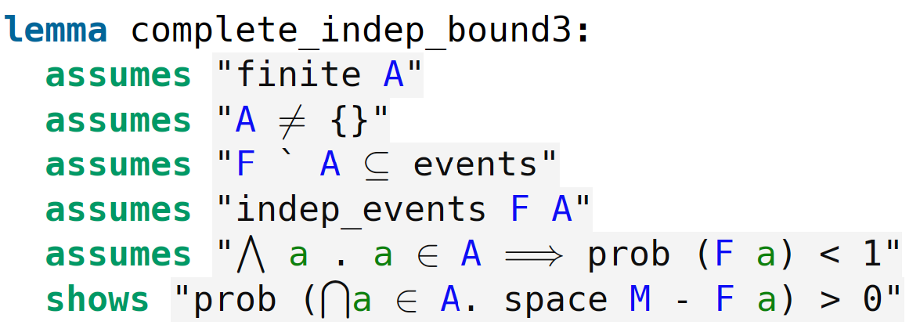
The Formalisation Framework – Step 3
The Union bound:
The Complete Independence Bound
Lemma “lifted” from measure theory libraries
New formalisation which uses measure theory basics.

Slide 17
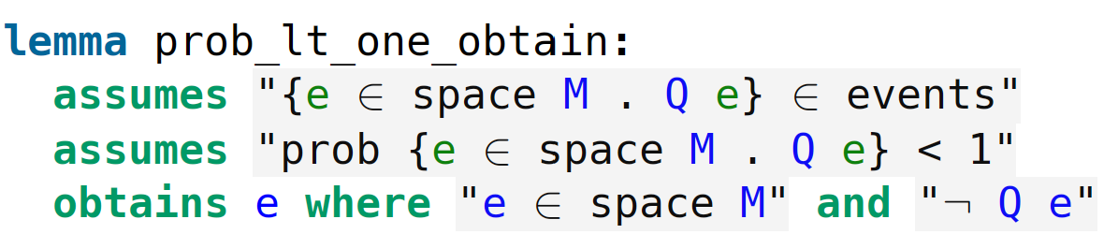
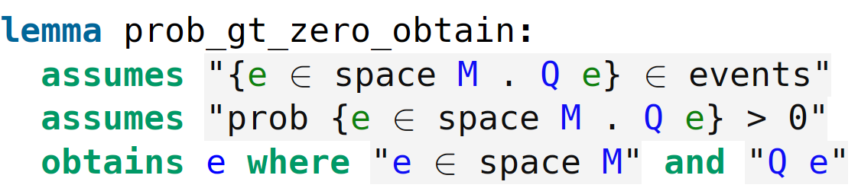
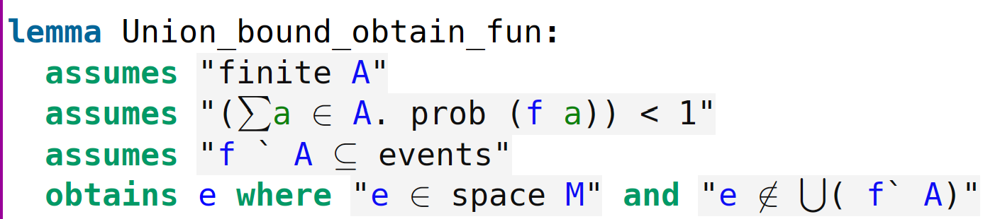
The Formalisation Framework – Step 4
Obtaining an object from a probability!
Some basic rules
Combining steps 3 & 4!

Slide 18
3. The Lovász Local Lemma (LLL)

Slide 19
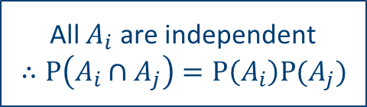
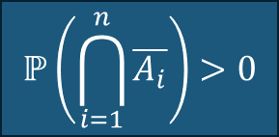
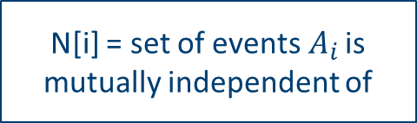
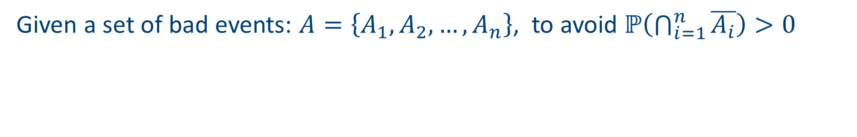

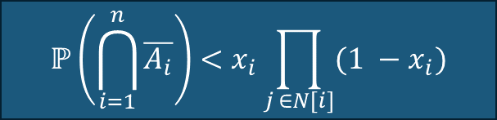

LLL – Step 3
Given a set of bad events: $A=\left\{A_{1},A_{2},…, A_{n}\right\}$, to avoid $ℙ\left(\bigcap_{i=1}^{n}{\overline{A_{i}}}\right)>0$
Lovász Local Lemma
(Relaxed Mutual Independence)
Complete Independence Bound
$$ℙ\left(\bigcap_{i=1}^{n}{\overline{A_{i}}}\right)<x_{i}\prod_{j ∈N[i]}{(1 −x_{i})}$$
$$ℙ\left(A_{i}\right)<1$$
$$x_{i}∈(0,1)$$
N[i] = set of events${ A}_{i}$ is mutually independent of
$$ℙ\left(\bigcap_{i=1}^{n}{\overline{A_{i}}}\right)>0$$
All $A_{i}$ are independent
$∴P\left(A_{i}∩A_{j}\right)=P\left(A_{i}\right)P(A_{j})$

Slide 20
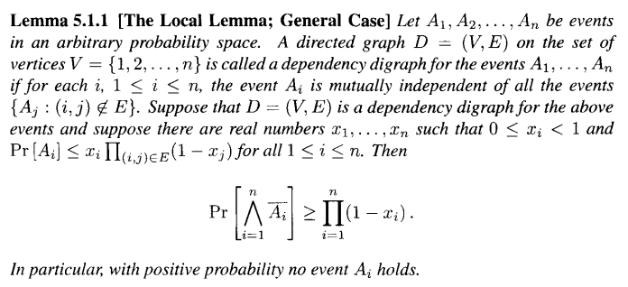
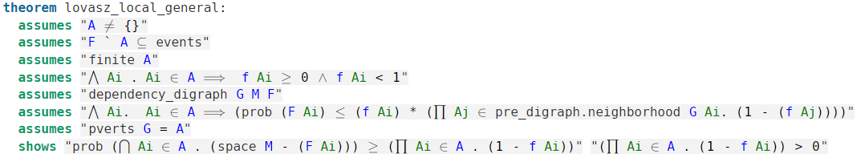
LLL – Step 3

Slide 21
LLL – Step 3
A1
A2
A3
A4
C1
C2
A1
A3
A2
A4
A2
C1
C2

Slide 22
LLL – Step 3
Hidden Induction Proof
LLL Helper
(Base Step)
General LLL
(Dep Graph)
General LLL (Mutual Event Set)
Obtain set from graph
Induction Proof
LLL Helper (Inductive Step)
Symmetric LLL (Dep Graph)
Symmetric LLL (Mutual Event Set)
Dependency Graph Extensions
Probability Library Extensions

Slide 23
4. Applications

Slide 24
Application: The basic method

Slide 25
Application: the basic method

Slide 26
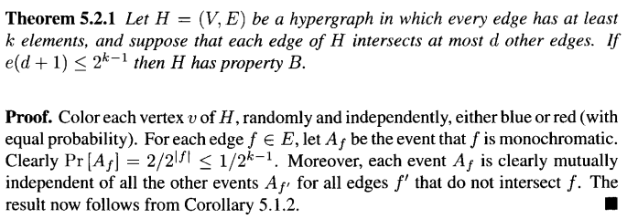
Application: A more advanced bound
n-uniform hypergraph
Hypergraph w/ edge conditions
Union Bound
Lovász Local Lemma
More advanced, but smaller proof?

Slide 27
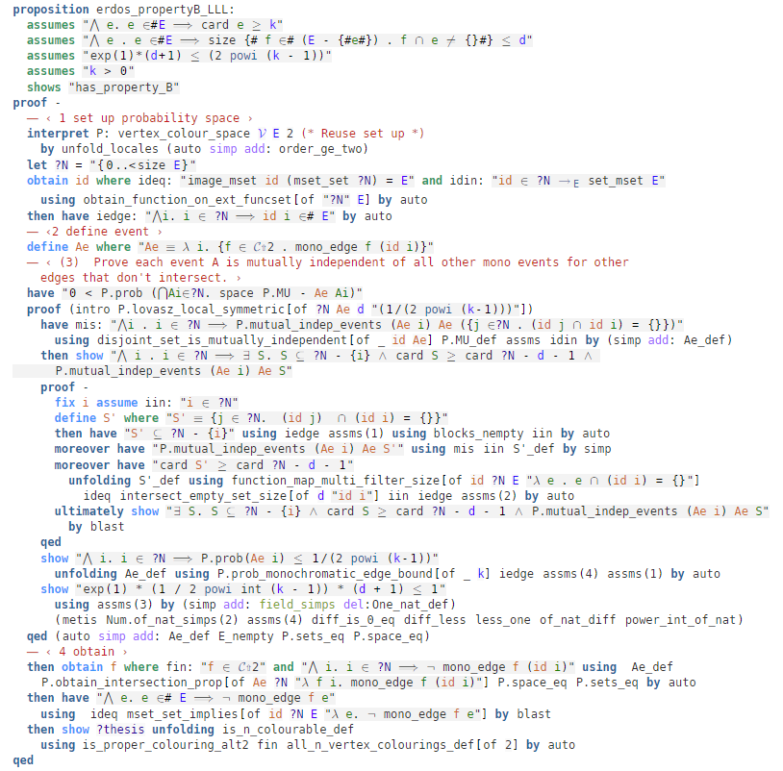
Application: A more advanced bound
… (5 lines)

Slide 28
Application: A more advanced bound
… (5 lines)
+ Mutual Independence Principle!!!

Slide 29
5. Formalisation Insights

Slide 30
Theme 1: Intuition in Probabilistic Proofs
Intuition is everywhere in probability proofs for combinatorics
Introducing Randomness
“Obtaining” an exemplar structure
Many calculation specific examples
General framework = partial solution

Slide 31

Theme 1: Intuition in Probabilistic Proofs
Two events are said to be independent if either can occur without being affected by the occurrence of the other (Chalmers, 2018).
Independent Events
Formally defining independent events
VS
Physical intuition to establish independence
The multiplication law
The basic multiplication law for independent events states: $P\left(A∩B\right)=P\left(A\right)P(B)$

Slide 32
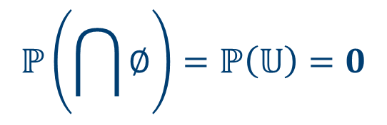




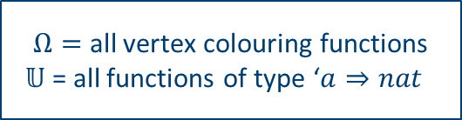
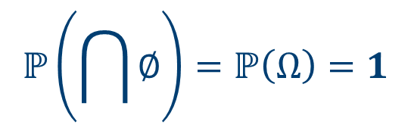
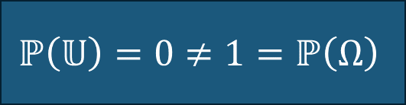

Theme 2: An Isabelle Probability Library Issue
The issue For example… Therefore …
The first time in four years that simple type theory caused me issues…
$Ω≠𝕌$in Isabelle
$Ω=$ all vertex colouring functions
$𝕌$ = all functions of type ‘$a⇒nat$
$$ℙ\left(\bigcap{∅}\right)=ℙ\left(𝕌\right)=0$$
(in Isabelle)
$$≠$$
Typically$Ω ⊂𝕌$
Clearly have$Ω ⊂𝕌$
$$ℙ\left(\bigcap{∅}\right)=ℙ\left(Ω\right)=1$$
$$ℙ\left(𝕌\right)=0≠1=ℙ\left(Ω\right)$$
$$ℙ\left(𝕌\right)=0≠1=ℙ\left(Ω\right)$$
(on paper proofs)

Slide 33
Theme 3: The importance of generality
Modular, reusable, and extensible formal libraries
Reducing duplication in formal libraries
This work’s general framework -> successfully minimised rework.
Interesting new use case of Isabelle’s locales.
General efforts -> formalise new proofs more naturally.
Balance practicality vs generality for ultimate usability

Slide 34
5. Conclusions

Slide 35
Concluding Thoughts
Key contributions:
Significant expansions to probability and hypergraph libraries in Isabelle/HOL
The general framework from the probabilistic method
First formalisation of the Lovász local lemma.
Formal proof of the “Mutual independence principle” (for hypergraphs).
Applications: formalised several bounds on hypergraph colourings.
Key lessons:
Generalisation is both possible & important in formalisation, particularly as formal mathematical libraries grow at a rapid pace! The up-front time investment is worth it.
Several insights into the mathematical intuition around probabilistic proofs.

Slide 36
Concluding Thoughts
Future work?
Expand on probabilistic methods in framework
Experimenting with more applications in different combinatorial structures.
Already some success with Balog-Szemeredi-Gowers proof
Full AFP Formalisations available online:
https://www.isa-afp.org/entries/Hypergraph_Basics.html
https://www.isa-afp.org/entries/Lovasz_Local.html
https://www.isa-afp.org/entries/Hypergraph_Colourings.html
Contact: c.l.edmonds@sheffield.ac.uk

