Slide 1
Building Trusted Systems with Protected Modules
Bryan Parno
Microsoft Research

Slide 2

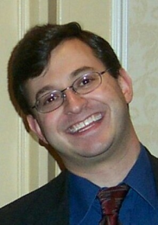

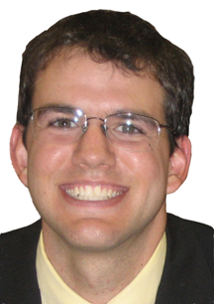
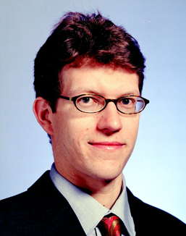
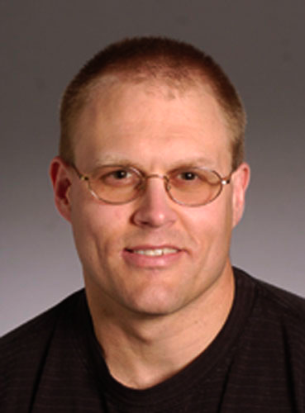

Collaborators
John R. Douceur
Jacob R. Lorch
James Mickens
Microsoft Research
Jonathan McCune
Adrian Perrig
Michael Reiter
Arvind Seshadri
Carnegie Mellon University

Slide 3

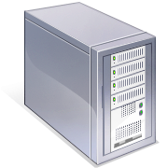



The Perils of Digital Data
HW
Violation!
Infected
[Holz et al. ‘08]
[Anderson & Kuhn ‘95]
[OECD ‘08]
X

Slide 4
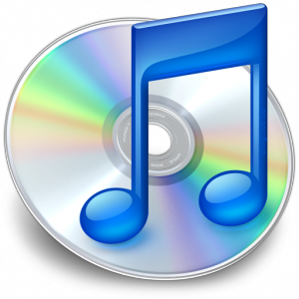




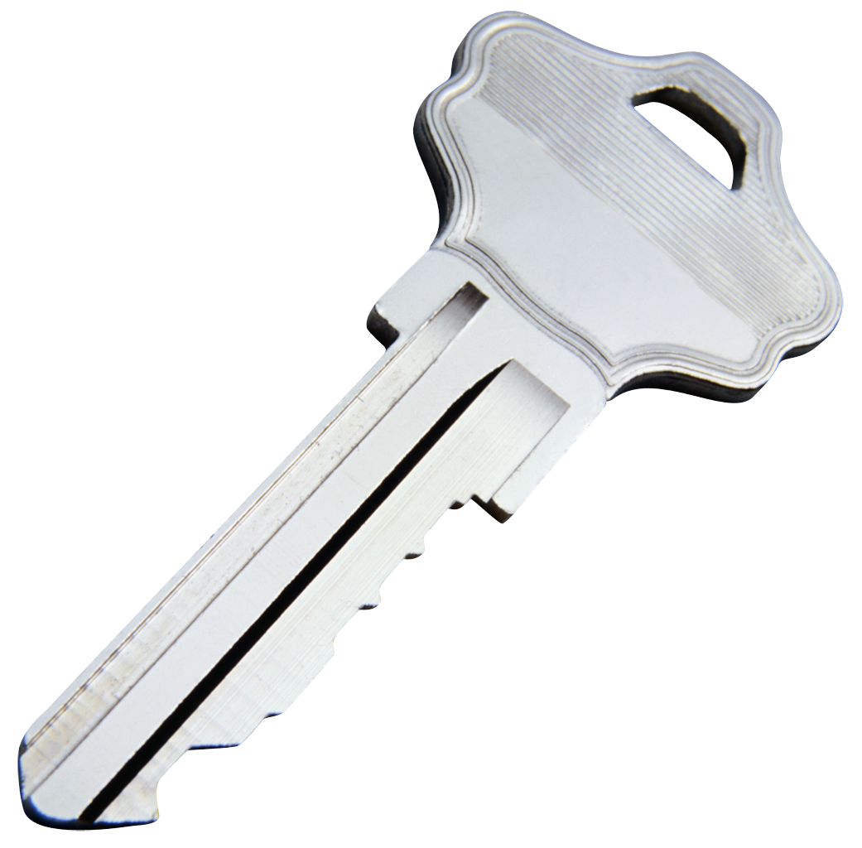


My Goal: Security & Features
Secrecy
Integrity
Isolation
Availability
And
Feature-rich
Low-cost
Quickly evolving

Slide 5


My Research: Trust Extension
Secure Code Execution
[IEEE S&P’07,’11] [EuroSys’08] [ASPLOS’08]
Verifiable Computing
[Crypto’10]
App
1
…
App
N
Bootstrapping Trust
[IEEE S&P’10] [Springer’11]
OS
Extension to the Network
[SIGCOMM ‘07]
Hardware
Fully Trusted
HW & SW
Minimal Trust
in HW & SW
Minimal Trust
in Endhosts
Fully Untrusted
HW & SW
Notes:
Explain color scheme.
For example, Alice might check that the computer in the Internet café is not running a keylogger.
Emphasize “outsourcing” aspect of VC.

Slide 6
Talk Overview
Introduction
Securely Executing Code On Demand
Practical State Continuity for Protected Modules
Conclusions
Notes:
Investigation of how to provide a secure environment on-demand

Slide 7
Problem Overview
S
App
App
…
S
OS
DMA Devices
(Ex: Network, Disk, USB)
CPU, RAM,
Chipset
Notes:
Emphasize that this is an overview!

Slide 8
Problem Overview
Adversary Capabilities
App
App
Run arbitrary code with maximum privileges
Subvert devices
Perform limited hardware attacks
  E.g., Power cycle the machine
  Excludes physically monitoring CPU-to-RAM communication
…
S
OS
DMA Devices
(Ex: Network, Disk, USB)
CPU, RAM,
Chipset
Notes:
Emphasize that this models a remote/software attacker, which is most common by far.

Slide 9
Previous Work: Persistent Security Layers
  [Gold et al. ‘84], [Shockley et al. ‘88], [Karger et al. ‘91], [England et al. ‘03], [Garfinkel et al. ‘03], …
App
…
App
S
S
OS
Security Kernel
Virtual Machine Monitor
Hardware
Hardware
Notes:
Once VMM takes over, it never gives up control
KVM/370 in Retrospect – Gold, Linde, Cudney
An Overview of the GEMSOS class A1 technology and application experience – Shockley, Tao, Thompson
A Retrospective on the VAX VMM Security Kernel – Karger, Zurko, Bonin, Mason, Kahn
Terra: A virtual machine-based platform for trusted computing – Garﬁnkel, Pfaff, Chow, Rosenblum, and Boneh.
Reducing TCB complexity for security-sensitive applications: Three case studies – Singaravelu, Pu, Haertig, and Helmuth.
A trusted open platform - England, B. Lampson, J. Manferdelli, M. Peinado, and B. Willman.

Slide 10
Previous Work: Persistent Security Layers
  [Gold et al. ‘84], [Shockley et al. ‘88], [Karger et al. ‘91], [England et al. ‘03], [Garfinkel et al. ‘03], …
App
…
App
Late Launch Support
New CPU instruction
Designed to securely start a VMM
Atomically protects and executes code
OS
OS
Late
S
Launch
Virtual Machine Monitor
VMM
DMA Devices
(Ex: Network, Disk, USB)
CPU, RAM,
Chipset
Notes:
VMM or Hypervisor

Slide 11

Previous Work: Persistent Security Layers
  [Gold et al. ‘84], [Shockley et al. ‘88], [Karger et al. ‘91], [England et al. ‘03], [Garfinkel et al. ‘03], …
Drawbacks:
App
…
App
Performance reduction
Feature elimination
Increased attack exposure
Additional complexity
OS
Allow?
Observation:
All result from persistence
S
Key Insight:
All avoided with
security on demand!
Virtual Machine Monitor
DMA Devices
(Ex: Network, Disk, USB)
CPU, RAM,
Chipset
Notes:
VMM or Hypervisor
Question: What causes these drawbacks?
Observation: Cause is Persistance, i.e., VMM is present even when not performing security-sensitive operations!
Insight: Avoid w/ security on-demand.

Slide 12
Flicker Overview: On-Demand Security
[IEEE S&P ‘07], [EuroSys ‘08], [ASPLOS ‘08]
App
App
App
App
…
…
S
OS
OS
Flicker
Hardware
Hardware

Slide 13
Flicker: An On-Demand Secure Environment
[IEEE S&P ‘07], [EuroSys ‘08], [ASPLOS ‘08]
Full secrecy
Full isolation
Minimal trust
Minimal complexity
App
App
1
App
App
…
…
Full HW access
Full performance
OS
OS
Insecure
Secure
S
Flicker
Hardware
Hardware
Notes:
Of course, by design, the Flicker environment is quite spartan. This means you can include exactly the code you need for your app and nothing else. Applications this work well for include computational tasks (e.g., crypto), those that require minimal UI, e.g., password entry, etc.

Slide 14
Challenges of On-Demand Security
1. Secure Context Switching
4. Leverage
Insecure Features
Insecure
Secure
2. Evidence of Security
3. Secure Data Preservation
Notes:
Emphasize why these are hard!
Example for #4: Use the network without including a network driver in the set of trusted code

Slide 15
Secure Context Switching
Steps:
App
App
App
App
App
…
Request Flicker
Late Launch
Application Code Execution
Resume OS
…
OS
Allow?
OS
✓
S
S
Inputs
Outputs
S
S
Late
Module
Module
Module
Module
Launch
Flicker
Flicker
Late
S
RAM
Launch
RAM
CPU
CPU
CPU
Flicker
Notes:
Module makes the decision, which prevents a malicious module from being run. Of course, the tradeoff is availability. A malicious OS may choose not to run Flicker. Fortunately, as I describe later, the user can detect this.

Slide 16
Challenges of On-Demand Security
1. Secure Context Switching
4. Leverage
Insecure Features
Insecure
Secure
2. Evidence of Security
3. Secure Data Preservation

Slide 17
App
App
…
OS
Module
Module
RAM
CPU

Slide 18
Must be unforgeable
Late
Launch
Flicker
S
How can we convey the log to Alice?
Must be tamper-proof
Inputs
Outputs
Prevents
Additions
Notes:
Mention that this log is what prevents (via later detection) the adversary from providing bad input

Slide 19
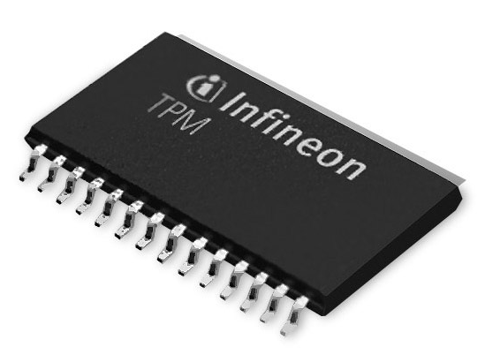
Hardware-Supported Logging
Trusted Platform Module (TPM)
John
Provides integrity for append-only logs
Can digitally sign logs
Equipped with a certificate of authenticity
Can authenticate that a Late Launch took place
Hancock
✓
✓
Late
Late
Launch
Launch
Notes:
Mention that logs don’t persist through reboot

Slide 20

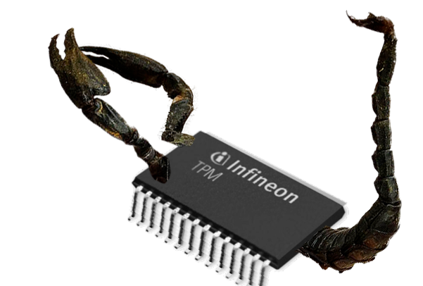
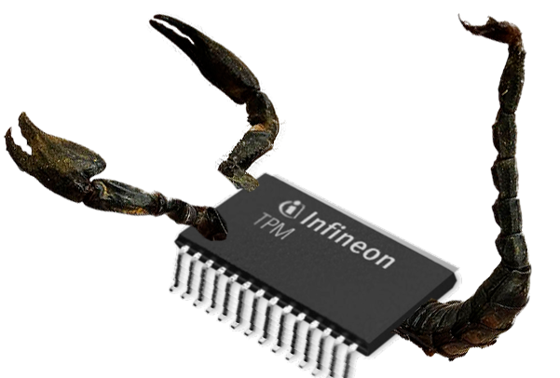
We Do Not Use the TPM to:
Take over your machine
Force you to run Windows (or Linux)
Enforce Digital-Rights Management (DRM)
Notes:
Using the TPM to benefit the user
Mention TPM not tamper-proof, so ill-suited to DRM

Slide 21
Late
Launch
Flicker
S
Inputs
Outputs

Slide 22
Attestation
Guarantees freshness
random #
random #
Trustworthy!
✓
Guarantees real TPM
John
Guarantees actual TPM logs
Hancock
John
Hancock
Notes:
Alice trusts her phone. Attestation is a protocol that allows Alice to extend the trust she has in her phone to allow her to trust the software on her computer.
Random # is “given” to the TPM
Allows Alice to conclude that the log is accurate, and hence she can trust that the code described did indeed execute in a secure environment.

Slide 23
Comparison With “Traditional” Attestation
  [Gasser et al. ‘89], [Arbaugh et al. ‘97], [Sailer et al. ‘04], [Marchesini et al. ‘04]
Traditional
Flicker
Key Insight:
Late Launch + Fine-Grained Attestations
BIOS
Late
Launch
Bootloader
OS
Flicker
Fine-Grained Attestations Simplify Verification
S
Input
Fine-Grained Attestations Improve Privacy
Output
Drivers 1…N
App 1…N
Notes:
Digital Distributed System Security Architecture – Gasser, Goldstein, Kaufman, Lampson
A Reliable Bootstrap Architecture- Arbaugh, Farber, Smith
Design and Implementation of a TCG-based Integrity Measurement Architecture - Sailer, Zhang, Jaeger, van Doorn
Open-Source Applications of TCPA hardware - Marchesini, Smith, Wild, Stabiner, Barsamian

Slide 24
Application: Verifiable Malware Scanning
No Malware
Detected!
App
1
App
1
App
1
App
N
App
N
…
App
N
…
…
Run Detector
OS
OS
OS
John
Hancock
D
Flicker
Hardware
Hardware
Hardware
Notes:
Let’s say Alice has noticed her computer is running slower than usual, and she wants to check if her computer is infected. Or suppose she wants to check her email using a computer in an Internet café.
Verifiably learns about software. Doesn’t tell her about modified hardware.

Slide 25
Application: Verifiable Malware Scanning
John
Hancock
Late
Launch
App
1
…
App
N
Run Detector
Flicker
OS
D
John
✓
Hancock
D
App
1
…
App
N
Inputs
Flicker
OS
Hardware
Outputs
Hardware

Slide 26



Additional Applications
Improved SSH password handling
Distributed computing
Protected CA keys

Slide 27
Implementation
Open-source versions for AMD & Intel
Linux and Windows kernel modules
Many implementation challenges:
  Hardware bugs, incomplete/incorrect vendor implementations, labyrinthine spec, etc.
http://flickertcb.sourceforge.net/
Notes:
Jon!

Slide 28
Performance: Context Switches
Late
Chipset Modifications [ASPLOS ‘08]
14 ms
TPM Storage ACLs
Launch
TPM Encryption
Retrieve Data
0.0005 ms
905 ms
20 ms
Total
0.0005 ms
929 ms
34 ms
Insecure
Secure
Store Data
0.0005 ms
20 ms
<1 ms
Notes:
Might be tough to do every keystroke, but acceptable for entering a password, signing an email, etc.

Slide 29
Related Approaches
Persistent security layers
  KVM [Gold et al. ‘84], GEMSOS [Shockley et al. ‘88],
  VAX VMM [Karger et al. ‘91], Terra [Garfinkel et al. ‘03], NGSCB [England et al. ‘03], Proxos [Ta-Min et al. ‘06]
System-wide attestation
  DDSSA [Gasser et al. ‘89], Secure Boot [Arbaugh et al. ‘97],
  IMA [Sailer et al. ‘04], Enforcer [Marchesini et al. ‘04]
Secure co-processors
  Dyad [Yee ‘94], IBM 4758 [Jiang et al. ‘01]
Notes:
KVM/370 in Retrospect – Gold, Linde, Cudney
An Overview of the GEMSOS class A1 technology and application experience – Shockley, Tao, Thompson
A Retrospective on the VAX VMM Security Kernel – Karger, Zurko, Bonin, Mason, Kahn
Terra: A virtual machine-based platform for trusted computing – Garﬁnkel, Pfaff, Chow, Rosenblum, and Boneh.
Reducing TCB complexity for security-sensitive applications: Three case studies – Singaravelu, Pu, Haertig, and Helmuth.
Splitting Interfaces: Making trust between applications and operating systems configurable – Ta-Min, Litty, Lie
Digital Distributed System Security Architecture – Gasser, Goldstein, Kaufman, Lampson
A Reliable Bootstrap Architecture- Arbaugh, Farber, Smith
Design and Implementation of a TCG-based Integrity Measurement Architecture - Sailer, Zhang, Jaeger, van Doorn
Open-Source Applications of TCPA hardware - Marchesini, Smith, Wild, Stabiner, Barsamian
Using Secure CoProcessors – Bennet Yee
Securing Web Servers Against Insider Attack - Jiang, Smith, Minami

Slide 30
Flicker Summary
[IEEE S&P ‘07], [EuroSys ‘08], [ASPLOS ‘08]
New paradigm:
On-Demand Security
New challenges:
  Secure context switches
  Evidence of security
  State preservation
New properties:
Fine-grained attestations
App
App
…
OS
S
Flicker
Hardware

Slide 31
Limitations
Current systems only support one Flicker session at a time
Flicker environment is spartan (by design!)
Flicker does not guarantee availability
Flicker is vulnerable to sophisticated HW attacks
Notes:
1st one is engineering. Next two are fundamental.

Slide 32
Talk Overview
Introduction
Securely Executing Code On Demand
Practical State Continuity for Protected Modules
  Defining protected modules
  Problems with naïve solutions
  Design of Memoir
  Implementation and evaluation
Conclusions
Notes:
Investigation of how to provide a secure environment on-demand

Slide 33

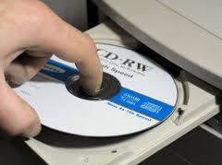
Protected Module: Data that’s only accessible via a small piece of code.
Code
Data

Slide 34
Protected modules are enabled by isolation architectures.
Small trusted computing base
Minimal code
Few devices
Untrusted system
Trusted system
Code
Storage
Secure execution infrastructure
Flicker
Trusted hypervisor
Secure coprocessor

Slide 35
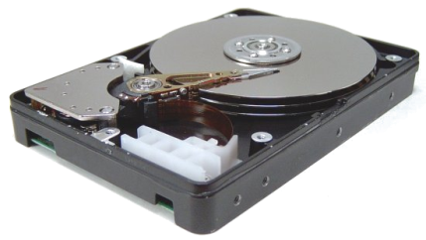
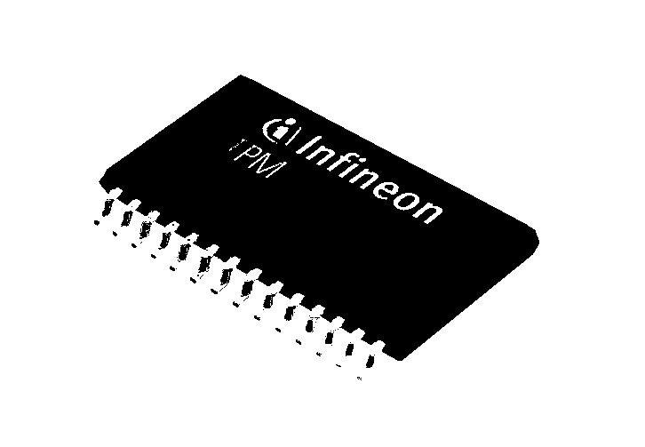
Isolation architectures have limited trusted storage.
Small trusted computing base
Minimal code
Few devices
Untrusted system
Trusted system
Disk device drivers
Code
Storage
TPM
1,280 bytes of NVRAM

Slide 36

Protected modules must leverage untrusted storage for their data.
Untrusted system
Trusted system
Bjcx
Data
Code
Signature
Storage
Data
Confidentiality
Data
Integrity

Slide 37
Cryptography is insufficient to prevent a rollback attack.
Untrusted system
Trusted system
Bjcx
Saved from 2008:
Code
Signature
Kebz
Storage
Signature

Slide 38
Encryption key protector illustrates the importance of rollback resistance.
Rolling back wrong-guess count allows dictionary attack.
Key protector
lorch: 1234?
lorch: 1235?
Guess PIN
Wrong
User | PIN | Recovery key | Disk key | # wrong
parno lorch johndo mickens mccune | 1111 0905 8034 9999 7654 | 90928389234 82378912837 29812982309 40954353458 32234528981 | A0FF23849083 B58890AD38E1 8293808E20CD 003827878EE3 C4358C380102 | 0 2 0 0 0
3
Recover

Slide 39
Rollback resistance is important for almost any stateful protected module.
Protected module | Consequences of rollback
Encryption key protector | Rolling back wrong-guess count allows a dictionary attack.
Privacy-preserving database using differential privacy | Rolling back privacy budget expenditure allows privacy safeguards to be subverted.
Monotonic counter | Rolling back counter updates makes the counter go backward.
Audit log | Rolling back the log tail subverts the append-only property of the log.
Game monitor | Rolling back recent activity lets player react to another player’s move after seeing it.
Access control list | Rolling back the removal of a user from a group restores access to the disallowed user.
… | …

Slide 40
Naive approach to rollback resilience creates problems.
Monotonic counter prevents rollback
But, it introduces new problems
  Potential for permanent unavailability after non-adversarial crash event
    OS crash or power failure
  Limited lifespan and slow operation
    due to trusted non-volatile write on each request

Slide 41
Memoir demonstrates how to make rollback resistance practical.
Memoir achieves rollback resistance yet still has...
  Crash resilience
  Long lifespan and fast operation, by avoiding writes to trusted NV storage
Non-adversarial crashes only
Adversarial attacks on availability are out of scope.

Slide 42
Talk Overview
Introduction
Securely Executing Code On Demand
Practical State Continuity for Protected Modules
  Defining protected modules
  Problems with naïve solutions
  Design of Memoir
  Implementation and evaluation
Conclusions
Notes:
Investigation of how to provide a secure environment on-demand

Slide 43
A monotonic counter can provide rollback resistance.
Code
Initialize
Data
Hwpb
Signature
Tag: 1
1
NV
1

Slide 44
A monotonic counter can provide rollback resistance.
Code
Hwpb
Signature
Tag: 1
NV
1

Slide 45
A monotonic counter can provide rollback resistance.
Request
Code
Hwpb
Data
Signature
Tag: 1
1

Slide 46
A monotonic counter can provide rollback resistance.
Code
Data’
Data
Yzqr’
Signature
Tag: 2
2
1
2

Slide 47
Problem 1: The monotonic-counter solution is not crash-resilient.
Code
Yzqr’
Signature
Tag: 2
2
1
2

Slide 48
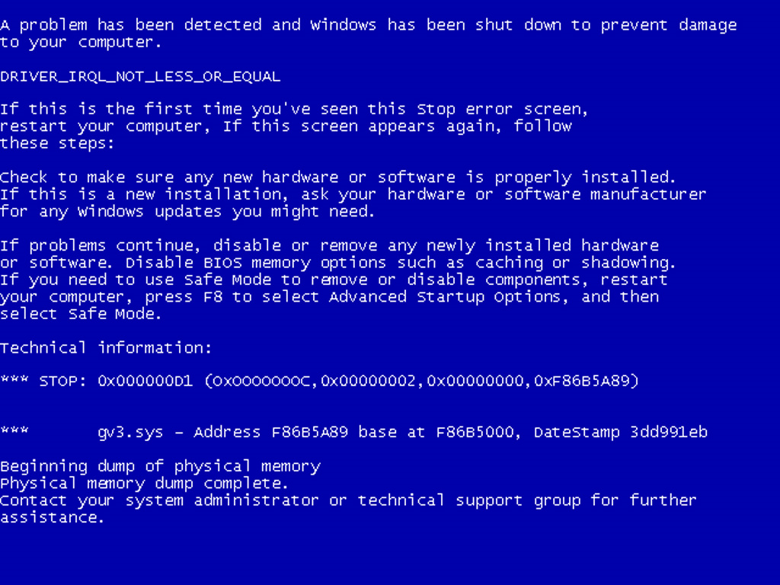

Slide 49
Problem 1: The monotonic-counter solution is not crash-resilient.
Request
Code
Yzqr
Window of vulnerability includes time to exit isolated environment, restore OS, write to disk.
Module permanently unusable
Signature
Tag: 1
2

Slide 50


Problem 2: Monotonic-counter frequently writes trusted NV storage.
an extra 30-80 ms per request
100,000 write-cycle limit
only 100,000 requests, ever!
lasts only 28 hours at
one request per sec

Slide 51
Two-phase commit also doesn’t work.
Performance problems
  Every request requires two invocations of isolation architecture, trusted randomness, an NV write
Fundamental security problem
  Adversary can observe side channels of request without performing it
For details, see paper.

Slide 52
Talk Overview
Introduction
Securely Executing Code On Demand
Practical State Continuity for Protected Modules
  Defining protected modules
  Problems with naïve solutions
  Design of Memoir
  Implementation and evaluation
Conclusions
Notes:
Investigation of how to provide a secure environment on-demand

Slide 53
For crash resilience, Memoir requires request execution be deterministic.
Source of non-determinism | How to avoid it
Random numbers | Seed secure PRNG with random data during initialization
Multi-thread scheduling | Apply others’ research to make deterministic (future work)
Time | Exchange messages with a trusted time source

Slide 54
Memoir achieves crash resilience by storing a secure history summary.
Request₁
Request₂
Request₃
h
= Hash(Hash(Hash( ) || ) || ) …
Request
Deterministic code
Ewfg
Signature
Tag: h
5
h

Slide 55
Memoir achieves crash resilience by storing a secure history summary.
Request
h’
= Hash( || )
h
Request
Deterministic code
Data’
Urvi’
Data
Signature
Tag: h’
h’
5
h
h’

Slide 56
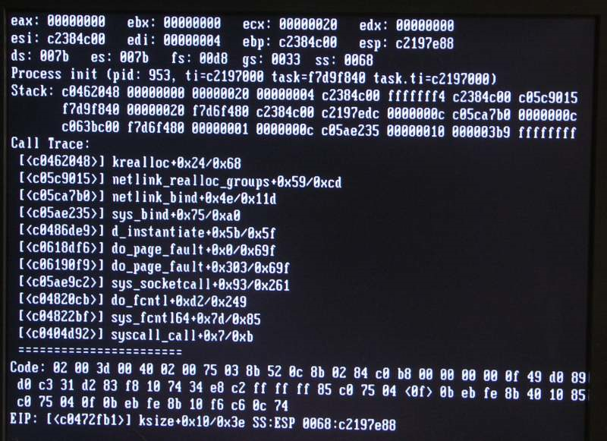

Slide 57
Memoir achieves crash resilience by storing a secure history summary.
Request
h’
= Hash( || )
h
Request
Deterministic code
Ewfg
Signature
Tag: h
Since request execution is deterministic, replaying will produce the same output.
Thus, it is safe to replay the last request.
h’

Slide 58
Memoir avoids non-volatile writes by using trusted volatile storage.
TPM
Platform
Configuration
Registers
PCR
PCR
PCR
PCR
A PCR can only be modified by extending it:
p’
= Hash( || )
p
h
or by rebooting, causing it to be zeroed.

Slide 59
Memoir avoids NV writes by using two-part history summaries.
n’
= Hash( || )
n
p
Deterministic code
At 1 reboot per day, 1 request per sec, module can last
136 years instead of the monotonic counter’s 28 hours.
Before reboot, a checkpoint routine must run, to incorporate trusted volatile state into trusted NV state.
n
Written twice per boot
n’
h
Updated on every request
p
p
0

Slide 60
Memoir must ensure correctness if an adversary doesn’t checkpoint.
Adversary can clear PCR without running checkpoint routine
  Guard bit in trusted NV storage indicates whether PCR should be non-zero
Adversary can extend PCR
  Extension secret used on each extension
For details, see paper.

Slide 61
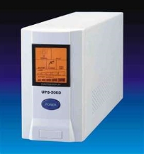
Checkpoint routine must run before a non-adversarial reboot.
For OS crashes:
System Management Interrupt Handler
Checkpoint routine
For power failures:

Slide 62
Memoir improves dramatically on the monotonic-counter solution.
Monotonic counter | Memoir
OS crash or power failure can make module permanently unusable | Non-adversarial crashes not a problem
Lasts only 28 hours at one request per sec | Lasts 136 years even with one reboot per day
Spends 30-80 ms per request to write NVRAM | Spends 15-25 ms per request to access a PCR

Slide 63
Also in the paper:
TLA+ High-Level Memoir Spec
CONSTANT InputType, OutputType, PublicStateType, PrivateStateType
ServiceResultType 
[ newPublicState : PublicStateType; newPrivateState : PrivateStateType; output : OutputType ]
CONSTANT Service(_, _, _)
CONSTANT InitialAvailableInputs, InitialPublicState, InitialPrivateState
VARIABLE AvailableInputs, ObservedOutputs, PublicState, PrivateState
Proof of correctness of Memoir protocols
  Machine-checked TLA+
  Full details in 390-page tech report
Supporting unlimited modules with constant NVRAM and one PCR
Suggestion for minor TPM modification to solve NVRAM issue
Obviating trusted randomness in execution
MakeInputAvailable 
∃ input ∈ InputType :
∧ input ∉ AvailableInputs
∧ AvailableInputs' = AvailableInputs ∪ {input}
∧ UNCHANGED ObservedOutputs
∧ UNCHANGED PublicState
∧ UNCHANGED PrivateState
AdvanceService 
∃ input ∈ AvailableInputs :
LET
sResult 
Service(PublicState, PrivateState, input)
IN
∧ PublicState' = sResult.newPublicState
∧ PrivateState' = sResult.newPrivateState
∧ ObservedOutputs' =
ObservedOutputs ∪ {sResult.output}
∧ UNCHANGED AvailableInputs
Init 
∧ AvailableInputs = InitialAvailableInputs
∧ ObservedOutputs = {}
∧ PublicState = InitialPublicState
∧ PrivateState = InitialPrivateState
Next  MakeInputAvailable ∨ AdvanceService
Spec  Init ∧ □[Next]⟨AvailableInputs, ObservedOutputs, PublicState, PrivateState⟩

Slide 64
Talk Overview
Introduction
Securely Executing Code On Demand
Practical State Continuity for Protected Modules
  Defining protected modules
  Problems with naïve solutions
  Design of Memoir
  Implementation and evaluation
Conclusions
Notes:
Investigation of how to provide a secure environment on-demand

Slide 65
Implementation is a framework for making and using protected modules.
Untrusted system
Trusted system, isolated by Flicker
Protected module
Memoir tools
MemoirLib
Service
Service
initialize_state
handle_request
serialize_state
deserialize_state
Client
create_module.exe
n
p
exec_request.
exe
Pseudo-random
numbers
Memoir ensures confidentiality, integrity, rollback resilience, crash resilience, and NV avoidance.
Memoir makes it easy to write protected modules.
Available at http://research.microsoft.com/memoir

Slide 66
Future implementation work
System management interrupt handler
Module management module
  Enables multiple modules to use constant NVRAM and one PCR

Slide 67
Our evaluation results answer three main questions.
How much does Memoir increase TCB size?
How fast can modules run with Memoir?
In particular, how useful is NVRAM avoidance?

Slide 68
Our experimental platform is a standard PC supported by Flicker.
Isolation mechanism: Flicker 0.5 secure execution infrastructure
HP Compaq 6005 Pro PC
  3.0 GHz AMD Athlon II X2 CPU with AMD-V
  2.0 GB memory, 160 GB SATA disk, Infineon TPM
Linux 2.6.31
Only one core enabled since Flicker doesn’t support multiprocessors

Slide 69
Memoir contribution to TCB
Only some of this code is safety-critical. Bugs in the tools can only hamper availability.
TCB increase is modest, much smaller than disk drivers.
Most of the code is well-tested cryptography code publicly and widely available.
Bugs can only lead to liveness violations.
Safety depends on this code.

Slide 70
Execution time of no-op module
Avoiding NVRAM writes saves 17 ms (and also increases module lifespan).
Rollback resistance adds about 33 ms, to write trusted NVRAM.
Encrypting and signing adds about 7 ms.
On this architecture, Flicker takes about 50 ms, mostly for late-launch.
Crash resilience adds about 43 ms, due to synchronous disk write before executing request.
Flicker
baseline
+ confidentiality
and integrity
+ crash
resilience
and rollback
resistance
+ avoiding
trusted
NV writes

Slide 71
Execution time of other modules
We built several prototype protected modules with Memoir.
Similar performance to no-op service, except different amounts of time to write state to disk.
Encryption key protector
Privacy-preserving database
Trusted monotonic counter
Without NV avoidance
With NV avoidance

Slide 72
Additional Research
Improved application security on client computers
  Eliminating manifests and pop-ups
  Eliminating the need for software updates
Privacy-preserving personalized online services
  Protected modules + fuzzed client requests
  New models for Oblivious RAM
Verifiable computation
  More efficient constructions
  Connections to attribute-based encryption

Slide 73
Conclusions
    Flicker provides an on-demand secure execution environment with minimal trust assumptions
Protected modules with rollback resistance are a powerful, general tool
Memoir is a practical framework for building protected modules with state continuity
http://flickertcb.sourceforge.net/
http://research.microsoft.com/memoir
Thank you!
parno@microsoft.com
Notes:
Emphasize: Flicker uses a new, on-demand security architecture to provide strong properties and avoid drawbacks of previous accepted architecture
Emphasize: VC achievable via the counter-intuitive use of secrecy to achieve integrity.

Slide 74

Application: SSH Passwords
S
Flicker
Start
Start
Generate
{K, K⁻¹}
John
Used for Encryption
Hancock
K
K⁻¹
S
K
Used for Decryption
Flicker
S
K⁻¹
S
Encrypt_{K}(passwd)
K⁻¹
✓
Flicker
Flicker
Encrypt_{K}(
)
Encrypt_{K}(passwd)
passwd
Notes:
Combine attestation with sealed storage to create a secure channel.

Slide 75


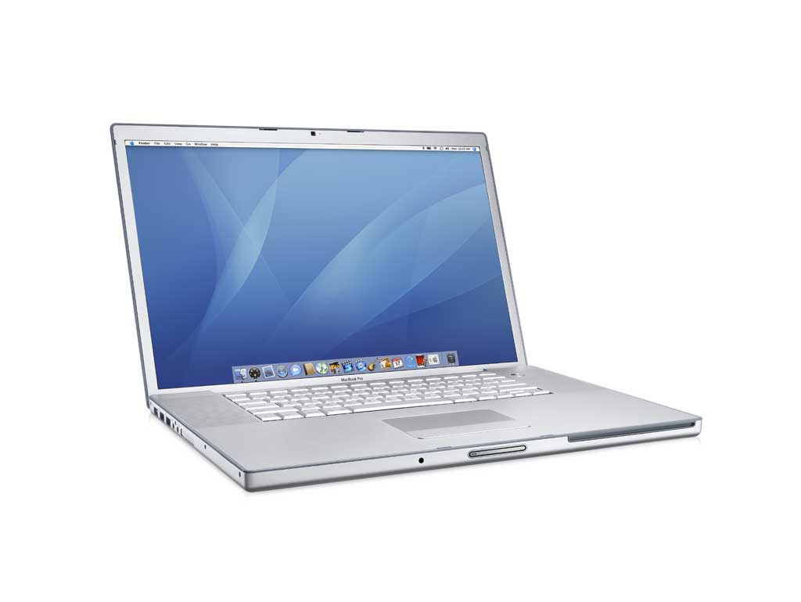
Application: Distributed Computing
Trustworthy!
Flicker
S
Prevents software-based cheating!
Inputs
…
Outputs

Slide 76
Default Functionality
Shim can execute arbitrary x86 code but provides very limited functionality
Fortunately, many security-sensitive functions do not require much
  E.g., key generation, encryption/decryption, FFT
Functionality can be added to support a particular security-sensitive operation
We have partially automated the extraction of support code for security-sensitive code

Slide 77
Existing Flicker Modules
OS Protection Memory protection, ring 3 execution
Crypto Crypto ops (RSA, SHA-1, etc.)
Memory Alloc. Malloc/free/realloc
Secure Channel Secure remote communication
TPM Driver Communicate with TPM
TPM Utilities Perform TPM operations

Slide 78
Developing With Flicker
Sensitive code linked against the Flicker library
Customized linker script lays out binary
Application interacts with Flicker via a Flicker kernel module
Made available at:
/sysfs/flicker/output
#include “flicker.h”
const char* msg = “Hello, world”;
void flicker_main(void *inputs) {
}
for(int i=0;i<13;i++)
OUTPUT[i] = msg[i];
Notes:
If we want developers to use Flicker, it must be easy to deploy

Slide 79
Flicker’s Impact on Suspended OS
User I/O ceases during Flicker session
Network can recover from dropped packets
In experiments with long-running Flicker sessions (~8 seconds):
  Copied files from CD to Disk to USB Drive
    No I/O errors reported
    File integrity unaffected
Conclusion: OS is resilient to Flicker sessions

Slide 80
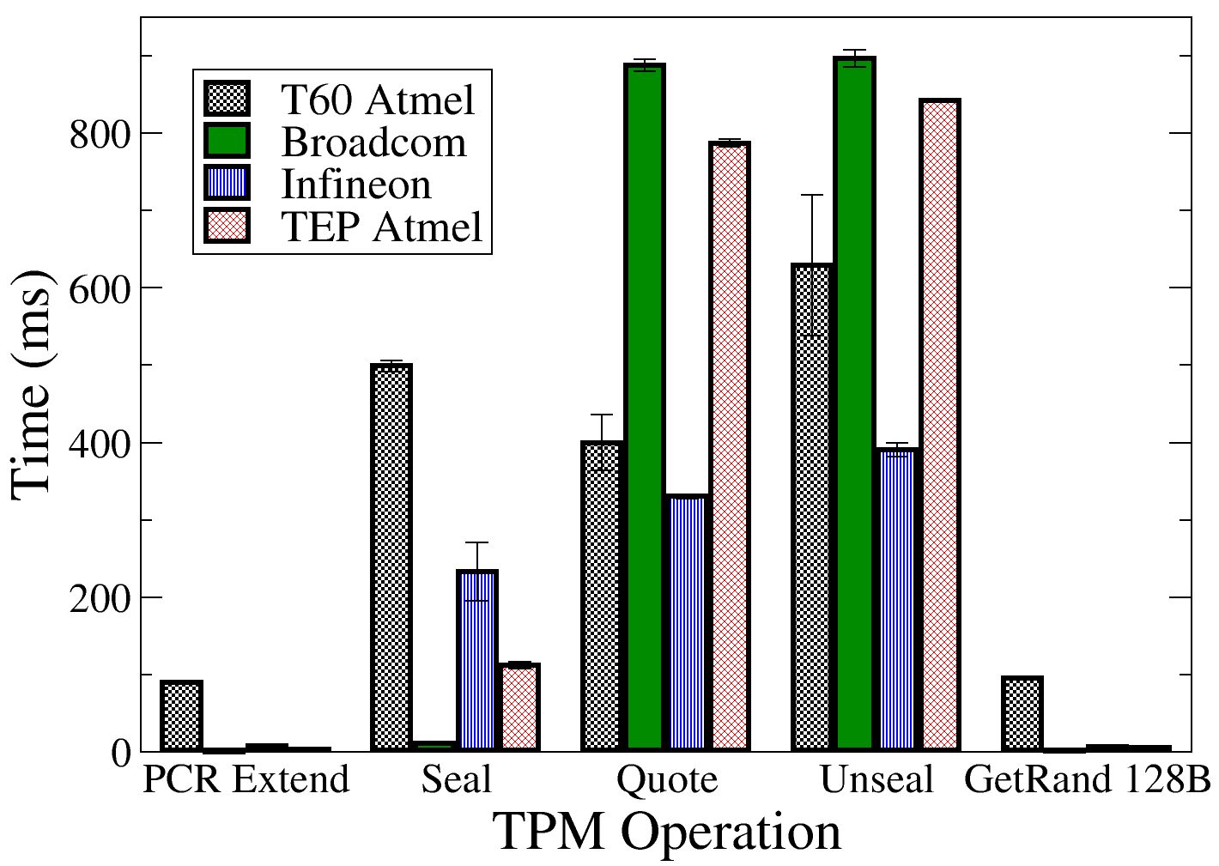
TPM Microbenchmarks
Significant variation by TPM model
Notes:
Be concise. Mention that each color of bar is for a different TPM model.

Slide 81
SKINIT (Secure Kernel Init)
Accepts address of Secure Loader Block (SLB)
  Memory region up to 64 KB (more on next slide)
SKINIT executes atomically
  Sets CPU state similar to INIT (soft reset)
  Enables DMA protection for entire 64 KB SLB
  Disables interrupts
  Causes TPM to reset locality-specific PCRs to 0
  Extends a measurement of the SLB into PCR 17
  Begins executing at SLB’s entry point

Slide 82
Secure Loader Block Layout
ESP
SL Runtime
Data Area
SL Stack
64 KB
SL Code and
Static Data
Length
SL Entry Point
SL Image
(hash area)
SL Header
Length
EP Offset
EAX

Slide 83
TPM Microbenchmarks
Significant variation by TPM model
Notes:
Be concise. Mention that each color of bar is for a different TPM model.

Slide 84
Overheads and Recommendations
O1 Late launch and TPM sealed storage overhead on every context switch
R1 Secure context switch between sensitive applications without TPM
O2 Other cores must halt to enable late launch
R2 Secure execution on multiple CPUs concurrently
O3 TPM equipped to store records from only one late launch
R3 TPM support for concurrent Flicker sessions
Notes:
Motivation: Minimize changes to existing arch.
HOW, not just should. Inspired by our system, but not particular to it. Don’t blame TPM for being inadequate for a non-existent architecture.
Summary: 1 CPU in secure mode, (n-1) CPUs keep going

Slide 85
Late Launch Performance
Late launch requires extra processors to stop execution
  More cores => more expensive
CPU
CPU
STOP
CPU
…
CPU
RAM
CPU
Memory
Controller
Memory
Controller
Memory
Controller
Memory
Controller
Memory
Controller
RAM
TPM
Other CPUs
I/O Devices
Other CPUs
I/O Devices
TPM
Notes:
Emphasize colored memory region is protected.

Slide 86
New States for Memory Pages
Avoid TPM for short-term data protection
Memory Controller supports DMA protection vector
All
Launch
Sensitive
Application
Exit
CPU i
Resume
Suspend
None
Memory
Notes:
Avoid TPM because it is slow (would be a waste of power even if it is fast)
Emphasize ONLU CPI I can touch memory

Slide 87
Concurrent Flicker Sessions
Other CPUs continue to perform useful work
Memory Controllers isolate secure state
CPU
RAM
CPU
Memory
Controller
Memory
Controller
Other CPUs
I/O Devices
Other CPUs
I/O Devices
TPM
Notes:
Not actually a large divergence from today’s systems since cache coherence is already maintained.
Summary: 1 CPU in secure mode, (n-1) CPUs keep going

Slide 88
Add Secure Execution PCRs to TPM
Each SE PCR holds state for one Flicker session
Bounds number of concurrent Flicker sessions
TPM
Static
PCRs
Dynamic
PCRs
Secure
Execution
PCRs

Slide 89
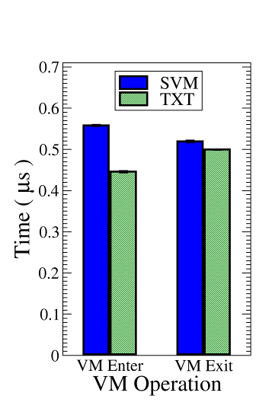
Anticipated Improvement
Late launch cost only incurred when Flicker session launches
TPM (Un)Seal only used
for long-term storage
Multicore systems remain interactive
Context switch overheads (common case) resemble
VM switches today
Notes:
Reminder: We’re better than VMMs due to our improved security properties
We care about VMMs because they are a common alternative for providing isolation
Our recommendations are designed to be similar to existing functionalities. The closest thing to a secure execution context switch is a VM context switch.

Slide 90
Challenges of On-Demand Security
1. Secure Context Switching
4. Leverage
Insecure Features
Insecure
Secure
2. Evidence of Security
3. Secure Data Preservation

Slide 91
Securely Preserving State
Seal data under code, inputs, and/or outputs
OS
S
S
S
S
Flicker
Flicker
Flicker
Flicker
Data
Data
Data
S
S
Flicker
S
Flicker
Flicker
Time

Slide 92
Securely Preserving State
Data
A
S
Flicker
Data
Data
Key Insight: Only possible via Code Identity
Insecure
Secure
A
B
Data
B
S
Flicker

Slide 93
Another naive solution, two-phase commit, also doesn’t work.
Performance problems: Every request requires...
  Two invocations of the isolation architecture
  Write to trusted non-volatile storage
  Trusted randomness
Fundamental security problem
  Adversary can observe phase 1, then decide whether to do phase 2
    Can tentatively perform request, observe side channels like output size and execution time, then decide whether to actually commit
  Example: dictionary attack on encryption key protector
    Guess a PIN, observe that output is too small to contain a key, don’t commit to prevent increment of wrong-guess count

Slide 94
Other Memoir operations

Slide 95
Preventing equivocation in distributed systems
TrInc (trusted incrementer)
Key: K
Sign_{K}(ID 2, 243=>244,
hash 90F357)
Monotonic counter ID | Value
1 2 3 4 5 | 17 243 0 1 19,012
ID 2 => 244, hash 90F357
Update counter
244

Slide 96
Privacy-preserving database
Differential-privacy database
Health record
Insert datum
Asymmetric key pair
Cancer rate?
Database
Answer + noise
Query
Privacy budget remaining

Slide 97
Privacy-preserving database
Privacy-preserving database
Key: K
Insert datum
Current query
Range: 3/1/2011 – 3/31/2011
Last item: 3/3/2011
Privacy budget to spend: 0.25
Query state: S
Sign_{K}(ID 2, 243=>244,
hash 90F357)
ID 2 => 244, hash 90F357
244
Start query
Date range | Privacy budget spent
1/1/2011 – 1/31/2011 2/1/2011 – 2/28/2011 3/1/2011 – 3/31/2011 | 0.75 0.50 0.25

