Slide 1

Across the Pond: An Update on Health Privacy and Health Data Security. How are American patients faring?
University of Cambridge
Wednesday 20 October 2010
Deborah C. Peel, MD
(c) 2010, Patient Privacy Rights. All rights reserved

Slide 2
security and privacy
clinical justification for security
  patients’ expectations/rights
  liability/reputation
privacy-enabling security (encryption, authentication/segmentation, etc)
HITECH: consumer protections
Consumer Choices Tech Hearing
ideal HIT systems

Slide 3
security ≠ privacy

Slide 4


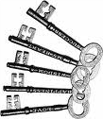
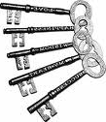
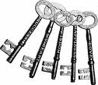
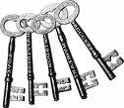

Privacy = how many keys?
Security

Slide 5
What does ‘privacy’ mean?
The NCVHS defined health information privacy as
“an individual’s right to control
the acquisition, uses, or
disclosures of his or her
identifiable health data”.
(June 2006, NCVHS Report to Sec. Leavitt, definition originally from the IOM)

Slide 6
privacy = control

Slide 7
comprehensive and meaningful privacy and security

Slide 9
10 Million Americans Expect
Privacy and Security
The bipartisan Coalition for Patient Privacy, 2010
AIDS Action Just Health
American Association of People with Disabilities Multiracial Activist
American Association of Practicing Psychiatrists Microsoft Corporation Inc.
American Chiropractic Association National Center for Transgender Equality
American Civil Liberties Union The National Center for Mental Health Prof. & Consumers
American Conservative Union National Whistleblower Center
American Psychoanalytic Association National Workrights Institute
Association of American Physicians and Surgeons Natural Solutions Foundation
Bazelon Center for Mental Health Law New Grady Coalition
Bob Barr (former Congressman R-GA) Pain Relief Network
Citizens for Health Patient Privacy Rights Foundation
Citizen Outreach Project Privacy Activism
Clinical Social Work Association Privacy Rights Now Coalition
Consumer Action Private Citizen, Inc.
Consumers for Health Care Choices Republican Liberty Caucus
Cyber Privacy Project Student Health Integrity Project
Doctors for Open Government TexPIRG
Ethics in Government Group Thoughtful House Center for Autism
Fairfax County Privacy Council Tolven, Inc.
Family Research Council Tradition, Family, Property, Inc.
Free Congress Foundation Universata, Inc.
Georgians for Open Government U.S. Bill of Rights Foundation
Gun Owners of America You Take Control, Inc.
Health Administration Responsibility Project, Inc.

Slide 10
clinical justification for security: patients’ expectations and rights

Slide 11
AHRQ: 2009
20 focus groups expect control
A majority want to “own” their health data, and to decide what goes into and who has access to their medical records. (AHRQ p. 6)
A majority believe their medical data is “no one else’s business” and should not be shared
without their permission….not about sensitive data but “a matter of principle”. (AHRQ p. 18)

Slide 12
AHRQ: 2009
20 focus groups expect control
no support for general rules that apply to all consumers
consumers should exert control over their own health information individually, rather than collectively.(AHRQ p. 29)
AHRQ Publication No. 09-0081-EF “Final Report: Consumer Engagement in
Developing Electronic Health Information Systems” Prepared by: Westat,
(July 2009)
http://healthit.ahrq.gov/portal/server.pt/gateway/PTARGS_0_1248_888520_0_0_18/09-0081-EF.pdf

Slide 13
2006 Privacy and EHR Systems:
Can We Avoid A Looming Conflict?
42% of public feels potential privacy
risks outweigh potential EHR benefits
60% of public wants to know EHR
impacts and the right to choose how
records used
Dr. Alan F. Westin
Professor of Public Law and
Government Emeritus, Columbia University
Markle Conference on “Connecting Americans to Their Health Care,”
Washington, D.C. Dec 7-8, 2006

Slide 14
2009 NPR/Kaiser/Harvard Poll
The Public and the Health Care Delivery System
59% are NOT confident online medical
records will remain confidential
76% believe unauthorized persons will
access their online medical records
http://www.kff.org/kaiserpolls/upload/7888.pdf

Slide 15
The right of privacy is a personal and fundamental right in the
United States
See Department of Justice v. Reporters Committee for Freedom of the Press, 489 U.S. 749, 763 (1989) (“both the common law and the literal understandings of privacy encompass the individual’s control of information concerning his or her person”); Whalen v. Roe, 429 U.S. 589, 605 (1977); United States v. Katz, 389 U.S. 347 (1967); Olmstead v. United States, 277 U.S. 438, 478 (1928) (Brandeis, J., dissenting).
The opportunities to secure employment, insurance, and credit, to obtain medical services and the rights of due process may be jeopardized by the misuse of personal information.
Fed. Trade Comm’n, Consumer Sentinel Network Data Book 11 (2009) (charts describing how identity theft victims’ information have been misused).

Slide 16
As the Supreme Court has made clear, and the DC Circuit Court of Appeals recently held, “both the common law and the literal understanding of privacy encompass the individual’s control of information concerning his or her person.”
U.S. Dep’t of Justice v. Reporters Comm. for Freedom of the Press, 489 U.S. 749, 763 (1989), cited in Nat’l Cable & Tele. Assn. v. Fed. Commc’ns. Comm’n, No. 07-1312 (D.C. Cir. Feb. 13, 2009).
“the constitutionally protected right to privacy of highly personal information is so well established that no reasonable person could be unaware of it.”
Sterling v. Borough of Minersville, 232 F.3d 190, 198 (3rd Cir. 2000).

Slide 17
ethical and human rights to privacy legal privileges common law
Notes:
17

Slide 18
The Madrid Privacy Declaration of November 2009 affirms that privacy is a basic human right, and notes“ corporations are acquiring vast amounts of personal data without independent oversight”
The Madrid Privacy Declaration: Global Privacy Standards for a Global World,
Nov. 3, 2009, see http://thepublicvoice.org/madrid-declaration/ .

Slide 19
Professional and research ethics
The ethical codes of all health professions require
informed consent before use or disclosures of
personal health information.
Report to HHS, NCVHS (June 22, 2006)
“the well- being of the human subject
should take precedence over the needs
and interests of society”
World Medical Association Declaration of Helsinki June 1964
Ethical Principles for Medical Research Involving Human Subjects

Slide 20
Privileges and Common Law
A physician-patient privilege is recognized in the laws of 43 states and the District of Columbia.
The State of Health Privacy, Health Privacy Project (2000)
All 50 states and the District of Columbia recognize
in tort law a common law or statutory right to
privacy of personal information.
HHS finding 65 Fed. Reg. at 82,464
Ten states have a right to privacy expressly
recognized in their state constitutions.

Slide 21
Americans expect privacy and control, but….

Slide 22
HIPAA regs eliminate consent and privacy
Congress passed HIPAA, but did not pass a federal medical privacy statute, so the Dept. of Health and Human Services (HHS) was required to develop regulations that specified patients’ rights to health privacy. Public Law 104-191
“… the Secretary of Health and Human Services shall submit to [Congress]…detailed recommendations on standards with respect to the privacy of individually identifiable health information.”
1996
President Bush implemented
the HIPAA “Privacy Rule” which recognized the “right of consent”.
HHS wrote these regulations.
65 Fed. Reg. 82,462
“….a covered health care provider must obtain the individual’s consent, in accordance with this section, prior to using or disclosing protected health information to carry out treatment, payment, or health care operations.”
2001
HHS amended the HIPAA
“Privacy Rule”, eliminating the right of consent.
67 Fed. Reg. 53,183
“The consent provisions…are replaced with a new provision…that provides regulatory permission for covered entities to use and disclose protected health information for treatment, payment, healthcare operations.”
2002
Notes:
22

Slide 24


Americans expect privacy and security,
but….

Slide 25

Where did this slide come from ? The Medical Information Bureau website. The MBI sells claims/health data to insurers and employers.

Slide 26
35% of Fortune 500 companies admit to using medical records for hiring and promotions
65 Fed. Reg. 82,467.

Slide 27


huge market for health data
+
theft and sale of health data
→
health data mining industry

Slide 28
2010: Top Fortune 500 Companies health data mining industry
General Electric (GE Centricity EHR/HIT systems,
sells clinical data) revenue 157B
14 McKesson (sells Rx data) revenue 107B
18 CVS Caremark (sells Rx data) revenue 99B
21 UnitedHealth Group (sells RX data thru
Ingenix subsidiary) revenue 87B
31 WellPoint (sells claims/clinical data via BHI)
revenue 65B
http://money.cnn.com/magazines/fortune/fortune500/2010/full_list/

Slide 29
2010: Top Fortune 500
Health Care: Pharmacy and Other Services (health data mining industry)
Rank Company/500 rank Revenues($ billions)
1 Medco Health Solutions #35 59.8 (sells Rx data)
2 HCA (largest US hospital chain) #77 30 (?? sells hospital and Rx data)
3 Express Scripts #96 25 (sells Rx data)
4 Quest Diagnostics #303 7 (sells data/sends data to HIEs?)
  “transforms millions of test results into valuable information products”
  http://www.questdiagnostics.com/brand/careers/index.html#services
5 Omnicare #347 6.3 (???)
  (leading Rx provider for seniors)“we capture a tremendous amount of data”
  ..combines data with outcomes algorithm technology
6 Lab Corp. of America #442 4.7 (sells data??/sends data to HIEs)

Slide 30

EHRs, PHRs, claims data, lab data, prescriptions, health searches, etc

Slide 31

PrimeResearch part of an EHR/Practice Management Suite
Key Benefits for Physicians:
“Make clinical research
participation a revenue
source” -
ie, doctors sell access
to their patients and
patients’ records
The result – increased practice revenues and access to
patient care improvements.”
GREENWAY HELPS
PHYSICIANS SELL:
“de-identified” clinical data
“de-identified” financial data
population data
data on 19 M patients
8 million prescriptions/yr
data on 8,000 providers
http://www.greenwaymedical.com/solutionprime-research/

Slide 32

athenahealth strives to be
the best at getting doctors
paid
used by 19,500 physicians
and medical providers
nationwide
Athenahealth Paying Dearly to Take on Larger Rivals by Ryan McBride 5/6/10
Athena might be able to halve the amount
that physicians pay to use its EHR if they
participate in “AthenaCommunity.”
Athena’s EHR customers who opt to share
their patients’ data with other providers
would pay a discounted rate to use
Athena’s health record software.
Athena would be able to make money with
the patient data by charging, say, a hospital
a small fee to access a patient’s insurance
and medical information from Athena’s
network.
http://www.athenahealth.com/strategic-alliances/
index.phphttp://www.athenahealth.com/strategic-alliances/index.php
http://www.xconomy.com/boston/2010/05/06/
athenahealth-paying-dearly to-take-on-largerrivals/3/

Slide 33

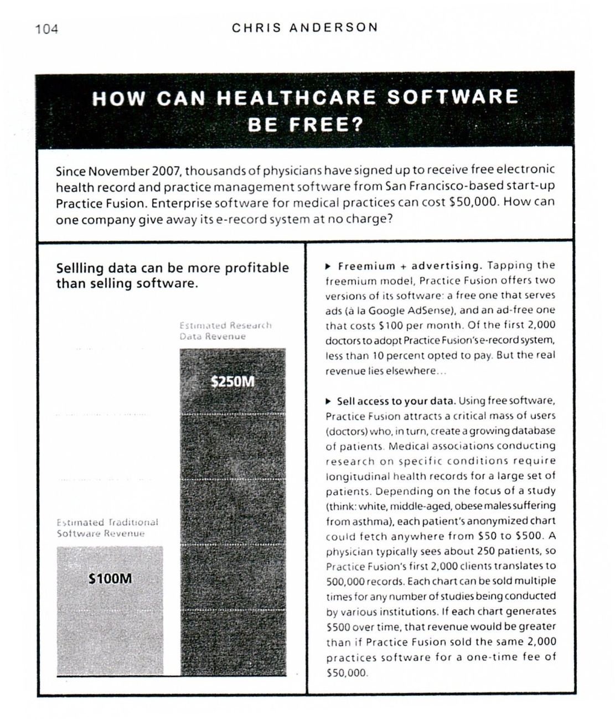

Slide 34

Practice Fusion expands, shows signs of rapid growth
By Diana Manos, Senior Editor 12/31/07
Practice Fusion subsidizes its free EMRs by
selling de-identified data to insurance groups,
clinical researchers and pharmaceutical
companies.
Howard said he does not expect data-sharing
will be a concern to physicians who use Practice
Fusion's EMRs. “Every healthcare vendor is
selling data.”

Slide 35

What is BHI® (Blue Health Intelligence)?
shares critical health information with employers
premier health intelligence resource
BHI sets the new standard for healthcare data aggregation, reporting and analysis
Size and Value of data for sale
1) longitudinal data on 54 million BCBS members [without consent]
2) reporting not only by MSA, industry and product type, but by Diagnosis Related Groups
(DRGs) code, age group and gender [allows re-identification]
How does BHI ensure the privacy and security of members’ healthcare information?
1) adheres to HIPAA regs = no consent for use and sale of data
2) Use a system-generated identifier, allowing longitudinal analysis [allows re-identification]
3) fully de-identified in accordance with HIPAA [17 identifiers removed, still allows re-
identification of .04%]
http://www.bcbs.com/innovations/bhi/bhi-faqs-1-12-09.pdf

Slide 36
Medicare and Medicaid data for sale
“at the patient level”

Slide 37
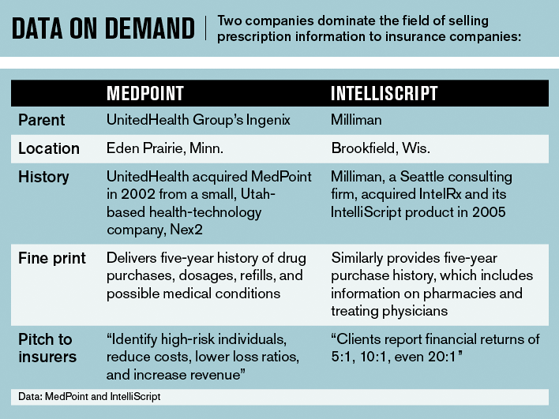
Businessweek July 23, 2008: “They Know What's in Your Medicine Cabinet,
How insurance companies dig up applicants' prescriptions—and use them to deny coverage" http://www.businessweek.com/magazine/content/08_31/b4094000643943.htm?chan=magazine+channel_in+depth

Slide 38


Slide 39
wait….it gets worse
health IT security is ABYSMAL

Slide 40



security breaches

Slide 41
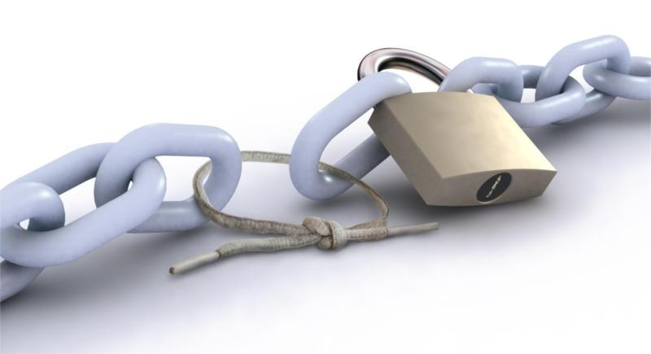
weak security → breaches
easy to hack
weak authentication
weak ‘role-based’ authorization → ‘insider’ snooping and theft
data is not encrypted despite HITECH
P2P software leaks data
web apps (SaaS/SSL) leak data*
ease of copying, stealing, losing mobile devices
de-identification and anonymization don’t work
unsafe clouds
* http://www.informatics.indiana.edu/xw7/WebAppSideChannel-final.pdf

Slide 42

Steady Bleed: State of HealthCare Data Breaches
Posted by George Hulme Study reveals that, for many healthcare providers, patient data breaches continue - month after month - at an alarming rate.
Sep 19, 2010
200-bed hospital 24/mo
20-clinic physician practice 29/mo
UK major teaching hospital 129/mo
Top 50 U.S. Health System 125/mo
http://www.informationweek.com/blog/main/archives/2010/09/steady_bleed_st.html

Slide 43

Fawcett's
cancer file
breached
The incident occurred
months before UCLA
hospital employees were
caught snooping in Britney
Spears' files.
By Charles Ornstein April 3, 2008

Slide 44
Cost of Security Breaches
EXAMPLE: In 2006, Providence Health & Services paid a $95,000 penalty and provided
two years of free credit monitoring to thousands of people after a car prowler broke
into the van of a Providence employee who had left computer disks and data tapes
inside. The records, some going back 20 years, contained Social Security numbers and
medical information for 365,000 people. Providence spent $8-9M defending against a
class action lawsuit.
Average direct, indirect, and opportunity costs to companies that experienced a data breach was $14 million/company.
average cost: $140/customer with breached data
100,000 is the average number of customers affected by security breaches
Laptop Data Breaches: Mitigating Risks Through Encryption and Liability Insurance
By Julie Machal-Fulks and Robert J. Scott,
http://www.scottandscottllp.com/main/uploadedFiles/resources/Articles/ArticleLaptop_Data_Breaches.pdf

Slide 45
Weak security results in massive fraud

Slide 46

Department of Justice Press Release
For Immediate Release United States Attorney's Office
October 13, 2010 Southern District of New York
Manhattan U.S. Attorney Charges 44 Members and Associates
of an Armenian-American Organized Crime Enterprise with
$100 Million Medicare Fraud
Defendants Also Charged with Racketeering, Identity Theft, and
Money Laundering Crimes Armenian "Vor" Charged with
Protecting Alleged Medicare Fraud Scheme

Slide 47
Cybercrime—Why Steal Healthcare Data?
Harder to detect:
  Medical id theft/fraud: 2x longer to detect than id theft
  Victims cannot delete or change their personal information, medical records or Hx of prescription use
It pays:
  The World Privacy Forum reports cost of stolen medical information is $50 v. $1 per #SS
  Avg payout for medical id theft = $20,000 v. $2,000 for id theft
RSA White Paper: Cybercrime and the Healthcare Industry

Slide 48
Cybercrime—How to Use Healthcare Data
Cybercriminals target not only consumer data but data from healthcare
providers, insurers, and pharmaceutical industry.
Types of fraud:
use patient info to file false patient claims with insurers, Medicare, and Medicaid
sell individual patient medical records in the black market
use physician info to submit fake prescriptions at multiple pharmacies and resell the medicine
use physician data to set up fake clinics and bill for treatment using stolen patient info
RSA White Paper: Cybercrime and the Healthcare Industry

Slide 49
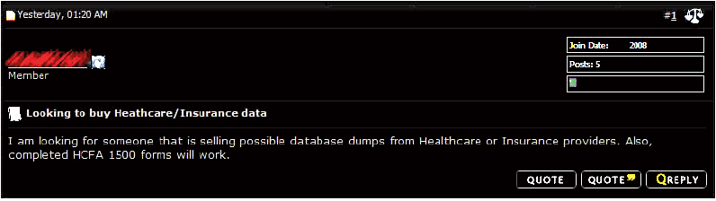
Cybercrime—Example 1
seeks data to file false medical claims:
RSA White Paper: Cybercrime and the Healthcare Industry

Slide 50
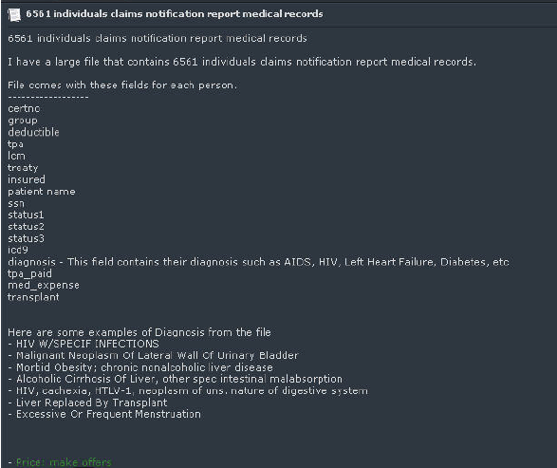
Cybercrime—Example 2
post seeks buyers for > 6,500 medical records
RSA White Paper: Cybercrime and the Healthcare Industry

Slide 51
HITECH: historic new consumer protections, but…

Slide 52
ARRA—new privacy rights and MU
Old rights under HIPAA:
Providers may offer consent (Original HIPAA Privacy Rule), so patients can restrict disclosures---not addressed in MU
Psychotherapy Notes require consent to disclose---not addressed in MU
New rights under ARRA:
Ban on sales of PHI (Protected Health Information)---2010 (waiting for comments on NPR and final rule)
Segmentation---delayed
Audit trails x 3 years---2011 or later
Breach notice---2010 ( added “harm” standard violates HITECH)
Encryption---2010 but industry is not doing this
Patient can prevent disclosures of PHI for ‘payment and healthcare operations’ if pays out-of-pocket---not addressed
Consent Technologies---2014 or later

Slide 53
“Meaningful Use” isn’t meaningful to patients

Slide 54
Latanya Sweeney on flaws in MU EHR criteria and NHIN/HIEs
Secondary use of PHI by Business Associates is “unbounded, widespread, hidden, and difficult to trace.”
Implementing MU EHRs will “increase data sharing, but adding the NHIN will massively increase data sharing.”
The two proposed NHIN models to link all Americans' health information online do not offer “utility or privacy”.
http://patientprivacyrights.org/wp-content/uploads/2010/04/Sweeney-CongressTestimony-4-22-10.pdf

Slide 55
Sweeney on designing privacy in HIT
Observation: "Scott McNealy, the CEO of Sun Microsystems,
famously quipped, "Privacy is dead. Get over it."
Sweeney's response: "Oh privacy is definitely not dead. When
people say you have to choose, it means they haven't actually
thought the problem through or they aren't willing to accept
the answer.
… he very much shares that attitude of the computer scientist
who built the technology that's invasive; who says, "Well, you
want the benefits of my technology, you'll get over privacy".
It's exactly the kind of computer scientist we don't want to be
graduating in the future.”
http://patientprivacyrights.org/2007/06/privacy-isnt-dead-or-at-least-it-shouldnt-
be-a-qa-with-latanya sweeney

Slide 56
MU EHR flaws
data mining for many uses without informed consent
“unbounded uses” by CEs and BAs—no trust without verification
NHIN/RHIO/HIE/HIO flaws
allow broad “stakeholder” (insurers, employers) access to data
patients don’t want “stakeholder” access, they want control
impossible to share data selectively (segment sensitive records)
illegal, blanket consents = impossible to share data 1-to-1
labs and Rx data industry will dump 1,000s of “batched” test
reports and prescriptions into HIOs—patients’ privacy will be violated
even if they opt-out
without segmentation, HIE/NHIN can’t exchange data across state lines
with states---all states require consent for sensitive data (segmentation)
without segmentation can’t put teens’ data, genetic data, STDs, mental
health, addiction data into HIT systems

Slide 57
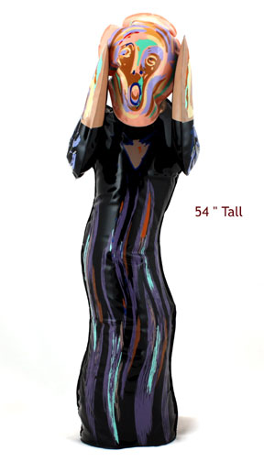

Slide 58
Health IT and HIE: 2 separate worlds
Corporations, Govt, & some Doctors
Industry-centered system
LOTS of Data = commodity = $$$$
massive data flows and 2^{ndary} use of sensitive personal data
Data theft, no consent
Robust HIT systems
  One hospital = 200+ HIT systems
Robust HIE
Vendors and users sell data
Data flows outside US
Massive security flaws
“Wild West”-- data mining for profit and discrimination
Unfair and deceptive trade practices
Patients, Family, & some Doctors:
Not “patient-centered”
Hardly any data
Limited control over PHI
Limited access to PHI
Limited benefits from HIT
Limited HIE
Massive harms/risks from HIT/HIE
Limited recourse from harms
Can’t restore data privacy = no way
to “make whole” or repair exposure
Generations of discrimination
Secret health data bases
No transparency/accountability
No privacy and weak security
Patient Safety—EHRs can harm, be source of errors, can’t delete/amend

Slide 59
Will we finally get meaningful and comprehensive privacy and security?

Slide 60
Consumer Choices
Technology Hearing
7 privacy-enhancing technologies
‘live’ demonstrations
Washington DC, June 29, 2010
video: http://nmr.rampard.com/hit/20100629/default.html
transcript and written testimony:
http://healthit.hhs.gov/portal/server.pt?open=512&mode=2&objID=2833&PageID=19477#062910

Slide 61
federal privacy precedents
TITLE 38 - PART V , CHAPTER 73 -
SUBCHAPTER III - PROTECTION OF
PATIENTRIGHTS
§ 7332. (a) (1) Confidentiality of certain medical
records drug abuse, alcoholism or alcohol abuse, HIV,
sickle cell anemia
42 CFR Part 2

Slide 62
July 8, 2010 New Privacy Policy:
Sec. Sebelius: "Administration-wide commitment to make sure no one has access to your personal information unless you want them to”.
Dr. Blumenthal: "we want to make sure it is possible for patients to have maximal control over PHI."
See: http://patientprivacyrights.org/2010/07/ppr-impressed-with-hhs-privacy-approach/

Slide 63
Patient-centered HIT systems
universal online consent tools--benefits
  dynamic, not static
  fine-grained decisions, like online banking "Bill Pay"
    automatic rules (like monthly payments), or case-by-case
  ability to share selectively (in accord with laws, rights,
  expectations)
  no need to update consents in many locations
  no need for MPI or single patient ID
  independent audit trails of all uses and disclosures
  via use of authentication and authorization systems
  (employees have unique access codes and can see selected data)

Slide 64
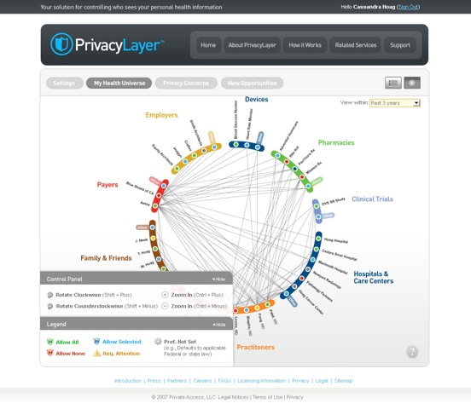
(c) 2007-2010, Private Access, Inc. All rights reserved. (Reprinted with permission).

Slide 65
Patient-centered HIT system
2. health banks--benefits
  ironclad security and architecture
  today there is no place w/ a complete and accurate
  copy of our health records
  patients control access and use of PHI
  only patients can collect complete and accurate PHI
  ‘safer’ research, less risk of exposing data
    like census bureau: run research queries on individual data
    unlike census bureau, no research without consent
    sensitive data is NOT released
  no need for MPI or UPIN (single ID)---patients have
  separate ID at each location = better privacy protections
  (stolen data has less value)

Slide 66
Patient-centered HIT systems
3. other systems--benefits
decentralized consents with centralized control. In this
situation, patients can make local data sharing decisions
at the time and place of service, but have a universal
portal to update or change consents as needed
an NHIN that works likes a filing cabinet. In this
situation, all patient information goes to a common
location, and the patient can make decisions about
sharing at that storage location

Slide 67
Deborah C. Peel, MD
Founder and Chair
(O) 512-732-0033 dpeelmd@patientprivacyrights.org www.patientprivacyrights.org

Slide 68
Key References:
EHRs “Your Medical Records Aren't Secure” by Deborah C. Peel in the WSJ, March 23, 2010 http://online.wsj.com/article/SB10001424052748703580904575132111888664060.html
PHRs “Who can snoop in your PHR? A Personal Health Record Report Card http://patientprivacyrights.org/personal-health-records/
HIEs and NHIN “Designing a Trustworthy Nationwide Health Information
Network (NHIN) Promises Americans Privacy and Utility, Rather than Falsely Choosing Between Privacy or Utility” by Latanya Sweeney, PhD, April 22, 2010, Congressional Briefing on the “Implementation of Health Information Technologies in a Healthcare Environment” http://patientprivacyrights.org/wpcontent/uploads/2101/04/SweeneyCongressTestimony-4-22-10.pdf
See Sweeney’s NHIN slides at: http://patientprivacyrights.org/wp-content/uploads/2010/06/Sweeney TrustworthyNHINDesigns.pdf
Research “Improve Privacy in Research by Eliminating Informed Consent?” IOM Report Misses the Mark. In The Journal of Law, Medicine & Ethics, Volume 37, Issue 3 (p 507-512) by Mark A. Rothstein.

Slide 69
Anonymous data isn’t
“… a common practice is for organizations to
release and receive person specific data with all
explicit identifiers, such as name, address and
telephone number, removed ….because the
resulting data look anonymous.
However,… the remaining data can be used to
re-identify individuals by linking or matching
the data to other data ..”*
Latanya Sweeney, PhD, Director, Laboratory for International Data
Privacy, School of Computer Science, Carnegie Mellon University
*k-anonymity: a model for protecting privacy. International Journal on Uncertainty,
Fuzziness and Knowledge-based Systems, 10 (5), 2002; 557-570.

Slide 70
Anonymous data isn’t
“We must respond to the surprising failure of
anonymization”
Anonymization , [is] the name for techniques for
protecting the privacy of individuals in large databases
by deleting information like names and social security
numbers
“[S]cientists have demonstrated they can often
“reidentify” or“deanonymize” individuals hidden in
anonymized data with astonishing ease”*
Paul Ohm, Associate Professor, University of Colorado Law School
* Broken promises of Privacy: Responding to the Surprising Failure of Anonymization,
VER. 0.99 SSRN: 8/14/2009:
http://papers.ssrn.com/sol3/papers.cfm?abstract_id=1450006&rec=1&srcabs=1446862

Slide 71
