Slide 1
Yet Another Heavy Hitter Detection Problem _{[on going work]}
Salvator Galea, Gianni Antichi, Andrew W. Moore
Department of Computer Science and Technology

Slide 2
Network Management
Monitors Network Traffic
Applies Management Techniques
Measures Network Traffic
Notes:
So what is traffic management , and why is it useful for?
Network management consists of monitoring, measuring network traffic and applying different management techniques to maintain and maximize the performance, reliability and security of a network.
Overall network management of a network allows network operators to address different kinds of bottlenecks in the network(Performace), to ensure that the network is protected from anauthorized users(Security) and to make sure the network is available to users at any time(Reliability)
--
Security: Ensuring that the network is protected from unauthorized users.
Performance: Eliminating bottlenecks in the network.
Reliability: Making sure the network is available to users and responding to hardware and software malfunctions.

Slide 3
Measurements as support for Management
Form the basis of all traffic management functions
Complex set of data traffic need to be analysed.
The analysis of the results will trigger the network tasks that need to be applied.
  Better traffic engineering techniques
  Better Quality of Service
  Better security
How do we analyse this complex set o data?
Do we need to classify the traffic?
Notes:
Traffic measurement is the process of measuring the amount and type of traffic in a particular network and
it forms the basis of all traffic management functions
If we have good measurement techniques then we have better understanding of the underlying network so better management.
By better management, I mean the traffic management functions that need to be applied to the network in order
to avoid losses,
improve application performance,
improve quality of service and
increase network security.
BUT Measuring is not about only averages, we need to consider how to analyse the set of data and how to classify it.
1.Better traffic engineering techniques
•avoid data losses
•improve app performance
2.Better Quality of Service techniques
•better control over jitter
•allow multimedia apps
3.Better energy saving techniques
•reduce datacenter’s energy footprint
•reduce operating expeditures

Slide 4
Flows are important
Providing an aggregate view of such data is important for summarization, visualization, and analysis.
Flows represent a number of packets or frames passing a network point during a certain time interval. The packets, which belong to a flow, have a set of common properties.
Traffic classification types (bursty, latency-sensitive, traffic-pattern change)
Apply management tasks (QoS, capacity planning, efficient traffic engineering)
Ex. Flows with high volume of traffic (a.k.a Heavy Flows) are interesting!
Management task : traffic engineering, accounting
Notes:
Network traffic can be described in terms of flows. Providing an aggregate view of such data is important for summarization, visualization, and analysis.
A Flow is defined as a set of packets or frames passing an Observation Point in the network during a certain time interval. All packets belonging to a particular Flow have a set of common properties.
and why this is usefull?
Because
Flows can define various types of traffic such as Bursty Traffic, Latency sensitive Traffic, Non-real Time traffic, change in traffic patterns.
This classification will help network administrators to facilitate the optimization of the network, providing QoS, capacity planning and efficient traffic engineering.
For example, detecting a source that sends a significant amount of traffic can be beneficial for accounting purposes and traffic engineering
On the other hand, detecting a destination that is contacted by many distinct sources can be useful to detect Distributed denial of service attacks in the network
(A heavy-hitter might be a source that sends a lot of packets, and thus exceeds a certain threshold of the total traffic. A superspreader, on the other hand, is a source that contacts many distinct destinations. )
----
Performance Management—Monitor and measure various aspects of performance so that overall performance can be maintained at an acceptable level.
Security Management—Provide access to network devices and corporate resources to authorized individuals.
Accounting---Usage information of network resources for better and balanced utilization
The first step is to define the metrics that have mostly been used to measure network traffic is by counting packets, bytes and packets that have common properties.
A superspreader is defined to be a host that contacts at least a given number of distinct destinations within a short time period. Superspreaders could be responsible for fast worm propagation.

Slide 5
Ideal Measuring Tool vs Reality
Unlimited resources (to store all the counters) + Fast traffic statistics processing
BUT
Resources in the observation point usually have a fixed size that is either constrained by hardware.
Solutions with acceptable(?) less accuracy:
packet sampling
streaming algorithms
“If we’re keeping per-flow state, we have a scaling problem, and we’ll be tracking millions of ants to track a few elephants.” — Van Jacobson, End-to-end Research meeting, June 2000.
Notes:
But what would be the ideal Measuring tool ?
An ideal measuring tool would offer an unlimited number of resources to store all the information that passes an observation point without deleting any historical data
And
Process/retrieve that amount of information efficiently and fast
The reality is a bit different because the Resources in the observation point usually have a fixed size that is either constrained by hardware.
For that reason, most of the current solutions rely on collecting or maintaining partial information of the observed traffic.
For example packet sampling offers the ability to collect 1 out of N samples over a period of time
Where other solutions, apply streaming algorithms to produce approximate statistics based on a summary or "sketch" of the data streams.

Slide 6
Streaming Algorithms
Stream
Sliding window model
Streaming traffic divided into multiple fixed time windows.
Why in windows?
Easy to implement. Feasible observation and collection of statistics.
Prevent counters overflow by flushing
So far so good ehm, so what’s the pitfall?
At the end of each time-interval, collect flow statistics and flush the counters
This create a coupling between detection and the window size itself
window
window
window
Notes:
Streaming algorithms have several applications in networking such as monitoring network links for counting the number of distinct flows, estimating the distribution of flow sizes, and so on
The most common model of streaming algorithm for network measuring is the sliding window model.
In theory, the measureming period of time can span for an infinite time.
In practice, we cannot observe and collect statistics for that amount of time.
Therefore, to overcome this problem we need to divide the streaming traffic into multiple fixed time windows.
In this model, the function of interest is computing over a fixed-size window in the stream.
As the stream progresses, items from past windows are removed from consideration while new items from the stream take their place.
This create a dependancy between statistics and the window size itself
--
In each time window, data arrives sequentially and is processed by the algorithm whose workspace is insufficient to store all the data, so the algorithm must process and then discard each data item

Slide 7
Window Size
Stream
Is the window size a problem?
What’s the ”right” window size?
Datacenters
ISP Backbones
Generic question: Do small variations of the window size affects the traffic statistics?
Window size = 10sec
10±1sec
10±1msec
10 ±1usec
Window size=?
Window size=?
Window size=?
Same results?
Notes:
Does a particular window size apply to any kind of traffic, can detect the same results
In datacenter network the traffic is bursty, that means a “big” window size wont detect the burstyness
In ISP backbone the traffic is more smooth but there is extremely large flow diversity

Slide 8
Experimental setup
Offline Analysis Tool*
Prefixes : Source IP
Baseline : 10sec window
Threshold : 5% of the total traffic in the window
Comparison metric : Jaccard similarity coefficient
(used for comparing the similarity and diversity of sample sets.)
Traces : CAIDA2016 DirA(~40M Packets and ~180K Flows for 20min traces)
Detection : Heavy Hitters, Hierarchical Heavy Hitter, Leaf Heavy Hitters, Top-k flows
Lets experiment and see…
*Acknowledgment : Jan Kucera (analyzer tool)
Notes:
The experiment is to contact an offline analysis on traces from Caida2016
[Considering that the structure of IP addresses implies a prefix based hierarchy ]
The analysis tool considers Source IP addresses to form a hierarchical(prefixes) domain with 32bit size granularity. (prefix trie)
Each node in the domain is associate with the volume of traffic that the particular prefix has produced.
Heavy hitter (HH) are flows which consist of any Source IP Prefixes in the domain model which has produced an amount of traffic during the time interval that is higher than the threshold
Hierarchical Heavy Hitters (HHH) is a special case of HH and account aggregates of flows that share certain IP prefixes.
It’s a prefix which exceeds a threshold after excluding the traffic contribution of all its HHH descendants.
Leaf Heavy htter: Fully specified IP addresses
Heavy Flows can be defined also as the fisrt Top k flows sorted by size in a particular time window
In the DDoS example, HHH can identify IP prefixes that are suddenly responsible for a large portion of traffic and such an anomaly may very well be a manifesting attack

Slide 9
Offline experiments
Details
 | Detection | Trace | Windows Comparison (sec)
Test 1 | HH,HHH | 20 minutes | [10] to [9,7]
Test 2 | HH,HHH | 10 minutes | [10] to [9.9, 9.8, 9.7]
Test 3 | HH,HHH | 20 minutes | [10] to [9.99, 9.96, 9.93, 9.90]
Test 4 | HH, HHH | 20 minutes | [10] to [10]+offset[ 1, 2, 3]
Test 5 | LeafHH, Top-k Flows | 60 minutes | [10] to [10]+skip_start[1, 2, 3, 4]
Notes:
This table summarises the tests
In four of them, the tool detects the heavy flows and hierarchical heavy flows that exceeds 5% of the total number of bytes in the particular time window.
The last experiments gives the full Source IPs which has contribute more than 1% of the total number of bytes in the time window.
The last experiment also reports, indepedantly of threshold, the heavy hitters can be defined also as the top k flows by size.
The plots depicts the cdf HH,HHH,LeafHH, Top-k Flows over the coefficient simlairy of the compared windows
Test_1 HH and HHH (total 20min)
10sec time window vs 9,8,7, 1sec difference
Test_2 HH and HHH (total 10min)
10sec time window vs [9.0-9.9]sec, 100msec difference
Test_3 HH and HHH (total 10min)
10sec time window vs [9.99-9.90]sec, 10000usec difference
Test_4 HH and HHH (total 20min)
10sec time window with different starting points +[1,2,3,4]sec
Test_5 LeafHH and Top50Flows (total 1h)

Slide 10
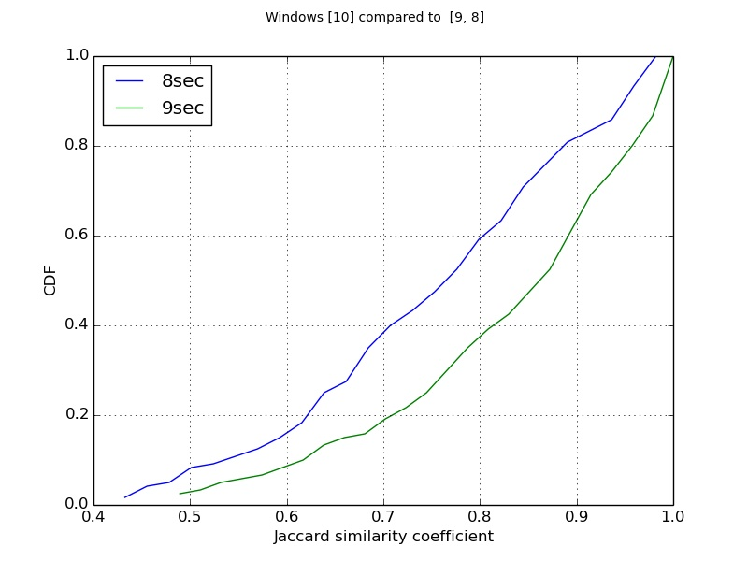
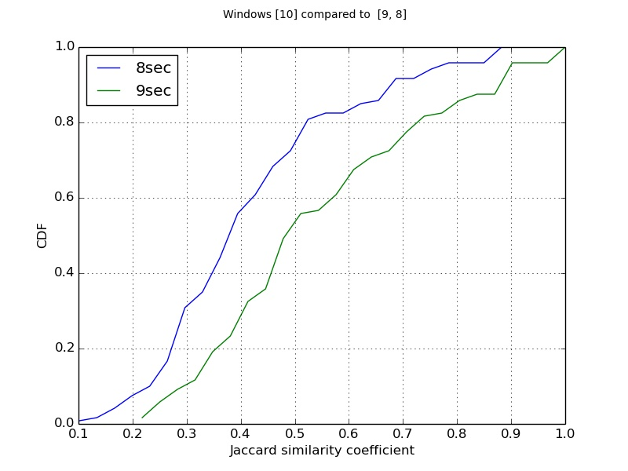
Experiment 1 (HH + HHH), sec
Time
10
10
10
9
9
9
8
8
8
Notes:
Lets consider the case where the windows under test are different by 1 and 2 seconds compared to 10seconds time window.
As we can see the differences are not so strong for the HH plot
as 80perctile of the HH have 9 and 9.5 coefficient for both cases
on the other hand the 80percetile of HHH for 8 and 9 time windwo is 0.5 and 0.7 respectively
But someone would argue that 1 or 2 seconds difference is a lot of time so its expected for the sets to diverge.
Ok , let see what happens when the difference is in mili seconds
---------
20min trace Splitted into 2min=12segments of 10sec each
Misalignment:
10-9 : after 10/1=10windows=90sec=1min30sec
10-8 : after 10/2=5window=40sec
10-7 : after 10/3=3.3windows=21sec
10-6 : after 10/4=2.25windows=13.5sec

Slide 11
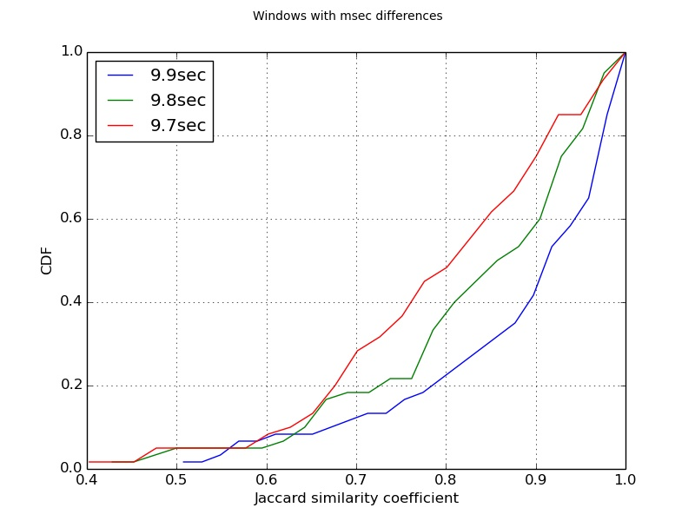
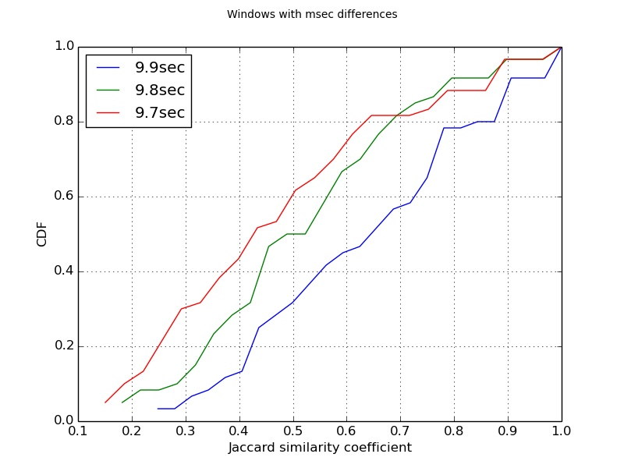
Experiment 2 (HH + HHH), msec
Time
10
10
10
9.9
9.9
9.9
9.8
9.8
9.8
9.7
9.7
9.7
Notes:
Here we compare again the HH and HHH of 10 seconds window with 9.9 9.8 and 9.7 time windows.
The plots seems to have quite similar trends with the previous one.
The 80 percentile for the HH have a similarity coefficient between 0.90 and 0.97
and for the HHH the coefficient spans from 0.6 to 0.85 for all three cases
and again I am sure that there should be someone who would argue that even 100 miliseconds is a lot of time and the sets we compare, will have differences
Ok lets see what happens with micro seconds difference....
-------------
10min trace, 60segments of 10sec each
Misalignment :
10-9.9 : 10sec/0.1=100windows 990sec=16min
10-9.8 : 10/0.2=50win 490sec=8.16min
10-9.7 : 10/0.3=33win 323sec=5.38min
10-9.6 : 10/0.4=25win 240sec=4min
10-9.5 : 10/0.5=20win 190sec=3.16min

Slide 12
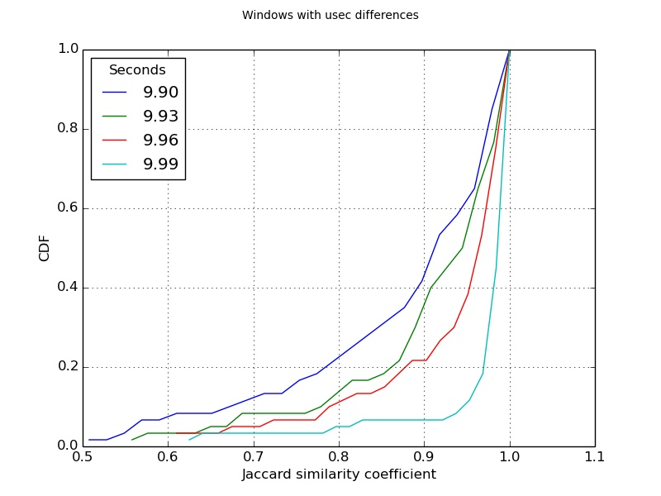
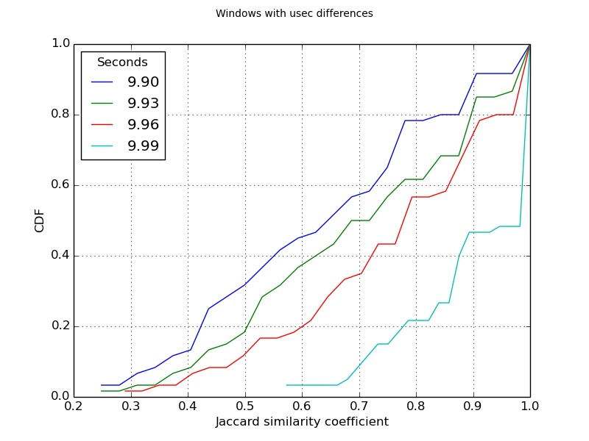
Experiment 3 (HH + HHH), usec
Time
10
10
10
9.99
9.99
9.99
9.98
9.98
9.98
9.97
9.97
9.97
Notes:
Even in micro seconds difference in the window size the results are different
50percentile of HH accounts for 0.90 to 0.98 similirarity coefficient
and for at most 50% of HHH the coefficient varies from 0.65 to 0. 9
10min trace, 60segments of 10sec windows
Misalignment :
10-9.99 : 10/0.01=1000win
10-9.98 : 10/0.02=500win
10-9.97 : 10/0.03=330win
10-9.96 : 10/0.04=250win
10-9.95 : 10/0.05=200win
10-9.94 : 10/0.06=166win
10-9.93 : 10/0.07=142win
10-9.92 : 10/0.08=125win
10-9.91 : 10/0.09=111win
10-9.90 : 10/0.10=100win

Slide 13
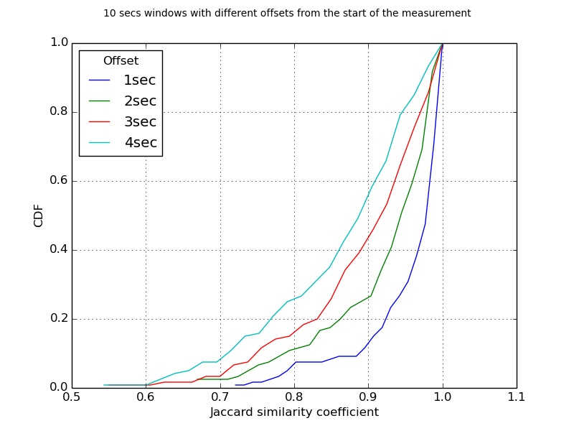
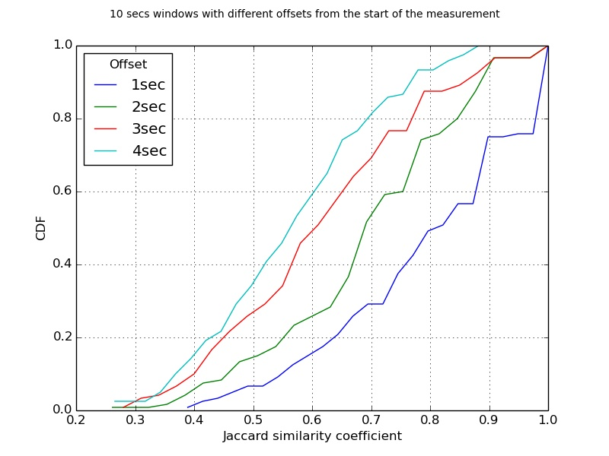
Experiment 4 (HH + HHH), +offset
Time
10
10
10
1
10
10
10
2
10
10
10
3
10
10
10
Notes:
This experiment is quite different from the previous as it
compares windows with the same size but starting at different time offset.
for example the baseline of 10sec time window is compared with another 10seconds time which starts after 1,2,3 seconds
the 60percentile of HH and HHH have a similiratiry coeficient of 0.90 to 0.98 and 0.6 to 0.88 respectively for all four cases

Slide 14
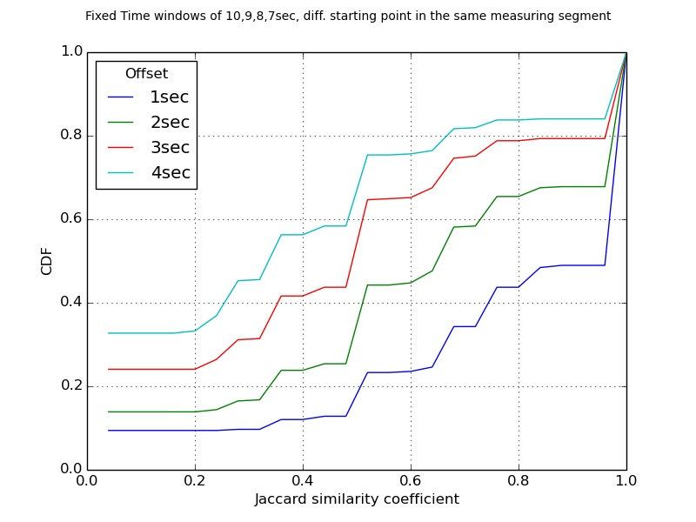
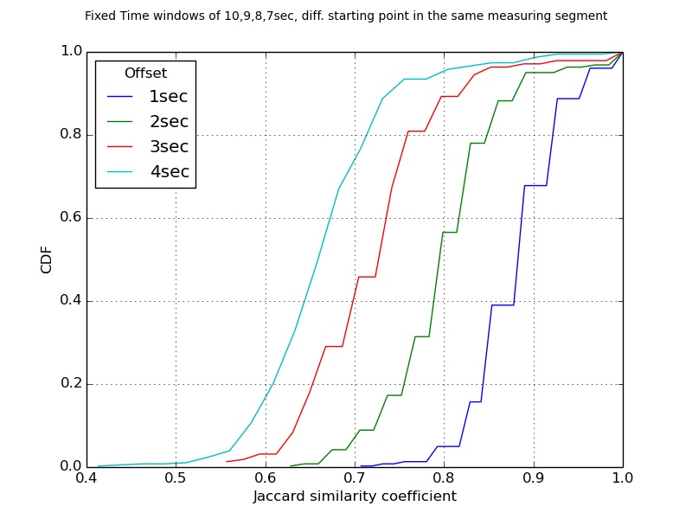
Experiment 5 (LeafHH + Top50 Flows)
Time
10
10
10
9
9
9
8
8
8
7
7
7
Notes:
In the last experiment, we compared the 10sec time window with windows of 6,7,8,9seconds window.
The difference in this experiments is that we aligned all the windows to have the same ending point.
the trace lasted for 1 hour
the 80percetile of HHH for each time window has a cofficient that varies from 0.7 to 0.92

Slide 15
So what? Food for thought
Why is this happening?
What’s the impact that this can have?
Even the small differences in the window size give different perception of Heavy Flows
Different time windows or different starting points of the same time window can produce different statistics.
Notes:
This is the results of window based model parsing large data streams, which trades something off to get real-time insights.
The real time insights are extremely dependant on the window size

Slide 16
Bloom Filters + Future Work
Counting Bloom Filter
Probabilistic data structure which maintains the frequency count for each item in a data stream
Window-based with Time-Decaying Counters
The value of each counter decays with time, by applying exponential time-decaying function
The significance of data items decreases over time
Continuous-Time Decaying Counters
On-demand Time-decaying Bloom filter, which relies on a continuous-time operation to overcome the accuracy/performance limitations of the original window-based approach
Any suggestions?
Any question?
Reference Kai Cheng, Limin Xiang and M. Iwaihara, "Time-decaying Bloom Filters for data streams with skewed distributions," 15th International Workshop on Research Issues in Data Engineering: Stream Data Mining and Applications (RIDE-SDMA'05), 2005
Reference: Giuseppe Bianchi, Nico d'Heureuse, and Saverio Niccolini. 2011. On-demand time-decaying bloom filters for telemarketer detection. SIGCOMM Comput. Commun. Rev. 41, 5 (October 2011)
Notes:
Bloom filter is a space-efficient probabilistic data structure and answers a simple question: is this element a member of a set? BF doesn’t store the actual element but its membership.
My intention is to focus on these two proposed streaming algorithms and analyze their accuracy network measurements.
------
False positive -> yes
False negatives -> no

Slide 17
BACKUP

Slide 18
Heavy flows are important!
Primitives
Packet Level
Flow Level
Classification
Flows
Super-spreader
Management Tasks
Traffic Engineering
DoS Detection
Accounting
Notes:
The first step is to define the metrics that have mostly been used to measure network traffic is by counting packets, bytes and packets that have common properties.
A Flow is defined as a set of packets or frames passing an Observation Point in the network during a certain time interval. All packets belonging to a particular Flow have a set of common properties.
A superspreader is defined to be a host that contacts at least a given number of distinct destinations within a short time period. Superspreaders could be responsible for fast worm propagation.
Identifying the type of traffic will help network administrators to facilitate the optimization of the network. The classification defines various types of traffic are:
Bursty Traffic, Latency sensitive Traffic, Non-real Time traffic, change in traffic patterns
Performance Management—Monitor and measure various aspects of performance so that overall performance can be maintained at an acceptable level.
Security Management—Provide access to network devices and corporate resources to authorized individuals.
Accounting---Usage information of network resources for better and balanced utilization
A heavy-hitter might be a source that sends a lot of packets, and thus exceeds a certain threshold of the total traffic. A superspreader, on the other hand, is a source that contacts many distinct destinations.

Slide 19
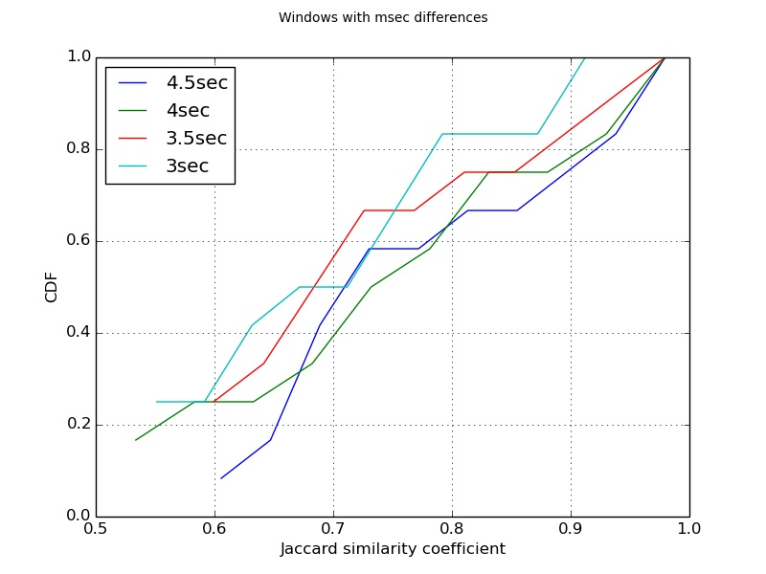
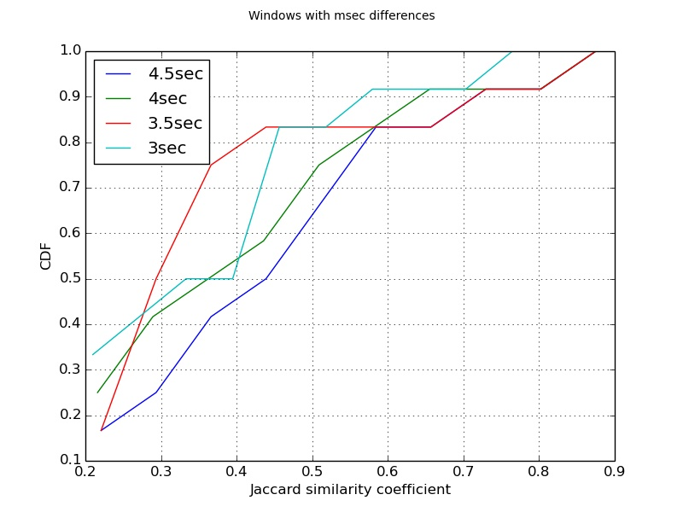
Experiment Ib (HH + HHH) ****ERASE****
Notes:
Splitted into 1min=12winows of 5sec
Misalignment:
5-4.5 : after 5/0.5=10windows=45sec=1min30sec
5-4 : after 5/1=5window=20sec
5-3.5 : after 5/1.5=3.3windows=11.6sec
5-3 : after 5/2=2.25windows=6.75sec

