Slide 1

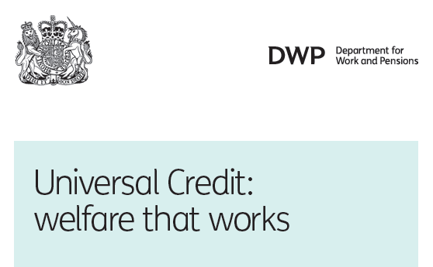
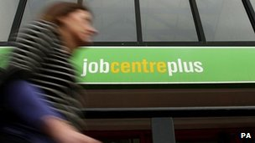

Review of Universal Credit
Veronica Marshall
18 February 2016

Slide 2
Structure of today’s talk
Background and context
The Universal Credit Programme
What went wrong?
UC: Where are we now?
Questions?
Data and figures are taken from the NAO report “Universal Credit: Early Progress”, Sep 2013 and NAO report “Universal Credit: Update” Oct 2014 unless otherwise stated.

Slide 3
Background and Context

Slide 4
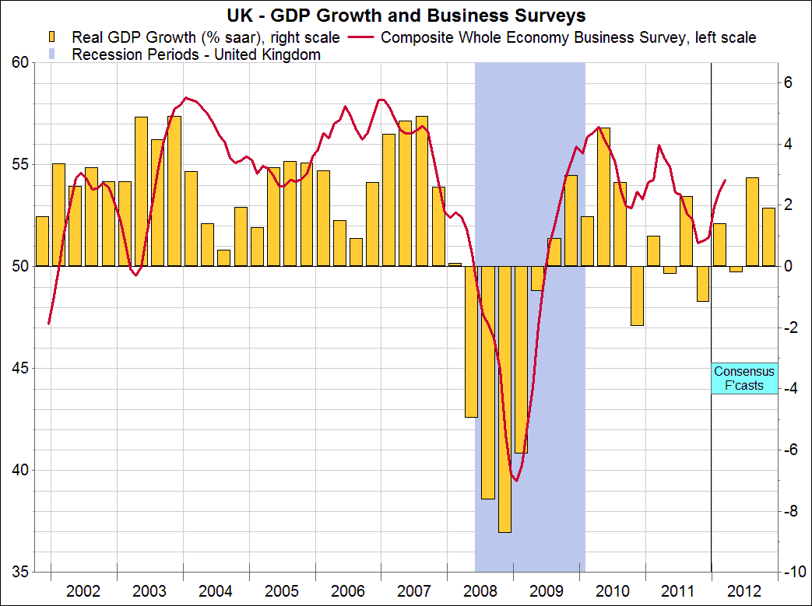
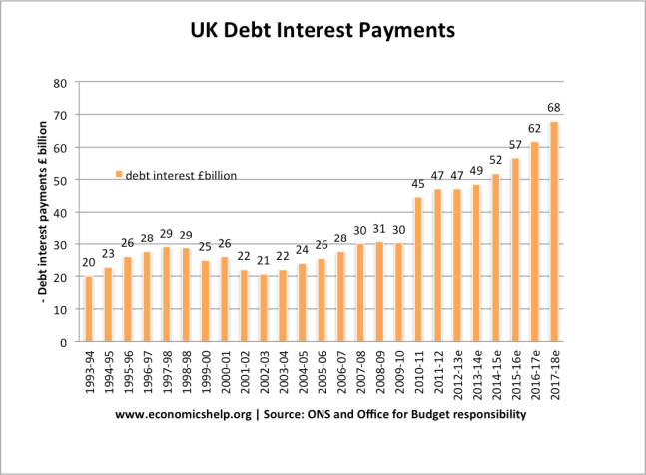
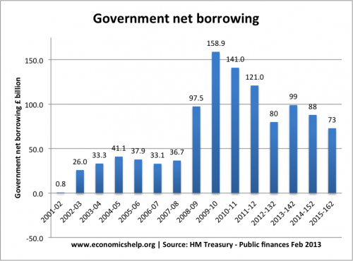
Economic context
When the coalition came to power in May 2010, the UK was suffering the worst economic recession for 60 years.
5%
£692bn
  Decrease in Gross Domestic Product between early 2008 and early 2010
  Total spend by government in 2010/11
50%
£141bn
  In 2009/10 Government spending was nearly 50% of GDP.
  2010/11 net borrowing, 7.6% of GDP.

Slide 5
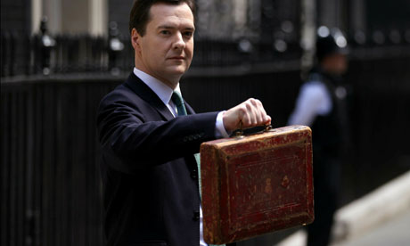
The drive to reduce public spending
In June 2010, George Osborne announced the deepest cuts ever seen in the public sector by ordering nearly all government departments to slash an average of 25% from their annual budgets before the next general election.
£2bn
Cancelled capital projects
£61bn
From departmental budgets
£3bn
On debt interest
£11bn
From the welfare budget
Data source: Cabinet Office Statistics 2013

Slide 6
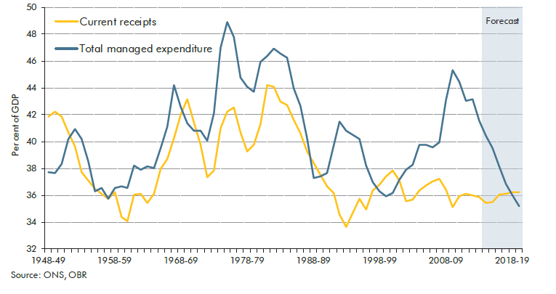
2014 UK Economy: Continued Pressure on Public Finance
2014: Budget deficit reduced by £6.3 billion to £91.3 billion, half the expected reduction.
2014: Wage and productivity growth disappointing leading to decreased tax revenues.
2014: Government spending pushed borrowing in Sep 2014 to £11.8bn, £1.6bn higher than September 2013.
2015-16: Net debt is forecast to rise by 0.8 per cent of GDP

Slide 7
The Universal Credit Programme

Slide 8
Department of Work and Pensions
Disability living
allowance
£12.57bn
Housing benefit £16.94bn
Spending Analysis 2011/12
Pension credit
£8.11bn
State pensions
£74.22bn
£167 billion
£5.45bn
Department for Work & Pensions (DWP) was the biggest spending department in the UK.
Rent rebates
State benefits
spending
£159bn
Attendance allowance
£5.34
bn
Total departmental spending
£166.98bn
2011/12
£4.94
bn
Incapacity benefit
23%
£4.91
bn
£1.73 bn
Of all public spending is spent on benefits
Job seeker’s allowance
£4.83
bn
£1.73 bn
£3.58bn
£2.55bn
£2.37 bn
Financial assistance scheme
Employment & support allowance
Carers allowance
Council
tax benefit
Statutory sick and maternity pay
Social Fund
Data source: Guardian analysis of public sector spending, 2011-12

Slide 9
What is Universal Credit?
Universal Credit is a new benefit that will replace 6 existing benefits with a single monthly payment.
The design of UC assumes the new service will be digital by default with 80% of claimants making claims and administering changes of circumstance on line.
Job
Seekers Allowance
Housing Benefit
Employment Support
Allowance
Business Case
December 2012
Benefits to be achieved:
Universal Credit
Child Tax Credit
Income Support
£38 billion
£7 billion
8.2 million
Working Tax Credit
DWP estimate of net benefit from 2010/11 – 2022/23
DWP estimate of annual net benefit from 2022/23
DWP estimate of UC claimants by 2017

Slide 10
Universal Credit aims
Claimant journey
New
claims
Claimant
culture
Claimant
obligations
Work
support
Incentives
Changes in
earnings
Other changes
Aims
Simplify benefits and reduce
confusion
Reduce the need to make new
claims when circumstances change
Encourage responsibility for
managing household budgets
Reduce welfare dependency
Increase job search skills and
preparation for work
Tie support more clearly to
conditions and incentives
Improve and make clearer the
incentives to work
Remove burden of closing and
reopening claims when moving
into work or reporting changes in
earned income
Simplify and improve reporting of
changes in circumstances
Changes
Consolidates six working-age benefits
into one
Aims for 80 per cent of claims
made online
Makes a single monthly payment
directly to claimant (rather than,
for example, the landlord)
Increases job search through
‘claimant commitment’
Extends work search conditions to
claimants in work
Clarifies how sanction regime relates
to conditions
Links to record of search on new
Universal Jobmatch system
Limits benefits withdrawal rate to
65 per cent of increase in income
Increases some disregards
Clarifies ‘better off’ calculations
Updates earnings automatically using
real time information (RTI)
Claimants update self-employed
income themselves online
Claimants report changes in
circumstances online
Claimants report childcare costs online

Slide 11
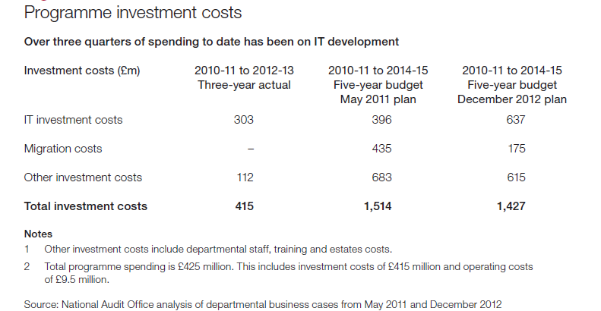
Programme costs

Slide 12
A complex landscape of stakeholders
CESG
GDS
Local authorities
Housing associations
DWP
MPA
Citizen’s advice Bureau
UC
HMT
Private
Landlords
Claimants
HMRC
BT
Social services
IBM
Charities
HP
Detica
Job Advisors
Banks
Francis Maude
Accenture
Credit agencies
Howard Shiplee
Ian Duncan Smith
Robert Devereux

Slide 13
Core components of Universal Credit
Policy clarity
Requirements clarity
Leadership
Vision
Commitment
Culture
Claimant journey
Access to systems (digital by default)
Premises alterations
Identity assurance
Secure
processes
Universal Credit
Communications
Stakeholder engagement
Ensuring stakeholder support
Clear delivery plans
Risk management
Programme
assurance
management
& control
Procurement
Financial management
IT infrastructure
Systems integration
Legacy systems
Migration plans
Staff training
Management information

Slide 14
Universal Credit IT systems components
Claimant interface
Customer account management
Internet
Interface
Interview
system
Security systems
Security operations centre
Identity assurance
Cyber
security
Evidence
system
Rules engine
Fraud and error
RTI
Claims administration
systems
Work
services module
Business process management
Evidence system
Document processing & case load management
Management Information systems
Financial and payments systems
Claimant identification systems
Real time earnings
Payments calculation
Real time information system
Bank wizard
Address verification
Customer information system
Claim system
Payment management system
Provider referral system

Slide 15
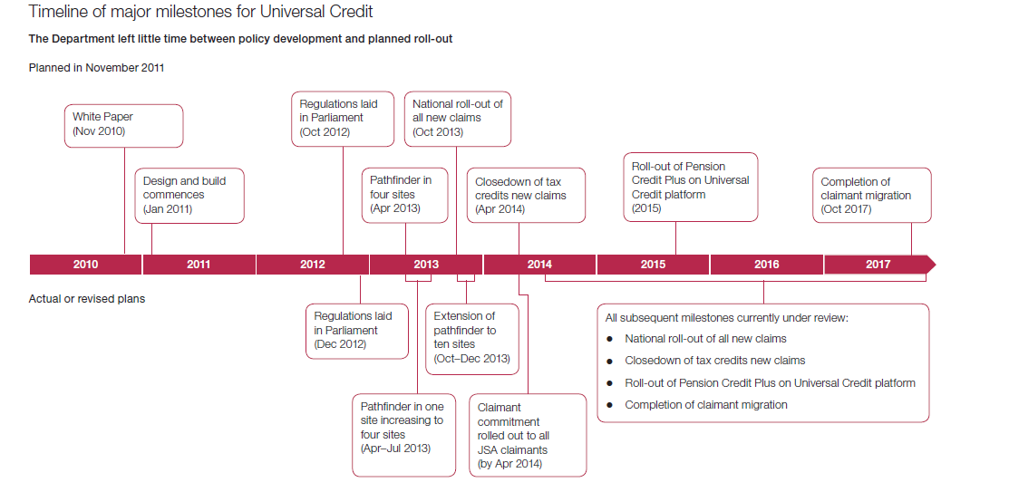
An ambitious rollout timetable

Slide 16
Which methodology to use?
Waterfall
Agile
With a waterfall methodology, development begins after business requirements have been defined and a specification of requirements produced.
Governance and accountability flow from the specification of requirements and can be clearly defined contractually. DWP is familiar with this method of acquiring systems and managing projects.
However, in the case of UC, there is insufficient time to use a waterfall development methodology if the project deadline is to be met.
In addition, concerns raised that a waterfall methodology may not guarantee a new service that meets user requirements or may wrongly specify those requirements as the UC concept is so new and complex.
There is no guarantee of successful implementation at the end of the development process.
With an agile development methodology, requirements and code emerge through developers and users working together to define user stories that are then used to define processes .
A specification of requirements is not produced before starting programming thus saving time and effort.
Extensive use is made of prototyping.
The system is developed in small, iterative steps lasting up to two weeks. It is envisaged that this method will be able to deliver the core of UC before the go-live date as no time is wasted on writing a detailed systems specification.
A high level of rework is envisaged as business requirements are not clearly defined at the outset of the UC development.
Concerns are raised that Agile may not be able to address complex legacy systems integration.
Contracts for agile development are in their infancy. The DWP commercial team struggled to implement commercial terms for agile development that gave them control over the suppliers.
There is no guarantee of successful implementation at the end of the development process.

Slide 17
Programme Reality

Slide 18
Planned versus Actual Delivery, Sep 2013
 | 2011 plan | 2012 plan | 2013 actual
Job seekers allowance | inc | inc | Inc
Employment support allowance | Inc | Excl | Excl
Income support | Inc | Excl | Excl
Housing benefit | Inc | Excl | Excl
Working tax credits | Inc | Excl | Excl
Child tax credit | Inc | Excl | Excl
Difficult cases (eg couples) | Inc | Excl | Excl
Change of circumstances | Online | Phone | F2F
Automated IT systems
Online data capture for new claims | Yes | Yes | Yes
Calculation of gross income | Yes | Manual | Manual
Calculation of net income | Manual | Manual | Manual
Back office integration | Yes | Yes | Manual
Payments | Yes | Yes | Yes

Slide 19
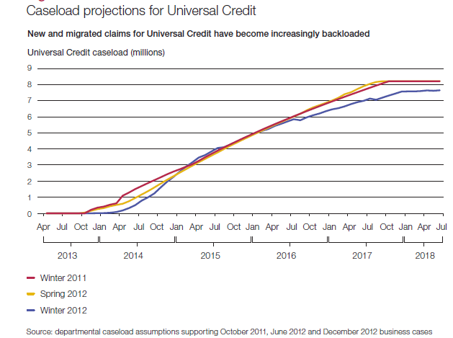
Planned take up rates versus actual rates
Pathfinder statistics up to Oct 2013:
Between April 2013 and 31 October 2013, a total of 2,960 people started on Universal Credit
The majority are male, with a male to female ratio around 7:3
Most new claims are from unemployed people aged under 25
The Universal Credit caseload at 31 October 2013 was 2,720 and nearly 7 in 10 were under 25.
Source DWP analysis of Pathfinder statistics Oct 2013

Slide 20
Where did Universal Credit fail?
Policy clarity
Requirements clarity
Leadership
Vision
Commitment
Culture
Claimant journey
Access to systems
Premises alterations
Identity assurance
Secure
processes
Universal Credit
Communications
Stakeholder engagement
Ensuring stakeholder support
Clear delivery plans
Risk management
Programme
assurance
management
& control
Procurement
Financial management
IT infrastructure
Systems integration
Legacy systems
integration
Migration plans
Staff training
Management information

Slide 21
Why did these failures occur?
Focus on technology rather than people
No overarching programme design
Is there such a thing as agile procurement?
Domain knowledge
Failure to understand programme complexity
Failure to ask the right questions?
Too risky?
Unfamiliar development methodology
Universal Credit
Optimism bias
Inconsistent leadership
Lack of clarity of requirements
Failure to heed warnings and advice
Culture of distrust
Failure to appreciate importance of IDA
Some claimants cannot adopt Digital by Default
Failure to manage suppliers because of unfamiliar routes to procurement
Correct policy assumptions?
Unrealistic delivery timetable
Political ambition versus programme reality

Slide 22
Universal Credit: Where are we Now?

Slide 23
2014: A New Programme Approach
Twin track “Test and Learn” approach adopted:
  Development and delivery of an online digital service providing the full scope of Universal Credit;
  Expansion of the current ‘live service’ across North West England
Programme delivery timetable slipped to the right by 6 years: Rollout complete 2021?
Increased sustained rate of claimant on-boarding
Integration of the two systems not fully defined.
 | Comparison of Business Cases
 | 2012 | 2014 | 2016
DWP estimate of net benefit from UC | £38 billion | £21 billion
Number of claimants at Oct 2014 | 1.5 million | 17,850 (actual) | 60,000
DWP estimate of UC claimants by April 2016 | 5.5 million | 500,000 | 200,000
DWP estimate of UC claimants by 2017 | 8.2 million | - | -
DWP estimate of UC claimants by 2019 | - | 7 million | ?

Slide 24
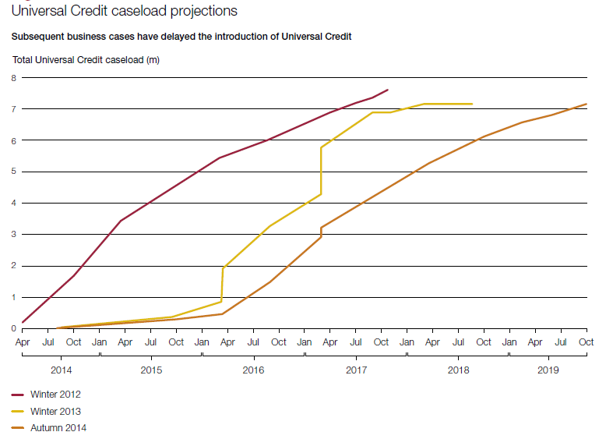
2014: Impact on Rollout Plans

Slide 25
2016: House of Commons; Committee of Public Accounts
Most recent review: Universal Credit: progress update, 25th January 2016.
Key findings taken from the report:
  Universal Credit has stabilised, however, there remains a long way to go.
  Implementation has focussed mainly on the simplest cases
  DWP has again delayed the programme.
  The business case is out of date and does not reflect the changes to the tax and benefits system announced by George Osbourne in November 2015.
  The Office for Budget Responsibility forecasts that there will be a further six-month delay beyond the Department’s latest planned end-date.
And finally, the committee :
  “Remains disappointed by the persistent lack of clarity and evasive responses by the Department to our inquiries, particularly about the extent and impact of delays.”
  “The Department’s response to the previous Committee’s recommendations do not convince us that it is committed to improving transparency about the programme’s progress.”

Slide 26
The Elephants Still in the Room……
No up to date business case
Programme design still unclear
No transitional strategy for claimants
Lack of transparency
Optimism bias
Universal Credit
Culture of distrust
Benefits realisation unclear
Unrealistic delivery timetable
Programme milestones still unclear
Integration of the twin track approach unclear
Some claimants cannot adopt Digital by Default

Slide 27
Questions?

