Slide 1
The Psychology of Security
Ross Anderson
Cambridge

Slide 2
Outline of talk
Beginnings in security / safety usability
Depersonalization and vindictiveness
Person salience and social cognition
Experiments with browser warnings
Foundations: heuristics and biases, Machiavellian brain hypothesis
The magic balance: engineering, economics, psychology of security

Slide 3
Psychology matters
It’s not just usability (however vital for biometrics)
Phishing costs serious money, yet banks react by ‘blame and train’ efforts (which we know don’t work)
There’s persistent personal irrationality: people say they care about privacy but act otherwise
A heuristics-and-biases analysis sheds light on everything from scams to terrorism
What’s the best way to deter deception online?
We need to know a lot more about the interaction between security and psychology!

Slide 4
Why Johnny (still) can’t encrypt
Alma Whitten and Doug Tygar’s 1995 paper “Why Johnny can’t encrypt” kicked things off
User errors cause or contribute to most security failures, yet user interfaces are awful
They tested PGP 5.0 which tried to do better
Most (college educated) users could not manage to sign and encrypt a message, given 90 minutes
So design for unmotivated users who don’t grok abstractions and get no feedback…

Slide 5
Cognitive Factors
Many systems are just poorly designed, as designers ignore the psychology that underlies errors
Slips and lapses
Forgetting plans, intentions; strong habit intrusion
Misidentifying objects, signals (often Bayesian)
Retrieval failures; tip-of-tongue, interference
Premature exits from action sequences, e.g. ATMs
Rule-based mistakes; applying wrong procedure
Knowledge-based mistakes; heuristics and biases

Slide 6
Lessons from safety usability
Some industries, such as cars and aerospace, are making some real progress
Incentives are well aligned there – accidents are visible, drivers/pilots don’t want to die and insurance statistics are good
But this is not the case everywhere
Research by Harold Thimbleby shows that safety usability failures kill over 2000 in UK hospitals (more than road traffic accidents)

Slide 7
Safety usability, Jan 8 1989
BMI London-Belfast, fan blade broke in port engine
Crew shut down starboard engine and did emergency descent to East Midlands
Opened throttle on final approach: no power
47 dead, 74 injured
Initially blamed wiring technician! Later: cockpit design

Slide 8
How the problem’s being fixed

Slide 9
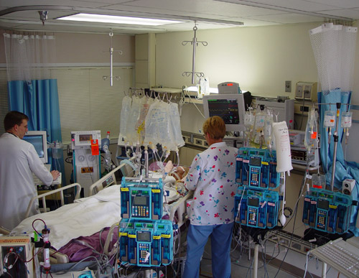
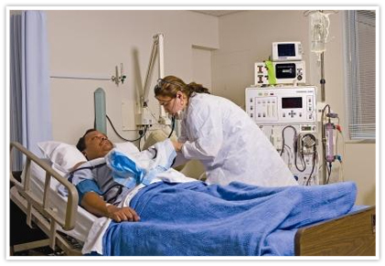
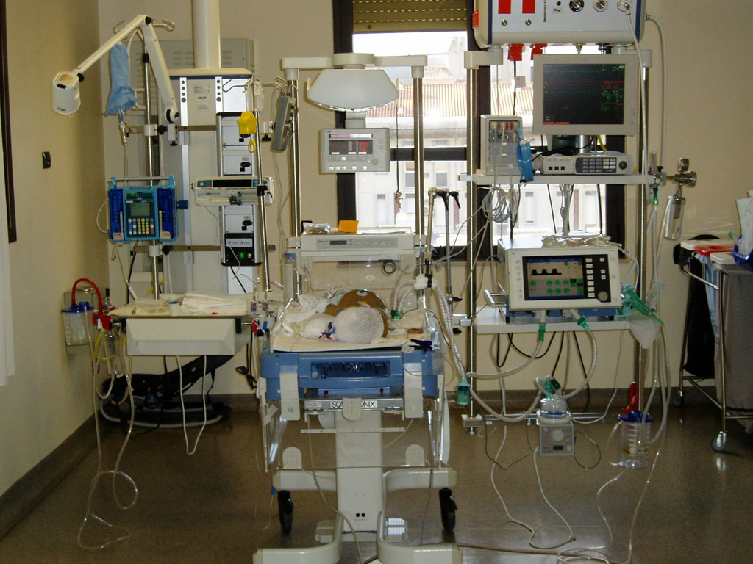
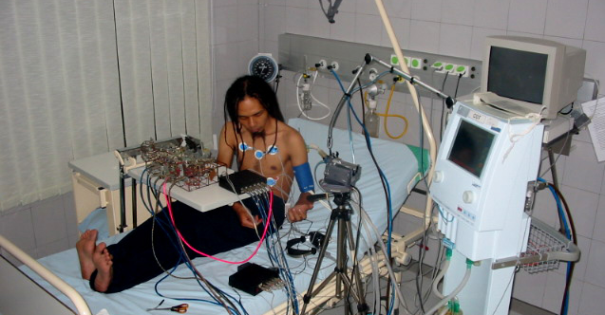
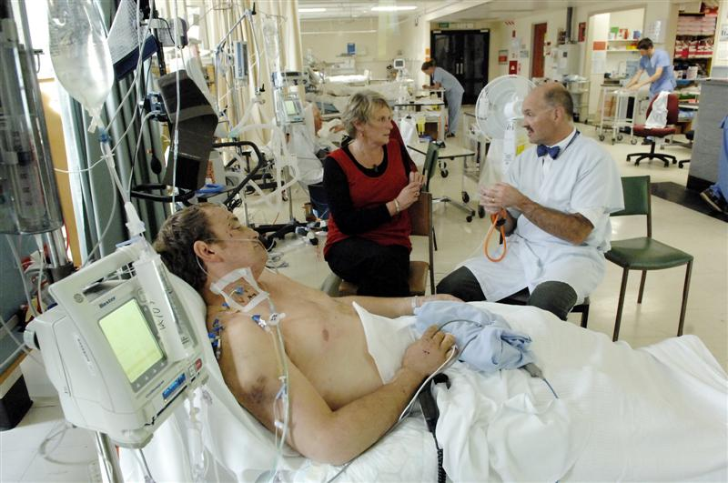

Slide 10
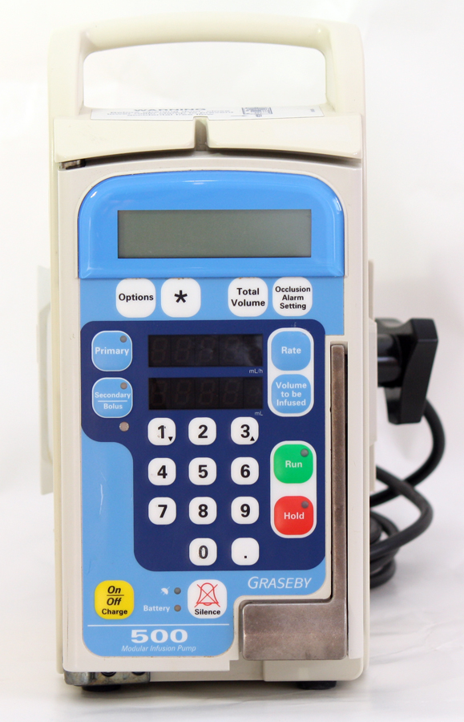
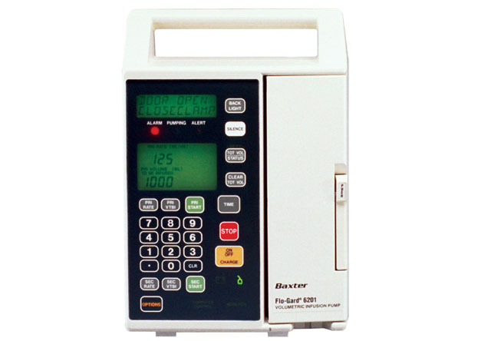
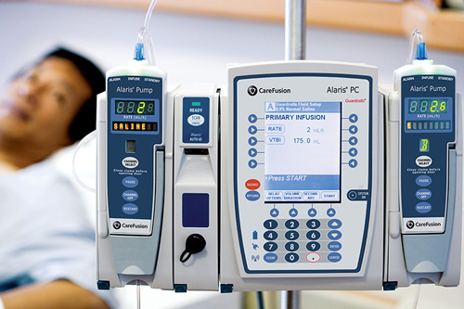
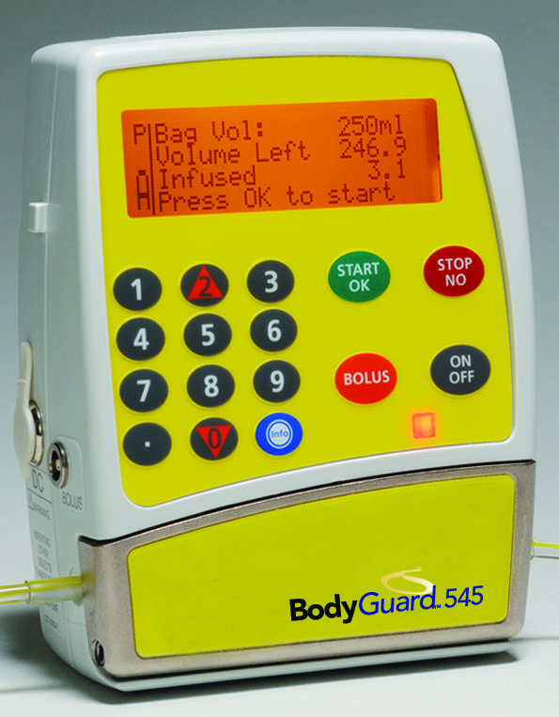
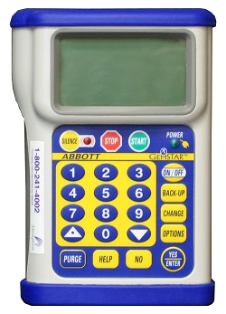
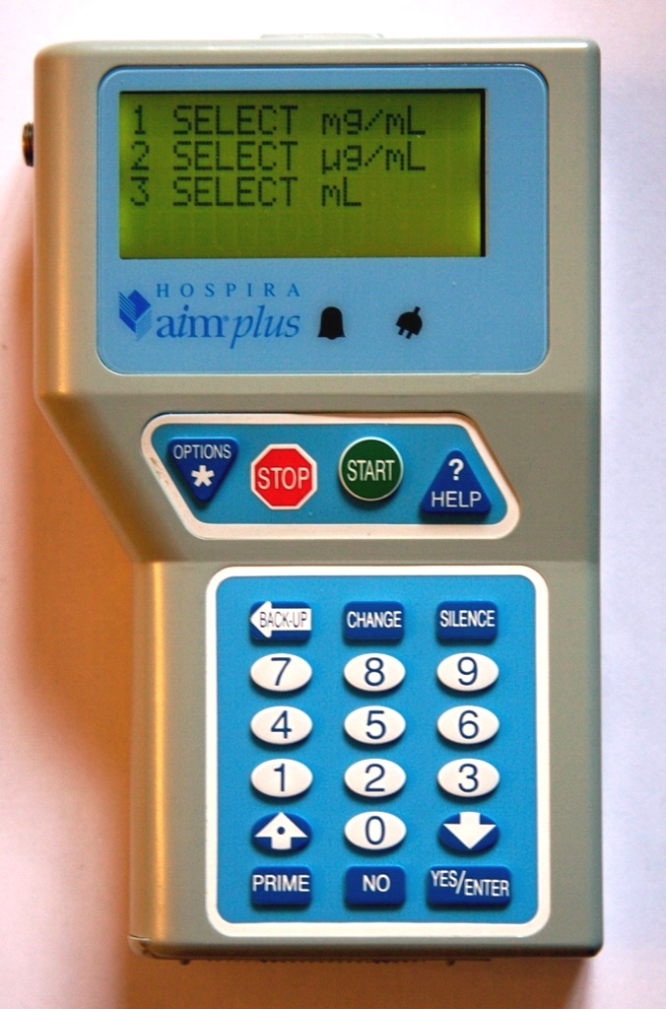
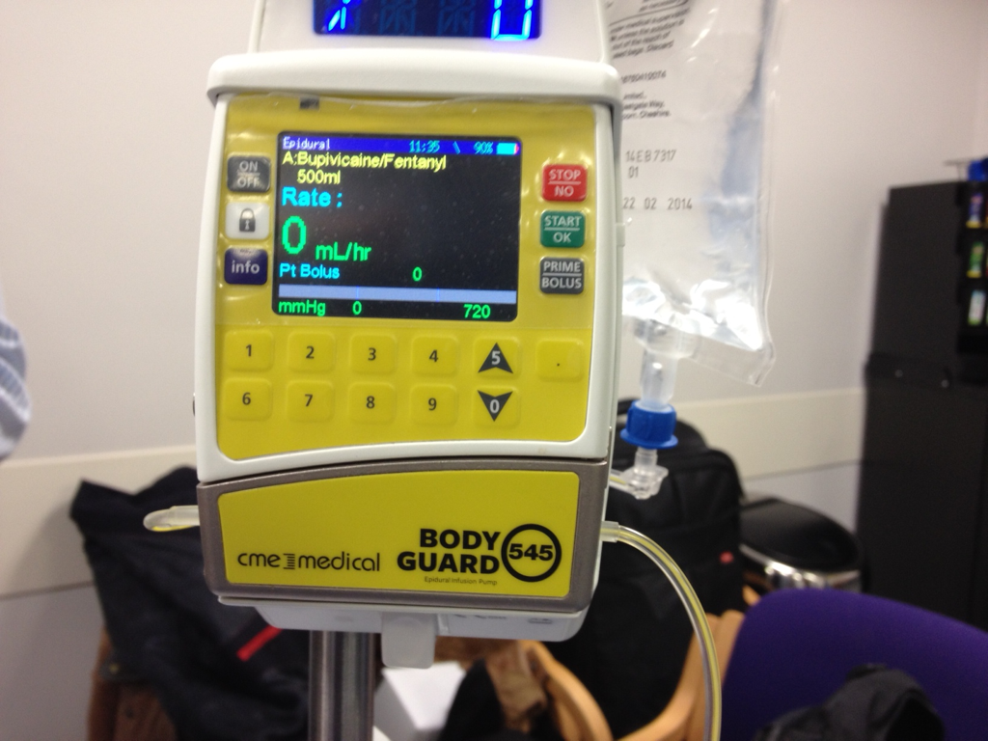

Slide 11
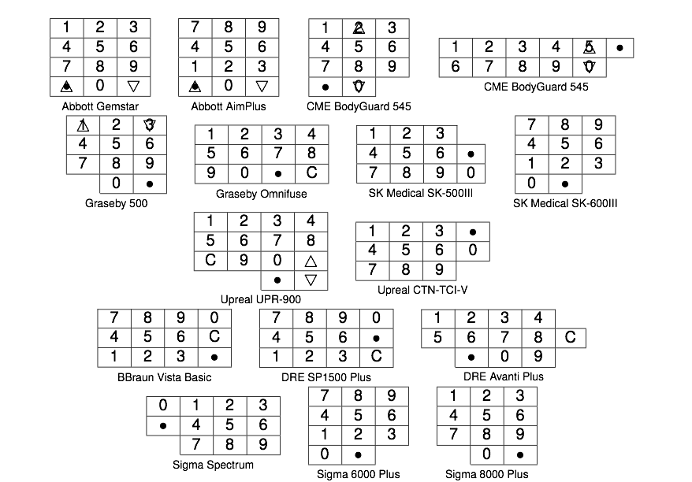

Slide 13
Cognitive Factors (2)
Violations of rules also matter
They’re often an easier way of working, and sometimes necessary
Compliance levels tell you how bad your system design was
‘Blame and train’ as an approach to systematic violation is suboptimal
The ‘right’ way of working should be easiest: look where people walk, then lay the path

Slide 14
Walk the path

Slide 15
Password choice advice
Sometimes the system is simple enough that we can test the whole thing realistically
E.g. investigated password choice (with Jeff Yan, Alan Blackwell, Ian Grant 1998)
Control group
Choose random letters and numbers
Make up a mnemonic phrase
3 was as strong as 2 but had as few resets as 1

Slide 16
Cognitive Factors (3)
Ability to perform certain tasks can very widely across subgroups of the population
Age, sex, education, … can all be factors
Risk thermostat – function of age, sex
Example: banks tell people ‘parse URLs’
Baron-Cohen: people can be sorted by SQ (systematizing) and EQ (empathising)
Is this correlated with ability to detect phishing websites by understanding URLs?

Slide 17
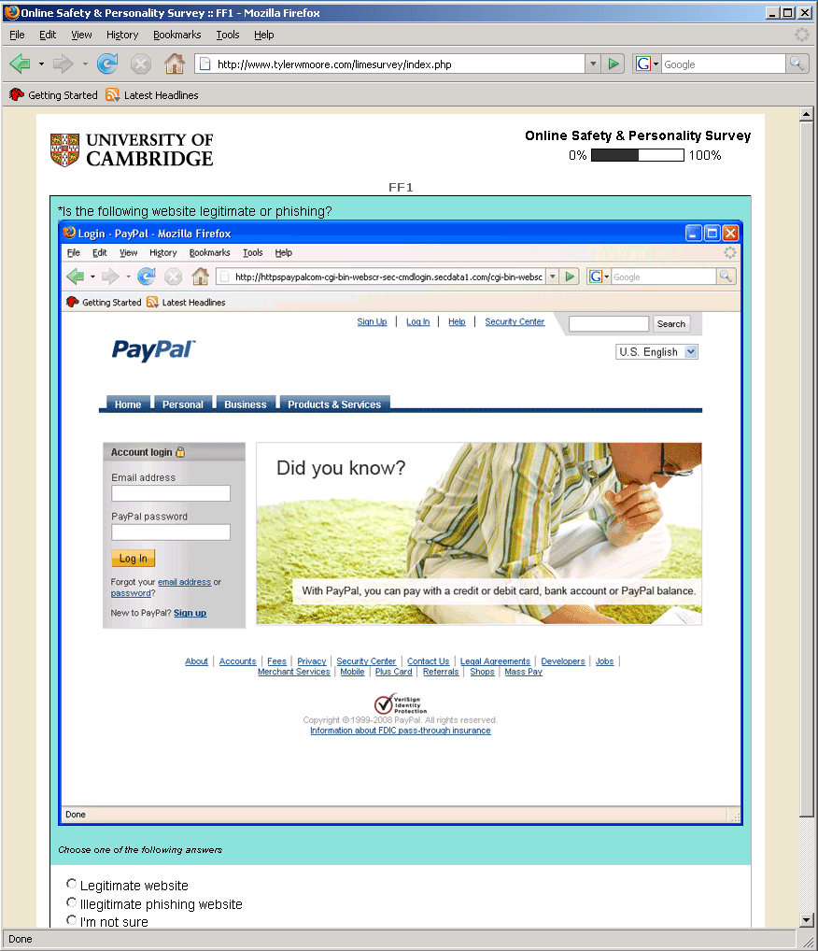

Slide 18
Results
Ability to detect phishing is correlated with SQ-EQ
and (independently) with gender
So the ‘gender HCI’ issue applies to security too (this was work with Tyler Moore)

Slide 19
Depersonalization and fraud
We have some literature (and much folk experience) on increased willingness to commit abuse online where the target’s personhood is less salient
Firms personalize operations of which they’re proud and depersonalize the shameful (so do liars)
British Crime Survey: a million people are victims each year of traditional acquisitive crime (burglary, car theft); modern variety (phishing, auctions, lottery scams) over twice that – and rising fast
Marian Fitzgerald: crime isn’t falling, just moving online

Slide 20
Vindictiveness too
2011 case: student defrauded professor of £18000 and got 200 hours unpaid work
The fraud was online, and they never met!
Had it been face-to-face, sentencing guidelines set the starting point at 3 years
There’s some literature on this (e.g. Small and Loewenstein, ‘The devil you know: The effects of identifiability on punitiveness’)
The USA is different – McKinnon, O’Dwyer…
Can we say anything useful?

Slide 21
Difficulties of robust research
Pilot experiments with mTurk, comparing criminal A with criminal B (with Alessandro Acquisti and Jim Graves). Interesting results!
A broke into a hospital medical records database and illegally copied a million patients’ records
B broke into a hospital medical records database and illegally copied a hundred patients’ records
Who do you think is worse?

Slide 22
Difficulties of robust research (2)
Larger study with over 2000 subjects
Tried 10, 100, 1000, 10000 records leaked
Vindictiveness was quite linear – the more victims the worse the crime / longer sentence
However the (U.S.) mTurkers were much less vindictive towards people who hacked for protest versus for money
This is the opposite of recent prosecutor behaviour!

Slide 23
Did the banks get it wrong?
In the late 1980s/early 1990s several banks put photos on credit cards. This cut fraud
Sainsbury’s experiment: Kemp, Towell, Pike, “When Seeing should not be Believing: Photographs, Credit Cards and Fraud”, App Cog Psych 11 (1997) 211–222
Checkout staff can’t tell if photo genuine
Banks went for EMV (chip-and-pin) instead
Fraud reduction from photos dismissed as ‘placebo’ which would eventually wear out

Slide 24
Future payment page?
Alessandro, you’re about to pay Ross $70.
Are you still Alessandro? Password: ******

Slide 25
Future payment page?
Alessandro, you’re about to pay Ross $70.
Are you still Alessandro? Password: ******
Enter your authorisation code: ****

Slide 26
Browser warnings
Browsers throw up warnings we ignore, e.g. if a web page contains malware, or is a phishing site, or has an invalid certificate
Chance discovery at Google: warnings with a cartoon head (or missing Chrome logo) had response elevated from 30% to 60%
Can we use words, or do we need a face?
Big experiment at Google: faces in this context don’t seem to help!

Slide 27
Browser warnings (2)
With David Modic, tested response to
Appeal to authority
Social compliance
Concrete vs vague threats
Based on much research on psychology of persuasion, and on scam compliance
We’re also investigating who turned off their browser phishing warnings (or would have had they known how)

Slide 28
Who turns off the warnings?
Of 496 mTurkers, 17 (3%) turned warnings off, and a further 34 would have if they could
Reasons given (descending order)
False positives
Prefers to make own decisions
Don’t like the hassle
Don’t understand them
Same rank ordering between those who did turn them off, and those who would have

Slide 29
Who turns off the warnings (2)?
Some interesting correlations turned up which explain most of the tendency to turn off warnings:
Desire for autonomy
Trust (in real-world and Facebook friends)
Confidence in IT competence
Lack of trust on authority (companies too)
Not using Windows
Gender
These explain over 80% of the effect!

Slide 30
What stops people clicking?
The most significant effect was giving concrete warnings as opposed to vague ones
Some way behind was appeal to authority
Factors other than our treatments: trust in the browser vendor was strongest, then mistrust of authority
All factors together explain 60% of the effect
A strong status quo bias emerged …

Slide 31
Heuristics and biases
We have two different mental processing systems: a fast one and a slow one
Most of the time we make snap judgments that are “good enough”; but the heuristics depart in predictable ways from the rational
Sometimes we have to think stuff through
There are complex interactions: for example, all memory access is mediated through “fast”
This biases our thinking in exploitable ways

Slide 32
Prospect theory
Kahneman & Tversky, 1970s: people value gains and losses differently
Evolutionary logic of risk aversion, status quo bias
Can drive fear marketing, ‘savings’, and (some of the) irrational behaviour of financial markets
We’re oversensitive to low-probability large losses

Slide 33
Context and Framing
Framing effects include ‘Was £8.99 now £6.99’ and the estate agent who shows you a crummy house first
Take along an ugly friend on a double date …
Typical phishing attack: user is fixated on task completion (e.g. why is a new payee on PayPal?)
Accommodation scams – exploit advance fee
Advance fee frauds take this to extreme lengths!
Risk salience is hugely dependent on context! E.g. CMU experiment on privacy

Slide 34
Risk Misperception
Why do we overreact to terrorism?
Risk aversion / status quo bias
‘Availability heuristic’ – easily-recalled data used to frame assessments
Our behaviour evolved in small social groups, and we react against the out-group
Morality effects: “If only gay sex caused global warming”
Mortality effects amplify group norms, codes
We are also sensitive to agency, hostile intent, …
See my book chapters 2, 24

Slide 35
Foundational questions
What drove the evolution of intelligence?
Old theory: make better tools
New theory: use other monkeys better as tools (the ‘Machiavellian brain’ hypothesis)
If this is right, then deception, and the detection of deception, were key
What makes it complex: self-deception. Is this largely defensive, or offensive? (or is it just an aspect of suggestibility?)

Slide 36
Foundational questions (2)
At age 8–11, we learn to eat the cherry on the cake last
We start discounting anticipated future joy
Depression often has to do with discounting anticipated future pain
Social phobia: being anxious about being anxious
We’re very bad an anticipating emotions!
Could we develop a robust account of this, a sort of ‘quantum field theory’ of expected utility?

Slide 37
A personal view
Physics has 3 laws that explain 97% of stuff; psychology is almost the other way round!
It’s easy to end up measuring your own ruler
You can’t just seamlessly absorb psychological knowledge, the way you can with economics or physics: too many warring tribes
Need a solidly empirical approach
But it’s so important we can’t ignore it!

Slide 38
The magic balance
Engineering, psychology, economics!
Why do we spend too little on cybersecurity and too much on terrorism?
The first is partly because industry makes computer systems appear innocuous than they are
The second is partly because governments make airports etc more scary than they are
But – how could you motivate a change??!?

Slide 39
Our current sec-psy research
One project: the deterrence of deception in socio-technical systems
Another: behavioural economics of cyber-crime
More: see my security psychology web page at http://www.cl.cam.ac.uk/~rja14/psysec.html
Workshops: SHB, SOUPS
Our blog at www.lightbluetouchpaper.org
And finally my book

Slide 40
