Slide 1
Stressing Out: Bitcoin “Stress Testing”
Khaled Baqer, Danny Yuxing Huang, Damon McCoy and Nick Weaver
(given by Ross Anderson)

Slide 2
Overview
Spam attack on Bitcoin (July 2015)
Importance: block size debate! At present you can bring down Bitcoin for $50k
Goal here: highlight spam motifs, investigate impact, analyse security economics (fee income increase, cost of spam campaign)
Used a clustering method to group transactions and find patterns

Slide 3
Bitcoin spam
Fan-in: Transactions that absorb a lot of inputs reduce the unspent transaction output (UTXO) set but still occupy substantial space in the blocks
Fan-out: Transactions that split a few inputs into many outputs occupy space in blocks and also increase the UTXO set (Mempool impact)
Dust output: “Dust” outputs convey a trivial amount of value but occupy the same amount of resources in the Bitcoin network

Slide 4
Spam campaign (July 2015)
Someone said, ‘stress testing Bitcoin network’
Motivation (?): show Bitcoin is vulnerable to DoS, and get support to raise the block size
DoS: send transactions with higher fees to deplete space in blocks
Spam also uses many similar transactions to have a significant impact on the network
But what does spam look like?

Slide 5
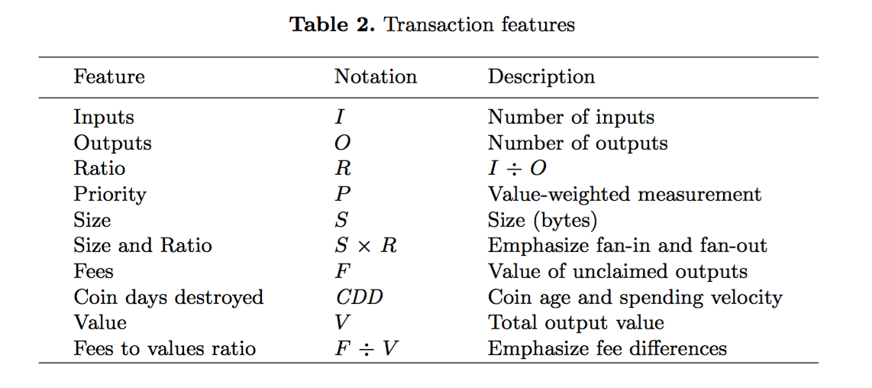
k-means Clustering

Slide 6
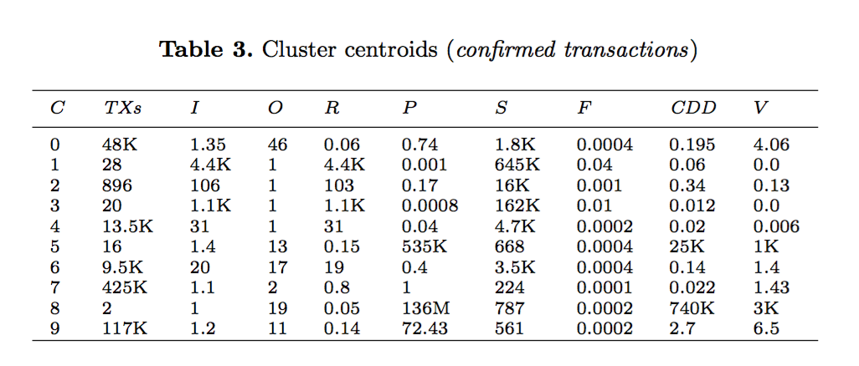
k-means Clustering (II)

Slide 7
Impact on Bitcoin: The number of transactions per day in the blockchain

Slide 8
Impact on Bitcoin (II): The average number of unconfirmed transactions

Slide 9
Impact on Bitcoin (III): The total amount of transaction fees every day

Slide 10
Impact on Bitcoin (IV): Average transaction delay

Slide 11
Impact on Bitcoin (V): Average transaction fees per transaction per day (normalized)

Slide 12
Summary of results (10-day spam campaign)
385,256 (23.41%) out of 1,645,667 total Bitcoin transactions were spam
Spam increased average fees by 51% (from 45 to 68 Satoshis/byte)
Spam increased processing delay by 7 times (from 0.33 to 2.67 hours)
Cost of this attack on Bitcoin: $49K, about half being to pay higher fees

Slide 13
Questions?
If skype doesn’t work,. email hard questions to khaled.baqer@cl.cam.ac.uk (who could not get a visa processed in time)
Further possible discussions for the barbecue: sovereign risk and other emergent problems of governance

