Slide 1
Ad hoc research group review
http://bit.ly/ipbillreview
Led by Prof Lorna Woods
Hosted by Information Law & Policy Centre, Institute of Advanced Legal Studies

Slide 2
AD HOC RESEARCH GROUP REVIEW
Oversight:
One of the important novelties of the draft IPB is the introduction of oversight mechanisms (via the Judicial Commissioner process: the ‘double lock’ mechanism, and the consolidation of various external review bodies into a new body, the IPC).
While this is significant in terms of accountability and control, there will be questions as to what the standards of judicial review actually are and whether ex post facto review is sufficient – questions that become increasingly important in the light of Grand Chamber judgments from both European courts.
There are also questions about the independence of the IPC and the scope of his/her review functions, and regarding the operation of the new error reporting provisions.

Slide 3
Oversight of Journalistic source protection

Slide 4
Clause 61 (1)
61. Commissioner approval for authorisations to identify or confirm journalistic sources
(1) Subsection (2) applies if—
  (a) a designated senior officer has granted an authorisation in relation to the obtaining by a relevant public authority (other than an intelligence service) of communications data for the purpose of identifying or confirming a source of journalistic information, and
  (b) the authorisation is not necessary because of an imminent threat to life.

Slide 5
Clause 61 (2,3)
(2) The authorisation is not to take effect until such time (if any) as a Judicial Commissioner has made an order under this section approving it.
(3) The relevant public authority for which the authorisation has been granted may apply to a Judicial Commissioner for an order under this section approving the authorisation.

Slide 6
Clause 61 (4)
(4) The applicant is not required to give notice of the application to—
  (a) any person to whom the authorisation relates, or
  (b) that person’s legal representatives.

Slide 7
Clause 61 (5,6)
(5) A Judicial Commissioner may approve the authorisation if, and only if, the Judicial Commissioner considers that—
  (a) at the time of the grant, there were reasonable grounds for considering that the requirements of this Part were satisfied in relation to the authorisation, and
  (b) at the time when the Judicial Commissioner is considering the matter, there are reasonable grounds for considering that the requirements of this Part would be satisfied if an equivalent new authorisation were granted at that time.
(6) Where, on an application under this section, the Judicial Commissioner refuses to approve the grant of the authorisation, the Judicial Commissioner may make an order quashing the authorisation.

Slide 8
Clause 61 (7)
(7) In this Act “source of journalistic information” means an individual who provides material intending the recipient to use it for the purposes of journalism or knowing that it is likely to be so used.

Slide 9
Transparency of interpretation

Slide 10
Political context

Slide 11
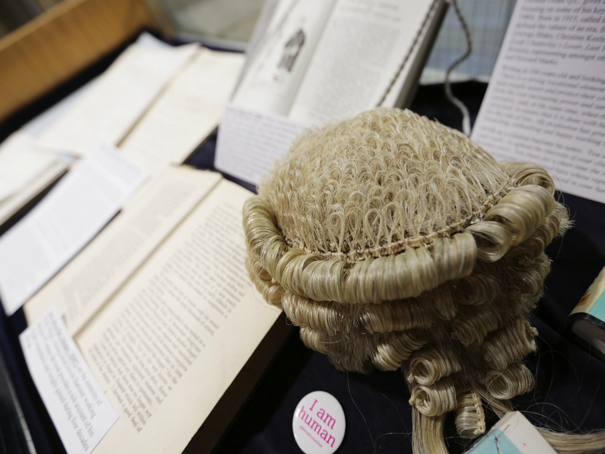
Contact
Email
judith.townend@sas.ac.uk
On Twitter
@jtownend /@infolawcentre
Website / blog
http://bit.ly/infolawcentre
http://infolawcentre.blogs.sas.ac.uk

