Slide 1
EMV: Why Payment Systems Fail
Ross Anderson
Cambridge

Slide 2
The EMV protocol suite
Named for Europay-MasterCard-Visa; also known as ‘chip and PIN’
Developed late 1990s; deployed in UK ten years ago (2003–5; mandatory 2006)
Europe, Canada followed
About to be deployed in the USA (by 2015)
Fascinating story of failures and frauds
Many lessons for security engineers!

Slide 3
Concept of operations
Make forgery harder by replacing the mag strip with a chip, which authenticates card
Make authentication of cardholder stronger by replacing the signature with a PIN
Keep verifying PINs online at ATMs, but verify on the chip at merchant terminals
Encourage deployment by making the merchant liable if PIN not used (‘liability shift’)

Slide 4
Fraud history, UK
Cardholder liable if PIN used
Else merchant pays
Banks hoped fraud would go down
It went up …
Then down, then up again

Slide 5
EMV shifted the landscape…
Like bulldozing a floodplain, it caused the fraud to find new channels
Card-not-present fraud shot up rapidly
Counterfeit took a couple of years, then took off once the crooks realised:
  It’s easier to steal card and pin details once pins are used everywhere
  You can still use mag-strip fallback overseas
  Tamper-resistance doesn’t work

Slide 6
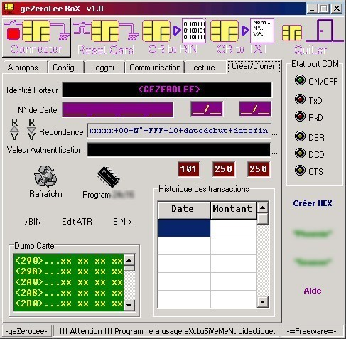
Attack the optimisations
Cheap cards are SDA (no public key capability, so static certificate)
A ‘yes card’ can impersonate in an offline terminal
Fairly easy to do, but not seen much

Slide 7
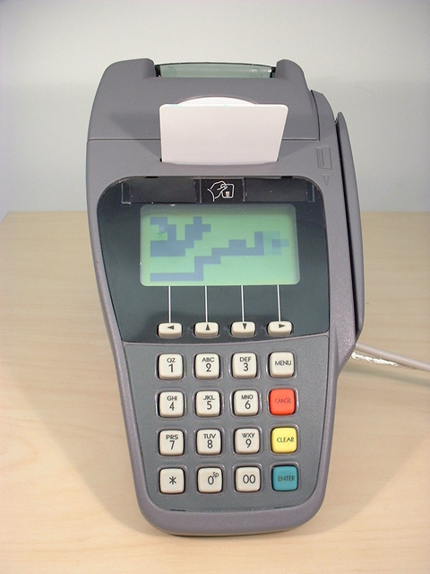
What about a false terminal?
Replace a terminal’s insides with your own electronics
Capture cards and PINs from victims
Use them to do a man-in-the-middle attack in real time on a remote terminal in a merchant selling expensive goods

Slide 8
The relay attack (2007)

Slide 9
Attacks in the real world
The relay attack is almost unstoppable, and we showed it in TV in February 2007
But it seems never to have happened!
So far, mag-strip fallback fraud has been easy
PEDs tampered at Shell garages by ‘service engineers’ (PED supplier was blamed)
Then‘Tamil Tigers’
After fraud at BP Girton: we investigate

Slide 10




Tamper-proofing of the PED
In EMV, PIN sent from PIN Entry Device (PED) to card
Card data flow the other way
PED supposed to be tamper resistant according to VISA, APACS (UK banks), PCI
‘Evaluated under Common Criteria’
Should cost $25,000 per PED to defeat

Slide 11
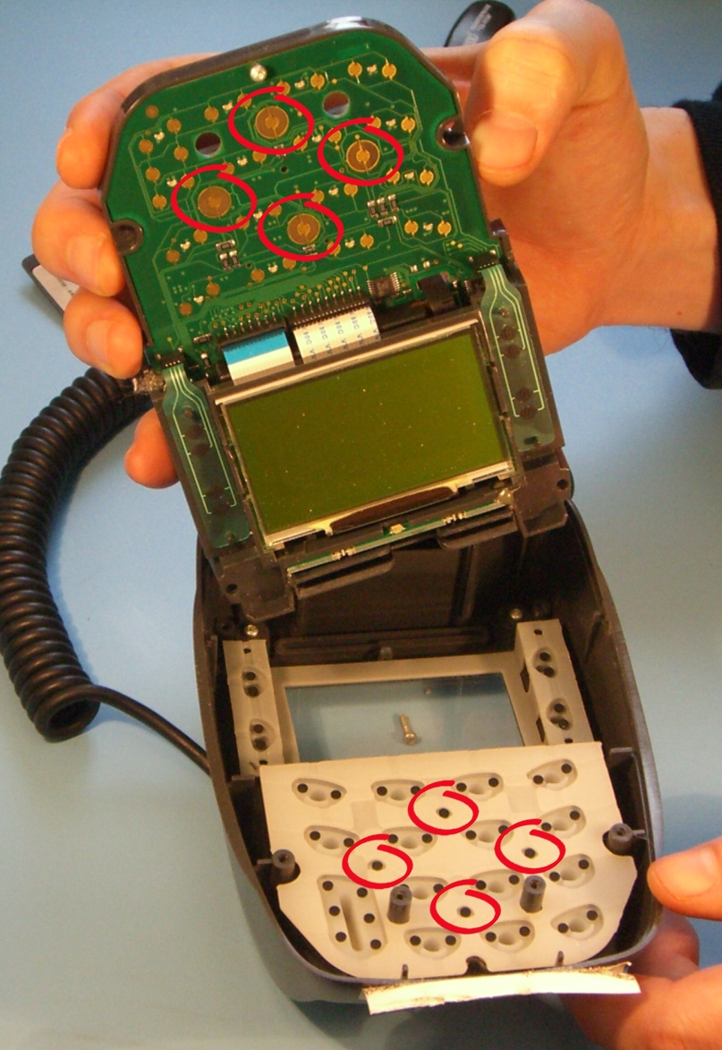
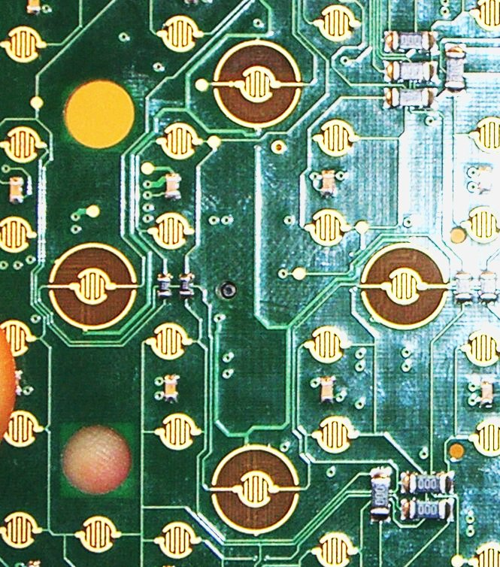
Tamper switches (Ingenico i3300)

Slide 12
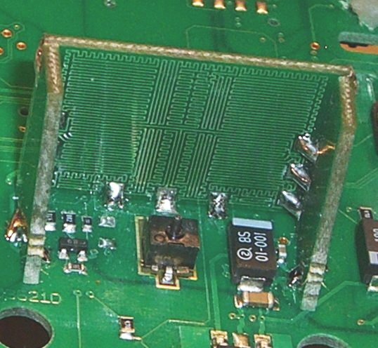
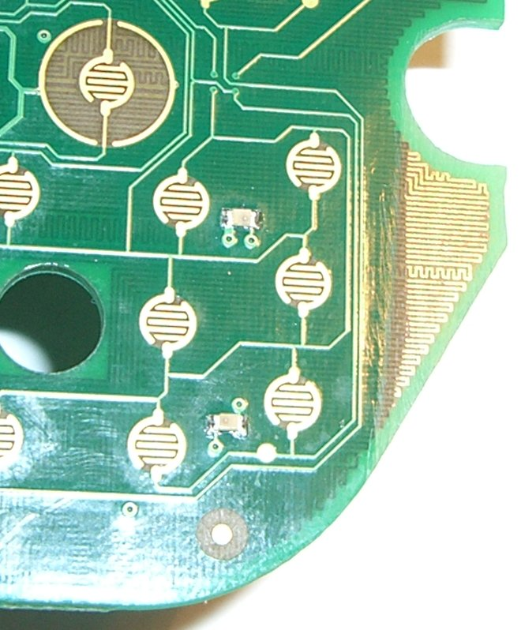
… and tamper meshes too

Slide 13
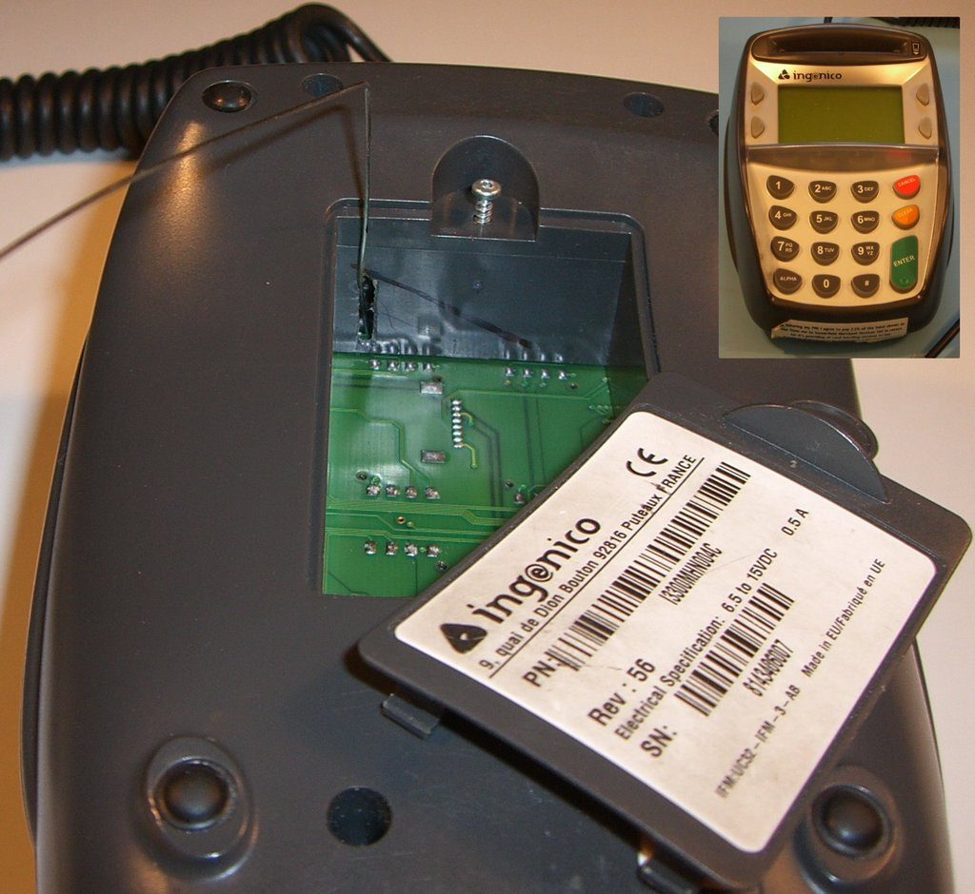
TV demo: Feb 26 2008
PEDs ‘evaluated under the Common Criteria’ were trivial to tap
Acquirers, issuers have different incentives
GCHQ wouldn’t defend the CC brand
APACS said (Feb 08) it wasn’t a problem…
Khan case (July 2008)

Slide 14
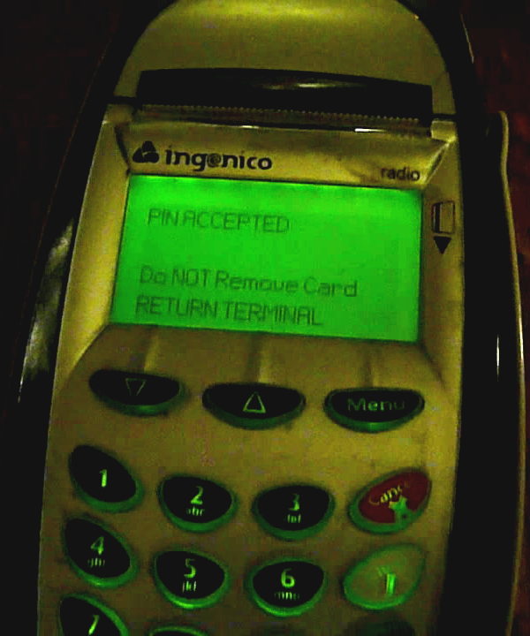
The ‘No-PIN’ attack
How could crooks use a stolen card without knowing the PIN?
We found: insert a device between card & terminal
Card thinks: signature; terminal thinks: pin
TV: Feb 11 2010

Slide 15
A normal EMV transaction

Slide 16
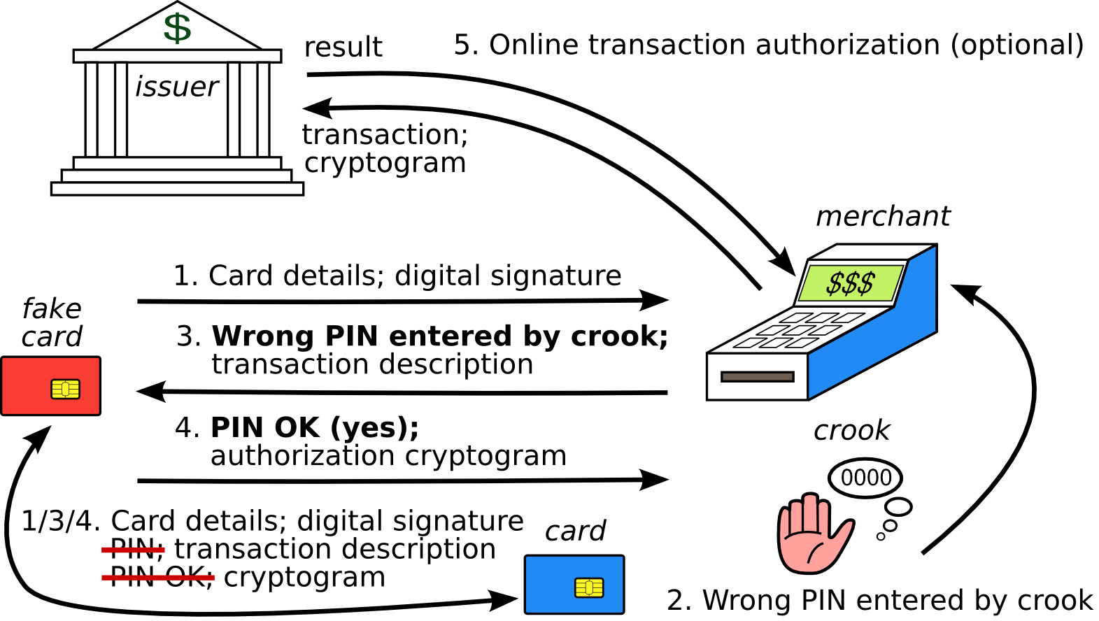
A ‘No-PIN’ transaction

Slide 17
Blocking the ‘No-PIN’ attack
In theory: might block at terminal, acquirer, issuer
In practice: may have to be the issuer (as with terminal tampering, acquirer incentives are poor)
Barclays blocked it July 2010 until Dec 2010
Real problem: EMV spec vastly too complex
With 100+ vendors, 20,000 banks, millions of merchants … a tragedy of the commons!
Later bank reaction: wrote to university PR department asking for Omar Chaudary’s thesis to be taken down from the website
Currently only HSBC seems to block it in the UK!

Slide 18
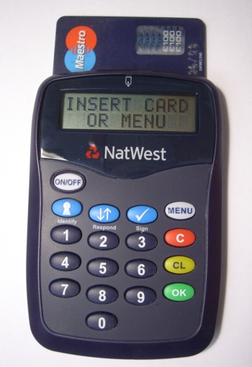
Card Authentication Protocol
Lets banks use EMV in online banking
Users compute codes for access, authorisation
A good design would take PIN and challenge / data, encrypt to get response
But the UK one first tells you if the PIN is correct
This puts your personal safety at risk …

Slide 19
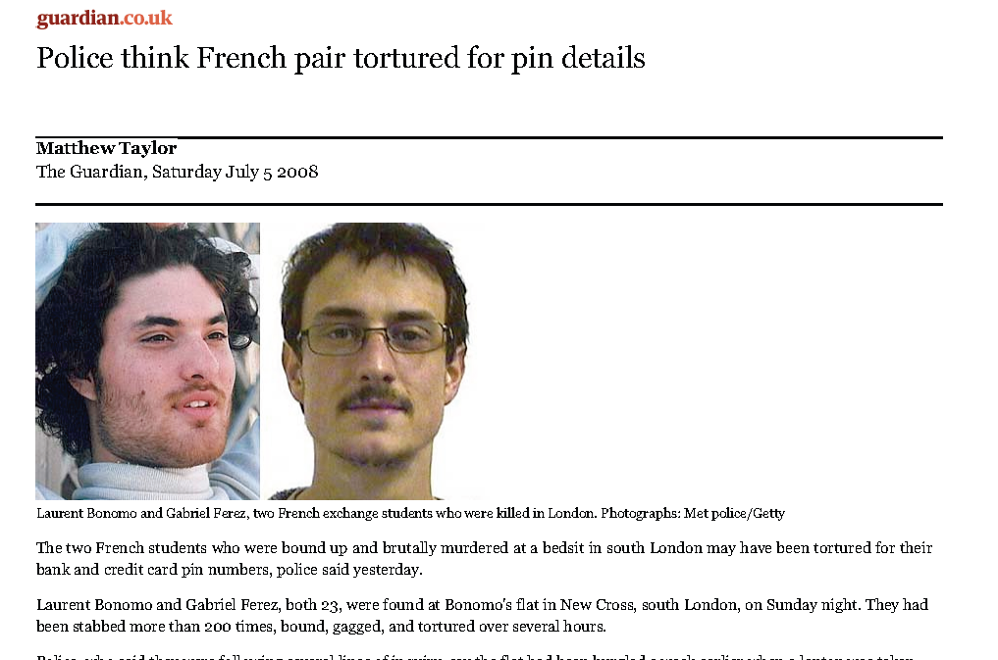
Crime victims tortured for PINs

Slide 20
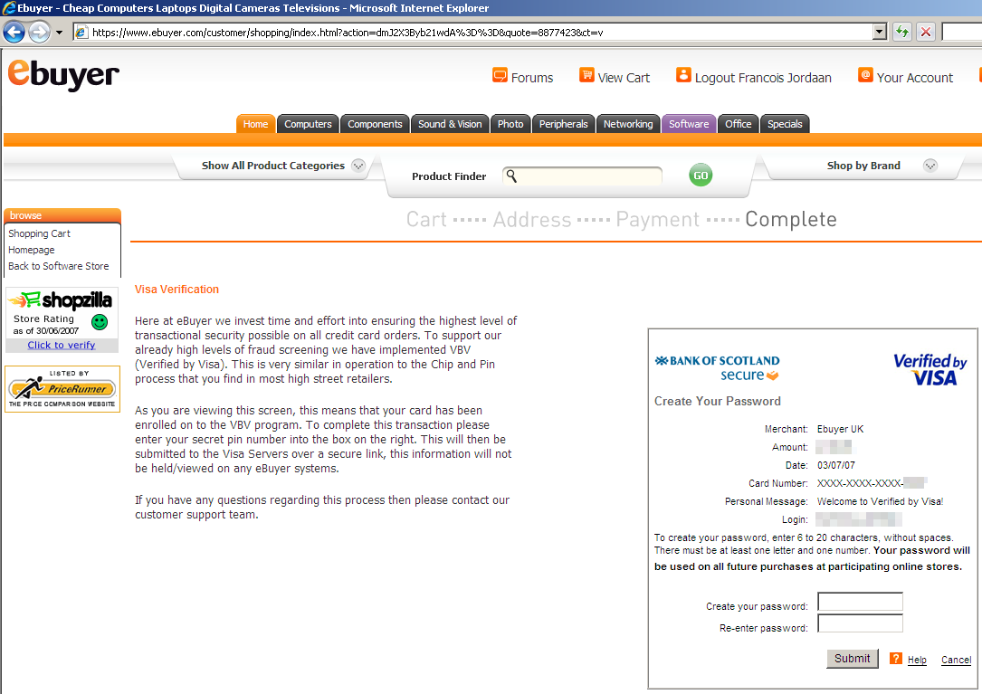
Phishing attacks?

Slide 21
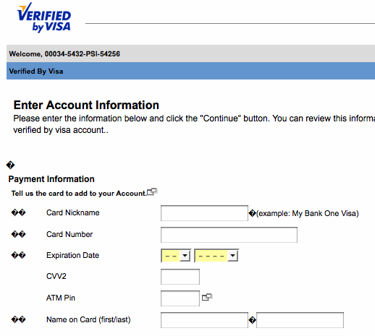
Less suspicious than this …

Slide 22
CAP attacks through wicked shops

Slide 23
EMV and Random Numbers
In EMV, the terminal sends a random number N to the card along with the date d and the amount X
The card computes an authentication request cryptogram (ARQC) on N, d, X
What happens if I can predict N for d?
Answer: if I have access to your card I can precompute an ARQC for amount X, date d

Slide 24
ATMs and Random Numbers (2)
Log of disputed transactions at Majorca:
N is a 17 bit constant followed by a 15 bit counter cycling every 3 minutes
We test, & find half of ATMs use counters!
2011-06-28 | 10:37:24 | F1246E04
2011-06-28 | 10:37:59 | F1241354
2011-06-28 | 10:38:34 | F1244328
2011-06-28 | 10:39:08 | F1247348

Slide 25
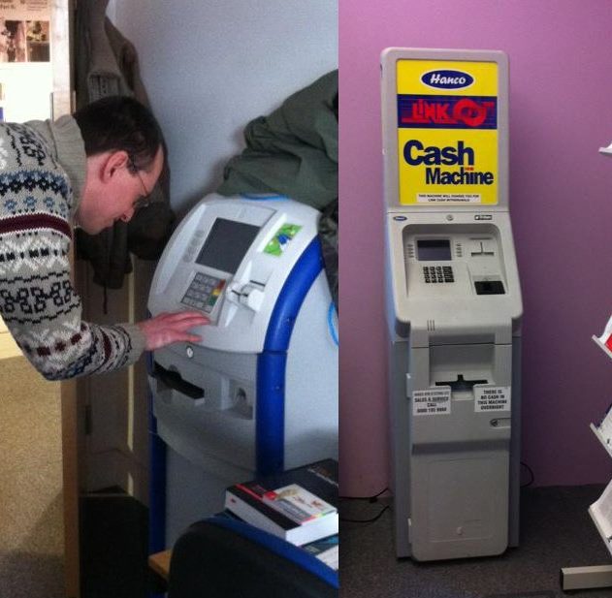
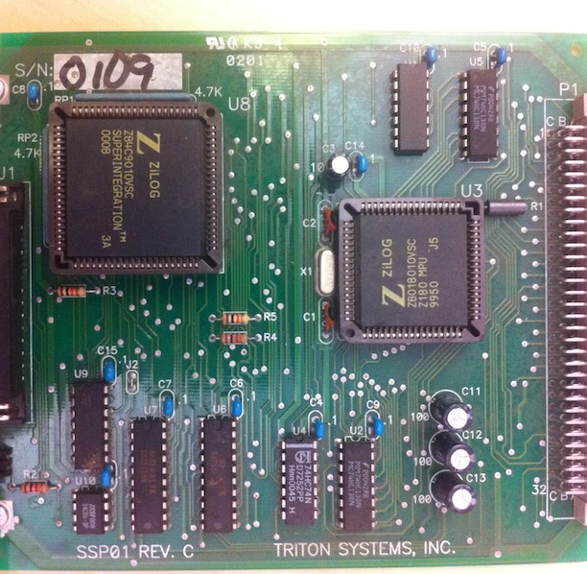
ATMs and Random Numbers (3)

Slide 26
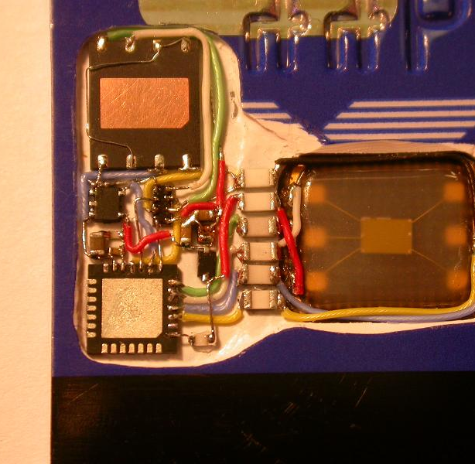
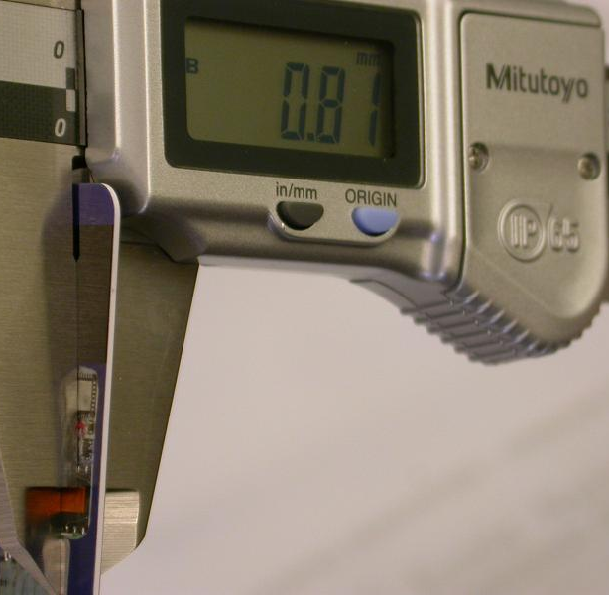
ATMs and Random Numbers (4)

Slide 27
The preplay attack
Collect ARQCs from a target card
Use them in a wicked terminal at a collusive merchant, which fixes up nonces to match
Paper accepted at Oakland this year
Since then, we have a live case…
Sailor spent €33 on a drink in a Spanish bar. He got hit with six transactions for €3300, an hour apart, from one terminal, through three different acquirers, with ATC collisions

Slide 28
Back end failures too …
Interesting case in R v Parsons, Manchester crown court, 2013
Authorisation and settlement are different systems with different transaction flows
Authorisation reversals not authenticated
How to take the banks for maybe £7.5m (and the banks only noticed £2.5m of it …)
Parsons now a fugitive from justice

Slide 29
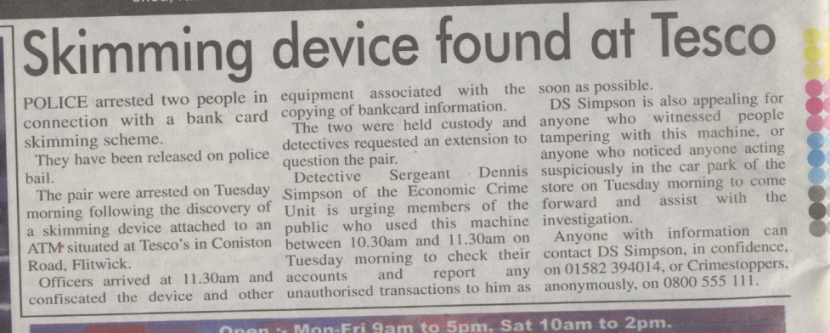
In the UK we have no Reg E, and no breach reporting laws…

Slide 30
Attack scale
Small: a specialist team can demonstrate it to a TV journalist
Medium: a gang of crooks can take a few million before they get caught
Large: scales to nine / ten figures and forces industry action
Most of the discussed attacks are ‘medium’
‘Large’ might be contained using analytics

Slide 31
What does EMV hold for the USA?
It looks like the effects of the liability shift will be mitigated by Reg E, Reg Z, & the Fed
Many banks may use chip-and-signature, as in Singapore
Consumer protection might still be undermined by payment innovation, e.g. move from credit cards to PIN debit, or phone payments
EMV with less liability shift will be an interesting natural experiment!

Slide 32
Broader lessons
Governance at global scale is hard
EMVCo largely superseded by vendor lobby …
Featuritis can break anything!
Issuers, acquirers have different interests (even if departments of the same bank)
No-one represents the poor consumer
Key: proper documentation, including breach notification and responsible vulnerability disclosure (NOT the NIS Directive!)

Slide 33
More …
Steven Murdoch’s talk on evidence, this morning
Our Oakland paper on the preplay attack (based on arxiv paper but with new material)
See www.lightbluetouchpaper.org for our blog
And http://www.cl.cam.ac.uk/~rja14/banksec.html
Workshop on Economics and Information Security (WEIS): Penn State, June
My book ‘Security Engineering – A Guide to Building Dependable Distributed Systems’

Slide 34
