Slide 1

The Flexible Open-Source Networking Platform
Noa Zilberman
University of Cambridge

Slide 2
Overview
Hardware overview
Research projects
Teaching
Community and Events
Conclusion

Slide 3
Section I: Overview

Slide 4
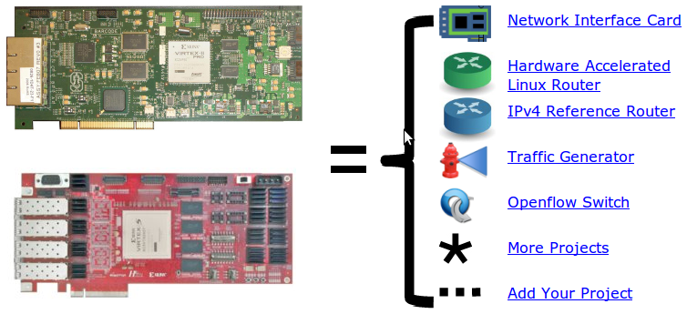
NetFPGA = Networked FPGA
A line-rate, flexible, open networking
platform for teaching and research

Slide 5
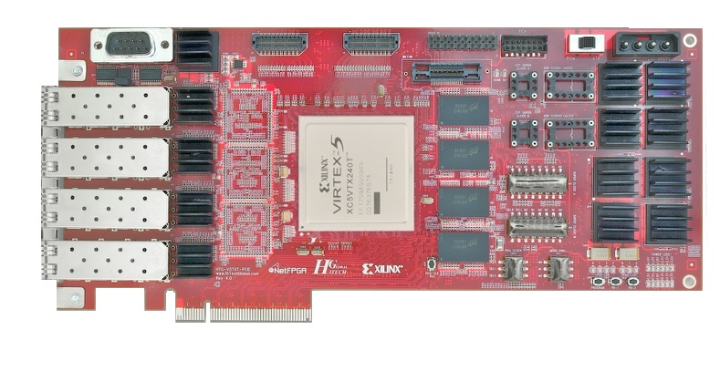

NetFPGA consists of…
Four elements:
NetFPGA board
Tools + reference designs
Contributed projects
Community

Slide 6
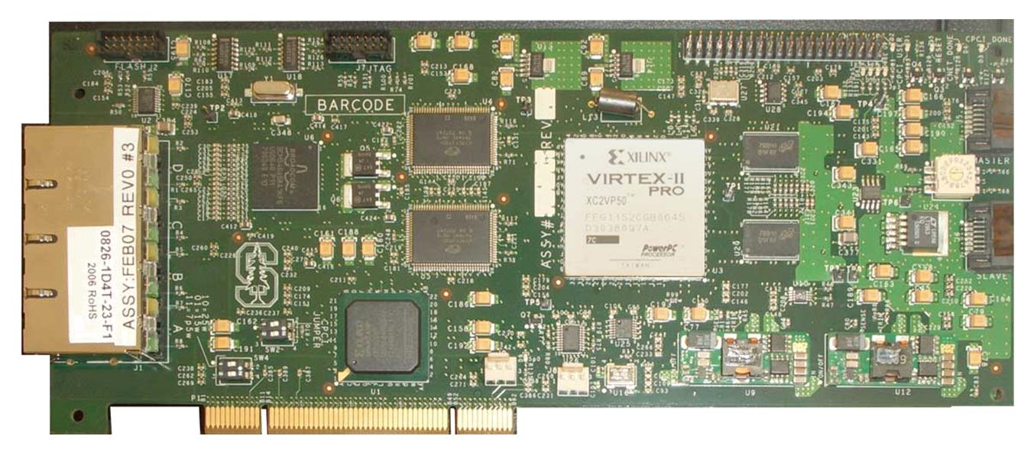
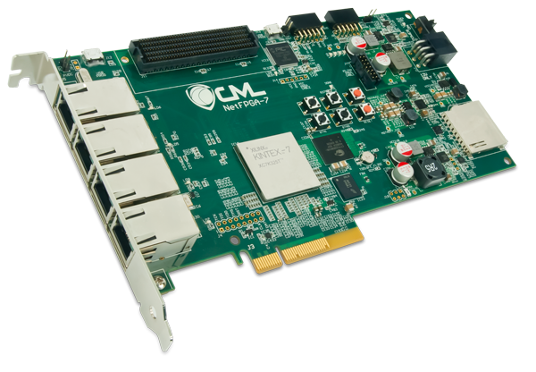
NetFPGA Family of Boards
NetFPGA-1G (2006)
NetFPGA-10G (2010)
NetFPGA-1G-CML (2014)
NetFPGA SUME (2014)

Slide 7
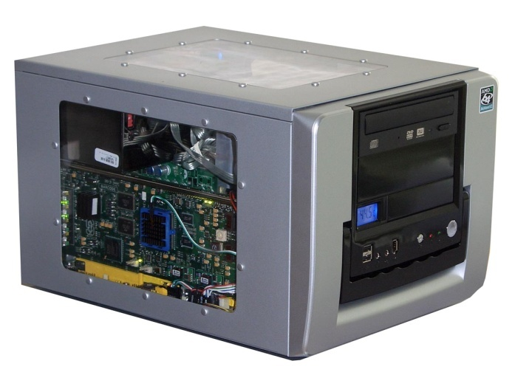
NetFPGA board
Networking
Software
running on a
standard PC
CPU
Memory
PCI-Express
PC with NetFPGA
A hardware
accelerator
built with Field
Programmable
Gate Array
driving 1/10/
100Gb/s
network links
10GbE
FPGA
10GbE
10GbE
Memory
10GbE

Slide 8
Tools + Reference Designs
Tools:
Compile designs
Verify designs
Interact with hardware
Reference designs:
Router (HW)
Switch (HW)
Network Interface Card (HW)
Router Kit (SW)
SCONE (SW)

Slide 9
Community
Wiki
Documentation
  User’s Guide “so you just got your first NetFPGA”
  Developer’s Guide “so you want to build a …”
Encourage users to contribute
Forums
Support by users for users
Active community - 10s-100s of posts/week

Slide 10
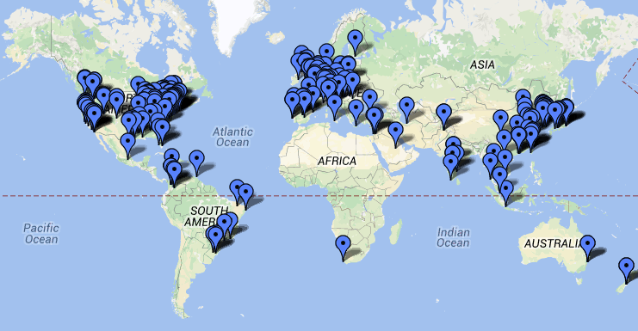
International Community
Over 1,000 users, using 3,115 cards at
150 universities in 40 countries

Slide 11
NetFPGA’s Defining Characteristics
Line-Rate
  Processes back-to-back packets
    Without dropping packets
    At full rate
  Operating on packet headers
    For switching, routing, and firewall rules
  And packet payloads
    For content processing and intrusion prevention
Open-source Hardware
  Similar to open-source software
    Full source code available
    BSD-Style License for 1G and LGPL 2.1 for 10G
  But harder, because
    Hardware modules must meeting timing
    Verilog & VHDL Components have more complex interfaces
    Hardware designers need high confidence in specification of modules

Slide 12
Test-Driven Design
Regression tests
  Have repeatable results
  Define the supported features
  Provide clear expectation on functionality
Example: Internet Router
  Drops packets with bad IP checksum
  Performs Longest Prefix Matching on destination address
  Forwards IPv4 packets of length 64-1500 bytes
  Generates ICMP message for packets with TTL <= 1
  Defines how to handle packets with IP options or non IPv4
    … and dozens more …
    Every feature is defined by a regression test

Slide 13
Who, How, Why
Who uses the NetFPGA?
  Researchers
  Teachers
  Students
How do they use the NetFPGA?
  To run the Router Kit
  To build modular reference designs
    IPv4 router
    4-port NIC
    Ethernet switch, …
Why do they use the NetFPGA?
  To measure performance of Internet systems
  To prototype new networking systems

Slide 14
Section II: Hardware Overview

Slide 15
NetFPGA-1G-CML
Available Now
FPGA Xilinx Kintex7
4x 10/100/1000 Ports
PCIe Gen.2 x4
QDRII+-SRAM, 4.5MB
DDR3, 512MB
SD Card
Expansion Slot

Slide 16
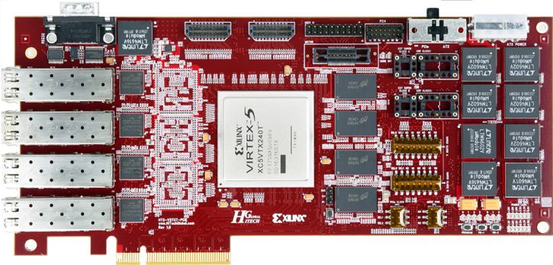
NetFPGA-10G
Available Now
FPGA Xilinx Virtex5
4 SFP+ Cages
  10G Support
  1G Support
PCIe Gen.1 x8
QDRII-SRAM, 27MB
RLDRAM-II, 288MB
Expansion Slot

Slide 17
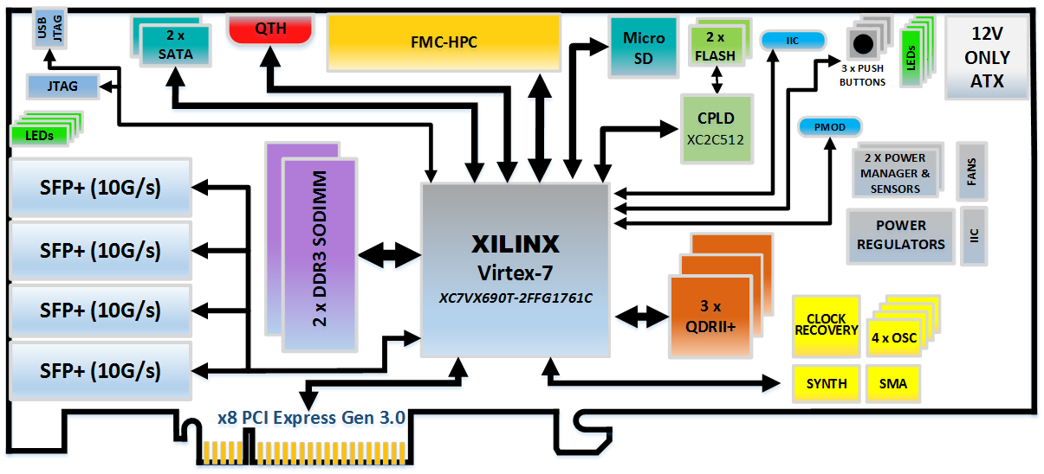
NetFPGA SUME
Available Q3/14
FPGA Xilinx Virtex7
4 SFP+ Cages
  10G Support
  1G Support
18x13.1Gb/s Additional Serial Links
PCIe Gen.3 x8
QDRII+-SRAM, 3x72Mb, 500MHz
DDR3 SoDIMM, 2x4GB, 1866MT/s
Expansion Slot
Micro-SD

Slide 18

Beyond Hardware
NetFPGA Board
Xilinx EDK based IDE
Reference designs with ARM AXI4
Software (embedded and PC)
Public Repository
Public Wiki
GitHub, User Community
MicroBlaze SW
PC SW
Xilinx EDK
Reference Designs
AXI4 IPs

Slide 19
Section III: Research Projects

Slide 20
OpenFlow
Past
The most prominent NetFPGA success
Has reignited the Software Defined Networking movement
NetFPGA enabled OpenFlow
  A widely available open-source development platform
  Capable of line-rate and
was, until its commercial uptake, the reference platform for OpenFlow.

Slide 21
Contributed Projects
Past
Platform | Project | Contributor
1G | OpenFlow switch | Stanford University
 | Packet generator | Stanford University
 | NetFlow Probe | Brno University
 | NetThreads | University of Toronto
 | zFilter (Sp)router | Ericsson
 | Traffic Monitor | University of Catania
 | DFA | UMass Lowell
10G | Bluespec switch | MIT/SRI International
 | Traffic Monitor | University of Pisa
 | NF1G legacy on NF10G | Uni Pisa & Uni Cambridge
 | Simple/better DMA core | Stanford RAMcloud project

Slide 22
Some Ongoing Projects
Present
Computing
  Stand alone computing unit (CHERI soft core)
  Security and capabilities over NetFPGA-10G
  (Cambridge & SRI)
Measurements
  Open Source Network Tester (6 contrib groups)
  Accurate Internet measurements (Cambridge & TAU)
SDN
  OpenFlow switch 1.4
  (Cambridge & SRI)

Slide 23
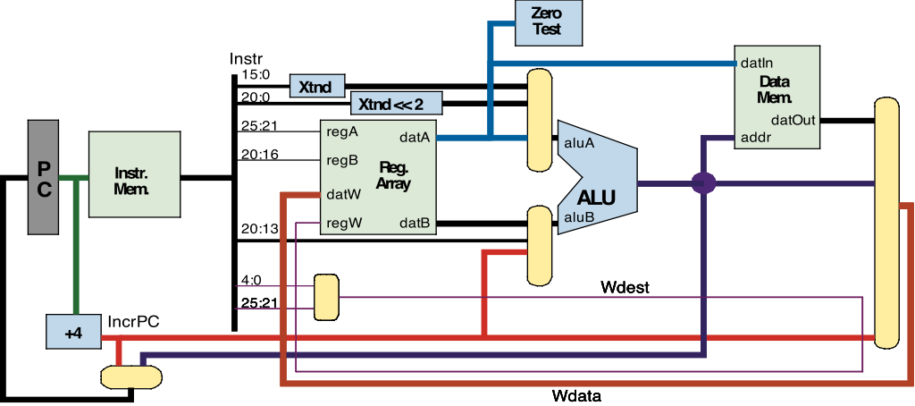
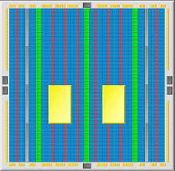
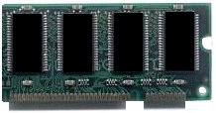
Soft Processors in FPGAs
Present
FPGA
Ethernet MAC
DDR controller
Processor(s)
Soft processors: processors in the FPGA fabric
User uploads program to soft processor
Easier to program software than hardware in the FPGA
Could be customized at the instruction level

Slide 24

Open Source Network Tester
Present
Long development cycles and high cost create a requirement for open-source network testing
Open-source hardware platform
For research and teaching community
high-performance (40GbE support)
low-cost ($1600, cost of NF board)
flexible
scalable
open-source community
www.osnt.org

Slide 25
OSNT Use Cases
Present
OSNT flexibility provides support for a wide range of use-cases
OSNT-TG (Traffic Generator)
  A single card, generating packets on four 10GbE ports
OSNT-MON (Traffic Monitor)
  a single card, capturing packets from four 10GbE ports
Hybrid OSNT
  the combination of OSNT-TG and OSNT-MON
  On a single card
Scalable OSNT
  Coordinating multiple generators and monitors
  Synchronized by a common time-base

Slide 26
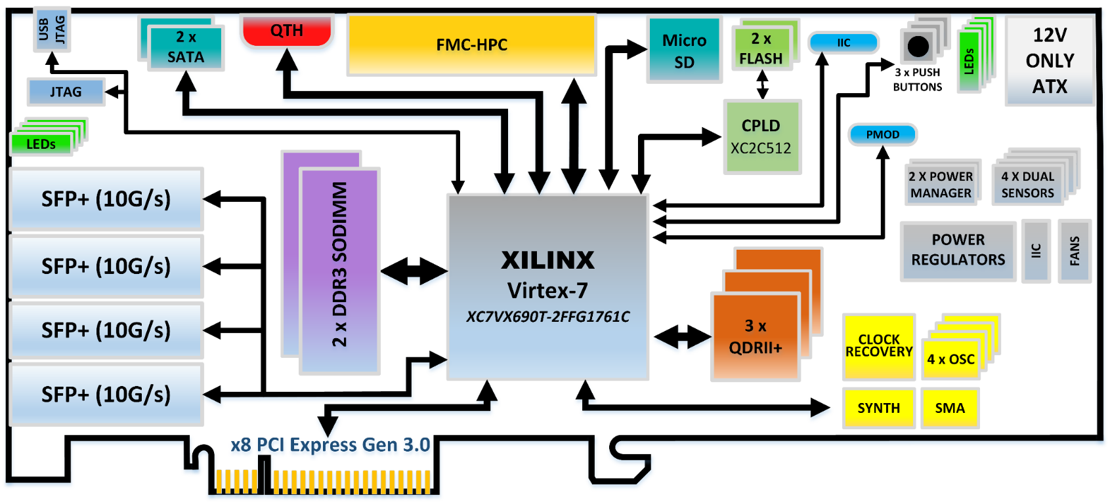
NetFPGA SUME
A Technology Enabler
Future
Stand Alone Device
100Gb/s Switch
PHY & MAC
PCIe Host Interface
Interconnect

Slide 27
100Gb/s Aggregation
Future
Need a development platform that can aggregate 100Gb/s for:
  Operating systems
  Protocols beyond TCP
NetFPGA SUME can:
  Aggregate 100Gb/s
  as Host Bus Adapter
  Be used to create large scale switches
Non-Blocking
300Gb/s Switch
Cost: ~$5000

Slide 28
Power Efficient MAC
Future
Need for 100Gb/s power-saving MAC design (e.g. lights-out MAC)
Porting MAC design to SUME permits:
  Power measurements
  Testing protocol’s response
  Reconsideration of power-saving mechanisms
  Evaluating suitability for complex architectures and systems

Slide 29
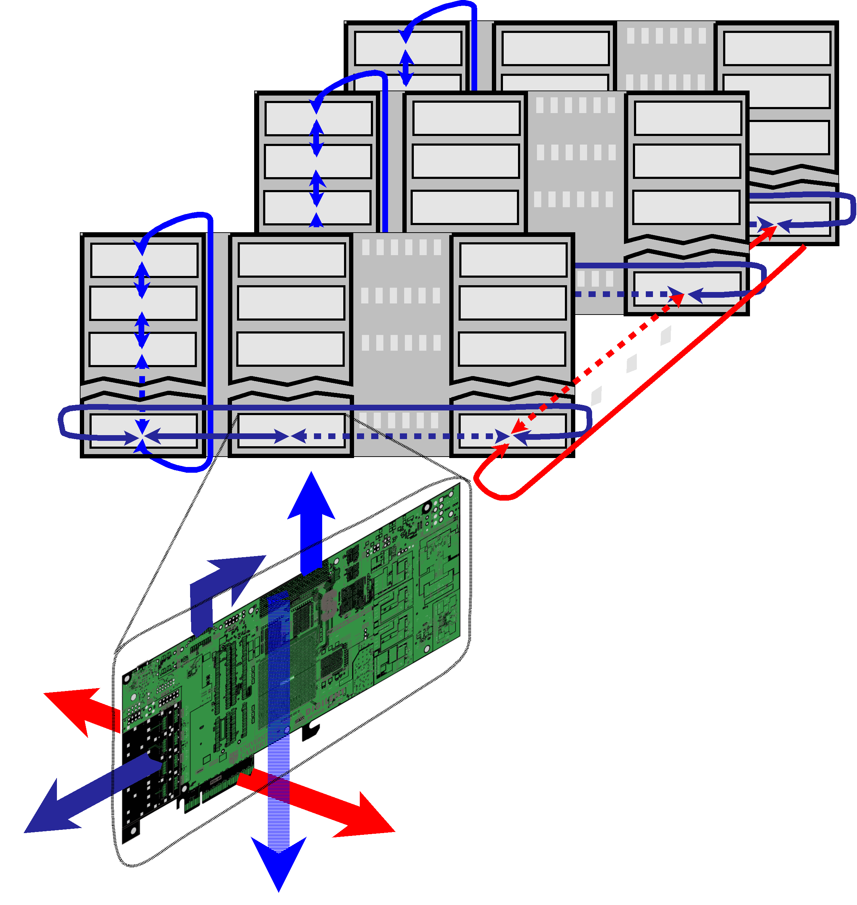
Interconnect
Future
Novel Architectures with line-rate performance
  A lot of networking equipment
  Extremely complex
NetFPGA SUME allows
prototyping a complete
solution
Camcube
N x N xN Hyper-cube

Slide 30
How might we use NetFPGA?
Build an accurate, fast, line-rate NetDummy/nistnet element
A flexible home-grown monitoring card
Evaluate new packet classifiers
  (and application classifiers, and other neat network apps….)
Prototype a full line-rate next-generation Ethernet-type
Trying any of Jon Crowcrofts’ ideas (Sourceless IP routing for example)
Demonstrate the wonders of Metarouting in a different implementation (dedicated hardware)
Provable hardware (using a C# implementation and kiwi with NetFPGA as target h/w)
Hardware supporting Virtual Routers
Check that some brave new idea actually works
  e.g. Rate Control Protocol (RCP), Multipath TCP,
toolkit for hardware hashing
MOOSE implementation
IP address anonymization
SSL decoding “bump in the wire”
Xen specialist nic
computational co-processor
Distributed computational co-processor
IPv6 anything
IPv6 – IPv4 gateway (6in4, 4in6, 6over4, 4over6, ….)
Netflow v9 reference
PSAMP reference
IPFIX reference
Different driver/buffer interfaces (e.g. PFRING)
or “escalators” (from gridprobe) for faster network monitors
Firewall reference
GPS packet-timestamp things
High-Speed Host Bus Adapter reference implementations
  Infiniband
  iSCSI
  Myranet
  Fiber Channel
Smart Disk adapter (presuming a direct-disk interface)
Software Defined Radio (SDR) directly on the FPGA (probably UWB only)
Routing accelerator
  Hardware route-reflector
  Internet exchange route accelerator
Hardware channel bonding reference implementation
TCP sanitizer
Other protocol sanitizer (applications… UDP DCCP, etc.)
Full and complete Crypto NIC
IPSec endpoint/ VPN appliance
VLAN reference implementation
metarouting implementation
virtual <pick-something>
intelligent proxy
application embargo-er
Layer-4 gateway
h/w gateway for VoIP/SIP/skype
h/w gateway for video conference spaces
security pattern/rules matching
Anti-spoof traceback implementations (e.g. BBN stuff)
IPtv multicast controller
Intelligent IP-enabled device controller (e.g. IP cameras or IP powermeters)
DES breaker
platform for flexible NIC API evaluations
snmp statistics reference implementation
sflow (hp) reference implementation
trajectory sampling (reference implementation)
implementation of zeroconf/netconf configuration language for routers
h/w openflow and (simple) NOX controller in one…
Network RAID (multicast TCP with redundancy)
inline compression
hardware accelorator for TOR
load-balancer
openflow with (netflow, ACL, ….)
reference NAT device
active measurement kit
network discovery tool
passive performance measurement
active sender control (e.g. performance feedback fed to endpoints for control)
Prototype platform for NON-Ethernet or near-Ethernet MACs
  Optical LAN (no buffers)
Build an accurate, fast, line-rate NetDummy/nistnet element
A flexible home-grown monitoring card
Evaluate new packet classifiers
  (and application classifiers, and other neat network apps….)
Prototype a full line-rate next-generation Ethernet-type
Trying any of Jon Crowcrofts’ ideas (Sourceless IP routing for example)
Demonstrate the wonders of Metarouting in a different implementation (dedicated hardware)
Provable hardware (using a C# implementation and kiwi with NetFPGA as target h/w)
Hardware supporting Virtual Routers
Check that some brave new idea actually works
  e.g. Rate Control Protocol (RCP), Multipath TCP,
toolkit for hardware hashing
MOOSE implementation
IP address anonymization
SSL decoding “bump in the wire”
Xen specialist nic
computational co-processor
Distributed computational co-processor
IPv6 anything
IPv6 – IPv4 gateway (6in4, 4in6, 6over4, 4over6, ….)
Netflow v9 reference
PSAMP reference
IPFIX reference
Different driver/buffer interfaces (e.g. PFRING)
or “escalators” (from gridprobe) for faster network monitors
Firewall reference
GPS packet-timestamp things
High-Speed Host Bus Adapter reference implementations
  Infiniband
  iSCSI
  Myranet
  Fiber Channel
Smart Disk adapter (presuming a direct-disk interface)
Software Defined Radio (SDR) directly on the FPGA (probably UWB only)
Routing accelerator
  Hardware route-reflector
  Internet exchange route accelerator
Hardware channel bonding reference implementation
TCP sanitizer
Other protocol sanitizer (applications… UDP DCCP, etc.)
Full and complete Crypto NIC
IPSec endpoint/ VPN appliance
VLAN reference implementation
metarouting implementation
virtual <pick-something>
intelligent proxy
application embargo-er
Layer-4 gateway
h/w gateway for VoIP/SIP/skype
h/w gateway for video conference spaces
security pattern/rules matching
Anti-spoof traceback implementations (e.g. BBN stuff)
IPtv multicast controller
Intelligent IP-enabled device controller (e.g. IP cameras or IP powermeters)
DES breaker
platform for flexible NIC API evaluations
snmp statistics reference implementation
sflow (hp) reference implementation
trajectory sampling (reference implementation)
implementation of zeroconf/netconf configuration language for routers
h/w openflow and (simple) NOX controller in one…
Network RAID (multicast TCP with redundancy)
inline compression
hardware accelorator for TOR
load-balancer
openflow with (netflow, ACL, ….)
reference NAT device
active measurement kit
network discovery tool
passive performance measurement
active sender control (e.g. performance feedback fed to endpoints for control)
Prototype platform for NON-Ethernet or near-Ethernet MACs
  Optical LAN (no buffers)
Well I’m not sure about you but here is a list I created:

Slide 31
How might YOU use NetFPGA?
Build an accurate, fast, line-rate NetDummy/nistnet element
A flexible home-grown monitoring card
Evaluate new packet classifiers
  (and application classifiers, and other neat network apps….)
Prototype a full line-rate next-generation Ethernet-type
Trying any of Jon Crowcrofts’ ideas (Sourceless IP routing for example)
Demonstrate the wonders of Metarouting in a different implementation (dedicated hardware)
Provable hardware (using a C# implementation and kiwi with NetFPGA as target h/w)
Hardware supporting Virtual Routers
Check that some brave new idea actually works
  e.g. Rate Control Protocol (RCP), Multipath TCP,
toolkit for hardware hashing
MOOSE implementation
IP address anonymization
SSL decoding “bump in the wire”
Xen specialist nic
computational co-processor
Distributed computational co-processor
IPv6 anything
IPv6 – IPv4 gateway (6in4, 4in6, 6over4, 4over6, ….)
Netflow v9 reference
PSAMP reference
IPFIX reference
Different driver/buffer interfaces (e.g. PFRING)
or “escalators” (from gridprobe) for faster network monitors
Firewall reference
GPS packet-timestamp things
High-Speed Host Bus Adapter reference implementations
  Infiniband
  iSCSI
  Myranet
  Fiber Channel
Smart Disk adapter (presuming a direct-disk interface)
Software Defined Radio (SDR) directly on the FPGA (probably UWB only)
Routing accelerator
  Hardware route-reflector
  Internet exchange route accelerator
Hardware channel bonding reference implementation
TCP sanitizer
Other protocol sanitizer (applications… UDP DCCP, etc.)
Full and complete Crypto NIC
IPSec endpoint/ VPN appliance
VLAN reference implementation
metarouting implementation
virtual <pick-something>
intelligent proxy
application embargo-er
Layer-4 gateway
h/w gateway for VoIP/SIP/skype
h/w gateway for video conference spaces
security pattern/rules matching
Anti-spoof traceback implementations (e.g. BBN stuff)
IPtv multicast controller
Intelligent IP-enabled device controller (e.g. IP cameras or IP powermeters)
DES breaker
platform for flexible NIC API evaluations
snmp statistics reference implementation
sflow (hp) reference implementation
trajectory sampling (reference implementation)
implementation of zeroconf/netconf configuration language for routers
h/w openflow and (simple) NOX controller in one…
Network RAID (multicast TCP with redundancy)
inline compression
hardware accelorator for TOR
load-balancer
openflow with (netflow, ACL, ….)
reference NAT device
active measurement kit
network discovery tool
passive performance measurement
active sender control (e.g. performance feedback fed to endpoints for control)
Prototype platform for NON-Ethernet or near-Ethernet MACs
  Optical LAN (no buffers)

Slide 32
Section IV: Teaching

Slide 33
NetFPGA in the Classroom
Stanford University
  EE109 “Build an Ethernet Switch”
    Undergraduate course for all EE students
    http://www.stanford.edu/class/ee109/
  CS344 “Building an Internet Router” (since ‘05)
    Quarter-long course targeted at graduates
    http://cs344.stanford.edu
Rice University
  Network Systems Architecture (since ‘08)
    http://comp519.cs.rice.edu/
Cambridge University
  Build an Internet Router (since ‘09)
    Quarter-long course targeted at graduates
    http://www.cl.cam.ac.uk/teaching/current/P33/
University of Wisconsin
  CS838 “Rethinking the Internet Architecture”
    http://pages.cs.wisc.edu/~akella/CS838/F09/
University of Bonn
  “Building a Hardware Router”
    http://bit.ly/Kmo0rA
See: http://netfpga.org/teachers.html

Slide 34
Components of NetFPGA Course
Documentation
  System Design
  Implementation Plan
Deliverables
  Hardware Circuits
  System Software
  Milestones
Testing
  Proof of Correctness
  Integrated Testing
  Interoperabilty
Post Mortem
  Lessons Learned

Slide 35
NetFPGA in the Classroom
Stanford CS344: “Build an Internet Router”
  Courseware available on-line
  Students work in teams of three
    1-2 software
    1-2 hardware
  Design and implement router in 8 weeks
  Write software for CLI and PW-OSPF
  Show interoperability with other groups
  Add new features in remaining two weeks
    Firewall, NAT, DRR, Packet capture, Data generator, …

Slide 36
CS344 Milestones
1
2
3
4
5
6
Build basic router
Command Line
Interface
Routing Protocol
(PWOSPF)
Integrate with H/W
Interoperability
Final Project
Management
& CLI
Exception
Processing
Routing
Protocols
Management
& CLI
Management
& CLI
Routing
Table
Routing
Protocols
Routing
Protocols
Innovate and add!
Presentations
Judges
Exception
Processing
Routing
Table
Exception
Processing
Routing
Table
Emulated
h/w in VNS
Emulated
h/w in VNS
Emulated
h/w in VNS
Management
& CLI
Exception
Processing
Routing
Protocols
software
Routing
Table
hardware
Forwarding
Table
Switching
Learning Environment
Modular design
Testing
Forwarding
Table
Switching
4-port non-learning
switch
4-port learning
switch
IPv4 router
forwarding path
Integrate with S/W
Interoperability

Slide 37
Typical NetFPGA Course Plan
Week | Software | Hardware | Deliver
1 | Verify Software Tools | Verify CAD Tools | Write Design Document
2 | Build Software Router | Build Non-Learning Switch | Run Software Router
3 | Cmd. Line Interface | Build Learning Switch | Run Basic Switch
4 | Router Protocols | Output Queues | Run Learning Switch
5 | Implement Protocol | Forwarding Path | Interface SW & HW
6 | Control Hardware | Hardware Registers | HW/SW Test
7 | Interoperate Software & Hardware |  | Router Submission
8 | Plan New Advanced Feature |  | Project Design Plan
9 | Show new Advanced Feature |  | Demonstration

Slide 38
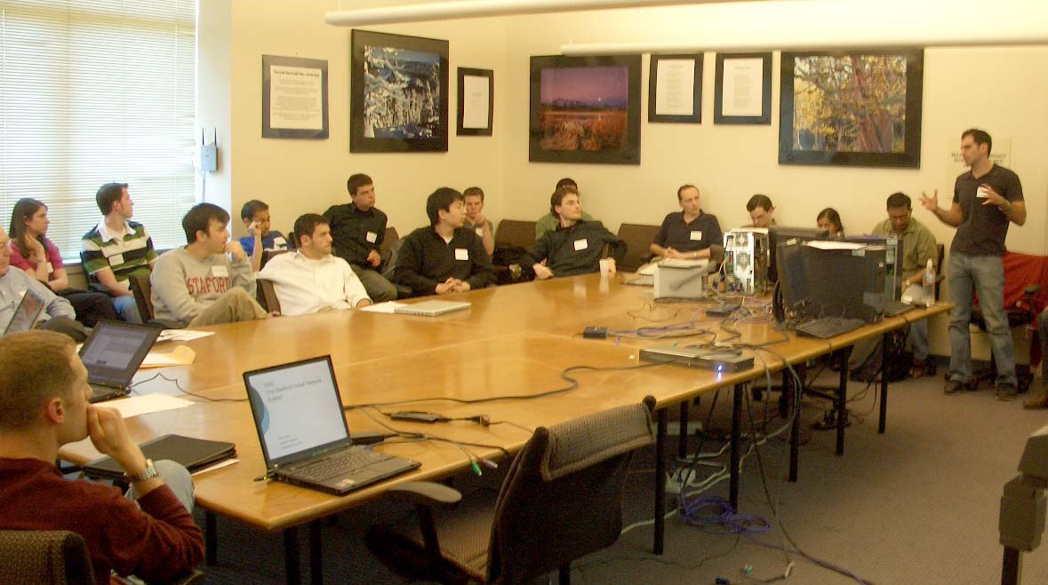
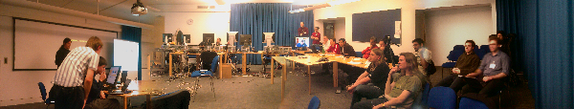
Presentations
  Stanford CS344
  http://cs344.stanford.edu
  Cambridge P33
  http://www.cl.cam.ac.uk/teaching/0910/P33/

Slide 39
Section VI: Where Next?

Slide 40
To get started with your project
New Software ideas? get familiar with the host-systems of the current reference (C and java)
replace them at will; no egos will be hurt
OR
New Hardware ideas? get familiar with
hardware description language
Prepare for your project
  Become familiar with the NetFPGA yourself
  Go to a hands-on event
Good practice is familiarity with hardware and
software…. (and it isn’t that scary - honest)

Slide 41
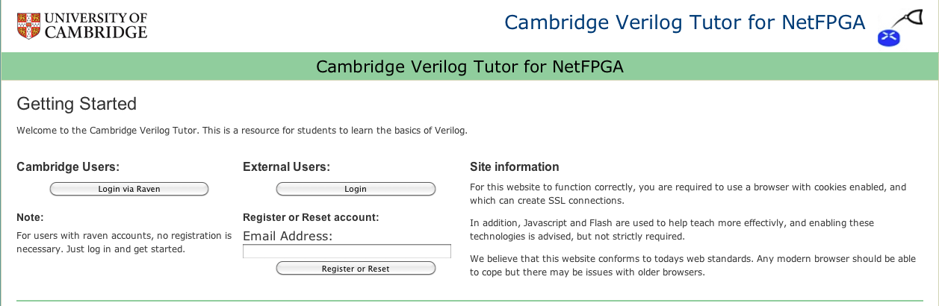

Scared by Verilog? Try our
Online Verilog tutor (with NetFPGA extensions)
www-netfpga.cl.cam.ac.uk
Support for NetFPGA enhancements provided by

Slide 42
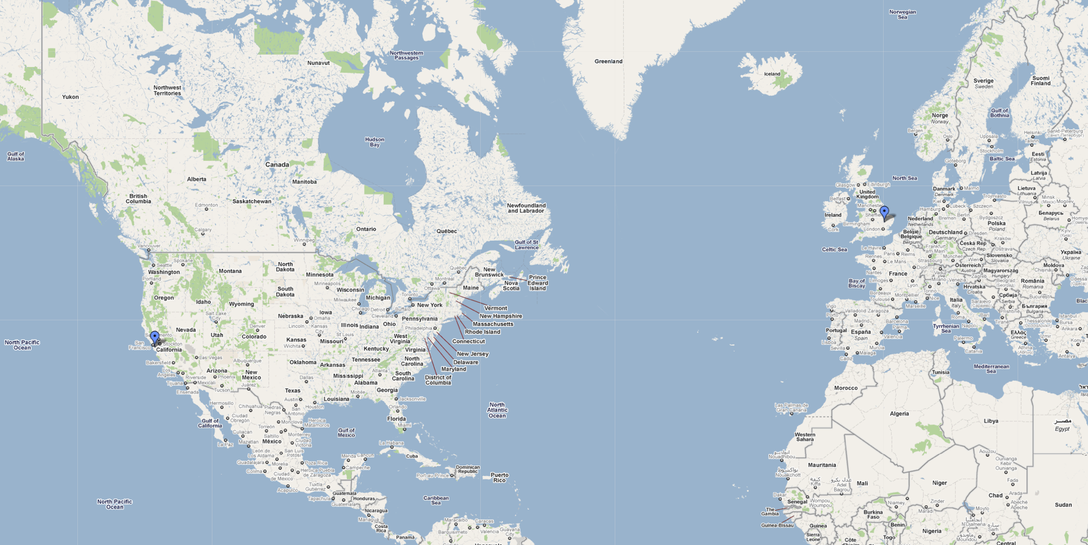
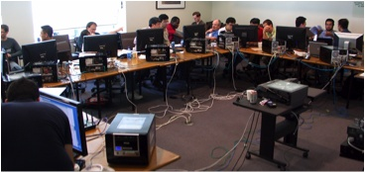
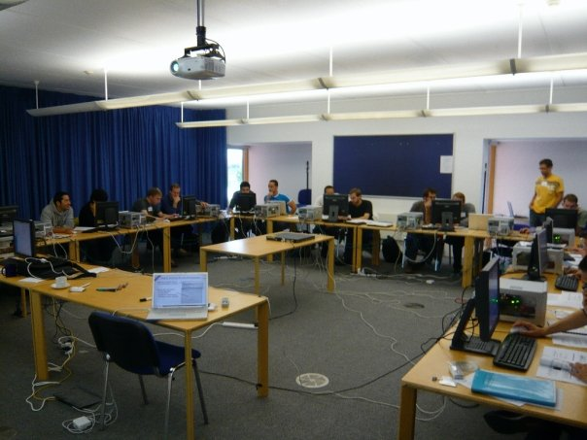
Go to a hands-on camp
Cambridge
Stanford
Check out http://www.netfpga.org/events.html

Slide 43
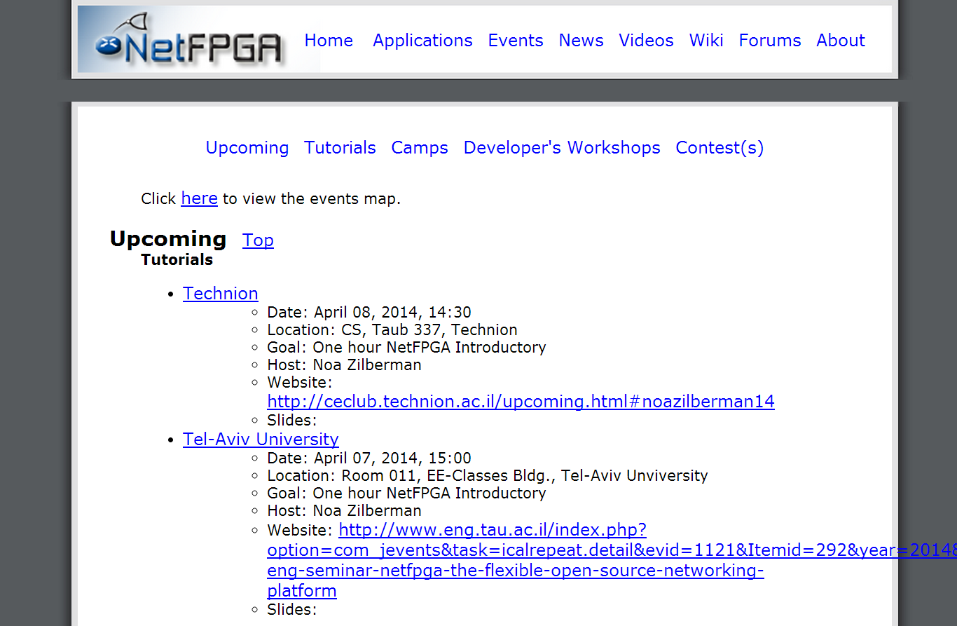
Get a hands-on tutorial
Events
NetFPGA website (www.netfpga.org)

Slide 44
Start with a board….
For US Universities (donations available)
http://netfpga.org/donation_request.html
For Non-US Universities (donations available)
http://www.xilinx.com/member/xup/donation/request.htm
For Non-Universities
http://www.hitechglobal.com/Boards/PCIExpress_SFP+.htm
http://www.digilentinc.com/Products/Detail.cfm?NavPath=2,400,1228&Prod=NETFPGA-1G-CML

Slide 45
Acknowledgments (I)
NetFPGA Team at Stanford University (Past and Present):
Nick McKeown, Glen Gibb, Jad Naous, David Erickson,
G. Adam Covington, John W. Lockwood, Jianying Luo, Brandon Heller, Paul Hartke, Neda Beheshti, Sara Bolouki, James Zeng,
Jonathan Ellithorpe, Sachidanandan Sambandan, Eric Lo
NetFPGA Team at University of Cambridge (Past and Present):
Andrew Moore, David Miller, Muhammad Shahbaz, Martin Zadnik
Matthew Grosvenor, Yury Audzevich, Neelakandan Manihatty-Bojan,
Georgina Kalogeridou, Jong Hun Han, Noa Zilberman, Gianni Antichi, Marco Forconesi
All Community members (including but not limited to):
Paul Rodman, Kumar Sanghvi, Wojciech A. Koszek,
Yahsar Ganjali, Martin Labrecque, Jeff Shafer,
Eric Keller , Tatsuya Yabe, Bilal Anwer,
Yashar Ganjali, Martin Labrecque
Kees Vissers, Michaela Blott, Shep Siegel

Slide 46












Acknowledgements (II)
Disclaimer: Any opinions, findings, conclusions, or recommendations expressed in these materials do not necessarily reflect the views of the National Science Foundation or of any other sponsors supporting this project.
This effort is also sponsored by the Defense Advanced Research Projects Agency (DARPA) and the Air Force Research Laboratory (AFRL), under contract FA8750-11-C-0249. This material is approved for public release, distribution unlimited. The views expressed are those of the authors and do not reflect the official policy or position of the Department of Defense or the U.S. Government.

Slide 47
Thank You!

Slide 48
Appendix I: Example

Slide 49
Operational IPv4 router
Java GUI
SCONE
Management
& CLI
Software
Control Plane
Routing
Protocols
Routing
Table
Reference router
Data Plane
per-packet
processing
Forwarding
Table
Switching
Queuing
Hardware

Slide 50
Streaming video

Slide 51
Streaming video
NetFPGA running
reference router
PC & NetFPGA
(NetFPGA in PC)

Slide 52

Streaming video
Video streaming over shortest path
Video
server
Video
client

Slide 53
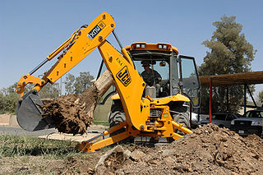
Streaming video
Video
server
Video
client

Slide 54
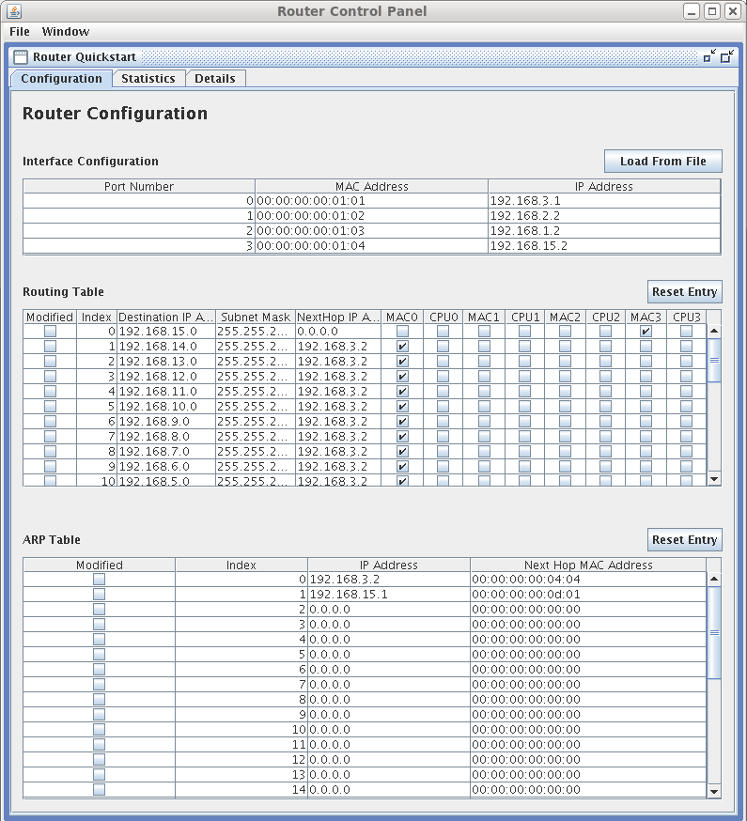
Observing the routing tables
Columns:
Subnet address
Subnet mask
Next hop IP
Output ports

Slide 55
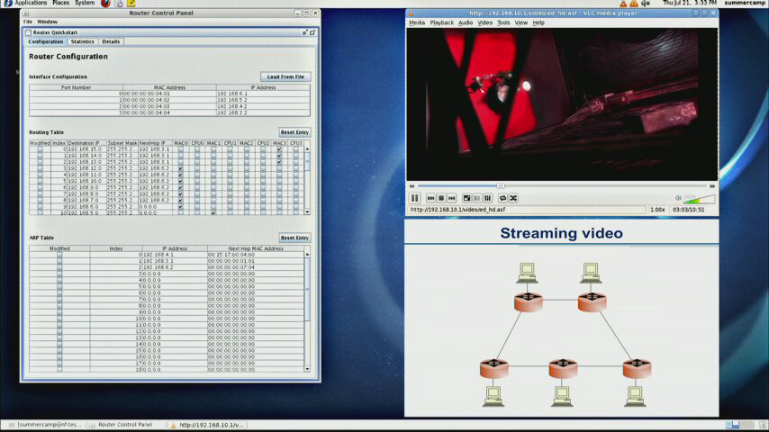

Slide 56
Review
NetFPGA as IPv4 router:
Reference hardware + SCONE software
Routing protocol discovers topology
Demo:
Ring topology
Traffic flows over shortest path
Broken link: automatically route around failure

Slide 57
Appendix II: Example II

Slide 58
Buffers in Routers
Internal Contention
Pipelining
Congestion
Rx
Tx
Rx
Tx
Rx
Tx

Slide 59





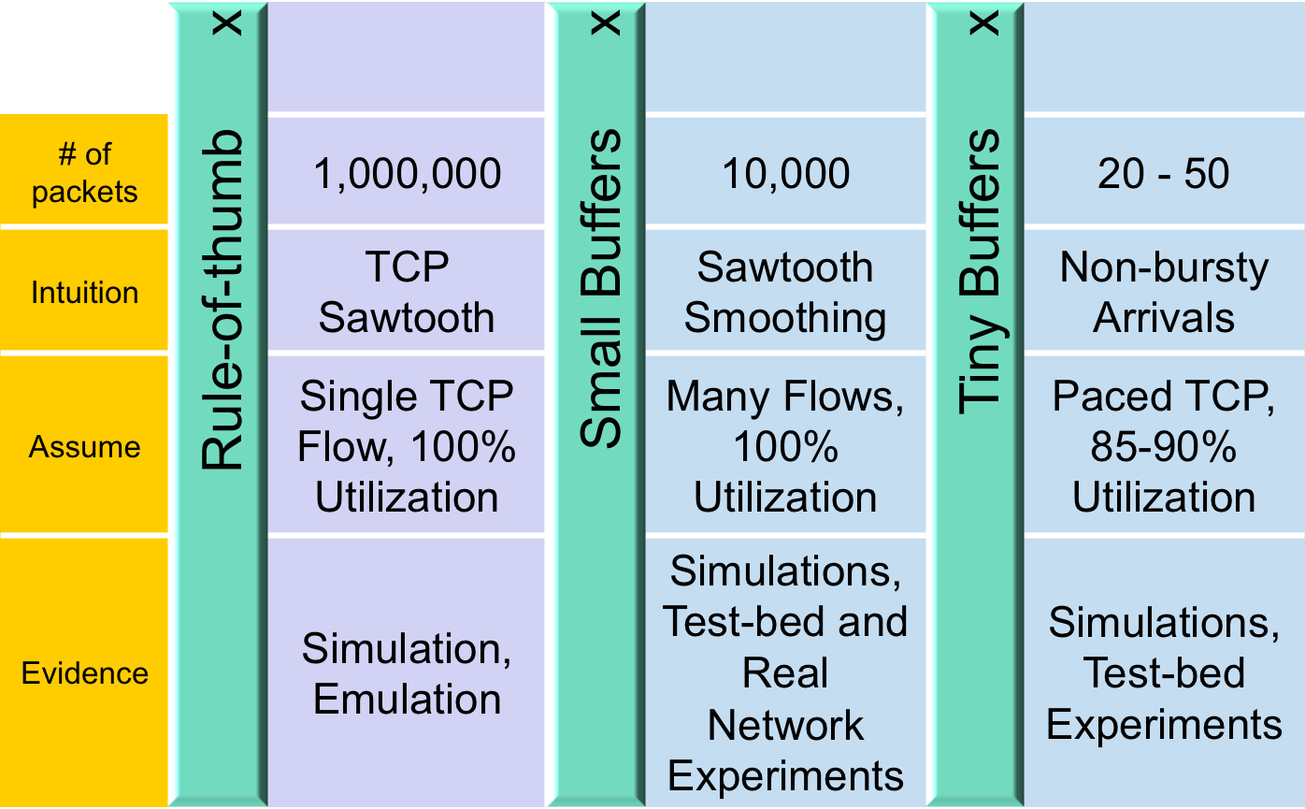
Buffer Sizing Story

Slide 60

Using NetFPGA to explore buffer size
Need to reduce buffer size and measure occupancy
Alas, not possible in commercial routers
So, we will use the NetFPGA instead
Objective:
  Use the NetFPGA to understand how large a buffer we need for a single TCP flow.

Slide 61
Reference Router Pipeline
MAC
RxQ
CPU
RxQ
MAC
RxQ
CPU
RxQ
MAC
RxQ
CPU
RxQ
MAC
RxQ
CPU
RxQ
Five stages
  Input interfaces
  Input arbitration
  Routing decision and packet modification
  Output queuing
  Output interfaces
Packet-based
module interface
Pluggable design
Input Arbiter
Output Port Lookup
Output Queues
MAC
TxQ
CPU
TxQ
MAC
TxQ
CPU
TxQ
MAC
TxQ
CPU
TxQ
MAC
TxQ
CPU
TxQ

Slide 62
Extending the Reference Pipeline
MAC
RxQ
CPU
RxQ
MAC
RxQ
CPU
RxQ
MAC
RxQ
CPU
RxQ
MAC
RxQ
CPU
RxQ
Input Arbiter
Output Port Lookup
Event Capture
Output Queues
MAC
TxQ
CPU
TxQ
Rate
Limiter
MAC
TxQ
CPU
TxQ
MAC
TxQ
CPU
TxQ
MAC
TxQ
CPU
TxQ

Slide 63
Enhanced Router Pipeline
MAC
RxQ
CPU
RxQ
MAC
RxQ
CPU
RxQ
MAC
RxQ
CPU
RxQ
MAC
RxQ
CPU
RxQ
Two modules added
  Event Capture to capture output queue events (writes, reads, drops)
  Rate Limiter to create a bottleneck
Input Arbiter
Output Port Lookup
Event Capture
Output Queues
MAC
TxQ
CPU
TxQ
Rate
Limiter
CPU
TxQ
MAC
TxQ
CPU
TxQ
MAC
TxQ
CPU
TxQ
MAC
TxQ

Slide 64
Topology for Exercise 2
Recall:
NetFPGA host PC is life-support: power & control
So:
The host PC may physically route its traffic through the local NetFPGA
NetFPGA running
extended reference router
nf2c2
nf2c1
eth2
PC & NetFPGA
(NetFPGA in PC)
eth1
Iperf
Server
Iperf Client

Slide 65
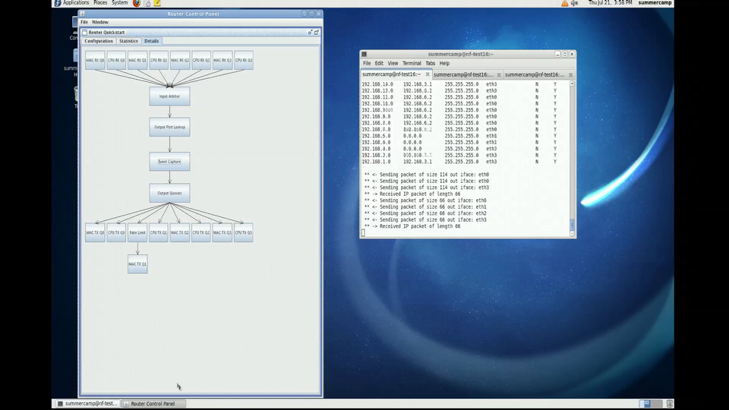

Slide 66
Review
NetFPGA as flexible platform:
Reference hardware + SCONE software
new modules: event capture and rate-limiting
Example 2:
Client Router Server topology
  Observed router with new modules
  Started tcp transfer, look at queue occupancy
  Observed queue change in response to TCP ARQ

