Slide 1
Development of Automatic Temperature Compensation Software for Optical Fibre Sensing Data
M.Res in Photonic Systems Development Mini Project
Malcolm Scott Supervisor: Prof. Kenichi Soga

Slide 2
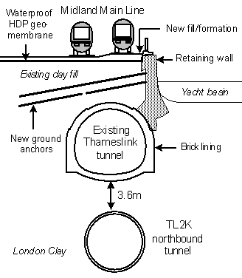
Strain Sensing in Civil Engineering
Determine how a structure moves over time
New structures – movement as soil settles, and as load increases
Old structures – measure structural health as surroundings are redeveloped
Piles, buildings, tunnels, bridges, …
Reproduced from Mohamad (2008)

Slide 3
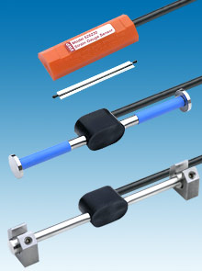
Traditional Strain Sensors
Vibrating Wire Strain Gauge
Resonant frequency of taut wire changes with tension
Point sensor, individually installed
Only a few points per structure
May miss important features in the spaces between sensors

Slide 4
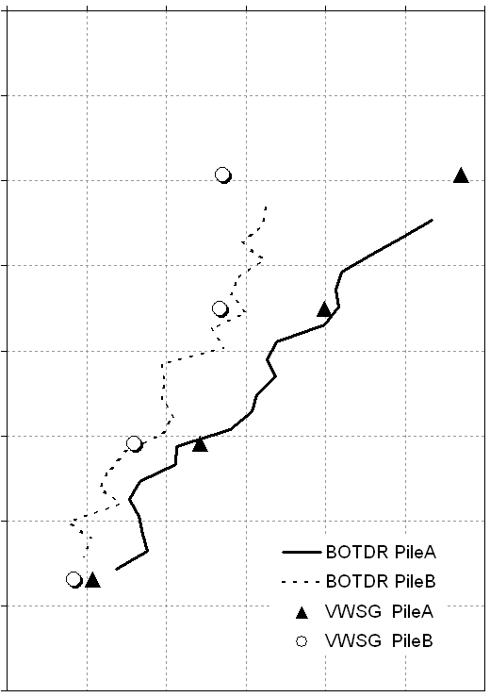
Distributed Optical Fibre Sensing
Strain
Strain profile rather than point data
Measure along the length of the fibre
Fibre itself is sensor
Brillouin Optical Time-Domain Reflectometry (BOTDR)
Distance
Reproduced from Bennett (2006)

Slide 5
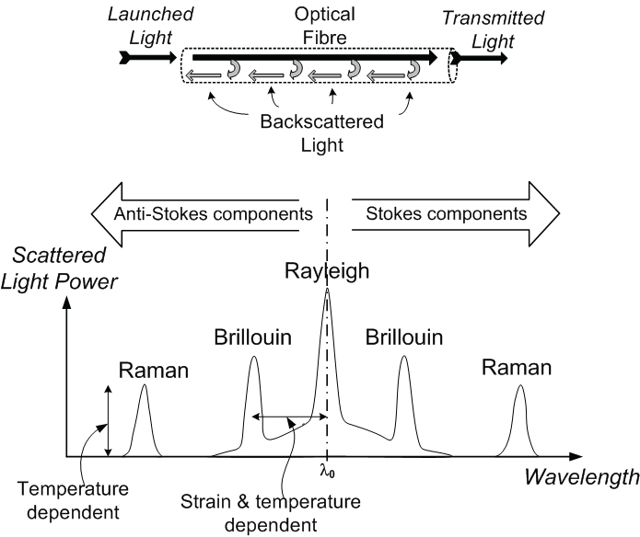
Optical Scattering
Reproduced from Mohamad (2008)

Slide 6
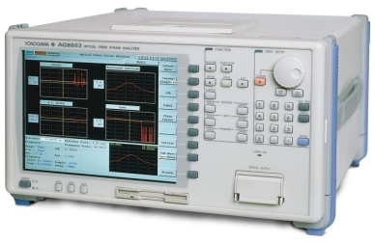
Brillouin Optical Time-Domain Reflectometry (BOTDR)
Send a short, high-power laser pulse into sensing fibre
Watch for backscattered light within the Brillouin frequency range
(Could use forward scattering, but that requires access to both ends of fibre)
Very low power!
Time of arrival  distance
Peak frequency  strain (contaminated by temperature)

Slide 7
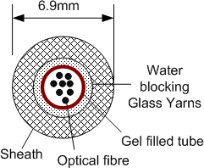
Temperature Compensation (Our Way)
Two fibres
One measures strain and temperature
One measures temperature only: Unitube gel-filled cable
Perform BOTDR on both; can (nearly) just subtract
(Take into account differing cable properties: constant factor)

Slide 8
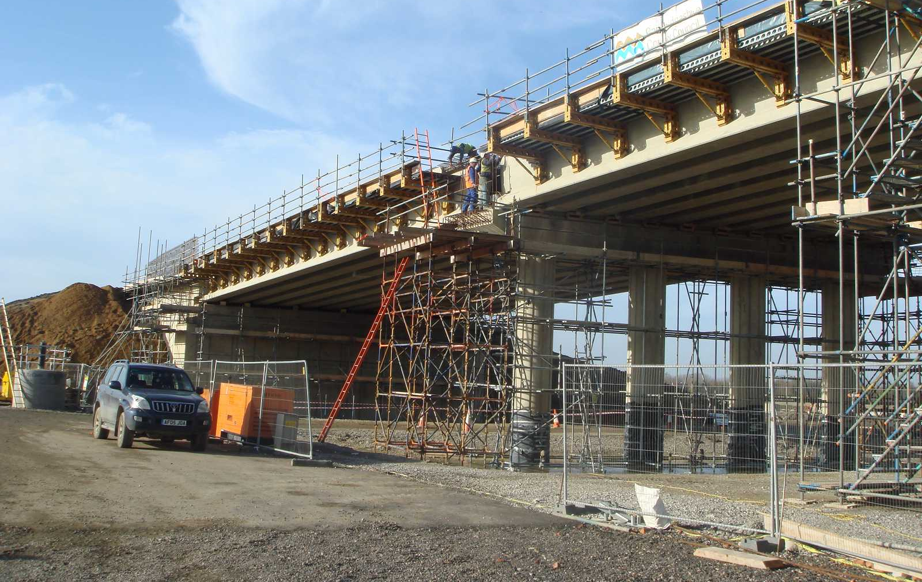
Case Study: Addenbrooke’s Access Road Bridge

Slide 9
Case Study: Addenbrooke’s Access Road Bridge

Slide 10
The Data
One strain profile: 10,000-100,000 points (calculated by equipment)
One pile/beam: ~10 strain profiles (strain + temperature, repeated; also both ends where fibre is broken)
One day’s readings: 2 beams + 7 piles
One project: so far, 7 individual days of readings; more to come
Potentially on the order of hundreds of millions of points
Processing and analysing this data is time-consuming

Slide 11
Analysis the Hard Way
Parse data
Remove bogus data from beyond the end of the fibre
Align & average repeat readings (fibre length may change: resplicing)
Mark region of interest
Correct for analyser miscalibration
Align temperature data and perform compensation
Filter noise (Savitzky-Golay)
Graph individual data sets
Resample and align successive days’ data sets
Compute and graph changes in strain profile over time
Huge Excel spreadsheet!

Slide 12
Analysis the Easy Way
Software for use by geotechnical researchers and civil engineers
Open source software
Written in Python
Object-oriented, modular, model-view-controller based
Using scientific computing libraries: NumPy, SciPy, Matplotlib
Easy to adapt and extend
Will be available online: http://strainanalyser.malc.org.uk/

Slide 13
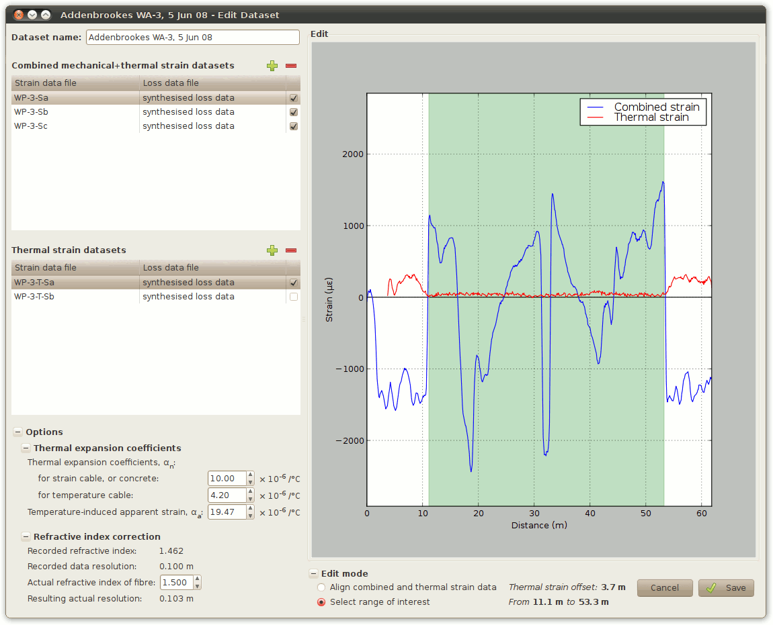

Slide 14
Thank you
http://strainanalyser.malc.org.uk/

