Slide 1

Information Flow Control and Audit for Cloud and IoT-Cloud
Jean Bacon
Computer Laboratory
University of Cambridge
jean.bacon@cl.cam.ac.uk
www.cl.cam.ac.uk/~jmb25

Slide 2


Projects
CloudSafetyNet (EPSRC), with Imperial College, Otago NZ, PHE
End-to-End Application Security in the Cloud
investigate (Decentralised) Information Flow Control (IFC) as a security technology for cloud computing
Jatinder Singh (PDRA), Thomas Pasquier (PGRA)
Microsoft Cloud Computing Research Centre, with QMUL
investigating technology to enforce laws/regulations and to demonstrate compliance and accountability

Slide 3
Structure of the talk
Need for protection, sharing and audit in cloud and cloud-IoT
Why cloud services are good for IoT
Traditional security is necessary but not sufficient
-------------------
(Decentralised) Information Flow Control (IFC)
introduction and examples
IFC CamFlow implementation (very brief)
What IFC can contribute – potential of IFC

Slide 4
Motivation
“Security concerns hinder cloud adoption”
Therefore, cloud design focus has always been on
strong isolation to keep tenants separate
  via VMs at IaaS level (e.g. Xen)
  via containers
  above a common OS for PaaS and SaaS levels
  also, IaaS level may provide an OS
Even with strong isolation technology, private clouds are still used for sensitive data e.g. PHE cancer registry

Slide 5
Isolation via Containers (e.g. Docker)
App A container
App B container
App A
Ann
App A
Bob
App B
Bob
App B
Carl
Resources
Resources
Cloud OS
Access Control is done separately by App A and App B
Ann can’t interact with Carl
Bob (App A) can’t share data with Bob (App B)
Sharing requires mutual trust e.g. if Bob’s App A data is shared with App B, App A must trust App B not to leak it to Carl.
No further control over data once access is granted

Slide 6
Data Sharing Requirements – Cloud
Sharing/interaction between related applications
  e.g. local government apps share data on citizens
  such as: council tax, parking fines, social services, electoral roll …
  e.g. marketplace of open services
  – compose dynamically to create higher-level services.
  such as: GCloud, Open Cloud Exchange (OCX)
Public - Private cloud interaction
e.g. health records on private cloud
  patients’ web portal on public cloud
  patients’ personal health and lifestyle monitoring data
  in home system and/or public or personal edge-cloud
Need protection AND controlled sharing ….
….. even more for IoT-Cloud

Slide 7
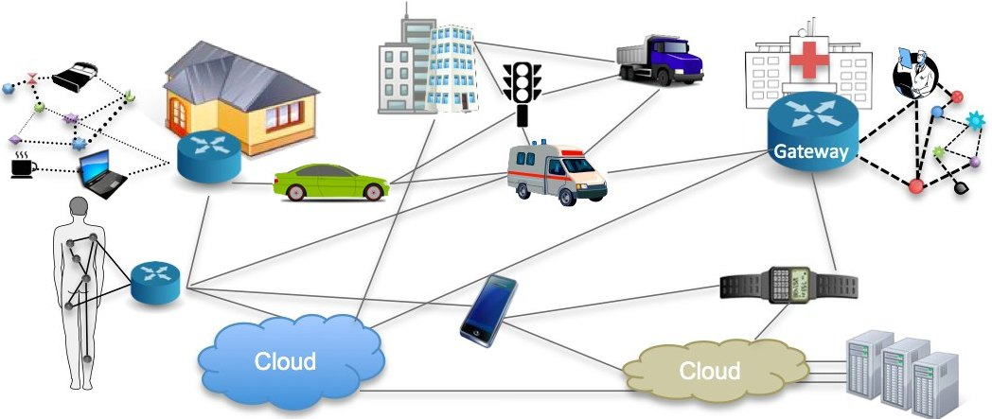
IoT-Cloud illustration
ISO: “an infrastructure of interconnected objects, people, systems and
information resources together with intelligent services to allow them
to process information of the physical and virtual world and to react.”

Slide 8
IoT Vision
ISO: “an infrastructure of interconnected objects, people, systems and information resources together with intelligent services to allow them to process information of the physical and virtual world and to react.”
Characteristics of IoT
Personal, sensitive data (ubiquitous surveillance)
  Dynamic composition of `things’ to create new applications
  - possibly unforeseen by things’ developers
Implication
`things’ cannot contain embedded policy on their usage
can’t “stop the world” to recompile, reconfigure and restart
policy needs to be managed separately
policy controls `things’ configurations and interactions dynamically

Slide 9
IoT-Cloud Benefits
Cloud services have a part to play in IoT
  Cloud services can operate across devices, systems, services, ….
  Natural place for data aggregation and analysis
  Natural place for management, coordination and control (policy)
  Natural place for sharing data between `things’
Benefits of using Cloud components in IoT
  Always on
  Resources scale to meet demand
  Support offloading for computation and storage
  e.g. from resource-constrained `things’

Slide 10
Security for Cloud and Cloud-IoT
Isolation technology
  cloud isolation technology can be used as needed
  for protection without sharing
  as well as data protection, data sharing will also be needed
OTS/standard security technologies
  point-to-point encryption for communications
  application-level encryption of data
  - needs (complex) key management for processing and sharing
  PKI to identify entities (`things’, `things’ owners, etc.)
Access Control for cloud and cloud-IoT?

Slide 11
Traditional Access Controls - 1
Authentication
  “you are who you say you are”
  use passwords, public/private key-pairs, biometrics …
Authorisation
  “you are entitled to carry out some action”
  use ACLs, Role Certificates, Capabilities
These are:
Application – specific
policy consistency not ensured across applications
cloud-provided data stores are shared by apps
Principal/Role - specific
Applied only at specific Policy Enforcement Points (PEPs)

Slide 12
Traditional Access Controls - 2
After access is granted:
  No subsequent control over data-use by authorised party
  No guarantee of consistent policy when apps are
  combined/configured dynamically
IoT
  similarly – no control after data leaves personal domain
  e.g. I may consent to usage A of my data
  but it may be used subsequently for B without my knowledge

Slide 13
Legal/Regulatory Sanctions?
Current cloud contracts
  “take it or leave it”
  “if a service is free, you’re not the customer, you’re the product”
  provider accepts no responsibility for data loss or data leakage
  you agree to data analytics and targeted advertising
  Ref “Cloud Computing Law” OUP 2013, ed. C. Millard

Slide 14
Audit
Need for Audit for both Cloud and IoT
  How has data been used as it flows system-wide?
  Compliance with contract – if negotiated contracts were possible ….
  Compliance with law and regulation, e.g. EU C7-0025/12
  “personal data on EU citizens should not leave the EU”
  Manual compliance processes are very expensive (certification)

Slide 15
CloudSafetyNet Project
Clouds need continuous, system-wide, data flow control
to provide protection AND (cross-application) sharing
with audit for accountability to demonstrate compliance/provenance
- investigate IFC for this purpose
Cloud-provided software is more trustworthy and trusted
than apps running as cloud tenants with end users
- investigate IFC as a cloud-OS mechanism for PaaS and SaaS clouds.

Slide 16
Structure of the talk
Need for protection, sharing and audit in cloud and IoT-cloud
Why cloud services are good for IoT
Traditional security is necessary but not sufficient
------------------------------
(Decentralised) Information Flow Control (IFC)
introduction and examples
IFC CamFlow implementation (very brief)
What IFC can contribute – potential of IFC

Slide 17
Information Flow Control (IFC)
Continuous, system-wide, data flow control with audit
  Data is tagged – tags stay with (stick to) data as metadata
  A tag represents a security concern e.g.
  e.g. source, type, sensitivity, state
  EU, hosp-dev, medical, personal, ann, encrypted, anonymised
  Tags are grouped into labels
  Secrecy label S and Integrity label I are sets of tags
  e.g. S = {medical, ann} I = {hosp-dev, consent}
  All entities, whether active or passive, are labelled
  (data, processes, pipes, files, messages etc.)
  Definition:
  the state of S and I is the security context of the entity

Slide 18
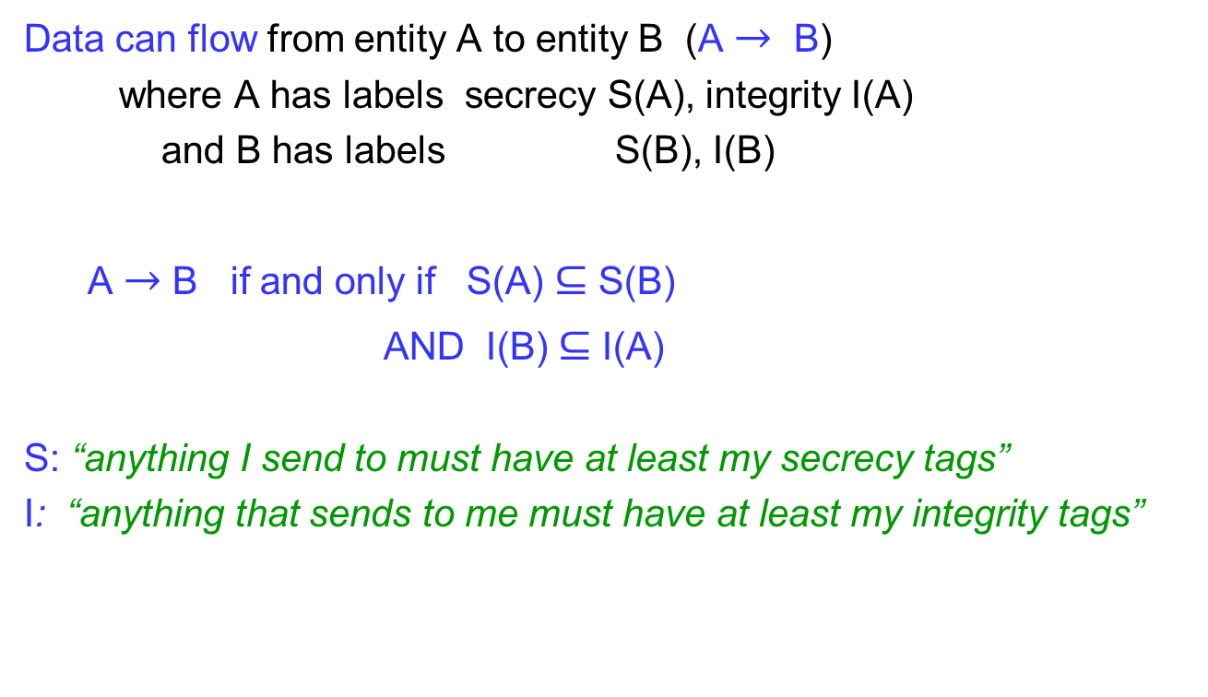
IFC – Flow Rule
Data can flow from entity A to entity B (A $→$ B)
where A has labels secrecy S(A), integrity I(A)
and B has labels S(B), I(B)
A $→$B if and only if S(A) $⊆$S(B)
AND I(B) $⊆$I(A)
S: “anything I send to must have at least my secrecy tags”
I: “anything that sends to me must have at least my integrity tags”

Slide 19
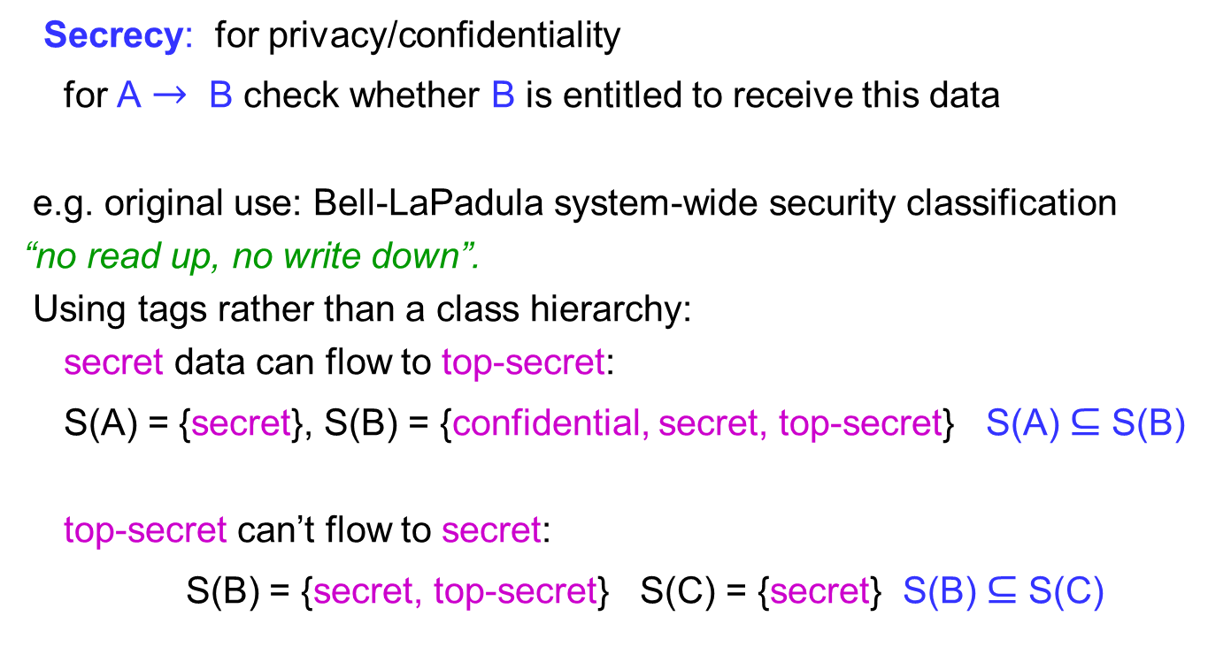
IFC – Flow Rule (secrecy)
Secrecy: for privacy/confidentiality
for A $→$ B check whether B is entitled to receive this data
e.g. original use: Bell-LaPadula system-wide security classification
“no read up, no write down”.
Using tags rather than a class hierarchy:
secret data can flow to top-secret:
S(A) = {secret}, S(B) = {confidential, secret, top-secret} S(A) $⊆$S(B)
top-secret can’t flow to secret:
S(B) = {secret, top-secret} S(C) = {secret} S(B) $⊆$S(C)

Slide 20
IFC – Flow Rule (integrity 1)
Integrity: the data quality/format,
the sender’s authority to send,
what the recipient will take responsibility for accepting
data quality/format:
  data from across the network and user input are not trustworthy
  downloaded software may be from an untrusted source
  input code/scripts may be attacks
  data may be from a non-standard device (BYOD)
  and/or in a non-standard data format

Slide 21
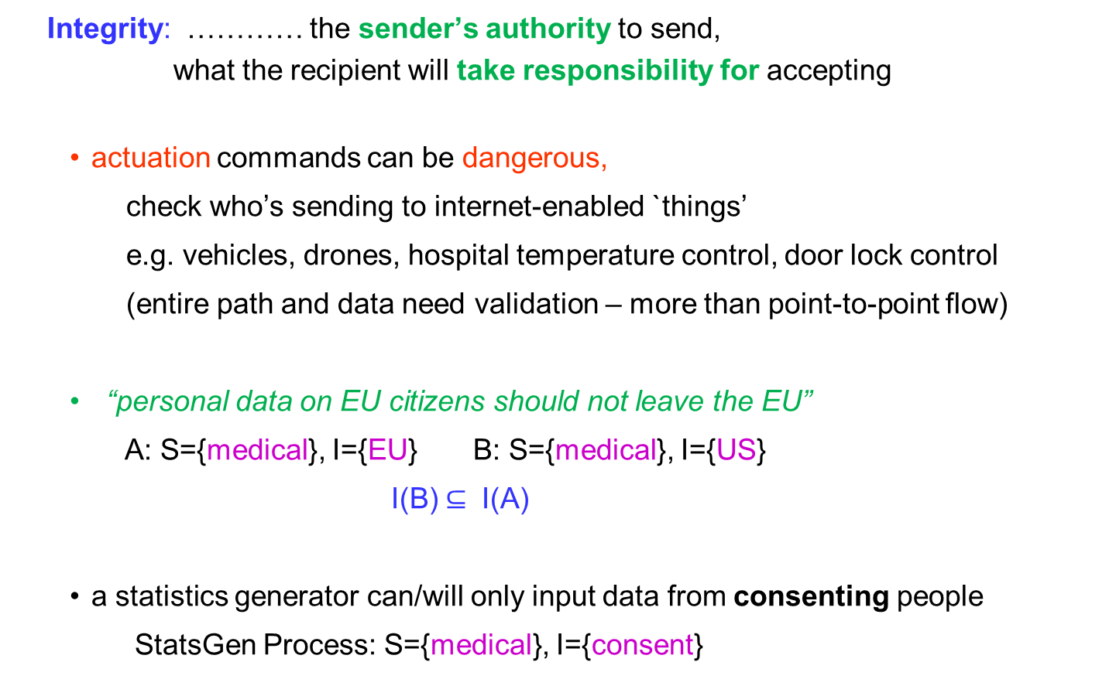
IFC – Flow Rule (integrity 2)
Integrity: ………… the sender’s authority to send,
what the recipient will take responsibility for accepting
  actuation commands can be dangerous,
  check who’s sending to internet-enabled `things’
  e.g. vehicles, drones, hospital temperature control, door lock control
  (entire path and data need validation – more than point-to-point flow)
    “personal data on EU citizens should not leave the EU”
A: S={medical}, I={EU} B: S={medical}, I={US}
I(B) $⊆$ I(A)
  a statistics generator can/will only input data from consenting people
  StatsGen Process: S={medical}, I={consent}

Slide 22
Reminder (slide 5): Isolation via Containers
App A container
App B container
App A
Ann
App A
Bob
App B
Bob
App B
Carl
Resources
Resources
Cloud OS
From slide 5:
Sharing requires mutual trust
e.g. if Bob’s App A data is shared with App B,
App A must trust App B not to leak it to Carl.
No further control over data once access is granted

Slide 23
Cloud Container Example redone with IFC (S)
AppA
Ann
AppA
Bob
AppB
Bob
AppB
Carl
S={cambsA,
ann}
S={cambsA,
bob,
cambsB}
S= {cambsB,
bob,
cambsA}
S={cambsB,
carl,
cambsA, ann}
Cloud OS with IFC enforcement
Protection between App A and App B by secrecy tags cambsA and cambsB,
and between end users of apps by secrecy tags ann, bob, carl
Sharing only allowed when tags are propagated to App instances according to policy and negotiation
Note: one-way or two-way flow can be set up. Two-way needs equal tags.
One way: S={cambsA, ann} to S={cambsB, carl, cambsA, ann} not vice-versa.
Carl can only send Ann’s data to a process with S containing {cambsA, ann}
(in fact, destination’s S label must contain tags {cambsB, carl, cambsA, ann} )

Slide 24
IFC: IoT-Cloud System Example
Sensor manager, collects data for processing and storage
Ann’s Home Monitoring App
S = {medical, ann} I = {hosp-dev, consent}
I: check source I has
hosp-dev, consent
Zeb’s Home Monitoring App
S = {medical, zeb} I = {byod, consent}
S: check destination S has
medical, ann
Illegal flow (prevented)
destination S has no zeb
source I has no hosp-dev
X
Ann’s (Cloud-Based) Hospital Data Analysis App
S = {medical, ann} I = {hosp-dev, consent}
Aggregates and analyses data – detects potential emergencies
sends alerts to emergency services

Slide 25
IFC – Creation Rule
When an active entity creates another entity
the child (created entity) inherits the labels of its parent (creator)
e.g. process (by fork), file, pipe, creating a message to send
So how can you create a child with fewer tags than you?
Privileged processes can change their security context
  they have privilege-sets of tags that they can
  add-to/remove-from their S and I labels
  in our system CamFlow, label change must be explicit
  (implicit is dangerous
  – could accidentally declassify and send out top secret data)

Slide 26
IFC: Creation of Labelled Entities
application instances
never change security context
- unaware of IFC
Ann’s Home Monitoring App
S = {medical, ann} I = {hosp-dev, consent}
Ann’s Hospital Data Analysis App
S = {medical, ann} I = {hosp-dev, consent}
Manager changes its security context
before creating Ann’s Apps
creation
S = {medical, ann} I = {hosp-dev, consent}
Manager of Hospital Home Monitoring
S = {medical, ann, ……., zeb} I = {hosp-dev, byod, consent}
A privileged Application Manager process

Slide 27
IFC Endorsement
this process is instanced for each patient
to manage sensor data
Zeb’s Home Monitoring App
S = {medical, zeb} I = {byod, consent}
privileged Input Sanitiser
sets up its security context to read Zeb’s non-standard data and convert it into standard form
S = {medical, zeb} I = {byod, consent}
Device Input Sanitiser
S = {medical, zeb} I = {hosp-dev, consent}
it changes its security context to output data
in standard format
to the Data Analyser
Zeb’s Hospital Data Analysis App
S = {medical, zeb} I = {hosp-dev, consent}
this process is instanced for each patient
to read data in standard format for processing

Slide 28
IFC Declassification
Ann’s (cloud-based) Hospital Data Analysis App.
S = {medical, ann} I = {hosp-dev, consent}
(standardised) data from
other patients bob … zeb
creates stats,
anonymises data
changes security context
before output
S = {medical, ann, ……., zeb} I = {hosp-dev, consent}
Hospital Home-Monitoring Statistics Generator
S = {medical, stats} I = {anon}
output can only go to appropriately labelled process
Hospital Manager (human)
S = {medical, stats} I = {anon}
Hospital Manager cannot read and does not take responsibility for knowing individual patient data

Slide 29
Composing components
Ann’s Home Monitoring App
etc. ….
Zeb’s Home Monitoring App
emergency actuations
Input Sanitiser
Ann’s Data Analyser
etc. ….
Zeb’s Data Analyser
data analyser
detects emergency,
sends alerts
emergency
doctor
Hospital Home-Monitoring
Statistics Generator
Medical Research
Statistics Generator
new components can be configured into the system
Hospital Manager
Medical
Researcher
Medical
Researcher

Slide 30
IFC Summary
IFC enforces data flows according to policy
provides protection and sharing as required
Tags are metadata, transparent to entities
Very simple policy expression
Continuous enforcement on every data flow
Audit – all flows can be recorded
– at a level meaningful to applications (a.o.t. syslogs)

Slide 31
IFC Implementation
Implemented? FlowR (Ruby+AoP), FlowK (syscall intercept)
CamFlow
- OS level: 2 open source LSMs www.camflow.org
CamFlow IFC and CamFlow Audit.
(LSMs became stackable during the project.)
- middleware: still some work needed on SBUS integration
ongoing work by Pasquier at Harvard uses MQTT
Overhead? CamFlow neglibible in OS for cloud – IoT still to be evaluated
Does software have to be rewritten to run with IFC?
Only (App) managers that need to change their security context.
(WiP on automating this - see ACM SACMAT 2016)
App instances can run without IFC awareness.

Slide 32
CamFlow OS-level Implementation
secure security contexts (S,I) set up for end users’ App instances.
context
store
translate between application-level
tag names and kernel-level names (64 bit IDs)
Name/Context Manager
CamFlow trusted process
Library with CamFlow
Application Process
(S, I )
Library with CamFlow
CamFlow Messaging
trusted process
Library with CamFlow
send message
OS kernel
CamFlow LSMs
message to
remote process
System calls are unchanged
Linux Security Module (LSM) enforces IFC
Rest of OS kernel is unchanged for maintainability
Processes need not be aware of IFC
unless they are privileged to change their security context (S,I)
IFC calls via CamFlow library

Slide 33
Much work remains
Our publications to date are at
http://cl.cam.ac.uk/research/srg/opera/publications
There are many interesting questions to work on!
More: Thursday Session 5 13:45
Big Ideas paper: Policy-driven middleware for a legally compliant IoT
Presented by Jat Singh
Thank You !

Slide 34
IFC – A Brief History
1976: Denning security hierarchies
  data labelled
  principals also labelled according to their security clearance
1990s IFC in languages and libraries (decentralised IFC (DIFC))
e.g. Myers and Liskov SOSP 1997
2000s IFC at the OS level
e.g. Flume, SOSP 2007
Distributed OS
e.g. Dstar, Usenix 2008
IFC implementations summarised in
our IEEE TNSM paper

Slide 35
IFC: Two-Component (2D) Tags
For large-scale data processing we propose 2D tags of the form <concern, specifier>
e.g. Ann may have tags <medical, ann>, <personal, ann> etc.
<medical,*> stands for all specifiers of concern medical
Ann’s Hospital Data Analysis App
S = {<medical, ann>} I = {<dev, hosp-dev>, <consent, Y>}
data from
other patients
S = {<medical, *>} I = {<dev, hosp-dev>, <consent,Y>}
Hospital Home-Monitoring Statistics Generator
S = {<medical, stats>} I = {<state, anon>, <consent, Y>}
Monitor changes
its security context
(declassifies the data)
before output
can only output to appropriately labelled process
Hospital Policy Manager
S = {<medical, stats>} I = {<state, anon>, <consent, Y>}

