Slide 1
Privacy-Preserving Analytics in and out of the Clouds
Jon Crowcroft,
http://www.cl.cam.ac.uk/~jac22

Slide 2
1. Private Data Center->Public Cloud
Health or Finance data, for example
  Farr/NHS Scotland
  HSBC
Motives for public cloud
  Scale out/cost save
  Higher Throughput analytics
  Share “access” with more researchers
  <Yours goes here>

Slide 3
Infrastructure Location
Keep friends&enemies near:
  Legal/Regulatory Stuff (incl GDPR)
  Latency/Availability etc
  Control (physical access etc)
Need to virtualise these (better)
  Crypt Data at rest
  Crypt data during “processing”
  key management etc
  Enclave… SGX,Trust Zone, AMD, CHERI

Slide 4
GDPR – 2018 – right to an explanaion
Mistakes happen
  Error on input
    e.g.amout of $, age, etc
  Mistake in code
    e.g. if (C=3) {} …
  Mistake in training
    e.g. Selection bias – prob of re-offending only trained on offenders
  Mistake in ML/Inference
    E.g. Acquire a latent variable/rule == gender (or age)
  Something we havnt though of yet
    Emergence?
Right to REDRESS, and balance asymmetric Power

Slide 5
MARU….@ turing.ac.uk
ATI w/ Intel, Dstl, Docker, Microsoft
Compare what is in SGX
  Enter/leave cost, crypt memory o/h etc
  Hypervisor?
Compare w/ container on trustzone, cheri, AMD etc
  Common APIs for keys etc
  Virtualize?
Pen test
  many side channel pb
  What if weak homomorphic crypto & diff priv?

Slide 6
Outline
1. Motivation: Trustworthy data processing in untrusted clouds
2. Overview of Intel SGX
3. Description of SGX-LKL Design
4. Description of preliminary SGX-Spark Design
5. Source code release of Java support on GitHub

Slide 7
1. Motivation: Trustworthy Data Processing

Slide 8


Trust Issues: Provider Perspective
Cloud provider does not trust users
Use virtual machines to isolate
users from each other and the host
VMs only provide one way protection
Redis
OS
VMM
Firmware
trusted
Cloud platform
Staff
…

Slide 9
Trust Issues: User Perspective
Users trust their applications
Users must implicitly trust
cloud provider
Existing applications implicitly
assume trusted operating system
Redis
OS
VMM
Firmware
untrusted
Cloud platform
Staff
…

Slide 10




Trusted Execution Support with Intel SGX
Users create HW-enforced trusted environment (enclave)
Supports unprivileged
user code
Protects against strong attacker model
Remote attestation
Available on
commodity CPUs
Enclave
OS
VMM
Firmware
untrusted
Cloud platform
Staff
…

Slide 11
2. Overview of Intel SGX

Slide 12
Trusted Execution Environments
Trusted execution environment (TEE)
in process
  Own code & data
  Controlled entry points
  Provides confidentiality & integrity
  Supports multiple threads
  Full access to application memory
User process
OS
Enclave
Enclave
code
Enclave
Enclave
data
Application
code
Threads
…
Application
data

Slide 13
Intel Software Guard Extensions (SGX)
Extension of Instruction Set Architecture (ISA) in recent Intel CPUs
  Skylake (2015), Kaby lake (2016)
Protects confidentiality and integrity of code & data in untrusted environments
  Platform owner considered malicious
  Only CPU chip and isolated region trusted

Slide 14
SGX Enclaves
SGX introduces notion of enclave
  Isolated memory region for code & data
  New CPU instructions to manipulate enclaves
  and new enclave execution mode
Enclave memory encrypted and integrity-
protected by hardware
  Memory encryption engine (MEE)
  No plaintext secrets in main memory
Enclave memory can be accessed only by enclave code
  Protection from privileged code (OS, hypervisor)
Application has ability to defend secrets
  Attack surface reduced to just enclaves and CPU
  Compromised software cannot steal application secrets
Process
✔
Enclave
✘
✘
✘
OS
Hypervisor

Slide 15
SGX SDK Code Sample
SGX application: untrusted code
char request_buf[BUFFER_SIZE];
char response_buf[BUFFER_SIZE];
int main()
{
...
while(1)
{
receive(request_buf);
ret = EENTER(request_buf, response_buf);
if (ret < 0)
fprintf(stderr, "Corrupted message\n");
else
send(response_buf);
}
...
}
Enclave: trusted code
char input_buf[BUFFER_SIZE];
char output_buf[BUFFER_SIZE];
int process_request(char *in, char *out)
{
copy_msg(in, input_buf);
if(verify_MAC(input_buf))
{
decrypt_msg(input_buf);
process_msg(input_buf, output_buf);
encrypt_msg(output_buf);
copy_msg(output_buf, out);
EEXIT(0);
} else
EEXIT(-1);
}
Server:
Receives encrypted requests
Processes them in enclave
Sends encrypted responses

Slide 16
SGX Enclave Construction
DRAM
1
char input_buf[BUFFER_SIZE];
char output_buf[BUFFER_SIZE];
int process_request(char *in, char *out)
{
copy_msg(in, input_buf);
if(verify_MAC(input_buf))
{
decrypt_msg(input_buf);
process_msg(input_buf, output_buf);
encrypt_msg(output_buf);
copy_msg(output_buf, out);
EEXIT(0);
} else
EEXIT(-1);
}
2
3
EPC
Enclave populated using special instruction (EADD)
Contents initially in untrusted memory
Copied into EPC in 4KB pages
Both data & code copied before execution commences in enclave

Slide 17
SGX Enclave Construction
Enclave contents distributed in plaintext
  Must not contain any (plaintext) confidential data
Secrets provisioned after enclave constructed and integrity verified
Problem: what if someone tampers with enclave?
  Contents initially in untrusted memory
int process_request(char *in, char *out)
{
copy_msg(in, input_buf);
if(verify_MAC(input_buf))
{
decrypt_msg(input_buf);
process_msg(input_buf, output_buf);
encrypt_msg(output_buf);
copy_msg(output_buf, out);
EEXIT(0);
} else
EEXIT(-1);
}
int process_request(char *in, char *out)
{
copy_msg(in, input_buf);
if(verify_MAC(input_buf))
{
decrypt_msg(input_buf);
process_msg(input_buf, output_buf);
copy_msg(output_buf, external_buf);
encrypt_msg(output_buf);
copy_msg(output_buf, out);
EEXIT(0);
} else
EEXIT(-1);
}
Write unencrypted response to outside memory

Slide 18
SGX Enclave Measurement
CPU calculates enclave measurement hash during enclave construction
  Each new page extends hash with page content and attributes (read/write/execute)
  Hash computed with SHA-256
Measurement can be used
to attest enclave to local or
remote entity
DRAM
CPU
c0 94 7d bc 35 52 ba
9a 16 a6 63 0b 72 09
0d 0f 15 0b d0 2d ae
1a 55 f9 2f a8 20 98
EPC
CPU calculates enclave measurement hash during enclave construction
Different measurement if enclave modified

Slide 19
SGX Enclave Attestation
Is my code running on remote machine intact?
Is code really running inside an SGX enclave?
Local attestation
  Prove enclave’s identity (= measurement) to another enclave on same CPU
Remote attestation
  Prove enclave’s identity to remote party
Once attested, enclave can be trusted with secrets

Slide 20
Local Attestation
Prove identity of A to local enclave B
Enclave A
Enclave B
1. Hi! I’m 5f904ba8910bff! Who are you?
0d 0f 15 0b d0 2d ae
0d 0f 15 0b d0 2d ae
4. Here is my report
3. Here you go!
Measurement (enclave A)
6. Here you go!
0d 0f 15 0b d0 2d ae
2. Please create a report for 5f904ba8910bff
Measurement (enclave B)
5. Please give me my report verification key
5f 90 4b a8 91 0b ff
CPU
Target enclave B measurement required for key generation
Report contains information about target enclave B, including its measurement
CPU fills in report and creates MAC using report key, which depends on random CPU fuses and target enclave B measurement
Report sent back to target enclave B
Verify report by CPU to check that generated on same platform, i.e. MAC created with same report key (available only on same CPU)
Check MAC received with report and do not trust A upon mismatch

Slide 21
Remote Attestation
Transform local report to remotely verifiable “quote”
Based on provisioning enclave (PE) and quoting enclave (QE)
  Architectural enclaves provided by Intel
  Execute locally on user platform
Each SGX-enabled CPU has unique key fused during manufacturing
  Intel maintains database of keys

Slide 22
Remote Attestation
PE communicates with Intel attestation service
  Proves it has key installed by Intel
  Receives asymmetric attestation key
QE performs local attestation for enclave
  QE verifies report and signs it using attestation key
  Creates quote that can be verified outside platform
Quote and signature sent to remote attester, which communicates with Intel attestation service to verify quote validity

Slide 23
SGX Limitations & Research Challenges
Amount of memory enclave can use needs to be known in advance
  Dynamic memory support in SGX v2
Security guarantees not perfect
  Vulnerabilities within enclave can still be exploited
  Side-channel attacks possible
Performance overhead
  Enclave entry/exit costly
  Paging very expensive
Application partitioning? Legacy code? …

Slide 24
3. Description of SGX-LKL

Slide 25


SGX-LKL: Supporting Managed Runtimes in SGX
Many applications need runtime support
  JVM
  .NET
  JavaScript/V8/Node.js
Requires complex system support
  Dynamic library loading
  Filesystem support
  Signal handling
  Complete networking stack
Notes:
So, what is meant by Remote Data Processing? I will use Cloud Computing as an obvious example, also because a lot of the research work I looked at during my survey take it as a basis. So, in recent years, many applications have been moved from private infrastructures into the cloud, often, the public cloud, were an external clodu provider such as Amazon, Google, or Microsoft provides the infrastructure for an application to run on. As you probably know, cloud computing can provide application owners with a number of advantages such as high performance, scalability, high flexiblity, reduced costs. All that is based on the sharing of resources in cloud environments which is one reason why cloud computing…

Slide 26
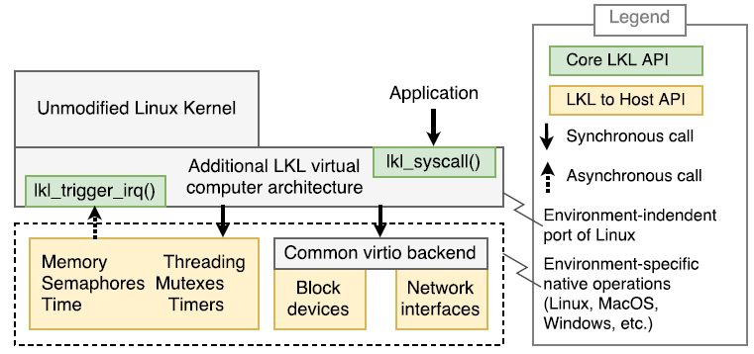
SGX-LKL: Linux Kernel Library inside SGX Enclaves
Based on Linux Kernel Library (LKL)
  Implemented as architecture-specific port of mainline Linux (github.com/lkl)
  Follows Linux no MMU architecture
  Full filesystem support
  Full network stack available
Notes:
So, what is meant by Remote Data Processing? I will use Cloud Computing as an obvious example, also because a lot of the research work I looked at during my survey take it as a basis. So, in recent years, many applications have been moved from private infrastructures into the cloud, often, the public cloud, were an external clodu provider such as Amazon, Google, or Microsoft provides the infrastructure for an application to run on. As you probably know, cloud computing can provide application owners with a number of advantages such as high performance, scalability, high flexiblity, reduced costs. All that is based on the sharing of resources in cloud environments which is one reason why cloud computing…

Slide 27
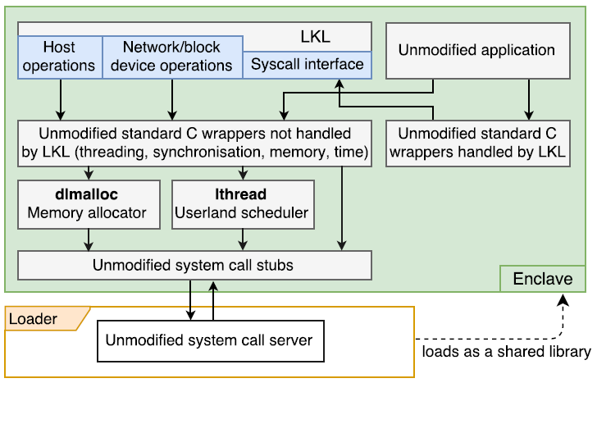
SGX-LKL Architecture
Runs unmodified Linux applications in SGX enclaves
Applications and dependencies provided via disk image
Full Linux kernel functionality available
Custom memory allocator
User-level threading
  In-enclave synchronisation
  primitives
Notes:
So, what is meant by Remote Data Processing? I will use Cloud Computing as an obvious example, also because a lot of the research work I looked at during my survey take it as a basis. So, in recent years, many applications have been moved from private infrastructures into the cloud, often, the public cloud, were an external clodu provider such as Amazon, Google, or Microsoft provides the infrastructure for an application to run on. As you probably know, cloud computing can provide application owners with a number of advantages such as high performance, scalability, high flexiblity, reduced costs. All that is based on the sharing of resources in cloud environments which is one reason why cloud computing…

Slide 28
4. Description of SGX-Spark

Slide 29

Secure Big Data Processing
Processing of large amounts of sensitive information
Outsourcing of data storage and processing
Cloud provider can access processed data
  Not acceptable for number of industries
Task 1
Task n
def main(args: Array[String]) {
new SparkContext(new SparkConf())
.textFile(args(0))
.flatMap(line => {line.split(" ")})
.map(word => {(word, 1)})
.reduceByKey{case (x, y) => x + y}
.saveAsTextFile(args(1))
}
Spark
Spark
Spark
Spark
Task1
T
...
Taskn
Task1
...
Taskn
Task1
...
Taskn
Task1
...
Taskn
Spark
Spark
Spark
Spark
JVM
JVM
JVM
JVM
JVM
JVM
JVM
JVM
OS
OS
TEE
OS
OS
TEE
OS
OS
TEE
OS
OS
TEE
Distributed File System

Slide 30
Secure Machine Learning
Secure machine learning (ML) killer application for Maru
  Resource-intensive thus good use case for cloud usage
  Raw training data comes with security impliations
Complex implementations of ML algorithms cannot be adapted for SGX
  Consider Spark MLlib with 100s of algorithms
Challenges
  Extremely data-intensive domain
  Must support existing frameworks (Spark, TensorFlow, MXNet, CNTK, …)
  ML requires accelerators support (GPUs, TPUs, …)
  Prevention of side-channel attacks

Slide 31
State of the Art
Protect confidentiality and integrity of tasks and input/output data
Opaque [Zheng, NSDI 2017]
  Hide access patterns of distributed data analytics (Spark SQL)
  Introduces new oblivious relational operators
  Does not support arbitrary/existing Scala Spark jobs
VC3 [Schuster, S&P 2015]
  Protects MapReduce Hadoop jobs
  Confidentiality/integrity of code/data; correctness/completeness of results
  No support for existing jobs → Re-implement for VC3

Slide 32

SGX Support for Spark
SGX-Spark
  Protect data processing from infrastructure provider
  Protect confidentiality & integrity of existing jobs
  No modifications for end users
  Acceptable performance overhead
Idea:
Execute only sensitive parts of Spark inside enclave
  Code that accesses/processes sensitive data
Code outside of enclave only accesses encrypted data
  Partition Spark
  Run two collaborating JVMs, inside enclave and outside of enclave
Spark
Spark
Manage-
ment
Spark
Taskn
Task1
Taskn
JVM
JVM
OS
OS
TEE
SGX

Slide 33
Challenges & Current State
1. Partitioning Spark
2. Data movement between JVMs
3. Memory efficiency

Slide 34
1. Partitioning Spark
Goal: Move minimal amount of Spark code to enclave
Outside | Enclave
HadoopRDD Provide iterator over input data partition (encrypted)
MapPartitionsRDD Execute user-provided function (f) (eg flatMap(line => {line.split(" ")}) (i) Serialise user-provided function f (ii) Send f and it to enclave JVM (iv) Receive result iterator it_result | (iii) Decrypt input data (iv) Compute f(it) = it_result (v) Encrypt result
ExternalSorter Execute user-provided reduce function g (eg reduceByKey{case (x, y) => x + y}) | (iii) Decrypt input data (iv) Compute g(it2) = it2_result (v) Encrypt result
ResultTask Output results
it
f,it
it2 = it_result
g,it2
it2_result

Slide 35
1. Partitioning Spark
RDD
Task
SgxTask
MapPartitions
RDD
HadoopRDD
ResultTask
SgxFirstTask
SgxOtherTask
SgxFct2
ItProvider
ItConsumer
ItConsumer
ItProvider
SgxMain
Encryption
Encryption
Encryption
Encryption
Encryption
Communication
Communication

Slide 36
1. Partitioning Spark
ResultTask
k’
MapPartitions
RDD C
j’
MapPartitions
RDD B
i’
HadoopRDD A
Outside
Enclave
Tasks
Iterators
Iterate via shm
<outfile>
<infile>
A,B,C,D
i,j,k

Slide 37
1. Partitioning Spark
ResultTask
I
Communication
ItConsumer k
k
ItProvider k
k’
k
MapPartitions
RDD C
k=SgxTask(C,j)
SgxTask C
j’
j
MapPartitions
RDD B
j=SgxTask(B,i)
SgxTask B
ItConsumer i
i’
HadoopRDD A
i
ItProvider i
Outside
Enclave
Tasks
Iterators
Iterate via shm
<outfile>
<infile>
A,B,C,D
i,j,k

Slide 38
2. Data Movement between JVMs
Goal: Shared memory
Use use host OS shared memory between two JVMs
  Outside access by enclave JVM
Manage shared memory between outside and enclave
Implement high-level read/write primitives

Slide 39
1. Partitioning Spark
RDD
Task
SgxTask
MapPartitions
RDD
HadoopRDD
ResultTask
SgxFirstTask
SgxOtherTask
SgxFct2
ItProvider
ItConsumer
ItConsumer
ItProvider
SgxMain
Encryption
Encryption
Encryption
Encryption
Encryption
Shm
Communication
Manager
Shm
Communication
Manager
RingBuffer
RingBuffer
Serialisation
Serialisation
Host OS
shmem

Slide 40
2. Distributed Analytics
Motives e.g.
  Move code to data
  Keep data close to owner/primary user
  Guarantee can audit trail access
  Add yours here
Challenges
  Depends on ML technology of choice & goal
    PCA/Clustering, random forests
    Curve fittign (regression etc)
    Model Inferencing – e.g. Bayesian inference
  Distrubuted differential privacy tricky
  Hierarchical versus P2P?

Slide 41
Future Proof for GDPR
Privacy by Design and by Default – HAT address all GDPR privacy requirement from its design principle to its security solution.
  HAT ecosystem data exchange is based on fully specified privacy terms - time specific, recipient specific, minimum data points specific with full intention disclosed. Violation against any of such terms may result a ban from the Ecosystem.
Consent by design and by default -
  the PCST PoC mandates a “specific, informed and freely given and unambiguous” intension disclosure of data usage, for every single personal data access instances.
  HAT technology ensures that an exchange is only authorised and kept valid by individual’s case specific consent
Rights for Individuals by design and by default – encapsulated personal data containers isolated for each individual, allows an individual is in full control of its HAT, hence inherently owns all of the following:
  Right to Access | Right to be informed | Right to rectification | Right to restrict processing | Right to object to market
  Right of data portability | Right to be forgotten | Right to object to automated decision making and profiling
Accountability and governance - PCST CoP mandates every ecosystem member to higher level of accountability and governance practice.
  Record keeping – HAT ecosystem automatically tracks data exchange, even at a much more granular level than GDPR requires – it documents the exchange parties, time of access, detailed data points, intension and T&C, for every single transaction.
  Data protection by design and by default - The HATDeX-serviced HAT is designed with multiple layers of protection, covering Data at Rest, Data in Transit and Data in Use. ( http://www.hatdex.org/wp-content/uploads/2016/06/hatdex-briefing-Issue-2_FINAL.pdf)
Mandatory breach notification - HAT’s API driven ecosystem automatically records all exchanges breach tracking and investigation
GDPR Roundtable discussion consulted a few HAT research team members for the design of the legislation. HAT ecosystem can ensure GDPR compliance, and further mandates tighter terms than GDPR as entry requirements from all parties who wish to operate within this ecosystem following its PCST (Privacy, Confidentiality, Security and Trust) Code of Practice (http://hatcommunity.org/other-resources/).
Notes:
GDPR 101 for internal use - https://docs.google.com/spreadsheets/d/1Z4kct1PH3scJ1f2WolNEUODP2Afjp9I8yiwFMLRc5ec/edit#gid=0

Slide 42

Distributed Analytics outline
Part I: Quick Overview of Owl
Part II: Probabilistic Synchronous Parallel

Slide 43
What Is Owl
An experimental and above all scientific computing system.
Designed in functional programming paradigm.
Goal: as concise as Python yet as fast as C, and safe.
A comprehensive set of classic numerical functions.
A fundamental tooling for modern data analytics (ML & DNN).
Native support for algorithmic differentiation, distributed & parallel computing, and GPGPU computing.

Slide 44














Vision Beyond Research Prototype
Write code once, then deploy it everywhere …
MirageOS
Unikernel
Owl
Owl system provides us a complete set of tooling from the powerful numerical supports in development to the deployment on various platforms.

Slide 45
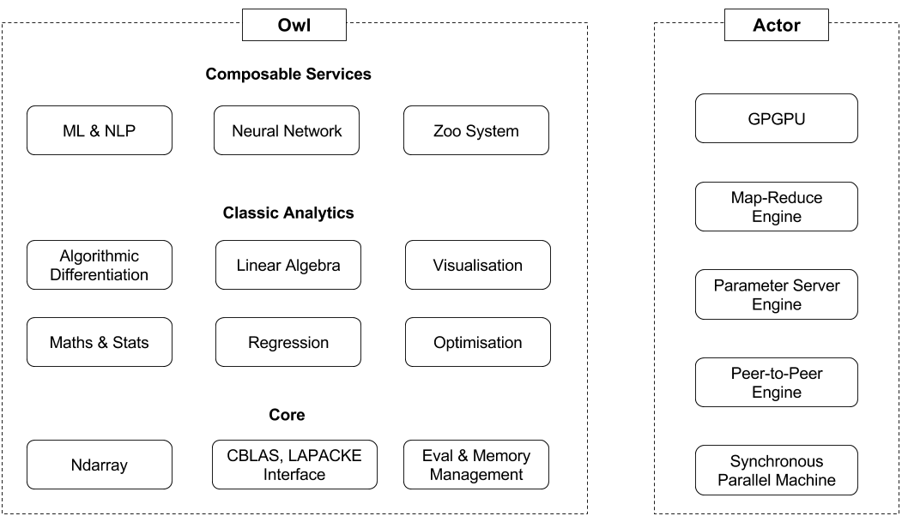
Owl’s Architecture
Owl + Actor = Distributed & Parallel Analytics
Owl provides numerical backend; whereas Actor implements the mechanisms of distributed and parallel computing. Two parts are connected with functors.
Various system backends allows us to write code once, then run it from cloud to edge devices, even in browsers.
Same code can run in both sequential and parallel mode with Actor engine.

Slide 46
Research
6
1. Jiaxin Zhao - Composable Analytical Services using Session Types for Distributed Personal Data
2. Ben Catterall - Probabilistic Synchronous Parallel - A New Barrier Control Method for Distributed Machine Learning
3. D.S.R Royson - Optimising Adaptive Learning in Distributed Machine Learning
4. Dhruv Makwana - Memory Management using Linear Types for High-Performance GPGPU Numerical Computing
5. Tudor Tiplea - Deploying Browser-based Data Analytics at Network Edge
1
3
5
4
2
6. Liang Wang - Owl: A General-Purpose Numerical Library in OCaml
Presented in ICFP’17 OCaml meeting, tutorial in CUFP’17.

Slide 47
Parallel and Distributed Computing
Parallel and distributed computing is achieved by composing the different data structures in Owl’s core library with specific engines in Actor system.

Slide 48
Owl + Actor : Ndarray Example
A map function on local ndarray x in Owl looks like this
Dense.Ndarray.S.map sin x
How to implement a distributed map on distributed ndarray?

Slide 49
Owl + Actor : Ndarray Example
Like playing LEGO, we plug Ndarray into Distribution Engine to make a distributed Ndarray.
module M = Owl.Parallel.Make (Dense.Ndarray.S) (Actor.Mapre)
Composed by a functor in Owl_parallel module, which connects two systems and hides details.
M.map sin x

Slide 50
Owl + Actor : Neural Network Example
Similarly, this also applies to more advanced and complicated data structures such as neural network. This is how we define a NN in Owl:
let network =
input [|28;28;1|]
|> lambda (fun x -> Maths.(x / F 256.))
|> conv2d [|5;5;1;32|] [|1;1|] ~act_typ:Activation.Relu
|> max_pool2d [|2;2|] [|2;2|]
|> dropout 0.1
|> fully_connected 1024 ~act_typ:Activation.Relu
|> linear 10 ~act_typ:Activation.Softmax
|> get_network
Then we can perform training locally as below
Owl.Neural.S.Graph.train network

Slide 51
Owl + Actor : Neural Network Example
To enable the parallel training on a computer cluster, we can combine Graph with Param engine.
module M = Owl.Parallel.Make (Owl.Neural.S.Graph) (Actor.Param)
We only write code once, Owl’s functor stack generates both sequential and parallel version for us!
M.train network

Slide 52
Key to Scalability
Actor implements three engines, maybe more in future.
All reply on a module called Synchronous Parallel which handles synchronisation.
Corner stone of large scale distributed learning :)

Slide 53
Synchronous Parallel Machine
An abstract computer for designing parallel algorithms.
Three components:
  A local processor equipped with fast memory;
  A network that routes messages between computers;
  A (hw/sw) component to synchronise all computers;
Powerful model for designing and programming parallel systems, building block of Apache Hadoop, Spark, Hama, etc.

Slide 54


Barrier Synchronisation
The third component barrier synchronisation, is the core of SPM. It’s all about how to coordinate computation on different computers to achieve certain consistency.
Progress is measured by supersteps (iterations).
That’s where we need a central server, in order to maintain the global state.
Progress
Global state
# 0
# 1
# 2
P#0
Comm may happen here, to ensure the consistency through the global state.
P#1
Processes
P#2
P#3
Barrier Synchronisation

Slide 55
Consistency Is Not Free Lunch
Real world iterative learning algorithm aims fast convergence.
Convergence rate decreases if iteration rate is slow or updates are noisy.
Synchronisation can reduce the noise in updates (improved consistency).
Tight synchronisation is sensitive to stragglers and has poor scalability.
Tight synchronisation renders high communication cost in large systems.

Slide 56
Existing Models in Use
Bulk synchronous parallel (BSP)
Stale Synchronous parallel (SSP)
Asynchronous parallel (ASP)
BSP
SSP
ASP
P#0
P#0
P#0
P#1
P#1
P#1
P#2
P#2
P#2
P#3
P#3
P#3
Hadoop, Spark, Parameter Server, Pregel, Owl+Actor ...
Parameter Server, Hogwild!, Cyclic Delay, Yahoo! LDA, Owl+Actor ...
Parameter Server, Hogwild!, Yahoo! LDA, Owl+Actor ...

Slide 57
A 10,000 Foot View
BSP
SSP
ASP
P#0
P#0
P#0
P#1
P#1
P#1
P#2
P#2
P#2
P#3
P#3
P#3
Most strict lockstep synchronisation; all the nodes are coordinated by a central server.
BSP is sensitive to stragglers so is very slow. But it is simple due to its deterministic nature, easy to write application on top of it.
SSP relaxes consistency by allowing difference in iteration rate. The difference is controlled by the bounded staleness.
SSP is supposed to mitigate the negative effects of stragglers. But the server still requires global state.
Least strict synchronisation, no communication among workers for barrier synchronisation all all.
Every computer can progress as fast as it can. It is fast and scalable, but often produces noisy updates. No theoretical guarantees on consistency and algorithm’s convergence.

Slide 58

Consistency vs. Iteration Rate
We must balance consistency vs. iteration rate , we can think in the following way to understand the trade-off:
Convergence Consistency Degree x Iteration Rate
SSP aims to cover this spectrum between BSP and ASP by parameterising the staleness.
Convergence rate
SSP parameterises the consistency by staleness.
ASP
BSP
Weak consistency
Fast iteration rate
Strong consistency
Slow iteration rate
Question: Is SSP really a generalisation of of BSP and ASP?
BSP and SSP are both centralised whereas ASP are fully distributed. It feels like SSP has missed something in this spectrum. What is it?

Slide 59
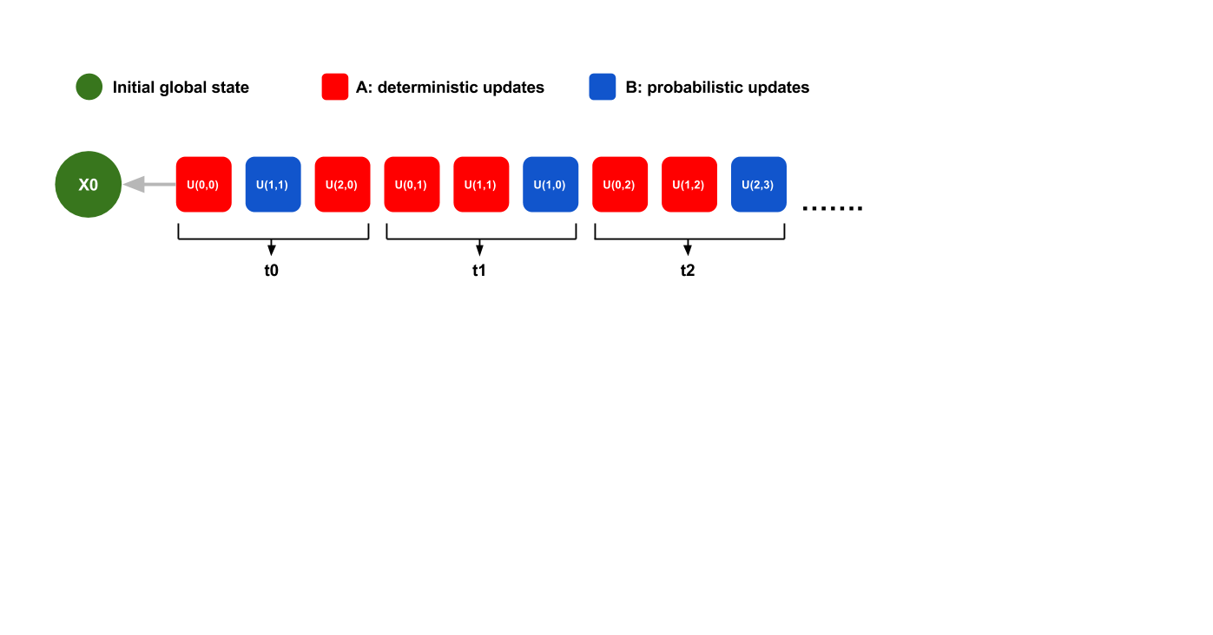
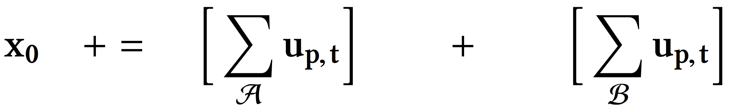
Analytical Model
The model is simple: a sequence of updates applying to an initial global state x0. The updates can be “noisy” hence are divided into two sets.
Although simple, it can model most iterative learning algorithms.
u(p,t)is update(node id, timestamp), sum over all the nodes and clock ticks ...

Slide 60
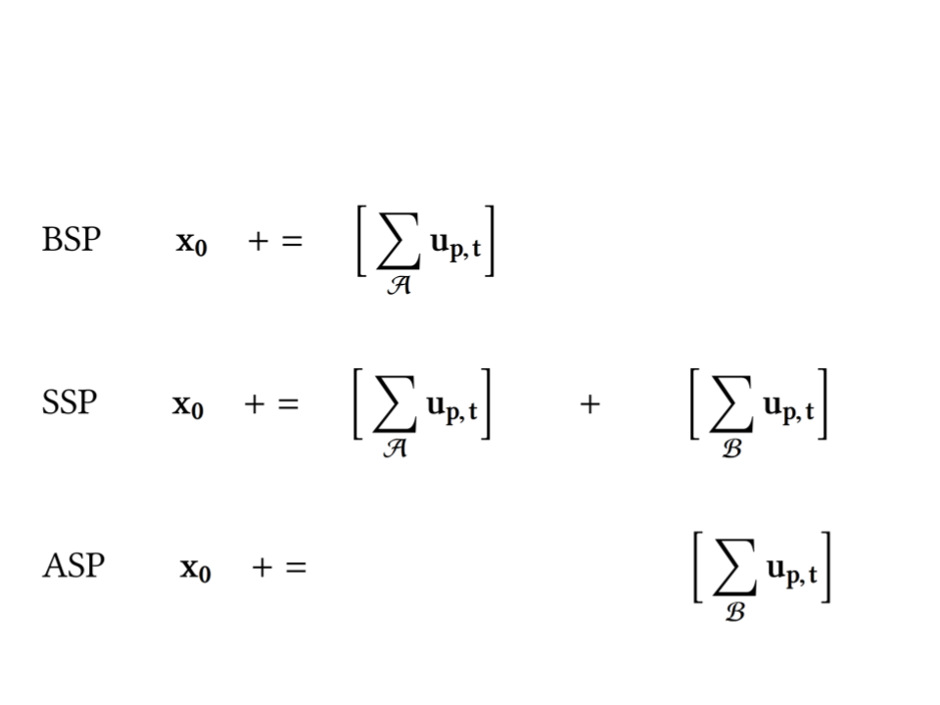
Decompose Synchronous Parallel Machine
Then we use the analytical model to express each synchronous parallel machine on the left.
The formulation reveals some very interesting structures from a system design perspective.
Let’s decompose these machines.

Slide 61
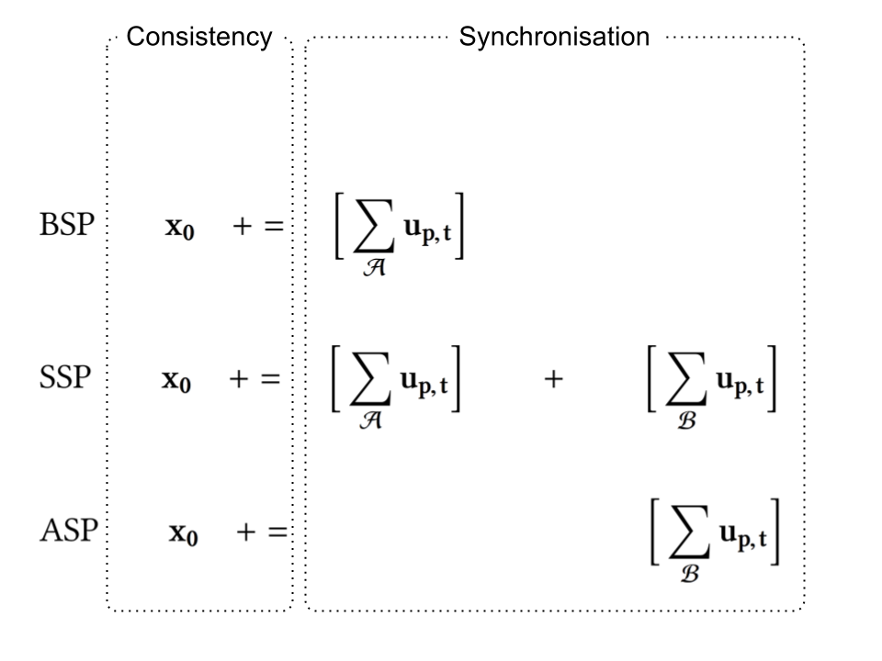
Decompose Synchronous Parallel Machine
Left part deals with the Consistency. += operator is the server logic about how to incorporate updates submitted to the central server into the global state.
Right part deals with synchronisation, computers either communicate to each other or contact the central server to coordinate their progress.

Slide 62
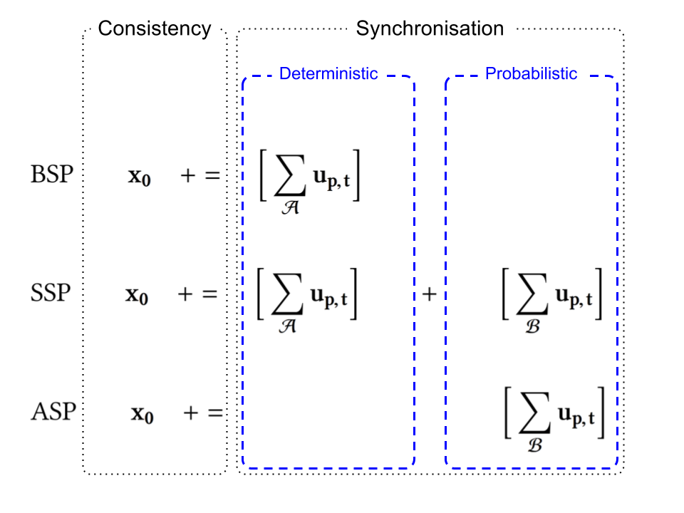
Decompose Synchronous Parallel Machine
Inside the synchronisation part, the synchronous parallel machine processes two types of updates.
The deterministic one is those we always expect if everything goes well as in BSP.
The probabilistic one is those out of order updates due to packet loss, network delay, node failure, and etc.

Slide 63
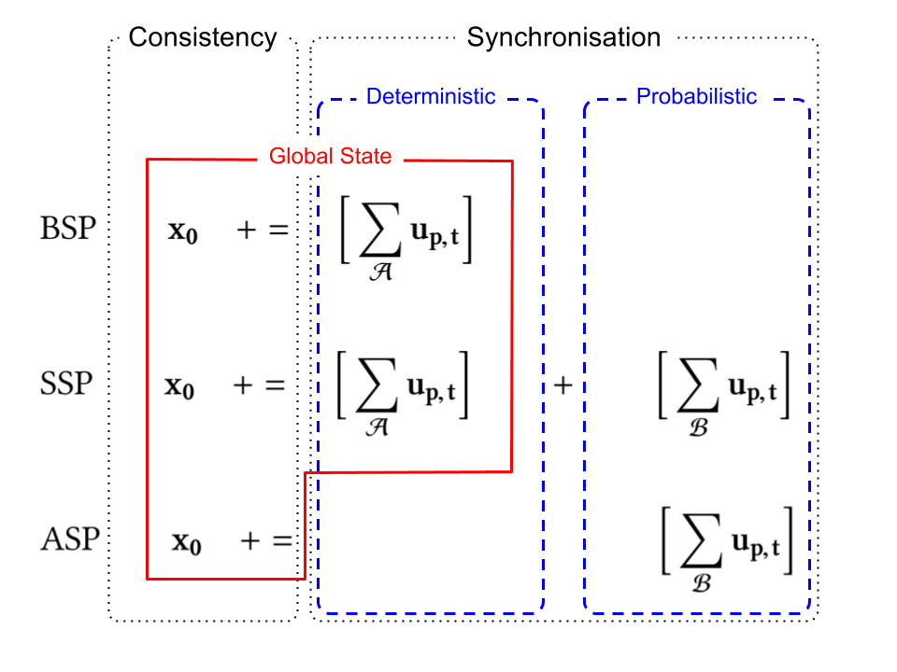
Decompose Synchronous Parallel Machine
The global state is maintained by a logic central server. In a distributed system, this is often the bottleneck and single point of failure.
Moreover, note that the server couples the consistency with the synchronisation two parts, for BSP and SSP.
ASP avoids such coupling by giving up synchronisation, consistency completely.

Slide 64
Missing Dimension in Design Space
SSP
BSP
??? the missing dimension in synchronisation
Strong consistency
Slow iteration rate
Fully centralised
Consistency
Weak consistency
Fast iteration rate
Fully distributed
ASP

Slide 65
Key Insights from Decomposition
Is it necessary to couple the consistency with synchronisation? No
Is it necessary to give up synchronisation completely in order to decouple consistency and synchronisation? No
Is it necessary to divide the updates into deterministic and probabilistic two parts? No
Is SSP really a generalisation of BSP and ASP, then what is the missing dimension in the design space? Completeness

Slide 66
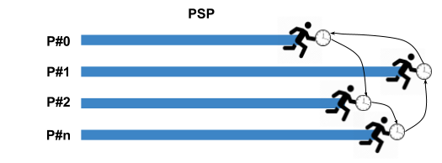
Probabilistic Synchronous Parallel
Core idea: combine both deterministic and probabilistic components, replace it with a sample distribution.
Each computer synchronises with a small group of others and the consistency is only enforced within the group.
The server decides how to incorporate the submitted updates.
No central server to coordinate them, instead each node synchronises within their groups. The consistency “propagates” by the possible overlapping of different groups.

Slide 67
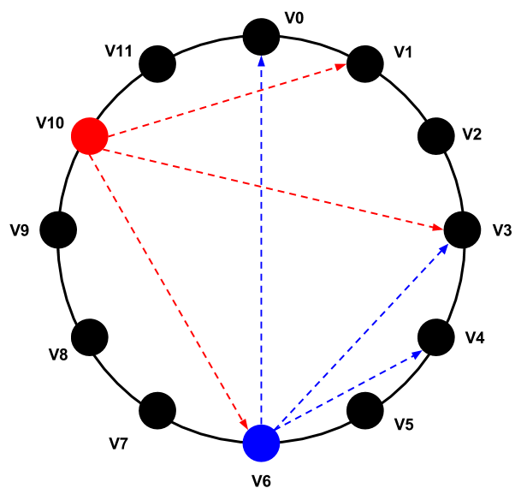
Sampling Primitive
How to implement PSP atop of current data analytics frameworks?
  Quite straightforward, add a new primitive - sample
How to guarantee the random sampling?
  Organise the nodes into a structural overlay, e.g. DHT
The random sampling is based on the fact that node identifiers are uniformly distributed in a name space.
Node can estimate the population size based on the allocated ID density in the name space.

Slide 68
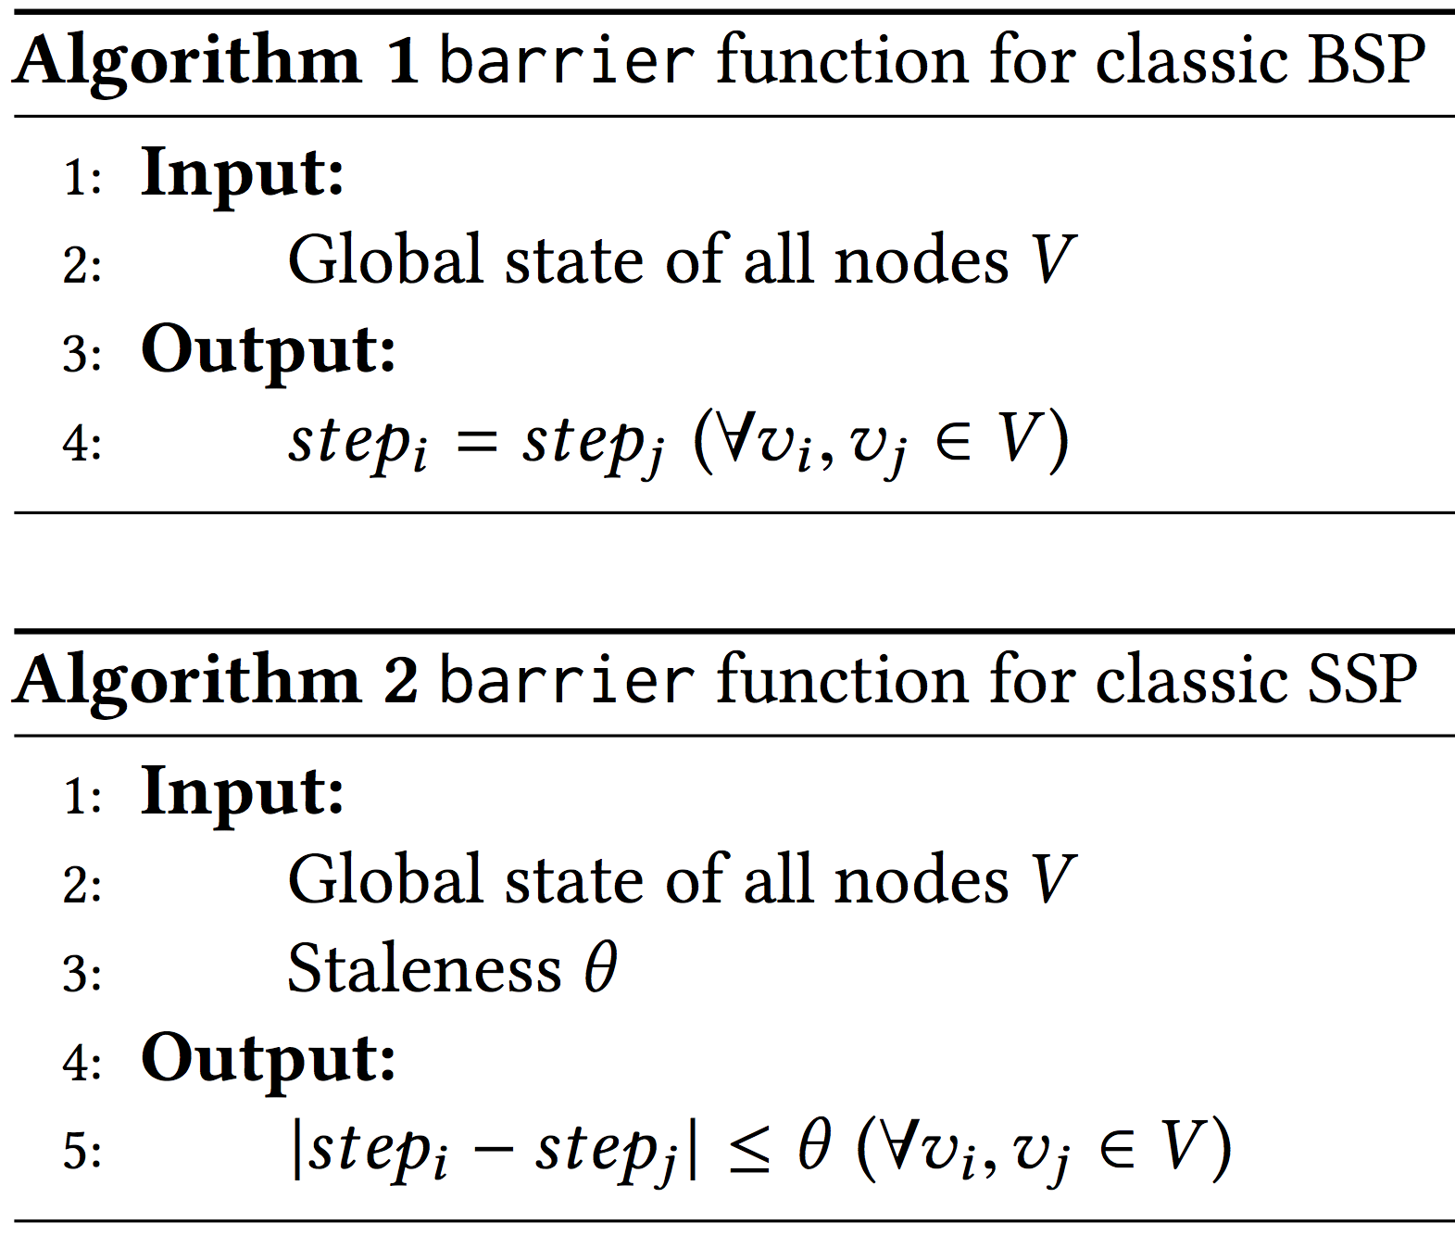
As A Higher-Order Function
PSP is a generalisation of BSP, SSP, ASP.
PSP can be applied to other synchronous machine as a higher-order function, to further derive a fully distributed version.
pBSP
Local state of sampled nodes V
Sample function ○ Barrier function
pSSP
Local state of sampled nodes V
Fully compatible with existing systems due to its generality.

Slide 69
A Newly Discovered Dimension
The degree of consistency is enforced upon a sample rather than the whole population.
PSP adds a new dimension to the existing synchronous parallel models, i.e. the degree of completeness in a sample, which renders a distribution of degree of consistency.
PSP allows us to parameterise the degree of completeness (or level of coordination), ranging from a fully centralised system to a fully distributed one.
PSP parameterised completeness by adjusting the sample size
Complete view
Centralised global state
Partial view
Distributed local state

Slide 70
Factorise Consistency by Completeness
PSP parameterised completeness by adjusting the sample size
Complete view
Centralised global state
Partial view
Distributed local state
Because of this new dimension, Consistency Degree is now factorised into two parts.
Convergence Consistency Degree x Iteration Rate
Convergence Consistency Degree in Sample x Completeness of Sample x Iteration Rate

Slide 71
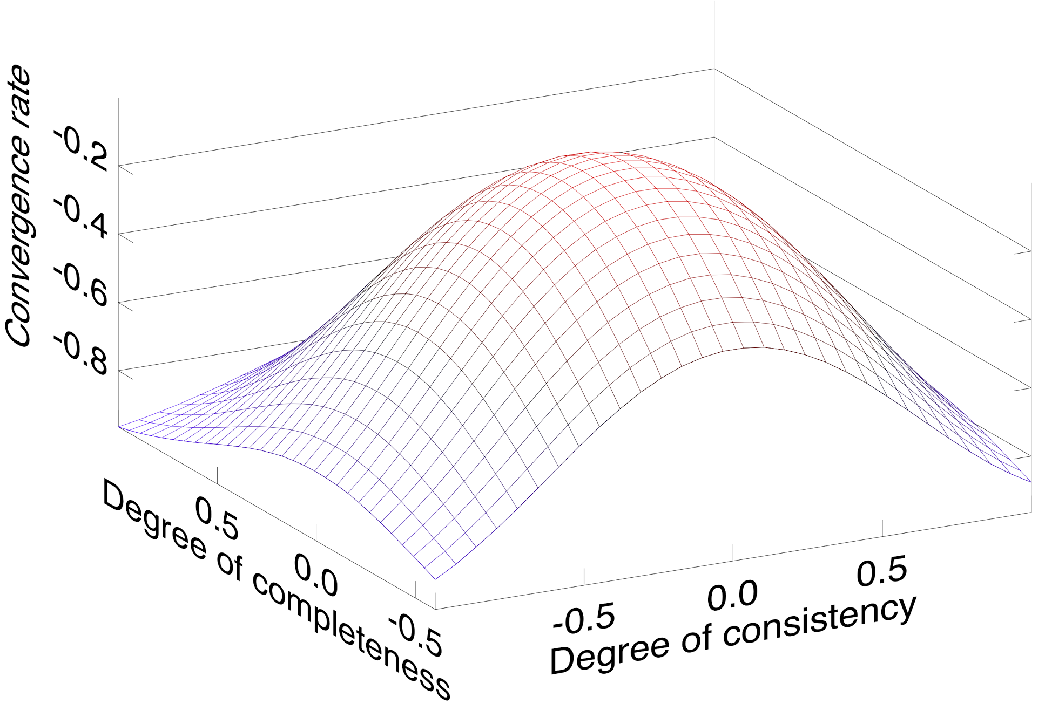
Trade-off in a Larger Design Space
Convergence = Consistency Degree in Sample x Completeness of Sample x Iteration Rate
The new dimension allows us to explore a larger design space, which further makes it possible to find better a trade-off to achieve better convergence rate.
ASP doesn’t really fall on the same Convergence - Consistency plane.
Degree of consistency along the new dimension becomes a distribution now.
pSSP
pBSP
ASP
SSP
ASP
BSP
Note this figure is plotted with Owl.

Slide 72
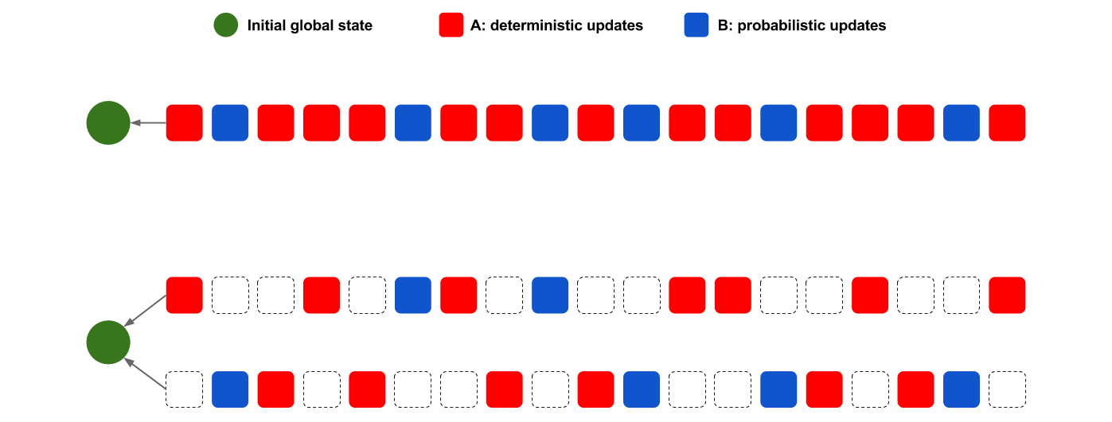
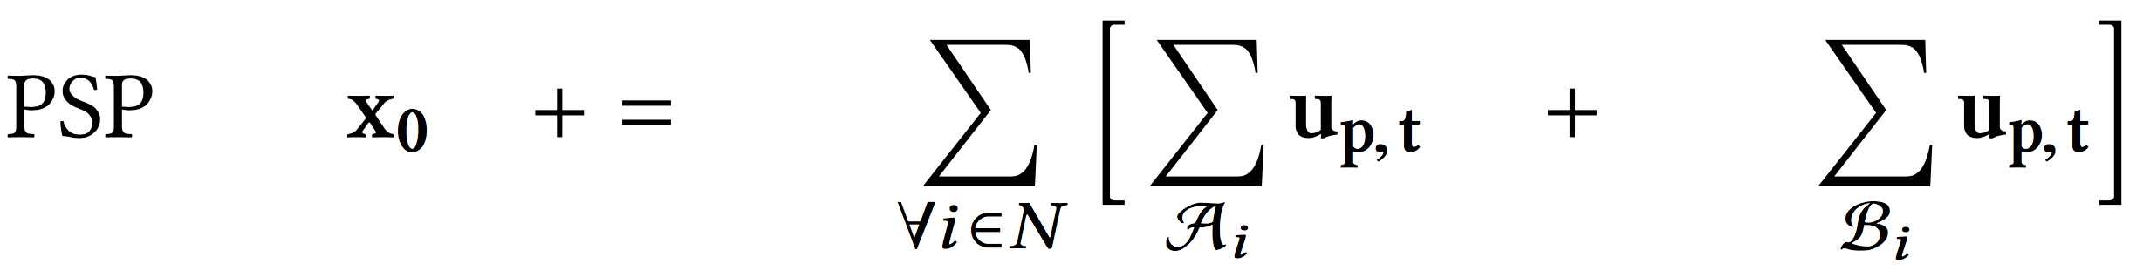
Effects of Sampling Primitive
PSP
Sampling primitive decomposes the original sequence into multiple sampling processes (assuming no replacement for simplicity), and each has a partial view of the original one
#0:A0, B0
#1:A1, B1

Slide 73
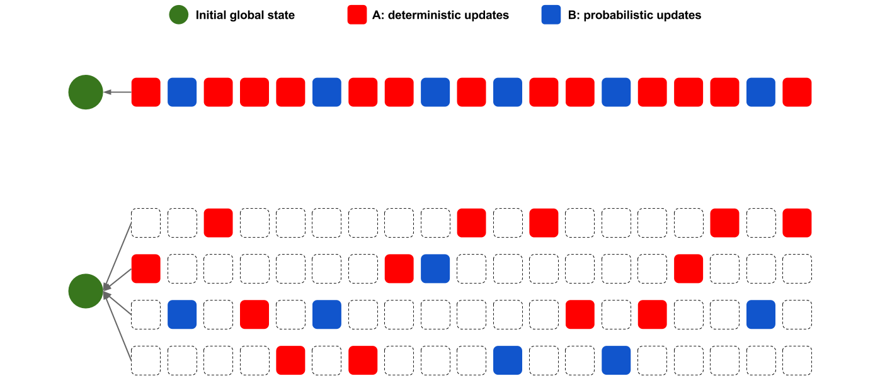
Effects of Smaller Samples
PSP
Smaller sample size results in more sampling processes, each has even less complete view of the original one (i.e. less completeness), further reduces synchronisation level.
#0:A0, B0
#1:A1, B1
#2:A2, B2
#3:A3, B3

Slide 74
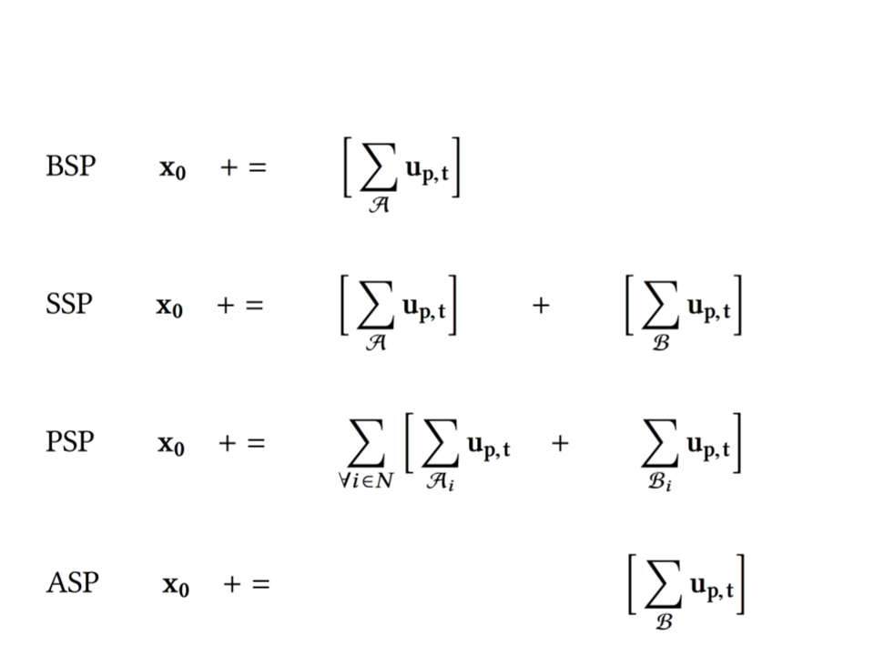
Revisit System Decomposition
PSP now bridges the gap between SSP and ASP by unifying the deterministic and probabilistic components with the updates of a distribution of clock ticks.

Slide 75
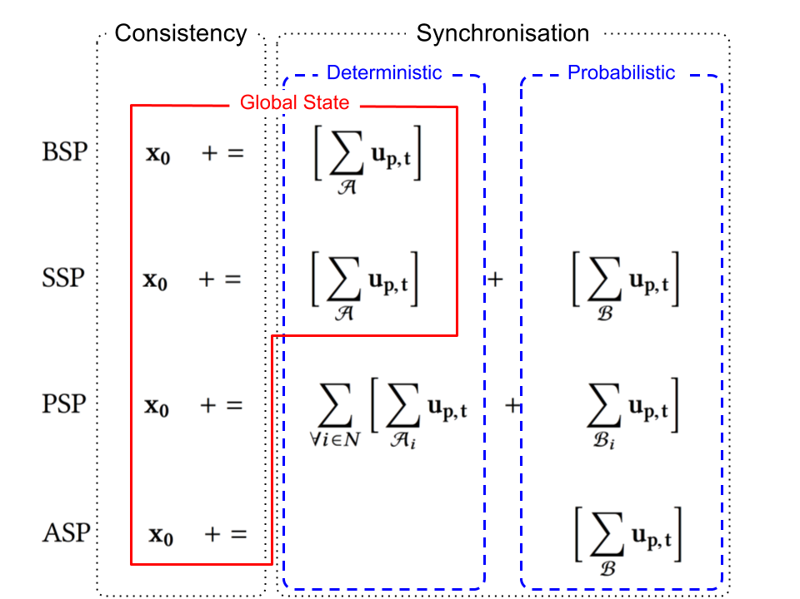
Revisit System Decomposition
First two (BSP, SSP) are centralised; whereas last two (PSP, ASP) are distributed.
Unlike SSP, PSP decouples the consistency and the synchronisation.
Unlike ASP, PSP does not give up synchronisation because of decoupling.

Slide 76
Indication on System Design
With decoupling, the server becomes a stream server, i.e. processes a sequence of submitted updates only, much easier to implement an efficient system.
Nodes coordination is fully distributed, mitigates bottleneck and single point failure to some extent.
Increment deployment as a higher-order function, compatible with existing data analytics frameworks.

Slide 77
Comparison Summary
PSP vs BSP: faster iteration, faster convergence, decentralised.
PSP vs SSP : faster iteration, faster convergence, decentralised.
PSP vs ASP: stronger consistency with synchronisation, stronger guarantees on convergence.
SSP
BSP
Strong consistency
Slow iteration rate
Fully centralised
Completeness
PSP
Consistency
Weak consistency
Fast iteration rate
Fully distributed
ASP

Slide 78
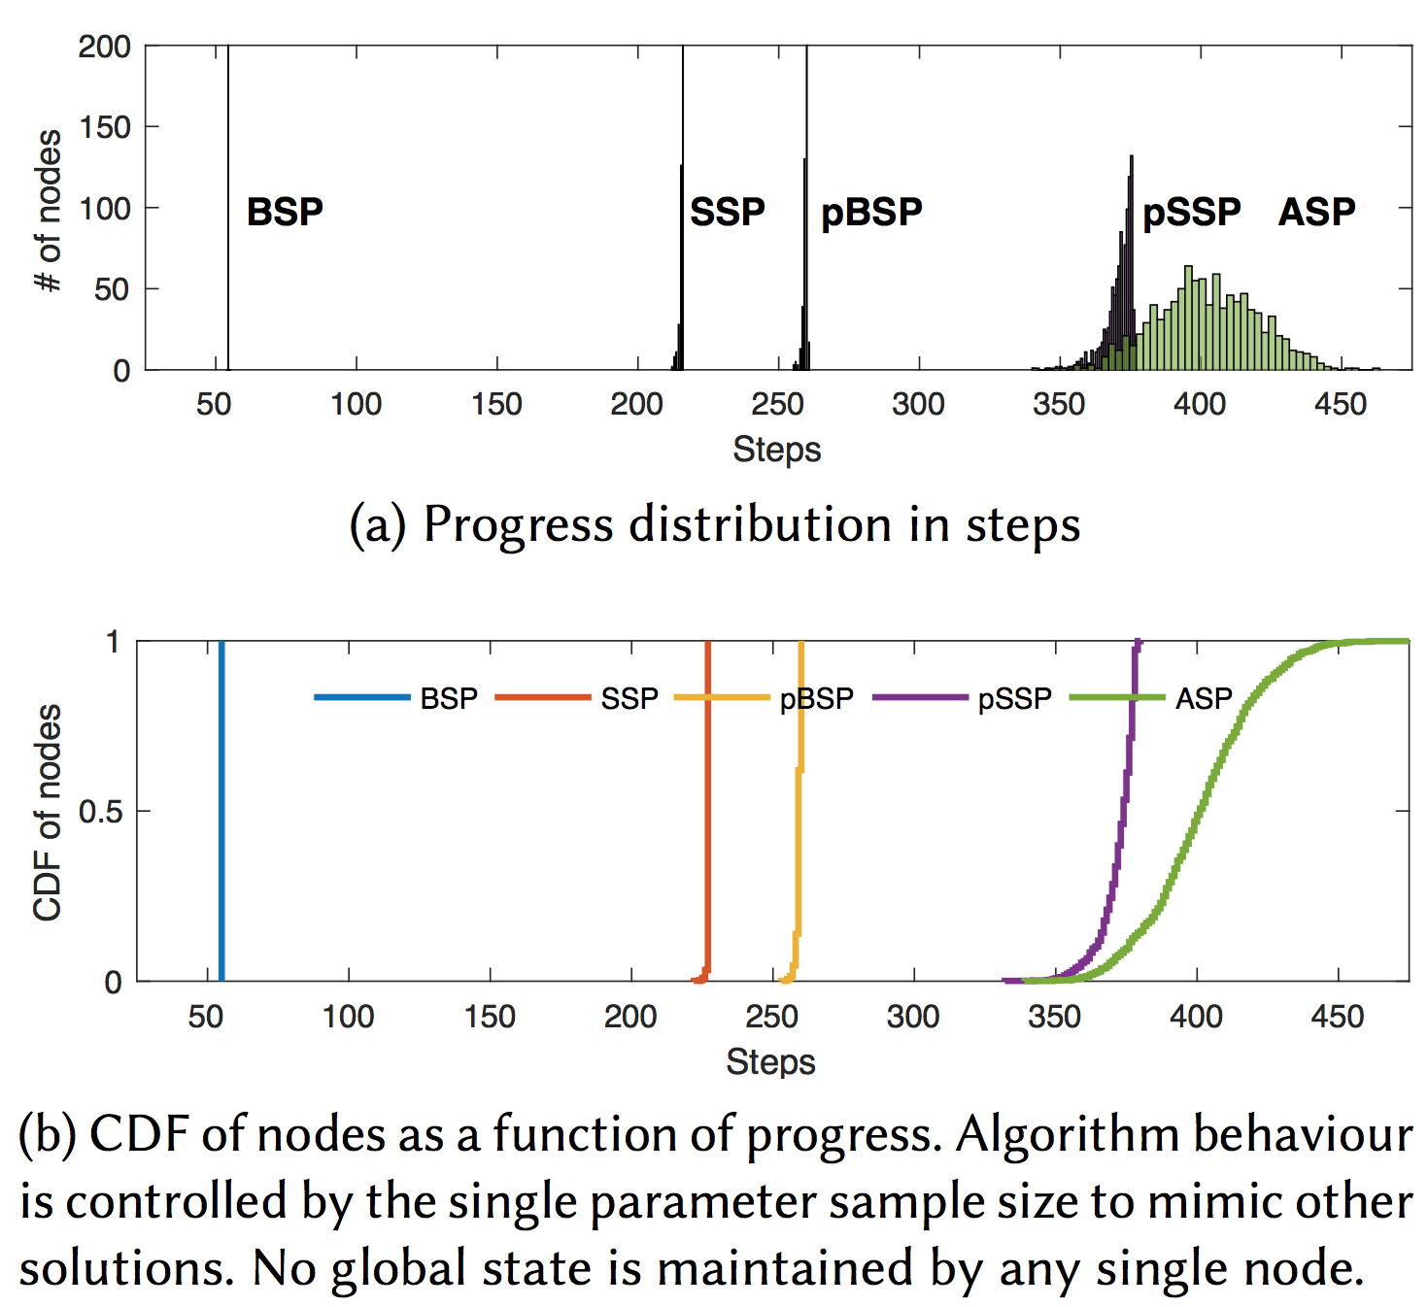
Step Distribution
Let’s look at a system of 1000 nodes, running stochastic gradient descent algorithm for a linear regression task.
Step distribution reflects the level of coordination, or how tightly the nodes are synchronised, or degree of consistency ...
Sample size is 10, and staleness is 4. PSP trade-off reasonable consistency for much faster iteration rate.
Note the trade-off betw. the speed and spread!

Slide 79
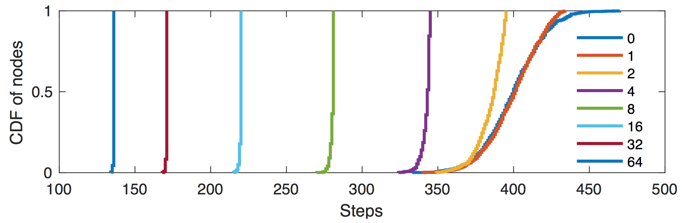
Reduce Discrepancy
CDF of step distribution at a given time in the system, we experimented with different sample size from 0 to 64. Increasing the sample size make the curves shift from right to left with decreasing spread, covering the whole spectrum from the most lenient ASP to the most strict BSP.
The smaller spread is at the price of slower iteration rate. Small sample sets seem very effective in reducing the spread.

Slide 80
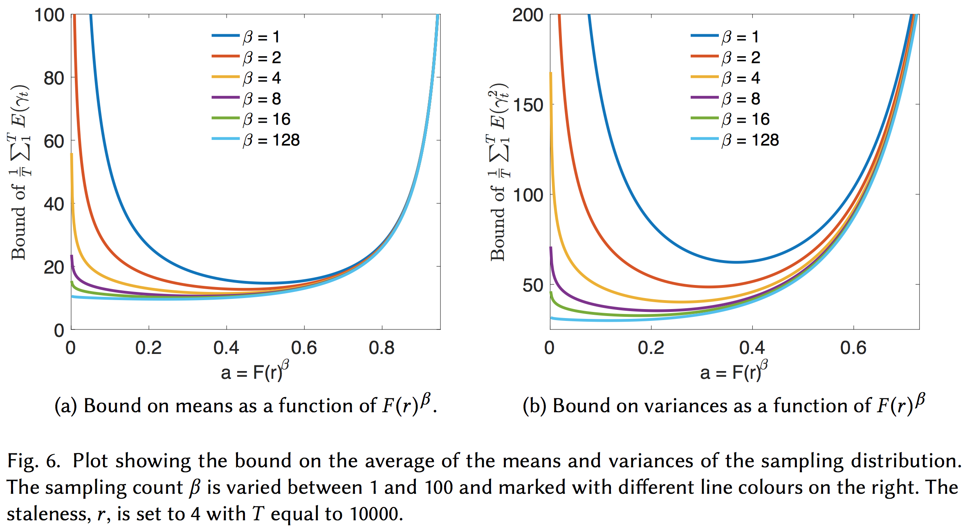
Tighten the Bounds
The smaller the area below the curve is, the tighter the bound becomes, leads to stronger guarantee on convergence.

Slide 81
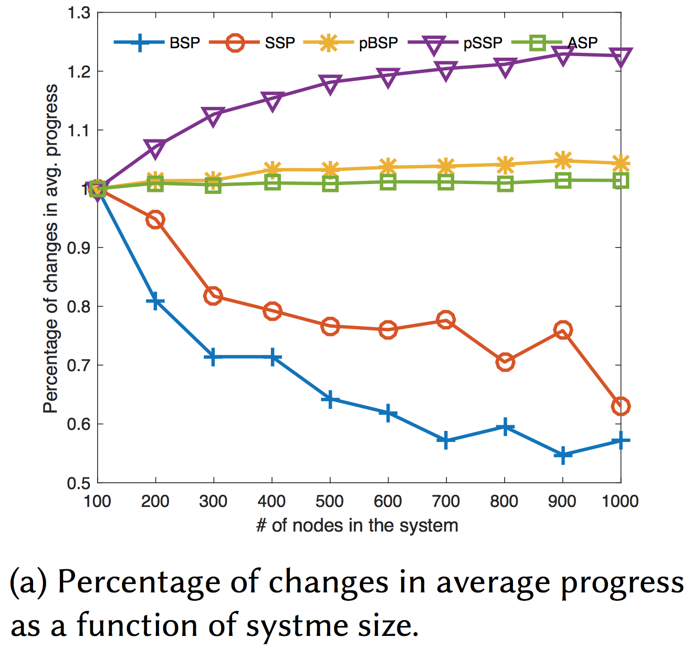
Scalability
Now, we increase the system size step by step, then check how much it will degrade the performance. (Note sample size is fixed as 10.)
Performance degradation is measured by checking the percent of changes regarding the accuracy of regression model at a fixed timestamp in each experiment (with varying system sizes).
ASP is a straight line as expected, due to no synchronisation is need so the system is very scalable. On the other hand, BSP and SSP are both degraded.
Interestingly, PSP improves the performance. Why is that?

Slide 82
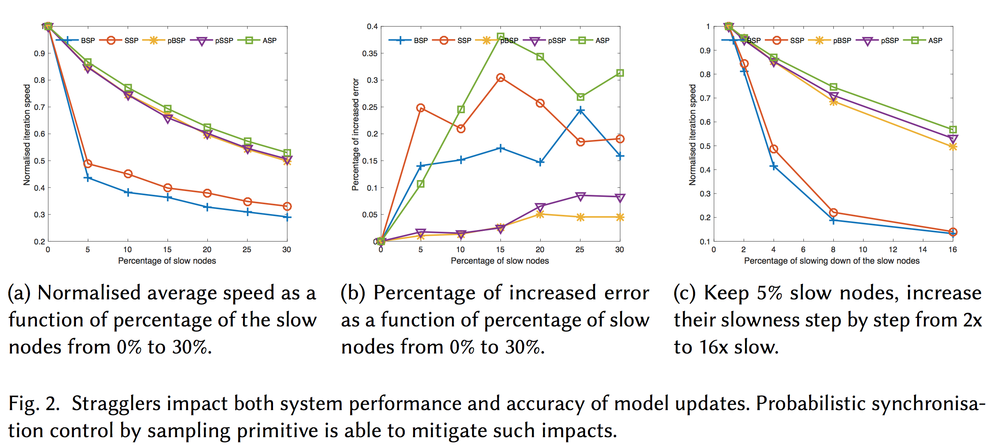
Robustness against Stragglers

Slide 83
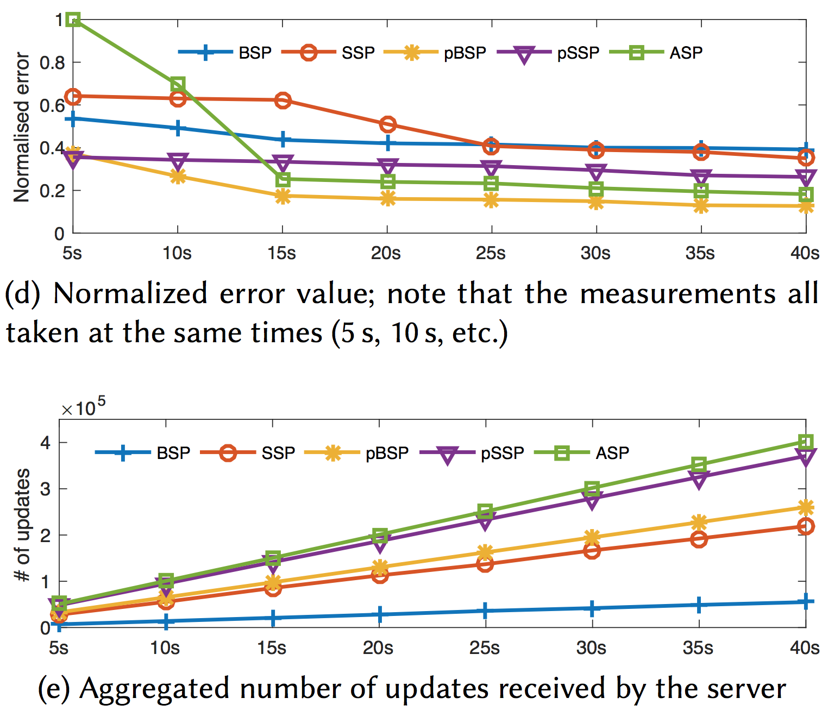
Convergence Rate
PSP can effectively accelerate convergence rate due to both increased iteration rate and improved consistency.
The number of submitted updates increases due to PSP’s faster iteration rate.

Slide 84
Implementation in Actor
type barrier =
| ASP (* Asynchronous Parallel *)
| BSP (* Bulk Synchronous Parallel *)
| SSP (* Stale Synchronous Parallel *)
| PSP (* Probabilistic Synchronous Parallel *)
val start : ?barrier:barrier -> string -> string -> unit
(** start running the model loop *)
val register_barrier : ps_barrier_typ -> unit
(** register user-defined barrier function at p2p server *)
val register_schedule : ('a, 'b, 'c) ps_schedule_typ -> unit
(** register user-defined scheduler *)
val register_pull : ('a, 'b, 'c) ps_pull_typ -> unit
(** register user-defined pull function executed at master *)
…….
PSP and other synchronous parallel machines are implemented in Actor system in a very modular way.
They can be plugged into different engines (Parameter Sever, Mapreduce) with register_barrier function

Slide 85
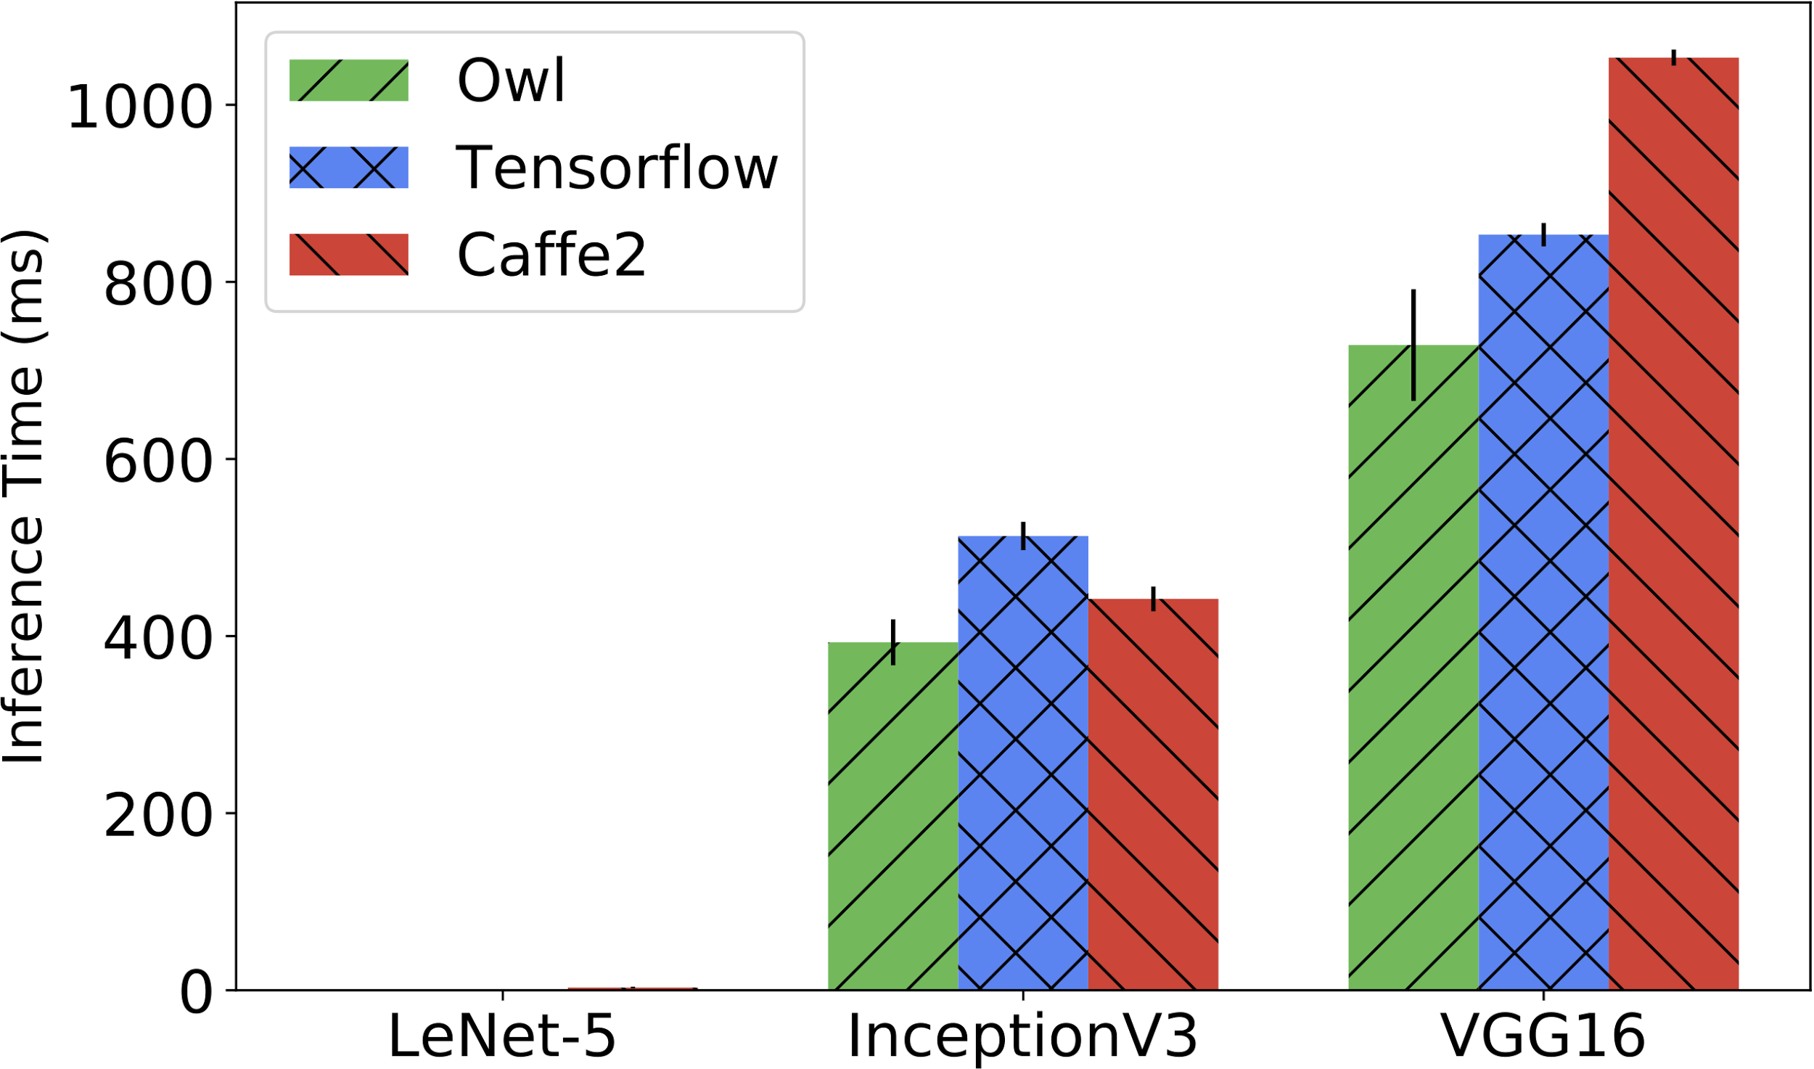
Owl’s Performance

Slide 86

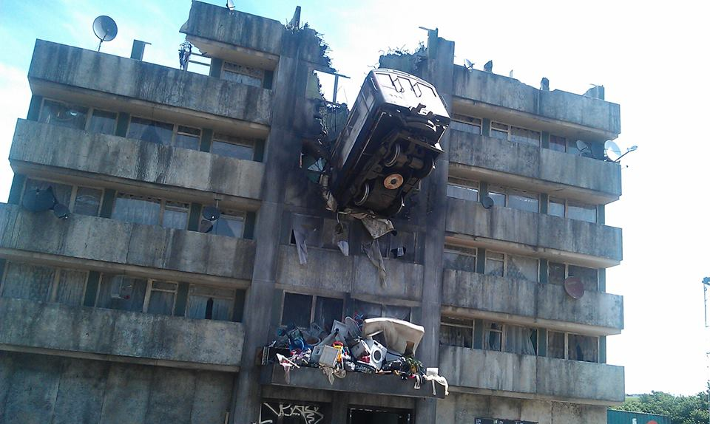
Who Am I? & lets not speculate further ☺
Thanks to EPSRC/databox
&Liang Wang, Cambridge
Thanks to Turing/Maru
&Peter Pietzuch, Imperial

