Slide 1
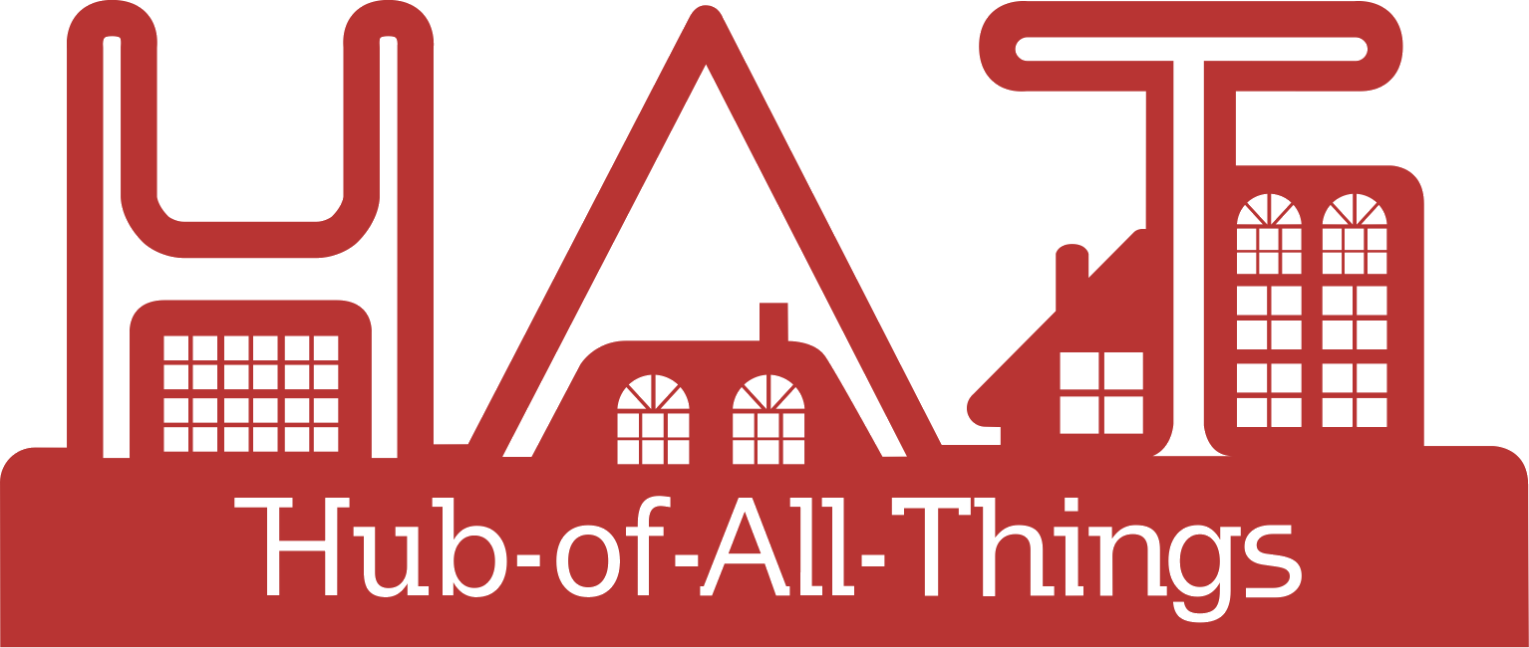
The HAT ecosystem
To evolve and emerge a digital service ecosystem of organisations and people where individuals are able to acquire, use, control and exchange their own data for their own good and the good of society

Slide 2
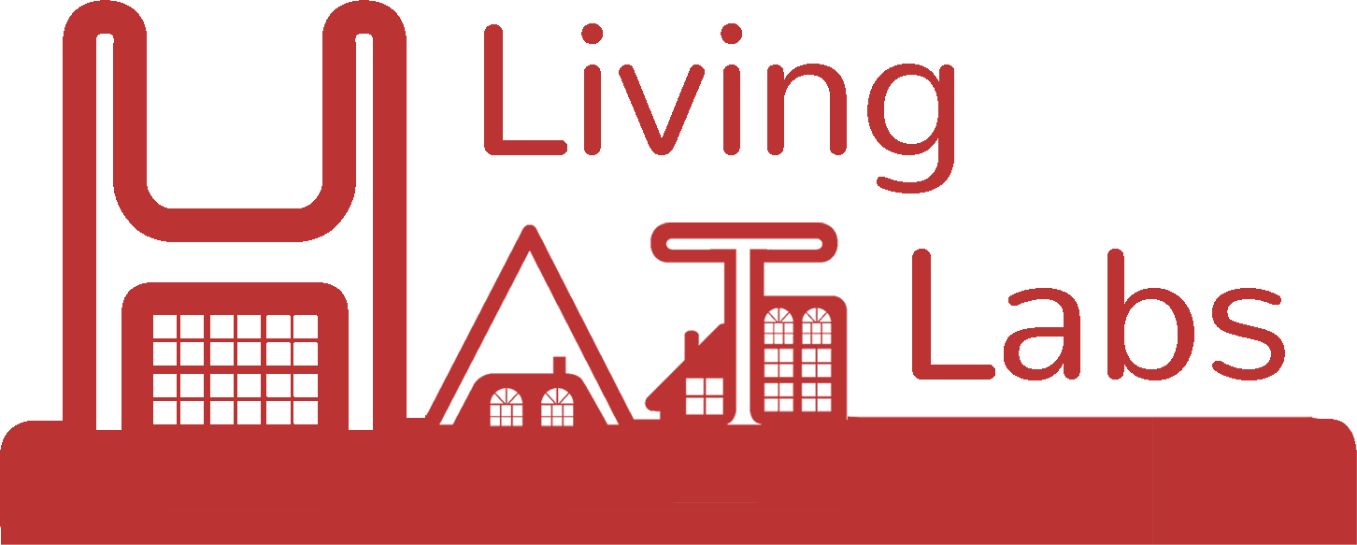
The HAT ecosystem
HAT Platform providers
HAT users with their HAT data in their own microservice containers
Retail Channel: direct provisioning of HATs
http://hatdex.org
Regulate
Innovate
Grow
Represent
http://hatcommunity.org/
HAT service providers
Wholesale channel
Personal hyper data browser (to see & act on HAT data & content)
http://rumpel.hubofallthings.net
Brand owners. IoT companies, SMEs, outsourcing personal data management & exchange
http://www.hatdex.org/hatdex-for-business/
Community space to browse data & content offers, interact & chat, ‘catalogue/store’, exchange data
http://marketsquare.hubfoallthings.net
Open source code repository
Community development
Other HAT Platform providers globally that host HATs on their own infrastructure
Personal HAT address
yourname.hubfoallthings.net
HAT Global Festival
Hackathons
Funding for startups
HAT-ready services contributing to and requesting HAT data & content
Rumpel add-ons
Marketsquare add-ons
Dataplugs
Continuing research on HAT ecosystem
Managed by WMG, University of Warwick
http://hubofallthings.com/hat-rd/
Direct HAT applications
Native applications (data does not leave the HAT/Rumpel space)
New views
Bundles/Contexts
Email, website, file service, messaging
Meta & aggregate level services
Data shoppers
Content shoppers
Social data sharing
Analytics, comparisons
Add new data into HATs
Social media, finance, Health, government data, supermarket purchases
Sign on services
Applications that use HAT schema, logic and APIs directly
wellbeing * blockchains * content * others

Slide 3
HAT Community Foundation
A members organisation (charity) startup for the Regulation, Innovation, Growth & Representation in the HAT personal data ecosystem

Slide 4
The HAT ecosystem
HAT Platform providers
HAT users with their HAT data in their own microservice containers
Retail Channel: direct provisioning of HATs
http://hatdex.org
Regulate
http://hatcommunity.org/
HAT service providers
Wholesale channel
Personal hyper data browser (to see & act on HAT data & content)
http://rumpel.hubofallthings.net
Brand owners. IoT companies, SMEs, outsourcing personal data management & exchange
http://www.hatdex.org/hatdex-for-business/
Community space to browse data & content offers, interact & chat, ‘catalogue/store’, exchange data
http://marketsquare.hubfoallthings.net
Certification
Ratings
on
Privacy
Security
Confidentiality
Other HAT Platform providers globally that host HATs on their own infrastructure
Personal HAT address
yourname.hubfoallthings.net
HAT-ready services contributing to and requesting HAT data & content
Rumpel add-ons
Marketsquare add-ons
Dataplugs
Continuing Research on HAT ecosystem
Managed by WMG, University of Warwick
http://hubofallthings.com/hat-rd/
Direct HAT applications
Native applications (data does not leave the HAT/Rumpel space)
New views
Bundles/Contexts
Email, website, file service, messaging
Meta & aggregate level services
Data shoppers
Content shoppers
Social data sharing
Analytics, comparisons
Add new data into HATs
Social media, finance, Health, government data, supermarket purchases
Sign on services
Applications that use HAT schema, logic and APIs directly
wellbeing * blockchains * content * others

Slide 5
The HAT ecosystem
HAT Platform providers
HAT users with their HAT data in their own microservice containers
Retail Channel: direct provisioning of HATs
http://hatdex.org
Innovate
http://hatcommunity.org/
HAT service providers
Wholesale channel
Personal hyper data browser (to see & act on HAT data & content)
http://rumpel.hubofallthings.net
Brand owners. IoT companies, SMEs, outsourcing personal data management & exchange
http://www.hatdex.org/hatdex-for-business/
Community space to browse data & content offers, interact & chat, ‘catalogue/store’, exchange data
http://marketsquare.hubfoallthings.net
Open source code repository
Community development
Other HAT Platform providers globally that host HATs on their own infrastructure
HAT Global Festival
Hackathons
Funding for startups
Personal HAT address
yourname.hubfoallthings.net
HAT-ready services contributing to and requesting HAT data & content
Rumpel add-ons
Marketsquare add-ons
Dataplugs
Continuing Research on HAT ecosystem
Managed by WMG, University of Warwick
http://hubofallthings.com/hat-rd/
Direct HAT applications
Native applications (data does not leave the HAT/Rumpel space)
New views
Bundles/Contexts
Email, website, file service, messaging
Meta & aggregate level services
Data shoppers
Content shoppers
Social data sharing
Analytics, comparisons
Add new data into HATs
Social media, finance, Health, government data, supermarket purchases
Sign on services
Applications that use HAT schema, logic and APIs directly
wellbeing * blockchains * content * others

Slide 6
The HAT ecosystem
HAT Platform providers
HAT users with their HAT data in their own microservice containers
Retail Channel: direct provisioning of HATs
http://hatdex.org
Grow
http://hatcommunity.org/
HAT service providers
Wholesale channel
Personal hyper data browser (to see & act on HAT data & content)
http://rumpel.hubofallthings.net
Brand owners. IoT companies, SMEs, outsourcing personal data management & exchange
http://www.hatdex.org/hatdex-for-business/
Community space to browse data & content offers, interact & chat, ‘catalogue/store’, exchange data
http://marketsquare.hubfoallthings.net
Other HAT Platform providers globally that host HATs on their own infrastructure
Personal HAT address
yourname.hubfoallthings.net
HAT-ready services contributing to and requesting HAT data & content
Rumpel add-ons
Marketsquare add-ons
Dataplugs
Continuing Research on HAT ecosystem
Managed by WMG, University of Warwick
http://hubofallthings.com/hat-rd/
Direct HAT applications
Native applications (data does not leave the HAT/Rumpel space)
New views
Bundles/Contexts
Email, website, file service, messaging
Meta & aggregate level services
Data shoppers
Content shoppers
Social data sharing
Analytics, comparisons
Add new data into HATs
Social media, finance, Health, government data, supermarket purchases
Sign on services
Applications that use HAT schema, logic and APIs directly
wellbeing * blockchains * content * others

Slide 7
The HAT ecosystem
HAT Platform providers
HAT users with their HAT data in their own microservice containers
Retail Channel: direct provisioning of HATs
http://hatdex.org
HAT service providers
Represent
http://hatcommunity.org/
Wholesale channel
Personal hyper data browser (to see & act on HAT data & content)
http://rumpel.hubofallthings.net
Brand owners. IoT companies, SMEs, outsourcing personal data management & exchange
http://www.hatdex.org/hatdex-for-business/
Community space to browse data & content offers, interact & chat, ‘catalogue/store’, exchange data
http://marketsquare.hubfoallthings.net
HAT trademarks
Associate members
Corporate members
Members meetings
Events
White papers
Advisory roles
Fund raising
Other HAT Platform providers globally that host HATs on their own infrastructure
Personal HAT address
yourname.hubfoallthings.net
HAT-ready services contributing to and requesting HAT data & content
Rumpel add-ons
Marketsquare add-ons
Dataplugs
Continuing Research on HAT ecosystem
Managed by WMG, University of Warwick
http://hubofallthings.com/hat-rd/
Direct HAT applications
Native applications (data does not leave the HAT/Rumpel space)
New views
Bundles/Contexts
Email, website, file service, messaging
Meta & aggregate level services
Data shoppers
Content shoppers
Social data sharing
Analytics, comparisons
Add new data into HATs
Social media, finance, Health, government data, supermarket purchases
Sign on services
Applications that use HAT schema, logic and APIs directly
wellbeing * blockchains * content * others

Slide 8
HAT Research
Increasing knowledge in the HAT personal data ecosystem

Slide 9
The HAT ecosystem
HAT Platform providers
HAT users with their HAT data in their own microservice containers
Retail Channel: direct provisioning of HATs
http://hatdex.org
Regulate
Innovate
Grow
Represent
http://hatcommunity.org/
HAT service providers
Wholesale channel
Personal hyper data browser (to see & act on HAT data & content)
http://rumpel.hubofallthings.net
Brand owners. IoT companies, SMEs, outsourcing personal data management & exchange
http://www.hatdex.org/hatdex-for-business/
Community space to browse data & content offers, interact & chat, ‘catalogue/store’, exchange data
http://marketsquare.hubfoallthings.net
Open source code repository
Community development
Other HAT Platform providers globally that host HATs on their own infrastructure
Personal HAT address
yourname.hubfoallthings.net
HAT Global Festival
Hackathons
Funding for startups
HAT-ready services contributing to and requesting HAT data & content
Rumpel add-ons
Marketsquare add-ons
Dataplugs
RCUK Digital Economy funded
£1.2m
Developed the HAT
Developed ecosystem guidelines
Developed regulatory guidelines
Developed economic & business model guidelines
Developed privacy guidelines
Open sourced HAT for community
6 Briefing papers for community
http://hubofallthings.com/home
Direct HAT applications
Native applications (data does not leave the HAT/Rumpel space)
New views
Bundles/Contexts
Email, website, file service, messaging
Meta & aggregate level services
Data shoppers
Content shoppers
Social data sharing
Analytics, comparisons
Add new data into HATs
Social media, finance, Health, government data, supermarket purchases
Sign on services
Applications that use HAT schema, logic and APIs directly

Slide 10
The HAT ecosystem
HAT Platform providers
HAT users with their HAT data in their own microservice containers
Retail Channel: direct provisioning of HATs
http://hatdex.org
Regulate
Innovate
Grow
Represent
http://hatcommunity.org/
HAT service providers
Wholesale channel
Personal hyper data browser (to see & act on HAT data & content)
http://rumpel.hubofallthings.net
Brand owners. IoT companies, SMEs, outsourcing personal data management & exchange
http://www.hatdex.org/hatdex-for-business/
Community space to browse data & content offers, interact & chat, ‘catalogue/store’, exchange data
http://marketsquare.hubfoallthings.net
Open source code repository
Community development
Other HAT Platform providers globally that host HATs on their own infrastructure
Personal HAT address
yourname.hubfoallthings.net
HAT Global Festival
Hackathons
Funding for startups
HAT-ready services contributing to and requesting HAT data & content
Rumpel add-ons
Marketsquare add-ons
Dataplugs
Direct HAT applications
Native applications (data does not leave the HAT/Rumpel space)
New views
Bundles/Contexts
Email, website, file service, messaging
Meta & aggregate level services
Data shoppers
Content shoppers
Social data sharing
Analytics, comparisons
Add new data into HATs
Social media, finance, Health, government data, supermarket purchases
Sign on services
Applications that use HAT schema, logic and APIs directly
Developed Rumpel
EPSRC Funded £385k
Open sourced for community

Slide 11
The HAT ecosystem
HAT Platform providers
HAT users with their HAT data in their own microservice containers
Retail Channel: direct provisioning of HATs
http://hatdex.org
Regulate
Innovate
Grow
Represent
http://hatcommunity.org/
HAT service providers
Wholesale channel
Personal hyper data browser (to see & act on HAT data & content)
http://rumpel.hubofallthings.net
Brand owners. IoT companies, SMEs, outsourcing personal data management & exchange
http://www.hatdex.org/hatdex-for-business/
Community space to browse data & content offers, interact & chat, ‘catalogue/store’, exchange data
http://marketsquare.hubfoallthings.net
Open source code repository
Community development
Other HAT Platform providers globally that host HATs on their own infrastructure
Personal HAT address
yourname.hubfoallthings.net
HAT Global Festival
Hackathons
Funding for startups
HAT-ready services contributing to and requesting HAT data & content
Rumpel add-ons
Marketsquare add-ons
Dataplugs
Direct HAT applications
Native applications (data does not leave the HAT/Rumpel space)
New views
Bundles/Contexts
Email, website, file service, messaging
Meta & aggregate level services
Data shoppers
Content shoppers
Social data sharing
Analytics, comparisons
Add new data into HATs
Social media, finance, Health, government data, supermarket purchases
Sign on services
HAT Living Labs
RCUK Digital Economy £1.2m
Sandbox live environment for research on Vulnerability, Control & Trust (CONTRIVE)
Sandboxes available for other research projects
Applications that use HAT schema, logic and APIs directly
wellbeing * blockchains * content * others

Slide 12
The HAT ecosystem
HAT Platform providers
HAT users with their HAT data in their own microservice containers
Retail Channel: direct provisioning of HATs
http://hatdex.org
Regulate
Innovate
Grow
Represent
http://hatcommunity.org/
HAT service providers
Wholesale channel
Personal hyper data browser (to see & act on HAT data & content)
http://rumpel.hubofallthings.net
Brand owners. IoT companies, SMEs, outsourcing personal data management & exchange
http://www.hatdex.org/hatdex-for-business/
Community space to browse data & content offers, interact & chat, ‘catalogue/store’, exchange data
http://marketsquare.hubfoallthings.net
Open source code repository
Community development
Other HAT Platform providers globally that host HATs on their own infrastructure
Personal HAT address
yourname.hubfoallthings.net
HAT Global Festival
Hackathons
Funding for startups
HAT-ready services contributing to and requesting HAT data & content
Rumpel add-ons
Marketsquare add-ons
Dataplugs
Direct HAT applications
Native applications (data does not leave the HAT/Rumpel space)
New views
Bundles/Contexts
Email, website, file service, messaging
Meta & aggregate level services
Data shoppers
Content shoppers
Social data sharing
Analytics, comparisons
Add new data into HATs
Social media, finance, Health, government data, supermarket purchases
Sign on services
Distributed Ledger of Data & Content exchanges
Applications that use HAT schema, logic and APIs directly
Personalised Content as a Service

Slide 13
HAT Data Exchange
A commercial startup managing and operating the HAT personal data ecosystem

Slide 14
The HAT ecosystem
HAT Platform providers
HAT users with their HAT data in their own microservice containers
Retail Channel: direct provisioning of HATs
http://hatdex.org
HAT provisioning & hosting
Regulate
Innovate
Grow
Represent
http://hatcommunity.org/
HAT service providers
Wholesale channel
Personal hyper data browser (to see & act on HAT data & content)
http://rumpel.hubofallthings.net
Brand owners. IoT companies, SMEs, outsourcing personal data management & exchange
http://www.hatdex.org/hatdex-for-business/
Data shopper agent service for HAT users, Metadata services
http://marketsquare.hubfoallthings.net
Open source code repository
Metadata freemium retail services
Community development
Other HAT Platform providers globally that host HATs on their own infrastructure
Personal HAT address
yourname.hubfoallthings.net
HAT Global Festival
Hackathons
Funding for startups
Meta data app services
HAT-ready services contributing to and requesting HAT data & content
Rumpel add-ons
Marketsquare add-ons
Dataplugs
Continuing research on HAT ecosystem
Managed by WMG, University of Warwick
http://hubofallthings.com/hat-rd/
Direct HAT applications
Native applications (data does not leave the HAT/Rumpel space)
New views
Bundles/Contexts
Email, website, file service, messaging
Meta & aggregate level services
Data shoppers
Content shoppers
Social data sharing
Analytics, comparisons
Add new data into HATs
Social media, finance, Health, government data, supermarket purchases
Sign on services
Applications that use HAT schema, logic and APIs directly
wellbeing * blockchains * content * others

