Slide 1

What could possibly go wrong IoT meets The Law
Data Insights talk
May 5, 2016,
Cambridge
Jon Crowcroft
jon.crowcroft@cl.cam.ac.uk
Christopher Millard
c.millard@qmul.ac.uk
Ian Walden
i.n.walden@qmul.ac.uk

Slide 2
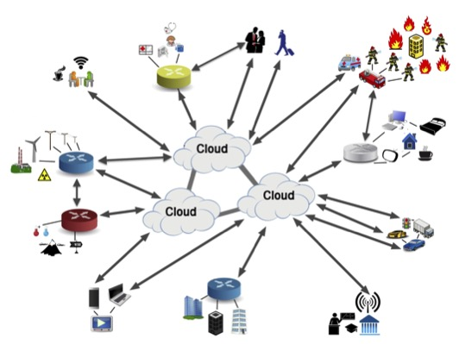
IoT Technical Considerations – Big Picture

Slide 3
Every time I give this talk, I look
For a story about IoT #fail
Yesterday…..without looking….
https://www.wired.com/2016/05/flaws-samsungs-smart-home-let-hackers-unlock-doors-set-off-fire-alarms/
http://www.bbc.co.uk/news/technology-36200012

Slide 4
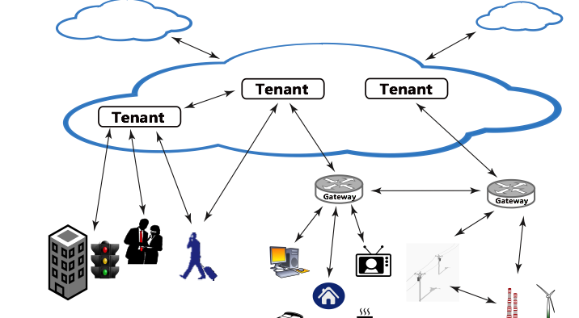
Interactions twixt IoT & Cloud

Slide 5
Clouds of Things: Technical Considerations (Confidentiality, Integrity, Availability)
Secure communications (C, I): Work is advanced and existing techniques can be leveraged. IoT could benefit from lighter-weight schemes, particularly where cryptography is involved.
Access controls for IoT-Cloud (C): Standard mechanisms can be used. IoT adds complexity due to the scale and dynamism of ‘thing’ access.
Identifying sensitive data (C): Largely a non-technical concern, but has an impact on how policies are defined.
Public, private or hybrid? (C, A): Currently blunt partitioning is supported, but emerging research will allow for more flexible deployments that facilitate data sharing.
In-cloud data protection (C): There are strong isolation techniques available and providers employ general access controls. More flexible approaches are needed for inter-application sharing to be possible (see 6, below).
In-cloud data sharing (C, A): Inter-application sharing is needed for IoT but currently is not part of the cloud philosophy.
Encryption by ‘things’ (C, I): Encryption techniques are mature, but this approach precludes most computations on protected data and involves complex key management. Ongoing work into homomorphic encryption will assist. Lightweight encryption mechanisms are being developed and will require robust testing and analysis.

Slide 6
Clouds of Things: Technical Considerations (Confidentiality, Integrity, Availability)
Data combination (C): Some techniques exist to prevent user re-identification, but much more work is needed.
Identifying ‘things’ (C): Existing work on identity management can be leveraged for IoT, but more experience at a larger scale is needed to determine suitability and/or limitations.
Identifying the provider (C): The basic issues are mostly architectural or configuration concerns. Some outstanding issues remain when resources are shared or where decisions need to be made at runtime.
Increase in interactions and data load (A): Cloud services manage elasticity well, but resource expansion is not unlimited. Peak IoT loads are unknown, but possibly controlled by economics (payment/ownership).
Logging at large scale (C, I, A): Currently logging is low-level and system-centered. More work is needed on logging and processing tools for applications and users.
Malicious ‘things’—protection of provider (C, I, A): Existing techniques can be deployed.
Malicious ‘things’—protection of others (C, I, A): There are potentially techniques that can assist. Experience is needed of cloud services operating across IoT subsystems.

Slide 7
Clouds of Things: Technical Considerations (Confidentiality, Integrity, Availability)
Certification of cloud service providers (C, I, A): This is currently manual and static, leading to delays when updates are required. Research is needed on automatic certification processes, possibly including hardware-based solutions.
Trustworthiness of cloud services (C, I, A ): An emerging field with ongoing research. Experience of practical implementation is needed.
Demonstrating compliance using audit (C, I, A): Currently, the compliance of cloud providers to their contractual obligations is not demonstrated convincingly. Research is needed, and IoT will add additional complexity.
Responsibility for composite services (C, I, A): The legal implications of the use of third-party and other services are unresolved. Such usage is not as yet transparent to tenants and/clients. More work is needed concerning user and application-level policy aspects.
Compliance with data location regulations (C, I, A): Currently not enforceable except at coarse granularity. There is research in IFC that can assist, but the concepts are not yet commercially deployed.
Impact of cloud decentralisation (C, I, A): This is an emerging field, where the current focus is on functionality. More attention is needed regarding security.

Slide 8
Clouds of Things: Relationships + Responsibilities
Relevant parties, their roles, and the contract ecosystem
Establishing contractual relationships using things
Who owns what?
Potential non-contractual sources of liability
Cyber-risk and insurance
Developing a taxonomy for the purposes of legal analysis

Slide 9
Personal Data in Clouds of Things
What is regulated as personal data?
Who is responsible?
Which laws apply?
What rights to individuals have?
How do rules on data location and data transfer work?

Slide 10
Governance of Clouds of Things
Surveillance issues
Identity and authentication
Standards
Demonstrating compliance with legal obligations
Consumer protection
Market and competition issues
Use of radio spectrum

Slide 11
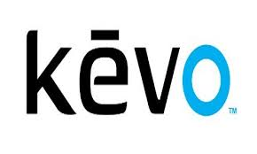

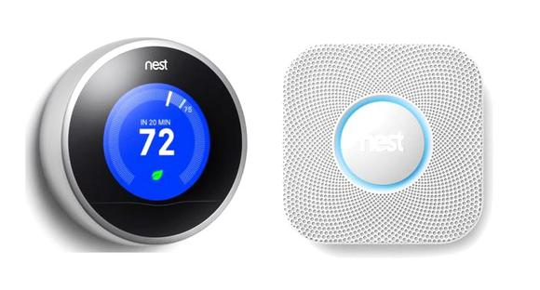


Clouds of Things: ‘Looking into the Nest’
Contracting and Regulating for IoT
Case study
Not survey
Supply chain
Transparency
Actors & ecosystem
Owners, tenants, users

Slide 12
Clouds of Things: Layered ‘legals’
Terms of Service (sites, web apps, mobile apps)
EULA (embedded software)
Sales terms (hardware)
Privacy statement (for the devices)
Website privacy policy (for monitoring data & accessing accounts)
Open-source compliance
IP and related notices
Community Forum Agreement (user sharing)
EU Declarations (type approval)
Installation ToS
Developer ToS

Slide 13
Clouds of Things: Private ordering & public control
‘Product’ as an inseparable mix of hardware and software and services and….
Liability standard: Boston Scientific Medizintechnik GmbH v AOK Sachsen-Anhalt (2015)
The ‘disconnected’ Thing?
Modifications, interoperability & portability
User interactions
Security & sharing
‘the products will share information with each other’

Slide 14
End Note
As someone notable said of IoT:
“Take all the moving parts in the world,
and now make them as easy to use
and reliable as your printer”

