Slide 1
Systems Research Group
Jon Crowcroft

Slide 2
Welcome!
I’m Jon Crowcroft of the Systems Research Group (SRG)
We are legion
Well, quite big (10 Academics, 7 Researchers, 16+ PhD Students … )
We build better useful stuff
Strong focus on building concrete artefacts to evaluate in a realistic environment, and (hopefully!) transition to deployment
We cover a lot of bases:
Networks, Operating Systems, Distributed Systems, Programming Languages, Databases, Modelling, Security, Hardware, Environment, Health, ...
Significant industrial funding from Google, Microsoft, Facebook, ARM, Qualcomm, Samsung, Xilinx, British Telecom, Huawei, etc…
Work with DTG, Security, Architecture, Theory, Programming Languages, …
2

Slide 3
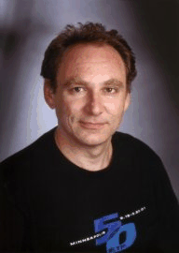




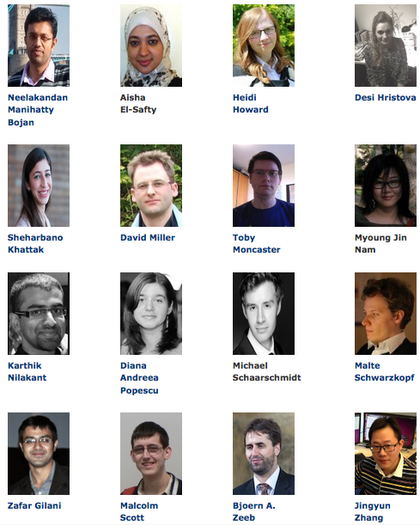
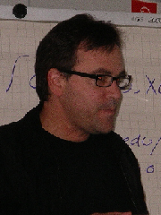






Who Are We?
http://www.cl.cam.ac.uk/research/srg/netos/people/
Noa Zilberman
2

Slide 4

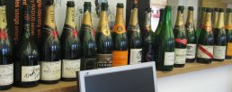
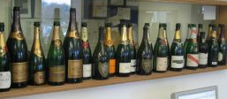
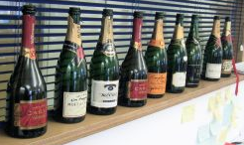
What Have We Done?
co-architect of Microsoft 360 Natal / Kinect
Founder Xensource, Bromium
Google Director in charge of web indexing and crawling
Author of AltaVista
Director of Toshiba Research
Research Director VMWare
Video-system architect for Nokia N8
Design Engineer at TomTom
Author of C++
Co-author of Gimp
Architect of the first hard-disk MP3 player
(NOT apple!)
Former University of Cambridge Pro-Vice Chancellor
<number>
Notes:
<number>

Slide 5

Where Have We Gone?
…the ONLY qualification that guarantees a job here is a good systems PhD from Cambridge…
(Director of a research lab in Palo Alto)
You will find SRG PhDs in
Amazon,Microsoft, Google, Intel, Sun, AT&T, IBM,…
AND founding a lot of other places too. Also,
MIT, Berkeley, Yale, HKUST, Helsinki Uni
August 15, 2007
January 10, 2001
<number>

Slide 6

A Selection of SRG Projects
Area
Program
Hardware
INTERNET
Resilient Clouds (MRC)
Theory
REMS
Languages
CADETS
OCaml Labs
Embedded
Horizon
Privacy
Networks-as-a-Service
User Centric Networking
Mobile
EmotionSense
Datacenter
Cloud Law
Data Centric Systems
Legal
CHERI
<number>

Slide 7
Jon Crowcroft
Stuff
Hub of All Things: personal data business models http://hubofallthings.org/
Cloud Legal: http://www.claw-workshop.org/
Internet Science: http://www.internet-science.eu/
Liquid Networking: http://trilogy2.it.uc3m.es/
Energy Aware Networking: http://www.internet-project.org.uk/
7

Slide 8
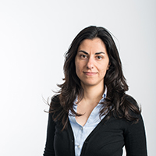
Eva Kalyvianaki
Cloud Computing, Big Data Processing, Autonomic Computing,
Distributed Systems and Systems Research in general.
Design and management of next generation, large-scale
applications in the Cloud. Addressing the complexity of modern
systems with mathematical reasoning.
Optimised resource management:
Integrating novel distributed optimisation techniques in large-scale management problems
Federated data center resource management:
Integrating novel federated processing algorithms in low-level resource management in virtualized data centers
8

Slide 9
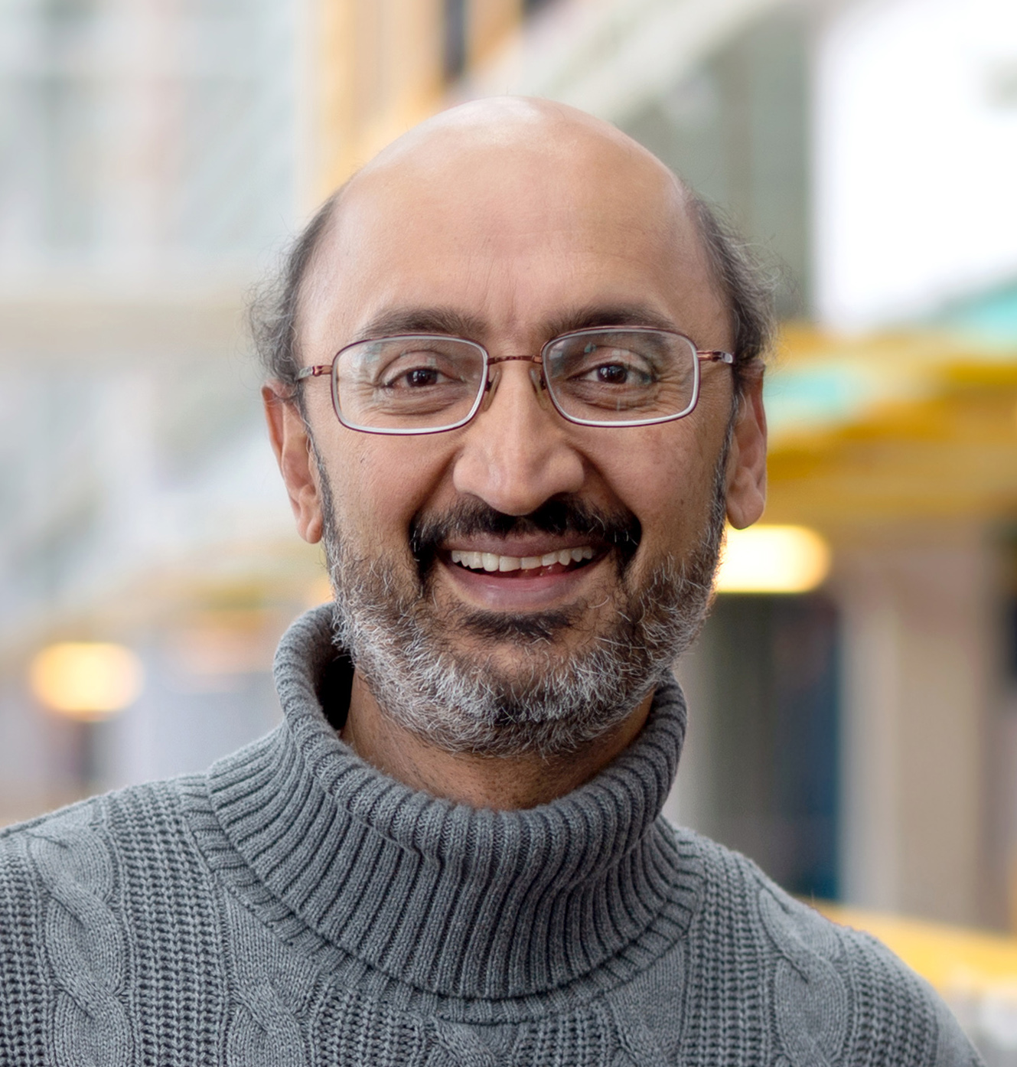
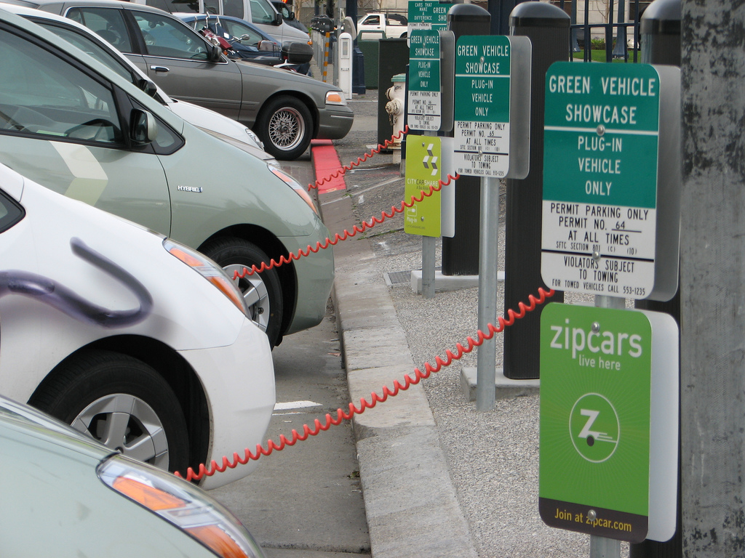
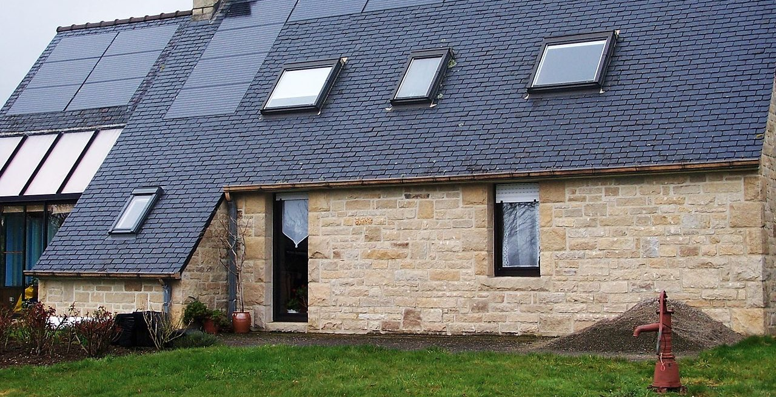
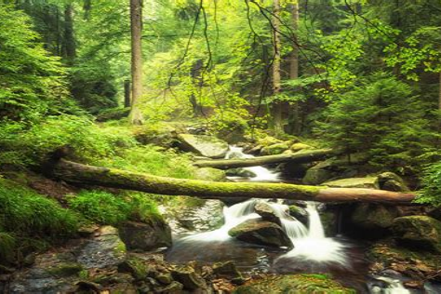
S. Keshav
Computer science to promote a sustainable future
Reducing the carbon footprint of existing energy systems
HVAC, transportation, building lighting, transmission grid
Optimal sizing and operation of solar PV and storage
Systems for forest conservation and restoration
Using mobile phones to measure trunk diameter in forest plots
Estimating reforestation rate in the Amazon from earth observation
Creating trust in carbon credits using blockchains and earth observation
Cambridge Centre for Carbon Credit
https://svr-sk818-web.cl.cam.ac.uk/keshav/wiki/index.php/Working_on
9

Slide 10
Anil Madhavapeddy
Programming languages meets operating systems
OCaml Labs: http://ocaml.io
Real World Functional Programming
Maintaining the core OCaml compiler toolchain and ecosystem
Buildsystem tooling, Ctypes
Unikernels
Mirage: Type-safe unikernel OS https://mirage.io/
Irmin: Branch-consistent git-like database library http://github.com/mirage/irmin
nqsb-TLS, Jitsu
OPAM
Large scale package management and solving http://opam.ocaml.org
jsOPAM for web applications, Windows port
10

Slide 11
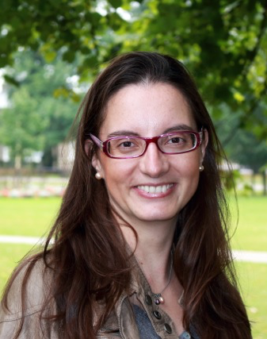
Cecilia Mascolo
All aspects of mobile systems
Mobility Modelling with Data
Prediction models, complex network models, recommender systems
Sensor Systems
Continuous sensing, new sensing modalities, sensing applications on wearables and phones
Applications to health and behaviour monitoring generally
11

Slide 12
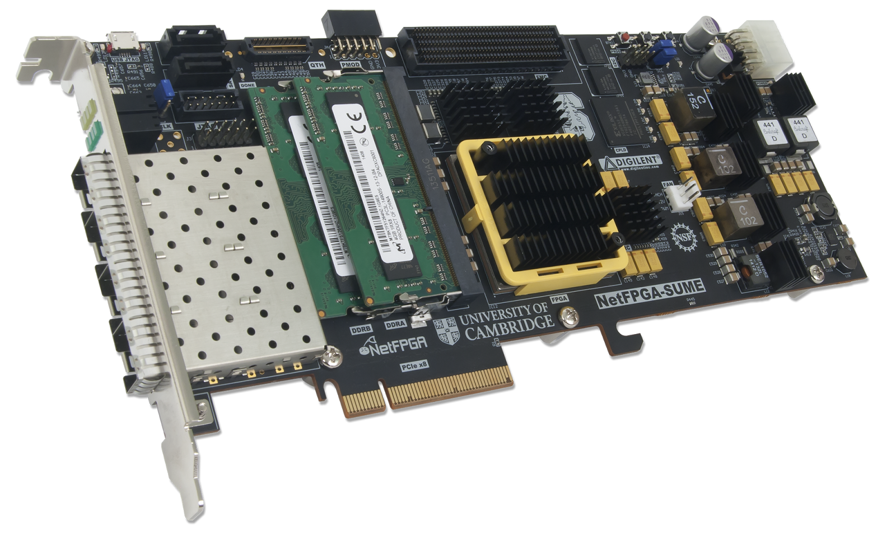
Andrew Moore
Network software meets network hardware
One language for all network hardware, firmware, and software www.naas-project.org
Open Hardware and 100Gb/s Research Reality www.netfpga.org
Useful Measurements: Merging Cause and Effect www.metrics-itn.eu
Datacenter heal thine self: Emulating 1 million machines http://selena-project.github.io
SSICLOPS: secure (fast) clouds for everyone www.ssiclops.net
ENDEAVOUR: exploring Software Defined Networking for Internet-wide switches
12

Slide 13
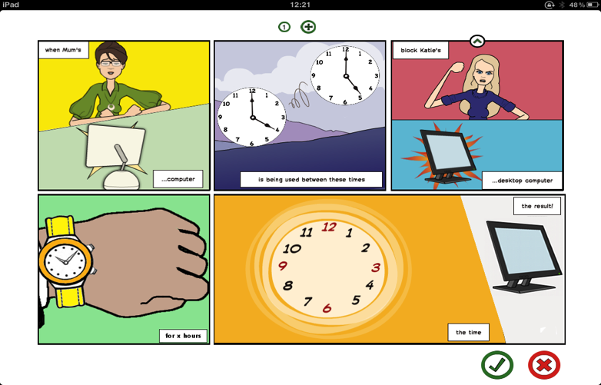
Richard Mortier
Intersecting systems with HCI to make things better
Homework redesigned home network technologies http://homenetworks.ac.uk
User-Centric Networking is rebuilding network technologies http://usercentricnetworking.eu
Human-Data Interaction seeks to use these developments to put people at the centre of our data-driven worldhttp://hdiresearch.org
13

Slide 14
Robert Watson
OSs, ISAs, and program analysis/transformation for security, performance, and sometimes (pragmatic) correctness
Capsicum: POSIX + the capability-system ideal
POSIX + microkernels/capability systems → support application sandboxing
Started as FreeBSD sandboxing technology; Google has ported to Linux
Network- and storage-stack specialisation for performance
Clean-slate network-stack and storage designs for performance
Microarchitecturally aware optimisation; 60+Gbps before we ran out of PCI buses
CHERI: Revisiting RISC for the age of risk
Processor ISAs for security: fine-grained memory safety, compartmentalisation
FPGA prototypes / tech transition: time for systems software researchers!
CADETS: DARPA new-start project on security via distributed tracing
Tracing distributed systems, LLVM-based program transformation
PhD studentships available for multiple of the above projects
14

Slide 15
Summary
Work across all systems areas
Hardware up to cloud & mobile applications
Work with wide range of industry
Microsoft, Google, Amazon, Facebook, etc
Funded from many sources
EU, UK, US, industry, government
We also welcome visitors!
<number>

