Slide 1
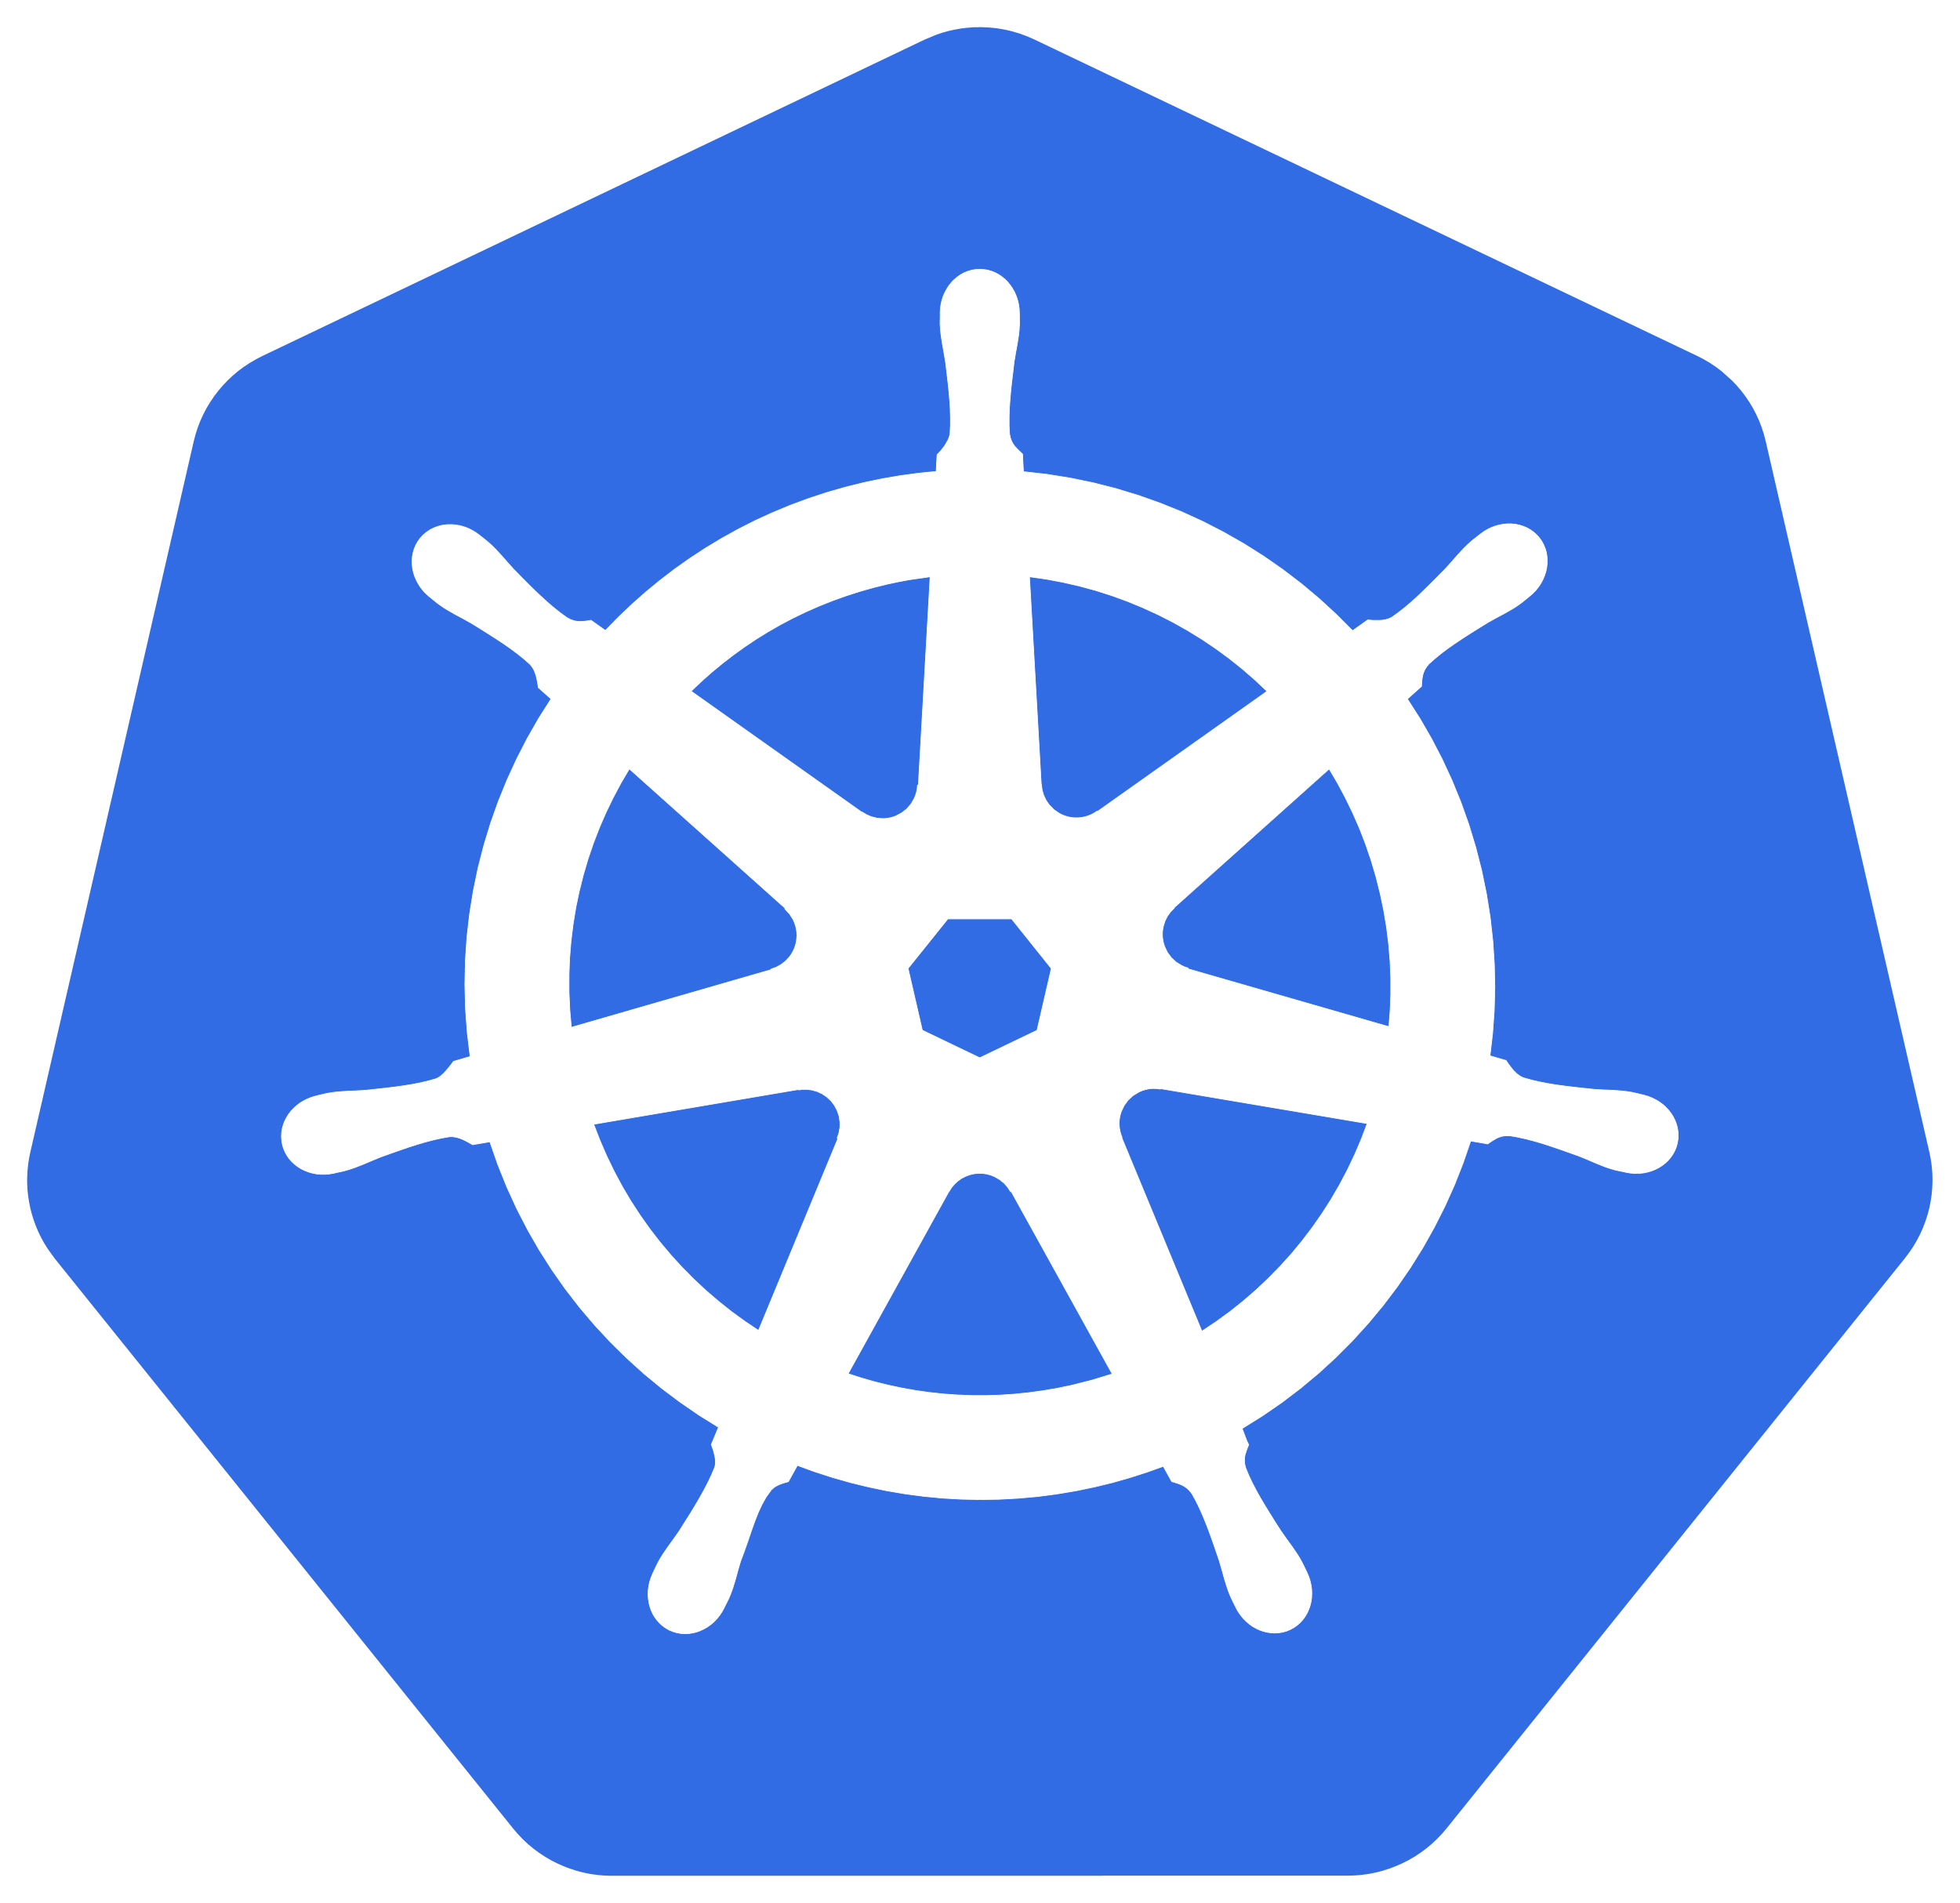
Kubernetes
Project study by Grzegorz Wilk

Slide 2
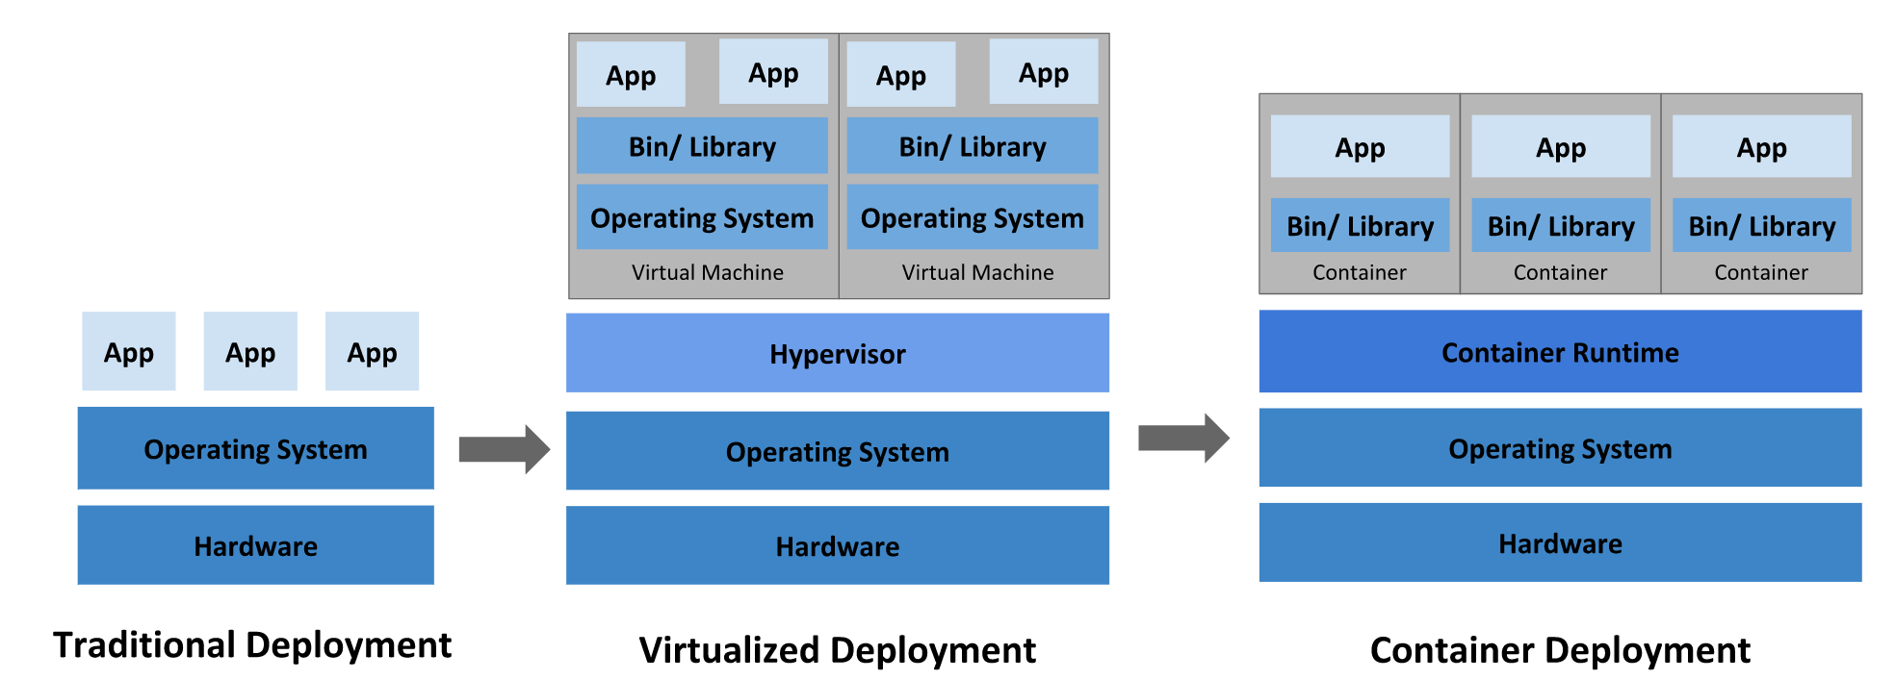
What is Kubernetes
Google’s third instalment of a container management system
Separates machine and OS concerns from the running applications
Allows for adding/removing instances, all handled by a load balancer

Slide 3
What does it get right?
Provides tools for telemetry, rollout and autoscaling
Strays away from a monolithic architecture (of Borg)
API simplicity:
Each container object exposes ObjectMetadata (props which all of them share), Spec (individual desired props) and Status (individual current props)
Hence, the principle to make Status equal Spec is shared

Slide 4
What do I aim to do with it?
Investigate what are the current solutions to problems that proved difficult in the past [1]:
Programmatic container configuration
Where non-existent functionality gets patched in (validation, release-management, version)
Separation between data and code? Turing complete languages? Avoiding DSLs?
Automatic dependency management
Having the container manage dependencies would be nice
But their instantiation may be complex
But it may be hard to do automatically, and require a list of dependancies
But it may quickly fall out-of-date
[1] Brendan Burns et al. “Borg, Omega, and Kubernetes”. In: ACM Queue14 (2016), pp. 70–93. url: http://queue.acm.org/detail.cfm?id=2898444.

Slide 5
Where am I at?
I have confirmed that I can install Kubernetes on my Windows laptop
I will be able to run local clusters through minikube on Virtualbox
But I won’t be able to run native hypervisors like Docker for Windows
This is because Windows 10 Home doesn’t support Hyper-V
AWS to the rescue

Slide 6
What is the plan?
Over the next couple of weeks, I will research how these two issues are handled in the wild. What are the industry approaches?
I will create my own toy-problems where I can explore the current approaches to container configuration and dependency management.
I will try to investigate/propose novel approaches to this problem.

