Slide 1
Why did it rain this morning?

Slide 2
Why did it rain this morning?
Why are you at this lecture?

Slide 3
Why did TCP give me throughput √2/(rtt √p)?
Why did TCP give me throughput √2/(rtt √p)?

Slide 4
τελος
teleology
The doctrine or study of ends or final causes, especially as related to the evidences of design or purpose in nature; also transf. such design as exhibited in natural objects or phenomena.

Slide 5

§5. The principles of resource allocation
Damon Wischik, UCL
Devavrat Shah, MIT

Slide 6


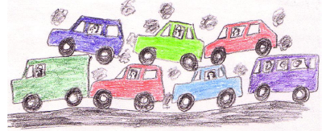


What do I mean by resource allocation?
In a data network, how much throughput should each user get?
In a data center, whose requests will I prioritize and whose will be dropped?
In a multi-tenanted data center, how many tenants can I fit?
Which drivers are on the roads?
How much should the state pay for health care?
Network neutrality

Slide 7
Why is it worth learning principles of resource allocation?
When you design a networked system, you will have to think about resource allocation sooner or later.
directly concerned
indirectly concerned
not yet concerned
with resource allocation
NSDI 2011 posters
NSDI 2011 papers

Slide 8

Why is it worth learning principles of resource allocation?
It’s hard to get right, except in simple cases.
Max-min fairness
Jain’s fairness index
Average throughput
Marginal benefit
Incentive compatibility
Identity issues:
bundled users, Sybil attacks

Slide 9
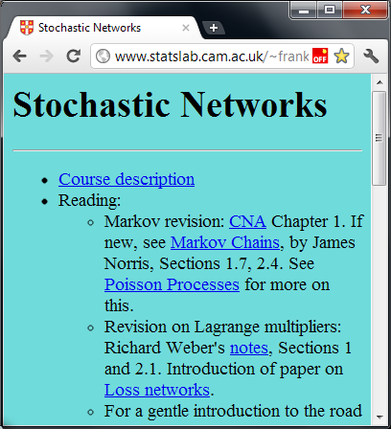
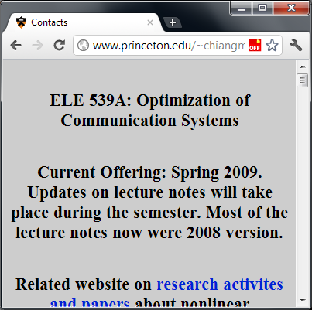
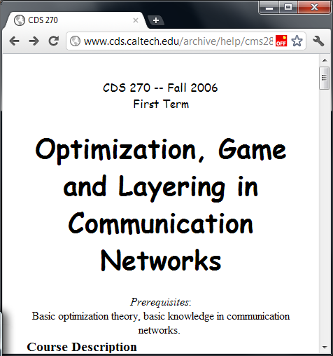
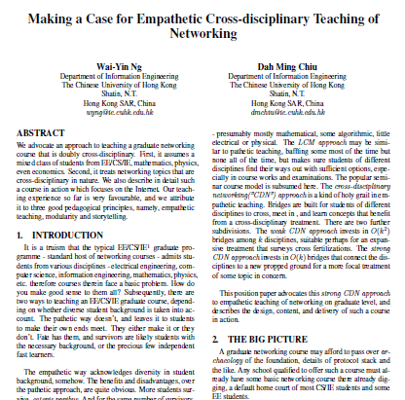

Why is it worth learning principles of resource allocation?
There is a systematic way to formulate the problem, and a systematic family of solutions.
Max-min fairness
Jain’s fairness index
Average throughput
Marginal benefit
Incentive compatibility
Identity issues:
bundled users, Sybil attacks

Slide 10
Why is it worth learning principles of resource allocation?
It is the only general solution we know.
TCP bandwidth sharing
Wireless interference
Admission control in a distributed hash table

Slide 11
Why is it worth learning principles of resource allocation?
Once you understand the systematic principle, you can apply it ‘horizontally’ to many systems.
Which bits of TCP are generic?
If I apply TCP-style resource allocation to DHT admission control, what do I get?
Which bits of TCP are the systems tweaks that make it actually work in practice?
“Design, implementation and evaluation of congestion control for multipath TCP”, NSDI 2011. Wischik, Raiciu, Greenhalgh, Handley.
This was 75% cranking the ‘resource allocation’ handle, 25% systems inspiration.

Slide 12
What are the principles of resource allocation?

Slide 13
Principle 1.
Every networked system has a capacity region.
The capacity region is the set of per-user traffic rates than can be carried.

Slide 14
Principle 2.
There is a systematic way to decide how resources should be allocated, given the capacity region.
Every one of these concepts is a special case of utility maximization, with the weighted α-fair utility function.

Slide 15
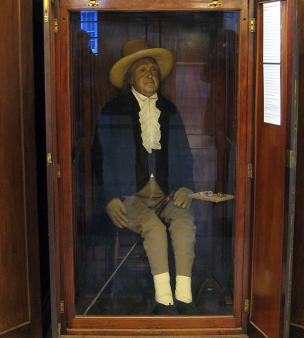
“The greatest happiness of the greatest number is the foundation of morals and legislation.”
Jeremy Bentham, 1748–1832
Notes:
This is what economists call a “social welfare maximization problem”.
Who is the designer? Certainly not Jacobson – his paper ¼ brilliant, ¾ “engineer’s maths”, i.e. plausible but wrong. He had no idea that this is what he was achieving; it just arose spontaneously from his code.
Meaning: if Jacobson runs experiments and measures the average throughput of each user, and if Bentham solves a centralized social welfare optimization, then they both come up with the same answer.
This is why the Internet succeeded – it has a distributed control mechanism for allocating resources, and this mechanism is trying to solve a sensible problem. No one had ever come up with a distributed control for such a large system before.

Slide 16
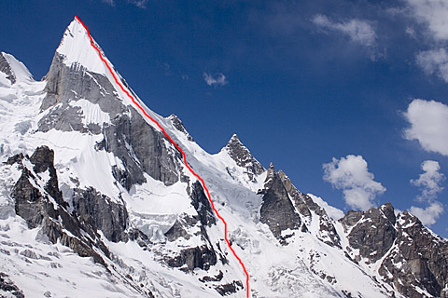
Principle 3.
There is a systematic family of algorithms for reaching any such allocation.
TCP behaves as if the network as a whole were trying to solve an optimization problem.

Slide 17
Principle 3.
There is a systematic family of algorithms for reaching any such allocation.
Every sensible goal in allocating network resources can be written as an optimization problem (namely, to maximize weighted α-fairness).
The simplest way to solve an optimization problem is gradient ascent.
TCP and backpressure (another type of congestion control) are both examples of gradient ascent. They correspond to different ways of writing out the optimization constraints.

