Slide 1

Poolability
Damon Wischik, UCL
Notes:
Resource Pooling is the technical concept at the heart of the project. I’ll explain what it’s all about.

Slide 2
Question
We have built a multipath version of TCP. For it to be useful, end systems need to have access to multiple paths. What mechanisms / protocols / algorithms should the Internet have for providing multiple paths?
For example:
Can we rely on multihomed users? Or on peer-to-peer applications? Or do we really do need support in the core of the Internet, e.g. through a change to BGP?

Slide 3
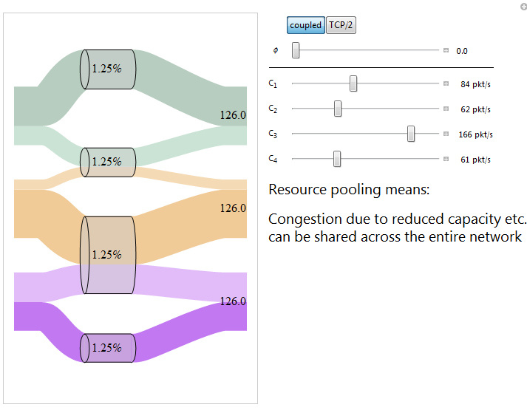
Note: these figures show the outcome from simulations of multipath TCP.

Slide 4
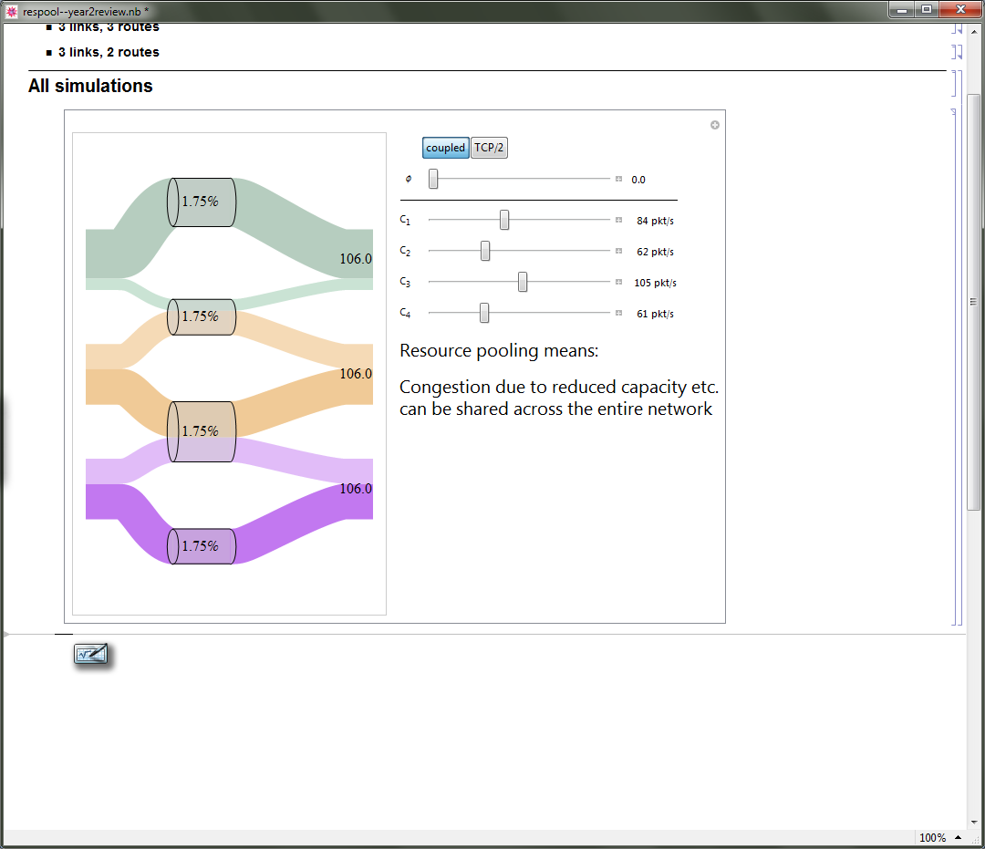
Note: these figures show the outcome from simulations of multipath TCP.

Slide 5
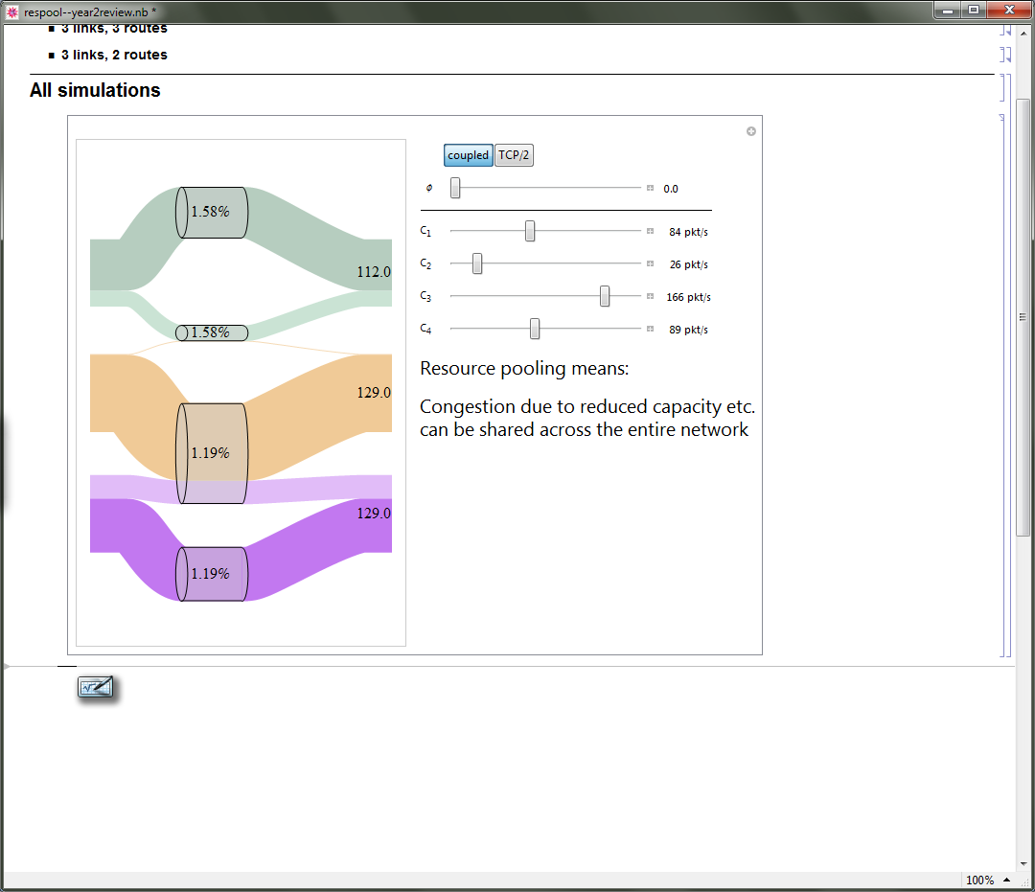
Note: these figures show the outcome from simulations of multipath TCP.

Slide 6
Sometimes the network behaves like a single “pooled resource”. This means it can easily adapt to changing conditions, and it shares total capacity as fairly as possible.
But sometimes the network behaves like several separate “pooled resources”.
How can we predict which?

Slide 7
A useful first step: remind ourselves of the classic multi-commodity flow problem

Slide 8
The capacity constraints in a multicommodity flow problem can be written as generalized cut constraints.

Slide 9
These generalized cut constraints also tell us something useful about queueing networks in heavy traffic.
[Laws, 1992, “Resource pooling in queueing networks”.]

Slide 10
The generalized cut constraints show up in the multicommodity flow problem, and in the heavy traffic queueing problem.
Do they also show up multipath TCP?

Slide 11
In this experiment, I asked:
“What is the effect on flow rates and on drop probabilities, of changing the capacity at one of the links?”
Let’s turn this into a maths problem.
We’ll know we’ve got the right answer, if the generalized cut constraints drop out in the analysis.

Slide 12
A simple flow allocation problem

Slide 13
A simple flow allocation problem

Slide 14
A simple flow allocation problem (relaxed version)
It can be shown that a suitable multipath TCP solves this problem.
Notes:
This is interesting, because K+V and K+L+T have congestion control algorithms that are distributed ways of solving this problem.

Slide 15
We want to know how the solution changes when capacities change.
I shall take y to be fixed, and only look at how x changes.
Notes:
This is interesting, because K+V and K+L+T have congestion control algorithms that are distributed ways of solving this problem.

Slide 16
We want to know how the solution changes when capacities change.
I shall take y to be fixed, and only look at how x changes.
Write out the complementary slackness conditions
Take the total derivative with respect to C_{j} for some j
Solve for dz_{i}/dC_{j} using linear algebra

Slide 17
Theorem
At an isolated link,
In a network with idealized multipath congestion control
I call Ψ_{jj} the “poolability score”, and C_{j}/(1-Ψ_{jj}) the “effective pooled capacity”. If Ψ_{jj} ≈1 then the link sheds load easily. If Ψ_{jj} ≈0 then the link is “solitary”.

Slide 18
My goal was to devise a metric for resource pooling. What is resource pooling? It means
“making a collection of resources
behave like a single pooled resource”.

Slide 19
My goal was to devise a metric for resource pooling. What is resource pooling? It means
“making a collection of resources
behave like a single pooled resource”.

Slide 20
My goal was to devise a metric for resource pooling. What is resource pooling? It means
“making a collection of resources
behave like a single pooled resource”.

Slide 21
If the poolability score is Ψ_{jj} ≈1 then the link sheds load easily.
If the poolability score is Ψ_{jj} ≈0 then the link is “solitary”.
Notes:
“Behaviour” – response to small changes in capacity.
(Circle the resource pools, and draw the pooled diagram. LHS: complete resource pooling.)
Typically, there are only a small number of resource pool configurations – either there is a pool, or there isn’t, it’s not a matter of degree.
We’d like paths such that there are as few resource pools as possible.

Slide 22
If the poolability score is Ψ_{jj} ≈1 then the link sheds load easily.
If the poolability score is Ψ_{jj} ≈0 then the link is “solitary”.

Slide 23
If the poolability score is Ψ_{jj} ≈1 then the link sheds load easily.
If the poolability score is Ψ_{jj} ≈0 then the link is “solitary”.

Slide 24
The same “magic coefficients” turn up in the multicommodity flow problem, in the heavy traffic queueing model.
Now we know they turn up in the rate allocation problem, and we know how to interpret them.
Can we use them to decide on a good protocol for multipath routing? Can they help in working out which parts of the network would benefit from extra capacity, or which flows would benefit from extra paths?
Is there an inductive way to calculate the “magic coefficients”, based on the formulae for series and parallel resistor networks?

Slide 25
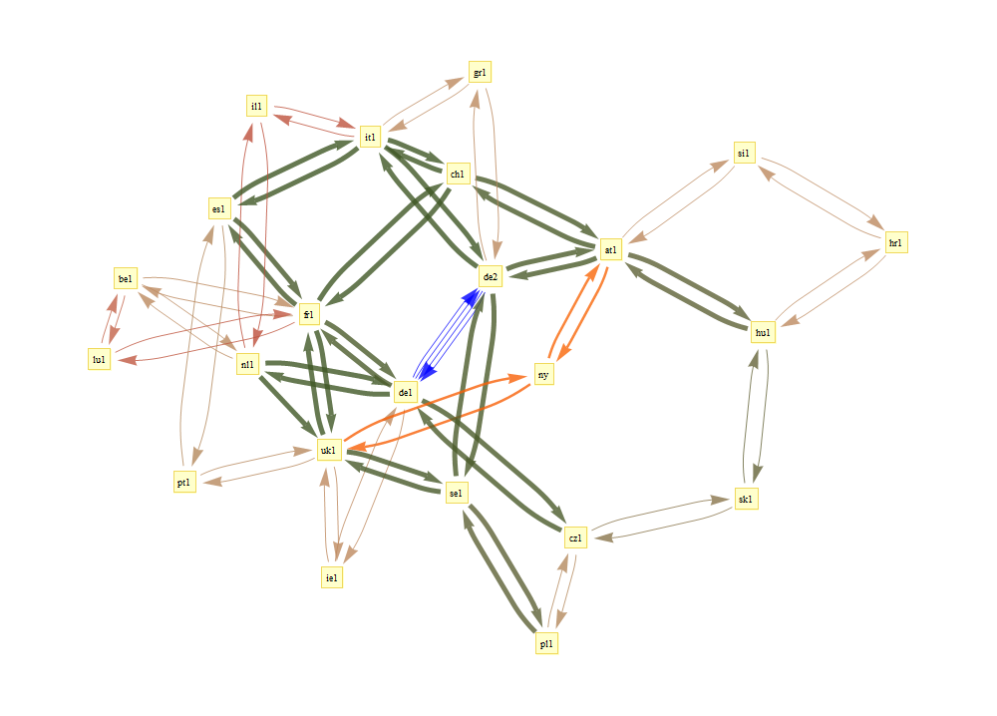
GEANT data provided by UCL Belgium
multipath routes, link capacities, and traffic matrices

Slide 26
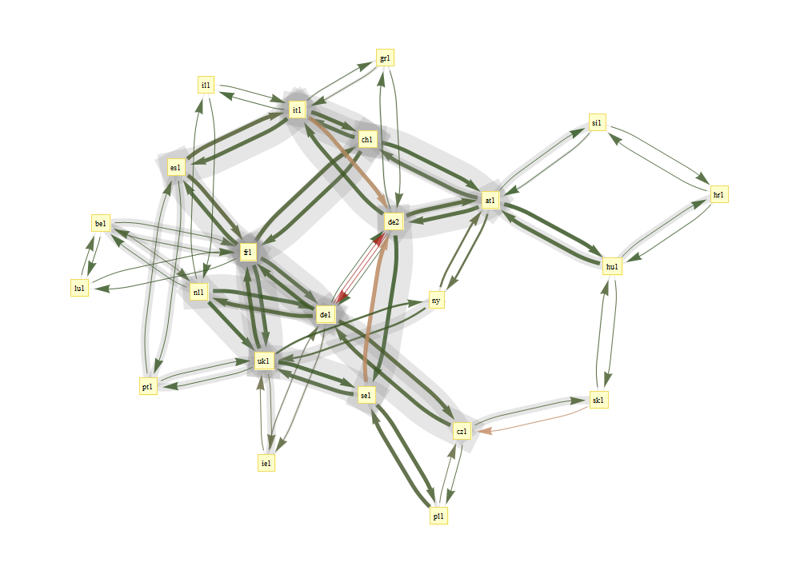
2005-05-04 16:30:00
Colours show utilization
Grey shows effective pooled capacity
Notes:
Some of the assumptions behind this:
I used the traffic matrix to estimate the number of flows between each pair, and then I made each flow run the idealized congestion controller. I assumed that there is no congestion at the access links. If I had data about access links, I could incorporate it into the computation.
Note: not all of the possible routes are made available. I just used the routes that were chosen by the WP1 algorithm. The multipath routing algorithm used local state to produce loop-free routes, and this prevented it from selecting certain paths.

Slide 27
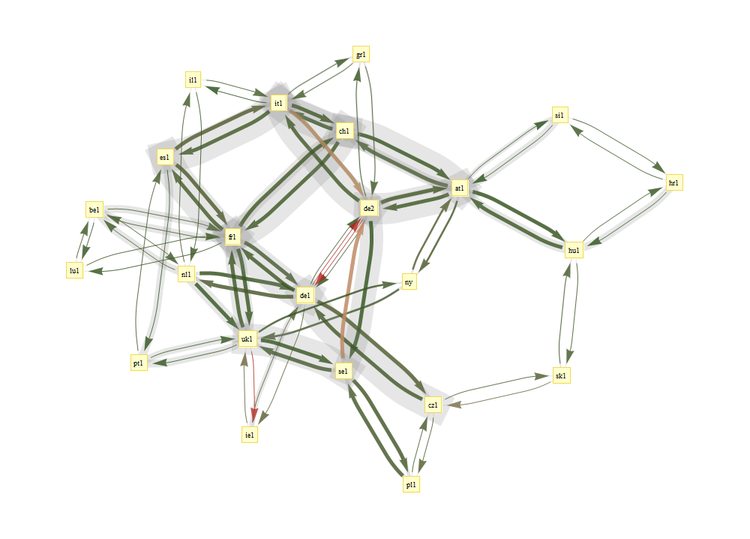
2005-05-04 17:45:00
Colours show utilization
Grey shows effective pooled capacity

Slide 28
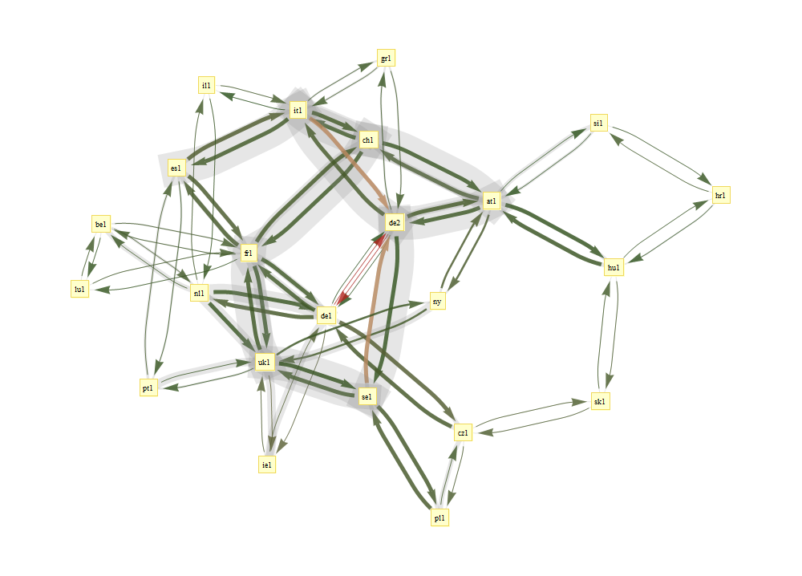
2005-05-04 19:00:00
Colours show utilization
Grey shows effective pooled capacity

Slide 29
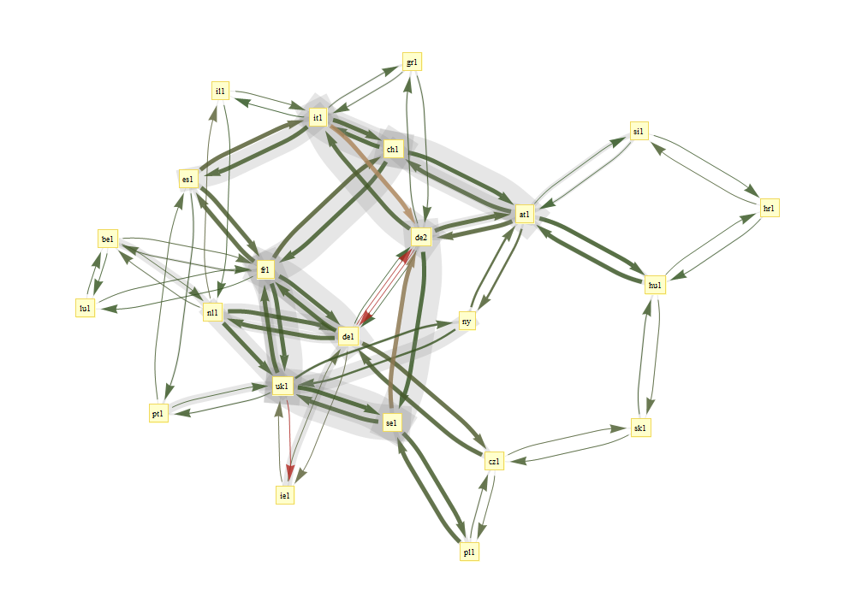
2005-05-04 20:15:00
Colours show utilization
Grey shows effective pooled capacity
Notes:
Summary: we have produced a metric, the “effective pooled capacity” at a link. This measures the beneficial effect of resource pooling. Hopefully, we’ll be able to use this to answer questions like “Is it sufficient to use end-host addressing?”

