Slide 1
MAC3:
Medium Access Coding
& Congestion Control
Devavrat Shah (MIT)
Damon Wischik (UCL)

Slide 2
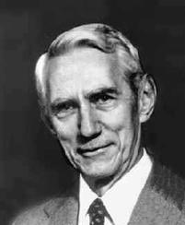
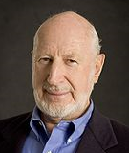
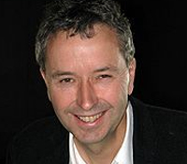
Information theory and coding theory “What is the theoretical limit on how much I can send?” full knowledge — coding — noisy channels
Wireless MAC “How can I learn when it’s safe to send?” contention — adapting — distributed algorithm
Congestion control “How can I learn how fast to send?” adapting — distributed algorithm — resource allocation — networks

Slide 3
The classic ALOHA model for a wireless channel is useful for studying contention & coordination.
Let there be n users, each with an infinite backlog of packets. Over a long timescale, n varies.
Time is slotted. In each timeslot, users can transmit a packet.
If exactly one user transmits, its packet is successfully delivered. If more than one user transmits, the packets collide and none is successfully delivered.
At the end of the timeslot, all users are told whether there were no attempts, one attempt, or more than one attempt.
The Medium Access Control (MAC) protocol is the algorithm for deciding whether a user should attempt transmission in a given timeslot. How should the MAC protocol be designed?

Slide 4
What are the typical mechanisms of a MAC protocol?
MAC protocols typically involve a random wait before transmission, and longer random back-off in the event of a collision.

Slide 5
In a network setting, it is more challenging to devise a good MAC protocol.
The hidden terminal problem. User 1 does not hear users 2 or 3, so it does not know to back off, so the receiver is overloaded.
The exposed terminal problem. Each user backs off when the other is transmitting, but this is not necessary since the receivers do not hear the collision.

Slide 6
What are the design goals of a MAC protocol?
Let θ_{i} be the rate of successfully delivered packets for user i. Let user i have a utility function U_{i}(θ_{i}). A reasonable objective is
The MAC layer has to discover how many users there are, and what rates are attainable, and solve this optimization.
It should be a distributed algorithm, and it should react quickly when the network changes. It should work in a multihop network.

Slide 7
A remarkable recent MAC algorithm shows a new way of thinking about contention
“ZigZag decoding: combating hidden terminals in wireless networks”,
Gollakota and Katabi, SIGCOMM 2008
The wireless medium is additive. Therefore, even when transmissions collide, ZigZag may be able to decode the signal.
But this decoding only works when there are few packets colliding. ZigZag relies on ALOHA-style adaptive backoff, to ensure that collisions are rare.

Slide 8
I propose a toy model for MAC, with which to explore some new styles of resource allocation
Let there be n users, each with an infinite backlog of packets. Over a long timescale, n varies.
Consider a slotted-time binary noiseless additive channel.
How should users choose what to send, in order to maximize aggregate utility?

Slide 9
A simple MAC encoding
Suppose there are two users. Let user 1 have packets P₁, P₂, … ϵ{0,1}^{K} to send. Let user 2 have packets Q₁, Q₂, …
Let A⊂{0,1}^{K×K} be a set of invertible matrices. Let A₁, A₂, … and B₁, B₂, … be sequences of IID matrices drawn from A.
User 1 sends | A₁ P₁ | A₂ P₁ | A₃ P₁ | A₄ P₂ | A₅ P₂ | A₆ P₂ | A₇ P₃
User 2 sends | B₁ Q₁ | B₂ Q₁ | B₃ Q₂ | B₄ Q₂ | B₅ Q₃ | B₆ Q₃ | B₇ Q₄
Receiver hears | Y₁ | Y₂ | Y₃ | Y₄ | Y₅ | Y₆ | Y₇

Slide 10
A simple MAC decoder
Suppose the receiver knows
  the sequences A₁, A₂, … and B₁, B₂, …
  which packets are transmitted in which timeslots
The receiver also knows,
at time 1, that | A₁ P₁ + B₁ Q₁ = Y₁
at time 2, that | A₂ P₁ + B₂ Q₁ = Y₂
at time 3, that | A₃ P₁ + B₃ Q₂ = Y₃
at time 4, that | A₄ P₂ + B₄ Q₂ = Y₄
…

Slide 11
How well does this MAC decoder work?
Let user i introduce new packets at rate θ_{i}
The receiver acquires new equations at rate 1 / timeslot
New unknowns are introduced at rate ∑θ_{i} / timeslot
This decoder’s success rate depends somehow on ∑θ_{i} and on the degree of linear independence in the equations.

Slide 12
A simple congestion controller
When the receiver fails to decode some packets, let it send a congestion notification to all the users whose signals it hears. (This notification might be “out of band”.)
Let each user i adapt θ_{i} according to his utility function
  increase θ_{i} steadily when there is no congestion
  decrease θ_{i} when it receives congestion feedback.
This should automatically solve the network utility maximization problem.

Slide 13
The wireless medium is additive.
ALOHA-style back-off protocols are a type of coding. There are other types of coding that take advantage of additivity: for these codes it is useful for users to keep sending all the time, so that the channel is never wasted.
It is necessary to study MAC design and channel coding together.
It is possible to combine coding with utility-maximizing congestion control. This automatically solves the hidden terminal and exposed terminal problems, and it applies automatically to multihop networks.

Slide 14
Some questions
For the MAC I described, what is the probability of successfully decoding a packet? How does it depend on A and on (θ_{i}, 1≤i≤n)?
What is a better MAC?
How can the good features of this toy model, especially the congestion control mechanism, be implemented in a practical system?

Slide 15
Our naïve decoder requires the receiver to be able to decode everything it hears, giving the capacity bound
θ₁ + θ₂ + θ₃ ≤ 1.
Shannon’s bound suggests we should be able to do better:
θ₁ + H(H⁻¹(θ₂) ⊕H⁻¹(θ₃)) ≤ 1
where p⊕q=p(1-q)+q(1-p). How might we achieve this?
If the three users coordinate their transmissions, the capacity constraint is even better:
θ₁ + max(θ₂ ,θ₃) ≤ 1.
How might users coordinate themselves?

Slide 16
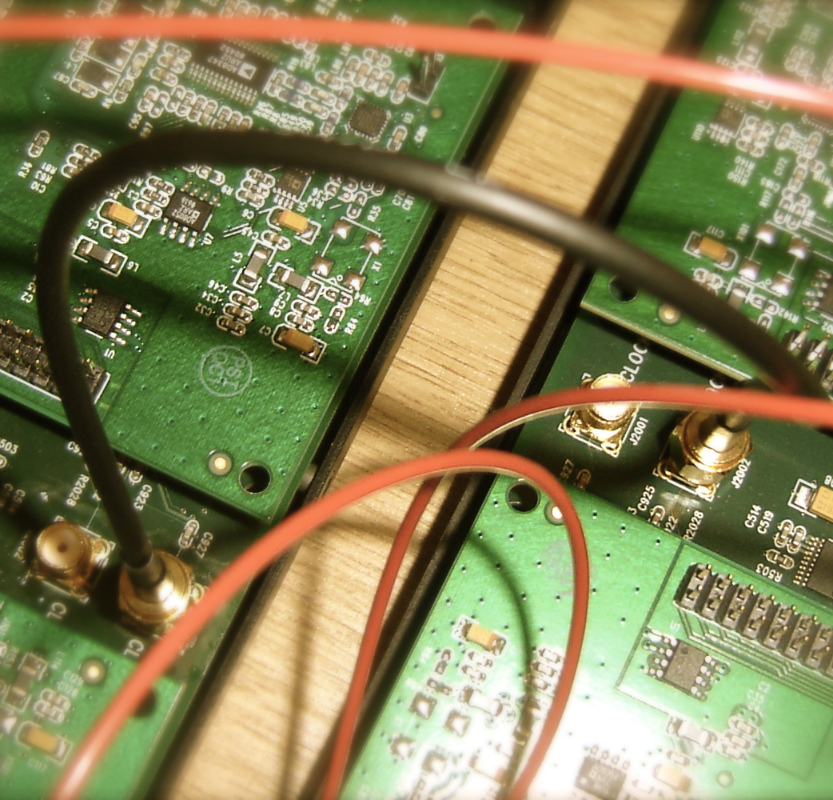
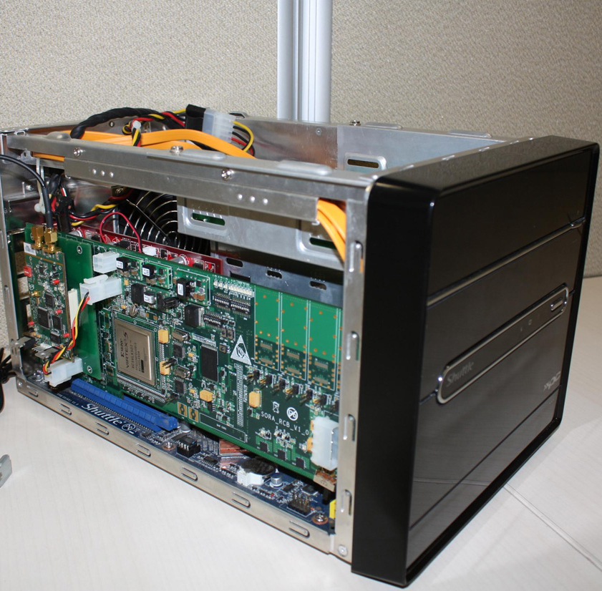

Software radios invite us to rethink how networks are organized – to rethink the layers of the network stack.

