Slide 1
Privacy-Preserving Analytics in and out of the Clouds
Jon Crowcroft,
http://www.cl.cam.ac.uk/~jac22
This work is funded in part by the EPSRC Databox (EP/N028260/1),
NaaS (EP/K031724/2) and Contrive (EP/N028422/1) and Turing/Maru (EP/N510129/1) projects.

Slide 2
Compute-First Networking
Should do to IP, what IP did to POTS
Need to think 40-50 years ahead in s/w terms
Scale up (10^23 nodes per person)
Verification or Generative (correct & smaller by design) code
Invariants (C (max latency), plank’s constant (min size)) matter more…

Slide 3
1 In Cloud. Trust Issues: Provider Perspective
Cloud provider does not trust users
Use virtual machines to isolate users from each other and the host
VMs only provide one way protection
Redis
OS
VMM
Firmware
trusted
Cloud platform
Staff
…

Slide 4
Trust Issues: User Perspective
Users trust their applications
Users must implicitly trust cloud provider
Existing applications implicitly assume trusted operating system
Redis
OS
VMM
Firmware
untrusted
Cloud platform
Staff
…

Slide 5
Trusted Execution Support with Intel SGX
Users create HW-enforced trusted environment (enclave)
Supports unprivileged user code
Protects against strong attacker model
Remote attestation
Available on commodity CPUs
Enclave
OS
VMM
Firmware
untrusted
Cloud platform
Staff
…

Slide 6
Trusted Execution Environments
Trusted execution environment (TEE) in process
Own code & data
Controlled entry points
Provides confidentiality & integrity
Supports multiple threads
Full access to application memory
User process
OS
Enclave
Enclave code
Enclave
Enclave data
Application code
Threads
…
Application data

Slide 7
Intel Software Guard Extensions (SGX)
Extension of Instruction Set Architecture (ISA) in recent Intel CPUs
Skylake (2015), Kaby lake (2016)
Protects confidentiality and integrity of code & data in untrusted environments
Platform owner considered malicious
Only CPU chip and isolated region trusted

Slide 8
SGX Enclaves
SGX introduces notion of enclave
Isolated memory region for code & data
New CPU instructions to manipulate enclaves and new enclave execution mode
Enclave memory encrypted and integrity- protected by hardware
Memory encryption engine (MEE)
No plaintext secrets in main memory
Enclave memory can be accessed only by enclave code
Protection from privileged code (OS, hypervisor)
Application has ability to defend secrets
Attack surface reduced to just enclaves and CPU
Compromised software cannot steal application secrets
Process
✔
Enclave
✘
✘
✘
OS
Hypervisor

Slide 9
SGX SDK Code Sample
SGX application: untrusted code
char request_buf[BUFFER_SIZE];
char response_buf[BUFFER_SIZE];
int main()
{ ...
while(1)
{ receive(request_buf); ret = EENTER(request_buf, response_buf); if (ret < 0)
fprintf(stderr, "Corrupted message\n");
else
send(response_buf); } ... }
Enclave: trusted code
char input_buf[BUFFER_SIZE];
char output_buf[BUFFER_SIZE];
int process_request(char *in, char *out)
{
copy_msg(in, input_buf); if(verify_MAC(input_buf))
{
decrypt_msg(input_buf); process_msg(input_buf, output_buf);
encrypt_msg(output_buf);
copy_msg(output_buf, out); EEXIT(0); } else EEXIT(-1); }
Server:
Receives encrypted requests
Processes them in enclave
Sends encrypted responses

Slide 10
SGX Enclave Construction
DRAM
1
char input_buf[BUFFER_SIZE];
char output_buf[BUFFER_SIZE];
int process_request(char *in, char *out)
{
copy_msg(in, input_buf); if(verify_MAC(input_buf))
{
decrypt_msg(input_buf); process_msg(input_buf, output_buf);
encrypt_msg(output_buf);
copy_msg(output_buf, out); EEXIT(0); } else EEXIT(-1); }
2
3
EPC
Enclave populated using special instruction (EADD)
Contents initially in untrusted memory
Copied into EPC in 4KB pages
Both data & code copied before execution commences in enclave

Slide 11
SGX Support for Spark
SGX-Spark
Protect data processing from infrastructure provider
Protect confidentiality & integrity of existing jobs
No modifications for end users
Acceptable performance overhead
Idea: Execute only sensitive parts of Spark inside enclave
Code that accesses/processes sensitive data
Code outside of enclave only accesses encrypted data
Partition Spark
Run two collaborating JVMs, inside enclave and outside of enclave
Spark
Spark
Manage-
ment
Spark
Taskn
Task1
Taskn
JVM
JVM
OS
OS
TEE
SGX

Slide 12
Partitioning Spark
Goal: Move minimal amount of Spark code to enclave
Outside | Enclave
HadoopRDD Provide iterator over input data partition (encrypted)
MapPartitionsRDD Execute user-provided function (f) (eg flatMap(line => {line.split(" ")}) (i) Serialise user-provided function f (ii) Send f and it to enclave JVM (iv) Receive result iterator it_result | (iii) Decrypt input data (iv) Compute f(it) = it_result (v) Encrypt result
ExternalSorter Execute user-provided reduce function g (eg reduceByKey{case (x, y) => x + y}) | (iii) Decrypt input data (iv) Compute g(it2) = it2_result (v) Encrypt result
ResultTask Output results
it
f,it
it2 = it_result
g,it2
it2_result

Slide 13
Partitioning Spark
ResultTask
k’
MapPartitions
RDD C
j’
MapPartitions
RDD B
i’
HadoopRDD A
Outside Enclave Tasks Iterators
Iterate via shm
<outfile>
<infile>
A,B,C,D
i,j,k

Slide 14
Partitioning Spark
ResultTask
I
Communication
ItConsumer k
k
ItProvider k
k’
k
MapPartitions
RDD C
k=SgxTask(C,j)
SgxTask C
j’
j
MapPartitions
RDD B
j=SgxTask(B,i)
SgxTask B
ItConsumer i
i’
HadoopRDD A
i
ItProvider i
Outside Enclave Tasks Iterators
Iterate via shm
<outfile>
<infile>
A,B,C,D
i,j,k

Slide 15
2. Alternatives (as well as)
MPC
Hard to comprehend
High latency
Homomorphic Cryptography
Easier to understand
Lower throughput
Differential Privacy or K-Anon or Fuzzing
Easier still to understand
Limited number of duty cycles

Slide 16
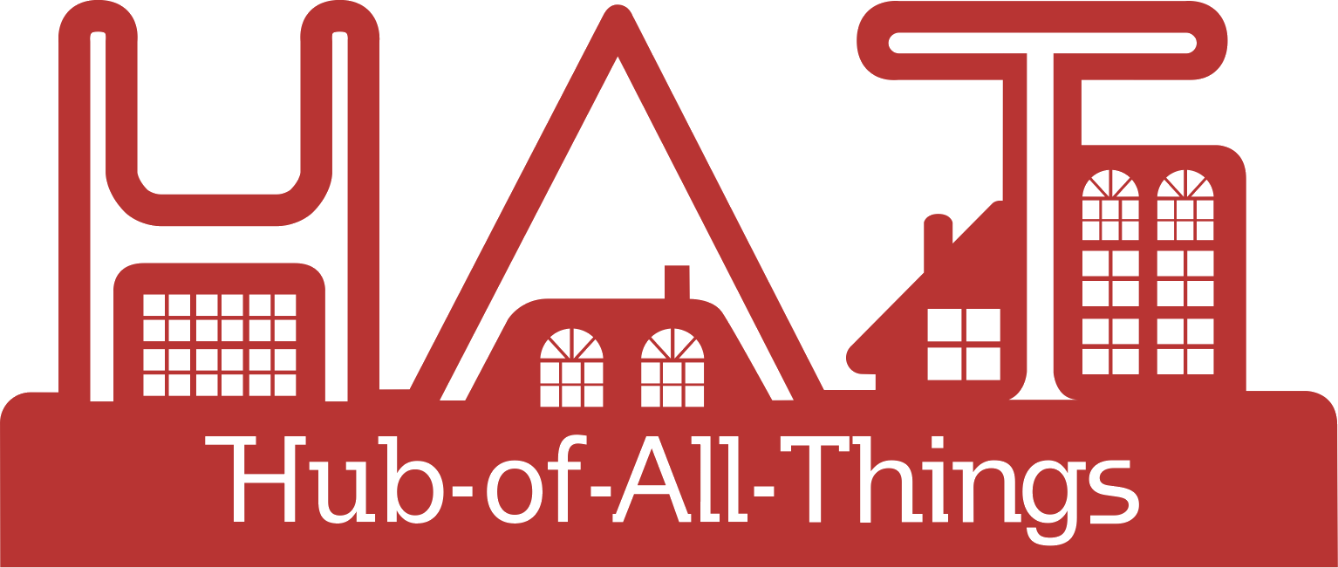
3. The HAT ecosystem – Not a Cloud == Databox in the Wild
To evolve and emerge a digital service ecosystem of organisations and people where individuals are able to acquire, use, control and exchange their own data for their own good and the good of society
Ownership Model:
http://wrap.warwick.ac.uk/108357/

Slide 17
The HAT ecosystem
HAT Platform providers
HAT users with their HAT data in their own microservice containers
Retail Channel: direct provisioning of HATs
http://hatdex.org
Regulate
Innovate
Grow
Represent
http://hatcommunity.org/
HAT service providers
Wholesale channel
Personal hyper data browser (to see & act on HAT data & content)
http://rumpel.hubofallthings.net
Brand owners. IoT companies, SMEs, outsourcing personal data management & exchange
http://www.hatdex.org/hatdex-for-business/
Community space to browse data & content offers, interact & chat, ‘catalogue/store’, exchange data
http://marketsquare.hubfoallthings.net
Open source code repository
Community development
Other HAT Platform providers globally that host HATs on their own infrastructure
Personal HAT address
yourname.hubfoallthings.net
HAT Global Festival
Hackathons
Funding for startups
HAT-ready services contributing to and requesting HAT data & content
Rumpel add-ons
Marketsquare add-ons
Dataplugs
Continuing research on HAT ecosystem
Managed by WMG, University of Warwick
http://hubofallthings.com/hat-rd/
Direct HAT applications
Native applications (data does not leave the HAT/Rumpel space)
New views
Bundles/Contexts
Email, website, file service, messaging
Meta & aggregate level services
Data shoppers
Content shoppers
Social data sharing
Analytics, comparisons
Add new data into HATs
Social media, finance, Health, government data, supermarket purchases
Sign on services
Applications that use HAT schema, logic and APIs directly
wellbeing * blockchains * content * others

Slide 18
HAT Community Foundation
A members organisation (charity) startup for the Regulation, Innovation, Growth & Representation in the HAT personal data ecosystem

Slide 19
The HAT ecosystem
HAT Platform providers
HAT users with their HAT data in their own microservice containers
Retail Channel: direct provisioning of HATs
http://hatdex.org
Regulate
http://hatcommunity.org/
HAT service providers
Wholesale channel
Personal hyper data browser (to see & act on HAT data & content)
http://rumpel.hubofallthings.net
Brand owners. IoT companies, SMEs, outsourcing personal data management & exchange
http://www.hatdex.org/hatdex-for-business/
Community space to browse data & content offers, interact & chat, ‘catalogue/store’, exchange data
http://marketsquare.hubfoallthings.net
Certification
Ratings
on
Privacy
Security
Confidentiality
Other HAT Platform providers globally that host HATs on their own infrastructure
Personal HAT address
yourname.hubfoallthings.net
HAT-ready services contributing to and requesting HAT data & content
Rumpel add-ons
Marketsquare add-ons
Dataplugs
Continuing Research on HAT ecosystem
Managed by WMG, University of Warwick
http://hubofallthings.com/hat-rd/
Direct HAT applications
Native applications (data does not leave the HAT/Rumpel space)
New views
Bundles/Contexts
Email, website, file service, messaging
Meta & aggregate level services
Data shoppers
Content shoppers
Social data sharing
Analytics, comparisons
Add new data into HATs
Social media, finance, Health, government data, supermarket purchases
Sign on services
Applications that use HAT schema, logic and APIs directly
wellbeing * blockchains * content * others

Slide 20
The HAT ecosystem
HAT Platform providers
HAT users with their HAT data in their own microservice containers
Retail Channel: direct provisioning of HATs
http://hatdex.org
Innovate
http://hatcommunity.org/
HAT service providers
Wholesale channel
Personal hyper data browser (to see & act on HAT data & content)
http://rumpel.hubofallthings.net
Brand owners. IoT companies, SMEs, outsourcing personal data management & exchange
http://www.hatdex.org/hatdex-for-business/
Community space to browse data & content offers, interact & chat, ‘catalogue/store’, exchange data
http://marketsquare.hubfoallthings.net
Open source code repository
Community development
Other HAT Platform providers globally that host HATs on their own infrastructure
HAT Global Festival
Hackathons
Funding for startups
Personal HAT address
yourname.hubfoallthings.net
HAT-ready services contributing to and requesting HAT data & content
Rumpel add-ons
Marketsquare add-ons
Dataplugs
Continuing Research on HAT ecosystem
Managed by WMG, University of Warwick
http://hubofallthings.com/hat-rd/
Direct HAT applications
Native applications (data does not leave the HAT/Rumpel space)
New views
Bundles/Contexts
Email, website, file service, messaging
Meta & aggregate level services
Data shoppers
Content shoppers
Social data sharing
Analytics, comparisons
Add new data into HATs
Social media, finance, Health, government data, supermarket purchases
Sign on services
Applications that use HAT schema, logic and APIs directly
wellbeing * blockchains * content * others

Slide 21
The HAT ecosystem
HAT Platform providers
HAT users with their HAT data in their own microservice containers
Retail Channel: direct provisioning of HATs
http://hatdex.org
Grow
http://hatcommunity.org/
HAT service providers
Wholesale channel
Personal hyper data browser (to see & act on HAT data & content)
http://rumpel.hubofallthings.net
Brand owners. IoT companies, SMEs, outsourcing personal data management & exchange
http://www.hatdex.org/hatdex-for-business/
Community space to browse data & content offers, interact & chat, ‘catalogue/store’, exchange data
http://marketsquare.hubfoallthings.net
Other HAT Platform providers globally that host HATs on their own infrastructure
Personal HAT address
yourname.hubfoallthings.net
HAT-ready services contributing to and requesting HAT data & content
Rumpel add-ons
Marketsquare add-ons
Dataplugs
Continuing Research on HAT ecosystem
Managed by WMG, University of Warwick
http://hubofallthings.com/hat-rd/
Direct HAT applications
Native applications (data does not leave the HAT/Rumpel space)
New views
Bundles/Contexts
Email, website, file service, messaging
Meta & aggregate level services
Data shoppers
Content shoppers
Social data sharing
Analytics, comparisons
Add new data into HATs
Social media, finance, Health, government data, supermarket purchases
Sign on services
Applications that use HAT schema, logic and APIs directly
wellbeing * blockchains * content * others

Slide 22
The HAT ecosystem
HAT Platform providers
HAT users with their HAT data in their own microservice containers
Retail Channel: direct provisioning of HATs
http://hatdex.org
HAT service providers
Represent
http://hatcommunity.org/
Wholesale channel
Personal hyper data browser (to see & act on HAT data & content)
http://rumpel.hubofallthings.net
Brand owners. IoT companies, SMEs, outsourcing personal data management & exchange
http://www.hatdex.org/hatdex-for-business/
Community space to browse data & content offers, interact & chat, ‘catalogue/store’, exchange data
http://marketsquare.hubfoallthings.net
HAT trademarks
Associate members
Corporate members
Members meetings
Events
White papers
Advisory roles
Fund raising
Other HAT Platform providers globally that host HATs on their own infrastructure
Personal HAT address
yourname.hubfoallthings.net
HAT-ready services contributing to and requesting HAT data & content
Rumpel add-ons
Marketsquare add-ons
Dataplugs
Continuing Research on HAT ecosystem
Managed by WMG, University of Warwick
http://hubofallthings.com/hat-rd/
Direct HAT applications
Native applications (data does not leave the HAT/Rumpel space)
New views
Bundles/Contexts
Email, website, file service, messaging
Meta & aggregate level services
Data shoppers
Content shoppers
Social data sharing
Analytics, comparisons
Add new data into HATs
Social media, finance, Health, government data, supermarket purchases
Sign on services
Applications that use HAT schema, logic and APIs directly
wellbeing * blockchains * content * others

Slide 23
HAT Research
Increasing knowledge in the HAT personal data ecosystem

Slide 24
The HAT ecosystem
HAT Platform providers
HAT users with their HAT data in their own microservice containers
Retail Channel: direct provisioning of HATs
http://hatdex.org
Regulate
Innovate
Grow
Represent
http://hatcommunity.org/
HAT service providers
Wholesale channel
Personal hyper data browser (to see & act on HAT data & content)
http://rumpel.hubofallthings.net
Brand owners. IoT companies, SMEs, outsourcing personal data management & exchange
http://www.hatdex.org/hatdex-for-business/
Community space to browse data & content offers, interact & chat, ‘catalogue/store’, exchange data
http://marketsquare.hubfoallthings.net
Open source code repository
Community development
Other HAT Platform providers globally that host HATs on their own infrastructure
Personal HAT address
yourname.hubfoallthings.net
HAT Global Festival
Hackathons
Funding for startups
HAT-ready services contributing to and requesting HAT data & content
Rumpel add-ons
Marketsquare add-ons
Dataplugs
RCUK Digital Economy funded
£1.2m
Developed the HAT
Developed ecosystem guidelines
Developed regulatory guidelines
Developed economic & business model guidelines
Developed privacy guidelines
Open sourced HAT for community
6 Briefing papers for community
http://hubofallthings.com/home
Direct HAT applications
Native applications (data does not leave the HAT/Rumpel space)
New views
Bundles/Contexts
Email, website, file service, messaging
Meta & aggregate level services
Data shoppers
Content shoppers
Social data sharing
Analytics, comparisons
Add new data into HATs
Social media, finance, Health, government data, supermarket purchases
Sign on services
Applications that use HAT schema, logic and APIs directly

Slide 25
The HAT ecosystem
HAT Platform providers
HAT users with their HAT data in their own microservice containers
Retail Channel: direct provisioning of HATs
http://hatdex.org
Regulate
Innovate
Grow
Represent
http://hatcommunity.org/
HAT service providers
Wholesale channel
Personal hyper data browser (to see & act on HAT data & content)
http://rumpel.hubofallthings.net
Brand owners. IoT companies, SMEs, outsourcing personal data management & exchange
http://www.hatdex.org/hatdex-for-business/
Community space to browse data & content offers, interact & chat, ‘catalogue/store’, exchange data
http://marketsquare.hubfoallthings.net
Open source code repository
Community development
Other HAT Platform providers globally that host HATs on their own infrastructure
Personal HAT address
yourname.hubfoallthings.net
HAT Global Festival
Hackathons
Funding for startups
HAT-ready services contributing to and requesting HAT data & content
Rumpel add-ons
Marketsquare add-ons
Dataplugs
Direct HAT applications
Native applications (data does not leave the HAT/Rumpel space)
New views
Bundles/Contexts
Email, website, file service, messaging
Meta & aggregate level services
Data shoppers
Content shoppers
Social data sharing
Analytics, comparisons
Add new data into HATs
Social media, finance, Health, government data, supermarket purchases
Sign on services
Applications that use HAT schema, logic and APIs directly
Developed Rumpel
EPSRC Funded £385k
Open sourced for community

Slide 26
The HAT ecosystem
HAT Platform providers
HAT users with their HAT data in their own microservice containers
Retail Channel: direct provisioning of HATs
http://hatdex.org
Regulate
Innovate
Grow
Represent
http://hatcommunity.org/
HAT service providers
Wholesale channel
Personal hyper data browser (to see & act on HAT data & content)
http://rumpel.hubofallthings.net
Brand owners. IoT companies, SMEs, outsourcing personal data management & exchange
http://www.hatdex.org/hatdex-for-business/
Community space to browse data & content offers, interact & chat, ‘catalogue/store’, exchange data
http://marketsquare.hubfoallthings.net
Open source code repository
Community development
Other HAT Platform providers globally that host HATs on their own infrastructure
Personal HAT address
yourname.hubfoallthings.net
HAT Global Festival
Hackathons
Funding for startups
HAT-ready services contributing to and requesting HAT data & content
Rumpel add-ons
Marketsquare add-ons
Dataplugs
Direct HAT applications
Native applications (data does not leave the HAT/Rumpel space)
New views
Bundles/Contexts
Email, website, file service, messaging
Meta & aggregate level services
Data shoppers
Content shoppers
Social data sharing
Analytics, comparisons
Add new data into HATs
Social media, finance, Health, government data, supermarket purchases
Sign on services
HAT Living Labs
RCUK Digital Economy £1.2m
Sandbox live environment for research on Vulnerability, Control & Trust (CONTRIVE)
Sandboxes available for other research projects
Applications that use HAT schema, logic and APIs directly
wellbeing * blockchains * content * others

Slide 27
The HAT ecosystem
HAT Platform providers
HAT users with their HAT data in their own microservice containers
Retail Channel: direct provisioning of HATs
http://hatdex.org
Regulate
Innovate
Grow
Represent
http://hatcommunity.org/
HAT service providers
Wholesale channel
Personal hyper data browser (to see & act on HAT data & content)
http://rumpel.hubofallthings.net
Brand owners. IoT companies, SMEs, outsourcing personal data management & exchange
http://www.hatdex.org/hatdex-for-business/
Community space to browse data & content offers, interact & chat, ‘catalogue/store’, exchange data
http://marketsquare.hubfoallthings.net
Open source code repository
Community development
Other HAT Platform providers globally that host HATs on their own infrastructure
Personal HAT address
yourname.hubfoallthings.net
HAT Global Festival
Hackathons
Funding for startups
HAT-ready services contributing to and requesting HAT data & content
Rumpel add-ons
Marketsquare add-ons
Dataplugs
Direct HAT applications
Native applications (data does not leave the HAT/Rumpel space)
New views
Bundles/Contexts
Email, website, file service, messaging
Meta & aggregate level services
Data shoppers
Content shoppers
Social data sharing
Analytics, comparisons
Add new data into HATs
Social media, finance, Health, government data, supermarket purchases
Sign on services
Distributed Ledger of Data & Content exchanges
Applications that use HAT schema, logic and APIs directly
Personalised Content as a Service

Slide 28
HAT Data Exchange
A commercial startup managing and operating the HAT personal data ecosystem

Slide 29
The HAT ecosystem
HAT Platform providers
HAT users with their HAT data in their own microservice containers
Retail Channel: direct provisioning of HATs
http://hatdex.org
HAT provisioning & hosting
Regulate
Innovate
Grow
Represent
http://hatcommunity.org/
HAT service providers
Wholesale channel
Personal hyper data browser (to see & act on HAT data & content)
http://rumpel.hubofallthings.net
Brand owners. IoT companies, SMEs, outsourcing personal data management & exchange
http://www.hatdex.org/hatdex-for-business/
Data shopper agent service for HAT users, Metadata services
http://marketsquare.hubfoallthings.net
Open source code repository
Metadata freemium retail services
Community development
Other HAT Platform providers globally that host HATs on their own infrastructure
Personal HAT address
yourname.hubfoallthings.net
HAT Global Festival
Hackathons
Funding for startups
Meta data app services
HAT-ready services contributing to and requesting HAT data & content
Rumpel add-ons
Marketsquare add-ons
Dataplugs
Continuing research on HAT ecosystem
Managed by WMG, University of Warwick
http://hubofallthings.com/hat-rd/
Direct HAT applications
Native applications (data does not leave the HAT/Rumpel space)
New views
Bundles/Contexts
Email, website, file service, messaging
Meta & aggregate level services
Data shoppers
Content shoppers
Social data sharing
Analytics, comparisons
Add new data into HATs
Social media, finance, Health, government data, supermarket purchases
Sign on services
Applications that use HAT schema, logic and APIs directly
wellbeing * blockchains * content * others

Slide 30
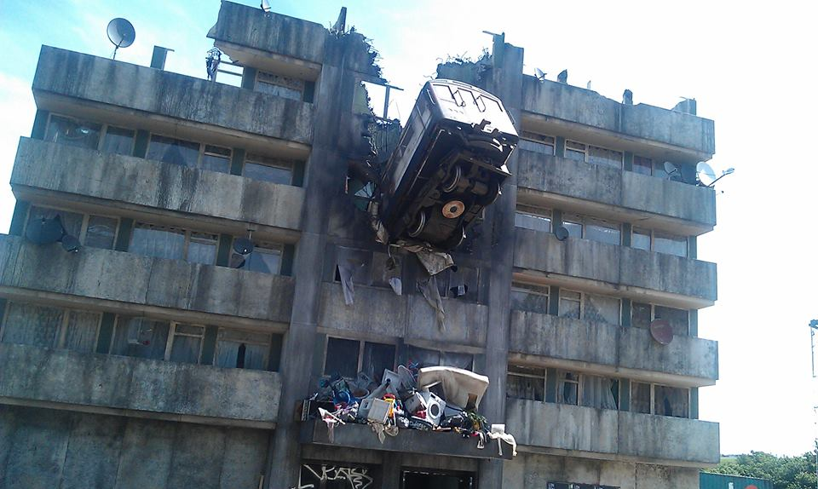
Who Am I? & lets not speculate further ☺
Thanks to EPSRC/databox
&Liang Wang, et al, Cambridge
Thanks to Turing/Maru
&Peter Pietzuch, Imperial

