Slide 1

Cloud Computing
VM Scheduling
Eva Kalyvianaki
ek264@cam.ac.uk

Slide 2
Contents
Resource management and scheduling.
Policies and mechanisms.
Case-study of CPU schedulers:
  Xen CPU schedulers: BVT, SEDF, Credit
Material is from the paper:
  “Comparison of the Three CPU Schedulers in Xen”,
  by L. Cherkasova, D. Gupta, A. Vahdat
  published in ACM SIGMETRICS Performance Evaluation Review, Volume 35 Issue 2, September 2007, pages 42-51
2

Slide 3
Cloud Resource Management Policies
Admission control → prevent the system from accepting workload in violation of high-level system policies.
Capacity allocation → allocate resources for individual activations of a service.
Load balancing → distribute the workload evenly among the servers.
Energy optimisation → minimisation of energy consumption.
Quality of service (QoS) guarantees → ability to satisfy timing or other conditions specified by a Service Level Agreement (SLA).
3

Slide 4
Resource Management and Scheduling
Scheduling in a computing system → deciding how to allocate resources of a system, such as CPU cycles, memory, secondary storage space, I/O and network bandwidth, between users and tasks.
What is a scheduler? → it is a program that implements a particular scheduling algorithm.
Critical function of any man-made system.
It affects the three basic criteria for the evaluation of a system:
  Functionality (does it work as it should?)
  Performance (does it perform well?)
  Cost (how much does it cost?)
Policies and mechanisms for resource allocation.
  Policy → principles guiding decisions.
  Mechanisms → the means to implement policies.
4

Slide 5
Motivation
Cloud resource management is challenging because:
  It requires complex policies and decisions for multi-objective optimisation.
  The complexity of the system makes it impossible to have accurate global state information.
  Cloud service providers are faced with large fluctuating loads which challenge the claim of Cloud elasticity.
  Affected by unpredictable interactions with the environment, e.g., system failures, attacks.
5

Slide 6
Scheduling Algorithms
Scheduling → responsible for resource sharing and multiplexing at several levels. For example:
  A server can be shared among several virtual machines.
  A virtual machine could support several applications.
A scheduler decides:
  The amount of resources allocated
  The duration of the particular resource allocation
A scheduling algorithm should be:
  efficient, fair, and starvation-free.
6
Notes:
In computer science, starvation is a problem encountered in concurrent computing where a process is perpetually denied necessary resources to process its work.^{[1]} Starvation may be caused by errors in a scheduling or mutual exclusion algorithm, but can also be caused by resource leaks, and can be intentionally caused via a denial-of-service attack such as a fork bomb.

Slide 7
Scheduling Algorithms (cont’d)
The objectives of a scheduler can vary according to application:
  Batch system → maximise throughput.
  Real-time system → meet the deadlines.
Common scheduling algorithms:
  Round-robin, First-Come-First-Serve (FCFS), Shortest-Job-First (SJF).
Multimedia applications (e.g., audio and video streaming)
  Have soft real-time constraints.
  Require statistically guaranteed maximum delay and throughput.
Real-time applications have hard real-time constraints.
7

Slide 8
Deadlines
Hard deadlines → if the task is not completed by the deadline, other tasks which depend on it may be affected and there are penalties; a hard deadline is strict and expressed precisely as milliseconds, or possibly seconds.
Soft deadlines → more of a guideline and, in general, there are no penalties; soft deadlines can be missed by fractions of the units used to express them, e.g., minutes if the deadline is expressed in hours, or hours if the deadlines is expressed in days.
8

Slide 9
Resource Management in Virtualized servers
Considerations:
Many different workloads
Finite numbers of workloads can be hosted on each server
Time-varying workload requirements
Performance and resource isolation among the workloads
  “Comparison of the Three CPU Schedulers in Xen”,
  by L. Cherkasova, D. Gupta, A. Vahdat
  published in ACM SIGMETRICS Performance Evaluation Review, Volume 35 Issue 2, September 2007, pages 42-51
9

Slide 10
Terminology for CPU Schedulers
Many schedulers are Proportional Share (PS) schedulers:
  PS scheduling allocates CPU in proportion to the number of shares (weights) that VMs have been assigned.
  Tend to provide instantaneous form of sharing
Evaluation criteria:
  Fairness: time interval over which the scheduler provides fair CPU allocation
  Allocation error: the difference between the allocation and real demanded allocation.
Fair-Share vs Proportional Scheduling:
  Fair-share schedulers attempt to provide a time-averaged form of proportional sharing based on the actual usage measured over long time periods.
10

Slide 11
Example of Fair and PS Schedulers
Problem:
Two clients C1 and C2 share a system with equal CPU shares. Assume that C1 is using the CPU for some time and that C2 is blocked.
Question: What happens when C2 becomes active again?
Solution:
A fair-scheduler will allocate a large CPU share to C2 to “catch up” with C1
A PS scheduler will treat C1 and C2 equally, because it is
unfair to penalise C1 for consuming otherwise idle resources
11

Slide 12
Terminology for CPU Schedulers (con’t)
Work-conserving (WC-mode)
  CPU shares are merely guarantees: as long as there is some work to be done and all clients have used their shares the CPU will be used.
Non work-conserving (NWC-mode)
  CPU shares are caps. Clients will get their share of CPU and only that.
12

Slide 13
Terminology for CPU Schedulers (con’t)
Non-preemptive schedulers
  These schedulers allow running clients to finish their CPU slice. These schedulers only make decisions when the running client gives up the CPU.
Preemptive schedulers
  Running clients can be preemptive for others clients to run. These schedulers rerun their scheduling decisions for when a new client arrives.
  Preemption is good for I/O intensive workloads, why?
13

Slide 14
Workload Management
Workload management is the ability to precisely assign (CPU, memory, I/O) resources to applications. Applications provide service levels on their desired performance and the workload managers assign resources to comply to these levels.
Workload management approaches:
Static:
  Resources are estimated once and are assigned statically to applications despite their varying workloads
  Problem of over-provisioning!!!!
Dynamic:
  Dynamically allocate resources to match application workload resource demands.
Workload managers usually use PS schedulers in NWC
  Why? → for performance isolation reasons
14

Slide 15
Case study: Xen CPU Schedulers
Over the years, there has been proposed and used different CPU schedulers for the Xen VMM:
Borrowed Virtual Time (BVT)
Simple Earliest Deadline First (SEDF)
Credit Scheduler
These algorithms were used as in the order above. Today, Xen uses the Credit Scheduler.
15

Slide 16
Borrowed Virtual Time (BVT) (very briefly)
Objective – is a fair-share scheduler based on the concept of virtual time, dispatching the thread with the runnable VM with the lowest virtual time first.
Allows latency-sensitive applications to wrap back in virtual time to gain scheduling priority and so applications borrows virtual time from its future allocation.
The VM effectively “borrows” virtual time from its future and thus does not disrupt long-term CPU sharing.
CPU allocation.
BVT has the following features:
  Preemptive, WC-mode only
  Optimally-fair
  Low-overhead implementation on uni- and multiprocessors
But, it does not support NWC-mode and so it limits isolation
16

Slide 17
Simple Earliest Deadline First (SEDF)
In SEDF each domain specifies three values: (s_{i}, p_{i}, x_{i}), where:
  s_{i} := is the slice
  p_{i} := is the period
  A Dom_{i} will receive s_{i} units of time every period of length p_{i}.
  x_{i} := indicates if the domain can receive extra CPU time (WC-mode)
  If WC-mode is enabled, SEDF distributes slack time fairly among all runnable domains.
  Example: how can we assign 30% of CPU to a domain?
    (3ms, 10ms, 0), or
    (30ms, 100ms, 0)
    Does it make a difference if we choose a period of 10ms or 30ms?
17

Slide 18
Simple Earliest Deadline First (SEDF)
For each domain, SEDF tracks two more values (d_{i}, r_{i}), where:
  d_{i} := is the time at which Dom_{i}‘s current period ends, i.e., the deadline
  r_{i} := is the remaining CPU time of Dom_{i}‘s current period
  Policy → The runnable domain with the earliest deadline is picked to be scheduled next.
  SEDF characteristics:
    Preemptive, WC and NWC modes
    Fairness depends on a value of a period
    Implements per CPU queue; but, lacks of global load balancing on multiprocessors
18

Slide 19
Credit Scheduler
Credit scheduler is Xen’s latest PS scheduler featuring automatic load balancing of virtual CPUs across physical CPUs on an SMP host.
Before a physical CPU goes idle, the scheduler will consider other CPUs with runnable vCPUs to run.
Goal → This approach guarantees that no CPU idles when there is runnable work in the system.
For each VM, the scheduler assigns a weight and a cap.
If cap is 0, then the VM can receive extra time (WC-mode)
If cap is non-0, it shows the max time it can receive (NWC)
19

Slide 20
Credit Scheduler
The scheduler works with 30ms of slice: a vCPU receives 30ms before being preempted by another VM.
Every slice (30ms) the priorities/credits of all runnable VMs are recalculated.
The scheduler monitors CPU usage every 10ms.
Credit Scheduler characteristics:
    Non-preemptive, WC and NWC modes
    Global load balancing on multiprocessors
20

Slide 21
BVT → SEDF → Credit
BVT → SEDF : NWC mode
BVT, SEDF → Credit: automatic, load balancing in SMPs
In theory there are distinct differences among the schedulers.
But, what about setting their different parameters? Would these affect their performance?
21

Slide 22
Experimental Comparison of the Three Schedulers
Experimental evaluation using three benchmarks:
  Web server application to measure web server throughput
  Iperf to measure the maximum achievable network throughput
  Disk read to measure disk read throughput
Machines’ specs:
  Dual CPU HP workstations LP200R, with 1-GHz PIII processors, 2GB RAM and 1 Gbits NICs (network interface cards) running Xen 3.0.3
22

Slide 23
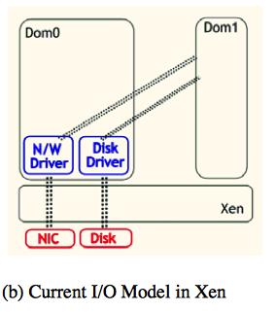
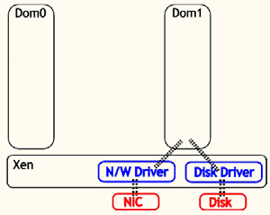
I/O model for VMs in Xen (Figure, 1b from paper)
(Figure 2.a from paper
(a) Initial I/O Model
(b) “Current” I/O Model in Xen
Dom₀ performs I/O processing on behalf of the guest domains
This design shows that Dom₀ also requires a certain CPU (resource) allocation to perform I/O for the VMs.
But, how much allocation is good enough?
23

Slide 24
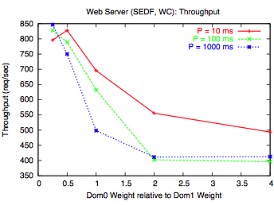
Effect in performance of SEDF parameters’ values
(Figure 2.a from paper
Figure 2.b from paper
Dom₀ performs I/O processing on behalf of the guest domains
Dom₀ = x * Dom₁ (across the x axis)
Web server throughput decreases to increasing weights
Web server throughput decreases to increasing P values, why?
MSc content Table 2 from paper
24
Notes:
Explanation in table 2 and next paragraph, really all about frequent context switches of dom0
At first glance, the lower web server throughput achieved by the
configuration with higher CPU share to Dom0 seems like a contradiction.
For P values, more context switches
However, frequently scheduled Dom0 is processing fewer I/O events that are accumulated in
between the Dom0 execution periods. This type of scheduling leads
to a higher context switch overhead and to a worse web server performance.
In such a way, while the observed CPU usage by Dom0
is higher, in fact, it performs less useful work which manifests itself
as degraded application performance.

Slide 25
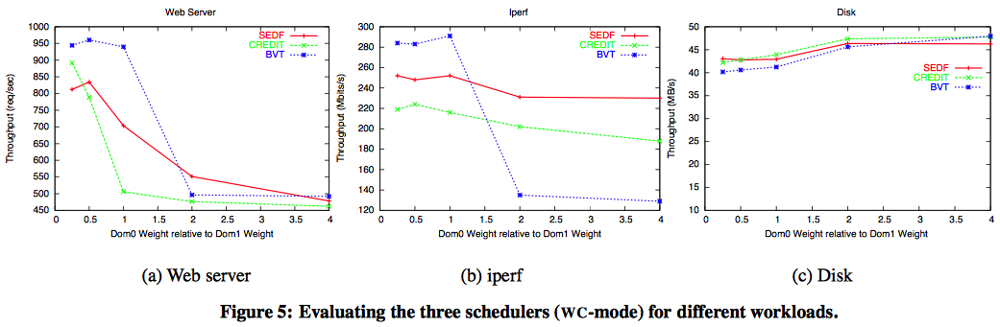
Comparison of schedulers for workloads
(Figure 2.a from paper
Figure 5 from paper
Application performance varies significantly under different schedulers
I/O applications are highly sensitive to the amount of CPU given to Dom₀.
25

Slide 26
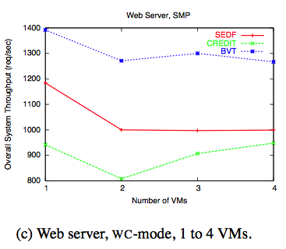
Performance comparison of the schedulers in the SMP case
(Figure 2.a from paper
Figure 10.c from paper
Machine specs: dual CPU HP workstation, 2 vCPUs for dom₀, dom₁
Each VM is given 2 vCPUs; runs a web server and all domains are given equal weights.
The Credit scheduler is able to increase throughput with more VMs
Credit throughput is lower than SEDF and BVT. Further analysis showed a high allocation error for Credit (Figure 11)
26

Slide 27
Summary
Resource management and scheduling
Policies and mechanisms.
Case-study of CPU schedulers:
  Xen CPU schedulers: BVT, SEDF, Credit
Material is from the paper:
  “Comparison of the Three CPU Schedulers in Xen”,
  by L. Cherkasova, D. Gupta, A. Vahdat
  published in ACM SIGMETRICS Performance Evaluation Review, Volume 35 Issue 2, September 2007, pages 42-51
27

