Slide 1
Computer Networking
Michaelmas/Lent Term
M/W/F 11:00-12:00
LT1 in Gates Building
Slide Set 4
Andrew W. Moore
andrew.moore@cl.cam.ac.uk
2016-2017

Slide 2
Topic 4: Network Layer
Our goals:
understand principles behind network layer services:
network layer service models
forwarding versus routing (versus switching)
how a router works
routing (path selection)
IPv6
For the most part, the Internet is our example – again.

Slide 3
Name: a something
Address: Where a something is
Routing: How do I get to the something

Slide 4
Addressing (at a conceptual level)
Assume all hosts have unique IDs
No particular structure to those IDs
Later in topic I will talk about real IP addressing
Do I route on location or identifier?
If a host moves, should its address change?
If not, how can you build scalable Internet?
If so, then what good is an address for identification?
Notes:
20-jan-17

Slide 5
Packets (at a conceptual level)
Assume packet headers contain:
Source ID, Destination ID, and perhaps other information
Destination
Identifier
Why include
this?
Source
Identifier
Payload

Slide 6
Switches/Routers
Multiple ports (attached to other switches or hosts)
Ports are typically duplex (incoming and outgoing)
incoming links
Switch
outgoing links

Slide 7
A Variety of Networks
ISPs: carriers
Backbone
Edge
Border (to other ISPs)
Enterprises: companies, universities
Core
Edge
Border (to outside)
Datacenters: massive collections of machines
Top-of-Rack
Aggregation and Core
Border (to outside)
Notes:
19-jan-2015

Slide 8

Switches forward packets
GLASGOW
EDINBURGH
switch#4
switch#2
Forwarding Table
111010010
EDIN
Destination | Next Hop
GLASGOW | 4
OXFORD | 5
EDIN | 2
UCL | 3
switch#5
OXFORD
UCL
switch#3

Slide 9
Forwarding Decisions
When packet arrives..
Must decide which outgoing port to use
In single transmission time
Forwarding decisions must be simple
Routing state dictates where to forward packets
Assume decisions are deterministic
Global routing state means collection of routing state in each of the routers
Will focus on where this routing state comes from
But first, a few preliminaries….

Slide 10
Forwarding vs Routing
Forwarding: “data plane”
Directing a data packet to an outgoing link
Individual router using routing state
Routing: “control plane”
Computing paths the packets will follow
Routers talking amongst themselves
Jointly creating the routing state
Two very different timescales….
Notes:
8/Feb/2012

Slide 11
Router definitions
1
N
2
N-1
3
R bits/sec
…
4
5
N = number of external router “ports”
R = speed (“line rate”) of a port
Router capacity = N x R

Slide 12
Networks and routers
JANET
edge (enterprise)
INTEL
AT&T
home, small business
core
edge (ISP)
MIT
core
Notes:
Bunch of different kinds of routers: small for homes, routers that connect different ISPs or ISPs to enterprises (edge)

Slide 13
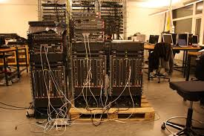
Examples of routers (core)
Cisco CRS-1
R=10/40/100 Gbps
NR = 922 Tbps
Netflix: 0.7GB per hour (1.5Mb/s)
~600 million concurrent Netflix users
72 racks, >1MW

Slide 14
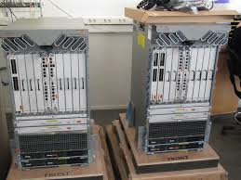
Examples of routers (edge)
Cisco ASR
R=1/10/40 Gbps
NR = 120 Gbps

Slide 15
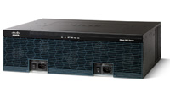
Examples of routers (small business)
Cisco 3945E
R = 10/100/1000 Mbps
NR < 10 Gbps

Slide 16
What’s inside a router?
Input and Output for the same port are on one physical linecard
Processes packets on their way in
Route/Control Processor
Processes packets before they leave
Linecards (input)
Linecards (output)
1
1
2
2
Interconnect (Switching)
Fabric
Transfers packets from input to output ports
N
N

Slide 17
What’s inside a router?
(1) Implement IGP and BGP protocols; compute routing tables
(2) Push forwarding tables to the line cards
Route/Control Processor
Linecards (input)
Linecards (output)
1
1
2
2
Interconnect (Switching)
Fabric
N
N

Slide 18
What’s inside a router?
Makes decisions over long time horizons : network change
Constitutes the control plane
Route/Control Processor
Constitutes the data plane
Linecards (input)
Linecards (output)
1
1
2
2
Interconnect Fabric
A decision for each packet.
N
N
Notes:
Control plane: software. Makes decisions over long time horizons.
Data plane: mostly hardware. A decision for each packet.

Slide 19

Context and Terminology
“Autonomous System (AS)” or “Domain” Region of a network under a single administrative entity
“End hosts”
“Clients”, “Users”
“End points”
“Border Routers”
“Route” or “Path”
“Interior Routers”
Notes:
2015-12-2

Slide 20
Context and Terminology
Destination
Destination
Destination
111010010
MIT
Destination
Destination
Destination
Destination
Destination
Internet routing protocols are responsible for constructing and updating the forwarding tables at routers
MIT

Slide 21
Routing Protocols
Routing protocols implement the core function of a network
Establish paths between nodes
Part of the network’s “control plane”
Network modeled as a graph
Routers are graph vertices
Links are edges
Edges have an associated “cost”
e.g., distance, loss
Goal: compute a “good” path from source to destination
“good” usually means the shortest (least cost) path
5
B
3
C
2
5
A
2
1
F
3
1
2
D
E
1

Slide 22
Internet Routing
Internet Routing works at two levels
Each AS runs an intra-domain routing protocol that establishes routes within its domain
(AS -- region of network under a single administrative entity)
Link State, e.g., Open Shortest Path First (OSPF)
Distance Vector, e.g., Routing Information Protocol (RIP)
ASes participate in an inter-domain routing protocol that establishes routes between domains
Path Vector, e.g., Border Gateway Protocol (BGP)

Slide 23
Addressing (for now)
Assume each host has a unique ID (address)
No particular structure to those IDs
Later in course will talk about real IP addressing

Slide 24
Outline
Link State
Distance Vector
Routing: goals and metrics

Slide 25
Link-State

Slide 26
Link State Routing
Each node maintains its local “link state” (LS)
i.e., a list of its directly attached links and their costs
(N1,N2)
(N1,N4)
(N1,N5)
Host C
Host A
Host D
N1
N2
N3
N5
Host B
N4
Host E
N6
N7

Slide 27
Link State Routing
Each node maintains its local “link state” (LS)
Each node floods its local link state
on receiving a new LS message, a router forwards the message to all its neighbors other than the one it received the message from
Host C
Host A
Host D
(N1,N2)
(N1, N4)
(N1, N5)
(N1,N2)
(N1, N4)
(N1, N5)
N1
N2
(N1,N2)
(N1, N4)
(N1, N5)
N3
(N1,N2)
(N1, N4)
(N1, N5)
(N1,N2)
(N1, N4)
(N1, N5)
N5
(N1,N2)
(N1, N4)
(N1, N5)
(N1,N2)
(N1, N4)
(N1, N5)
(N1,N2)
(N1, N4)
(N1, N5)
Host B
N4
Host E
(N1,N2)
(N1, N4)
(N1, N5)
(N1,N2)
(N1, N4)
(N1, N5)
N6
N7

Slide 28
Link State Routing
Each node maintains its local “link state” (LS)
Each node floods its local link state
Hence, each node learns the entire network topology
Can use Dijkstra’s to compute the shortest paths between nodes
A
C
D
Host C
C
A
D
Host A
Host D
B
E
B
E
N1
N2
A
C
D
C
A
D
N3
B
E
N5
A
C
D
A
C
D
B
E
Host B
N4
B
Host E
E
B
E
A
C
D
N6
N7
B
E

Slide 29
Dijkstra’s Shortest Path Algorithm
INPUT:
Network topology (graph), with link costs
OUTPUT:
Least cost paths from one node to all other nodes
Iterative: after k iterations, a node knows the least cost path to its k closest neighbors
Notes:
How many people know this algorithm?
Well, last year….

Slide 30
Example
5
3
B
C
2
5
A
2
1
F
3
1
2
D
E
1

Slide 31
Notation
c(i,j): link cost from node i to j; cost is infinite if not direct neighbors; ≥ 0
D(v): total cost of the current least cost path from source to destination v
p(v): v’s predecessor along path from source to v
S: set of nodes whose least cost path definitively known
5
B
3
C
2
5
A
2
1
F
3
1
2
D
E
1
Source

Slide 32
Dijkstra’s Algorithm
c(i,j): link cost from node i to j
D(v): current cost source → v
p(v): v’s predecessor along path from source to v
S: set of nodes whose least cost path definitively known
1 Initialization:
2 S = {A};
3 for all nodes v
4 if v adjacent to A
5 then D(v) = c(A,v);
6 else D(v) = ;
7
8 Loop
9 find w not in S such that D(w) is a minimum;
10 add w to S;
11 update D(v) for all v adjacent to w and not in S:
12 if D(w) + c(w,v) < D(v) then
// w gives us a shorter path to v than we’ve found so far
13 D(v) = D(w) + c(w,v); p(v) = w;
14 until all nodes in S;

Slide 33
Example: Dijkstra’s Algorithm
Step
0
1
2
3
4
5
set S
A
D(B),p(B)
2,A
D(C),p(C)
5,A
D(D),p(D)
1,A
D(E),p(E)
D(F),p(F)
5
1 Initialization:
2 S = {A};
3 for all nodes v
4 if v adjacent to A
5 then D(v) = c(A,v);
6 else D(v) = ;
…
B
3
C
2
5
A
2
1
F
3
1
2
D
E
1

Slide 34
Example: Dijkstra’s Algorithm
Step
0
1
2
3
4
5
set S
A
D(B),p(B)
2,A
D(C),p(C)
5,A
D(D),p(D)
1,A
D(E),p(E)
D(F),p(F)
…
8 Loop
9 find w not in S s.t. D(w) is a minimum;
10 add w to S;
update D(v) for all v adjacent
to w and not in S:
If D(w) + c(w,v) < D(v) then
D(v) = D(w) + c(w,v); p(v) = w;
14 until all nodes in S;
5
B
3
C
2
5
A
2
1
F
3
1
2
D
E
1

Slide 35
Example: Dijkstra’s Algorithm
Step
0
1
2
3
4
5
set S
A
AD
D(B),p(B)
2,A
D(C),p(C)
5,A
D(D),p(D)
1,A
D(E),p(E)
D(F),p(F)
…
8 Loop
9 find w not in S s.t. D(w) is a minimum;
10 add w to S;
update D(v) for all v adjacent
to w and not in S:
If D(w) + c(w,v) < D(v) then
D(v) = D(w) + c(w,v); p(v) = w;
14 until all nodes in S;
5
B
3
C
2
5
A
2
1
F
3
1
2
D
E
1

Slide 36
Example: Dijkstra’s Algorithm
Step
0
1
2
3
4
5
set S
A
AD
D(B),p(B)
2,A
D(C),p(C)
5,A
4,D
D(D),p(D)
1,A
D(E),p(E)
2,D
D(F),p(F)
…
8 Loop
9 find w not in S s.t. D(w) is a minimum;
10 add w to S;
update D(v) for all v adjacent
to w and not in S:
If D(w) + c(w,v) < D(v) then
D(v) = D(w) + c(w,v); p(v) = w;
14 until all nodes in S;
5
B
3
C
2
5
A
2
1
F
3
1
2
D
E
1

Slide 37
Example: Dijkstra’s Algorithm
Step
0
1
2
3
4
5
set S
A
AD
ADE
D(B),p(B)
2,A
D(C),p(C)
5,A
4,D
3,E
D(D),p(D)
1,A
D(E),p(E)
2,D
D(F),p(F)
4,E
…
8 Loop
9 find w not in S s.t. D(w) is a minimum;
10 add w to S;
update D(v) for all v adjacent
to w and not in S:
If D(w) + c(w,v) < D(v) then
D(v) = D(w) + c(w,v); p(v) = w;
14 until all nodes in S;
5
B
3
C
2
5
A
2
1
F
3
1
2
D
E
1

Slide 38
Example: Dijkstra’s Algorithm
Step
0
1
2
3
4
5
set S
A
AD
ADE
ADEB
D(B),p(B)
2,A
D(C),p(C)
5,A
4,D
3,E
D(D),p(D)
1,A
D(E),p(E)
2,D
D(F),p(F)
4,E
…
8 Loop
9 find w not in S s.t. D(w) is a minimum;
10 add w to S;
update D(v) for all v adjacent
to w and not in S:
If D(w) + c(w,v) < D(v) then
D(v) = D(w) + c(w,v); p(v) = w;
14 until all nodes in S;
5
B
3
C
2
5
A
2
1
F
3
1
2
D
E
1

Slide 39
Example: Dijkstra’s Algorithm
Step
0
1
2
3
4
5
set S
A
AD
ADE
ADEB
ADEBC
D(B),p(B)
2,A
D(C),p(C)
5,A
4,D
3,E
D(D),p(D)
1,A
D(E),p(E)
2,D
D(F),p(F)
4,E
…
8 Loop
9 find w not in S s.t. D(w) is a minimum;
10 add w to S;
update D(v) for all v adjacent
to w and not in S:
If D(w) + c(w,v) < D(v) then
D(v) = D(w) + c(w,v); p(v) = w;
14 until all nodes in S;
5
B
3
C
2
5
A
2
1
F
3
1
2
D
E
1

Slide 40
Example: Dijkstra’s Algorithm
Step
0
1
2
3
4
5
set S
A
AD
ADE
ADEB
ADEBC
ADEBCF
D(B),p(B)
2,A
D(C),p(C)
5,A
4,D
3,E
D(D),p(D)
1,A
D(E),p(E)
2,D
D(F),p(F)
4,E
…
8 Loop
9 find w not in S s.t. D(w) is a minimum;
10 add w to S;
update D(v) for all v adjacent
to w and not in S:
If D(w) + c(w,v) < D(v) then
D(v) = D(w) + c(w,v); p(v) = w;
14 until all nodes in S;
5
B
3
C
2
5
A
2
1
F
3
1
2
D
E
1

Slide 41
Example: Dijkstra’s Algorithm
Step
0
1
2
3
4
5
set S
A
AD
ADE
ADEB
ADEBC
ADEBCF
D(B),p(B)
2,A
D(C),p(C)
5,A
4,D
3,E
D(D),p(D)
1,A
D(E),p(E)
2,D
D(F),p(F)
4,E
5
To determine path A → C (say), work backward from C via p(v)
B
3
C
2
5
A
2
1
F
3
1
2
D
E
1

Slide 42
The Forwarding Table
Running Dijkstra at node A gives the shortest path from A to all destinations
We then construct the forwarding table
Destination | Link
B | (A,B)
C | (A,D)
D | (A,D)
E | (A,D)
F | (A,D)
5
B
3
C
2
5
A
2
1
F
3
1
2
D
E
1
Notes:
Separate routing and forwarding tables - not always the case. For efficiency, hardware implementation

Slide 43
Issue #1: Scalability
How many messages needed to flood link state messages?
O(N x E), where N is #nodes; E is #edges in graph
Processing complexity for Dijkstra’s algorithm?
O(N²), because we check all nodes w not in S at each iteration and we have O(N) iterations
more efficient implementations: O(N log(N))
How many entries in the LS topology database? O(E)
How many entries in the forwarding table? O(N)

Slide 44
Issue#2: Transient Disruptions
Inconsistent link-state database
Some routers know about failure before others
The shortest paths are no longer consistent
Can cause transient forwarding loops
B
C
B
C
A
F
A
F
D
E
Loop!
D
E
A and D think that this is the path to C
E thinks that this is the path to C
Notes:
here. 12/jan/2014

Slide 45
Distance Vector

Slide 46
Learn-By-Doing
Let’s try to collectively develop distance-vector routing from first principles

Slide 47
Experiment
Your job: find the (route to) the youngest person in the room
Ground Rules
You may not leave your seat, nor shout loudly across the class
You may talk with your immediate neighbors
(N-S-E-W only) (hint: “exchange updates” with them)
At the end of 5 minutes, I will pick a victim and ask:
who is the youngest person in the room? (date&name)
which one of your neighbors first told you this info.?

Slide 48
Go!

Slide 49
Distance-Vector

Slide 50
Example of Distributed Computation
I am three hops away
I am two hops away
I am one hop away
I am two hops away
I am two hops away
I am three hops away
I am one hop away
Destination
I am three hops away
I am one hop away
I am two hops away

Slide 51
Distance Vector Routing
Each router knows the links to its neighbors
Does not flood this information to the whole network
Each router has provisional “shortest path” to every other router
E.g.: Router A: “I can get to router B with cost 11”
Routers exchange this distance vector information with their neighboring routers
Vector because one entry per destination
Routers look over the set of options offered by their neighbors and select the best one
Iterative process converges to set of shortest paths

Slide 52
A few other inconvenient truths
What if we use a non-additive metric?
E.g., maximal capacity
What if routers don’t use the same metric?
I want low delay, you want low loss rate?
What happens if nodes lie?
Notes:
23-Jan-17

Slide 53
Can You Use Any Metric?
I said that we can pick any metric. Really?
What about maximizing capacity?

Slide 54
What Happens Here?
A high capacity link gets reduced to low capacity
All nodes want to maximize capacity
Problem:“cost” does not change around loop
Additive measures avoid this problem!

Slide 55
No agreement on metrics?
If the nodes choose their paths according to different criteria, then bad things might happen
Example
Node A is minimizing latency
Node B is minimizing loss rate
Node C is minimizing price
Any of those goals are fine, if globally adopted
Only a problem when nodes use different criteria
Consider a routing algorithm where paths are described by delay, cost, loss

Slide 56
What Happens Here?
Cares about price,
then loss
Cares about delay,
then price
Low price link
Low loss link
Low delay link
Cares about loss,
then delay
Low delay link
Low loss link
Low price link
Notes:
Figure this out. Break into groups….

Slide 57
Must agree on loop-avoiding metric
When all nodes minimize same metric
And that metric increases around loops
Then process is guaranteed to converge

Slide 58
What happens when routers lie?
What if a router claims a 1-hop path to everywhere?
All traffic from nearby routers gets sent there
How can you tell if they are lying?
Can this happen in real life?
It has, several times….

Slide 59
Link State vs. Distance Vector
Core idea
LS: tell all nodes about your immediate neighbors
DV: tell your immediate neighbors about (your least cost distance to) all nodes

Slide 60
Link State vs. Distance Vector
LS: each node learns the complete network map; each node computes shortest paths independently and in parallel
DV: no node has the complete picture; nodes cooperate to compute shortest paths in a distributed manner
LS has higher messaging overhead
LS has higher processing complexity
LS is less vulnerable to looping

Slide 61
Link State vs. Distance Vector
Message complexity
LS: O(NxE) messages;
N is #nodes; E is #edges
DV: O(#Iterations x E)
where #Iterations is ideally O(network diameter) but varies due to routing loops or the count-to-infinity problem
Processing complexity
LS: O(N²)
DV: O(#Iterations x N)
Robustness: what happens if router malfunctions?
LS:
node can advertise incorrect link cost
each node computes only its own table
DV:
node can advertise incorrect path cost
each node’s table used by others; error propagates through network

Slide 62
Routing: Just the Beginning
Link state and distance-vector are the deployed routing paradigms for intra-domain routing
Inter-domain routing (BGP)
more Part II (Principles of Communications)
A version of DV

Slide 63
What are desirable goals for a routing solution?
“Good” paths (least cost)
Fast convergence after change/failures
no/rare loops
Scalable
#messages
table size
processing complexity
Secure
Policy
Rich metrics (more later)

Slide 64
Delivery models
What if a node wants to send to more than one destination?
broadcast: send to all
multicast: send to all members of a group
anycast: send to any member of a group
What if a node wants to send along more than one path?

Slide 65
Metrics
Propagation delay
Congestion
Load balance
Bandwidth (available, capacity, maximal, bbw)
Price
Reliability
Loss rate
Combinations of the above
In practice, operators set abstract “weights” (much like our costs); how exactly is a bit of a black art

Slide 66
From Routing back to Forwarding
Routing: “control plane”
Computing paths the packets will follow
Routers talking amongst themselves
Jointly creating the routing state
Forwarding: “data plane”
Directing a data packet to an outgoing link
Individual router using routing state
Two very different timescales….

Slide 67
Basic Architectural Components of an IP Router
Management
& CLI
Control Plane
network-change
processing
Routing
Protocols
Software
Routing
Table
Datapath
per-packet
processing
Forwarding
Table
Switching
Hardware

Slide 68
Independent operation!
If the control-plane fails…..
The data-path is not affected…
like a loyal pet it will keep going using the current (last) table update
This is a feature not a bug
Management
& CLI
Control Plane
network-change
processing
Routing
Protocols
Software
Routing
Table
Datapath
per-packet
processing
Forwarding
Table
Switching
Hardware

Slide 69
Per-packet processing in an IP Router
1. Accept packet arriving on an incoming link.
2. Lookup packet destination address in the forwarding table, to identify outgoing port(s).
3. Manipulate packet header: e.g., decrement TTL, update header checksum.
4. Send packet to the outgoing port(s).
5. Buffer packet in the queue.
6. Transmit packet onto outgoing link.

Slide 70
Generic Router Architecture
Header Processing
Data
Hdr
Lookup
IP Address
Update
Header
Queue
Packet
Data
Hdr
IP Address
Next Hop
Address
Table
Buffer
Memory
~1M prefixes
Off-chip DRAM
~1M packets
Off-chip DRAM

Slide 71
Generic Router Architecture
Data
Hdr
Data
Header Processing
Hdr
Buffer
Manager
Lookup
IP Address
Update
Header
Address
Table
Buffer
Memory
Data
Hdr
Data
Header Processing
Hdr
Buffer
Manager
Lookup
IP Address
Update
Header
Address
Table
Buffer
Memory
Data
Hdr
Data
Hdr
Header Processing
Buffer
Manager
Lookup
IP Address
Update
Header
Address
Table
Buffer
Memory

Slide 72
Forwarding tables
IP address
32 bits wide → ~ 4 billion unique address
Naïve approach:
One entry per address
Entry | Destination | Port
1 2 ⋮ 2³² | 0.0.0.0 0.0.0.1 ⋮ 255.255.255.255 | 1 2 ⋮ 12
~ 4 billion entries
Improved approach:
Group entries to reduce table size
Entry | Destination | Port
1 2 ⋮ 50 | 0.0.0.0 – 127.255.255.255 128.0.0.1 – 128.255.255.255 ⋮ 248.0.0.0 – 255.255.255.255 | 1 2 ⋮ 12

Slide 73
IP addresses as a line
Your computer
My computer
Cambridge
Oxford
USA
Europe
0
2³²-1
All IP addresses
Entry | Destination | Port
1 2 3 4 5 | Cambridge Oxford Europe USA Everywhere (default) | 1 2 3 4 5

Slide 74
Longest Prefix Match (LPM)
Entry | Destination | Port
1 2 3 4 5 | Cambridge Oxford Europe USA Everywhere (default) | 1 2 3 4 5
Universities
Continents
Planet
Matching entries:
Cambridge
Europe
Everywhere
Most specific
To: Cambridge
Data

Slide 75
Longest Prefix Match (LPM)
Entry | Destination | Port
1 2 3 4 5 | Cambridge Oxford Europe USA Everywhere (default) | 1 2 3 4 5
Universities
Continents
Planet
Matching entries:
Europe
Everywhere
Most specific
To: France
Data

Slide 76
Implementing Longest Prefix Match
Entry | Destination | Port
1 2 3 4 5 | Cambridge Oxford Europe USA Everywhere (default) | 1 2 3 4 5
Searching
Most specific
FOUND
Least specific
Notes:
2014-1-23

Slide 77
Switching Via Memory
First generation routers:
traditional computers with switching under direct control of CPU
packet copied to system’s memory
speed limited by memory bandwidth (2 bus crossings per datagram)
Input
Port
Memory
Output
Port
System Bus
Notes:
2017-1-25

Slide 78
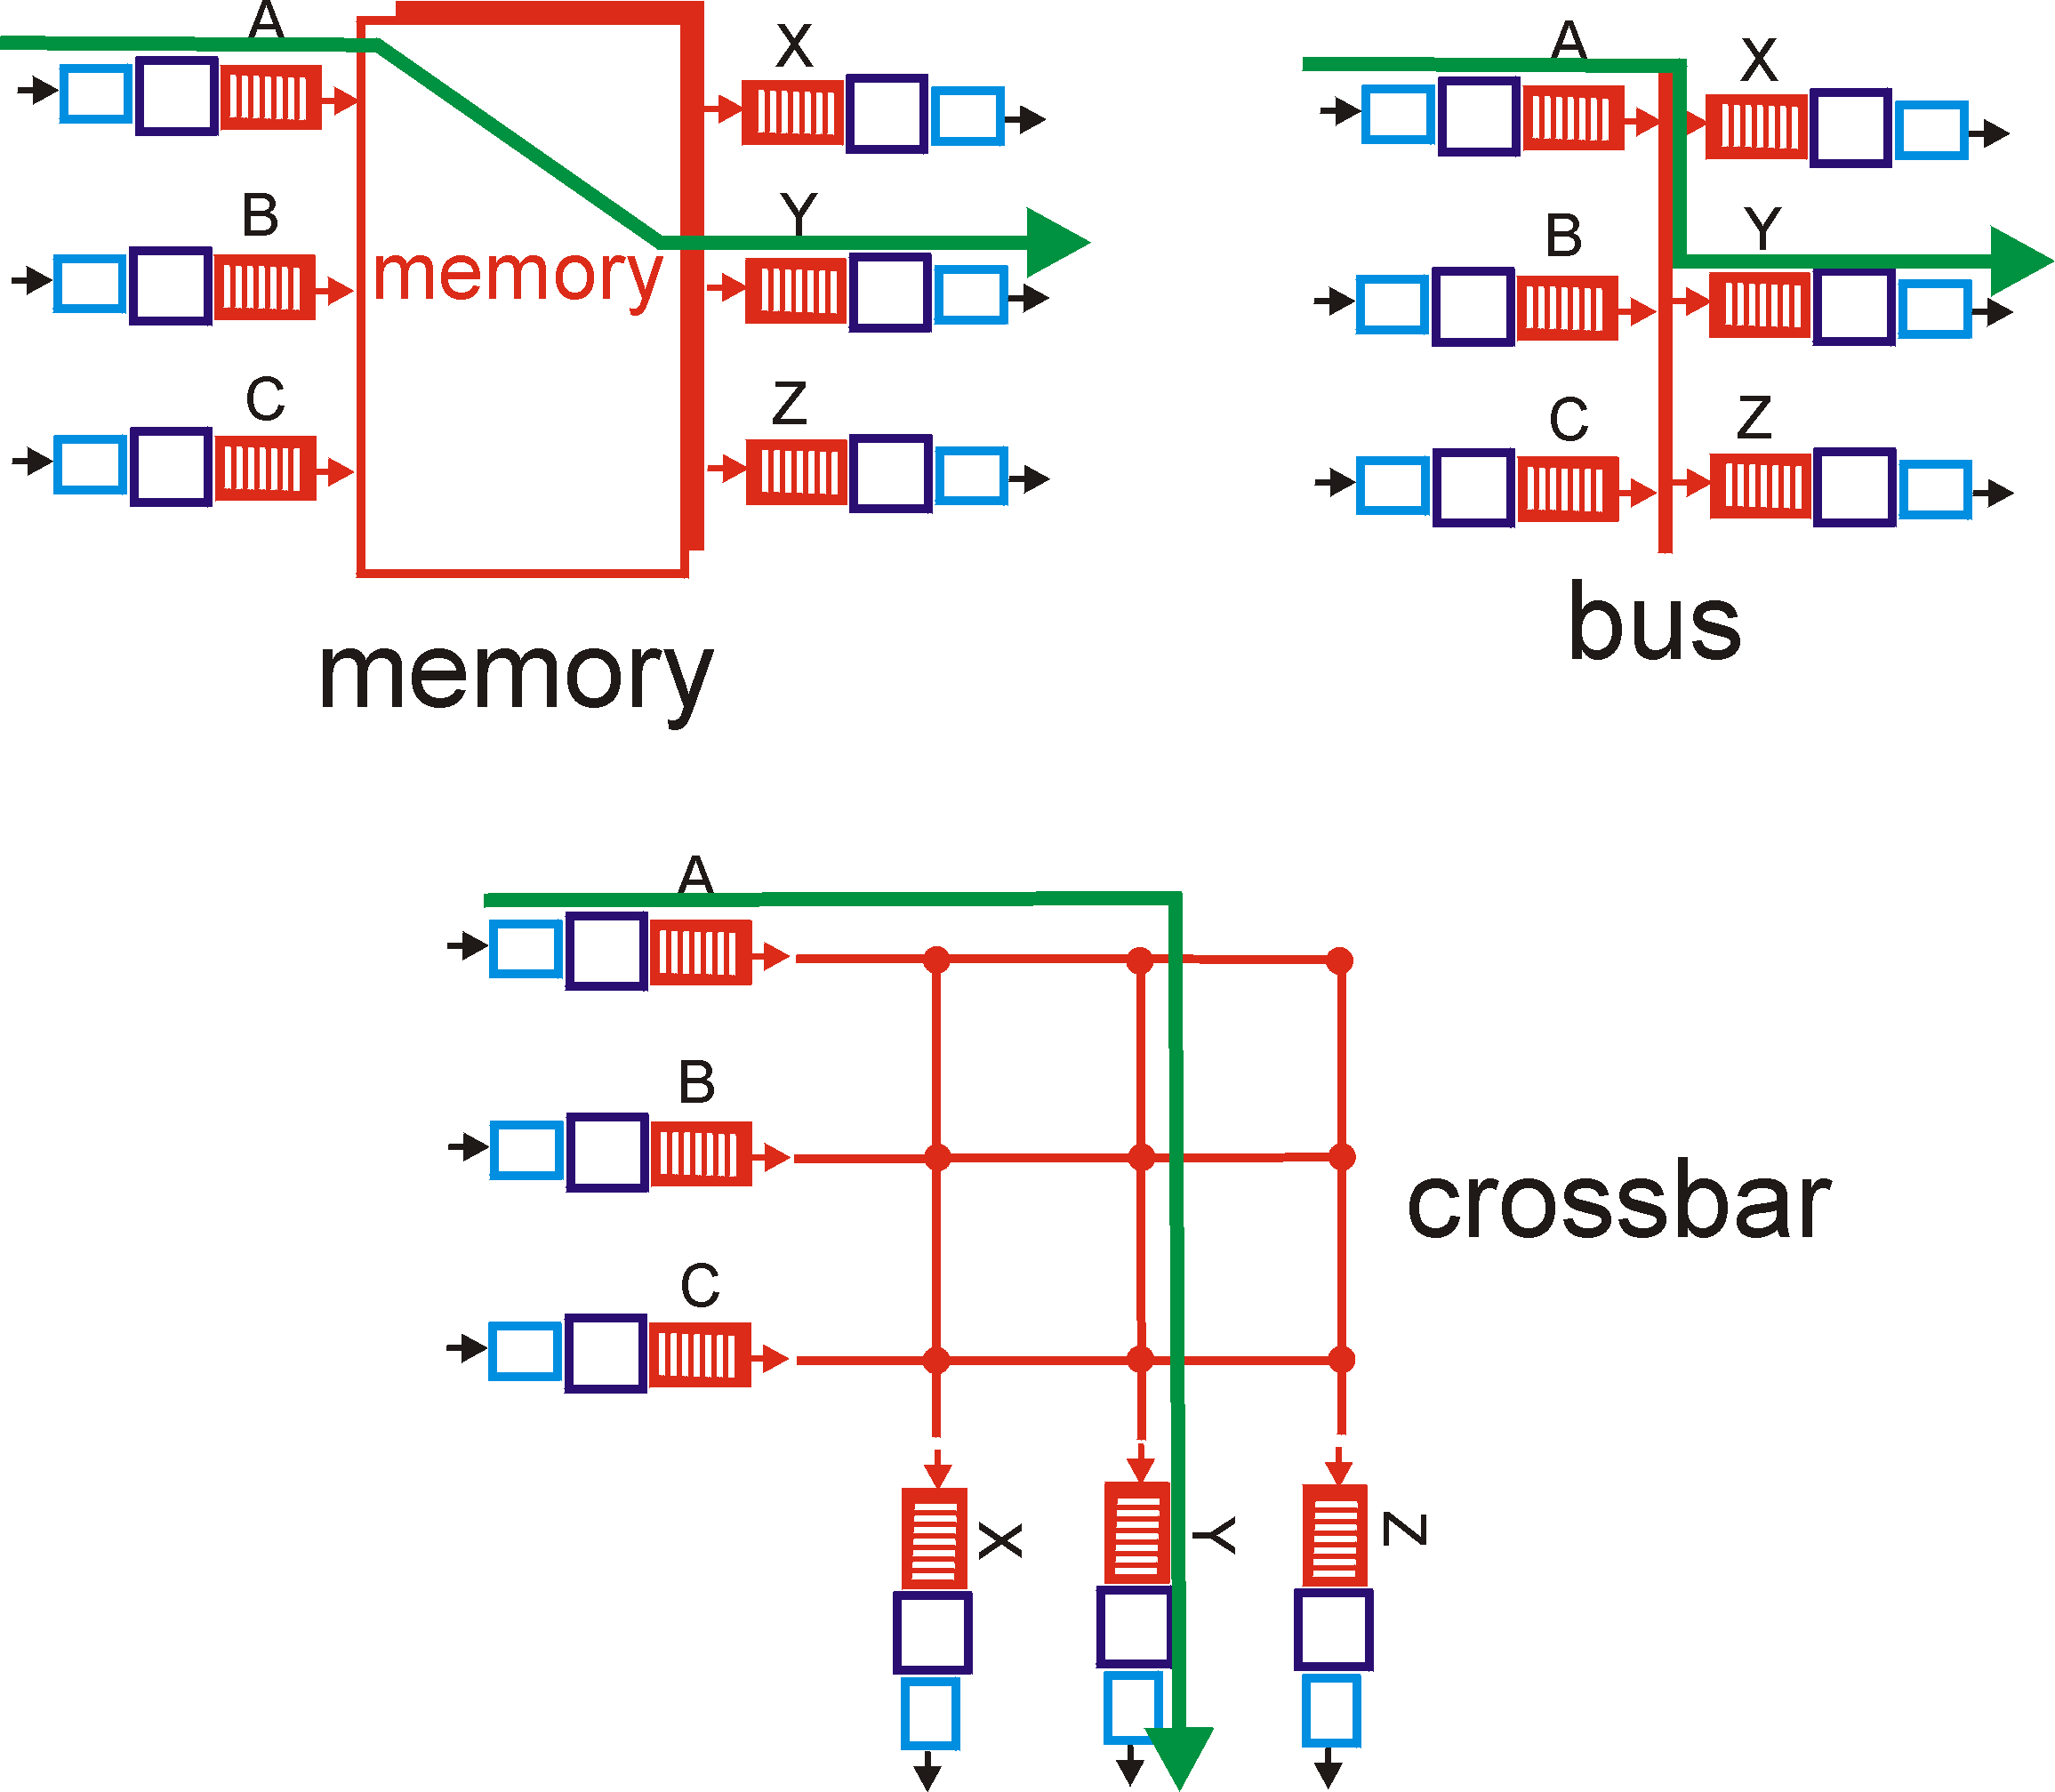
Switching Via a Bus
datagram from input port memory
to output port memory via a shared bus
bus contention: switching speed limited by bus bandwidth
Lots of ports?? speed up the bus
no contention bus speed =
2 x port speed x port count
32 Gbps bus, Cisco 5600: sufficient speed for access routers
78

Slide 79
Switching Via An Interconnection Network
overcome bus bandwidth limitations
Banyan networks, other interconnection nets initially developed to connect processors in multiprocessor stages
advanced design: fragmenting datagram into fixed length cells, switch cells through the fabric.
Cisco CRS-1: switches 1.2 Tbps through the interconnection network

Slide 80
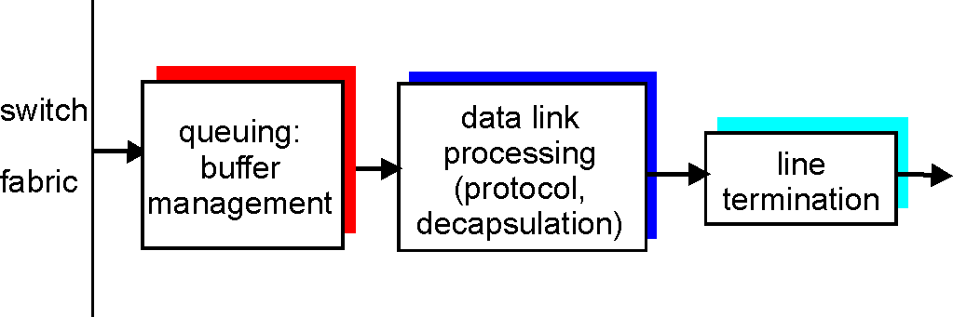
Output Ports
Buffering required when datagrams arrive from fabric faster than the transmission rate
Scheduling discipline chooses among queued datagrams for transmission
➔ Who goes next?

Slide 81
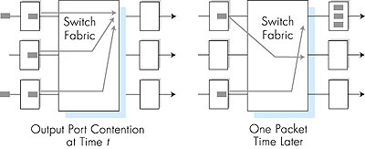
Output port queueing
buffering when arrival rate via switch exceeds output line speed
queueing (delay) and loss due to output port buffer overflow!

Slide 82
Queueing to Queue…. ➔ Who goes next?

Slide 83
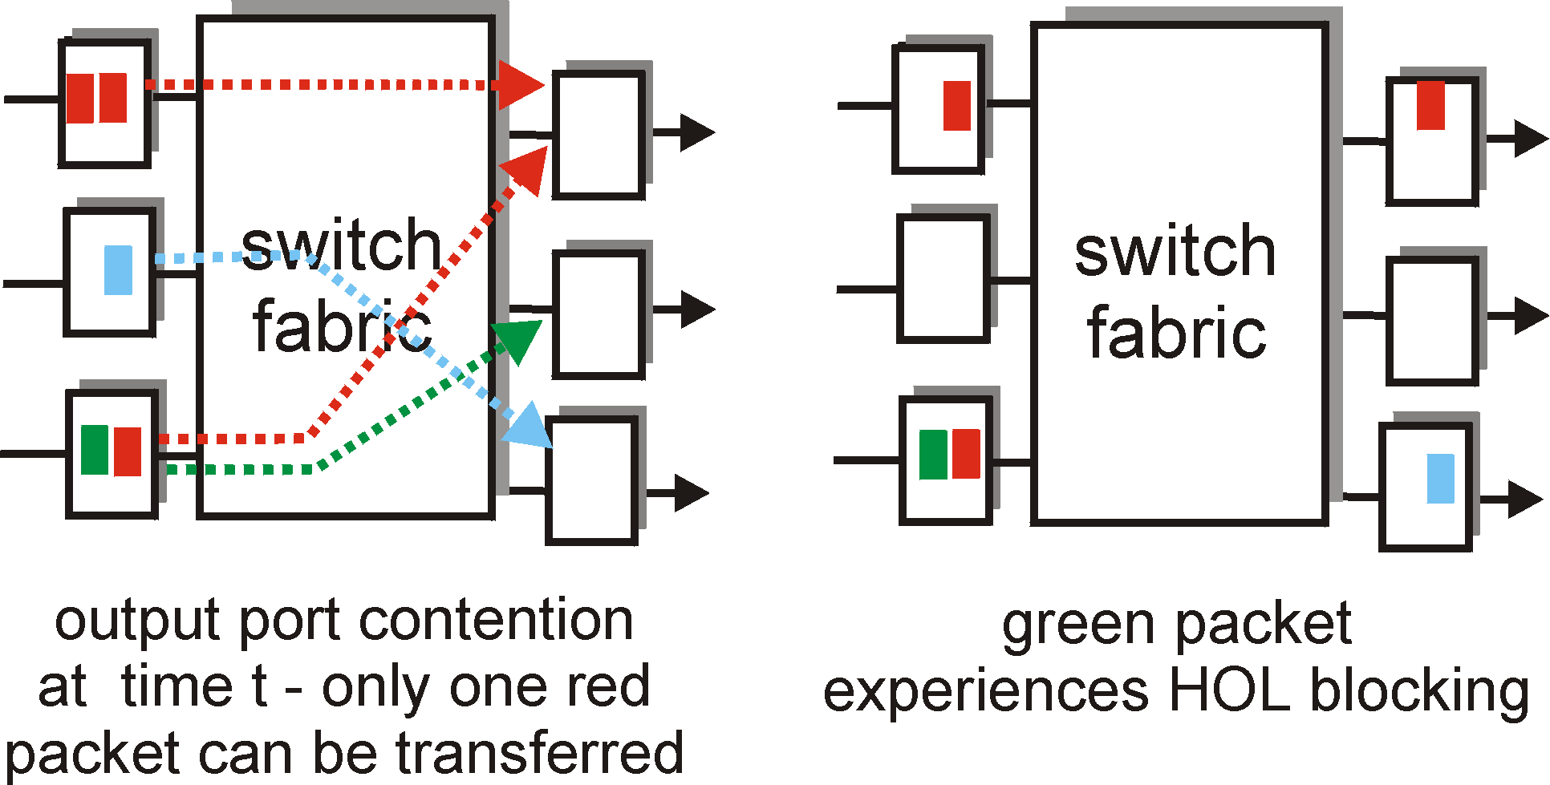
Input Port Queuing
Fabric slower than input ports combined -> queueing may occur at input queues
Head-of-the-Line (HOL) blocking: queued datagram at front of queue prevents others in queue from moving forward
queueing delay and loss due to input buffer overflow!

Slide 85
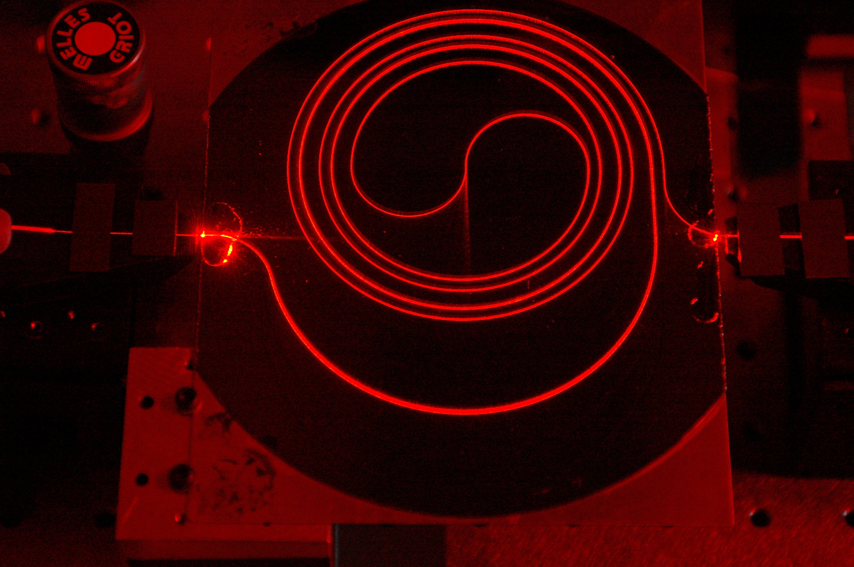
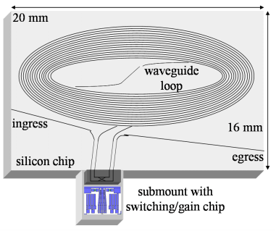
Buffers in Routers
So how large should the buffers be?
Buffer size matters
End-to-end delay
Transmission, propagation, and queueing delay
The only variable part is queueing delay
Router architecture
Board space, power consumption, and cost
On chip buffers: higher density, higher capacity
Optical buffers: all-optical routers
1.4m long spiral waveguide with input from HeNe laser
You are now touching the edge of the research zone……

Slide 86





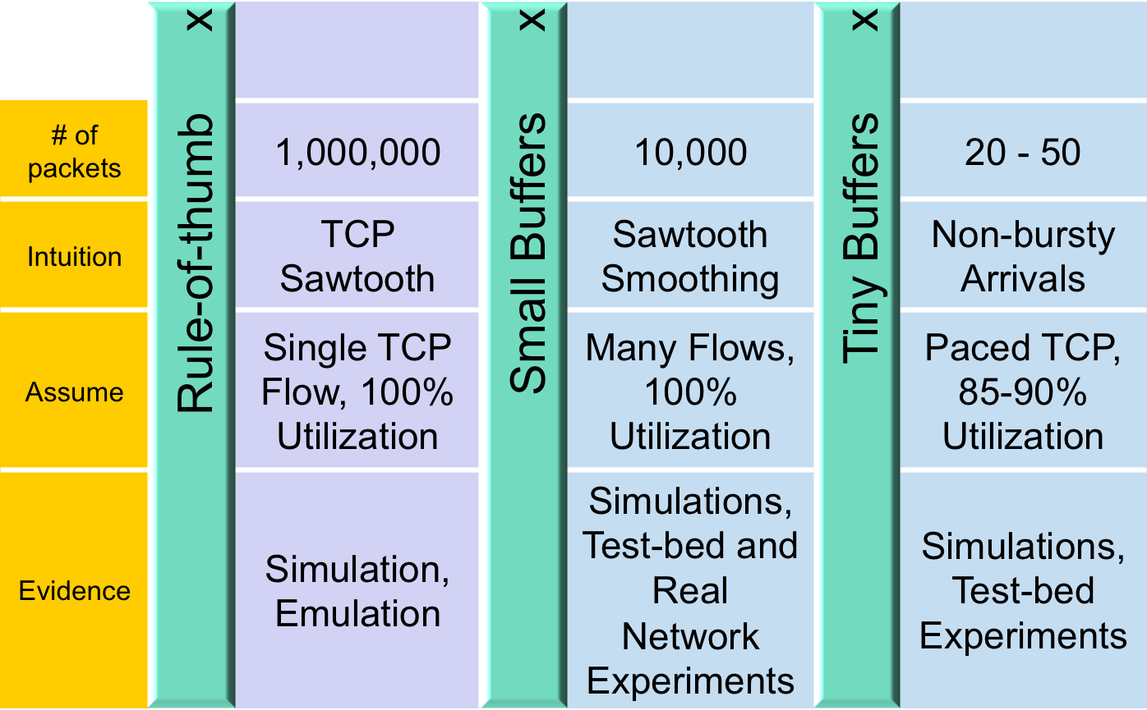
Buffer Sizing Story

Slide 87
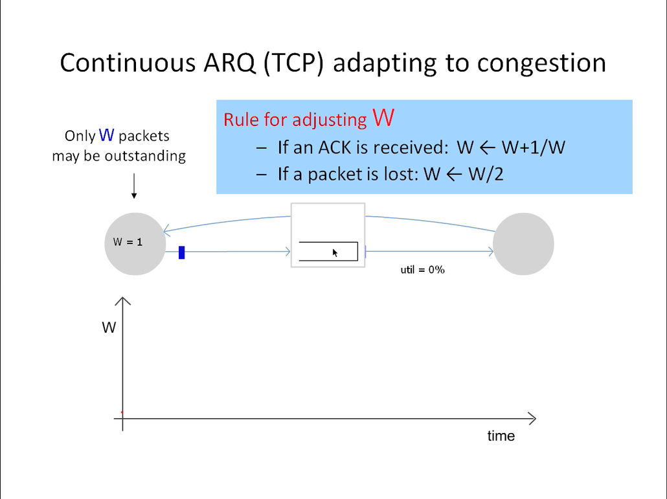
Notes:
18 jan 2016

Slide 88


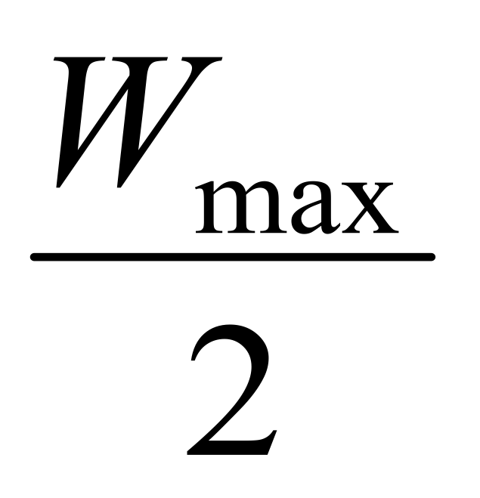
Rule-of-thumb – Intuition
Rule for adjusting W
If an ACK is received: W ← W+1/W
If a packet is lost: W ← W/2
Only W packets may be outstanding
Source
Dest
Window size
t

Slide 89
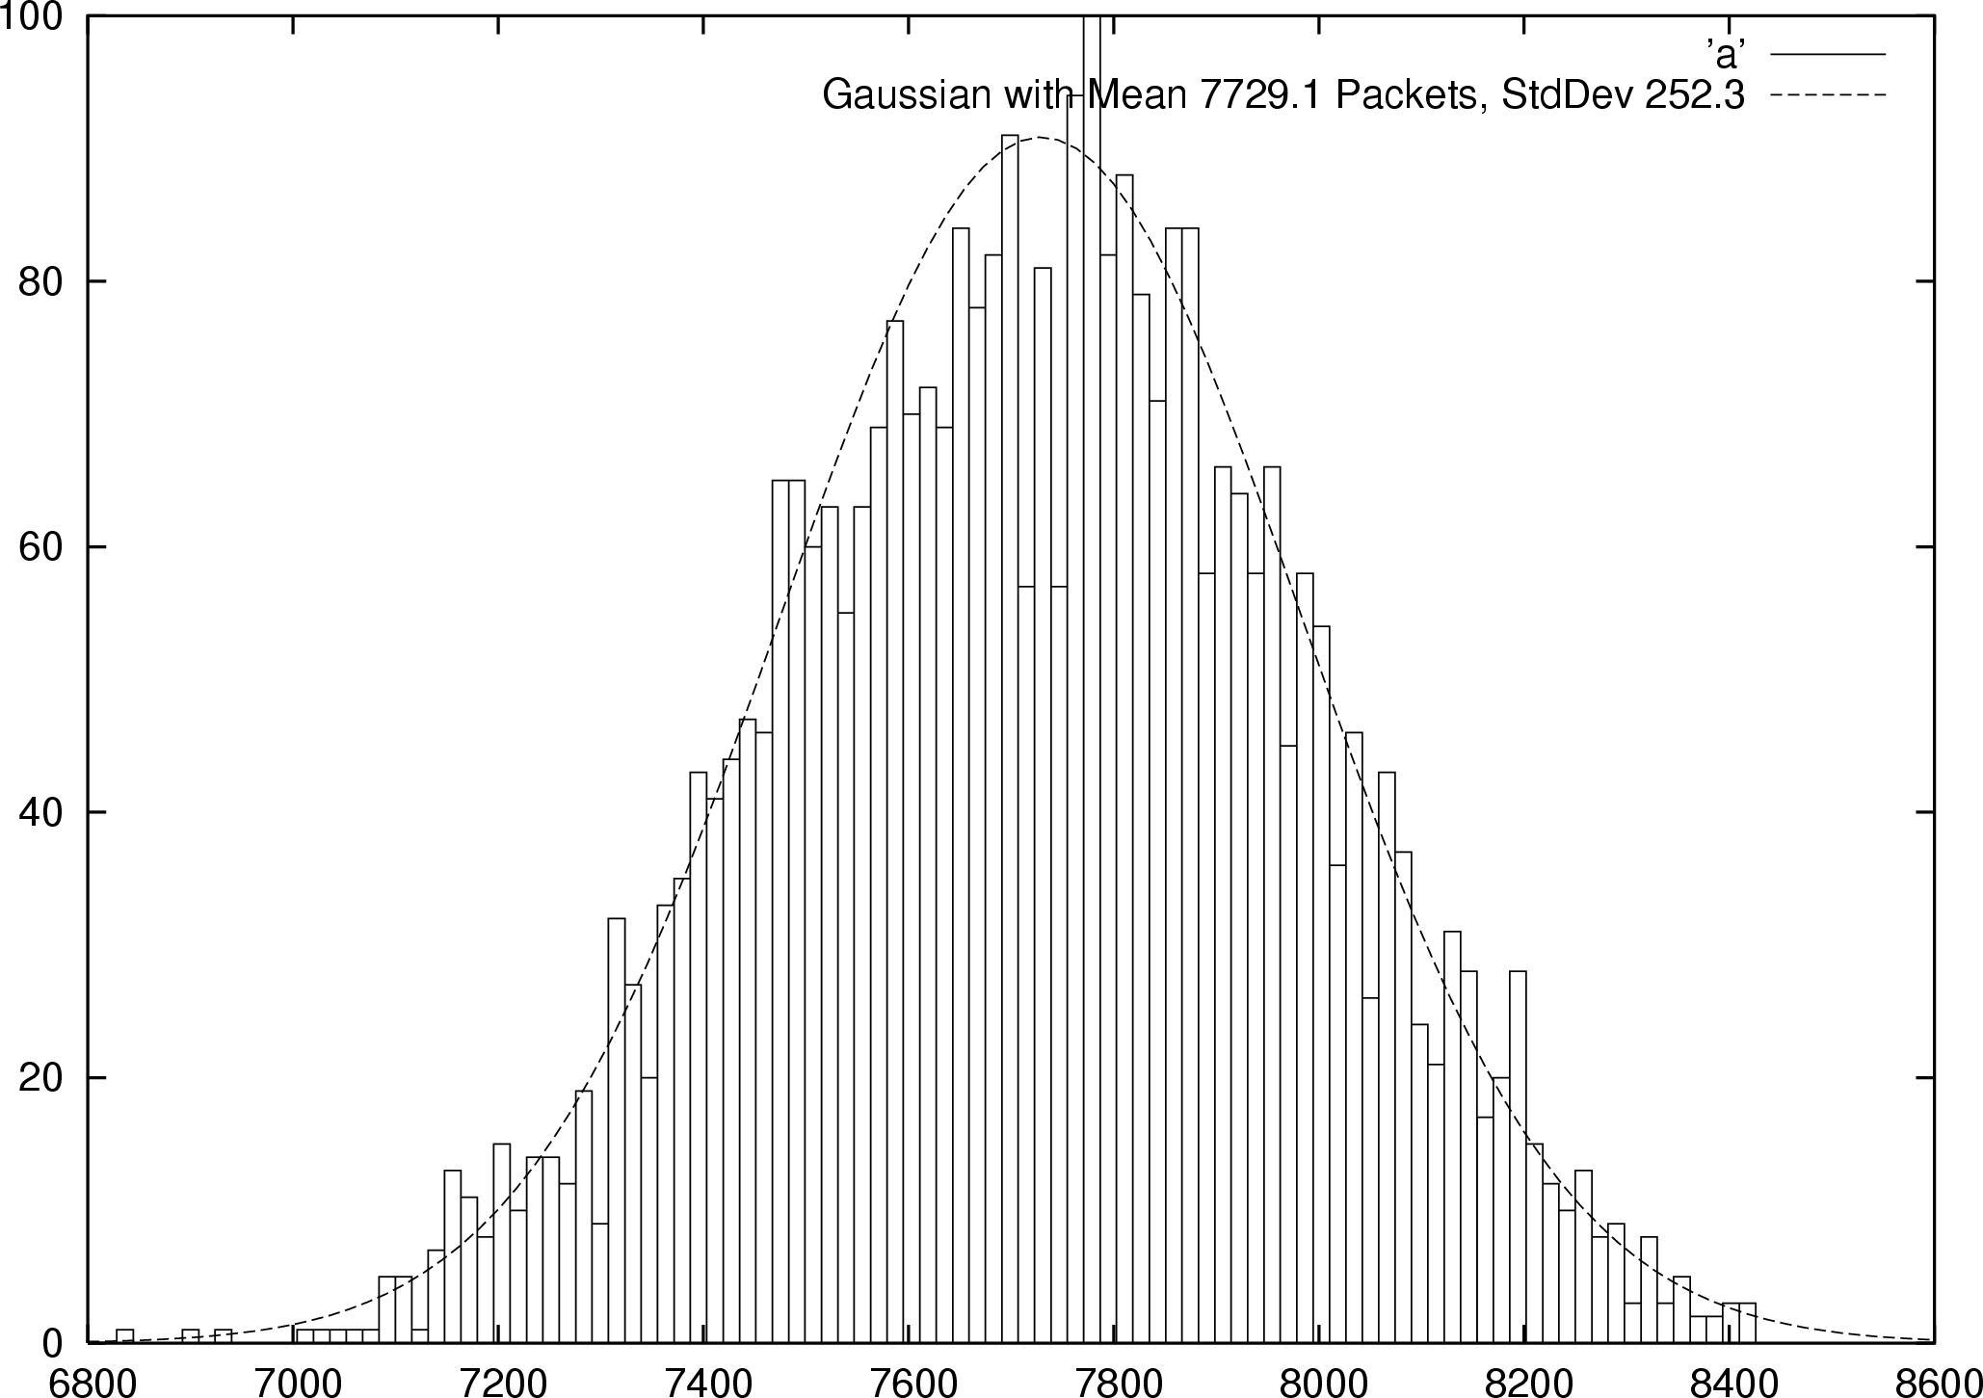


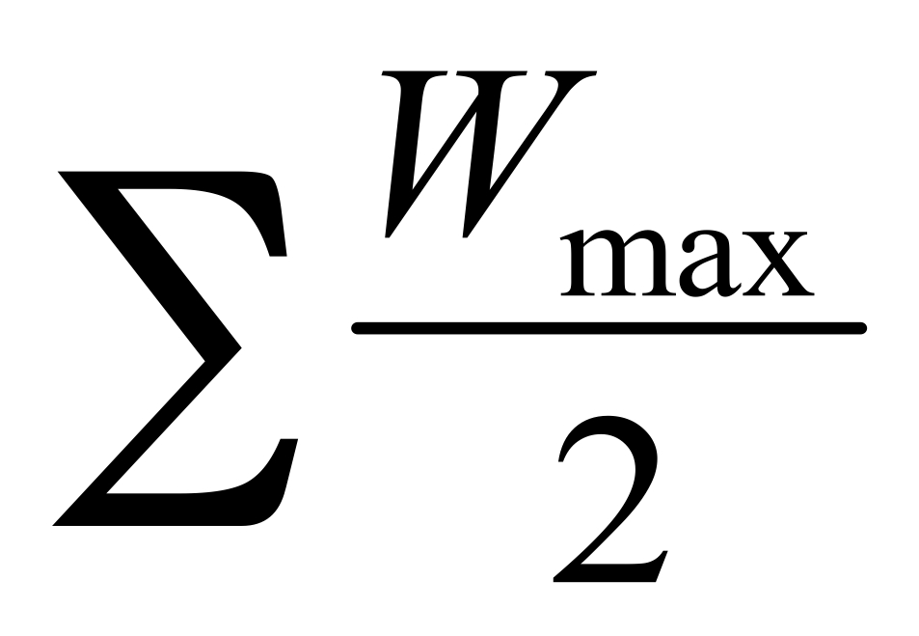

Small Buffers – Intuition
Synchronized Flows
Many TCP Flows
Aggregate window has same dynamics
Therefore buffer occupancy has same dynamics
Rule-of-thumb still holds.
Independent, desynchronized
Central limit theorem says the aggregate becomes Gaussian
Variance (buffer size) decreases as N increases
Buffer Size
Probability
Distribution
t
t
Notes:
2017-1-27

Slide 90
The Internet version of a Network layer
Host, router network layer functions:
Transport layer: TCP, UDP
Routing protocols
path selection
RIP, OSPF, BGP
IP protocol
addressing conventions
datagram format
packet handling conventions
Network
layer
forwarding
table
ICMP protocol
error reporting
router “signaling”
Link layer
physical layer

Slide 91
IPv4 Packet Structure 20 Bytes of Standard Header, then Options
4-bit
Version
4-bit
Header
Length
8-bit
Type of Service
(TOS)
16-bit Total Length (Bytes)
16-bit Identification
3-bit
Flags
13-bit Fragment Offset
8-bit Time to
Live (TTL)
8-bit Protocol
16-bit Header Checksum
32-bit Source IP Address
32-bit Destination IP Address
Options (if any)
Payload
Notes:
15/Feb/2013

Slide 92
(Packet) Network Tasks One-by-One
Read packet correctly
Get packet to the destination
Get responses to the packet back to source
Carry data
Tell host what to do with packet once arrived
Specify any special network handling of the packet
Deal with problems that arise along the path

Slide 93
Reading Packet Correctly
4-bit
Version
4-bit
Header
Length
8-bit
Type of Service
(TOS)
16-bit Total Length (Bytes)
16-bit Identification
3-bit
Flags
13-bit Fragment Offset
8-bit Time to
Live (TTL)
8-bit Protocol
16-bit Header Checksum
32-bit Source IP Address
32-bit Destination IP Address
Options (if any)
Payload
Version number (4 bits)
Indicates the version of the IP protocol
Necessary to know what other fields to expect
Typically “4” (for IPv4), and sometimes “6” (for IPv6)
Header length (4 bits)
Number of 32-bit words in the header
Typically “5” (for a 20-byte IPv4 header)
Can be more when IP options are used
Total length (16 bits)
Number of bytes in the packet
Maximum size is 65,535 bytes (2¹⁶ -1)
… though underlying links may impose smaller limits

Slide 94
Getting Packet to Destination and Back
4-bit
Version
4-bit
Header
Length
8-bit
Type of Service
(TOS)
16-bit Total Length (Bytes)
16-bit Identification
3-bit
Flags
13-bit Fragment Offset
8-bit Time to
Live (TTL)
8-bit Protocol
16-bit Header Checksum
32-bit Source IP Address
32-bit Destination IP Address
Two IP addresses
Source IP address (32 bits)
Destination IP address (32 bits)
Destination address
Unique identifier/locator for the receiving host
Allows each node to make forwarding decisions
Source address
Unique identifier/locator for the sending host
Recipient can decide whether to accept packet
Enables recipient to send a reply back to source
Options (if any)
Payload

Slide 95
Telling Host How to Handle Packet
4-bit
Version
4-bit
Header
Length
8-bit
Type of Service
(TOS)
16-bit Total Length (Bytes)
16-bit Identification
3-bit
Flags
13-bit Fragment Offset
8-bit Time to
Live (TTL)
8-bit Protocol
16-bit Header Checksum
32-bit Source IP Address
32-bit Destination IP Address
Options (if any)
Protocol (8 bits)
Identifies the higher-level protocol
Important for demultiplexing at receiving host
Most common examples
E.g., “6” for the Transmission Control Protocol (TCP)
E.g., “17” for the User Datagram Protocol (UDP)
Payload
protocol=6
protocol=17
IP header
IP header
TCP header
UDP header

Slide 96
Special Handling
4-bit
Version
4-bit
Header
Length
8-bit
Type of Service
(TOS)
16-bit Total Length (Bytes)
16-bit Identification
3-bit
Flags
13-bit Fragment Offset
8-bit Time to
Live (TTL)
8-bit Protocol
16-bit Header Checksum
32-bit Source IP Address
32-bit Destination IP Address
Options (if any)
Payload
Type-of-Service (8 bits)
Allow packets to be treated differently based on needs
E.g., low delay for audio, high bandwidth for bulk transfer
Has been redefined several times
Options
Notes:
26-jan-2015

Slide 97
Potential Problems
Header Corrupted: Checksum
Loop: TTL
Packet too large: Fragmentation

Slide 98
Header Corruption
4-bit
Version
4-bit
Header
Length
8-bit
Type of Service
(TOS)
16-bit Total Length (Bytes)
16-bit Identification
3-bit
Flags
13-bit Fragment Offset
8-bit Time to
Live (TTL)
8-bit Protocol
16-bit Header Checksum
32-bit Source IP Address
32-bit Destination IP Address
Options (if any)
Payload
Checksum (16 bits)
Particular form of checksum over packet header
If not correct, router discards packets
So it doesn’t act on bogus information
Checksum recalculated at every router
Why?
Why include TTL?
Why only header?

Slide 99
_{Preventing Loops} _{(aka} _{Internet Zombie plan)}
4-bit
Version
4-bit
Header
Length
8-bit
Type of Service
(TOS)
16-bit Total Length (Bytes)
16-bit Identification
3-bit
Flags
13-bit Fragment Offset
8-bit Time to
Live (TTL)
8-bit Protocol
16-bit Header Checksum
32-bit Source IP Address
32-bit Destination IP Address
Options (if any)
Forwarding loops cause packets to cycle forever
As these accumulate, eventually consume all capacity
Time-to-Live (TTL) Field (8 bits)
Decremented at each hop, packet discarded if reaches 0
…and “time exceeded” message is sent to the source
Using “ICMP” control message; basis for traceroute
Payload

Slide 100
Fragmentation (some assembly required)
4-bit
Version
4-bit
Header
Length
8-bit
Type of Service
(TOS)
16-bit Total Length (Bytes)
16-bit Identification
3-bit
Flags
13-bit Fragment Offset
8-bit Time to
Live (TTL)
8-bit Protocol
16-bit Header Checksum
32-bit Source IP Address
32-bit Destination IP Address
Options (if any)
Payload
Fragmentation: when forwarding a packet, an Internet router can split it into multiple pieces (“fragments”) if too big for next hop link
Must reassemble to recover original packet
Need fragmentation information (32 bits)
Packet identifier, flags, and fragment offset

Slide 101
IP Fragmentation & Reassembly
network links have MTU (max.transfer size) - largest possible link-level frame.
different link types, different MTUs
large IP datagram divided (“fragmented”) within net
one datagram becomes several datagrams
“reassembled” only at final destination
IP header bits used to identify, order related fragments
IPv6 does things differently…
fragmentation:
in: one large datagram
out: 3 smaller datagrams
reassembly

Slide 102
IP Fragmentation and Reassembly
length
=4000
ID
=x
fragflag
=0
offset
=0
Example
4000 byte datagram
MTU = 1500 bytes
One large datagram becomes
several smaller datagrams
length
=1500
ID
=x
fragflag
=1
offset
=0
1480 bytes in data field
length
=1500
ID
=x
fragflag
=1
offset
=185
offset =
1480/8
length
=1040
ID
=x
fragflag
=0
offset
=370
Pop quiz question: What happens when a fragment is lost?

Slide 103
Fragmentation Details
4-bit
Version
4-bit
Header
Length
8-bit
Type of Service
(TOS)
16-bit Total Length (Bytes)
16-bit Identification
3-bit
Flags
13-bit Fragment Offset
8-bit Time to
Live (TTL)
8-bit Protocol
16-bit Header Checksum
32-bit Source IP Address
32-bit Destination IP Address
Options (if any)
Payload
Identifier (16 bits): used to tell which fragments belong together
Flags (3 bits):
Reserved (RF): unused bit
Don’t Fragment (DF): instruct routers to not fragment the packet even if it won’t fit
Instead, they drop the packet and send back a “Too Large” ICMP control message
Forms the basis for “Path MTU Discovery”
More (MF): this fragment is not the last one
Offset (13 bits): what part of datagram this fragment covers in 8-byte units
Pop quiz question: Why do frags use offset and not a frag number?
Notes:
map into memory
further downstream locations doing fragmentation would be v. hard with frag number (you would need reissue or reassemble or some craziness

Slide 104
Options
4-bit
Version
4-bit
Header
Length
8-bit
Type of Service
(TOS)
16-bit Total Length (Bytes)
16-bit Identification
3-bit
Flags
13-bit Fragment Offset
8-bit Time to
Live (TTL)
8-bit Protocol
16-bit Header Checksum
32-bit Source IP Address
32-bit Destination IP Address
Options (if any)
Payload
End of Options List
No Operation (padding between options)
Record Route
Strict Source Route
Loose Source Route
Timestamp
Traceroute
Router Alert
…..
Notes:
2017-1-30

Slide 105
IP Addressing: introduction
IP address: 32-bit identifier for host, router interface
interface: connection between host/router and physical link
router’s typically have multiple interfaces
host typically has one interface
IP addresses associated with each interface
223.1.1.1
223.1.2.1
223.1.1.2
223.1.1.4
223.1.2.9
223.1.2.2
223.1.1.3
223.1.3.27
223.1.3.1
223.1.3.2
223.1.1.1 = 11011111 00000001 00000001 00000001
223
1
1
1

Slide 106
Subnets
IP address:
subnet part (high order bits)
host part (low order bits)
What’s a subnet ?
device interfaces with same subnet part of IP address
can physically reach each other without intervening router
223.1.1.0/24
223.1.2.0/24
223.1.1.1
223.1.2.1
223.1.1.2
223.1.1.4
223.1.2.9
223.1.1.3
223.1.2.2
223.1.3.27
subnet
223.1.3.1
223.1.3.2
subnet
part
host
part
11011111 00000001 00000011 00000000
223.1.3.0/24
223.1.3.0/24
CIDR: Classless InterDomain Routing
subnet portion of address of arbitrary length
address format: a.b.c.d/x, where x is # bits in subnet portion of address
Subnet mask: /24
network consisting of 3 subnets

Slide 107
IP addresses: how to get one?
Q: How does a host get IP address?
hard-coded by system admin in a file
Windows: control-panel->network->configuration->tcp/ip->properties
UNIX: /etc/rc.config (circa 1980’s your mileage will vary)
DHCP: Dynamic Host Configuration Protocol: dynamically get address from as server
“plug-and-play”

Slide 108
DHCP client-server scenario
Goal: allow host to dynamically obtain its IP address from network server when it joins network
Can renew its lease on address in use
Allows reuse of addresses (only hold address while connected an “on”)
Support for mobile users who want to join network (more shortly)
DHCP server: 223.1.2.5
arriving
client
DHCP discover
src : 0.0.0.0, 68
dest.: 255.255.255.255,67
yiaddr: 0.0.0.0
transaction ID: 654
DHCP offer
src: 223.1.2.5, 67
dest: 255.255.255.255, 68
yiaddrr: 223.1.2.4
transaction ID: 654
Lifetime: 3600 secs
DHCP request
src: 0.0.0.0, 68
dest:: 255.255.255.255, 67
yiaddrr: 223.1.2.4
transaction ID: 655
Lifetime: 3600 secs
A
223.1.1.1
DHCP
223.1.2.1
server
223.1.1.2
time
223.1.1.4
223.1.2.9
DHCP ACK
B
src: 223.1.2.5, 67
dest: 255.255.255.255, 68
yiaddrr: 223.1.2.4
transaction ID: 655
Lifetime: 3600 secs
223.1.2.2
E
arriving DHCP
client needs
address in this
network
223.1.1.3
223.1.3.27
223.1.3.1
223.1.3.2

Slide 109
IP addresses: how to get one?
Q: How does network get subnet part of IP addr?
A: gets allocated portion of its provider ISP’s address space
ISP's block 11001000 00010111 00010000 00000000 200.23.16.0/20
Organization 0 11001000 00010111 00010000 00000000 200.23.16.0/23
Organization 1 11001000 00010111 00010010 00000000 200.23.18.0/23
Organization 2 11001000 00010111 00010100 00000000 200.23.20.0/23
... ….. …. ….
Organization 7 11001000 00010111 00011110 00000000 200.23.30.0/23

Slide 110
Hierarchical addressing: route aggregation
Hierarchical addressing allows efficient advertisement of routing
information:
Organization 0
200.23.16.0/23
Organization 1
200.23.18.0/23
“Send me anything
with addresses
beginning
200.23.16.0/20”
Organization 2
200.23.20.0/23
.
Fly-By-Night-ISP
.
.
.
.
Internet
Organization 7
.
200.23.30.0/23
ISPs-R-Us
“Send me anything
with addresses
beginning
199.31.0.0/16”

Slide 111
Hierarchical addressing: more specific routes
ISPs-R-Us has a more specific route to Organization 1
Organization 0
200.23.16.0/23
“Send me anything
with addresses
beginning
200.23.16.0/20”
Organization 2
200.23.20.0/23
.
Fly-By-Night-ISP
.
.
.
.
Internet
Organization 7
.
200.23.30.0/23
ISPs-R-Us
“Send me anything
with addresses
beginning 199.31.0.0/16
or 200.23.18.0/23”
Organization 1
200.23.18.0/23
Notes:
18 feb 2013

Slide 112
IP addressing: the last word...
Q: How does an ISP get a block of addresses?
A: ICANN: Internet Corporation for Assigned
Names and Numbers
allocates addresses
manages DNS
assigns domain names, resolves disputes

Slide 113
NAT: Network Address Translation
Cant get more IP addresses? well there is always…..
rest of
Internet
local network
(e.g., home network)
10.0.0/24
10.0.0.1
10.0.0.4
10.0.0.2
138.76.29.7
10.0.0.3
All datagrams leaving local
network have same single source NAT IP address: 138.76.29.7,
different source port numbers
Datagrams with source or
destination in this network
have 10.0.0/24 address for
source, destination (as usual)
Notes:
28 Jan 2015

Slide 114
NAT: Network Address Translation
Motivation: local network uses just one IP address as far as outside world is concerned:
range of addresses not needed from ISP: just one IP address for all devices
can change addresses of devices in local network without notifying outside world
can change ISP without changing addresses of devices in local network
devices inside local net not explicitly addressable, visible by outside world (a security plus).

Slide 115
NAT: Network Address Translation
Implementation: NAT router must:
outgoing datagrams: replace (source IP address, port #) of every outgoing datagram to (NAT IP address, new port #)
. . . remote clients/servers will respond using (NAT IP address, new port #) as destination addr.
remember (in NAT translation table) every (source IP address, port #) to (NAT IP address, new port #) translation pair
incoming datagrams: replace (NAT IP address, new port #) in dest fields of every incoming datagram with corresponding (source IP address, port #) stored in NAT table

Slide 116
NAT: Network Address Translation
NAT translation table
WAN side addr LAN side addr
1: host 10.0.0.1
sends datagram to
128.119.40.186, 80
2: NAT router
changes datagram
source addr from
10.0.0.1, 3345 to
138.76.29.7, 5001,
updates table
138.76.29.7, 5001 10.0.0.1, 3345
…… ……
S: 10.0.0.1, 3345
D: 128.119.40.186, 80
10.0.0.1
1
2
S: 138.76.29.7, 5001
D: 128.119.40.186, 80
10.0.0.4
10.0.0.2
138.76.29.7
S: 128.119.40.186, 80
D: 10.0.0.1, 3345
4
S: 128.119.40.186, 80
D: 138.76.29.7, 5001
3
10.0.0.3
4: NAT router
changes datagram
dest addr from
138.76.29.7, 5001 to 10.0.0.1, 3345
3: Reply arrives
dest. address:
138.76.29.7, 5001
Notes:
2016-1-20

Slide 117
NAT: Network Address Translation
16-bit port-number field:
60,000 simultaneous connections with a single LAN-side address!
NAT is controversial:
routers should only process up to layer 3
violates end-to-end argument (?)
NAT possibility must be taken into account by app designers, eg, P2P applications
address shortage should instead be solved by IPv6

Slide 118
NAT traversal problem
client wants to connect to server with address 10.0.0.1
server address 10.0.0.1 local to LAN (client can’t use it as destination addr)
only one externally visible NATted address: 138.76.29.7
solution 1: statically configure NAT to forward incoming connection requests at given port to server
e.g., (138.76.29.7, port 2500) always forwarded to 10.0.0.1 port 25000
10.0.0.1
Client
?
10.0.0.4
138.76.29.7
NAT
router

Slide 119
NAT traversal problem
solution 2: Universal Plug and Play (UPnP) Internet Gateway Device (IGD) Protocol. Allows NATted host to:
learn public IP address (138.76.29.7)
add/remove port mappings (with lease times)
i.e., automate static NAT port map configuration
10.0.0.1
IGD
10.0.0.4
138.76.29.7
NAT
router

Slide 120


NAT traversal problem
solution 3: relaying (used in Skype)
NATed client establishes connection to relay
External client connects to relay
relay bridges packets between to connections
2. connection to
relay initiated
by client
1. connection to
relay initiated
by NATted host
10.0.0.1
3. relaying
established
Client
138.76.29.7
NAT
router

Slide 121
Remember this? Traceroute at work…
traceroute: rio.cl.cam.ac.uk to munnari.oz.au
(tracepath on pwf is similar)
Three delay measurements from
rio.cl.cam.ac.uk to gatwick.net.cl.cam.ac.uk
traceroute munnari.oz.au
traceroute to munnari.oz.au (202.29.151.3), 30 hops max, 60 byte packets
1 gatwick.net.cl.cam.ac.uk (128.232.32.2) 0.416 ms 0.384 ms 0.427 ms
2 cl-sby.route-nwest.net.cam.ac.uk (193.60.89.9) 0.393 ms 0.440 ms 0.494 ms
3 route-nwest.route-mill.net.cam.ac.uk (192.84.5.137) 0.407 ms 0.448 ms 0.501 ms
4 route-mill.route-enet.net.cam.ac.uk (192.84.5.94) 1.006 ms 1.091 ms 1.163 ms
5 xe-11-3-0.camb-rbr1.eastern.ja.net (146.97.130.1) 0.300 ms 0.313 ms 0.350 ms
6 ae24.lowdss-sbr1.ja.net (146.97.37.185) 2.679 ms 2.664 ms 2.712 ms
7 ae28.londhx-sbr1.ja.net (146.97.33.17) 5.955 ms 5.953 ms 5.901 ms
8 janet.mx1.lon.uk.geant.net (62.40.124.197) 6.059 ms 6.066 ms 6.052 ms
9 ae0.mx1.par.fr.geant.net (62.40.98.77) 11.742 ms 11.779 ms 11.724 ms
10 ae1.mx1.mad.es.geant.net (62.40.98.64) 27.751 ms 27.734 ms 27.704 ms
11 mb-so-02-v4.bb.tein3.net (202.179.249.117) 138.296 ms 138.314 ms 138.282 ms
12 sg-so-04-v4.bb.tein3.net (202.179.249.53) 196.303 ms 196.293 ms 196.264 ms
13 th-pr-v4.bb.tein3.net (202.179.249.66) 225.153 ms 225.178 ms 225.196 ms
14 pyt-thairen-to-02-bdr-pyt.uni.net.th (202.29.12.10) 225.163 ms 223.343 ms 223.363 ms
15 202.28.227.126 (202.28.227.126) 241.038 ms 240.941 ms 240.834 ms
16 202.28.221.46 (202.28.221.46) 287.252 ms 287.306 ms 287.282 ms
17 * * *
18 * * *
19 * * *
20 coe-gw.psu.ac.th (202.29.149.70) 241.681 ms 241.715 ms 241.680 ms
21 munnari.OZ.AU (202.29.151.3) 241.610 ms 241.636 ms 241.537 ms
trans-continent
link
* means no response (probe lost, router not replying)
Notes:
Where did the delay come from??

Slide 122
Traceroute and ICMP
Source sends series of UDP segments to dest
First has TTL =1
Second has TTL=2, etc.
Unlikely port number
When nth datagram arrives to nth router:
Router discards datagram
And sends to source an ICMP message (type 11, code 0)
Message includes name of router& IP address
When ICMP message arrives, source calculates RTT
Traceroute does this 3 times
Stopping criterion
UDP segment eventually arrives at destination host
Destination returns ICMP “host unreachable” packet (type 3, code 3)
When source gets this ICMP, stops.

Slide 123
ICMP: Internet Control Message Protocol
used by hosts & routers to communicate network-level information
error reporting: unreachable host, network, port, protocol
echo request/reply (used by ping)
network-layer “above” IP:
ICMP msgs carried in IP datagrams
ICMP message: type, code plus first 8 bytes of IP datagram causing error
Type Code description
0 0 echo reply (ping)
3 0 dest. network unreachable
3 1 dest host unreachable
3 2 dest protocol unreachable
3 3 dest port unreachable
3 6 dest network unknown
3 7 dest host unknown
4 0 source quench (congestion
control - not used)
8 0 echo request (ping)
9 0 route advertisement
10 0 router discovery
11 0 TTL expired
12 0 bad IP header

Slide 124
Gluing it together:
How does my Network (address) interact
with my Data-Link (address) ?

Slide 125
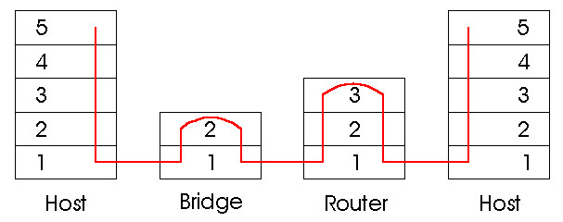
Switches vs. Routers Summary
both store-and-forward devices
routers: network layer devices (examine network layer headers)
switches are link layer devices
routers maintain routing tables, implement routing algorithms
switches maintain switch tables, implement filtering, learning algorithms
Notes:
FINAL SLIDE IN PART 5

Slide 126
MAC Addresses (and IPv4 ARP) or How do I glue my network to my data-link?
32-bit IP address:
network-layer address
used to get datagram to destination IP subnet
MAC (or LAN or physical or Ethernet) address:
function: get frame from one interface to another physically-connected interface (same network)
48 bit MAC address (for most LANs)
burned in NIC ROM, also (commonly) software settable

Slide 127
LAN Addresses and ARP
Each adapter on LAN has unique LAN address
1A-2F-BB-709-AD
Ethernet
Broadcast address =
FF-FF-FF-FF-FF-FF
LAN
(wired or
wireless)
= adapter
71-6F7-2B-08-53
58-23-D7-FA-20-B0
0C-C4-11-6F-E3-98

Slide 128
Address Resolution Protocol
Every node maintains an ARP table
<IP address, MAC address> pair
Consult the table when sending a packet
Map destination IP address to destination MAC address
Encapsulate and transmit the data packet
But: what if IP address not in the table?
Sender broadcasts: “Who has IP address 1.2.3.156?”
Receiver responds: “MAC address 58-23-D7-FA-20-B0”
Sender caches result in its ARP table
Notes:
Wed 7th start here.

Slide 129
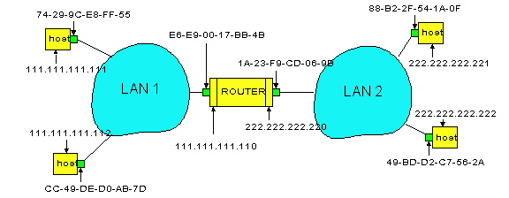
Example: A Sending a Packet to B
How does host A send an IP packet to host B?
A
R
B

Slide 130
Example: A Sending a Packet to B
How does host A send an IP packet to host B?
A
R
B
1. A sends packet to R. 2. R sends packet to B.

Slide 131
Host A Decides to Send Through R
Host A constructs an IP packet to send to B
Source 111.111.111.111, destination 222.222.222.222
Host A has a gateway router R
Used to reach destinations outside of 111.111.111.0/24
Address 111.111.111.110 for R learned via DHCP/config
A
R
B

Slide 132
Host A Sends Packet Through R
Host A learns the MAC address of R’s interface
ARP request: broadcast request for 111.111.111.110
ARP response: R responds with E6-E9-00-17-BB-4B
Host A encapsulates the packet and sends to R
A
R
B

Slide 133
R Decides how to Forward Packet
Router R’s adaptor receives the packet
R extracts the IP packet from the Ethernet frame
R sees the IP packet is destined to 222.222.222.222
Router R consults its forwarding table
Packet matches 222.222.222.0/24 via other adaptor
A
R
B

Slide 134
R Sends Packet to B
Router R’s learns the MAC address of host B
ARP request: broadcast request for 222.222.222.222
ARP response: B responds with 49-BD-D2-C7-52A
Router R encapsulates the packet and sends to B
A
R
B

Slide 135

Security Analysis of ARP
Impersonation
Any node that hears request can answer …
… and can say whatever they want
Actual legit receiver never sees a problem
Because even though later packets carry its IP address, its NIC doesn’t capture them since not its MAC address
Notes:
1/Fab/2013

Slide 136
Key Ideas in Both ARP and DHCP
Broadcasting: Can use broadcast to make contact
Scalable because of limited size
Caching: remember the past for a while
Store the information you learn to reduce overhead
Remember your own address & other host’s addresses
Soft state: eventually forget the past
Associate a time-to-live field with the information
… and either refresh or discard the information
Key for robustness in the face of unpredictable change

Slide 137
Why Not Use DNS-Like Tables?
When host arrives:
Assign it an IP address that will last as long it is present
Add an entry into a table in DNS-server that maps MAC to IP addresses
Answer:
Names: explicit creation, and are plentiful
Hosts: come and go without informing network
Must do mapping on demand
Addresses: not plentiful, need to reuse and remap
Soft-state enables dynamic reuse
Notes:
Two key points

Slide 138
No More IPv4 Addresses
IPv4 address space in terms of /8’s
0 | 1 | 2 | 3 | 4 | 5 | 6 | 7 | 8 | 9 | 10 | 11 | 12 | 13 | 14 | 15
16 | 17 | 18 | 19 | 20 | 21 | 22 | 23 | 24 | 25 | 26 | 27 | 28 | 29 | 30 | 31
32 | 33 | 34 | 35 | 36 | 37 | 38 | 39 | 40 | 41 | 42 | 43 | 44 | 45 | 46 | 47
48 | 49 | 50 | 51 | 52 | 53 | 54 | 55 | 56 | 57 | 58 | 59 | 60 | 61 | 62 | 63
64 | 65 | 66 | 67 | 68 | 69 | 70 | 71 | 72 | 73 | 74 | 75 | 76 | 77 | 78 | 79
80 | 81 | 82 | 83 | 84 | 85 | 86 | 87 | 88 | 89 | 90 | 91 | 92 | 93 | 94 | 95
96 | 97 | 98 | 99 | 100 | 101 | 102 | 103 | 104 | 105 | 106 | 107 | 108 | 109 | 110 | 111
112 | 113 | 114 | 115 | 116 | 117 | 118 | 119 | 120 | 121 | 122 | 123 | 124 | 125 | 126 | 127
128 | 129 | 130 | 131 | 132 | 133 | 134 | 135 | 136 | 137 | 138 | 139 | 140 | 141 | 142 | 143
144 | 145 | 146 | 147 | 148 | 149 | 150 | 151 | 152 | 153 | 154 | 155 | 156 | 157 | 158 | 159
160 | 161 | 162 | 163 | 164 | 165 | 166 | 167 | 168 | 169 | 170 | 171 | 172 | 173 | 174 | 175
176 | 177 | 178 | 179 | 180 | 181 | 182 | 183 | 184 | 185 | 186 | 187 | 188 | 189 | 190 | 191
192 | 193 | 194 | 195 | 196 | 197 | 198 | 199 | 200 | 201 | 202 | 203 | 204 | 205 | 206 | 207
208 | 209 | 210 | 211 | 212 | 213 | 214 | 215 | 216 | 217 | 218 | 219 | 220 | 221 | 222 | 223
224 | 225 | 226 | 227 | 228 | 229 | 230 | 231 | 232 | 233 | 234 | 235 | 236 | 237 | 238 | 239
240 | 241 | 242 | 243 | 244 | 245 | 246 | 247 | 248 | 249 | 250 | 251 | 252 | 253 | 254 | 255
Class A
Class B
Class C
Class D & E

Slide 139
No More IPv4 Addresses
24 /8’s on January 12, 2010
0 | 1 | 2 | 3 | 4 | 5 | 6 | 7 | 8 | 9 | 10 | 11 | 12 | 13 | 14 | 15
16 | 17 | 18 | 19 | 20 | 21 | 22 | 23 | 24 | 25 | 26 | 27 | 28 | 29 | 30 | 31
32 | 33 | 34 | 35 | 36 | 37 | 38 | 39 | 40 | 41 | 42 | 43 | 44 | 45 | 46 | 47
48 | 49 | 50 | 51 | 52 | 53 | 54 | 55 | 56 | 57 | 58 | 59 | 60 | 61 | 62 | 63
64 | 65 | 66 | 67 | 68 | 69 | 70 | 71 | 72 | 73 | 74 | 75 | 76 | 77 | 78 | 79
80 | 81 | 82 | 83 | 84 | 85 | 86 | 87 | 88 | 89 | 90 | 91 | 92 | 93 | 94 | 95
96 | 97 | 98 | 99 | 100 | 101 | 102 | 103 | 104 | 105 | 106 | 107 | 108 | 109 | 110 | 111
112 | 113 | 114 | 115 | 116 | 117 | 118 | 119 | 120 | 121 | 122 | 123 | 124 | 125 | 126 | 127
128 | 129 | 130 | 131 | 132 | 133 | 134 | 135 | 136 | 137 | 138 | 139 | 140 | 141 | 142 | 143
144 | 145 | 146 | 147 | 148 | 149 | 150 | 151 | 152 | 153 | 154 | 155 | 156 | 157 | 158 | 159
160 | 161 | 162 | 163 | 164 | 165 | 166 | 167 | 168 | 169 | 170 | 171 | 172 | 173 | 174 | 175
176 | 177 | 178 | 179 | 180 | 181 | 182 | 183 | 184 | 185 | 186 | 187 | 188 | 189 | 190 | 191
192 | 193 | 194 | 195 | 196 | 197 | 198 | 199 | 200 | 201 | 202 | 203 | 204 | 205 | 206 | 207
208 | 209 | 210 | 211 | 212 | 213 | 214 | 215 | 216 | 217 | 218 | 219 | 220 | 221 | 222 | 223
224 | 225 | 226 | 227 | 228 | 229 | 230 | 231 | 232 | 233 | 234 | 235 | 236 | 237 | 238 | 239
240 | 241 | 242 | 243 | 244 | 245 | 246 | 247 | 248 | 249 | 250 | 251 | 252 | 253 | 254 | 255

Slide 140
No More IPv4 Addresses
20 /8’s on April 10, 2010
0 | 1 | 2 | 3 | 4 | 5 | 6 | 7 | 8 | 9 | 10 | 11 | 12 | 13 | 14 | 15
16 | 17 | 18 | 19 | 20 | 21 | 22 | 23 | 24 | 25 | 26 | 27 | 28 | 29 | 30 | 31
32 | 33 | 34 | 35 | 36 | 37 | 38 | 39 | 40 | 41 | 42 | 43 | 44 | 45 | 46 | 47
48 | 49 | 50 | 51 | 52 | 53 | 54 | 55 | 56 | 57 | 58 | 59 | 60 | 61 | 62 | 63
64 | 65 | 66 | 67 | 68 | 69 | 70 | 71 | 72 | 73 | 74 | 75 | 76 | 77 | 78 | 79
80 | 81 | 82 | 83 | 84 | 85 | 86 | 87 | 88 | 89 | 90 | 91 | 92 | 93 | 94 | 95
96 | 97 | 98 | 99 | 100 | 101 | 102 | 103 | 104 | 105 | 106 | 107 | 108 | 109 | 110 | 111
112 | 113 | 114 | 115 | 116 | 117 | 118 | 119 | 120 | 121 | 122 | 123 | 124 | 125 | 126 | 127
128 | 129 | 130 | 131 | 132 | 133 | 134 | 135 | 136 | 137 | 138 | 139 | 140 | 141 | 142 | 143
144 | 145 | 146 | 147 | 148 | 149 | 150 | 151 | 152 | 153 | 154 | 155 | 156 | 157 | 158 | 159
160 | 161 | 162 | 163 | 164 | 165 | 166 | 167 | 168 | 169 | 170 | 171 | 172 | 173 | 174 | 175
176 | 177 | 178 | 179 | 180 | 181 | 182 | 183 | 184 | 185 | 186 | 187 | 188 | 189 | 190 | 191
192 | 193 | 194 | 195 | 196 | 197 | 198 | 199 | 200 | 201 | 202 | 203 | 204 | 205 | 206 | 207
208 | 209 | 210 | 211 | 212 | 213 | 214 | 215 | 216 | 217 | 218 | 219 | 220 | 221 | 222 | 223
224 | 225 | 226 | 227 | 228 | 229 | 230 | 231 | 232 | 233 | 234 | 235 | 236 | 237 | 238 | 239
240 | 241 | 242 | 243 | 244 | 245 | 246 | 247 | 248 | 249 | 250 | 251 | 252 | 253 | 254 | 255

Slide 141
No More IPv4 Addresses
13 /8’s on May 8, 2010
0 | 1 | 2 | 3 | 4 | 5 | 6 | 7 | 8 | 9 | 10 | 11 | 12 | 13 | 14 | 15
16 | 17 | 18 | 19 | 20 | 21 | 22 | 23 | 24 | 25 | 26 | 27 | 28 | 29 | 30 | 31
32 | 33 | 34 | 35 | 36 | 37 | 38 | 39 | 40 | 41 | 42 | 43 | 44 | 45 | 46 | 47
48 | 49 | 50 | 51 | 52 | 53 | 54 | 55 | 56 | 57 | 58 | 59 | 60 | 61 | 62 | 63
64 | 65 | 66 | 67 | 68 | 69 | 70 | 71 | 72 | 73 | 74 | 75 | 76 | 77 | 78 | 79
80 | 81 | 82 | 83 | 84 | 85 | 86 | 87 | 88 | 89 | 90 | 91 | 92 | 93 | 94 | 95
96 | 97 | 98 | 99 | 100 | 101 | 102 | 103 | 104 | 105 | 106 | 107 | 108 | 109 | 110 | 111
112 | 113 | 114 | 115 | 116 | 117 | 118 | 119 | 120 | 121 | 122 | 123 | 124 | 125 | 126 | 127
128 | 129 | 130 | 131 | 132 | 133 | 134 | 135 | 136 | 137 | 138 | 139 | 140 | 141 | 142 | 143
144 | 145 | 146 | 147 | 148 | 149 | 150 | 151 | 152 | 153 | 154 | 155 | 156 | 157 | 158 | 159
160 | 161 | 162 | 163 | 164 | 165 | 166 | 167 | 168 | 169 | 170 | 171 | 172 | 173 | 174 | 175
176 | 177 | 178 | 179 | 180 | 181 | 182 | 183 | 184 | 185 | 186 | 187 | 188 | 189 | 190 | 191
192 | 193 | 194 | 195 | 196 | 197 | 198 | 199 | 200 | 201 | 202 | 203 | 204 | 205 | 206 | 207
208 | 209 | 210 | 211 | 212 | 213 | 214 | 215 | 216 | 217 | 218 | 219 | 220 | 221 | 222 | 223
224 | 225 | 226 | 227 | 228 | 229 | 230 | 231 | 232 | 233 | 234 | 235 | 236 | 237 | 238 | 239
240 | 241 | 242 | 243 | 244 | 245 | 246 | 247 | 248 | 249 | 250 | 251 | 252 | 253 | 254 | 255

Slide 142
No More IPv4 Addresses
7 /8’s on November 30th, 2010
0 | 1 | 2 | 3 | 4 | 5 | 6 | 7 | 8 | 9 | 10 | 11 | 12 | 13 | 14 | 15
16 | 17 | 18 | 19 | 20 | 21 | 22 | 23 | 24 | 25 | 26 | 27 | 28 | 29 | 30 | 31
32 | 33 | 34 | 35 | 36 | 37 | 38 | 39 | 40 | 41 | 42 | 43 | 44 | 45 | 46 | 47
48 | 49 | 50 | 51 | 52 | 53 | 54 | 55 | 56 | 57 | 58 | 59 | 60 | 61 | 62 | 63
64 | 65 | 66 | 67 | 68 | 69 | 70 | 71 | 72 | 73 | 74 | 75 | 76 | 77 | 78 | 79
80 | 81 | 82 | 83 | 84 | 85 | 86 | 87 | 88 | 89 | 90 | 91 | 92 | 93 | 94 | 95
96 | 97 | 98 | 99 | 100 | 101 | 102 | 103 | 104 | 105 | 106 | 107 | 108 | 109 | 110 | 111
112 | 113 | 114 | 115 | 116 | 117 | 118 | 119 | 120 | 121 | 122 | 123 | 124 | 125 | 126 | 127
128 | 129 | 130 | 131 | 132 | 133 | 134 | 135 | 136 | 137 | 138 | 139 | 140 | 141 | 142 | 143
144 | 145 | 146 | 147 | 148 | 149 | 150 | 151 | 152 | 153 | 154 | 155 | 156 | 157 | 158 | 159
160 | 161 | 162 | 163 | 164 | 165 | 166 | 167 | 168 | 169 | 170 | 171 | 172 | 173 | 174 | 175
176 | 177 | 178 | 179 | 180 | 181 | 182 | 183 | 184 | 185 | 186 | 187 | 188 | 189 | 190 | 191
192 | 193 | 194 | 195 | 196 | 197 | 198 | 199 | 200 | 201 | 202 | 203 | 204 | 205 | 206 | 207
208 | 209 | 210 | 211 | 212 | 213 | 214 | 215 | 216 | 217 | 218 | 219 | 220 | 221 | 222 | 223
224 | 225 | 226 | 227 | 228 | 229 | 230 | 231 | 232 | 233 | 234 | 235 | 236 | 237 | 238 | 239
240 | 241 | 242 | 243 | 244 | 245 | 246 | 247 | 248 | 249 | 250 | 251 | 252 | 253 | 254 | 255

Slide 143
No More IPv4 Addresses
0 /8’s on January 31st, 2011!
0 | 1 | 2 | 3 | 4 | 5 | 6 | 7 | 8 | 9 | 10 | 11 | 12 | 13 | 14 | 15
16 | 17 | 18 | 19 | 20 | 21 | 22 | 23 | 24 | 25 | 26 | 27 | 28 | 29 | 30 | 31
32 | 33 | 34 | 35 | 36 | 37 | 38 | 39 | 40 | 41 | 42 | 43 | 44 | 45 | 46 | 47
48 | 49 | 50 | 51 | 52 | 53 | 54 | 55 | 56 | 57 | 58 | 59 | 60 | 61 | 62 | 63
64 | 65 | 66 | 67 | 68 | 69 | 70 | 71 | 72 | 73 | 74 | 75 | 76 | 77 | 78 | 79
80 | 81 | 82 | 83 | 84 | 85 | 86 | 87 | 88 | 89 | 90 | 91 | 92 | 93 | 94 | 95
96 | 97 | 98 | 99 | 100 | 101 | 102 | 103 | 104 | 105 | 106 | 107 | 108 | 109 | 110 | 111
112 | 113 | 114 | 115 | 116 | 117 | 118 | 119 | 120 | 121 | 122 | 123 | 124 | 125 | 126 | 127
128 | 129 | 130 | 131 | 132 | 133 | 134 | 135 | 136 | 137 | 138 | 139 | 140 | 141 | 142 | 143
144 | 145 | 146 | 147 | 148 | 149 | 150 | 151 | 152 | 153 | 154 | 155 | 156 | 157 | 158 | 159
160 | 161 | 162 | 163 | 164 | 165 | 166 | 167 | 168 | 169 | 170 | 171 | 172 | 173 | 174 | 175
176 | 177 | 178 | 179 | 180 | 181 | 182 | 183 | 184 | 185 | 186 | 187 | 188 | 189 | 190 | 191
192 | 193 | 194 | 195 | 196 | 197 | 198 | 199 | 200 | 201 | 202 | 203 | 204 | 205 | 206 | 207
208 | 209 | 210 | 211 | 212 | 213 | 214 | 215 | 216 | 217 | 218 | 219 | 220 | 221 | 222 | 223
224 | 225 | 226 | 227 | 228 | 229 | 230 | 231 | 232 | 233 | 234 | 235 | 236 | 237 | 238 | 239
240 | 241 | 242 | 243 | 244 | 245 | 246 | 247 | 248 | 249 | 250 | 251 | 252 | 253 | 254 | 255

Slide 144

IPv6
Motivated (prematurely) by address exhaustion
Address field four times as long
Steve Deering focused on simplifying IP
Got rid of all fields that were not absolutely necessary
“Spring Cleaning” for IP
Result is an elegant, if unambitious, protocol

Slide 145
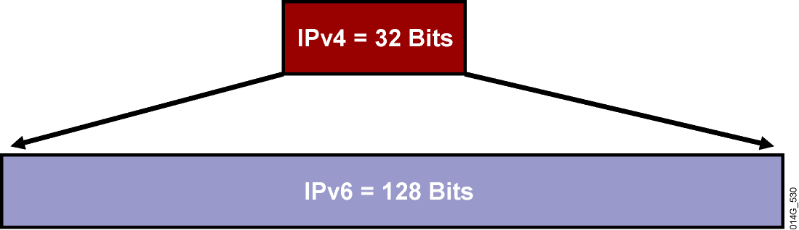
Larger Address Space
IPv4 = 4,294,967,295 addresses
IPv6 = 340,282,366,920,938,463,374,607,432,768,211,456 addresses
4x in number of bits translates to huge increase in address space!

Slide 146
Other Significant Protocol Changes
Increased minimum MTU from 576 to 1280
No enroute fragmentation… fragmentation only at source
Header changes
Replace broadcast with multicast
IPv4
Version
IHL
Type of Service
Total Length
IPv6
Version
Traffic Class
Flow Label
Identification
Flags
Fragment Offset
Payload Length
Next Header
Hop Limit
Time to Live
Protocol
Header Checksum
Source Address
Source Address
Destination Address
Options
Padding
Field’s Name Kept from IPv4 to IPv6
Fields Not Kept in IPv6
Name and Position Changed in IPv6
New Field in IPv6
Destination Address
Legend

Slide 147
IPv4 | IPv6
Addresses are 32 bits (4 bytes) in length. | Addresses are 128 bits (16 bytes) in length
Address (A) resource records in DNS to map host names to IPv4 addresses. | Address (AAAA) resource records in DNS to map host names to IPv6 addresses.
Pointer (PTR) resource records in the IN-ADDR.ARPA DNS domain to map IPv4 addresses to host names. | Pointer (PTR) resource records in the IP6.ARPA DNS domain to map IPv6 addresses to host names.
IPSec is optional and should be supported externally | IPSec support is not optional
Header does not identify packet flow for QoS handling by routers | Header contains Flow Label field, which Identifies packet flow for QoS handling by router.
Both routers and the sending host fragment packets. | Routers do not support packet fragmentation. Sending host fragments packets
Header includes a checksum. | Header does not include a checksum.
Header includes options. | Optional data is supported as extension headers.
ARP uses broadcast ARP request to resolve IP to MAC/Hardware address. | Multicast Neighbor Solicitation messages resolve IP addresses to MAC addresses.
Internet Group Management Protocol (IGMP) manages membership in local subnet groups. | Multicast Listener Discovery (MLD) messages manage membership in local subnet groups.
Broadcast addresses are used to send traffic to all nodes on a subnet. | IPv6 uses a link-local scope all-nodes multicast address.
Configured either manually or through DHCP. | Does not require manual configuration or DHCP.
Must support a 576-byte packet size (possibly fragmented). | Must support a 1280-byte packet size (without fragmentation).

Slide 148
Roundup: Why IPv6?
Larger address space
Auto-configuration
Cleanup
Eliminate fragmentation
Eliminate checksum
Pseudo-header (w/o Hop Limit) covered by transport layer
Flow label
Increase minimum MTU from 576 to 1280
Replace broadcasts with multicast

Slide 149
No Checksum!
Provided by transport layer, if needed
Ala TCP, includes pseudo-header
Pseudo-header doesn’t include Hop Limit
No per-hop re-computation!
Allows end-to-end implementation (transport layer)
UDP checksum required (wasn’t in IPv4) rfc6936: No more zero
Pseudo-header added to ICMPv6 checksum

Slide 150
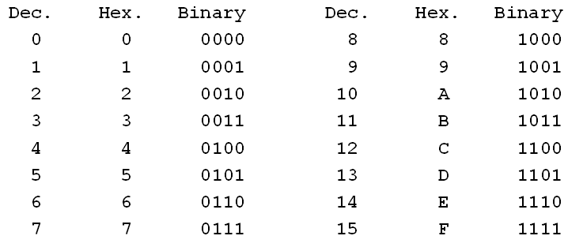
IPv6 Address Notation
RFC 5952
128-bit IPv6 addresses are represented in:
Eight 16-bit segments
Hexadecimal (non-case sensitive) between 0000 and FFFF
Separated by colons
Example:
3ffe:1944:0100:000a:0000:00bc:2500:0d0b
Two rules for dealing with 0’s
One Hex digit = 4 bits

Slide 151
0’s Rule 1 – Leading 0’s
The leading zeroes in any 16-bit segment do not have to be written.
Example
3ffe : 1944 : 0100 : 000a : 0000 : 00bc : 2500 : 0d0b
3ffe : 1944 : 100 : a : 0 : bc : 2500 : d0b
3ffe:1944:100:a:0:bc:2500:d0b

Slide 152
0’s Rule 1 – Leading 0’s
Can only apply to leading zeros… otherwise ambiguous results
Example
3ffe : 1944 : 100 : a : 0 : bc : 2500 : d0b
Could be either
3ffe : 1944 : 0100 : 000a : 0000 : 00bc : 2500 : 0d0b
3ffe : 1944 : 1000 : a000 : 0000 : bc00 : 2500 : d0b0
Which is correct?

Slide 153
0’s Rule 1 – Leading 0’s
Can only apply to leading zeros… otherwise ambiguous results
Example
3ffe : 1944 : 100 : a : 0 : bc : 2500 : d0b
Could be either
3ffe : 1944 : 0100 : 000a : 0000 : 00bc : 2500 : 0d0b
3ffe : 1944 : 1000 : a000 : 0000 : bc00 : 2500 : d0b0
Which is correct?

Slide 154
0’s Rule 2 – Double Colon
Any single, contiguous string of 16-bit segments consisting of all zeroes can be represented with a double colon.
ff02 : 0000 : 0000 : 0000 : 0000 : 0000 : 0000 : 0005
ff02 : 0 : 0 : 0 : 0 : 0 : 0 : 5
ff02 : : 5
ff02::5

Slide 155
0’s Rule 2 – Double Colon
Only a single contiguous string of all-zero segments can be represented with a double colon.
Example:
2001 : 0d02 : 0000 : 0000 : 0014 : 0000 : 0000 : 0095
Both of these are correct
2001 : d02 :: 14 : 0 : 0 : 95
OR
2001 : d02 : 0 : 0 : 14 :: 95

Slide 156
0’s Rule 2 – Double Colon
However, using double colon more than once creates ambiguity
Example
2001:d02::14::95
2001:0d02:0000:0000:0000:0014:0000:0095
2001:0d02:0000:0000:0014:0000:0000:0095
2001:0d02:0000:0014:0000:0000:0000:0095

Slide 157
Network Prefixes
In IPv4, network portion of address can by identified by either
Netmask: 255.255.255.0
Bitcount: /24
Only use bitcount with IPv6
3ffe:1944:100:a::/64
Notes:
2016-1-22

Slide 158
Special IPv6 Addresses
Default route: ::/0
Unspecified Address: ::/128
Used in SLAAC (coming later)
Loopback/Local Host: ::1/128
No longer a /8 of addresses but a single address

Slide 159
Types of IPv6 Addresses
RFC 4291– “IPv6 Addressing Architecture”
Global Unicast
Globally routable IPv6 addresses
Link Local Unicast
Addresses for use on a given subnet
Unique Local Unicast
Globally unique address for local communication
Multicast
Anycast
A unicast address assigned to interfaces belonging to different nodes

Slide 160
Types of IPv6 Addresses
RFC 4291– “IPv6 Addressing Architecture”
Global Unicast
Globally routable IPv6 addresses
Link Local Unicast
Addresses for use on a given subnet
Unique Local Unicast
Globally unique address for local communication
Multicast
Anycast
A unicast address assigned to interfaces belonging to different nodes

Slide 161
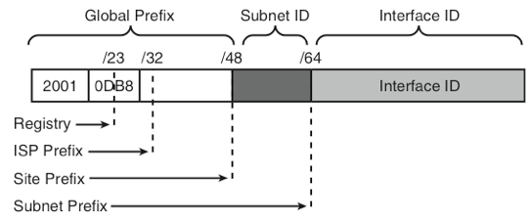
Global Unicast Addresses
Globally routable addresses
RFC 3587
3 parts
48 bit global routing prefix
Hierarchically-structured value assigned to a site
Further broken down into Registry, ISP Prefix, and Site Prefix fields
16 bit Subnet ID
Identifier of a subnet within a site
64(!) bit Interface ID
Identify an interface on a subnet
Motivated by expected use of MAC addresses (IEEE EUI-64 identifiers) in SLAAC…
Except GUAs that start with ‘000…’ binary
Used for, e.g., “IPv4-Mapped IPv6 Addresses” (RFC 4308)

Slide 162
Global Unicast Addresses
Current ARIN policy is to assign no longer than /32 to an ISP
American Registry for Internet Numbers
https://www.arin.net/policy/nrpm.html
UCSC allocation is 2607:F5F0::/32
IANA currently assigning addresses that start with ‘001…’ binary
2000::/3
(2000:: - 3FFF:FFFF:FFFF:FFFF:FFFF:FFFF:FFFF:FFFF)
Supports
Maximum 2²⁹ (536,870,912… 1/8 of an Internet address space of) ISPs
2⁴⁵ sites (equivalent to 8,192 IASs of sites!)
ISP can delegate a minimum of 2¹⁶, or 65,535 site prefixes
Difference between Global Prefix (48 bits) and ISP Prefix (32 bits)

Slide 163
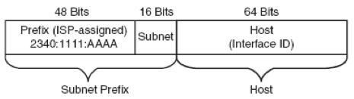
Subnetting Global Unicast Addresses
Each site can identify 2¹⁶ (65,535) subnets
2340:1111:AAAA:1::/64
2340:1111:AAAA:2::/64
2340:1111:AAAA:3::/64
2340:1111:AAAA:4::/64
...
Subnet has address space of 2⁶⁴… an IAS of IASs!
Can extend the subnet ID into the interface ID portion of the address…
Sacrifice ability to use EUI-64 style of SLAAC…
Maybe not a bad thing… more later

Slide 164
These are huge numbers!!
Assume average /16’s allocated to ISPs and /22’s allocated to sites in IPv4
And this keeps assumption of /64 subnets!
IPv6 2000::/3 block
Description | Range | Count | Scale vs IPv4
Total # ISPs | /3 – /32 | 2²⁹ = 512M | 9,362
Total # Sites | /3 – /48 | 2⁴² = 4T | 1.2M
Sites/ISP | /48 – /64 | 2¹⁶ = 64K | 1,024
IPv4 class A, B, and C blocks
Total # ISPs | /16 * 7/8 | 57K
Total # Sites | /22 * 7/8 | 3.6M
Sites/ISP | /16 - /22 | 2⁶ = 64
Notes:
Why “7/8” for class A, B, C restriction?
Class A starts with ‘0XX…’ for a total of 4 /3’s
Class B starts with 10X…’ for a total of 2 /3’s
Class C starts with ‘110…’ for 1 /3
Classes D and E start with ‘111…’ for 1/3
Total of 8 /3’s, 7 of which are used in classes A, B, and C… thus 7/8.

Slide 165
IPv6 Address Space
Allocated
2000::/3 Global Unicast
FC00::/7 Unique Local Unicast
FE80::/10 Link Local Unicast
FF00::/8 Multicast
Accounts for a bit more than 2¹²⁵ of the address space.
Unallocated (“Reserved by IETF”)
/3’s – 4000::, 6000::, 8000::, A000::, C000::
/4’s – 1000::, E000::
/5’s – 0800::, F000::
/6’s – 0400::, F800::
/7’s – 0200::
/8’s – 0000::, 0100::
/9’s – FE00::
/10’s – FEC0::
Accounts for a little more than 2¹²⁷, or more than half, of the address space!!
http://www.iana.org/assignments/ipv6-address-space/ipv6-address-space.xml
Notes:
Allocated:
2^125 + 2^121 + 2^118 + 2^120
2^118 * (2^7 + 2^3 + 1 + 2^2)
2^118 * (128 + 8 + 1 + 4)
2^118 * 141 > 2^125
Unallocated:
5*2^125 + 2*2^124 + 2*2^123 + 2*2^122 + 2^121 + 2*2^120 + 2^119 + 2^118
5*2^125 + 2^125 + 2^124 + 2^123 + 2^121 + 2^121 + 2^119 + 2^118
6*2^125 + 2^124 + 2^123 + 2*2^121 + 2^119 + 2^118
3*2^126 + 2^124 + 2^123 + 2^122 + 2^119 + 2^118
2^118 * (3*2^8 + 2^6 + 2^5 + 2^4 + 2^1 + 1)
2^118 * (3*256 + 64 + 32 + 16 + 2 + 1)
2^118 * 883 > 2^118 * 512 = 2^118 * 2^9 = 2^127

Slide 166
Problem with /64 Subnets
Scanning a subnet becomes a DoS attack!
Creates IPv6 version of 2⁶⁴ ARP entries in routers
Exhaust address-translation table space
So now we have:
ping6 ff02::1 All nodes in broadcast domain
ping6 ff02::2 All routers in broadcast domain
Solutions
RFC 6164 recommends use of /127 to protect router-router links
RFC 3756 suggest “clever cache management” to address more generally

Slide 167
Types of IPv6 Addresses
RFC 4291– “IPv6 Addressing Architecture”
Global Unicast
Globally routable IPv6 addresses
Link Local Unicast
Addresses for use on a given subnet
Unique Local Unicast
Globally unique address for local communication
Multicast
Anycast
A unicast address assigned to interfaces belonging to different nodes

Slide 168
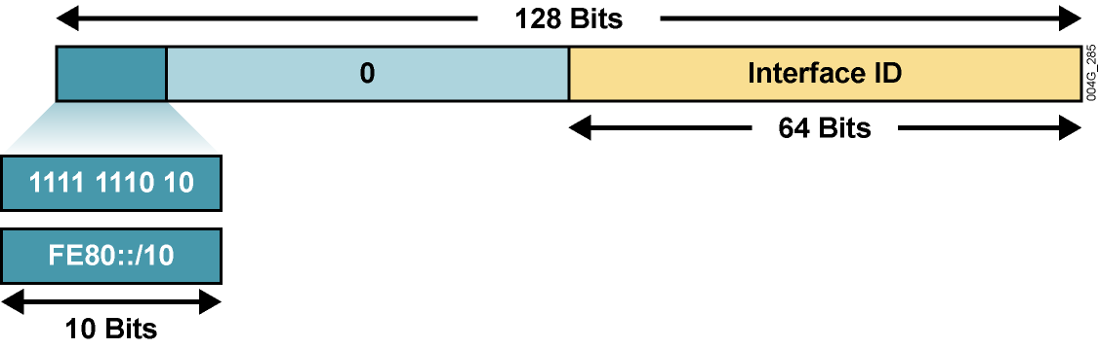
Link-Local Addresses
‘11111110 10…’ binary (FE80::/10)
According to RFC 4291 bits 11-64 should be 0’s… so really FE80::/64?
For use on a single link.
Automatic address configuration
Neighbor discovery (IPv6 ARP)
When no routers are present
Routers must not forward
Addresses “chicken-or-egg” problem… need an address to get an address.
Address assignment done unilaterally by node (later)
IPv4 has link-local address (169.254/16, RFC 3927)
Only used if no globally routable addresses available
Remaining 54 bits

Slide 169
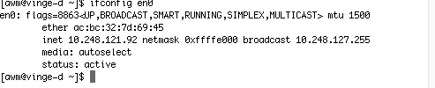
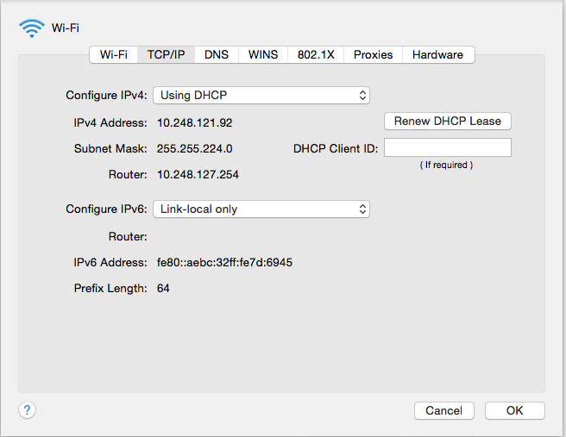

Slide 170
Types of IPv6 Addresses
RFC 4291– “IPv6 Addressing Architecture”
Global Unicast
Globally routable IPv6 addresses
Link Local Unicast
Addresses for use on a given subnet
Unique Local Unicast
Globally unique address for local communication
Multicast
Anycast
A unicast address assigned to interfaces belonging to different nodes

Slide 171
Unique Local Addresses
‘1111110…’ binary (FC00::/7)
Globally unique addresses intended for local communication
IPv6 equivalent of IPv4 RFC 1918 addresses
Defined in RFC 4193
Replace “site local” addresses defined in RFC 1884, deprecated in RFC 3879
Should not be installed in global DNS
Can be installed in “local DNS”

Slide 172
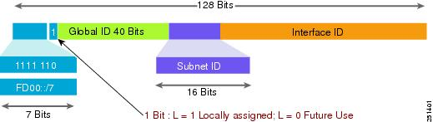
Unique Local Addresses
4 parts
“L” bit always 1
Global ID (40 bits) randomly generated to enforce the idea that these addresses are not to be globally routed or aggregated
Subnet ID (16 bits)… same as Globally Unique Subnet ID
Interface ID (64 bits)… same as Globally Unique Interface ID

Slide 173
Types of IPv6 Addresses
RFC 4291– “IPv6 Addressing Architecture”
Global Unicast
Globally routable IPv6 addresses
Link Local Unicast
Addresses for use on a given subnet
Unique Local Unicast
Globally unique address for local communication
Multicast
Anycast
A unicast address assigned to interfaces belonging to different nodes

Slide 174
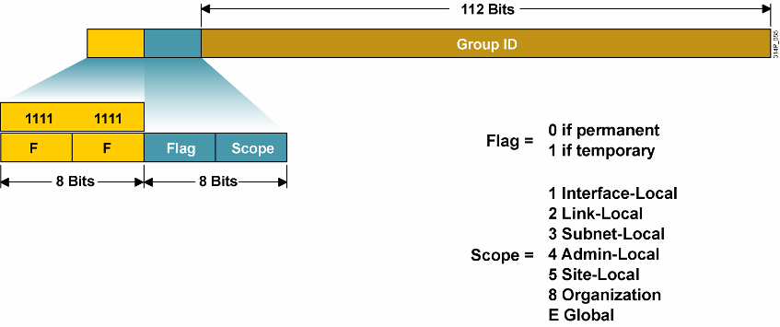
Multicast Addresses
‘11111111…’ binary (FF00::/8)
Equivalent to IPv4 multicast (224.0.0.0/8)
3 parts
Flag (4 bits)
Scope (4 bits)

Slide 175
Reserved Multicast Addresses
All nodes
FF01::1 – interface-local; used for loopback multicast transmissions
FF02::1 – link-local; replaces IPv4 broadcast address (all 1’s host)
All routers
FF01::2 (interface-local), FF02::2 (link-local)
Solicited-Node multicast
Used in Neighbor Discovery Protocol (later)
FF02::FF00:0/104 (FF02::FFXX:XXXX)
Construct by replacing ‘XX:XXXX’ above with low-order 24 bits of a nodes unicast or anycast address
Example
For unicast address 4037::01:800:200E:8C6C
Solicited-Node multicast is FF02::1:FF0E:8C6C

Slide 176
Types of IPv6 Addresses
RFC 4291– “IPv6 Addressing Architecture”
Global Unicast
Globally routable IPv6 addresses
Link Local Unicast
Addresses for use on a given subnet
Unique Local Unicast
Globally unique address for local communication
Multicast
Anycast
A unicast address assigned to interfaces belonging to different nodes

Slide 177
Anycast Addresses
Allocated from unicast address space
Syntactically indistinguishable from unicast addresses
An address assigned to more than one node
Anycast traffic routed to the “nearest” host with the anycast address
Typically used for a service (e.g. local DNS servers)
Nodes must be configured to know an address is anycast
Don’t do Duplicate Address Detection
Advertise a route?

Slide 178
A Node’s Required Addresses
Link-local address for each interface
Configured unicast or anycast addresses
Loopback address
All-Nodes multicast interface and link addresses
Solicited-Node multicast for each configured unicast and anycast address
Multicast addresses for all groups the node is a member of
Routers must add
Subnet-Router anycast address for each interface
Subnet prefix with all 0’s host part
All-Routers multicast address
Red = new for IPv6

Slide 179
Roundup: IPv6 Addresses
“Interface ID” (host part) is 64 bits
New addresses required by all nodes (host or router)
Link-local address
All-nodes interface-local and link-local multicast
Solicited-node multicast for each unicast/anycast address
New addresses required by routers
All-routers interface-local, link-local and site-local multicast
Subnet-Router anycast for each interface?

Slide 180
Host Configuration

Slide 181
Assigning Address to Interfaces
Static (manual) assignment
Needed for network equipment
DHCPv6
Needed to track who uses an IP address
StateLess Address AutoConfiguration (SLAAC)
New to IPv6
Describe SLAAC in the following…

Slide 182
SLAAC
RFC 4862 – IPv6 Stateful Address Autoconfiguration
Used to assign unicast addresses to interfaces
Link-Local Unicast
Global Unicast
Unique-Local Unicast?
Goal is to minimize manual configuration
No manual configuration of hosts
Limited router configuration
No additional servers
Use when “not particularly concerned with the exact addresses hosts use”
Otherwise use DHCPv6 (RFC 3315)

Slide 183
SLAAC Building Blocks
Interface IDs
Neighbor Discovery Protocol
SLAAC Process

Slide 184
SLAAC Building Blocks
Interface IDs
Neighbor Discovery Protocol
SLAAC Process

Slide 185
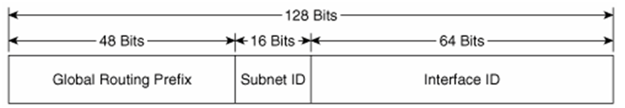
Interface IDs
Used to identify a unique interface on a link
Thought of as the “host portion” of an IPv6 address.
64 bits: To support both 48 bit and 64 bit IEEE MAC addresses
Required to be unique on a link
Subnets using auto addressing must be /64s.
EUI-64 vs Privacy interface IDs

Slide 186
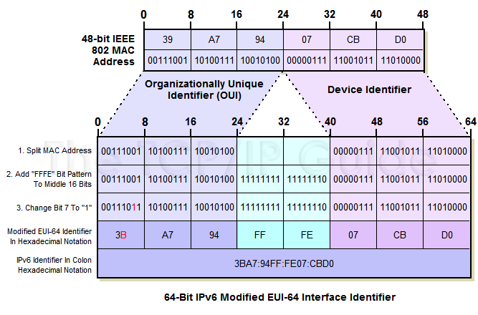
IEEE EUI-64 Option for Interface ID
Use interface MAC address
Insert FFFE to convert EUI-48 to EUI-64
FlipUniversal/Local bit to “1”
Section 2.5.1 RFC 4291

Slide 187
Privacy Option for Interface ID
Using MAC uniquely identifies a host… security/privacy concerns!
Microsoft(!) defined an alternative solution for Interface IDs (RFC 4941)
Hosts generates a random 64 bit Interface ID
Randomly generated

Slide 188
SLAAC Building Blocks
Interface IDs
Neighbor Discovery Protocol
SLAAC Process

Slide 189
NDP
RFC 4861 – Neighbor Discovery for IPv6
Used to
Determine MAC address for nodes on same subnet (ARP)
Find routers on same subnet
Determine subnet prefix and MTU
Determine address of local DNS server (RFC 6106)
Uses 5 ICMPv6 messages
Router Solicitation (RS) – request routers to send RA
Router Advertisement (RA) – router’s address and subnet parameters
Neighbor Solicitation (NS) – request neighbor’s MAC address (ARP Request)
Neighbor Advertisement (NA) – MAC address for an IPv6 address (ARP Reply)
Redirect – inform host of a better next hop for a destination

Slide 190


NDP RS & RA
Router Solicitation (RS)
Originated by hosts to request that a router send an RA
Source = unspecified (::) or link-local address,
Destination = All-routers multicast (FF02::2)
Router Advertisement (RA)
Originated by routers to advertise their address and link-specific parameters
Sent periodically and in response to Router Solicitation messages
Source = link-local address,
Destination = All-nodes multicast (FF02::1)
ipv6 unicast-routing
RA (Address, prefix, link MTU)
RS (Need RA from Router)

Slide 191
NDP NS & NA
Neighbor Solicitation (NS)
Request target MAC address while providing target of source (IPv4 ARP Request)
Used to resolve address or verify reachability of neighbor
Source = unicast or “::” (Duplicate Address Detection… next slide)
Destination = solicited-node multicast
Neighbor Advertisement (NA)
Advertise MAC address for given IPv6 address (IPv4 ARP Reply)
Respond to NS or communicate MAC address change
Source = unicast, destination = NS’s source or all-nodes multicast (if source “::”)
ipv6 unicast-routing
NS (Request for another node’s Link Layer Address)
NA (Sent in response to NS)

Slide 192
Duplicate Address Detection
Duplicate Address Detection (DAD) used to verify address is unique in subnet prior to assigning it to an interface
MUST take place on all unicast addresses, regardless of whether they are obtained through stateful, stateless or manual configuration
MUST NOT be performed on anycast addresses
Uses Neighbor Solicitation and Neighbor Advertisement messages
NS sent to solicited-node multicast; if no NA received address is unique
Solicited-node multicast: FF02::1:FF:0/104 w/ last 24 bits of target

Slide 193
Duplicate Address Detection
My Global Address is
2340:1111:AAAA:1:213:19FF:FE7B:5004
I need to make sure nobody else has this Global Unicast Address…
“Tentative”: Need to do Duplicate Address Detection
NS (Neighbor Solicitation)
- Target Address = 2340:1111:AAAA:1:213:19FF:FE7B:5004
Destination: Solicited-Node Multicast Address = FF02::1::FF7B:5004

Slide 194
SLAAC Building Blocks
Interface IDs
Neighbor Discovery Protocol
SLAAC Process

Slide 195
SLAAC Steps
Select link-local address
Verify “tentative” address not in use by another host with DAD
Send RS to solicit RAs from routers
Receive RA with
router address,
subnet MTU,
subnet prefix,
local DNS server (RFC 6106)
Generate global unicast address
Verify address is not in use by another host with DAD

Slide 196
Create Link-local address
Link-local Address =
Link-local Prefix + Interface Identifier (EUI-64 format)
FE80 [64 bits] + [48 bit MAC u/l flipped + 16 bit FFFE]
A
Make sure Link-local address is unique
NS (Neighbor Solicitation)
Make sure Link-local address is unique
DAD: Okay if no NA returned
Destination: Solicited-Node Multicast Address
Target address = Link-local address
Get Network Prefix to create Global unicast address
RS (Router Solicitation)
Get Prefix and other information
RA (Router Advertisement)
Source = Link-local address
Destin = FF02::1 All nodes multicast address
Query = Prefix, Default Router, MTU, options
IPv6 Address =
Prefix + Interface ID (EUI-64 format)
[64 bits] + [48 bit MAC u/l flipped + 16 bit FFFE]
DAD
NS (Neighbor Solicitation)
Make sure IPv6 Address is unique
Target Address = IPv6 Address
DAD: Okay if no NA returned

Slide 197
Prefix Leases
Prefix information contained in RA includes lifetime information
Preferred lifetime: when an address’s preferred lifetime expires SHOULD only be used for existing communications
Valid lifetime: when an address’s valid lifetime expires it MUST NOT be used as a source address or accepted as a destination address.
Unsolicited RAs can reduce prefix lifetime values
Can be used to force re-addressing

Slide 198
Roundup: ICMPv6
Implements router discovery and ARP functions
ICMPv6 messages
Router Solicitation/Router Advertisement
Neighbor Solicitation/Neighbor Advertisement
(Next hop) Redirect
Duplicate Address Detection (DAD)
verify unique link-local and global-unicast addresses
Uses:
NS/NA (i.e. gratuitous ARP)
Solicited node multicast address

Slide 199
Review - SLAAC
Assigns link-local and global-unicast addresses
Goals
Eliminate manual configuration
Require minimal router configuration
Require no additional servers
Host part options
EUI-64
Random (“privacy” addresses)
Steps
Generate link-local address and verify with DAD
Find router - RS/RA
Generate global unicast address and verify with DAD

Slide 200
Improving on IPv4 and IPv6?
Why include unverifiable source address?
Would like accountability and anonymity (now neither)
Return address can be communicated at higher layer
Why packet header used at edge same as core?
Edge: host tells network what service it wants
Core: packet tells switch how to handle it
One is local to host, one is global to network
Some kind of payment/responsibility field?
Who is responsible for paying for packet delivery?
Source, destination, other?
Other ideas?

Slide 201
Summary Network Layer
understand principles behind network layer services:
network layer service models
forwarding versus routing (versus switching)
how a router works
routing (path selection)
IPv6
Algorthims
Two routing approaches (LS vs DV)
One of these in detail (LS)
ARP
Notes:
30-jan-2015 / 25-jan-2016

