Slide 1

www.
.net

Slide 2
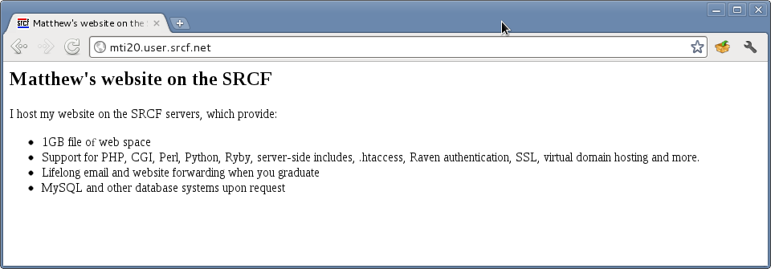
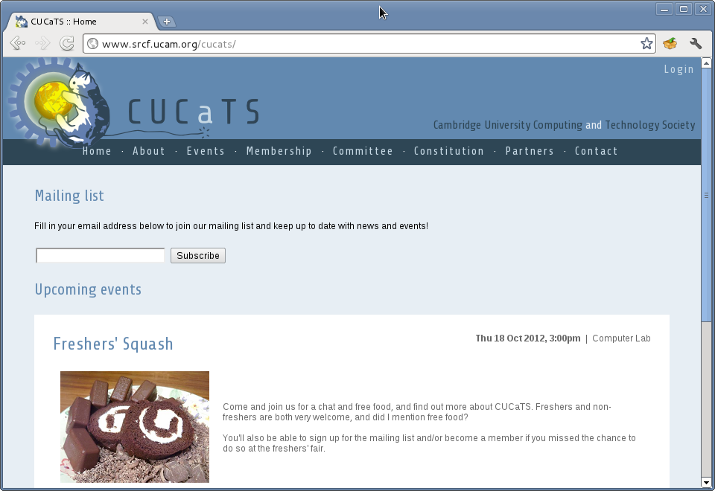
srcf
Web hosting
student-run computing facility
Personal hosting
Society hosting
www.srcf.net

Slide 3
srcf
Linux Box/Virtual Machines
student-run computing facility
Long running job?
Want to experiment?
SSH and SCP/SFTP access
Databases on request
Provision of VMs (Xen) for individual projects where justified
www.srcf.net

Slide 4
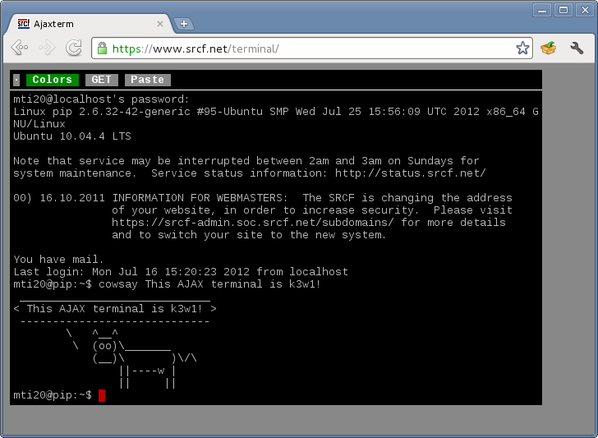
srcf
AJAX terminal
student-run computing facility
www.srcf.net

Slide 5
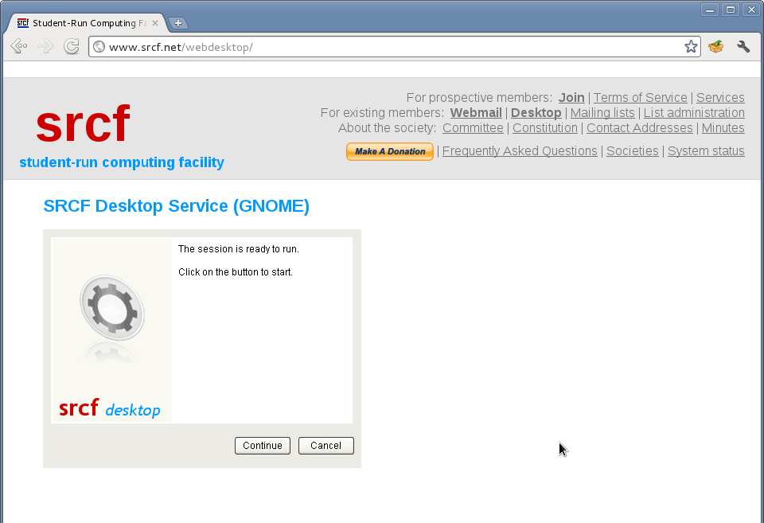
srcf
Desktop service (1)
student-run computing facility
www.srcf.net/webdesktop

Slide 6
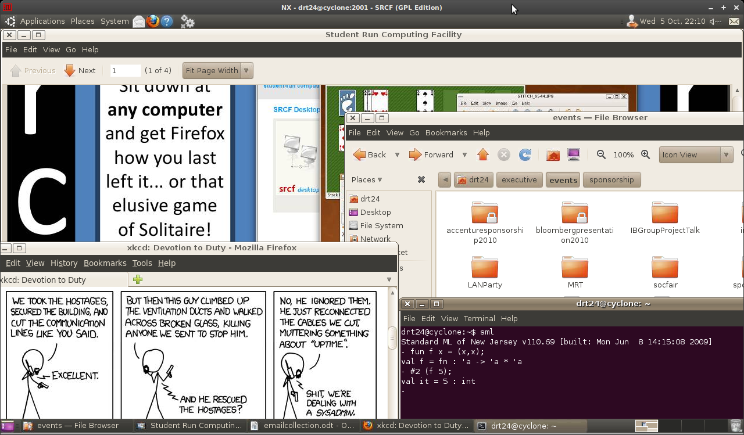
srcf
Desktop service (2)
student-run computing facility
www.srcf.net/webdesktop

Slide 7
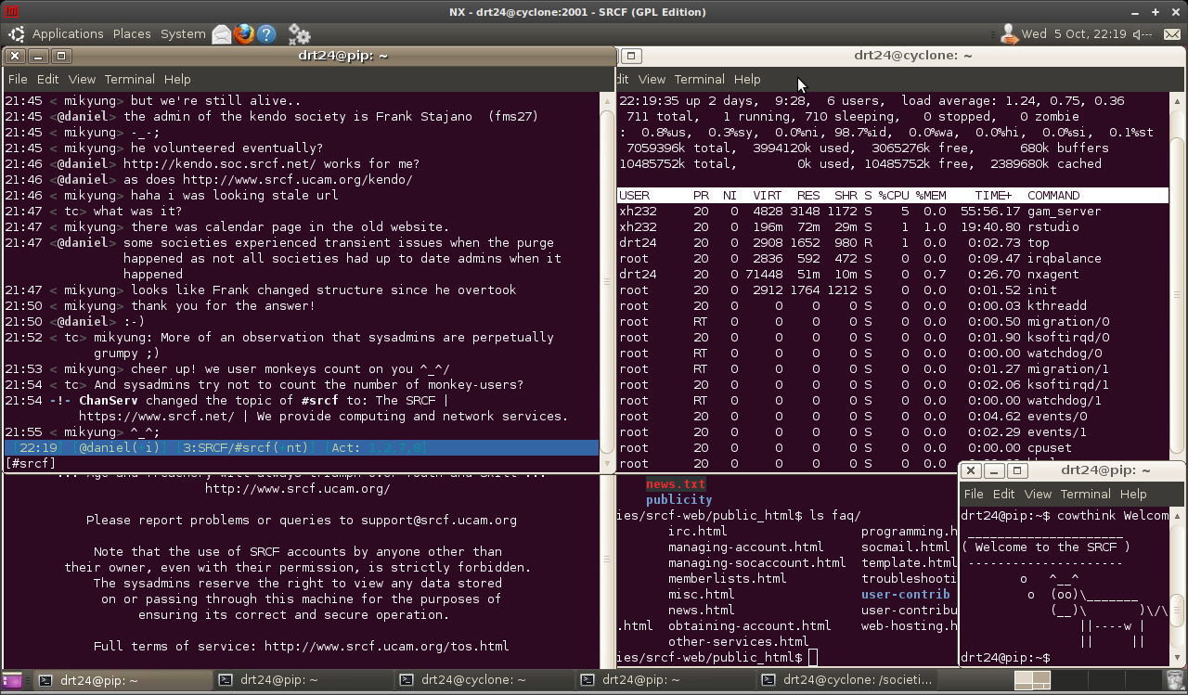
srcf
IRC server
student-run computing facility
www.srcf.net

Slide 8
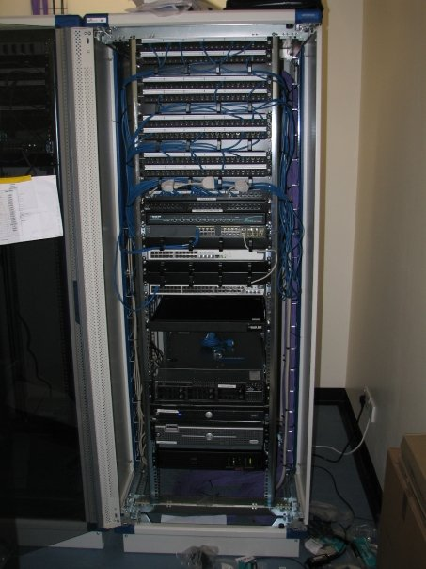
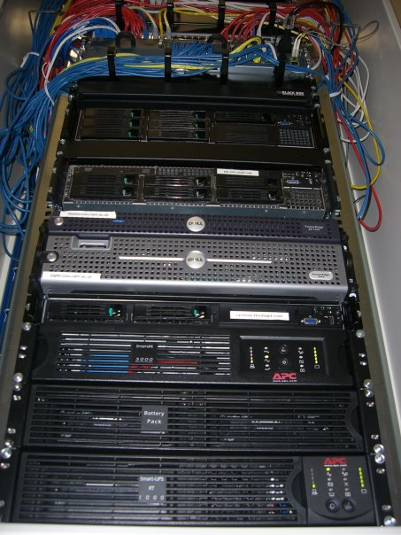
srcf
The technical side
student-run computing facility
www.srcf.net

Slide 9
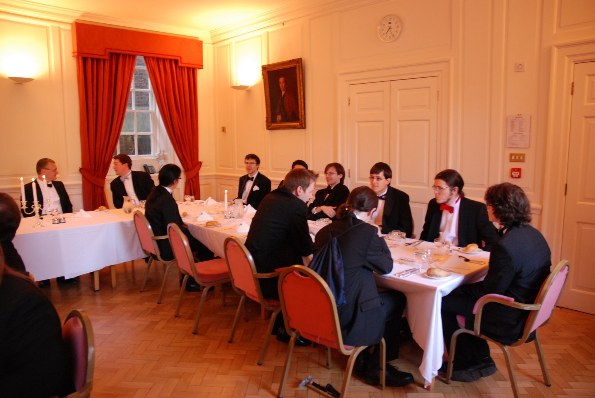
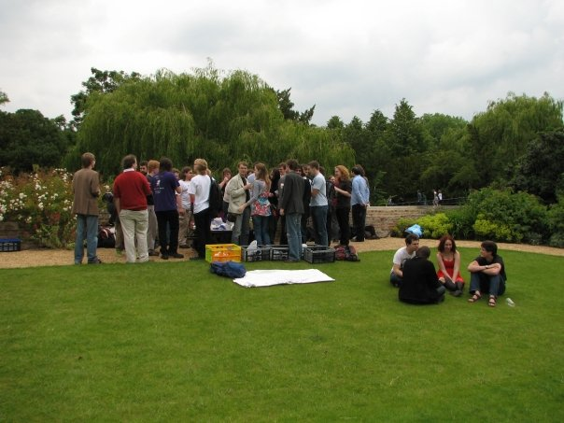
srcf
Social events
student-run computing facility
Welcome Social: Monday 20th October, 19.00, Selwyn
www.srcf.net

Slide 10
... and all of that completely free.
www.srcf.net
www.facebook.com/groups/srcf1
Sign up today!
Questions?
committee@srcf.net
irc.srcf.net #srcf

