Slide 1
Economics and Law Summary

Slide 2
Prisoners’ dilemma
Two prisoners are arrested on suspicion of planning a robbery. The police tell them separately: if neither confesses, one year each for gun possession; if one confesses he goes free and the other gets 6 years; if both confess then each will get 3 years
Benjy
Alfie
(confess, confess) is the dominant strategy equilibrium
It’s obviously not optimal for the villians!
Is this a problem? If so, what’s the solution?
 | confess | deny
confess | -3, -3 | 0, -6
deny | -6, 0 | -1, -1

Slide 3
Game theory and evolution
John Maynard Smith protposed the ‘Hawk-dove’ game as a simple model of animal behaviour. Consider a mixed population of aggressive and docile individuals:
Food v at each round; doves share; hawks take food from doves; hawks fight (with risk of death c)
If v > c, whole population becomes hawk (dominant strategy)
What happens if c > v?
 | Hawk | Dove
Hawk | (v-c)/2, (v-c)/2 | v, 0
Dove | 0,v | v/2, v/2

Slide 4
Game theory and evolution (2)
If c > v, a small number of hawks will prosper as most interactions will be with doves. Equilibrium reached at hawk probability p setting hawk payoff = dove payoff
I.e. p(v-c)/2 + (1-p)v = (1-p)v/2
⇔ pv - -c + 2v -2pv = v - pv
⇔ -pc = -v
⇔ p = v/c
 | Hawk | Dove
Hawk | (v-c)/2, (v-c)/2 | v, 0
Dove | v, 0 | v/2, v/2

Slide 5
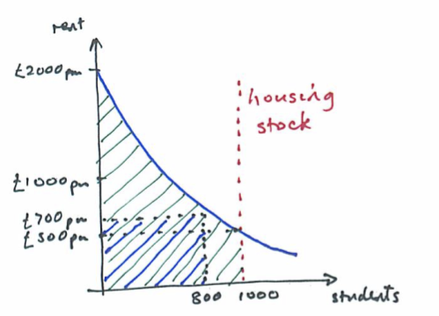
Discriminating monopolist
If you know what everyone can pay, charge them just that!
This arrangement is Pareto efficient!
The monopolist captures all the consumer surplus …

Slide 6
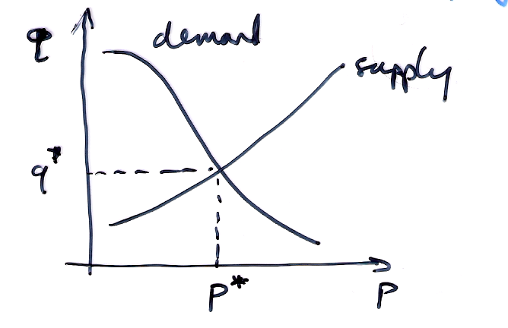
Putting it all together
In the classical synthesis, prices are set where supply and demand curves intersect in competitive markets
p* will be the marginal cost of the marginal supplier
Similar models apply in markets for labour etc
Intrinsic advantages of non-marginal suppliers (e.g. easily mined coal, good farmland) get built into rental values
By 100 years ago, people thought they understood the ‘invisible hand’ and just had to guard against monopoly

Slide 7
Lock-in
Often, buying a product commits you to buying more of it, or spending money on one or more of:
  durable complementary assets, such as software for a computer or PBX, or CDs for a sound system
  skills, e.g. fluency with Win/Mac/Linux of Office
  services, e.g. network service for a PC or mobile phone, directory service for a PVR
Same applies to services – facilities management firms make it hard to switch to their competitors
Not entirely new (fewer people change their bankers than their spouses) but has some pronounced effects in information goods markets

Slide 8
Lock-in (2)
‘Fundamental theorem’ (Shapiro, Varian); the net present value of your customer base is the total cost of switching
  Suppose you’re an ISP and it costs £25 to set up a new customer
  Suppose it costs a customer £50 of hassle to switch
  If you can find a business model that makes the customer worth £100, offer them £60 cashback to switch
  They’re £10 ahead, £15 ahead
So the value of Microsoft is what it would cost people to switch to OpenOffice and Linux …

Slide 9
Network externalities
Many networks become more valuable to each user the more people use them
Metcalfe’s law: the value of a network is proportional to the square of the number of users
It’s actually more complex than this – local effects are stronger
Overall effect: past some threshold, network use takes off rapidly
  Telephone – late 19th century
  Fax – 1985–88
  Email – 1995–99

Slide 10
Strategic issues
Each of these factors – high fixed costs plus low marginal costs, significant switching costs due to technical lock-in, and network externalities – tends to lead to a dominant-firm market model
With all three together, monopoly is even more likely
Hence the race for market share whenever a new information market opens up
Hence the 1990s Microsoft philosophy ‘ship it Tuesday and get it right by version 3’
Competition in the market versus competition for the market
Policy: do you hope that tech change will make incumbents obsolete, or do you regulate?

Slide 11
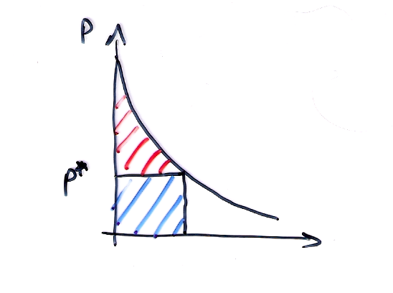
Price discrimination
Recall: an efficient monopolist sells to each customer at her reservation price - ‘selling to value’
Pigou’s three degrees of price discrimination:
  Personalised pricing (e.g. haggling, loyalty cards …)
  Versioning (e.g. first / business / economy class)
  Group pricing (e.g. student and OAP discounts)
Around for generations – but getting more powerful, more pervasive
Tech simultaneously increases the motive and the means

Slide 12
Asymmetric information
Recall Akerlof’s ‘market for lemons’
  100 cars for sale – 50 good cars worth $2000, 50 lemons worth $1000
  Buyers can’t tell difference so price $1000
One fix is for sellers to offer a warranty – this is cheaper for owners of good cars, so can act as a ‘signal’ for the hidden information
Labour markets too – it’s hard for employers to tell smart diligent employees from interview, so use education as a signal
Signalling theory is also important for recommender systems – Google, eBay, Grameen

Slide 13
Types of auction
English, or ascending-bid: start at reserve price and raise till a winner is left (art, antiques)
Dutch, or descending-bid: start high and cut till somebody bids (flowers)
First-price sealed-bid auction: one bid per bidder (government contracts)
Second-price sealed-bid auction, or Vickrey auction: highest bidder wins and pays second-highest bid (postage stamps)
All-pay auction: everyone pays at every round until one remaining bidder gets the goods (war)

Slide 14
Strategic equivalence
A Dutch auction and a first-price sealed-bid auction give the same result: highest bidder gets goods at his reservation price
They are ‘strategically equivalent’
Ditto the English auction and the second-price sealed-bid auction (modulo the bid increment)
But the two pairs are not strategically equivalent!
  in a second-price auction it’s best to bid truthfully
  in a Dutch / first-price auction, you should bid low if you think your valuation is much higher than everybody else’s

Slide 15
Revenue equivalence
This is weaker – not ‘who will win’ but ‘how much money on average’
According to the revenue equivalence theorem, you get the same revenue from any well-behaved auction under ideal conditions
These include risk-neutral bidders, no collusion, Pareto efficiency (highest value bidder gets goods), suitable reserve price, valuations independent, …
Then the English, Dutch and all-pay auction yield the same – because bidders adjust their strategies
So auction design must focus on departures from the ideal conditions

Slide 16
What goes wrong (2)
Bidding rings – bidders collude to buy low, have a private auction later, split the proceeds
First-price auctions are harder to rig; with second-price, New Zealand bids of $7m and $5000
Entry detection / deterrence: in 1991, ITV franchise auction required bidders to draw up a detailed programming plan. In Midlands & Central Scotland, no competition; bids under 1p per head (vs £9–16 elsewhere)
Predation: ‘we’ll top any other bid’ in takeovers
Sniping and other boundary effects

Slide 17
IPR
Intellectual Property Rights
  Patent
  Copyright
  Trademark
    Does not imply URL or Company name,
    “Passing off”
  Design Right
  Registered Design
  Database Right
  Plant breeders rights
  Trade secret

Slide 18
Undesirablity of Patents
Expense
  3K first application
  10K grant
  100K international
  1M+ to defend
    Thermo nuclear stand-off
Network effect
  Bio vs tech
  Utility increases with square of users
  Standards
Timescale
  Moore’s Law
Untimely Publication
Hard to administer
  No large IPR collection has ever worked
    E.g NRDC, IBM, Gemstar, University
Typically
  Tech has many weak patents
  Ways arounf
  Bio-tech has strong patents
Conclusions
  Defensive rather than offensive for tech
  Be very selective
  Handy for bean counters, but suppress innovation

Slide 19

CUE Business plan competition

Slide 20
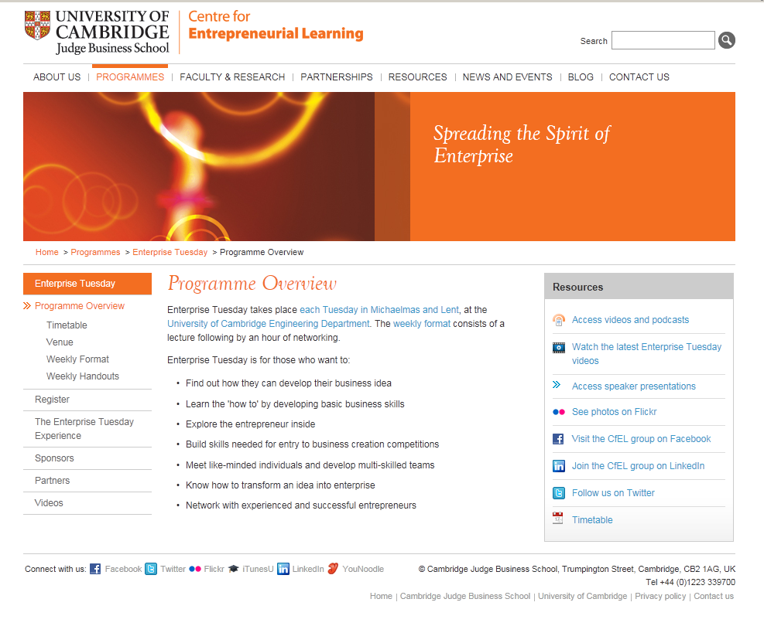
Enterprise Tuesday

