Slide 1
Building secure systems on & for Social Networks
Lecture 2
Or, Securing the ties that bind us
Nishanth Sastry

Slide 2
Objectives
In this hour, you will learn how to:
Preserve your privacy in social network systems
Prevent Sybil attacks in social networks
Build a secure DHT overlay on the social graph
Engineer security using offline methods
You should be able to describe/define:
Privacy breach & de-anonymization in social nets
Attribute-based encryption
Fast mixing in social networks, and its uses

Slide 3
Preserving your privacy
Part 1: Keeping you anonymous from Facebook, its advertisers, and Big Brother

Slide 4
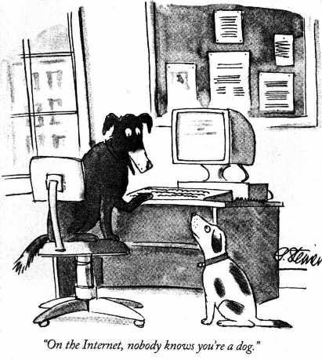
In the good old days, you could be anonymous…

Slide 5
Now: Attribute data leaks identity!
AOL releases “anonymized” user search histories
  ID 4417749 traced to a 62 year old woman in Georgia
87% of Americans uniquely identified using just 3 attributes: zip, sex, date of birth (1990 census)
“8 friends are enough” [BASA09]: searchable public listings of facebook users can be attacked to obtain aggregate statistics about graph
Notes:
http://arstechnica.com/tech-policy/news/2009/03/pulling-back-the-curtain-on-anonymous-twitterers.ars

Slide 6


What is a privacy breach? [NS09]
Sanitized = Twitter
Sanitized
Graph
Auxiliary
Graph
Probabilistic mapping
Aux=Flickr
Privacy breach: Prior belief in value of some (node/edge) attribute X in Auxiliary Graph is improved using topological information from the Sanitized Graph

Slide 7
Social network de-anonymization
Identify seed nodes
  k-cliques whose degree distributions correspond in the two graphs
Propagation (Add heuristics to taste):
  If threshold no. of neighbours of unmapped node u are mapped to neighbours of node v, then map u to v
  Reverse AUX←→SANITIZED. Is mapping is stable?
  Lather, rinse, repeat…
Truth testing: common strings map each other?
  Mapping Tamedfalcon213 in two networks is valuable, but joe19, not so much…

Slide 8
Securing online social networks (OSN)
Problem: Users trust OSN providers, developers of 3rd party apps, advertisers etc. to not misuse their attribute data
Solution: Hide 1. topology or 2. attributes:
Dispense with the OSN. Keep the social apps. Use crypto for distributed access control.
  Persona [BBS+09] (our focus), Lockr [TSGW09]
Hide attributes in plain sight. NOYB [GTF08]
  Use a cipher to pick another user’s attribute, preserving the overall distribution of attribute values.
    Alice, F, 25 takes her age from Bob, M, 28.
    OSN providers and advertisers see Alice, F, 28
    Only auth users can do the reverse mapping to Alice, F, 25.
Notes:
Note that just because you’re not explicitly listing all your friends does not mean that the social app cannot learn all your friends. If they all access your wall, they can see and list the IDs that manage to get access! But adversary cannot access attributes without access

Slide 9
OSN Access Control Challenges
“Called in sick to work. Let’s go skiing”
  Status intended for friends only, not co-workers
  Need fine-grained access control
Alice wants to send “Surprise party for Bob” to all friends of Bob, who are also local to Cam
  Bob has pre-defined groups “Friends” & “in-Cam”
  Need friend-of-friend interactions & flexible groups
Social Apps involve multi-party read-write with writers not always knowing reader set
Many groups can be defined:
  friend, foe, friend AND in-cam, foe OR customer

Slide 10
Simple solutions have drawbacks
Individual keying for intended readership
  Won’t work without writers knowing audience
Traditional group keying (symmetric keys) requires writer to be member of group
Too many groups (friend, foe, friend AND in-cam, foe OR customer) → Group keying is not scalable
Possible solution: Composable groups
  Alice needs to send to friend AND in-cam: Double encrypt, first for friend and then for in-cam
  Susceptible to collusion! Foe in-cam AND friend in London can collude to decrypt.

Slide 11
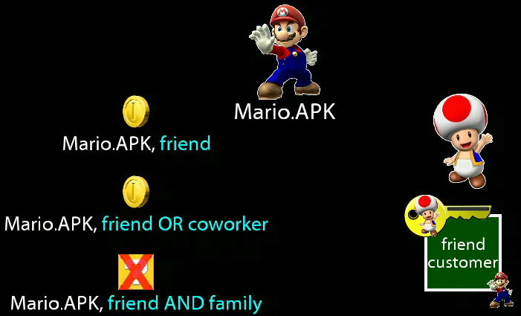
Cryptonite: Attribute-based Encryption
Notes:
Imagine these keys are like the common keys to an apartment building/floor. You can open your building key

Slide 12
OSN in Persona Architecture
Persona separates storage from social apps
Storage has encrypted data. Apps have refs to data
Attribute-based secret keys distributed out-of-band
  User has a master key to generate new keys for friends
Writer
  stores encrypted data on their storage server
  Posts reference to data on social app
Reader get reference to data from social app
Anyone can fetch encrypted data
… But can decrypt only if access structure allows

Slide 13
preventing sybil attacks
Part 2: Making users on social network accountable

Slide 14
Sybils: “schizophrenic” identities
If # of sybil nodes accepted | Then applications can do
< n | majority voting
< n/2 | byzantine consensus
< n/c for some constant c | secure DHT [Awerbuch’06, Castro’02, Fiat’05]
Assuming social graph with n nodes and m edges
Notes:
Next few slides adapted from Haifeng Yu’s talk

Slide 15
Sybil threat and solution
Sybils can create any number of false nodes
Any number of false relations between nodes
  Sybil net can look identical to real social sub-graph
Solution: It is more difficult to create link between an honest node and a sybil node
Exploit scarcity of such attack edges

Slide 16
SybilLimit: Strawman Design – Goal 1
K: registered keys of
sybil nodes
Ensure that sybil nodes (collectively) register only on limited number of honest nodes
  Still provide enough “registration opportunities” for honest nodes
K: registered keys of
honest nodes
K
K
K
K
K
K
K
K
K
K
K
K
K
K
K
K
honest region
sybil region

Slide 17
SybilLimit: Strawman Design – Goal 2
K: registered keys of
sybil nodes
Accept S iff K_{S} is registered on sufficiently many honest nodes
  Without knowing where the honest region is !
  Circular design? We can break this circle…
K: registered keys of
honest nodes
K
K
K
K
K
K
K
K
K
K
K
K
K
K
K
K
honest region
sybil region

Slide 18
Random Route: Convergence
a
f
b
d
e
a → d
d → e
c
randomized
routing table
b → a
e → d
c → b
f → f
d → c
Random 1 to 1 mapping between
incoming edge and outgoing edge
Using routing table gives Convergence Property:
Routes merge if crossing the same edge

Slide 19
Tails of Sybil Suspects
Every sybil suspect initiates a random route from itself and registers its key at the tail
tainted tail
honest
nodes
sybil
nodes

Slide 20
The number of tainted tails is small
attack edge
honest
nodes
sybil
nodes
Suppose we do w step random routes from each node
Claim: There are at most w tainted tails per attack edge
  Proof: By the Convergence property
  Regardless of whether sybil nodes follow the protocol
  Will show w can be chosen to be O(log(n)) in social networks
Attack edges are few → #tainted edges (=gw) is small!
Probability of honest tails “escaping” to sybil region=gw/n
  If g = #attack edges is < o(log(n)/n), escape probability = o(1)

Slide 21
Verification Procedure
1. request S’s set of tails
A→B
2. I have three tails
A→B; C→D; E→F
S
V
3.common tail: E→F
4. Is K_{S} registered?
E→F
C→D
5. Yes.
F

Slide 22
Leveraging fast mixing in social nets
If w = mixing time, tails (of S & V) are uniformly random
Assuming V has tails in the honest region
Intersection prob p
Help to bound # of sybil nodes accepted
1.0
Social nets are fast mixing → w is small (O(log(n))
Birthday paradox
0
# of S’s tails in honest region

Slide 23
SybilLimit Summary
Goal 1: Ensure that sybils (collectively) register only on limited number of honest nodes
Tainted tails < gw
w small due to fast mixing of social nets
Goal 2: Accept S iff K_{S} is registered on sufficiently many honest nodes
“Sufficiently many” =
Intersection occurs iff S has tails in the honest region

Slide 24
a sybil-proof DHT
Part 3. Application of fast-mixing in social networks

Slide 25
Sybil attack in the DHT context
DHT primer: nodes arranged in a virtual ring. “Finger tables” route look ups close to target id.
  e.g. Sergei looks up Tanya’s IP from finger Umberto
  Goal: sub-linear (typ. logarithmic or faster) look ups.
If Umberto is evil, he could tell Sergei to ask his (sybil) finger Uma, who sends Sergei to Upton, who sends Sergei to Ursula…

Slide 26
A Sub-linear Sybil-proof DHT [L08]
(Precursor to Whanau [LK10])
Assumes fewer than g=o(log(n)/n) attack edges
Routing table setup: Do r independent w-step random walks and record final node as finger
  o(1) escape probability → Ω(r) fingers are honest
  mixing time = w → fingers are ends of random edges
    target node is a finger with at least Ω(r)/m probability

Slide 27
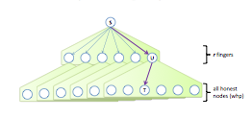
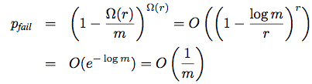
Key lookups succeed w.h.p.
Ask each finger whether they know target
If honest finger has target in its table, the IP is returned
Choose

Slide 28
Is social engineering really hard?
Security relies on hardness of social engineering: Both SybilLimit and Whanau assume inducing edge from honest node to Sybil node is hard
  At least, much harder than creating new sybils
BUT…
Many well-networked users have guessable passwords
People “friend” out of politeness: Brazilians on Orkut
A Facebook friend is worth about 37 cents: Burger King offered free burger if you removed 10 friends
  Nearly 200,000 friend links were removed

Slide 29
Social engineering for anonymity and accountability
Part 4. Offline foundations for online security

Slide 30
Confounding Charlie
Boston metro introduced the Charlie card (like Oyster), which makes user journeys traceable
Richard Stallman hated this
Introduced Charlie card parties: Attendees exchange zero valued Charlie cards to confound Big Brother

Slide 31
Pseudonym parties [FS08]
Step 2: confound Big Brother & prevent Sybils
One day designated for “Pseudonym party”
Users obtain/exchange IDs
  protected by masks to preserve privacy
Parties are geographically separated, but synchronously scheduled to prevent user from attending two parties → prevent sybils

Slide 32
Summary
Social graph = who’s connected to whom + what are their features/attributes
This information is
  Sensitive and private
  Available in unprecedented detail via OSNs
  Incredibly useful: to both good and bad guys
Research Questions
  How do we keep this data from unsafe disclosure?
  Depends on what data & how apps need to use it
  2. How do we exploit this data (in good ways)?
    hinges on properties of social graph (fast mixing, homophily)
    Answers will always be proviso a threat model

