Slide 1
Information-centric Internetworking
A Few Insights
Computer Laboratory

Slide 2
Overview
Background and motivation
Architectural foundations
Example: intra-domain forwarding

Slide 3
!!!WARNING!!!
If you understand IP and a socket-based RPC model
…
FORGOT IT FOR THE NEXT HOUR!

Slide 4
Observation
Fundamentals of the Internet
Collaboration
Reflected in forwarding and routing
Cooperation
Reflected in trust among participants
Endpoint-centric services (mail, FTP, even web)
Reflected in E2E principle
⇒ IP with full end-to-end reachability
Reality in the Internet Today:
Trust erosion through phishing, spam, viruses
Current technology economically favors senders
Receivers are forced to carry the cost of unwanted traffic
Do endpoints really matter?
Information more important
Endpoint-centric services move towards information retrieval through, e.g., CDNs
⇒ Ossification of IP-based architecture
vs.

Slide 5
Hypothesis: Increased Importance of Information Requires Information-centric Network Approaches
Application developers care about information concepts
Creation of information topologies of various kinds
-> Endpoint-centric networking structures are inadequate
Topological network changes too slow in timescale
Topological network boundaries often not aligned with information topologies (in particular in cross-organisation scenarios)
Overlaying possible but restricted in (developer) scalability
-> If it is all about information, why not route on information?

Slide 6
Vision
Envision a system that dynamically adapts to evolving concerns and needs of their participating users
Provides an improved impedance match between net & svc/apps
Better aligned with today’s application concepts
Provides tussle delineation of crucial functions
Better suited for future (unknown) business models
Enables optimized sub-architectures
Better suited for variety of access technologies
Provides high performance
Scales to the needs of the Future Internet
Routing
Security
network economics
Unification of
wireline and wireless

Slide 7
Main Design Principles…
Everything is Information
Higher-level information semantics are constructed as graphs of information
Information is scoped
Provide a simple mechanism for structuring data and limiting the reachability of information to the parties having access to the particular mechanism that implements the scoping
Functionality is scoped
Functions to disseminate information implement a scoped strategy!
Scoped information neutrality
Within each scope of information, data is only forwarded based on the given (scoped) identifier
Ensure balance of power
No entity is provided with data unless it has agreed to receive those beforehand

Slide 8
…Translating into Architecture Invariants
Flat-label referencing: identify anything as information
Scoping: group information and functions (including scopes themselves)
Pub/sub service model: anything is delivered by pub/sub
Separation of functions: each scope provides functions for finding (rendezvous), constructing (topology) and delivering (forwarding)
Can be implemented jointly for optimization reasons
Dissemination strategy per scope: the implementation of the functions is described by a dissemination per scope
Inherited by each sub-scope

Slide 9
Information-Centrism is Key
Data: Mail
Data: Picture
Information is everything and everything is information
Scopes build information networks
Notion of metadata by linking to other identifiers
Policy is metadata
Producers and consumers need no internetwork-level addressing!
Governance
policy
Governance
policy
Scope Company A
Scope Family
Scope Friends
Governance
policy
Spouse
Father
Friend
Colleague

Slide 10
Our Current IDs
Might include some form
of application ID
Information is labelled with (statistically) unique RId
Information defined by semantics of the problem at hand!
RId is assigned to one or more SId
Information can reside in several information networks
Can build powerful application concepts from this
Identity, channels, documents, sensor swarms
Resolution from application ID to RId is not within scope!
Used within implementation of network functions, too!
Application
(Data)
resolve
(RId, SId, Data)
(RId, SId, Data)
Rendezvous
(RId, SId, Data)
Notes:
This is taken right from D2.2. There is little on grouping on information rather than the ‘levels’ of information that exist. What this picture does not show is the SId subclass character with respect to RIds, as discussed on the mailing list.

Slide 11
A Functional Model
Pub/Sub
Each scope implements the solution to a problem
The architecture is concerned with facilitating the exchange of information for the problem solution!
Think object-oriented!
Functional and information scoping is achieved here!
Strategies are represented through standards, running code etc!
Strategies can be represented as explicit representations
Semantic Web technologies help here
Functions need not to be strongly separated
Example: link-local dissemination!
Dissemination
Strategy
Rendezvous
Topology
Forwarding
Functional scoping
RId
Information scoping
RId
RId

Slide 12
An E2E Principle…
The problem in question can be implemented through an assembly of sub-problem solutions, whose individual dissemination strategies are not in conflict with the ones set out by the problem in question.
Hence, problems are assembled to larger solutions by recursively applying the scoping invariant of the functional model!
Conflicts are avoided through design and re-design, e.g., via standards procedures!
Can extend this to runtime reconciliation!

Slide 13
… Leading to A High-Level Architecture
RP : Rendezvous point
ITF : Inter-domain topology formation
TM : Topology management
FN : Forwarding node
Apps
pub
sub
Node Architecture
pub
Fragmentation
pub
Service Model
Caching
Topology
Rendezvous
Helper
ITF
ITF
RP
…
RP
Rendezvous
Network
Error Ctrl
Network Architecture
Forwarding
TM
TM
TM
TM
FN
Forwarding
Network
Forwarding
Network
Forwarding
Network
Forwarding
Network

Slide 14
An Example: Intra-Domain Forwarding

Slide 15
Motivation
Information is sent along a route of (intra-domain) hops in the Internet
-> Requires some form of minimal state in each hop
Question: What if we could include the state in the packet?
A: {HOP1; HOP2;
HOP3; HOP4;
HOP5; ... HOP 40}
A: {Bloom Filter}

Slide 16
What are Bloom Filters?
Inserting items
Hash the data n times, get index values, and set the bits
10-bit Bloom Filter
0
0
1
0
0
0
0
0
1
0
Hash 1(Data1) = 9
Hash 2(Data1) = 3
Data 1
Hash 1(Data2) = 7
Hash 2(Data2) = 9
Hash 1
Hash 2
Data 2
Notes:
Insert first item, set the corresponding hashed bits to one

Slide 17
What are Bloom Filters?
Test if “Data 1” has been inserted in the BF
All corresponding bits are set => positive response!
10-bit Bloom Filter
0
0
1
0
0
0
1
0
1
0
Verifying
Hash and check if set
Hash 1(Data1) = 9
Hash 2(Data1) = 3
Data 1
Hash 1
Hash 2

Slide 18
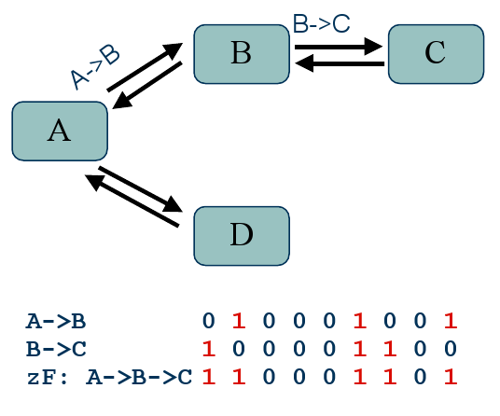
Idea: Line Speed Publish/Subscribe Inter-Network (LIPSIN)
Line speed forwarding with simplified logic
Links are (domain-locally) named instead of nodes (LId), therefore there is no equivalent to IP addresses
Link identifiers are combined in a bloom filter (called zFilter) that defines the transit path
Advantages
Very fast forwarding
No need for routing tables
Native multicast support

Slide 19
Forwarding Decision
Forwarding decision based on binary AND and CMP
zFilter in the packet matched with all outgoing Link IDs
Multicasting: zFilter contains more than one outgoing links
Interfaces
Link ID
&
=
Yes/No
zFilter
zFilter

Slide 20
Problem: False Positives in Forwarding
False positives occur when test is positive in a given node despite non-hashed LId (probability for consecutive false positives is multiplicative!)
Increase with number of links in a domain (since more data is hashed into constant length Bloom filter)
Two solutions:
Use Link Identity Tags: tag a single link with N names instead of one, then pick resulting Bloom filter with lowest false positive probability
Virtual trees: fold “popular” sub-trees into single virtual link, i.e., decrease number of LIds to be used

Slide 21
Virtual trees
Popular paths can be merged into virtual trees
A single Link ID for the tree
PRO: Increase scalability due to decreased false positives, which could be combined with lower-layer optical techniques
CON: Additional state in the forwarding nodes
A virtual tree is not bound to a certain publication
E.g. a single tree for all AS transit traffic
C
D
A
B
E
F

Slide 22
Avoiding Loops
…by lowering the amount of loops
Instead of fixed d determining the used LIT, change the d e.g. with d=(d+1) MOD e
In case of a loop, the packet will have the same d only if the loop is e hops long
Simple, stateless solution
Host 1
Host 2
Host 3
Link ID
Link ID
Link ID
LIT 1
LIT 1
LIT 1
LIT 2
LIT 2
LIT 2
LIT 3
LIT 3
LIT 3
zFilter

Slide 23
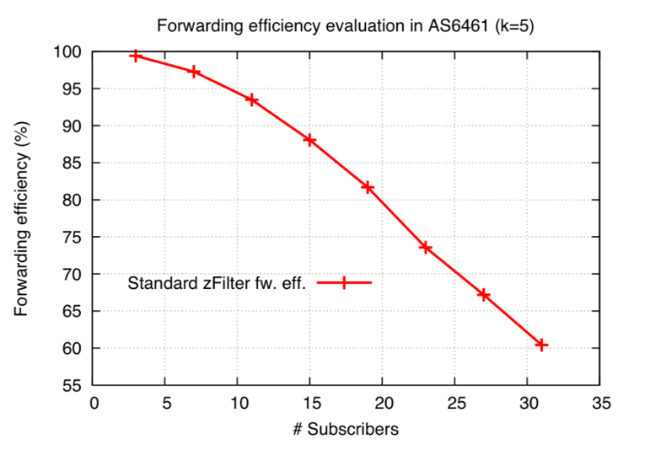
Forwarding Efficiency
Simulations with
Rocketfuel
SNDlib
Forwarding efficiency with 20 subscribers
~80%
-> suited for MAN-size multicast groups

Slide 24
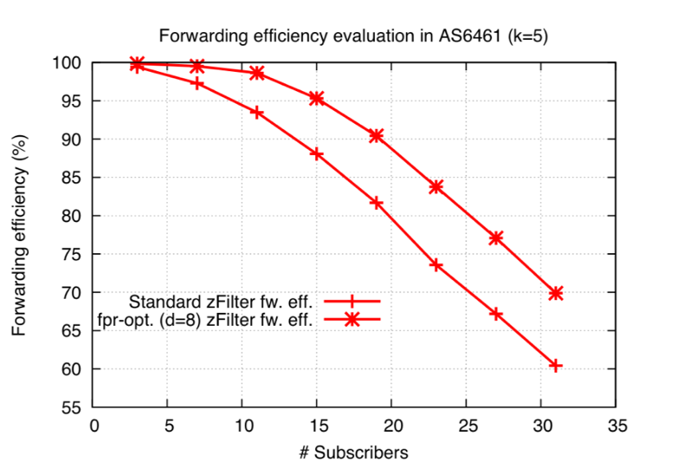
Forwarding Efficiency
Simulations with
Rocketfuel
SNDlib
Forwarding efficiency with 20 subscribers
~80%
Can be optimized to 88% using extended mechanisms
n

Slide 25
Conclusions
Changing the internetworking architecture surely is ambitious!
But there’s a growing case being made in the community!
CCN, PSIRP, PURSUIT, recent pubs (e.g., ACM CCR 04/2010)
A sound architectural model is crucial
Principles, invariants, functional models, E2E assembly
There is lots of technology providing already solutions
LIPSIN, DHT, caching based on locality/social relation, swarming, …
Some of it seems to fit better in an information-centric model
Pieces are being put together as we speak
Work on deployment strategies and socio-economic evaluation
PISPR/PURSUIT test bed between 6 major sites with working prototype

Slide 26
More Information
Websites
http://www.psirp.org (the start of this work)
http://www.fp7-pursuit.org (the continuation of this work)
http://www.named-data.net/ (successor of CCN)
Papers
ACM CCR 04/2010, SIGCOMM 2009 (LIPSIN), CONEXT 2009 (CCN), and many more on http://www.psirp.org
Contact: dirk.trossen@cl.cam.ac.uk (for questions or student projects)

