Slide 1
Data centre networking
Malcolm Scott
Malcolm.Scott@cl.cam.ac.uk

Slide 2
Who am I?
Malcolm Scott
1st year PhD student supervised by Jon Crowcroft
Researching:
Large-scale layer-2 networking
Intelligent energy-aware networks
Started this work as a Research Assistant
Also working for Jon Crowcroft
Working with Internet Engineering Task Force (IETF) to produce industry standard protocol specifications for large data centre networks

Slide 3
What I’ll talk about
Overview / revision of Ethernet
The data centre scenario: why Ethernet?
Why Ethernet scales poorly
What we can do to fix it
Current research

Slide 4
Overview of Ethernet

Slide 5
Ethernet: 1970s version
Shared medium (coaxial cable)
Every host receives every frame
How does a host tell which frames to process?

Slide 6
Ethernet: 1970s: addressing
Each interface has a unique MAC address
00:1f:d0:ad:cb:2a
Frame header contains source and destination addresses
NIC filters incoming packets by destination
Group addresses for broadcast/multicast
Assigned by the manufacturer
Identifies the manufacturer

Slide 7
Ethernet: modern day version
Shared medium = poor performance
Instead, use point-to-point links and switches

Slide 8
Ethernet: switching
Switch learns the location of a MAC address when it first sees a frame from that address
Forwarding database (FDB) stores mapping from MAC address to physical port
Since control messages (ARP, DHCP, ...) are broadcast, this will be refreshed often
Switch forwards frames using FDB
Floods frames where destination is not known

Slide 9
Ethernet in the OSI model
OSI layer | Functions | Standard
... | ...
3 – Network | IP; routing
2¼? | Ethernet switching (“MAC bridges”) | IEEE 802.1D
2 – Data link | Ethernet MAC (addressing, etc.) | IEEE 802.3
1 – Physical | Ethernet PHY (“Gigabit Ethernet”: 1000BASE-T, etc.)
“Ethernet” means three different things
Switch behaviour is specified separately from the rest of Ethernet
(Originally bridging: join together shared-medium Ethernets)

Slide 10
Ethernet and IP
Applications communicate using IP addresses (or hostnames), not MAC addresses
Therefore, hosts need to convert IP addresses into MAC addresses
ARP (Address Resolution Protocol):
Broadcast request (to ff:ff:ff:ff:ff:ff): “who has IP address 78.129.234.130?”
Unicast reply (to sender of request): “78.129.234.130 is 00:1f:d0:ad:cb:2a”

Slide 11
Ethernet: assorted extra features
Virtual LANs (VLANs, 802.1q):
Multiple isolated networks (IP subnets) using a single Ethernet infrastructure
Tag frames with VLAN ID
Very widely used in data centres
Spanning tree protocol, (R)STP:
Switches cannot cope with loops
Broadcast frames would go around forever: no TTL
RSTP disables redundant links to remove loops

Slide 12
Spanning tree switching illustrated
Notes:
Densely-connected mesh, but spanning tree protocol disables links

Slide 13
Spanning tree switching illustrated
destination
Notes:
ANIM: data from [here] to [here]
Direct link, but can’t use [CLICK]
Packet takes long way round

Slide 14
The data centre scenario

Slide 15
Virtualisation is key
Make efficient use of hardware
Scale apps up/down as needed
Migrate off failing hardware
Migrate onto new hardware
All without interrupting the VM (much)

Slide 16
Virtual machine migration
VM memory image transferred between physical servers
Apps keep running; connections stay open
Must not change IP address
Therefore, can only migrate within subnet
Ideally, allow any VM to run on any server
So entire data centre (or multiple data centres!) must be one Ethernet

Slide 17
The scale of the problem
Microsoft: 100,000 physical servers
...And then virtualisation: tens of virtual machines per server
...All on one Ethernet
Servers contain virtual switches to link VMs together and to the data centre LAN
Segregate traffic using VLANs
But every VLAN must reach every physical server

Slide 18
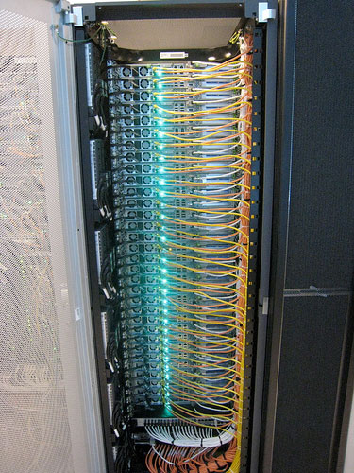
Data centre topology: rack
Servers
“Top” of rack (ToR) switch

Slide 19
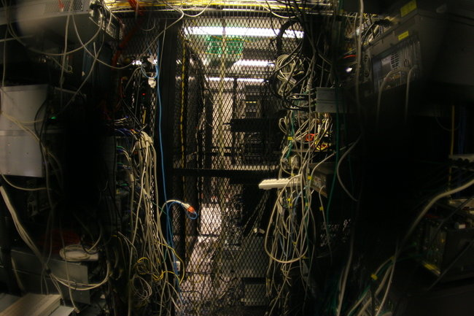
Data centre entropy

Slide 20
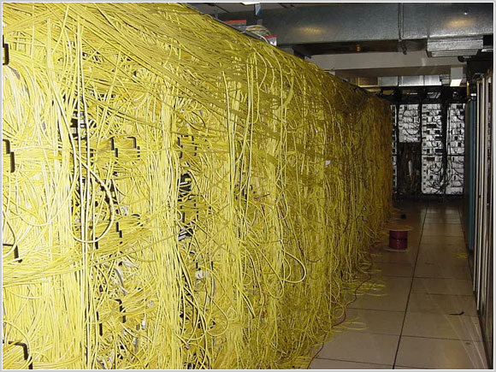
Data centre entropy

Slide 21
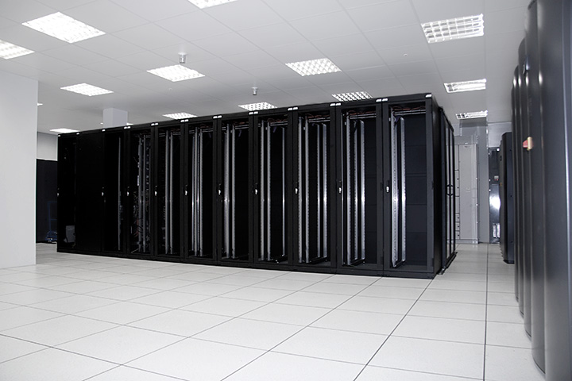
Data centre topology: row
ToR switches
End-of-Row (EoR) switch

Slide 22
Data centre topology: core
EoR
EoR
EoR
Core switch
EoR
EoR
EoR
Rows of server racks
Basically a tree topology (but with redundant EoRs, becomes a “fat tree”)

Slide 23
Data centre topology: multi-centre
Data centre 2
Data centre 1
No longer a tree!
Data centre 3

Slide 24
Ethernet Scalability

Slide 25
So what goes wrong?
Volume of broadcast traffic
Can extrapolate from measurements
Carnegie Mellon CS LAN, one day in 2004: 2456 hosts, peak 1150 ARPs per second [Myers et al]
For 1 million hosts, expect peak of 468000 ARPs per second
Or 239 Mbps!
Conclusion: ARP scales terribly
(However, IPv6 ND may manage better)

Slide 26
So what goes wrong?
Forwarding database size:
Typical ToR FDB capacity: 16K-64K addresses
Must be very fast: address lookup for every frame
Can be enlarged using TCAM, but expensive and power-hungry
Since hosts frequently broadcast, every switch FDB will try to store every MAC address in use
Full FDB means flooding a large proportion of traffic, if you’re lucky...

Slide 27
So what goes wrong?
Spanning tree:
Inefficient use of link capacity
Causes congestion, especially around root of tree
Causes additional latency
Shortest-path routing would be nice

Slide 28
Data centre operators’ perspective
Industry is moving to ever larger data centres
Starting to rewrite apps to fit the data centre (EC2)
Data centre as a single computer (Google)
Google: “network is the key to reducing cost”
Currently the network hinders rather than helps

Slide 29
How to fix Ethernet
Current research

Slide 30
Ethernet’s underlying problem
MAC addresses provide no location information
(NB: This is my take on the problem; others have tackled the problem differently)

Slide 31
Flat vs. Hierarchical address spaces
Flat-addressed Ethernet: manufacturer-assigned MAC address valid anywhere on any network
But every switch must discover and store the location of every host
Hierarchical addresses: address depends on location
Route frames according to successive stages of hierarchy
No large forwarding databases needed

Slide 32
Hierarchical addresses: how?
Ethernet provides facility for Locally-Administered Addresses (LAAs)
Perhaps these could be configured in each host based on its current location
By virtual machine management layer?
Better (more generic): do this automatically – but Ethernet is not geared up for this
No “Layer 2 DHCP”

Slide 33

MOOSE Multi-level Origin-Organised Scalable Ethernet
A new way to switch Ethernet
Perform MAC address rewriting on ingress
Enforce dynamic hierarchical addressing
No host configuration required
Transparent: appears to connected equipment as standard Ethernet
Also, a stepping-stone to shortest-path routing
(My research)

Slide 34
MOOSE
Switches assign each host a MOOSE address switch ID : host ID
Placed in Ethernet source address in each frame
No encapsulation: no rewriting of destination address
(would require another large table, equivalent to FDB)
Notes:
Flat, manufacturer-allocated namespace → hierarchy
Split MAC address
Reiterate: switches rewrite addresses so hosts don’t have to

Slide 35
The journey of a frame
Host: “00:16:17:6D:B7:CF”
From: 00:16:17:6D:B7:CF
To: broadcast
New frame,
so rewrite
02:11:11
From: 02:11:11:00:00:01
To: broadcast
02:22:22
02:33:33
Host: “00:0C:F1:DF:6A:84”
Notes:
ANIM: Host transmits broadcast frame (simplicity) [CLICK]
Switch one sees non-MOOSE source address → [CLICK] new frame on net → rewrite
[CLICK] Packet makes its way to all destinations

Slide 36
The return journey of a frame
Host: “00:16:17:6D:B7:CF”
Destination is local
02:11:11
From: 02:33:33:00:00:01
To: 00:16:17:6D:B7:CF
Destination is on 02:11:11
02:22:22
Destination is on 02:11:11
New frame,
so rewrite
From: 02:33:33:00:00:01
To: 02:11:11:00:00:01
02:33:33
From: 02:33:33:00:00:01
To: 02:11:11:00:00:01
Host: “00:0C:F1:DF:6A:84”
From: 00:0C:F1:DF:6A:84
To: 02:11:11:00:00:01
Notes:
ANIM: now transmit reply. Note dest addr MOOSE. [CLICK]
As before, [CLICK] rewrite source
Now route frame using switch ID ONLY: [CLICK] each sw on path knows where sw one is
Last switch [CLICK] rewrites dest to avoid confusion
[CLICK] Deterministic address tables

Slide 37
Shortest path routing
MOOSE switch ≈ layer 3 router
One “subnet” per switch
E.g. “02:11:11:00:00:00/24”
Run a routing protocol between switches
Multipath-capable, ideally: OSPF-ECMP?

Slide 38
What about ARP?
One solution: cache and proxy
Switches intercept ARP requests, and reply immediately if they can; otherwise, cache the answer when it appears for future use
ARP Reduction (Shah et al): switches maintain separate, independent caches
ELK (me): switches participate in a distributed directory service (convert broadcast ARP request into unicast)
SEATTLE (Kim et al): switches run a distributed hash table

Slide 39
Open questions
How much does MOOSE help?
Simulate it and see (Richard Whitehouse)
How much do ARP reduction techniques help?
Implement it and see (Ishaan Aggarwal)
How much better is IPv6 Neighbour Discovery?
In theory, fixes the ARP problem entirely
But only if switches understand IPv6 multicast
And only if NICs can track numerous multicast groups
No data, just speculation...
Internet Engineering Task Force want someone to get data!
How much can VM management layer help?

Slide 40
Conclusions
Data centre operators want large Ethernet-based subnets
But Ethernet as it stands can’t cope
(Currently hack around this: MPLS, MAC-in-MAC...)
Need to fix:
FDB use
ARP volume
Spanning tree
Active efforts (in academia and IETF) to come up with new standards to solve these problems

Slide 41
Thank you!
Malcolm Scott
Malcolm.Scott@cl.cam.ac.uk
http://www.cl.cam.ac.uk/~mas90/

