Slide 1
A reflection on types
Simon Peyton Jones, Stephanie Weirich,
Richard Eisenberg, Dimitrios Vytiniotis
Microsoft Research
University of Pennsylvania
August 2016

Slide 2
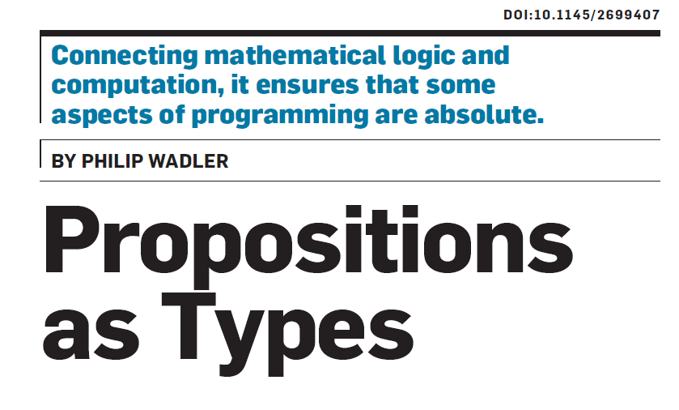
CACM Dec 2015

Slide 3
Bad type systems
Programs that are well typed
All programs
Programs that work
Zone of Abysmal Pain

Slide 4
Sexy type systems
Programs that are well typed
All programs
Programs that work
Smaller Zone of Abysmal Pain

Slide 5
Implementing a store
newSTRef :: a -> ST (STRef a)
readSTRef :: STRef a -> ST a
writeSTRef :: STRef a -> a -> ST ()
Let’s implement this in Haskell, as a state transformer
newtype ST a = MkST (Store -> (a,Store))
But what is a “Store”??

Slide 6
Promising failures

Slide 7
Implementing a store
But what is a “Store”?
It maps keys (STRefs) to values of many different types.
Attempt 1: use Data.Map
newtype STRef a = MkSTRef Int
type Store = Map Int ????
lookupStore :: STRef s a -> Store -> Maybe a

Slide 8
Implementing a store
Attempt 2: we need dynamic types, even in a statically typed language
newtype STRef a = MkSTRef Int
type Store = Map Int Dynamic
fromDynamic :: Dynamic -> Maybe a
lookupStore :: STRef a -> Store -> Maybe a
lookupStore (MkSTRef key) store
= case Data.Map.lookup key store of
Nothing -> Nothing
Just d -> fromDynamic d

Slide 9
Implementing a store
Attempt 2: we need dynamic types, even in a statically typed language
Too polymorphic!
See “Theorems for Free”
newtype STRef a = MkSTRef Int
type Store = Map Int Dynamic
fromDynamic :: Dynamic -> Maybe a
lookupStore :: STRef s a -> Store -> Maybe a
lookupStore (MkSTRef key) store
= case Data.Map.lookup store key of
Nothing -> Nothing
Just d -> fromDynamic d

Slide 10
Implementing a store
Attempt 3: enumerate the types we need
data Dynamic = DInt Int | DBool Bool
| DPair Dynamic Dynamic | …etc…
class Dyn a where
fromDynamic :: Dynamic -> Maybe a
toDynamic :: a -> Dynamic
lookupStore :: Dyn a => STRef a -> Store -> Maybe a
lookupStore (MkSTRef key) store
= case Data.Map.lookup store key of
Nothing -> Nothing
Just d -> fromDynamic d

Slide 11
Implementing a store
data Dynamic = DInt Int | DBool Bool
| DPair Dynamic Dynamic | …etc…
class Dyn a where
fromDynamic :: Dynamic -> Maybe a
toDynamic :: a -> Dynamic
instance Dyn Int where
fromDynamic (DInt i) = Just i
fromDynamic _ = Nothing
toDynamic i = DInt i
instance Dyn Bool where
fromDynamic (DBool b) = Just b
fromDynamic _ = Nothing
toDynamic b = DBool b

Slide 12
Implementing a store
Attempt 3: enumerate the types we need
data Dynamic = DInt Int | DBool Bool
| DPair Dynamic Dynamic | …etc…
Non-starter because it requires a closed world
We want
readSTRef :: STRef a -> ST a
to work for any type ‘a’, including new ones
Also: converting to and fro takes a deep traversal
instance (Dyn a, Dyn b) => Dyn (a,b) where
toDynamic (a,b) = DPair (toDynamic a) (toDynamic b)

Slide 13
Getting closer
(GHC )

Slide 14
What’s in a Dynamic?
A Dynamic should consist of
The value itself
A runtime representation of its type
data Dynamic where
Dyn :: TypeRep -> a -> Dynamic
Runtime representation of the type of the value
The value itself

Slide 15
Q1: where do TypeReps come from?
class Typeable a where
typeRep :: a -> TypeRep
toDynamic :: Typeable a => a -> Dynamic
toDynamic x = Dyn (typeRep x) x
data Dynamic where
Dyn :: TypeRep -> a -> Dynamic
NB proxy argument

Slide 16
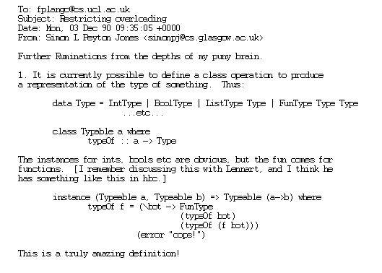
The birth of TypeRep

Slide 17
Q2: what can you do with a TypeRep?
class Typeable a where
typeRep :: a -> TypeRep
data Dynamic where
Dyn :: TypeRep -> a -> Dynamic
fromDynamic :: forall a. Typeable a
=> Dynamic -> Maybe a
fromDynamic (Dyn trx x)
| trx == trr = Just x
| otherwise = Nothing
where
trr = typeRep (undefined :: a)
Eek!

Slide 18
Q2: what can you do with a TypeRep?
class Typeable a where
typeRep :: a -> TypeRep
data Dynamic where
Dyn :: TypeRep -> a -> Dynamic
fromDynamic :: ∀a. Typeable a
=> Dynamic -> Maybe a
fromDynamic (Dyn trx x)
| trx == trr = Just (unsafeCoerce x)
| otherwise = Nothing
where
trr = typeRep (undefined :: a)

Slide 19
The right way

Slide 20
Type-indexed type reps
A Dynamic should consist of
The value itself
A runtime representation of its type
data Dynamic where
Dyn :: TypeRep a -> a -> Dynamic
Runtime representation of the type of the value
The value itself
A type-indexed data structure

Slide 21
Q1: where do TypeReps come from?
class Typeable a where
typeRep :: TypeRep a
toDynamic :: Typeable a => a -> Dynamic
toDynamic x = Dyn typeRep x
data Dynamic where
Dyn :: TypeRep a -> a -> Dynamic
No proxy argument
No deep traversal
Instances of Typeable are built in
data Wurble a = MkWurble a | …
-- Implicitly you get
-- instance Typeable a => Typeable (Wurble a)

Slide 22
Q1: where do TypeReps come from?
class Typeable a where
typeRep :: TypeRep a
toDynamic :: Typeable a => a -> Dynamic
toDynamic x = Dyn typeRep x
newtype Typeable a = MkT (TypeRep a)
toDynamic :: Typeable a -> a -> Dynamic
toDynamic (MkT tr) x = Dyn tr x
data Wurble a = MkWurble a | …
-- Implicitly you get
-- instance Typeable a => Typeable (Wurble a)
$tWurble :: Typeable a -> Typeable (Wurble a)
$tWurble (MkT tra) = MkT (mkTrApp “Wurble” [tra])

Slide 23
Q2: what can you do with TypeRep?
data Dynamic where
Dyn :: TypeRep a -> a -> Dynamic
fromDynamic :: ∀b. Typeable b
=> Dynamic -> Maybe b
fromDynamic (Dyn (ra :: TypeRep a) (x::a))
= let rb = typeRep :: TypeRep b
in case ra == rb of
True -> Just x
False -> Nothing

Slide 24
Q2: what can you do with TypeRep?
data Dynamic where
Dyn :: TypeRep a -> a -> Dynamic
fromDynamic :: ∀b. Typeable b
=> Dynamic -> Maybe b
fromDynamic (Dyn (ra :: TypeRep a)) (x::a)
= let rb = typeRep :: TypeRep b
in case ra == rb of
True -> Just x
False -> Nothing
Type error 2
Just x :: Maybe a,
but we need Maybe b
Type error 1
ra :: TypeRep a
but rb :: TypeRep b

Slide 25
We need type-aware equality!
Fix error 1
compares TypeReps with different indices
eqT :: TypeRep a -> TypeRep b -> Maybe (a :=: b)
data a :=: b where
Refl :: a :=: a
fromDynamic :: ∀b. Typeable b => Dynamic -> Maybe b
fromDynamic (Dyn (ra :: TypeRep a)) (x::a)
= let rb = typeRep :: TypeRep b
in case ra `eqT` rb of
Just Refl -> Just x
Nothing -> Nothing
Fix error 2
In here we know that a ~ b
Refl :: ∀ab. (a~b) => a :=: b

Slide 26
Do notation for the Maybe monad
eqT :: TypeRep a -> TypeRep b -> Maybe (a :=: b)
data a :=: b where
Refl :: a :=: a
fromDynamic :: ∀b. Typeable b => Dynamic -> Maybe b
fromDynamic (Dyn (ra :: TypeRep a)) (x::a)
= do { Refl <- ra `eqT` (typeRep :: TypeRep b)
; return x }
Use do-notation
(convenience only)

Slide 27
Soundness
eqT :: TypeRep a -> TypeRep b -> Maybe (a :=: b)
Soundness: must not be able to forge TypeReps
A (TypeRep a) is a singleton type
That is why the Typeable instances are built-in

Slide 28
Where have we got to?
ST library
Type-safe reflection
Small trusted code base
Smaller, more re-usable primitive than Dynamic
Store
Type-safe
Data.Map
Dynamic, fromDynamic, toDynamic
Trusted code base
TypeRep a, Typeable a
eqT :: TypeRep a -> TypeRep b -> Maybe (a :=: b)

Slide 29
Typeable and TypeRep

Slide 30
Typeable and TypeRep
castR :: TypeRep a -> TypeRep b -> a -> Maybe b
cast :: (Typeable a, Typeable b) => a -> Maybe b
cast takes two dictionary arguments

Slide 31
Typeable and TypeRep
castR :: TypeRep a -> TypeRep b -> a -> Maybe b
cast :: (Typeable a, Typeable b) => a -> Maybe b
castR r1 r2 x
= do { Refl <- r1 `eqT` r2
; return x }

Slide 32
Typeable and TypeRep
castR :: TypeRep a -> TypeRep b -> a -> Maybe b
cast :: (Typeable a, Typeable b) => a -> Maybe b
castR r1 r2 x
= do { Refl <- r1 `eqT` r2
; return x }
cast x = castR typeRep typeRep x
Do we need both?
Yes: sometimes cast is useful,
sometimes castR.

Slide 33
Typeable and TypeRep
Have a Typeable dictionary, need a TypeRep: easy, just use typeRep!
Have a TypeRep, need a Typeable dictionary: not so easy. Need a new primitive function withTypeable:
withTypeable :: TypeRep a -> (Typeable a => r) -> r

Slide 34
Decomposing TypeRep

Slide 35
What next?
dynHead :: Dynamic -> Maybe Dynamic
Return Nothing if the argument Dynamic turns out not to be a list

Slide 36
Decomposing TypeRep
dynHead :: Dynamic -> Maybe Dynamic
dynHead (Dyn (rxs :: TypeRep txs) (xs :: txs))
| …txs looks like [tx]…
…rxs looks like [rx]…
= Just (Dyn rx (head xs))
| otherwise
= Nothing
This should be [tx] but it’s actually txs

Slide 37
Decomposing TypeRep
dynHead :: Dynamic -> Maybe Dynamic
dynHead (Dyn (rxs :: TypeRep txs) (xs :: txs))
= do { App rl rx <- splitApp rxs
; Refl <- rl `eqT` (typeRep :: TypeRep [])
; return (Dyn rx (head xs)) }
Decompose rxs into (rl rx)
Check that rl = []

Slide 38
Decomposing TypeRep
dynHead :: Dynamic -> Maybe Dynamic
dynHead (Dyn (rxs :: TypeRep txs) (xs :: txs))
= do { App rl rx <- splitApp rxs
; Refl <- rl `eqT` (typeRep :: TypeRep [])
; return (Dyn rx (head xs)) }
data AppResult t where
App :: TypeRep a -> TypeRep b -> AppResult (a b)
splitApp :: TypeRep t -> Maybe (AppResult t)

Slide 39
Kind polymorphism
dynHead :: Dynamic -> Maybe Dynamic
dynHead (Dyn (rxs :: TypeRep txs) (xs :: txs))
= do { App rl rx <- splitApp rxs
; Refl <- rl `eqT` (typeRep :: TypeRep [])
; return (Dyn rx (head xs)) }
Representation of the list type constructor
TypeRep :: ∀k. k -> *
Argument can be of any kind

Slide 40
Kind polymorphism
data AppResult t where
App :: TypeRep a -> TypeRep b -> AppResult (a b)
App :: ∀ kr kb (r::kr) (a::kb->kr) (b::kb).
(r ~ a b)
=> TypeRep a -> TypeRep b -> AppResult r
dynHead :: Dynamic -> Maybe Dynamic
dynHead (Dyn (rxs :: TypeRep txs) (xs :: txs))
= do { App rl rx <- splitApp rxs
; Refl <- rl `eqT` (typeRep :: TypeRep [])
; return (Dyn rx (head xs)) }

Slide 41
New problem!
App :: ∀ kr kb (r::kr) (a::kb->kr) (b::kb).
(r ~ a b)
=> TypeRep a -> TypeRep b -> TypeRep r
dynHead :: Dynamic -> Maybe Dynamic
dynHead (Dyn (rxs :: TypeRep txs) (xs :: txs))
= do { App rl rx <- splitApp rxs
; Refl <- rl `eqT` (typeRep :: TypeRep [])
; return (Dyn rx (head xs)) }
rl :: TypeRep (a :: kb->*)
TypeRep ([] :: *->*)

Slide 42
New problem!
App :: ∀ kr kb (r::kr) (a::kb->kr) (b::kb).
(r ~ a b)
=> TypeRep a -> TypeRep b -> TypeRep r
dynHead :: Dynamic -> Maybe Dynamic
dynHead (Dyn (rxs :: TypeRep txs) (xs :: txs))
= do { App rl rx <- splitApp rxs
; Refl <- rl `eqT` (typeRep :: TypeRep [])
; return (Dyn rx (head xs)) }
rl :: TypeRep (a :: kb->*)
TypeRep ([] :: *->*)
Conclusion: eqT must be herero-kinded

Slide 43
Kind equalities
a and b can have different kinds
eqT :: ∀ k1 k1 (a::k1) (b::k2).
TypeRep a -> TypeRep b -> Maybe (a :=: b)
data a :=: b where
Refl :: a :=: a
Refl :: ∀ k1 k2 (a::k1) (b::k2).
(k1 ~ k2, a ~ b) => a :=: b
Matching against Refl gives us a kind equality as well as a type equality

Slide 44
Implementing TypeRep

Slide 45
Building TypeReps
-- TypeRep :: ∀k. k -> *
data TypeRep a where
TrApp :: TypeRep a -> TypeRep b -> TypeRep (a b)
TrTyCon :: TyCon -> TypeRep a
instance (Typeable a, Typeable b) => Typeable (a b) where
typeRep = TrApp typeRep typeRep
data Wurble a = MkWurble a | …
-- Implicitly you get
-- instance Typeable Wurble where
-- typeRep = TrTyCon (TyCon “mypackage” “M” “Wurble”)

Slide 46
Another new problem!
-- Typeable :: ∀ k. k -> Constraint
data T f a = MkT (f a)
-- T :: ∀ k. (k -> *) -> k -> *
What does (TypeRep (T IO Int)) look like?
TrApp (TrApp trT trIO) trInt
trIo = TyCon “base” “GHC.IO” “IO”
trInt = TyCon “base” “GHC.Num” “Int”
trT = TyCon “mypkg” “M” “T” -- ???
But is (TypeRep (T :: (*->*) -> * -> *)) equal to
(TypeRep (T :: (Bool -> *) -> Bool -> *))?

Slide 47
Solution
-- TypeRep :: ∀k. k -> *
data TypeRep a where
TrApp :: TypeRep a -> TypeRep b -> TypeRep (a b)
TrTyCon :: TyCon -> TypeRep k -> TypeRep (a::k)
instance (Typeable a, Typeable b) => Typeable (a b) where
typeRep = TrApp typeRep typeRep
instance Typeable k => Typeable (T :: k) where
typeRep = TrTyCon (TyCon “mypkg” “M” “T”)
(typeRep :: TypeRep k)
Now eqT on a TrTyCon can compare the kinds

Slide 48
Shortcomings

Slide 49
Polymorphic types
Can we have (TypeRep (∀a. [a] -> [a])) to use to make a Dynamic value for polymorphic ‘reverse’?
Alas no:
  that would require impredicative polymorphism
  and what would the TypeRep look like?
  and how could you decompose it?
I have no idea how to solve this

Slide 50
Where does that leave us?
Type-safe reflection, with
extensible dynamic types, and
a small trusted code base
Requires some Heavy Duty Type Artillery
  Type classes
  GADTs and local type equalities
  Kind polymorphism
  Kind-heterogeneous type equalities
  Local kind equalities
Type support implemented in GHC 8.0
TypeRep library changes in GHC 8.2

