Slide 1
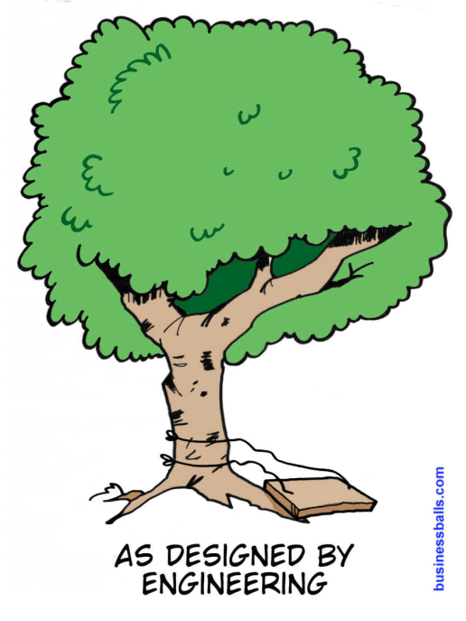
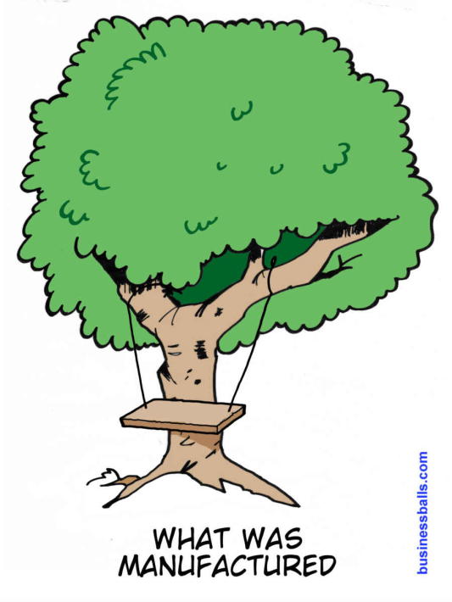
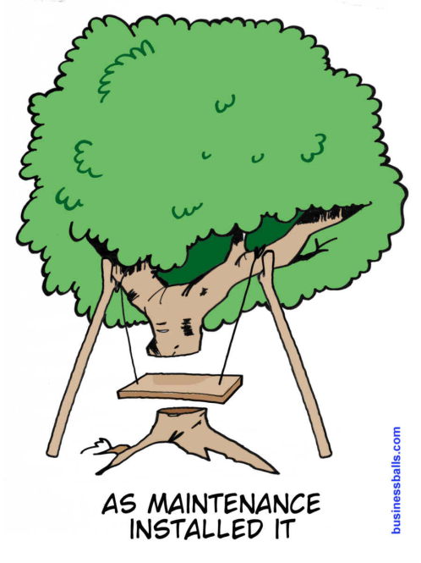
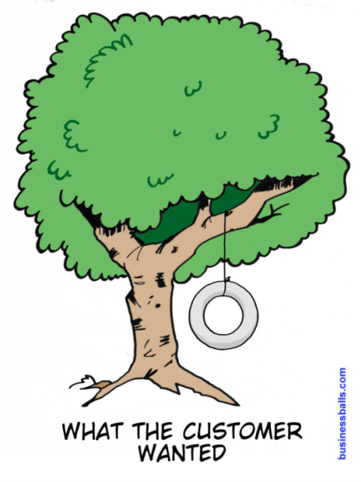
#

Slide 2
Programming Methods Dr Robert Harle
IA NST CS and CST
Lent 2008/09
Handout 4

Slide 3
Our Motivating Example
We’re going to make the world’s simplest web server
It’s not going to challenge apache etc
But it will give us something to think about...
I can’t assume you know how the internet works (pixie dust primarily)
So we’ll start with a really brief review
You can find out much more online

Slide 4
Client-Server
The key notion these days is that of client-server
A server is a machine that sits there waiting for connections from one or more clients
The web is packed with servers that deliver web pages and browsers that act as clients
But what if we have multiple types of server application (web, email, etc)?
How does the client know where to connect?
For this we use Berkeley sockets (“sockets”)

Slide 5
Sockets
Each machine has an address (c.f. Phone number)
Each machine has lots of ports to contact it on (c.f. Phone extensions)
In software we create sockets which are software objects that represent a connection between two systems
S
C
Server S is listening on port P (red)
Client C creates a socket and associates it with some port (green)
C attempts to connect to its socket to port P on server S (shorthand is S:P)
S responds and creates a socket at its end to represent the now open connection in software

Slide 6
Java Sockets
Java class library does the hard work for us
Class Socket
Represents a socket (there was a clue in the title...)
Class ServerSocket
Listens for connections of a specified port
Each time a connection comes in, it queues it up
Each time we call accept() on it, it gives us a Socket object that is attached to the connection at the top of the queue

Slide 7
Usage
Setup a listening socket on port 10000 (server):
Create a socket and connect to mymachine.com, port 10000 (client):
ServerSocket ss = null;
Socket result = null;
try {
ss = new ServerSocket(10000);
// The call below will wait until there is a connection
// from someone and then give us access to that
// connection via variable result
result = ss.accept();
} ...
Socket s = null;
try {
s = new Socket(“mymachine.com", 10000);
}
catch(IOException ioe) {
...
}

Slide 8
Usage
Once we have a connected Socket, it’s just a place to get or receive data
You can just apply the usual stream reading or writing tools that you have seen in the practicals
E.g
Socket s = new Socket(“somewhere.com”,4000);
Reader r = new InputStreamReader(s.getInputStream());
BufferedReader br = new BufferedReader(r);
String text = br.getLine();
Note that the docs for BufferedReader say: “In general, each read request made of a Reader causes a corresponding read request to be made of the underlying character or byte stream. It is therefore advisable to wrap a BufferedReader around any Reader whose read() operations may be costly, such as FileReaders and InputStreamReaders.“ Which design pattern is in use here?

Slide 9
Common Ports You Might Know (?)
21 – FTP
22 – SSH
23 – Telnet
53 – DNS
80 – Internet (web traffic)
When you go to www.howtogetafirst.com this is just client-server in action
Your machine connects to a preconfigured DNS machine that tells it a numerical address for the machine associated with www.howtogetafirst.com
Your machine then connects to that address on port 80
If there is a web server there, it gets the web page

Slide 10
Web Server Design
WebServer
0...1
HTTPConnection
Really simplistic
WebServer encapsulates the server part (listening for connections)
HTTPConnection encapsulates a single, live HTTP connection and handles any requests

Slide 11
WebServer State
public class WebServer {
/**
* The connection to a client (if any)
*/
private HTTPConnection mConnection = null;
/**
* The server port
*/
private int mPort;
/**
* Constructor stores the web server's port
* @param port
*/
public WebServer(int port) {
mPort = port;
}
Initialise our HTTP connection to null to indicate there is no live connection
Private port number to listen on
Constructor requires that a port number be specified when creating the server

Slide 12
WebServer Process
public void runServer() {
while (true) {
// Wait until we are contacted
listenForNewConnection();
// mConnection now set up
mConnection.process();
}
}

Slide 13
WebServer: Listening
private void listenForNewConnection() {
ServerSocket serversocket = null;
while (true) {
try {
serversocket = new ServerSocket(mPort);
Socket connection = serversocket.accept();
mConnection = new HTTPConnection(connection);
}
catch(IOException ioe) {
// Something went wrong
}
}
}

Slide 14
The Connection Functionality
public void process() {
try {
// This just gets us something we can read from
BufferedReader input = new BufferedReader(new
InputStreamReader(mSocket.getInputStream()));
// Wait for a message to come in
String line = input.readLine();
// handle the request
handleRequest(line);
}
catch (IOException ioe) { }
finally {
try { mSocket.close(); }
catch(IOException ioe) {}
}
}

Slide 15
HTTP/1.0
We’ll be using the simplest communications protocol for web pages – HyperText Transfer Protocol (HTTP) v1.0
The browser connect to the web server and sends it some text
The server responds in some way (hopefully with a web page!)
The connection is terminated
The commands we need to respond to
“GET /path/to/file/index.html HTTP/1.0“ This is a request for a file /path/to/file/index.html on the server. It wants the whole file in reply
“HEAD /path/to/file/index.html HTTP/1.0” This is a request for information about the file /path/to/file/index.html. It does not expect to get the entire contents.

Slide 16
The HTTP Header
Everything we send must be prefixed with a nice ‘header’ that describes the actual data. This is just a string of text for HTTP:
This is done in the method sendHeader()
HTTP/1.0
200 OK
Connection: close
Server: SomeServerName
Content-Type: text/html
<data if any>
The protocol we’re using
The message type
We intend to close the connection
The name of the server
The data type (we only do HTML)
Usually the web page

Slide 17
Sending the File
Open the file for input
Get the socket’s output
Read each byte in from the file
Send each byte out to the socket
DataInputStream input=null;
try {
FileInputStream f = new FileInputStream(file);
input = new DataInputStream(f);
}
...
DataOutputStream output = new
DataOutputStream(mSocket.getOutputStream());
while (true) {
int b = input.read();
if (b == -1) {
break; //end of file
}
output.write(b);
}

Slide 18
Does it work?

Slide 19
But...
While we are dealing with a new connection
The SocketServer will queue up any other incoming connections (to a point)
But we process them one at a time
Two problems here
The SocketServer queue might get full and we might lose connections
If the current request takes a long time to process, the queued requests will be stuck waiting. Thus our web server will seem really sluggish
What we want to do is have the server process requests in parallel and not in serial...

Slide 20
Multiple Processes (for the NSTs)
A single processor can only do one thing at a time
So how does it manage to run multiple applications simultaneously (word, skype, eclipse, etc)?
Answer: it fakes it.
It rapidly shifts between programs, allowing them to run for very small amounts of time (milliseconds)
To us, everything seems to run simultaneously
Skype
Firefox
Eclipse
TIME

Slide 21
Threading (for the NSTs)
When a single application wants to run multiple things at the same time, it creates a new thread which is treated in exactly the same way as a new process
Why are threads useful?
Allow one web page to load while you scroll through another
Allow you to calculate results and still process input (for example, the cancel button!!)
Skype
Firefox
Eclipse (2 threads)
TIME

Slide 22
Threads in Java
Really easy to create
Extend from java.lang.Thread
Implement a method to run
Thread
run()
start()
public void run()
Override this abstract method. When started, the new thread treats this as the new main() method i.e. It’s the entry point for the thread
MyThreadedClass
run()
public void start()
This method does all the clever stuff for us. It starts the new thread and runs the run() method

Slide 23
Our webserver
We can make HTTPConnection extend from Thread
We don’t have to change any existing code, just add a run() method that calls that existing code!
public class ThreadedHTTPConnection extends Thread {
....
public void run() {
this.process();
}
....
}

Slide 24
Our webserver
The we just modify the server so that it starts a new thread to process anything incoming
private void listenForNewConnection() {
ServerSocket serversocket = null;
while (true) {
try {
if (serversocket==null) serversocket = new ServerSocket(mPort);
Socket s = serversocket.accept();
ThreadedHTTPConnection conn = new ThreadedHTTPConnection(s);
conn.start();
}
}
.... // etc
}

Slide 25
Does it work?
Yes!
And no...

Slide 26
Close...
When multiple clients requests come in simultaneously for different files, they are handled ‘simultaneously’
If we stress test it, there will come a point where it can’t handle the rate of requests, but...
The problem comes when two clients want the same file
The second request ends up waiting until the first one has finished with the file!
There are obviously ways around this, but that’s a whole lecture course in itself!

Slide 27
Why Threads Suck...
It is cool being able to run things concurrently
But it gets really complex when:
We need to share information between threads
We need to share resources (files etc) between threads
One thread depends on another in any way

Slide 28
Why Threads Suck...
This is an area known as concurrency control
Really quite interesting to study that just becomes even more relevant as we start getting multi-processor chips
Catches out a huge number of programmers and is the source of many bugs
The simplest solution is rarely the most efficient!
For those of you doing CST next year, you’ll get to study it in gory detail!

Slide 29
For This Course
You don’t need to know about concurrency programming in any detail
I expect you to:
Have a general idea of what a thread is
Know has to make your own class that can run in a thread

