Slide 1
Computing at School Putting the thrill back into computing at School
Jon Crowcroft, The Computer Lab, University of Cambridge
(standing in for Simon Peyton Jones
Microsoft Research)
and
The Computing at School Working Group

Slide 2
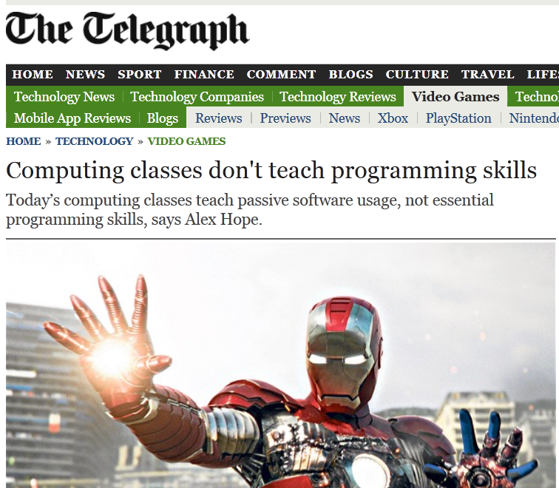
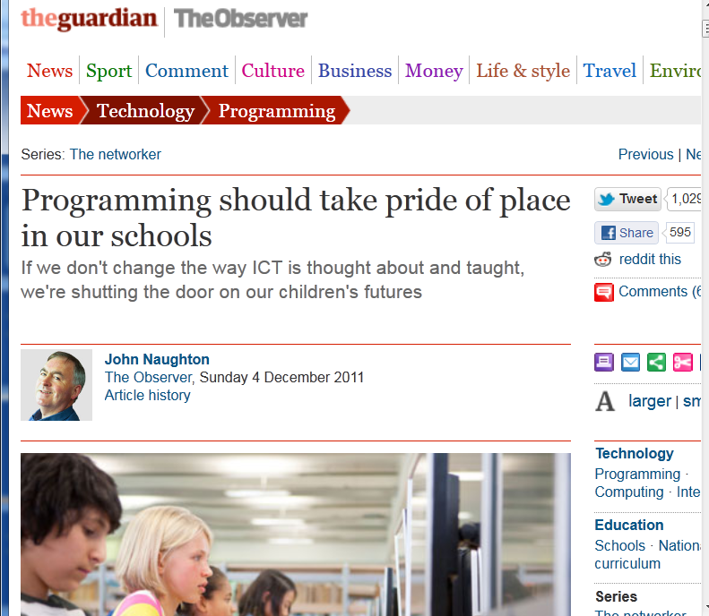
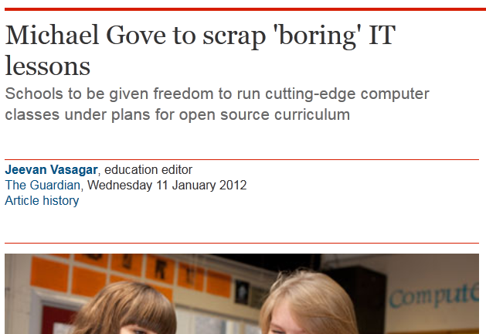
ICT in the spotlight

Slide 3
What is going on?
A real sense of dissatisfaction unease about the way we teach our kids about computing

Slide 4
What is education for
Education should prepare young people for a world that does not yet exist, requiring technologies that have not yet been invented, to solve problems of which we are not yet aware.

Slide 5
What’s wrong?
Teach them how to fish (don’t give them fishes)
Teach disciplines as well as skills
Disciplines
Principles, ideas
Knowledge, laws
Techniques, methods
Broadly applicable
Dates slowly
Skills
Technology, artefacts
Machines
Programs
Products
Organisations
Business processes
Dates quickly
Physics, chemistry, mathematics, English
Budgeting, presentation skills, metalwork, textiles

Slide 6
What’s wrong?
Computer Science
(discipline)
Barely taught
ICT
(technology focused)
Dominant
Spreadsheets
Databases
Powerpoint
Using the web
Safety on the internet
Plan communication projects
Analysing and automating processes
Principles
Ideas
Laws
Broadly applicable
But needs application
Dates slowly
No KS4 qualification at all [OCR piloting Computing GCSE in 2010/11]
Range of 14+ different KS4 qualifications

Slide 7
Net effect
The most exciting discipline on the planet comes over as dull and de-motivating
“The image of IT-related degrees and careers was that they would be repetitive, boring, and more-of-the-same; for example use of IT office applications such as word processing, spreadsheets, and databases”. The next bullet says “The ICT GCSE had a major part to play in creating their (negative) impressions”. [2008 “IT & Telecoms Insight Report” published by Eskills UK]
“The assessment requirements of some vocational qualifications may actually be limiting students’ achievement. In many of the schools visited, higher-attaining students were insufficiently challenged....much of the work in ICT at Key Stage 4, particularly for the higher attainers, often involved consolidating skills that students had already gained proficiency.” [2009 Ofsted report “The importance of ICT”]

Slide 8
Teachers agree
“It’s the biggest sales environment ever. Always going for figures, always going for 100%. ICT is purely there to boost the results in my school, that’s all it’s there for.”
“I’m afraid I’ve done enough dragging students through qualifications, it’s demoralising and it’s morally wrong, so I’m moving on”
“Half the year group choose ICT because they enjoyed it so much at KS3, but then KS4 just squeezes the creativity out, it sucks the life out of the subject and they hate it”
“The exam is just so easy compared to the silly amount of effort they have to put into doing the coursework in order to get basic grades… my kids do no work for the exams and do really well at them”

Slide 9
Voting with their feet
Students are voting with their feet. Numbers taking ICT GCSE declined 33% 2003-6. Similar falls in A level ICT, A level Computing. Rise in related (arguably easier!) ICT qualifications.
2009 Edge survey of 1000 GCSE students found 56% “unmotivated by three or more of their subjects”. Asked what they wanted to study instead the top pick was computer programming (22%).
University applications in computing has fallen by 50% in the last decade, despite strong employer demand for graduates

Slide 10
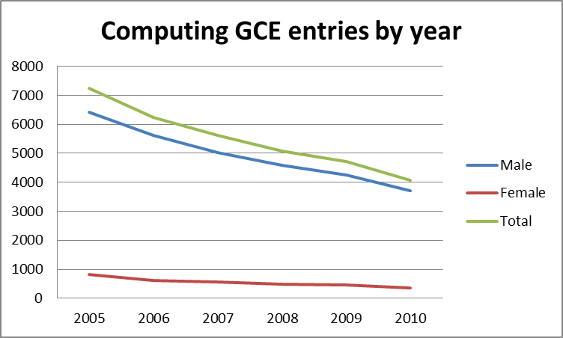
Students are voting with their feet

Slide 11
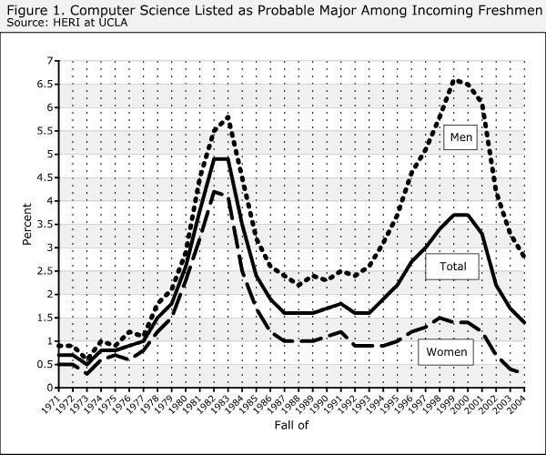
University trends 1970-2005
Source: CRA, May 2005

Slide 12
What is going on?
An increasing sense of unease about the way we teach our kids about computing
2008: let’s fix this. Birth of the Computing at School Working Group.

Slide 13
The Computing At School working group (CAS)
Simply a group of individuals, concerned about the state of computing education at school in the UK
Including
Teachers
Industry (eg Google, Microsoft)
University academics (incl CPHC, UKCRC)
Members of exam board (eg AQA)
Members of professional societies (eg BCS)
Parents
Local educational advisers
Teacher trainers
Varied backgrounds, common concerns
Now fully part of BCS, the Chartered Institute for IT
Regions: CAS Scotland, CAS Wales

Slide 14
Headline messages
Computer Science should be recognised in school as a rigorous subject discipline, like physics or history, quite distinct from the (useful) skills of digital literacy.
Just as every student needs to learn a bit of chemistry, even though few will become chemists, so every student should learn a bit of computer science (including some elementary programming) because they live in a digital world.
From primary school onwards (like science).
Re-introduce the thrill and excitement of computational thinking and creation.

Slide 15
What is going on?
An increasing sense of unease about the way we teach our kids about computing
2008: let’s fix this. Birth of the Computing at School Working Group.
2008-11: chug chug chug

Slide 16
Started 2008
Growing fast
Very fast
About 70% classroom teachers

Slide 17
What is going on?
An increasing sense of unease about the way we teach our kids about computing
2008: let’s fix this. Birth of the Computing at School Working Group.
2008-11: chug chug chug
2012:
BLAM!

Slide 18
January 2012: breakthrough
We’re encouraging rigorous Computer Science courses
The new Computer Science courses will reflect what you all know: that Computer Science is a rigorous, fascinating and intellectually challenging subject. Computer Science requires a thorough grounding in logic and set theory, and is merging with other scientific fields into new hybrid research subjects like computational biology.
So I am also announcing today that, if new Computer Science GCSEs are developed that meet high standards of intellectual depth and practical value, we will certainly consider including Computer Science as an option in the English Baccalaureate.
Although individual technologies change day by day, they are underpinned by foundational concepts and principles that have endured for decades. Long after today’s pupils leave school and enter the workplace – long after the technologies they used at school are obsolete – the principles learnt in Computer Science will still hold true.” Michael Gove, BETT speech January 2012

Slide 19
…and there is more
Feb 2011: The Livingstone/Hope report
Bring computer science into the National Curriculum as an essential discipline
Jan 2012: Royal Society Computing in Schools Report
The current delivery of Computing education in many UK schools is highly unsatisfactory
Computer Science is a rigorous academic discipline and needs to be recognised as such in schools
Every child should have the opportunity to learn Computing at school

Slide 20
..and more: qualifications
Sept 2009: No GCSE in Computer Science
May 2010: OCR launches the first GCSE in Computing
Jan 2012: Edexcel announces a GCSE in Computing Science
Feb 2012: AQA announces a GCSE in Computing
Feb 2012: WJEC announces a Computing GCSE, based on CAS curriculum
March 2012: CIE says they will launch a International GCSE in CS for UK schools

Slide 21
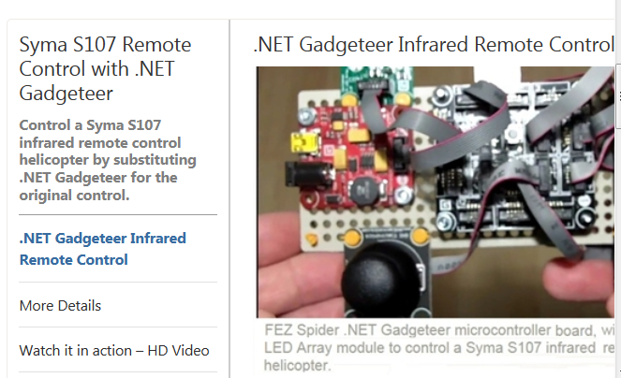
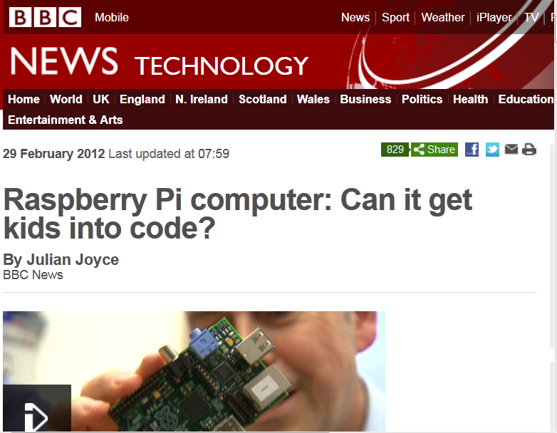
...and more: new dirt-cheap hardware platforms

Slide 22
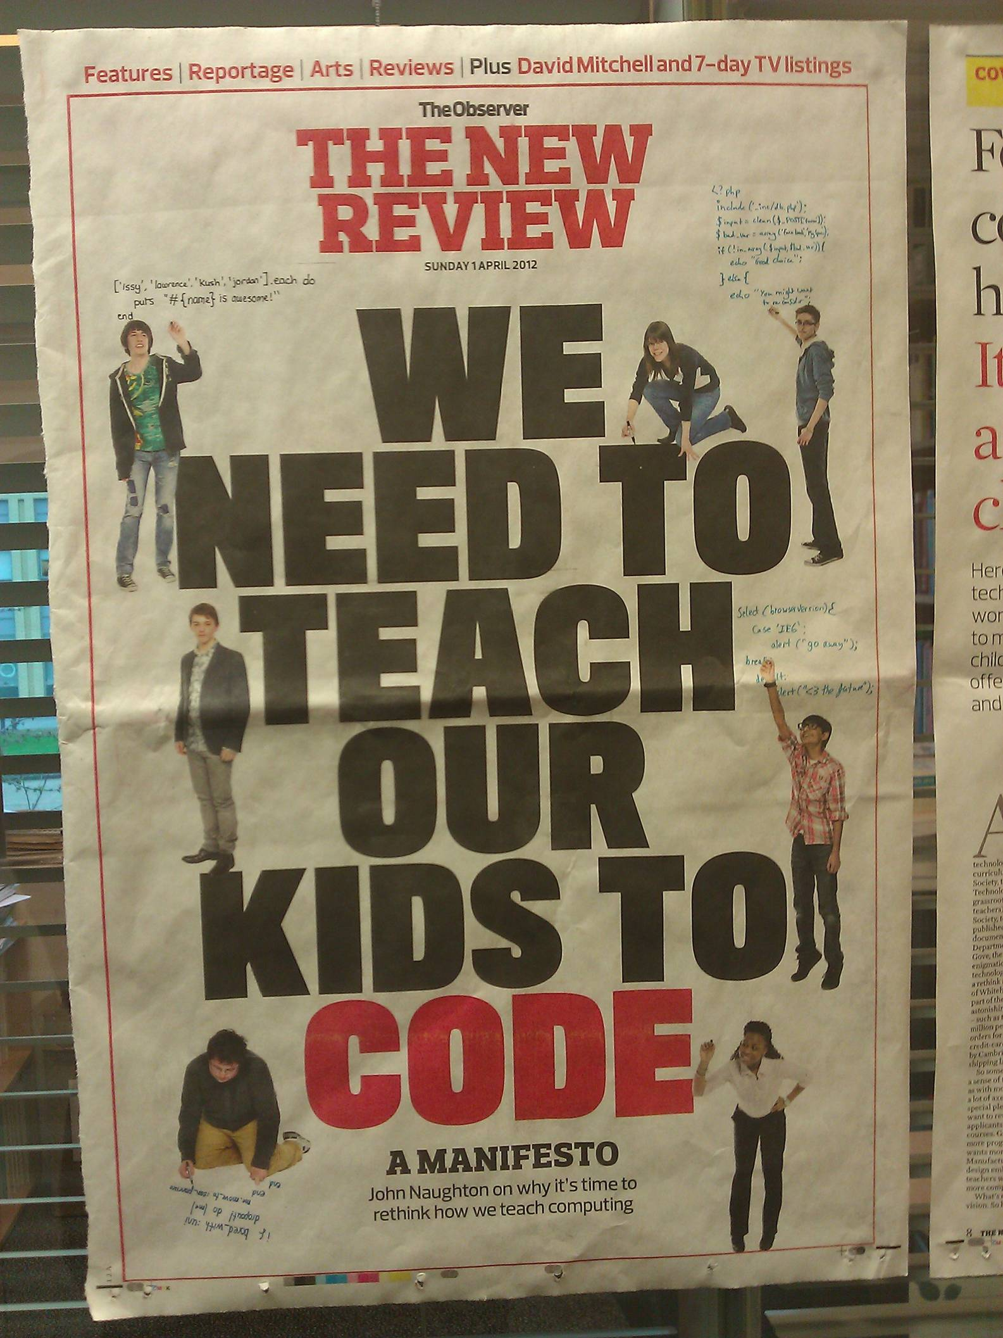
Amazing
media coverage
e.g Observer
1 April 2012

Slide 23
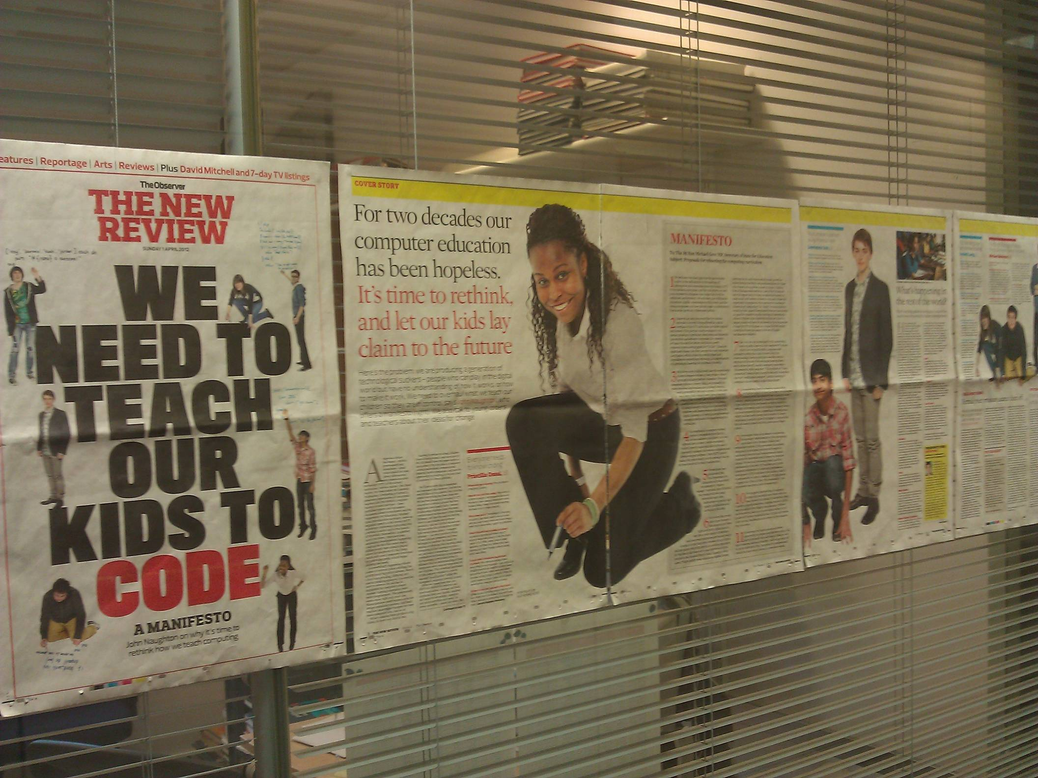

Slide 24
..and more : curriculum
Dec 2012: Interim Report of the Expert Panel of the National Curriculum Review:
Despite their importance in balanced educational provision, we are not entirely persuaded of claims that design and technology, information and communication technology and citizenship have sufficient disciplinary coherence to be stated as discrete and separate National Curriculum ‘subjects’.
We recommend that .... Information and communication technology is reclassified as part of the Basic Curriculum. We have also noted the arguments, made by some respondents to the Call for Evidence, that there should be more widespread teaching of computer science in secondary schools. We recommend that this proposition is properly considered.
Jan 2012: Gove withdraws the National Curriculum for ICT (although ICT will remain compulsory). Schools are now free to teach whatever they want under that title.

Slide 25
So what now?

Slide 26
Bottom line
Situation unrecognisable compared to 12 months ago. The ice has melted. Everything is in flux.
The DfE is treating ICT/CS as a guinea pig. They are consciously “standing back” to allow “the community” to sort it out.
Opportunity – and danger.

Slide 27
Opportunities
“What I'm finding striking as I put together bits for the Newsletter is just how much grassroots activity is being initiated by the CAS community. The number of hubs is exploding and the amount of self initiated CPD being organised is wonderful. This sets us apart from those who spend more time debating than doing. There hasn't been a teachers body like this before.”
Roger Davies, ICT teacher, Cumbria
Re-invigorating computer science as a school subject is so obviously the Right Thing to do!
It is educationally crucial
It is economically crucial
It is so motivating and exciting to teach
We have a fair wind: media coverage, DfE cautiously supportive
Tremendous energy and enthusiasm, within CAS and more broadly (eg Technocamps, Young Rewired State, Hack to the Future, Raspberry Pi, .NET Gadgeteer, etc)

Slide 28
Challenges
Much fear, uncertainty, and doubt.
Starting from zero: few schools, students, parents, governors, recognise Computer Science as a school subject at all
Confusion between (a) the curriculum questions of CS/ICT, and (b) the infrastructure and technology to enhance learning across the curriculum.
Teachers are under-qualified; though they are keen to learn. Major CPD programme is required
Danger: schools will withdraw from ICT altogether, just the opposite of what we all want.
Driver is the accountability system: league tables. How to argue for (hard) CS compared to (relatively easy) ICT.
Biggest danger
Everyone thinks someone else will do it
Raised expectations are dashed
We miss the boat

Slide 29
What universities can do
This is our discipline
If we don’t get stuck in, who will?
Many university CS depts have good outreach programmes
CPHC has been supportive of CAS
But universities have not (yet) been a driving force. Eg only a tiny number of academics are active members of CAS.

Slide 30
What universities can do
Admissions policy
Few students take A level Computing, so universities tend to discount or ignore it
Message to school teachers: don’t bother, we’ll handle it. Unintended, but real.
Case by case, plus Russell Group “Informed choices”
Dealing with a shifting intake
If we are successful, more and more kids will arrive at university with some significant CS under their belts
Good news: university CS can go further
Bad news: slow, and perhaps expensive, transition process

Slide 31
What universities can do
Help review syllabi for new GCSEs, and substantiate the case for adding CS to the Ebacc
DfE regards universities as custodians of the discipline; wants to increase their leadership role in school CS
Become the glue of the Network of Excellence for Teaching Computer Science
Being launched now
250 schools teaching CS Sept 2012
500 Sept 2013
Need encouragement, support, and above all access to CPD

Slide 32
To discuss
Could CPHC/UKCRC make a corporate commitment to engage actively in computing at school?
In concrete terms: fund a seconded academic (the right person!) to
Coordinate a national programme of CPD
...offered by university CS depts to their locality (quite a bit of this is happening already)
Talk to university admissions about shaping admissions messages to reflect the changing scene

Slide 33
OTHER SLIDES

Slide 34
CAS’s information pack
CAS is sending an information pack to all state secondary heads in England
To frame the strategic choices that each school must make, and provide background information
Do not leave your Head of ICT alone in this: SLTs and governors should be involved.

Slide 35
Contents
Covering letter
Royal Society Report summary
Computer Science as a school subject
What is computer science anyway?
Why should it be a school subject
How could we introduce it?
The CAS Computer Science Curriculum
A framework for Computer Science and Information Technology
An invitation to join a Network of Excellence

Slide 36
Who will do it?
CAS has bags of credibility, thought leadership, and heavyweight backing (BCS, Microsoft, Google, Intellect,...)
...plus
No office
No staff
Very little money
Just you
There is no “them”; there is only us

Slide 37
A framework for CS & ICT
CS A range of qualifications at KS4 ICT
KS4
Computer Science
Information & communication
technology
Technology Enhanced Learning
KS3
KS2
KS1
Digital literacy

Slide 38
A Network of Excellence
Start with schools that are keen
Access to CPD
Share best practice
Supported by BCS, Google, Microsoft, etc.
Help other schools to join in
Get Computer Science into the EBacc

Slide 39
What is CAS doing?
Influencing national policy
Computing: a curriculum for schools
Directly support teachers
“on the ground”

Slide 40
If we say Computing is a discipline,
we have to say what it is
Need to tell ourselves
Need to tell our head teachers
Need to tell DfE
Need to tell ministers
“Is there a core body of knowledge for Computing that doesn’t change from year to year?” DfE offical, June 2011

Slide 41
http://www.computingatschool.org.uk (follow the “Documents” link)
The same structure as NC Programmes of Study (but in more detail)
Importance of the subject
Key concepts
Key processes (what students should be able to do)
Range and content (what students should know)
Level descriptors
Total 22 pages.

Slide 42
General aims
Focus on fundamentals
Not much change year to year
Not much about Facebook, YouTube, mobile phones
Focus on what the subject is, not how it should be taught
You add the “how”
Initial focus on secondary (KS3, KS4). We are now adding primary (KS1, KS2) in the next few months.
Ambitious but do-able

Slide 43
What is CAS doing?
Influencing national policy
Computing: a curriculum for schools
Directly support teachers
“on the ground”

Slide 44
Teachers: the myth
ICT teachers are not very good
They are happy with the status quo
They couldn’t teach computer science even if we wanted them to
So: we are stuck at Square 1

Slide 45
Teachers: the reality
Most teachers live and die for their students: they work nights
Few are happy with the status quo
It’s the biggest sales environment ever. Always going for figures, always going for gold, always going for 100%. ICT is purely there to boost the results in my school, that’s all it’s there for.
I’m afraid I’ve done enough dragging students through qualifications, it’s demoralising and it’s morally wrong, so I’m moving on
Half the year group choose ICT because they enjoyed it so much at KS3, but then KS4 just squeezes the creativity out, it sucks the life out of the subject and they hate it
The exam is just so easy compared to the silly amount of effort they have to put into doing the coursework in order to get basic grades… my kids do no work for the exams and do really well at them

Slide 46
Teachers: the reality
Many teachers are longing to introduce computing, but they feel
isolated (seldom more than one ICT specialist in a school)
under-qualified (even specialist ICT teachers seldom have a computer science degree)
under the gun for results (a Computing GCSE will be demanding)
But they are keen. Very keen. Very very keen.

Slide 47
There is a lot we can do to help
Annual CAS Teachers Conference (June)
Teaching material, classroom resources
Local hubs
Training courses (residential, distance, teachshares)
Sixth form conferences
Newsletter (once a term)
STEM ambassadors (embryonic)
Teacher-practitioner exchange

Slide 48
What is CAS doing?
Influencing national policy
Computing: a curriculum for schools
Directly support teachers
“on the ground”

Slide 49
In short…
The cat is among the pigeons. Everything is in motion: it is a time of opportunity
The Government is explicitly stepping back and saying “you fix it”
So much to do:
Schools and teachers are beset by FUD
Danger that they’ll simply drop ICT altogether
Crying need for teacher training
And advocacy by parents, governors..
Huge opportunity

Slide 50
What people here might do
Join CAS – lurk on the mailing list
Give a talk at your local hub – or help to organise one
Help with Technocamps or after school clubs
Talk to school governors about whether computing is on their curriculum radar
Contribute to infrastructure: Raspberry Pi, Gadgeteer, web presence
Help fix the School Infrastructure Problem (can’t teach programming because the network is mission-critical)

Slide 51
Let’s get to work
There is no “them”
There is only us
http://www.computingatschool.org.uk
simonpj@microsoft.com

